Slide 1


Presentation for public librarians offering training on safe YouTube use for young people aged 12 and above
Slides and notes for trainers compiled by Ugne Lipeikaite,
EIFL Public Library Innovation Programme
2026
Information source: SafetyDetectives
Notes:
This resource, which includes PowerPoint presentation and notes for trainers, is designed to support public librarians in delivering engaging and informative training on Safe use of Youtube for young people aged 12 and above.
The objective of this resource is to help learners understand how to use YouTube safely while recognising common online risks, including misleading titles, scams, unsafe interactions, manipulative advertising, and videos that have been created or edited using Artificial Intelligence (AI). It also offers practical tips for using YouTube safely and responsibly.
The training session based on this resource should take approximately 60–90 minutes, depending on the amount of discussion and interaction. The presentation includes warm-up activities, quizzes, discussion questions, and a practical exercise to encourage learners to apply what they have learned. Throughout the session, facilitators are encouraged to pause regularly, ask questions, invite learners to share their experiences, and discuss real-life examples that make the content more relevant and engaging.
This presentation was compiled by Ugne Lipeikaite from the EIFL Public Library Innovation Programme (EIFL-PLIP). It draws on recommendations and guidance from Safety Detectives (URL: https://www.safetydetectives.com/blog/parents-guide-for-safe-youtube-and-internet-streaming-for-kids). We recommend delivering this training after the presentation Navigating the Truth: Understanding Misinformation, as it introduces key concepts and terminology related to misinformation that learners will encounter in this session (URL: https://www.eifl.net/resources/navigating-truth-understanding-misinformation-presentation-public-library-trainers-use).

Slide 2


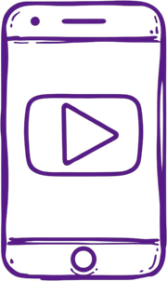
Staying Safe on YouTube
Learn how to enjoy YouTube safely and protect yourself online!
Notes:
Begin the session by briefly introducing the purpose of the training. Explain to learners that the session will help them understand how to enjoy YouTube while staying safe online. Encourage learners to participate throughout the session by sharing their experiences and answering questions. Emphasize that the goal of the training is not to stop students from using YouTube, but to help them develop smart and safe habits when watching videos online.

Slide 3
Warm-up activity
A
Gaming
Raise your hand if you use YouTube!
What do you watch most?
B
Music
C
Shorts
D
Tutorials
Notes:
Start the session with a quick show-of-hands activity. Ask learners: "Who here uses YouTube?" and invite them to raise their hands. If some learners have never used YouTube, invite their peers to briefly explain what it is and what people typically use it for. This helps ensure everyone has a basic understanding before continuing.
Next, ask: "What do you usually watch the most?" Read the options on the slide (Gaming, Music, Shorts, Tutorials) and ask learners to raise their hands for each option. You can briefly comment on the results—for example, "It looks like gaming videos are the most popular today!"
Then connect the discussion to the topic of the training:
"YouTube is a great place to learn new things, watch fun videos, and discover new hobbies. But not everything we see there is safe or trustworthy. Today, we will learn how to enjoy YouTube while staying safe online."

Slide 4
YouTube
Can Be
Amazing
🎨
Learn new skills & talents
⭐
Discover hobbies
🎵
Listen to music
📚
Learn for school
⚠️
But be careful... Some videos aren’t suitable for kids
It has so much to offer!
Notes:
Explain to learners that YouTube can be a very useful and fun place, and many people use it to learn new things, relax, and explore their interests:
Learn new skills and tutorials — people learn how to draw, cook, build things, code, or even practice sports using YouTube videos.
Discover hobbies — YouTube can introduce you to activities like art, crafts, music, science experiments, or building things.
Listen to music — many people use YouTube to listen to their favorite songs and discover new artists.
Learn for school — there are many educational channels that explain school subjects like science, history, or math.
You may ask learners a quick question:
“Has anyone learned something new from YouTube?”
Invite 2–3 students to briefly share an example.
Then explain that even though YouTube has many great things, not every video is safe and suitable for learners. In the next slide, we will discuss what this content might be.

Slide 5
What Can
Go Wrong
on YouTube?
⚠️
Scary or disturbing videos
⚠️
Fake information & lies
⚠️
Mean or hateful messages
⚠️
Manipulative ads
⚠️
Dangerous challenges
These can appear unexpectedly
💡
Watch out for these risks when browsing!
Report inappropriate content
💡
Notes:
Start by explaining that YouTube is a platform where people and organisations from all over the world share videos. Many videos are created by ordinary people who want to share their stories, hobbies, talents, or ideas. Others are uploaded by media companies, schools, museums, businesses, charities, and many other organisations. Because anyone can upload videos, YouTube offers an enormous variety of content—from educational lessons and music to news, entertainment, and gaming. Explain that while most videos on YouTube are safe and enjoyable, some may not be appropriate for learners.
Go through the examples of videos they should be careful with:
Videos that make you feel scared or uncomfortable – Some videos contain frightening or disturbing scenes that can make viewers feel upset or anxious.
Videos with false information or tricks – Not everything on YouTube is true. Some videos may contain misleading information or try to persuade viewers to share personal information, click on suspicious links, or spend money.
Videos or comments that are unkind – Sometimes people post hurtful comments or videos that bully, insult, or disrespect others.
Videos encouraging risky behaviour – Some videos encourage viewers to copy dangerous stunts or challenges that could lead to serious injuries.
Explain that these videos can appear unexpectedly through automatic recommendations, misleading thumbnails or titles, trending topics, or links shared by other people.
To involve learners, ask:
"What would you do if you opened a video and it wasn't what you expected?"
Allow one or two learners to briefly share their ideas.
Remind learners that if a video makes them feel scared, uncomfortable, confused, or pressured to do something, they should stop watching and ask a trusted adult for help. If appropriate, they can also ask that adult to report the video to YouTube. Explain that reporting helps YouTube review content that may violate its Community Guidelines. If YouTube determines that the content breaks its rules, it may remove individual videos or take broader action to prevent more inappropriate or harmful videos from the same person or organisation from appearing on the platform. Reporting inappropriate content helps make YouTube safer for everyone.
Finally, explain that YouTube offers several built-in safety tools to help reduce the chances of seeing inappropriate content. These include YouTube Kids, designed for children under 13 with age-appropriate content and parental controls, and Restricted Mode, which can help limit mature content for older children and teens.

Slide 6

Why Filters Don't Catch Everything
Millions of videos are uploaded every day.
YouTube uses AI and reports to filter content, but some bad videos still slip through.
The most important safety tool is YOUR brain!
Notes:
Explain to learners that YouTube is an enormous platform, with millions of videos uploaded every single day. Because of this huge amount of content, YouTube can‘t check every video perfectly before people see it. Explain briefly how YouTube tries to manage this:
Artificial Intelligence (AI) scans videos, titles, and descriptions to detect harmful content.
In addition, User reports help YouTube identify videos that break the rules. YouTube content moderators review videos after they are reported.
However, even with these systems, some inappropriate or misleading videos may still appear. Technology cannot catch everything right away.
Then emphasize the main message: "That’s why the most important safety tool is not a computer or a filter — it’s your brain. Learning to think carefully about what you watch helps you stay safe online."

Slide 7
Question
How to Draw a Cartoon Cat – Step-by-Step Tutorial
Which of these titles is a red flag for suspicious YouTube content?
A
B
🎁 FREE iPhone 17 for EVERYONE! 😱
C
How Rainbows Form
Why Do Astronauts Float in Space?
D
Notes:
Tell learners that they will now practise spotting suspicious or misleading content on YouTube. Explain that some videos use tricks to attract viewers, such as fake promises, sensational claims, or exaggerated titles. Read the question on the slide and give learners a moment to think before answering: "Which of these titles is a red flag for suspicious YouTube content?" Read the options aloud:
A – How to Draw a Cartoon Cat – Step-by-Step Tutorial
B – 🎁 FREE iPhone 17 for EVERYONE! 😱
C – How Rainbows Form
D – Why Do Astronauts Float in Space?
Ask learners to raise their hands for the option they think is correct. After a few responses, explain that the correct answer is:
B – 🎁 FREE iPhone 17 for EVERYONE! 😱
Explain that many misleading videos use clickbait—titles or thumbnails that promise something unrealistic, such as free expensive prizes, miracle cures, or unbelievable results, simply to attract clicks.
Remind learners that anyone can upload videos to YouTube. Encourage them to think carefully before believing what they see, especially when a video gives advice about health, beauty, or money, asks them to buy something, follow risky advice, or share personal information. If the message claims to have important information, encourage learners to check whether the same message also comes from reliable sources, such as their school, a teacher, a library, a government or health organisation, or another well-known educational organisation. If they are unsure, they should ask a trusted adult for help.
You may then ask:
"What other suspicious or misleading video titles have you seen online?" Allow one or two learners to share examples before continuing to the next activity on recognising misleading content.

Slide 8
Understanding Influencers
YouTubers often get paid to show gadgets, games, and products.
Just because they say something is "amazing" doesn't mean it really is!
Notes:
Explain to learners that many popular Youtube content creators (so called “YouTubers”) are also influencers, which means companies sometimes pay them to promote products such as toys, games, gadgets, apps, or other items. Help learners understand that this is a common way online creators earn money. Give a few examples:
Gadget unboxing videos – Videos where a creator opens a new gadget, shows what is inside, and shares their first impressions.
Gaming gear reviews – Videos where creators test and discuss gaming equipment, such as headphones, keyboards, controllers, or gaming chairs, often recommending certain brands.
Product reviews or recommendations – Videos where creators demonstrate, test, or review products such as beauty items, electronics, clothing, or apps and encourage viewers to consider buying them.
Explain that these videos are not always dishonest, and many creators clearly disclose when they are sponsored. However, learners should remember that the purpose of these videos is often to encourage people to buy or use a product.
Emphasize that just because a YouTuber says something is "amazing," "the best ever," or "you must buy this," it does not necessarily mean the product is actually that good. They may genuinely like it, but they may also be promoting it because they are being paid or sponsored. Encourage learners to think critically and, when possible, compare reviews from different sources before deciding whether to trust a recommendation.
You can ask learners a quick question to make the discussion interactive:
"Have you ever seen a YouTuber promoting a game, gadget, or another product?"
Allow one or two learners to share an example. Then transition to the next slide, which will introduce AI-generated videos and deepfakes.

Slide 9
AI Videos & Deepfakes
AI can create fake voices, fake images, and even fake people that look totally real!
Always ask yourself: "Is this real?“ If it seems too weird or perfect, it might be AI-made.
Notes:
Explain to learners that they may sometimes come across videos created or edited using Artificial Intelligence (AI). These videos can look or sound very real, even though they are not. Three common examples are:
Fake voices – AI can copy a person's voice so it sounds as if they said something they never actually said.
Fake images – AI can create realistic pictures of people, places, or events that never existed.
Fake people in videos – AI can change a person's face or appearance in a video so it looks like someone else.
Explain that this type of manipulated content is called a deepfake. Encourage learners to pause and ask themselves a few simple questions whenever a video seems unusual, surprising, or too perfect:
Does this look realistic?
Could this have been created or edited with AI?
Where did this video come from?
To involve the class, ask:
"Why do you think someone might create a fake video?" Possible answers include getting attention, making money, spreading false information, or making a joke.

Slide 10
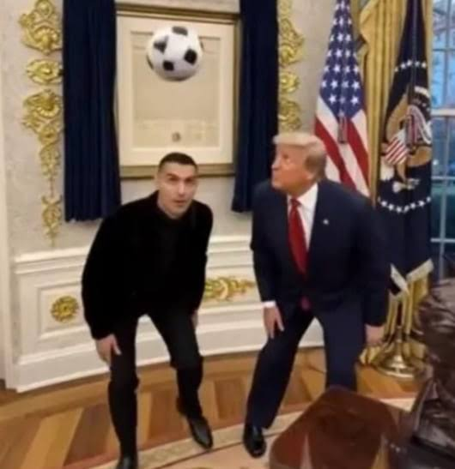
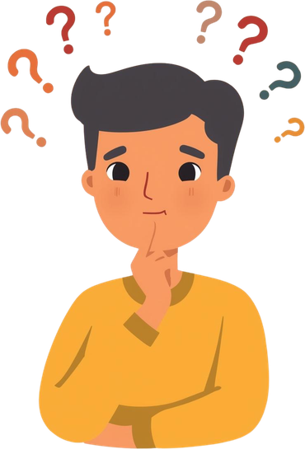
Real or Fake?
Notes:
If possible, show learners the video (URL: https://www.youtube.com/shorts/__A4kujg7BI). If this is not possible, ask whether they know Cristiano Ronaldo and briefly describe what happens in the video.
Explain that the video is an AI-generated deepfake based on a real meeting between Cristiano Ronaldo and Donald Trump at the White House. In the video, it appears that the two are playing football together. However, this scene never happened—it was created using artificial intelligence.
Explain that in this case, the video was shared with a clear indication that it was AI-generated, making it easier to recognise as a deepfake. However, this is not always the case. Some AI-generated videos are not labelled and can be very difficult to distinguish from real ones.
Explain that a deepfake is a video created using artificial intelligence to make it appear that real people are doing or saying things they never actually did. Because deepfakes often look realistic and feature well-known people, they can easily mislead viewers.
Remind learners that when they come across surprising, unusual, or sensational videos online, they should think critically before believing or sharing them. Encourage them to ask questions such as: Could this be AI-generated?, Who posted it?, and Can I find the same story from another reliable source?
Conclude by reinforcing the main message:
"AI is becoming more powerful every day. That's why it's important to think critically and not believe everything we see online."
Transition to the next slide by explaining that another important part of staying safe on YouTube is understanding why comment sections can sometimes be risky.

Slide 11
Be Careful
With
Comments
🚫
Bullying & mean messages
🔗
Spam links to bad sites
⚠️
Scams asking for info
✋
Don't click suspicious links
🙅
Don't argue with trolls
🚨
Report harmful comments
🛡️
Block users who are mean
Comment sections can be risky!
Notes:
Explain to learners that the comment section under YouTube videos can sometimes be risky. While many comments are friendly or helpful, some may contain negative or harmful messages. Go through the examples on the slide:
Bullying and mean messages – Sometimes people post rude or hurtful comments to upset others.
Spam links to bad sites – Some comments include links that lead to unsafe websites.
Scams asking for information – A comment might promise prizes or rewards and ask viewers to share personal information.
Explain that learners should never click suspicious links in comments, because they could lead to scams, viruses, or unsafe websites.
Also explain the idea of “trolls.” Trolls are people online who try to start arguments or upset others. Encourage learners not to respond or argue with them, because that often makes the situation worse.
You may ask learners:
"What would you do if you saw a mean or suspicious comment under a video?"
Allow one or two learners to respond, then highlight the actions they can take:
Report the comment to YouTube so that YouTube can review whether it violates its Community Guidelines.
Block the user who posted the comment to prevent that person from interacting with them or commenting on their content in the future.

Slide 12
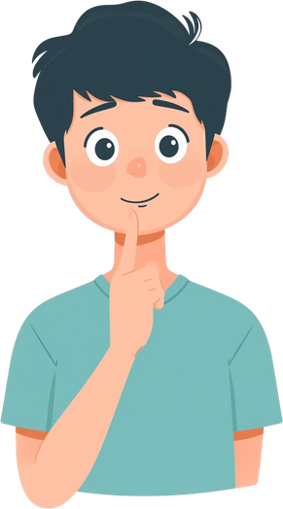
Question
Great video, thanks for sharing!
A
Which of these comments is trying to trick you?
I can make you famous! Click this link and enter your phone and email and we will contact you!
B
I disagree with this, but good points.
C
This video was really helpful, thanks!
D
Notes:
Explain to learners that this question helps them practice spotting comments that try to trick people. Read the question aloud: "Which of these comments is trying to trick you?" Then read the options:
A – Great video, thanks for sharing!
B – I can make you famous! Click this link and enter your phone and email and we will contact you!
C – I disagree with this, but good points.
D – This video was really helpful, thanks!
Ask learners to raise their hands for the answer they think is correct. After collecting responses, explain that the correct answer is:
B – I can make you famous! Click this link and enter your phone and email and we will contact you!
Briefly explain why: this comment promises something but asks for personal information (phone number and email address) in return — The promise sounds suspicious and vague - to make you famous - but they will have your personal contact information and can use it for bad purposes.
To alert and warn learners, you can suggest other scam examples according to your local situation.

Slide 13

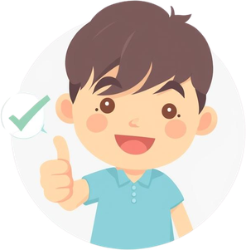



Smart Watching Tips
Watch channels you trust
Don’t share personal information
Avoid clicking strange links
Talk to a trusted adult
Notes:
As this is the final slide before transitioning to the practical activity, explain that now you will summarize main recommendations for using YouTube safely and responsibly. These tips can help them enjoy videos while reducing online risks. Go through each tip on the slide and explain it in simple language:
Choose channels carefully – Not every YouTube channel is equally reliable. Some creators share helpful and accurate information, while others may post misleading or harmful content. Later in the lesson, you will practise together how to recognise channels that are more trustworthy.
Avoid clicking links or downloading files shared in videos or comments – Some links may lead to unsafe websites, and downloads can contain harmful software. If you are not sure whether something is safe, ask a trusted adult before clicking or downloading.
Don't share personal information – Never share your full name, address, school, phone number, passwords, or other personal information in comments or messages.
Talk to a trusted adult if something feels wrong – If a video makes you feel scared, uncomfortable, confused, or pressured to do something, stop watching and ask a trusted adult for help.
General recommendation to have a safer and more enjoyable experience online is to choose trusted YouTube channels. Explain that next you will do a practical activity to explore positive and educational Youtube channels.

Slide 14


Practical activity
Think of and write down at least one YouTube channel or video that you consider safe and positive, and share it with others.
Notes:
Educational channels are more likely to provide accurate information and helpful content. Show a few examples, such as:
National Geographic Kids – Wildlife, geography, exploration, and environmental science. https://www.youtube.com/@natgeokids
Veritasium – Explores science and engineering questions in an engaging, easy-to-follow way. Suitable for ages 12+. https://www.youtube.com/user/1veritasium
MinuteEarth – Animated explanations of fascinating scientific topics. Suitable for ages 10+. https://www.youtube.com/@MinuteEarth
Scratch Team / ScratchEd – Tutorials for Scratch, a visual programming language designed for kids to build games and animations. Suitable for ages 8+. https://www.youtube.com/@scratchteam
Tasty (or Food Network Kids) – Simple, step-by-step cooking tutorials that teach kids basic kitchen skills. Suitable for ages 10+. https://www.youtube.com/@buzzfeedtasty
Ask learners to think about YouTube channels or videos they enjoy that teach them something new or help them learn a skill. Invite them to write down one example. If internet access is available, learners can explore YouTube individually or in small groups and look for channels about:
Science and nature
Art and drawing
School subjects
Music or other hobbies that teach new skills
Then invite learners to share one channel they found and explain why they think it is a good choice. Encourage answers such as:
It teaches something useful.
The information seems accurate.
It explains things clearly.
It is respectful and appropriate for youth.
Conclude by reinforcing the key message: Choosing educational and well-known channels is one of the best ways to enjoy YouTube while reducing the chance of seeing misleading or inappropriate content.

Slide 15
Wrap up
Can anyone remember one safety tip we learned today?
Thank you for learning with us.
Stay safe online!
Notes:
Before finishing, you may ask one final question to reinforce learning:
“Can anyone remember one safety tip we learned today?”
Allow a few learners to share examples, such as:
Identify suspicious titles
Don’t click suspicious links
Not all videos are real
Tell an adult if something feels wrong
Watch trusted channels
End the session by thanking learners for participating and reminding them: “Be curious, think before you click, and always use your brain to stay safe online.”

