Slide 1

Presentation for use by
public librarians offering Artificial Intelligence (AI) training for children and teenagers
Slides and notes for trainers compiled by Ugne Lipeikaite,
EIFL Public Library Innovation Programme
2026
Notes:
This presentation, titled “Smart Use of Artificial Intelligence (AI)”, is designed for public librarians to train children and teenagers in AI literacy. The suggested target age group is 12–15 years. However, after reviewing the materials, librarians can adapt the session for younger or older learners, as appropriate, depending on their prior exposure to technology and their level of digital skills. Librarians are also encouraged to further adapt the presentation to meet learners’ learning needs with respect to the topic, their interests, the languages they speak, and what technology is available. The session should take approximately one hour to complete.

Slide 2
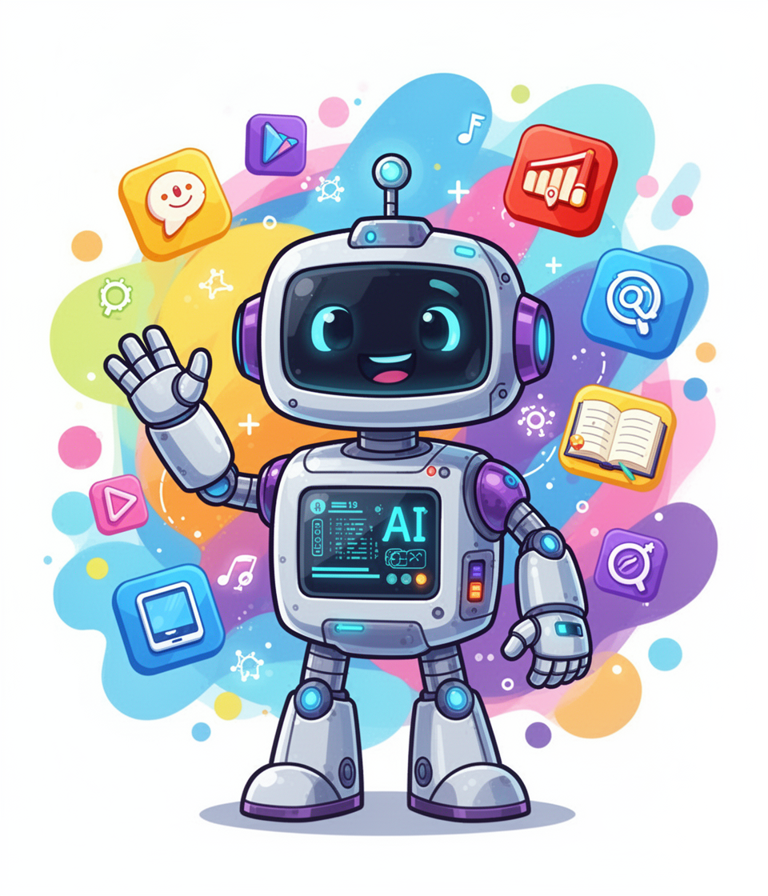
Smart Use of Artificial Intelligence (AI)
Notes:
Facilitator notes:
Welcome!
Today we are going to explore Artificial Intelligence (AI) — the technology behind many apps and tools you use every day.
We will learn: • what AI is • where we see it in real life • how to use it smartly and responsibly
You will also try a few fun activities to see what AI can do!

Slide 3
1. Stand up if you like football ⚽
2. Stand up if you like music 🎧
3. Stand up if you like reading 📚
Warm up exercise
Notes:
Facilitator notes:
Ask all learners to stand up. Explain that you will read a few statements. If the statement is true for them, they should remain standing. If it is not true, they should sit down. Read the following statements one by one:
Stand up if you like football.
Stand up if you like music.
Stand up if you like reading.
After the activity, ask everyone to sit down and lead a short discussion using this question:
Imagine YouTube or TikTok saw this information about you. What kind of videos would it recommend to you?
Invite a few learners to share their ideas.
Then explain:
Nowadays, Apps like YouTube and TikTok use artificial intelligence - AI - to decide what content and information to show you. Today we will learn how AI works, and how to use AI in a smart and responsible way.

Slide 4
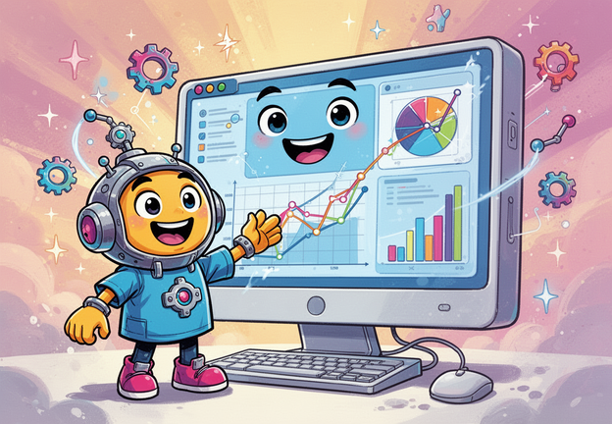
What is Artificial Intelligence (AI)?
Notes:
Facilitator notes:
Ask learners: What do you think Artificial Intelligence (AI) is?
Invite 3–4 students to share their ideas. If learners are unsure, you can help the discussion with a few questions:
Have you heard about AI before?
Do you think AI is a robot?
Do you think computers can think like people?
Then explain:
Artificial Intelligence, or AI, is a kind of software that makes it possible for computers to learn from information and use it to help solve problems or answer questions. People often imagine AI as a robot, but most AI is actually a kind of software that exists inside the computers and the apps we use every day.
Some people also think AI has a brain like humans. In reality, AI does not understand things the way people do. It creates text, pictures, music, videos, or code by analysing huge amounts of information and finding patterns, enabling it to produce content that resembles content that is created by humans.
For example, AI can write sentences. When AI writes a sentence, it predicts which word is most likely to come next. This means AI is very good at recognizing patterns and putting information together in new ways. However, it does not truly understand the world like humans do, and it does not have its own thoughts or experiences. The way in which AI works is by using information that may be in different formats (like film, music or text), on which it was trained. Computer scientists train AI by feeding it information. If the information fed to the AI is inaccurate or biased, it will provide misleading responses to questions.

Slide 5
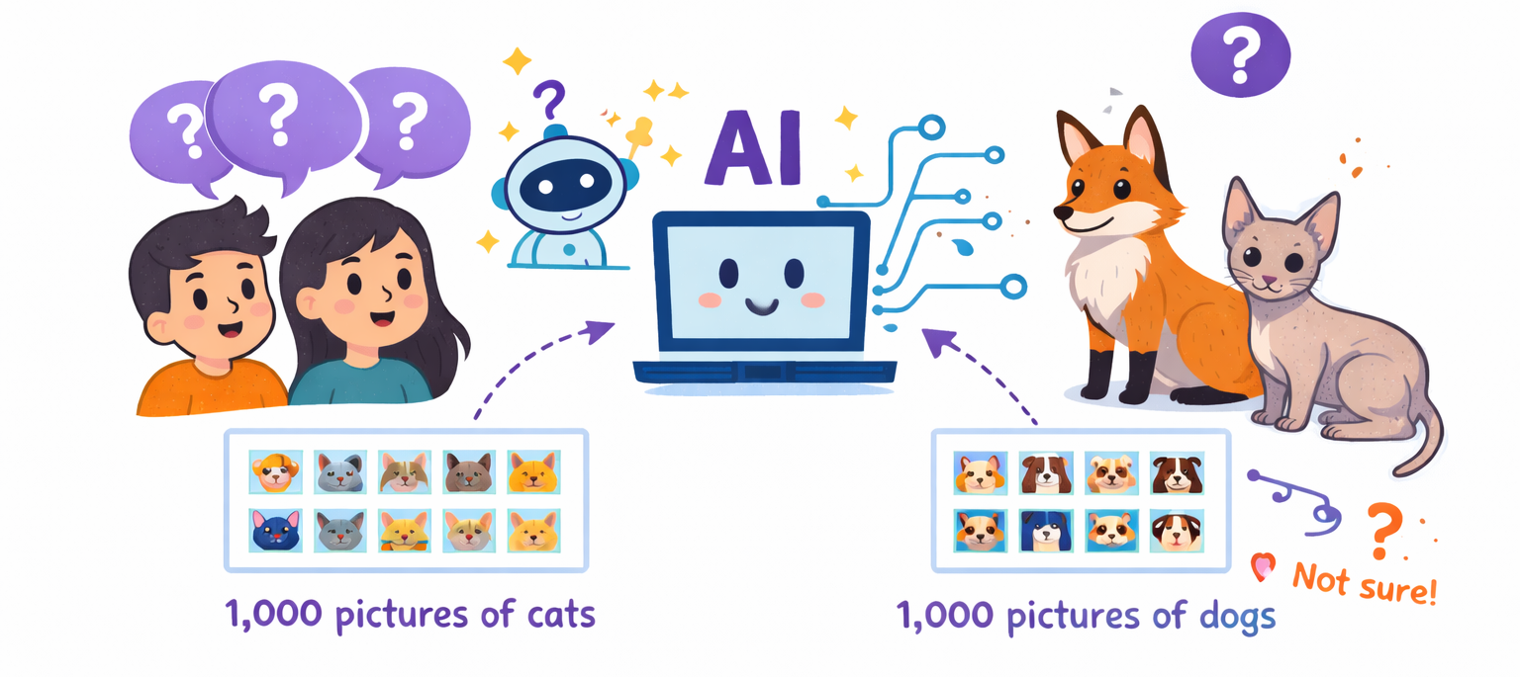
So how does AI learn?
Notes:
Facilitator notes:
Explain that AI does not actually think like a human. Instead, it learns from many examples.
You can say:
Now, you might be wondering what we mean by “feeding AI with information.” Let me give you a simple example on how AI systems learn. Imagine showing an AI system 1,000 pictures of cats and 1,000 pictures of dogs. After analyzing many examples, the AI can start to learn how to tell the difference between them.
However, AI can still make mistakes. For example, if it sees a fox or a very unusual cat, it might become confused.
Conclude with the key idea:
AI is not magic. It is a computer system that learns from lots of examples and information available online.

Slide 6
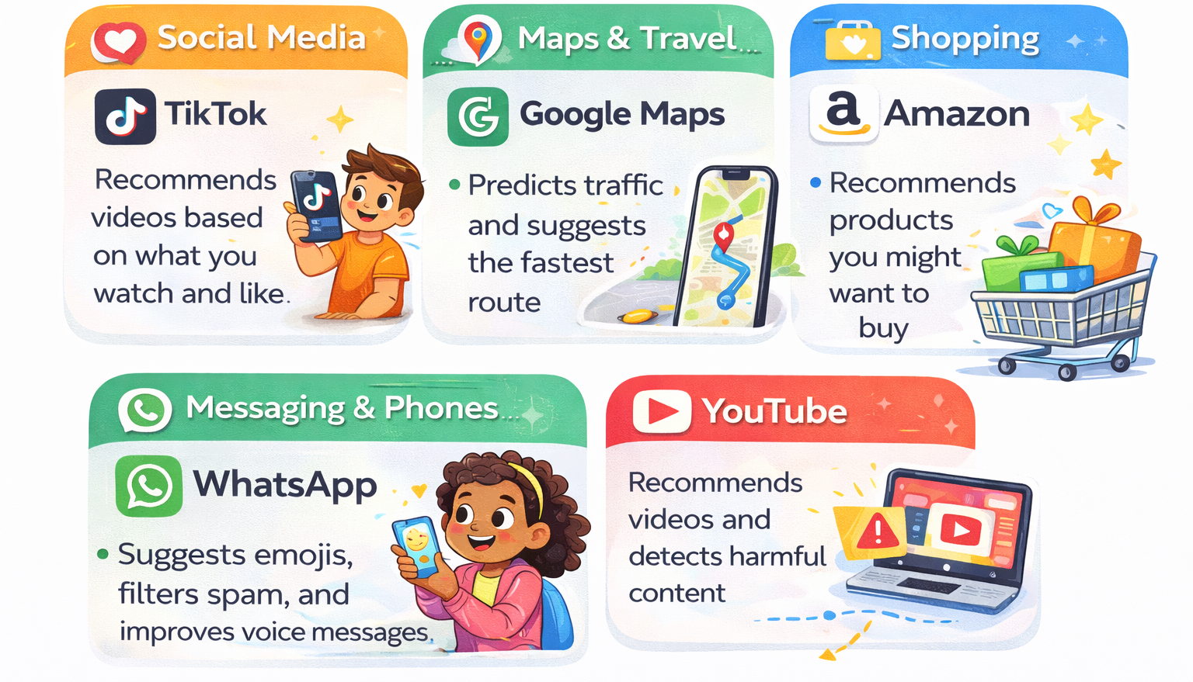
Everyday apps that use AI
Notes:
Facilitator notes:
Start by asking: “Who here uses TikTok, YouTube, WhatsApp, or Google Maps?”
Most learners will likely raise their hands. Then say: “Did you know that all of these apps use Artificial Intelligence?”
Explain that AI is already part of many apps people use every day, often without noticing it.
1. Social Media – TikTok TikTok observes which videos people watch, like, or skip. Over time, it learns what they enjoy and shows more similar videos.
2. Video & Entertainment – YouTube YouTube recommends videos it thinks users will enjoy. It also uses AI to help detect harmful or inappropriate content. In addition, YouTube uses AI to show advertisements that are tailored to users’ interests and online behaviour.
3. Maps & Travel – Google Maps Google Maps collects traffic information from many phones and cars. AI helps predict traffic and suggests the fastest routes.
4. Messaging – WhatsApp AI can suggest emojis, help correct words, filter spam (junk) messages, and improve voice messages by reducing background noise.
5. Shopping – Amazon Amazon analyzes what people search for and buy. AI then recommends products users might be interested in. If this information is shared with other platforms or content providers, their algorithms may also use it to show similar products or content.
Finish by asking: “Can you think of another app that might use AI?”
Possible examples: Facebook, Instagram, Netflix, Spotify.

Slide 7
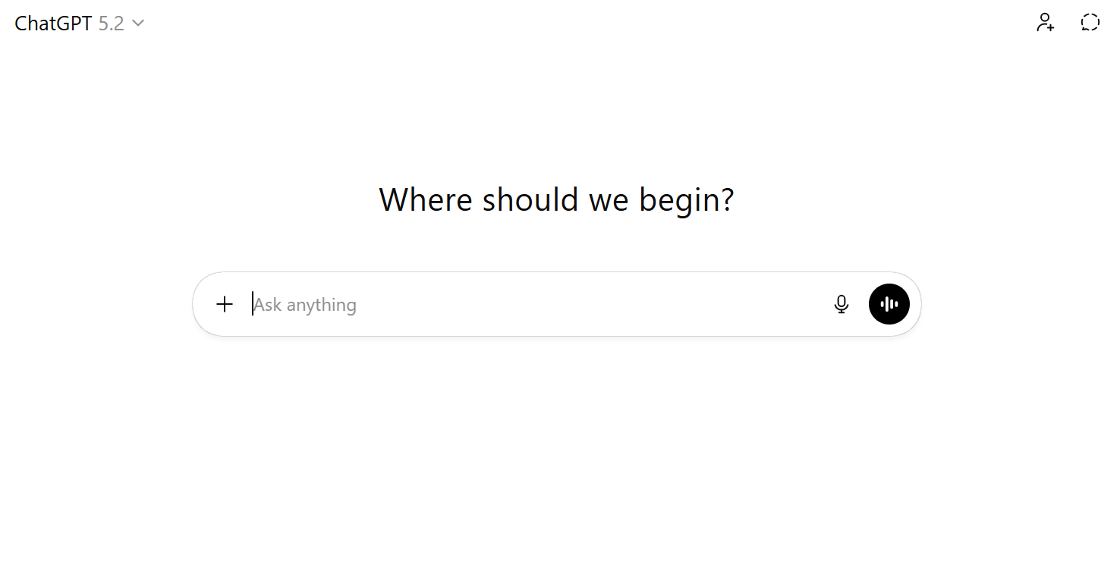
AI Assistants - ChatGPT
Notes:
Facilitator notes:
Explain that another type of computer program that uses AI is called a chatbot, or more simply, an AI assistant.
One of the most popular example is ChatGPT. People can interact with it by typing or speaking their questions or messages aloud.
Explain that AI assistants can help with many things, such as:
answering questions
explaining ideas
helping write stories
helping with homework topics
And many more
Mention that ChatGPT is not the only one. There are other AI assistants as well, such as Gemini, Copilot, and Claude.
You can ask learners: “What would you ask an AI assistant if you could ask anything?”
Invite a few students to share their ideas.

Slide 8
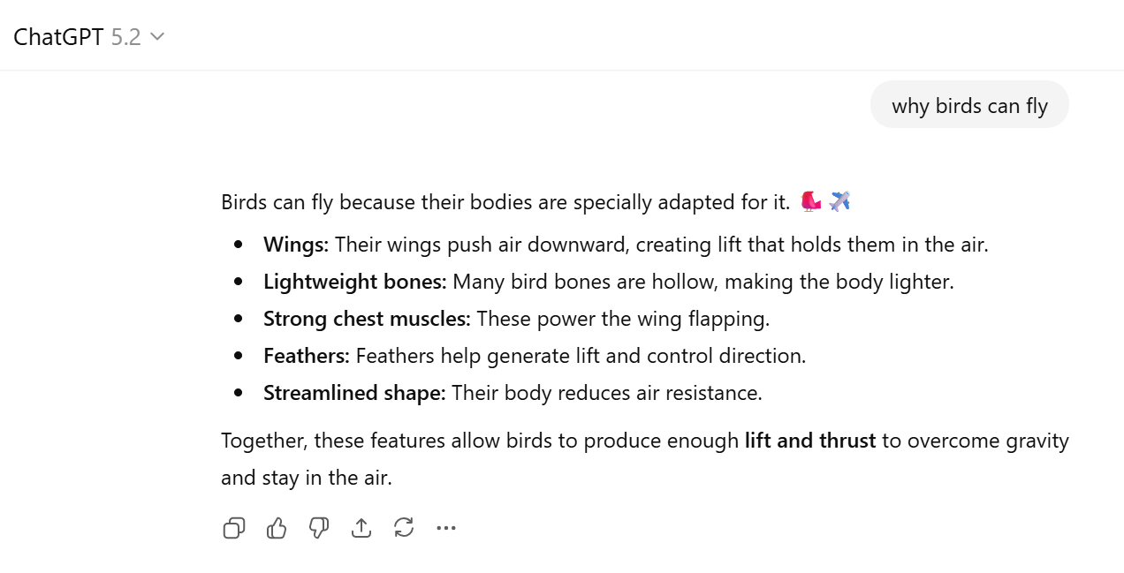
Example: Ask ChatGPT
Notes:
Facilitator notes:
Tell students: “Let’s look at an example of what ChatGPT can do.”
Explain that you will ask it a simple question. For example: “Why can birds fly?”
Type the question and read the answer aloud.
Then explain:
ChatGPT has learned from a huge amount of text, such as books, websites, and articles. Because of this, it can give answers that sound like a real conversation and help explain different topics.
You can add:
Remember, though, that AI can sometimes make mistakes, so it's always a good idea to check whether the information you're given is accurate and true by consulting other sources. It is always a good idea to pause and think critically about an AI response before accepting it as true, checking assumptions and evidence.

Slide 9
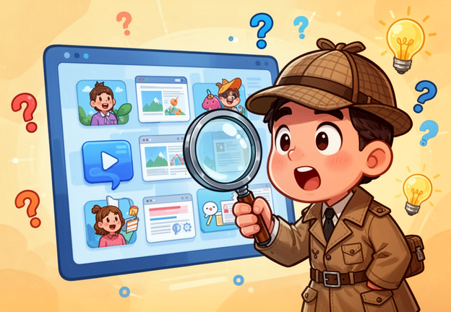

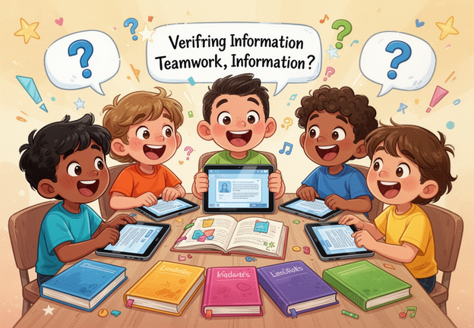
Evaluating AI Content
Check the Source
Cross-Reference
Look for Bias
Notes:
Facilitator notes:
Explain to learners that ChatGPT and other AI assistants can be very helpful, but they are not perfect. Sometimes they can give incorrect or outdated information. That is why it is important to check important facts, especially for homework, research, or decisions.
Introduce three simple ways to check information.
1. Check the Source Encourage learners to look at where the information comes from. Ask questions such as:
Is this a trusted website?
Who wrote this information?
Is it from a school, university, news organization, or another reliable group?
Explain that good information usually comes from sources that clearly show who created it.
2. Cross-check the Information Explain that it is important not to rely on just one source. Encourage learners to check the same information in two or three different places, such as:
another website
a book
a teacher or librarian
If several reliable sources say the same thing, the information is more likely to be correct.
3. Look for Bias Explain that sometimes information is written to persuade people or promote a certain opinion. Ask learners to think about questions like:
Is this trying to sell something?
Does it show only one side of the story?
Are other viewpoints missing?
Remind learners that good research means being open to different perspectives and thinking critically about what we read.
Note that, just like an ordinary internet search, AI assistants can provide false and inaccurate responses based on fake news, disinformation, propaganda and biased opinions that has been spread online. The use of AI tools to create fake and manipulative images, voice and video messages of real people poses an even more significant threat, as it can lead to situations where safety and well-being are at risk.

Slide 10
Don’t believe everything AI says
Don’t use AI to cheat
Protect your personal information
Be kind and respectful
Think before sharing
How to Use AI Responsibly
Notes:
Facilitator notes:
Explain that AI can be a powerful and helpful tool for supporting learning and work. However, it is important to use it responsibly and to ensure that you do not allow it to think for you. Share a few simple rules for using AI wisely.
1. Don’t believe everything AI says AI can make mistakes or provide incorrect information. Encourage learners to check important facts using books, teachers, librarians, or trusted websites.
2. Don’t use AI to cheat AI can support learning, but it should not do the work for you. It is best used for getting ideas, explanations, or help understanding a topic. Also remind learners to be honest about using AI. If AI helped with something they wrote, it is good practice to say so.
3. Protect your personal information Remind learners never to share personal details online, such as:
their full name
home address
school name
passwords
private photos
Explain that AI tools are online services, so staying safe is important.
4. Be kind and respectful Encourage learners not to use AI to create:
hurtful messages
fake images of people
embarrassing or harmful content
Technology should help people, not harm them.
5. Think before sharing AI can create very realistic images, videos, or messages that may not be true. Encourage learners to ask themselves:
Is this real? Could sharing this hurt someone?
Remind them that responsible technology use means thinking carefully before posting or sharing content online.

Slide 11
• AI can change faces or voices in videos • It can make people appear to say or do things they never did • Some are for fun • Some try to trick people
What is Deepfake?
Notes:
Facilitator notes:
The use of AI tools to create fake and manipulative images, voice and video messages of real people poses an even more significant threat, as it can lead to situations where safety and well-being are at risk.
Explain that deepfakes are videos, pictures, or audio that have been changed using AI to make something look real when it is not. For example, AI can make it appear as if someone said something they never actually said, or place a person’s face into another video.
Tell learners that sometimes deepfakes are used for entertainment, such as in movies, games, or memes. However, they can also be used to trick people or spread false information.
Give a few examples:
scams where someone pretends to be a family member in a video call and asks for money
political manipulation where politicians appear to say or do things they never actually did
fake celebrity videos online, such as edited videos of well-known actors
Finish with a key message:
Encourage learners to think carefully about what they see online and to check whether something is real before believing or sharing it.

Slide 12
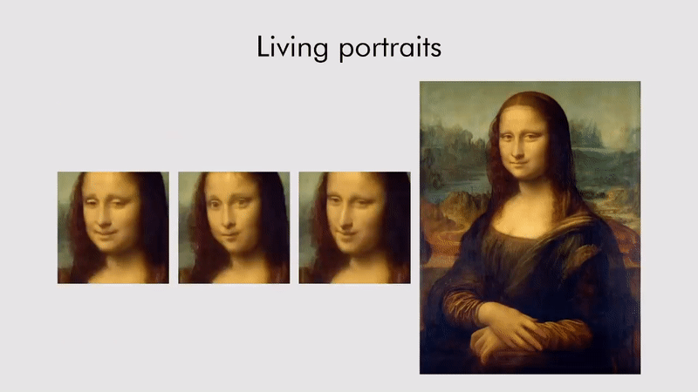
Examples of Deepfake
Source: https://www.livescience.com/65573-mona-lisa-deepfakes.html
Notes:
Facilitator notes:
Explain that the famous painting Mona Lisa is known around the world for her mysterious smile. Recently, people have used Artificial Intelligence to make it appear as if the Mona Lisa is moving.
In some videos, the painting seems to move her head or lips, almost as if she is speaking. Of course, the real painting does not move. A computer program creates this effect using AI that can study images and change them.
Explain that AI can analyze pictures and recognize shapes such as eyes, faces, and mouths. It can then create a new version of the image that looks realistic.
Tell learners that this can be fun and interesting, but it also shows how technology can make things look real even when they are not.
Finish by reminding learners that, when watching videos online, it is important to be aware that some images or videos may have been created or altered using AI with the intention of manipulating and influencing their behaviour, beliefs and choices. It is vital to remain critical and verify what you read, hear and see online.

Slide 13
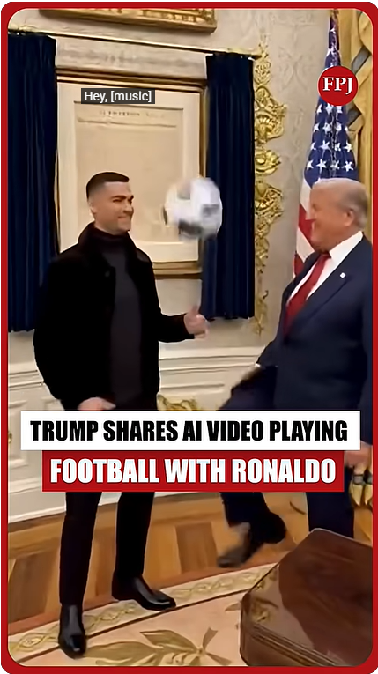
Examples of Deepfake
Source: https://www.youtube.com/shorts/__A4kujg7BI
Notes:
Facilitator notes:
If possible, show the learners the video (URL:https://www.youtube.com/shorts/__A4kujg7BI). If this is not possible, ask students if they know Cristiano Ronaldo and briefly describe what happens in the video.
Explain that the video shows a deepfake created after a meeting between Cristiano Ronaldo and Donald Trump at the White House. In the video, it appears that the two are playing football together. However, this scene is not real—it was created using artificial intelligence. Explain that this type of video is called a deepfake—a video made with AI to make it look like real people are doing or saying things they never actually did. Because the video looks realistic and features well-known public figures, it can be easy for people to believe it is real.
Highlight that this technology can be used in different ways:
For entertainment or humour (as in this example)
But also to mislead people or spread false information
In some cases, to support financial scams or manipulate public opinion
Explain that deepfakes are becoming more common and harder to detect.
Finish by highlighting the key lesson: AI-generated videos can look very convincing. That is why it is important to be careful online, question what we see, and check information before trusting it.

Slide 14
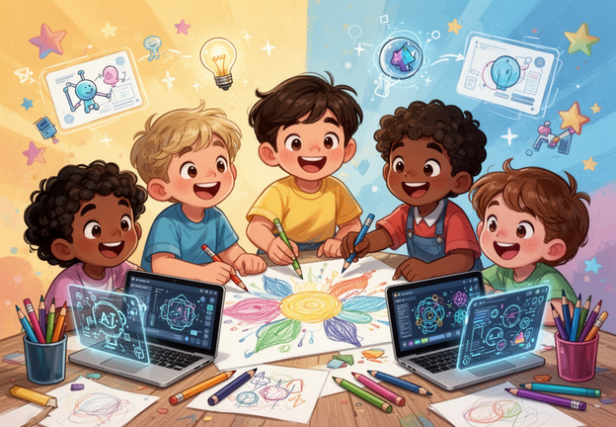
Let’s Practice using AI for Learning and Creative Work!
Notes:
Facilitator notes:
Tell learners that it is time to practice using AI for learning and creative work.
Explain that they will do three short and fun activities to explore different ways AI can be used.
If learners have their own devices or are sharing devices, they can follow along and try the activities themselves.
If only one device is available, the facilitator can demonstrate the activities using a projector, computer, or phone and involve the learners by asking questions and inviting suggestions.
Encourage learners to participate and share their ideas during the activities.

Slide 15
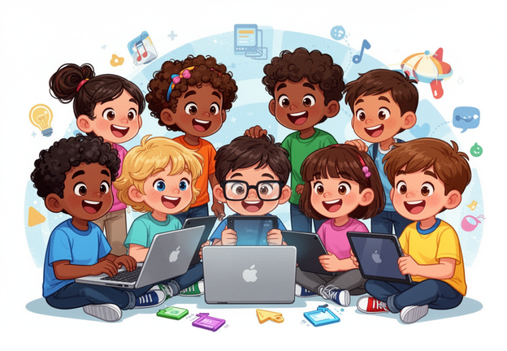
Activity 1:
The Better Question
1. Ask ChatGPT a question 2. Improve the question 3. Compare the answers
Notes:
Facilitator notes:
Introduce the first activity: The Better Question. Explain that the goal is to show how AI gives better answers when questions are clearer and more specific.
Step 1 Ask ChatGPT a simple question about something you would like to learn. For example: “Tell me about sharks.” Read the answer aloud to the group.
Step 2 Ask learners how the question could be improved to make it clearer or more specific. For example: “Explain why sharks are important in the ocean for a 12-year-old.”
Discuss Ask the learners which answer was more helpful and why.
Key message AI works better when we give clear and detailed instructions.

Slide 16
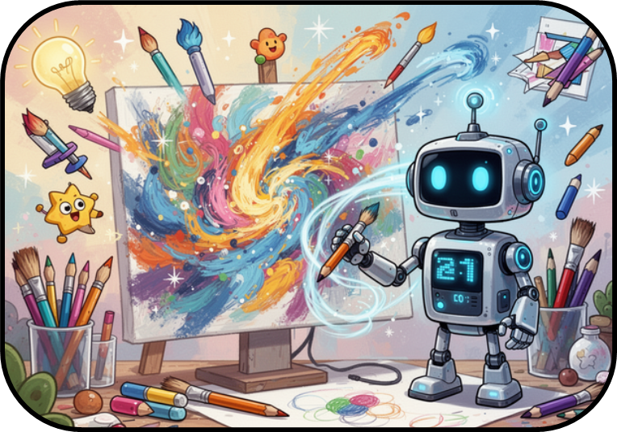
Activity 2:
Story Creator
Choose three things
Ask ChatGPT to write a short story using them
Change something in the story
Notes:
Facilitator notes:
Introduce the second activity: Story Creator. Explain that the goal is to show how AI can help create stories and ideas.
Ask learners to suggest three things, for example: a library, a robot, and a mystery door.
Type a prompt into ChatGPT using these ideas. For example: “Write a short funny story about a robot who finds a secret door in a library.”
Read the story to the group.
Follow-up Ask learners how they would like to change the story. For example:
make it scary
make it shorter
change the ending
Show how ChatGPT can edit or improve the story based on their suggestions.
Key message AI can help generate ideas and modify creative content.

Slide 17

Activity 3: Factcheck
Ask ChatGPT for 3 facts about octopuses
Read the facts together and ask: Do we trust them?
Check one fact using other source of information
Notes:
Facilitator notes:
Introduce the third activity: Factcheck. Explain that the goal is to learn how to think critically about information provided by AI.
Ask ChatGPT a question such as: “Give me three facts about octopuses.”
Read the answers together with the learners.
Then ask: “Do we trust this information?”
Explain that even though AI can be helpful, it is important to check important facts.
Choose one of the facts and verify it together using another source, such as:
Google
a science website
a book
Key message AI can be a useful tool, but we should always verify important information.

Slide 18
Thank you!
Notes:
Facilitator notes:
If you would like to run more than one AI training session with the same group of learners, you may wish to explore the additional training materials created by the University of Washington's Center for an Informed Public for use in libraries (URL: https://lokisloop.org/AIMisAdventures).
The materials include six activities organized into three main topics:
1. What is AI and Why Does it Impact Me? This section introduces the basics of AI. Learners explore how AI learns from data, how it creates new content, and how it differs from human learning.
2. Training Data, Bias, and Misinformation This section explains how AI uses training data. Through hands-on, low-tech activities, learners discover how data influences machine learning and how manipulating data can lead to misinformation.
3. People, Misinformation, and Ethical Perspectives In this section, learners explore the challenges of misinformation and the ethical questions related to AI. They also connect AI to their everyday lives and discuss how to think critically about AI tools.

