Slide 1


Presentation for Public Librarians Offering Training on Basic Graphic Design Using Canva
Slides and notes for trainers compiled by Ugne Lipeikaite, EIFL Public Library Innovation Programme, based on: https://www.canva.com/designschool
Notes:
This presentation, titled 'Unleash Your Creativity with Canva,' is designed for public librarians to help youth and adults understand the basics of graphic design principles, learn how to navigate the online design tool Canva, and create simple design projects, such as logos, social media posts or flyers. The presentation is based on Canva Design School’s open learning resources: https://www.canva.com/designschool

Slide 2

Unleash Your Creativity with Canva
Introduction to Graphic Design with Canva
Notes:
In this hands-on workshop, you'll learn the basics of graphic design and how to create eye-catching designs using a free online platform, Canva. With Canva you can make almost anything from slides for your presentation to flyers for your events or infographics for your social media posts. Canva’s user-friendly interface makes it ideal for beginners or people who just need something simple, so don’t worry if you do not have any design experience – just use your imagination!

Slide 3

ICEBREAKER:
"Design Your Name" Challenge
Notes:
Icebreaker: "Design Your Name" Challenge
Note for Facilitators: To start the session, we recommend a fun icebreaker called the "Design Your Name" challenge. The facilitator will ask each participant to think about how they would visually represent their name using just one colour. They don't have to actually draw it (unless you have extra time and materials such as paper and colour pens), but they should explain their choices to the group in a quick round.
For example:
"I would draw my name with in red because it's bold and energetic, like me!“
"I would use a blue because I like stability and clarity.”

Slide 4
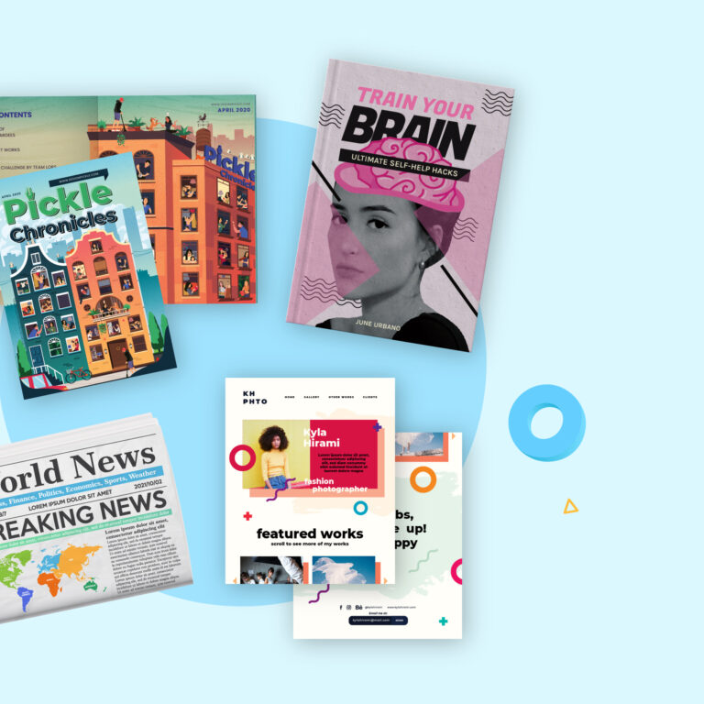
What is Graphic Design?
Graphic design is the art of creating visual content to communicate ideas or messages. It uses things like pictures, text, colors, and layouts to make things look attractive and easy to understand.
Notes:
Graphic design is the art of creating visual content to communicate ideas or messages. It uses things like pictures, text, colours, and layouts to make things look attractive and easy to understand. Good graphic design helps grab attention and share messages quickly.
We all see examples of graphic design in everyday life. Can you give any examples that come to your mind? [pause for responses].
Examples of graphic design include:
Print Media like posters, flyers, and magazines.
Digital Media like graphics for websites, social media posts, and online ads.
Branding like logos and packaging to help people recognize a brand and what it stands for.
Motion Graphics like animated (moving) visuals used in videos and ads.
Graphic design is important in many areas, like marketing, education, and entertainment. It helps people connect with ideas and feelings through visuals.

Slide 5
Basic Design Principles
Colours
Typography
Layout & Alignment
White Space
Notes:
As you create your design, there are several principles to consider to ensure that your design is attractive and effectively communicates your message. These principles include:
Colours: Choose colours that suit your topic and work out suitable colour combinations.
Typography: Choose the right fonts for your topic.
Layout & Alignment: Arrange and align elements on the page to create a clean and balanced design.
White Space: Leave some space so that your design is not too cramped and busy.
In the following slides, we will look at each of the principles in more detail.

Slide 6




COLOuRS
RED
BLUE
GREEN
YELLOW
Notes:
Different colours have various meanings, emotions, and psychological effects. There is even a science called colour psychology that studies how certain colours impact human behavior.
According to this field:
Red represents energy, passion, love, urgency, and excitement.
Blue represents calmness, trust, dependability, intelligence, and coolness.
Green represents nature, growth, calmness, freshness, and health.
Yellow represents happiness, optimism, friendliness, creativity, and warmth.
However, the meanings of colours can differ across cultures. For example, in Western cultures, white is often associated with purity and weddings. In contrast, in some Eastern cultures, such as China and India, white is traditionally linked to mourning and funerals.
Note for Facilitators: Discuss with the learners why these famous brands have chosen particular colours for their logos. These choices often reflect the values associated with those colours. You can also choose some widely known local brands and discuss their colour choices.

Slide 7
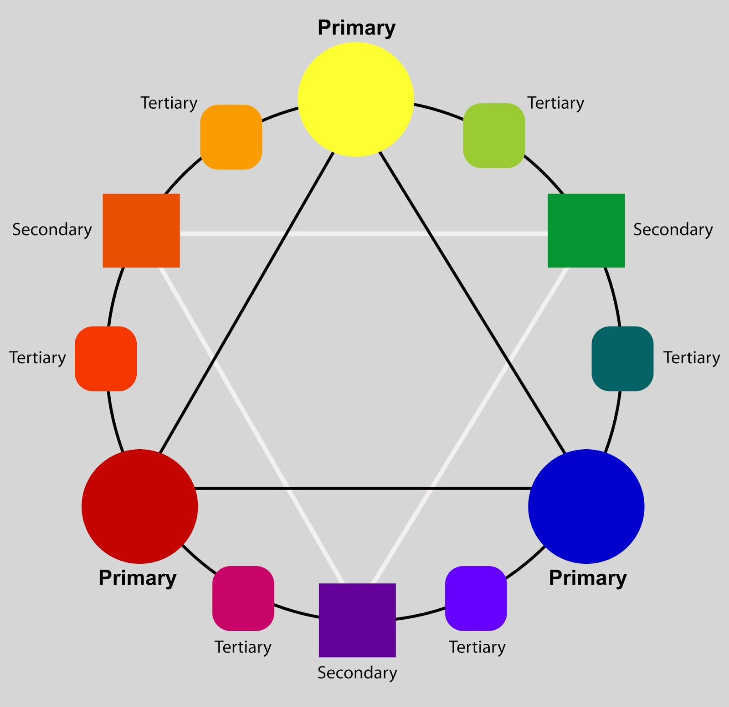
COLOuR WHEEL
https://www.canva.com/colors/color-wheel
Notes:
Note for Facilitators: Introduce learners to the colour wheel, explaining primary, secondary, and tertiary colours:
Primary colours are foundational colours that cannot be made by mixing other colours and are used for creating other colours.
Secondary colours are colours that result from mixing two primary colours (green, orange, and purple).
Tertiary colours are colours made by combining a secondary color with a primary color.
To create a good design, you need to know which colour combinations to use. The easiest way to do this is by using online colour wheels, such as Canva's Color Wheel, which can help us choose colours that look good together.
Note for Facilitators: if possible, demonstrate https://www.canva.com/colors/color-wheel. Your learners should follow along on their devices. If you are not familiar with Canva Color Wheel, we recommend you try it out in advance. You can also watch this tutorial: https://youtu.be/7qxT7aiyJrY?si=oik8SUPtc7AkUzyS
You can also discuss with learners how colour combinations are used in design for various communication purposes, such as representing a sports team’s identity or the branding of a school, university, or college. For example, the University of Cape Town in South Africa uses blue and white in its logo and branding, reflecting both its coastal location and its commitment to excellence. Similarly, many African national football teams incorporate their national colours into their jerseys and logos, like Nigeria’s "Super Eagles" green and white, which mirrors the Nigerian flag and symbolizes unity and vitality.

Slide 8
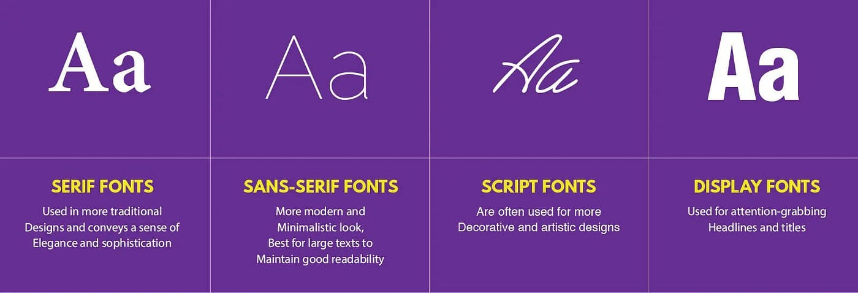
Typography
https://fontjoy.com
Notes:
Typography is about choosing the right fonts for your design. There are different types of fonts that are categorized into groups, such as serif (with small lines at the ends of letters), sans-serif (without those lines), script (handwritten look), and display (decorative).
Note for Facilitators: Discuss with the group how each font type conveys different feelings and styles. For example, a fun, playful font works well for a children’s event, while a clean, professional font is better for a presentation.
If you want to use several fonts in your design project, ensure they complement each other. This can be done using online tools, such as Fontjoy . However, limit font choices by using a maximum of two to three different fonts in a design.
Note for Facilitators: if possible, demonstrate https://fontjoy.com. Your learners should follow along on their devices. If you are not familiar with Fontjoy, we recommend you try it out in advance. You can also watch this tutorial: https://www.youtube.com/watch?v=Ts49eTz60PA

Slide 9
Layout & Alignment
Prioritizing
Prioritize Key Information
Grouping
Group Related Elements
Spacing
Ensure Consistency in Margins and Padding
Notes:
Layout and alignment involve arranging visual elements (text, images, buttons, etc.) on the page to create a clean and balanced design that helps guide the viewer’s eye, making information easy to find and understand:
Prioritize Key Information: Use size, colour, and placement to draw attention to the most important content. Larger and bolder elements should represent the key information to guide the viewer’s eye effectively. For example: Imagine creating a flyer for a community event. To emphasize the date, time, and location, you might make these elements larger and use a bold colour like red to catch attention. For instance, “Saturday, 5 PM” could be in large, bold text at the top, guiding the viewer's eye immediately to the essential details.
Group Related Elements: Place related elements close together to create a sense of unity. This helps viewers understand the relationships between different parts of the design and enhances overall coherence. For example: For a school flyer, you could group all contact information—phone number, email, and website—in the bottom corner. By keeping these elements close together, viewers understand that they’re related, which improves readability and helps people find the details they need at a glance.
Ensure Consistency in Margins and Padding: Maintain uniform margins and padding around elements to create a tidy appearance and support alignment.
Much of this can be achieved using alignment tools in design software (like Canva) to ensure elements are properly aligned and spaced. For example, for a social media post showcasing a sale, you’d maintain equal margins around each image and text block, creating a balanced, neat look.

Slide 10
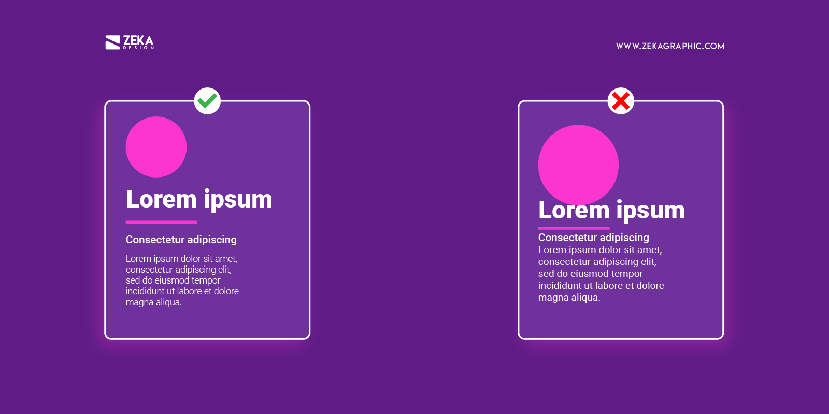
White space
Balance Elements
Avoid Clutter
Be Intentional
Notes:
White space, also known as negative space, refers to the blank or empty areas in a design that are not filled with text, images, or other elements. It doesn’t have to be white—it simply means space that’s free of text, images, or other visual element.
It is an essential component of graphic design and plays a crucial role in creating effective layouts:
Balance Elements: Ensure there is enough space between different design elements to create a balanced layout.
Avoid Clutter: Resist the urge to fill every area with content. Allowing for empty space enhances clarity and focus.
Be Intentional: Use white space purposefully to emphasize key information or to create a specific mood or tone.

Slide 11
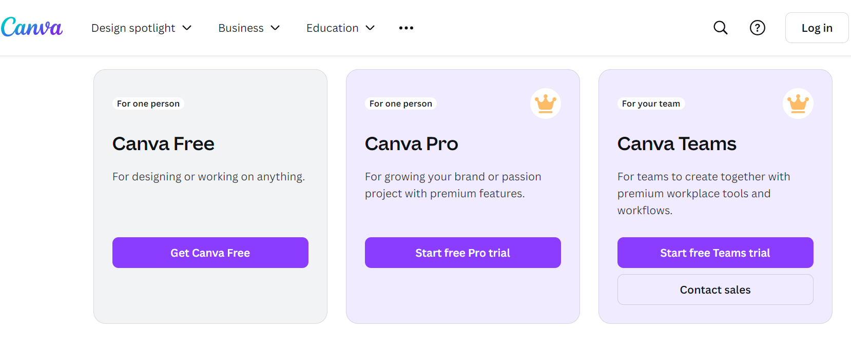
Getting started with Canva
https://www.canva.com
Notes:
Here we arrive at the main topic of today’s session: an introduction to the online design software called Canva. To access Canva, go to https://www.canva.com and choose "Get Canva Free." You will be prompted to create an account or sign in with your Google account.
Note for Facilitators: If possible, demonstrate switching to the Canva website to continue the demonstration. Your learners should follow along on their devices. Don’t worry if the interface looks slightly different on different devices; the main features will still be the same.

Slide 12
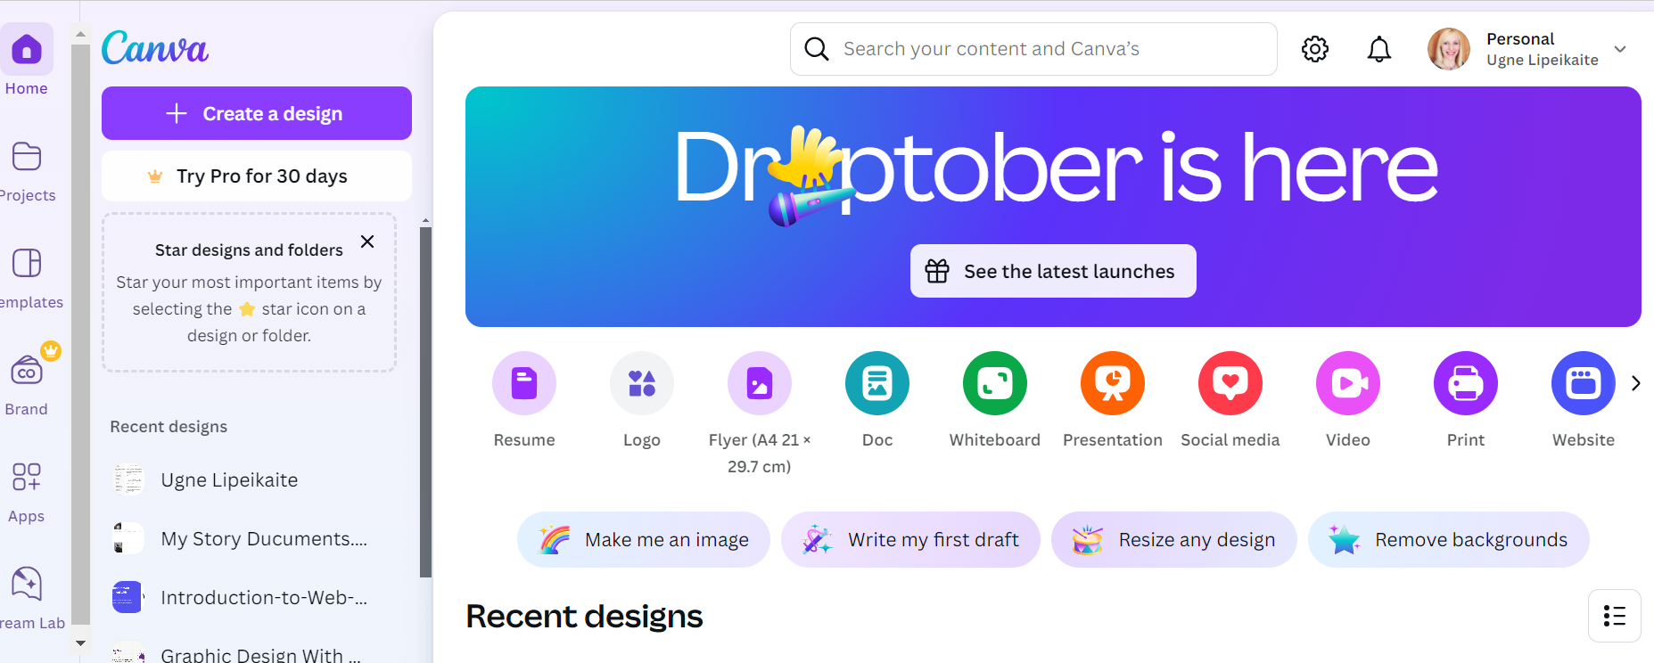
Canva dashboard
Notes:
Once you log in, you’ll arrive at Canva’s main page, known as the Dashboard. The easiest way to start a design is by using one of Canva's templates. In the center of the page, you’ll see a selection of popular templates grouped by categories, such as Resume, Logo, Flyer, and more. To start designing with one of these, simply click on the category button that matches your needs, and a new page will open where you can select and customize a specific template.
For access to the full range of Canva templates, click the "Create a design" button and choose the design type you want. Alternatively, you can type what you’re looking for directly into the search bar at the top of the page.

Slide 13
Canva Dashboard
Notes:
On the left side of the Canva dashboard, you'll find panels for adding text, images, and other elements. The dashboard also offers options to view recent designs that you have worked on.

Slide 14
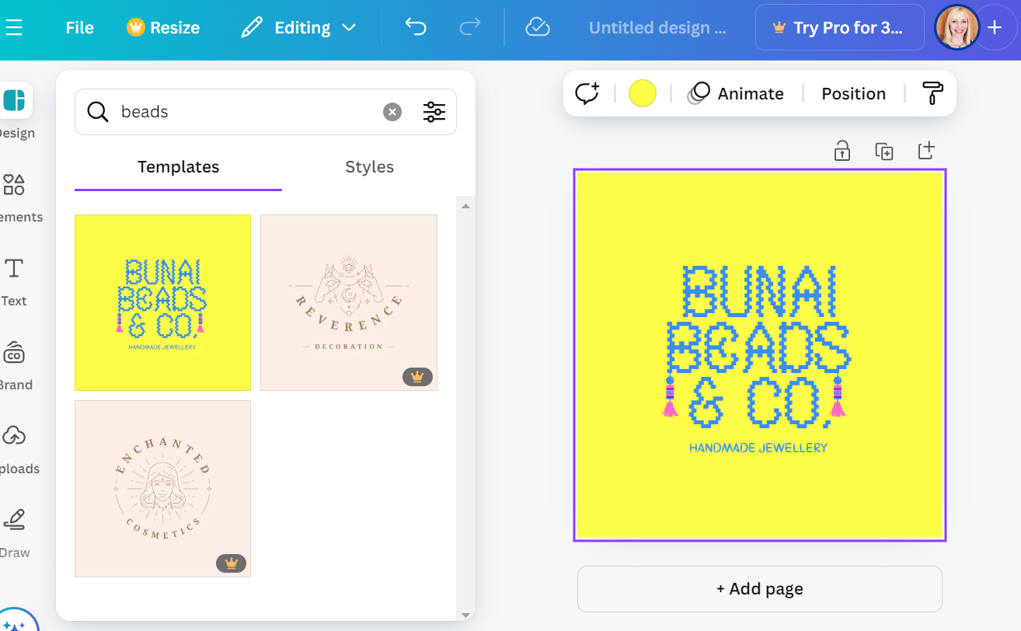
Creating a logo
In the search bar, type "Logo" to see Canva’s library of logo templates.
To narrow down options, type a keyword that represents your brand in the search bar (e.g., “crafts," “lifestyle," “clothing").
Browse through the suggested logos and choose the one that you like best.
Notes:
The easiest way for a beginner to start working with Canva is by selecting and customizing templates. Let’s say you want to create a logo. First, in the search bar, type "Logo" to see Canva’s library of logo templates. To narrow down the options, enter a keyword that represents your brand (e.g., “crafts,” “lifestyle,” “clothing”). For example, if I want to make a logo for a personal brand related to creating and selling handmade bead jewelry, I type "beads" in the search bar. Canva will display several logo templates related to bead jewelry. Browse through these options and choose the one that best fits your style. Note that templates marked with “Crown” symbolled are paid, while others are free of charge. To start editing, click on the template you like. It will open in a separate editing area, where you can customize colours, text, fonts, layout, and other elements as needed.

Slide 15
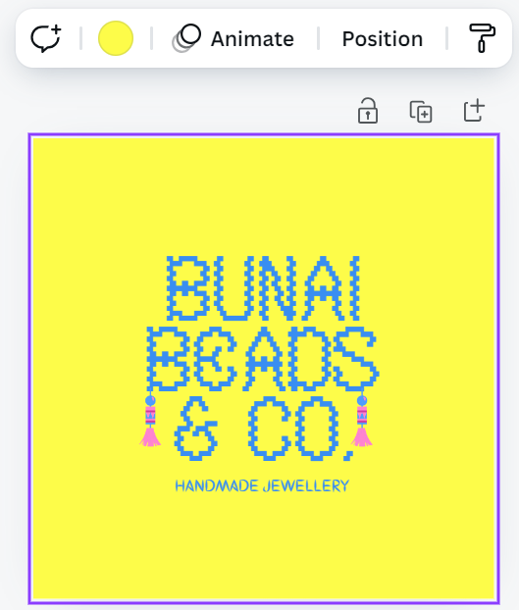
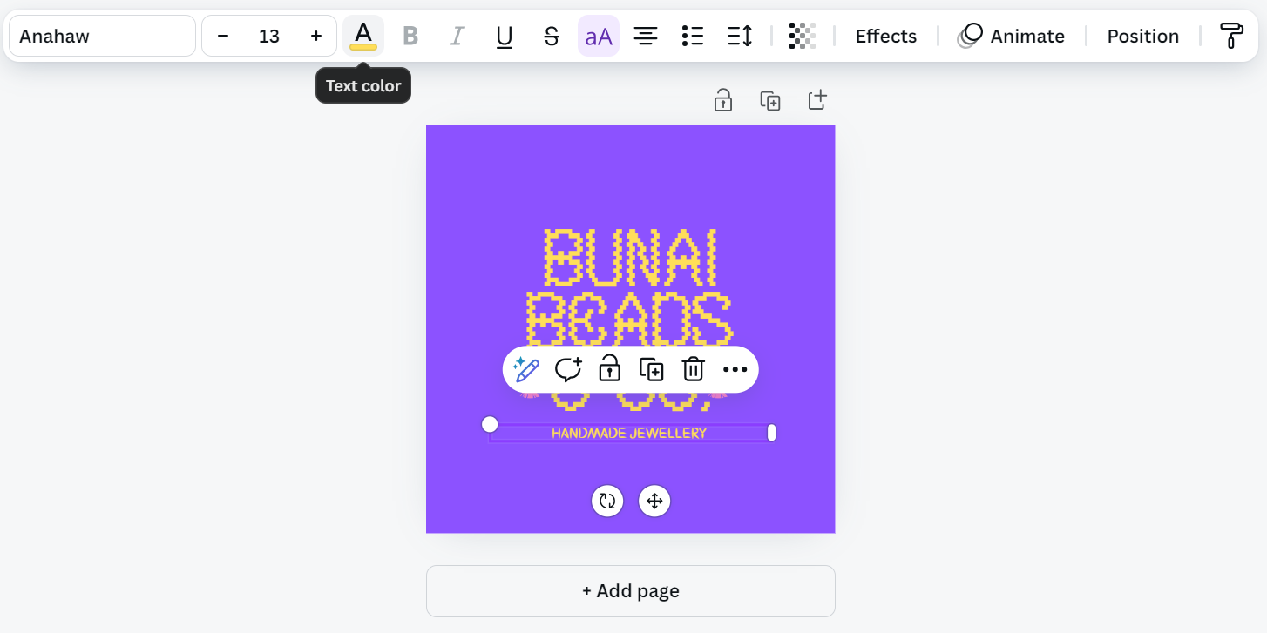
Customizing your logo- colours
Decide on a colour palette that reflects your brand’s.
Use the colour tool to customize each element’s color in your chosen template.
Notes:
Start by choosing colours for your logo. Use the color wheel to find colors that work well together, and consider which colours reflect your brand’s personality. As we discussed, calm and trustworthy brands often use blues, while energetic brands may go for bright colours. To change the background colour, click on the Colour tool at the top and select your preferred colour. Then, click on the text and change its colour to match your design.

Slide 16
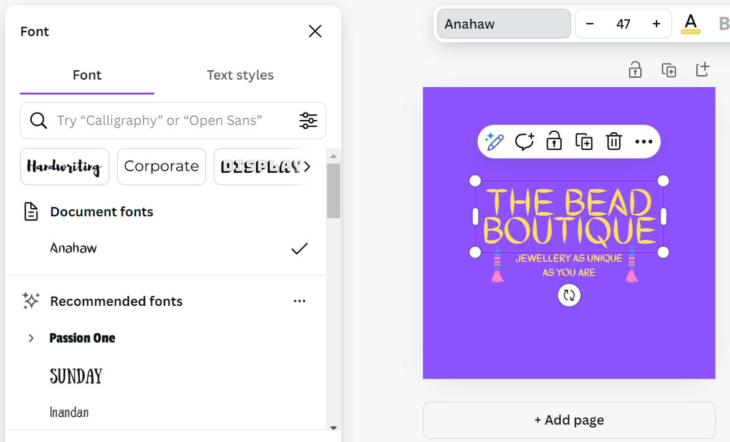
Customizing your logo - text
Replace any text with your brand’s name and tagline.
Choose fonts that represent your brand’s style.
Adjust the size, spacing, and colour.
Notes:
Now, replace any text with your brand’s name and tagline. To do this, I clicked on the text and changed the current font to a more readable one. I also replaced the text with the title of my brand, which is "The Bead Boutique," and added a subtitle: "Jewelry as Unique as You Are." I adjusted the colour of the text to enhance readability. Remember to choose fonts that represent your brand’s style (e.g., bold for a modern look, script fonts for elegance).

Slide 17
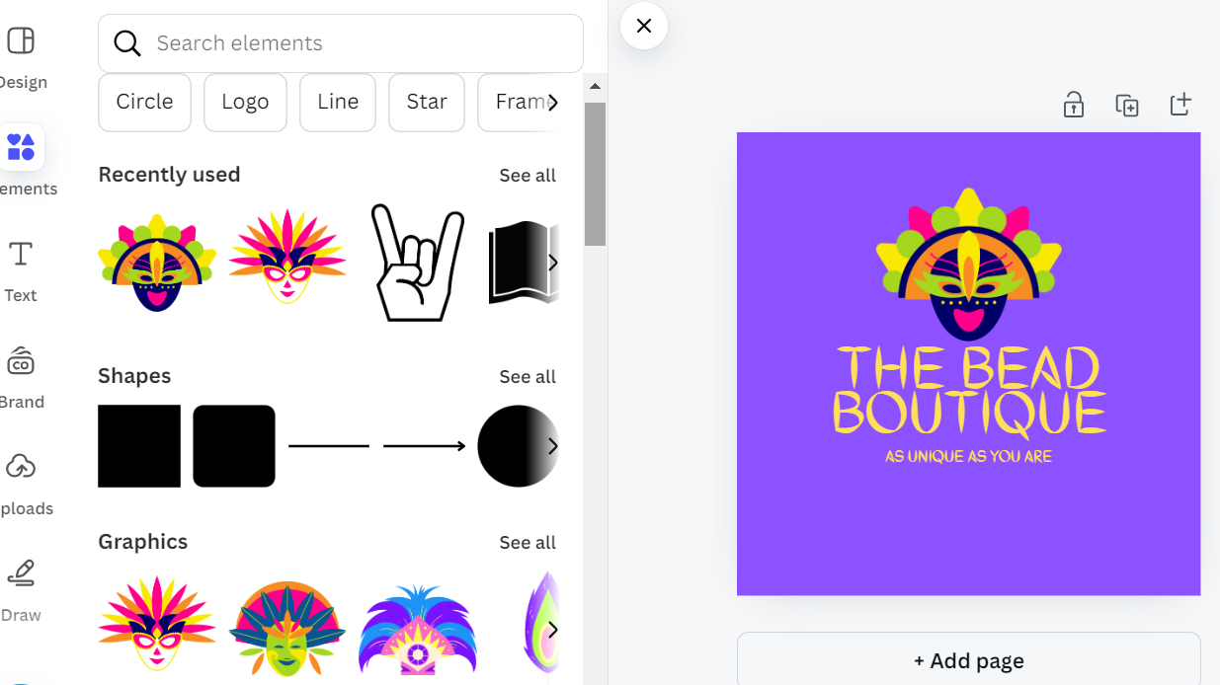
Customizing your logo- graphics
In the “Elements” tab, search for symbols, icons, or graphics relevant to your brand.
Drag the chosen element onto your logo design and resize or reposition it as needed.
Stick to one or two graphics to keep the logo simple and clean.
Notes:
Lastly, I want to replace the graphic elements of the logo with something different. First, I click on the existing graphic elements and delete them. Then, I click on the “Elements” tab and search for symbols, icons, or graphics that are relevant to my brand (e.g., a leaf icon for a nature brand). I found a colorful mask that I liked, so I dragged it onto my logo.

Slide 18
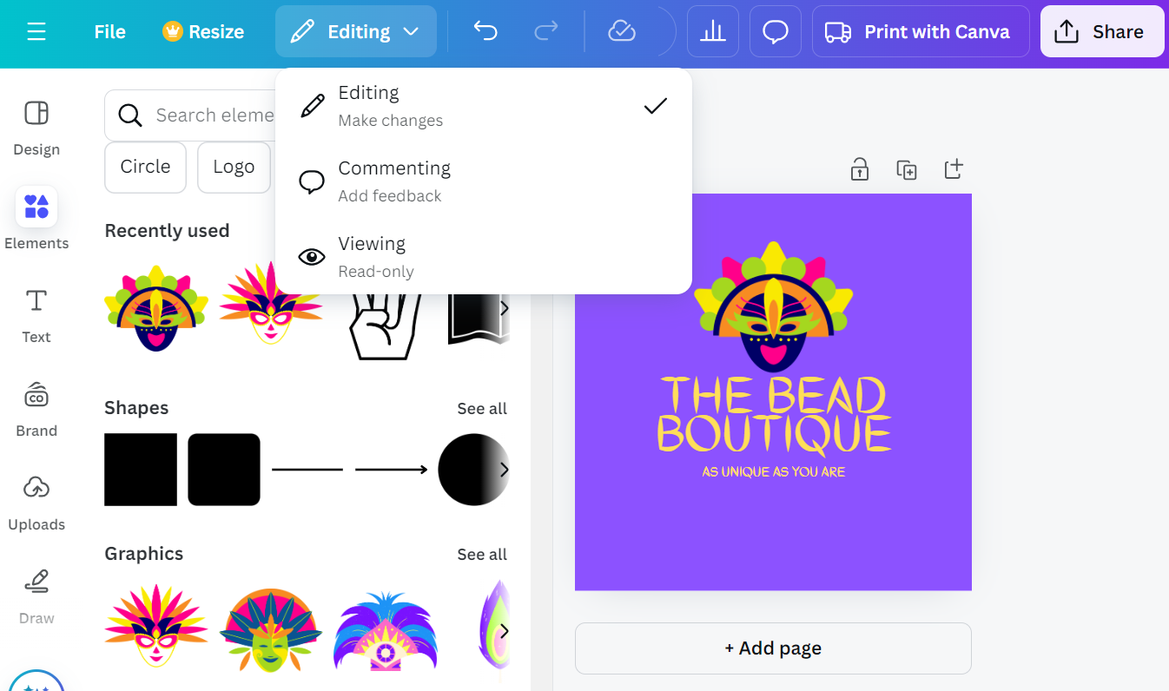
FINAL adjustments and Downloading
Adjust the layout by arranging the text, icons, and other elements in a balanced way.
Remove any unnecessary elements or details.
Switch to viewing mode to preview it.
Click “Share” and select “Download.”
Notes:
Finally, I want to proceed with downloading my logo. However, before doing that, I make final touches to ensure all my elements—text, icons, and other components—are arranged in a balanced way. I use Canvas alignment tools to center elements or create symmetry, which helps my logo look polished and professional. I also remove any unnecessary elements or details to keep the logo clear, simple, and memorable. I ensure that all elements (text, icons, colors) complement each other.
Once I am done, I switch to viewing mode to preview the logo. I make sure everything looks as intended, and if I need to make any adjustments, I can switch back to editing mode. Lastly, I click “Share” and select “Download.” Here you have an option to choose from several suggested formats, such as:
PNG – which is ideal for digital use, as it supports transparency, meaning you can place your logo on different backgrounds without a white box around it. Select PNG if you want a high-quality logo with a transparent background (check the "Transparent background" option in Canva if available).
JPEG - Suitable for web use where transparency isn’t required. JPEG files are typically smaller than PNGs but don’t support transparent backgrounds, so it’s better for use on consistent background colours or images.
SVG - Best for scalability, as SVG files retain quality at any size. This format is recommended for web use or if you need to resize your logo frequently. Note that SVG files are vector-based, making them ideal for large-format printing or responsive designs. However all design elements must be digitally created, you can not use actual photos or other elements which are not vector-based.
WebP - is a future format that provides good quality, smaller file sizes, and faster loading times, making it ideal for web use. It also supports transparency and animation, making it a versatile image format developed as a replacement for PNG and JPG.
PDF (Print) - If you need the logo for print materials, this option provides high-quality output suitable for printing on paper, business cards, etc.
It is easy to get lost among so many options, so a quick recommendation would be to use SVG as the most versatile for resizing and consistent quality across all sizes. If you need transparency, PNG is the top choice. For optimized web use, WebP could be advantageous if supported by your platform.

Slide 19
Time to practice
Notes:
Note for Facilitators: We have prepared three types of practical exercises for you to choose from: creating a logo, creating a personalized social media post, and creating a flyer. Depending on the time available for practice, you can assign all three activities or select the one that best suits your audience. The logo and social media post exercises take about 30-45 minutes each to complete, while creating a flyer requires at least 60-90 minutes. Also, if the group is interested and available, you could consider organizing a series of workshops over several weeks on using the Canva tool for different purposes.

Slide 20
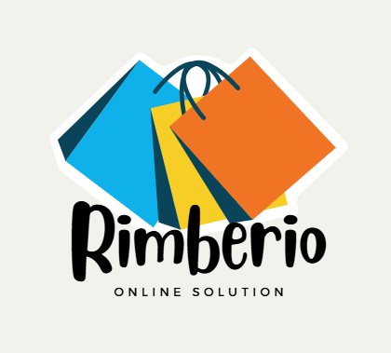
Practice: a Logo
Choose a template
Change Colours
Edit Text
Add or Remove Elements
Adjust Layout and Alignment
Finalize and Download
Notes:
Now it’s your turn to practice. Your task is to create a logo using Canva template for your real or invented brand. Follow these steps:
1. Choose a Template: go to Canva’s homepage, search for “Logo” in the template search bar, and select it. This will open up a range of logo templates to choose from. Browse through Canva’s logo templates and pick one that matches the style you want for your logo.
2. Adjust Colours: update the colours to reflect your brand’s colour palette or something that stands out and is visually appealing.
3. Change Text: edit the text to include the name of your brand or initials. Adjust the font style, size, and color to suit your brand’s personality.
4. Add Icons or Shapes: use Canva’s “Elements” tool to add icons, shapes, or symbols that represent your brand. You could choose a symbol related to your industry, such as a book for a library or a leaf for an eco-friendly brand.
5. Experiment with Layout and Alignment: rearrange elements to create a balanced look. Try to keep the logo simple and easy to recognize.
6. Finalize and Download: review your logo to make sure it’s clear and visually balanced. When satisfied, click “Share” and then “Download” to save it as a PNG with a transparent background.
Note for Facilitators: After completing the logo, encourage learners to share their designs with each other for feedback and discuss why they chose certain colors, fonts, and icons.

Slide 21
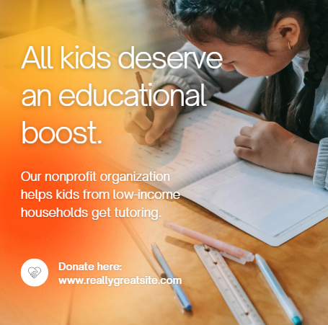
Practice: a Personalized Social Media Post
Choose a Template
Customize the Text
Add Images or Backgrounds
Add Icons, Shapes, or Graphics
Experiment with Colors and Layout
Finalize and Download
Notes:
Next, we will create a personalized social media post. Follow these steps:
Choose a Template: on Canva’s homepage, search for “Social Media” in the template search bar. Choose a format that matches the platform you want to create a post for (e.g., Instagram, Facebook). Browse through Canva’s social media templates and select one that you like.
Customize the Text: click on any text in the template to edit it. Change the text to something meaningful for your post, such as a quote, announcement, or greeting. You can adjust the font style, size, colour, and alignment to make it more eye-catching.
Add Images or Backgrounds: use Canva’s “Photos” tab to search for images that match your theme or upload your own photo. Alternatively, you can choose a colored or patterned background to enhance the design.
Add Icons, Shapes, or Graphics: explore Canva’s “Elements” section to add icons, stickers, or shapes that complement your post. For example, add a heart icon for a motivational quote or a frame to highlight text.
Experiment with Colours and Layout: adjust colours to create a cohesive look, and rearrange elements as needed for a balanced and visually appealing design.
Finalize and Download: review your post to ensure it’s visually balanced and impactful. Once you’re satisfied, click “Share” and then “Download” to save it as a PNG or JPEG, or share it directly to your social media.
Note for Facilitators: After completing the post, have learners share their designs with each other for feedback. Discuss what design choices they made, like color selection, font styles, and imagery, and how it impacts the message.

Slide 22
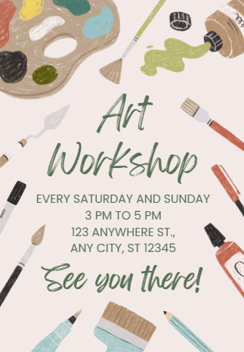
PRACTICE- a Flyer
Choose a Template
Customize the Text
Add Images or Backgrounds
Include Icons and Decorative Elements
Experiment with Layout and Colours
Finalize and Download
Notes:
Finally, we will create a flyer. Follow these steps:
1. Choose a Template: go to Canva’s homepage, type “Flyer” into the search bar, and select it. This will bring up a variety of flyer templates to choose from. Browse through Canva’s flyer templates and pick one that fits the theme or purpose of your flyer (e.g., event, promotion, announcement).
2. Customize the Text: click on each text box to edit it with your own content. Include key information, such as:
Headline: A catchy title or main message.
Details: Information like date, time, location, or promotional details.
Contact Information: Website, phone number, or email for further inquiries. Adjust the font style, size, and colour to make important information stand out.
3. Add Images or Backgrounds: use the “Photos” or “Uploads” tab to add images related to the flyer’s purpose. For example, if it’s an event flyer, include a photo from a previous event or a relevant stock image. You can also add a background colour or pattern to make the flyer more visually appealing.
4. Include Icons and Decorative Elements: enhance the flyer with icons, shapes, or decorative elements from the “Elements” section. For example, add a location pin icon next to the address or a calendar icon next to the date.
5. Experiment with Layout and Colours: arrange the elements on your flyer to ensure the layout is clear and easy to follow. Play around with colours to make the flyer visually engaging while keeping it professional and readable.
6. Finalize and Download: review your flyer to make sure all information is accurate and the design is balanced. Once you’re satisfied, click “Share” and then “Download” to save it as a PDF for printing, or as a PNG/JPEG if you plan to share it digitally.
Note for Facilitators: After completing the flyer, encourage learners to share their designs with the group for feedback. Discuss what design choices they made to highlight key information and make the flyer visually appealing.

Slide 23
Additional resources
Canva Design School - free, self-paced courses and tutorials on using Canva’s features and design principles: https://designschool.canva.com
OpenLearn – online course "How to Make Great Visuals with Canva“ introduces Canva and basic design principles: https://www.open.edu/openlearn
CourseCanva’s YouTube Channel - up-to-date tutorials and webinars on using Canva for various design projects: https://www.youtube.com/c/Canva
Notes:
To finish this training, I would like to recommend a few open educational resources, which can help you to further advance your graphic design skills using Canva:
1. Canva Design School: Canva's own Design School offers free, self-paced courses and tutorials on using Canva’s features and design principles.
2. OpenLearn: "How to Make Great Visuals with Canva": This OpenLearn course introduces Canva and basic design principles for creating visually appealing graphics.
3. Canva’s Official YouTube Channel: Canva's YouTube channel provides up-to-date tutorials and webinars on using Canva for various design projects.
Note for Facilitators: If time allows, you can encourage learners to explore additional online graphic design tools. Many platforms offer free access for creating digital designs, such as Pixlr, Adobe Express, and Picsart. However, Canva remains the most popular tool today.

