Slide 1

Presentation for
public librarians offering training on the safe and effective use of WhatsApp for teenagers
Slides and notes for trainers compiled by Ugne Lipeikaite,
EIFL Public Library Innovation Programme
Based on Mobile Internet Skills Training Toolkit by GSMA
https://www.gsma.com/mobilefordevelopment/mistt
2024
Notes:
This presentation, titled 'Getting the Best from WhatsApp,' is intended for use by public librarians to equip teenagers with the skills to safely and effectively navigate WhatsApp - one of the most popular messaging apps in the world.

Slide 2

Getting the best from WhatsApp
Smart and safe ways of using WhatsApp on your smartphone
Notes:
This workshop will help you to unlock the full potential of WhatsApp, one of the most popular messaging apps in the world. It's not just a messaging app – it's like your own social hub where you can chat with friends, join group conversations, and stay connected with important people in your life. In this fun and interactive session, we'll show you some of the great features that WhatsApp has to offer and will teach you to avoid safety risks.

Slide 3
ENERGIZER
How are you feeling right now?
1. 😂 Face with Tears of Joy
2. ❤️ Red Heart
3. 😍 Smiling Face with Heart-Eyes
4. 😊 Smiling Face with Smiling Eyes
5. 🥺 Pleading Face
6. 🙏 Folded Hands
7. 😭 Loudly Crying Face
8. 😊 Smiling Face
9. 😘 Face Blowing a Kiss
10. 🤔 Thinking Face
Notes:
We encourage trainers to start the training by introducing an energizer to help the teenagers focus on the topic. For example, use this slide and ask each participant to choose an emoji from the list of 10 that best represents their mood or how they're feeling. Once everyone has selected an emoji, invite a few participants to share their chosen emoji and briefly explain to the group, why they chose it. For example, the librarian can say - "Can I have a few volunteers to share their chosen emoji and tell us why they picked it?“ If someone chooses a happy emoji, the facilitator can say: "Great to hear you're feeling happy! A positive mood can really boost our learning today.“ If someone chooses a sad or tired emoji: "Thanks for sharing. We’ll try to keep things engaging to help everyone stay energized."

Slide 4

What is a smartphone
These phones are like mini-computers.
Normally you control them by touching the screen rather than using buttons.
They can take photos, play music and videos, and have various apps.
Notes:
Before we delve into today’s main topic, WhatsApp, it's important to understand what a smartphone is, as we use it to access the WhatsApp application. A smartphone is like a smart mini-computer that fits right in your pocket. It's not just for calling and texting like a regular phone. With a smartphone, you can do many other things like connecting to and searching the internet, chatting with friends on social media, taking pictures and videos, playing games, listening to music, watching videos, and even using apps to help you with schoolwork or hobbies.

Slide 5

How to access the internet on your smartphone
To use the internet on your phone, you can use mobile data or Wi-Fi.
Mobile data means buying internet from your phone provider or a shop.
Be careful, though – watching videos or listening to music can use a lot of data and cost more money.
Notes:
Many things that you can do with your smartphone, such as browsing websites or social media, chatting, etc., require you to be connected to the internet. There are two ways of doing it – first, if you are in a place where there is a WiFi connection – for example, in the library – you can connect your smartphone to the internet using WiFi. If not, you will need a mobile data plan, which you can buy from your mobile phone provider and depending on the provider’s plan it usually has limited amount of data. Although some internet websites and applications can be accessed at no charge, others, like watching videos or listening to music, use more data, and will cost you more money.

Slide 6

Using WhatsApp
WhatsApp is a messaging service, a bit like SMS, where you can also send voice messages, photos, and message groups of people.
WhatsApp uses internet data so it is cheaper to send messages, and the distance of the person you are messaging does not change the cost.
This Photo by Unknown Author is licensed under CC BY-SA-NC
Notes:
This brings us to the main topic of today, which is the WhatsApp application. WhatsApp is similar to text messages, but it offers many additional features such as voice messages, videos, group conversations, etc. The WhatsApp app is free to download, and when you use it you will only have to pay for the internet data you use. A big advantage of WhatsApp is that it uses the internet to send information, making it much cheaper than traditional calling. Additionally, the price does not depend on the geographic location of the sender and receiver – it costs the same to send a message to your friend next door as it does to someone in another country. Just keep in mind that the people you are communicating with must also have the WhatsApp app, and you need to have their phone number, because the system operates using phone numbers.

Slide 7
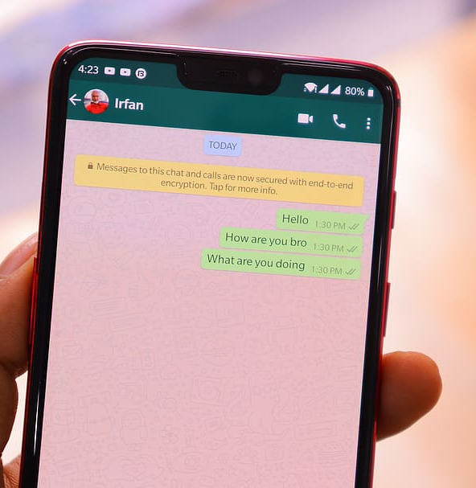
Key WhatsApp features
Text Messaging
Voice Calls
Video Calling
Voice Messages
Group chats
Media sharing
Notes:
Let’s take a look into some of the key WhatsApp features:
Text Messaging: You can send text messages instantly to your friends and family, just like you would with regular SMS, but for free.
Voice Calls: You can call your contacts using WhatsApp. It's like talking on the phone but through the app instead of your regular phone network.
Video Calling: You can make face-to-face video calls with your friends and family, no matter where they are.
Voice Messages: You can record and send short voice messages to your contacts instead of typing.
Group Chats: You can chat with multiple friends at once in a group chat. It's perfect for planning events, sharing memes, or just catching up with everyone at once.
Media Sharing: Easily share photos, videos, GIFs, and even documents with your contacts – for example, your homework assignments.
If you have internet connection, you can play a video that demonstrates main features: https://youtu.be/AyGvZ2E9qEE?si=uqq97yR7cMGGeun3

Slide 8
WhatsApp safety tips
Review and adjust privacy settings
Decline calls and messages from unknown people
Avoid sharing personal information
Avoid sharing your photos or videos
Report any suspicious or uncomfortable interactions
Be respectful and mindful of what to share in group chats
Notes:
Before we dive into the details of how to use various features of WhatsApp, let's talk about some safety tips. While this app is generally considered safe, there are still some things to watch out for:
Check your privacy settings to control who can see your profile and contact you by opening Settings > Account > Privacy.
Be careful about messages, calls, or group invites from people you don't know. It is better not to accept any unfamiliar requests.
Don't share things like your address or school details via WhatsApp.
Think well before sharing photos or videos, especially with people you don't know well.
Tell a trusted adult or WhatsApp if something feels weird or wrong.
Watch what you say in group chats and avoid saying anything hurtful or wrong and be polite - start conversations with a greeting like "Hello" or "Good Morning" and say "Thank you" where applicable.

Slide 9
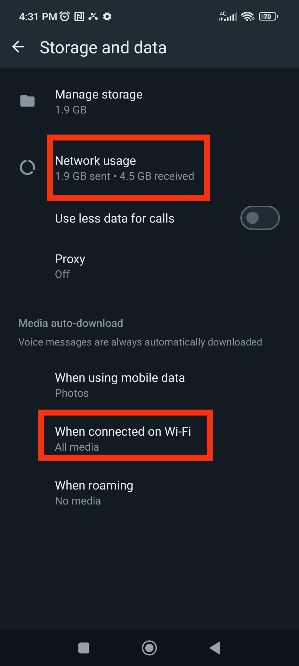
Tips for saving your data and storage: monitor data usage
To save data on WhatsApp, manage when media downloads and check usage in settings to control data consumption effectively.
Notes:
Now let's talk about some tips to make your WhatsApp experience better. If you have limited Internet data, you don't want WhatsApp to use it all up, which can quickly happen if you randomly download everything that anyone shared with you on WhatsApp. Instead, you should decide when photos, videos, and files download. Open WhatsApp settings and go to Storage and Data to see how much data you're using. You'll find details on messages sent and received, and data used. To limit downloads, set WhatsApp to download media only on Wi-Fi. Go to WhatsApp settings > Data and Storage Usage > Media Auto-Download, and choose Wi-Fi for photos, audio, videos, and documents.

Slide 10
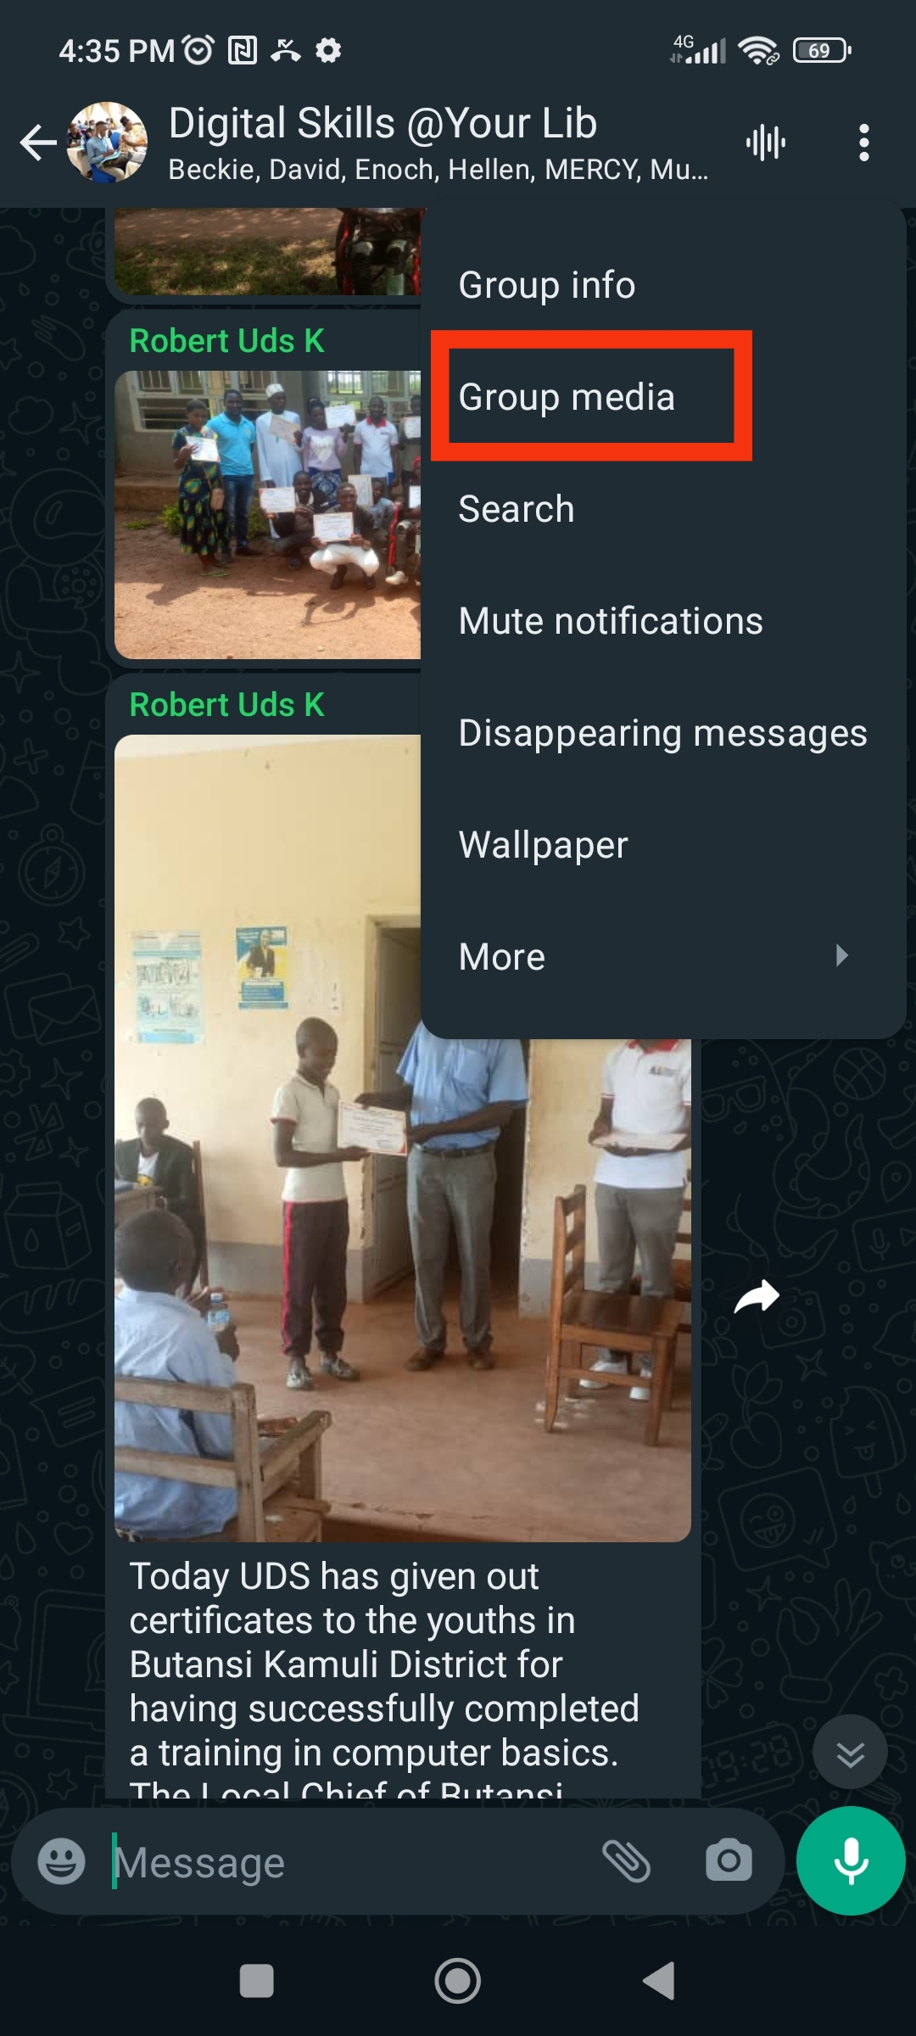
Tips for saving your data and storage: manage chats and media
Regularly clear unnecessary chats and media files from your conversations
Notes:
In addition to the internet data, using WhatsApp can take up a significant part of your phone storage from all the photos, videos, and files people share. To prevent this, delete chats and media you don't need. To manage media go into your chat and delete photos, videos, and documents you don't want anymore. To clear chat, tap the three dots or settings icon > More > Clear Chat. Decide if you want to delete messages with or without media.

Slide 11
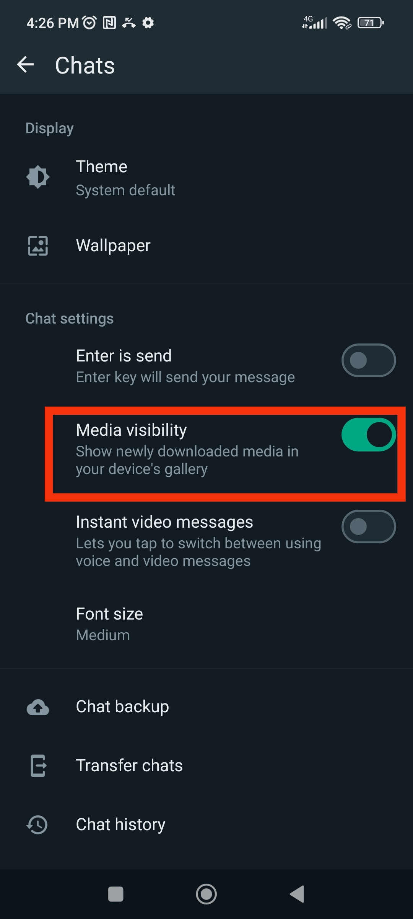
Tips for saving your data and storage: Stop images and videos appearing in your phone’s gallery
Sharing photos and videos on WhatsApp is great, but you might not want them added to your phone's gallery.
Notes:
Another way to save storage on your phone is to stop images and videos from showing up in your gallery. You can do this by going to WhatsApp Settings, tapping on Chats, and turning off Media visibility.

Slide 12
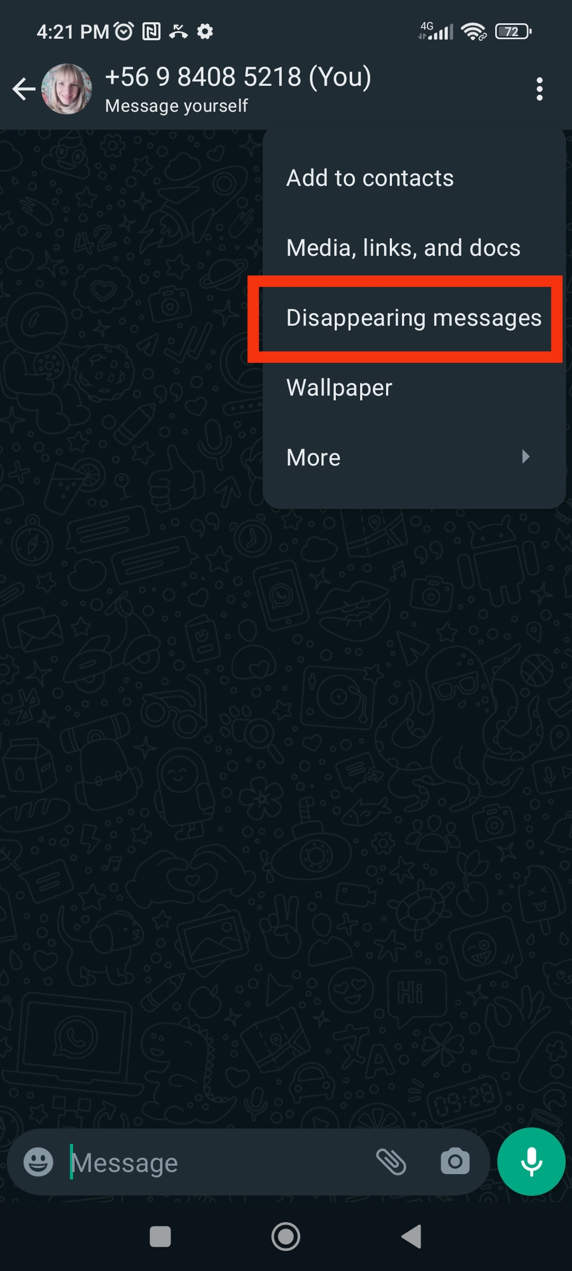
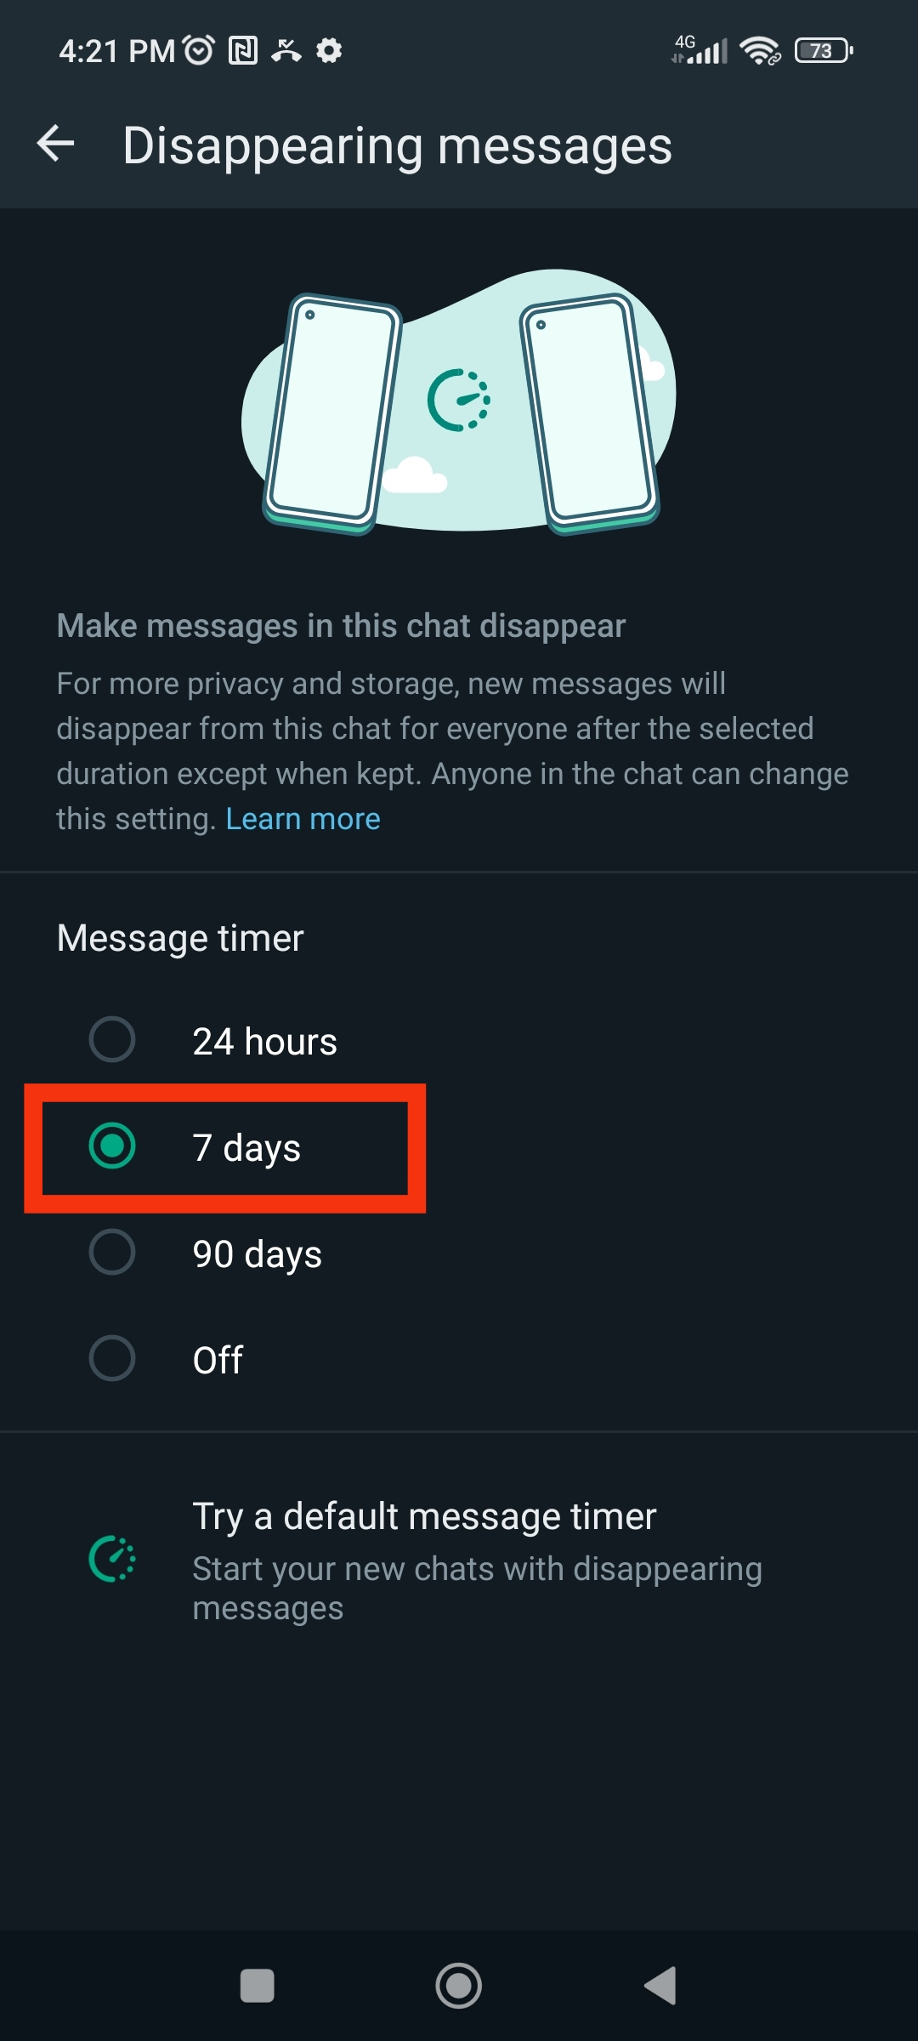
Tips for saving your data and storage: Disappearing Messages
Automatically delete messages after a week, keeping your chats tidy and ensuring sensitive conversations don't stick around too long on your phone.
Notes:
Another tip that will help you to save storage and keep your chats more private and organized is Disappearing Messages. When you turn on Disappearing Messages, any messages you get will vanish after 7 days. To use this feature, open a chat in WhatsApp. Tap on the contact's name or group name at the top of the chat. Scroll down and select "Disappearing Messages. Choose "On" to enable disappearing messages for that chat.

Slide 13
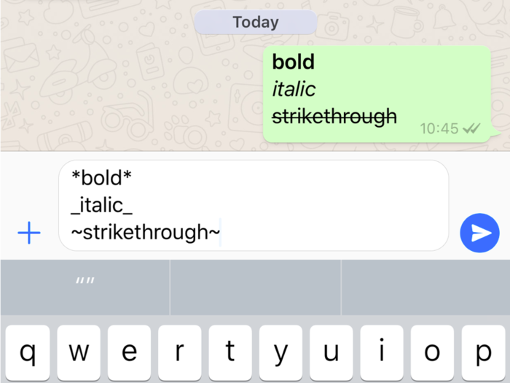
Handy functions: Bold, Italics, and Strikethrough Text
You can change the format of the WhatsApp font to express yourself more clearly.
Notes:
Now that we’ve learned the main features of WhatsApp, let’s check out some really handy functions of WhatsApp that not everyone knows about, such as editing your messages.
To make your text bold, just put an asterisk (*) before and after the word or phrase. For example, typing this will make the word "this" appear in bold.
Italics: To italicize your text, place an underscore (_) before and after the word or phrase. For instance, typing this will make the word "this" appear in italics.
Strikethrough: If you want to strike through your text, use a tilde (~) before and after the word or phrase. For example, typing this will make the word "this" appear with a line through it.

Slide 14
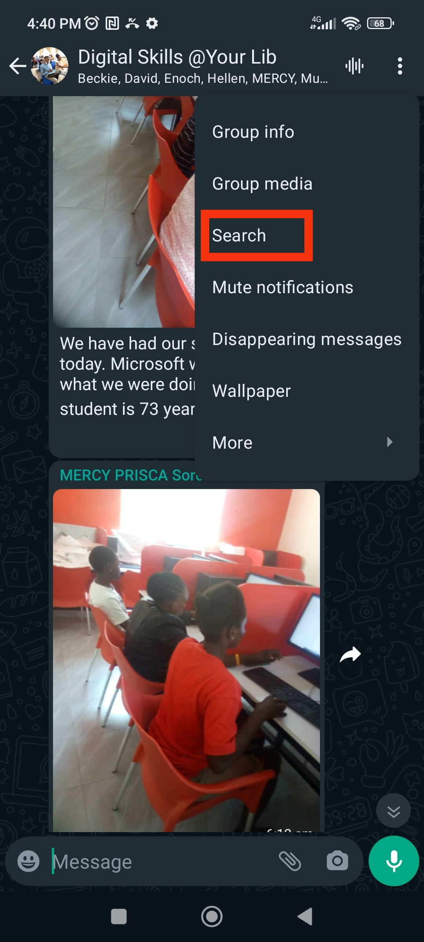
Handy functions: Search a specific chat
WhatsApp's chat search function allows users to quickly find specific messages or content within their chat history.
Notes:
Over time, you'll get lots of messages from different people or groups. If you need to find a specific message, it's easier to search within a particular chat rather than all your chats. To do this, open the chat, tap on the three dots in the top right corner, and select "Search." Type in a keyword or phrase, and WhatsApp will highlight all the matching messages in that chat.

Slide 15
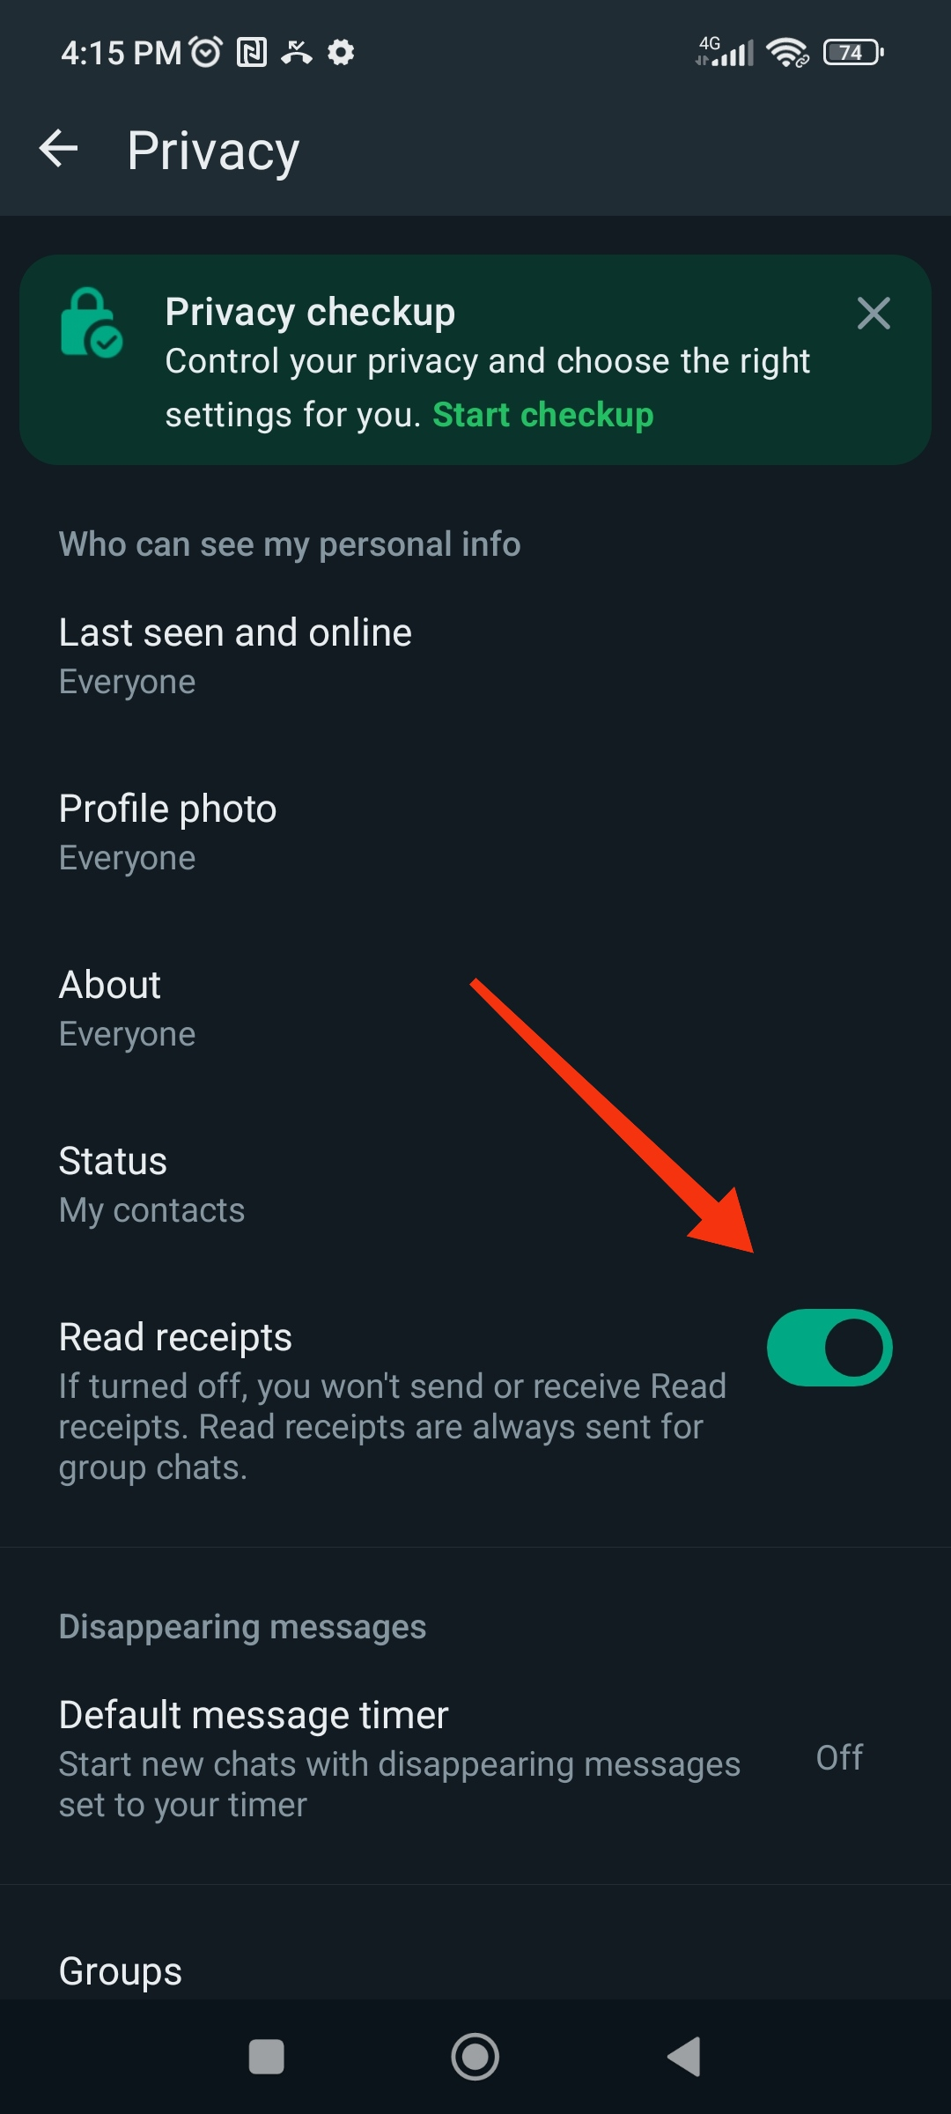
Handy functions: Read Messages Without Replying
Turning off WhatsApp's Read Receipts hides the blue checkmarks, so only gray checkmarks appear, keeping it a secret if you've read someone's message.
Notes:
If you turn off WhatsApp's Read Receipts, the blue checkmarks won't show up when someone reads your message.
Only a gray checkmark will be there, so the person you're chatting with won't know if you've read the message or not.
It's like a secret message feature!

Slide 16
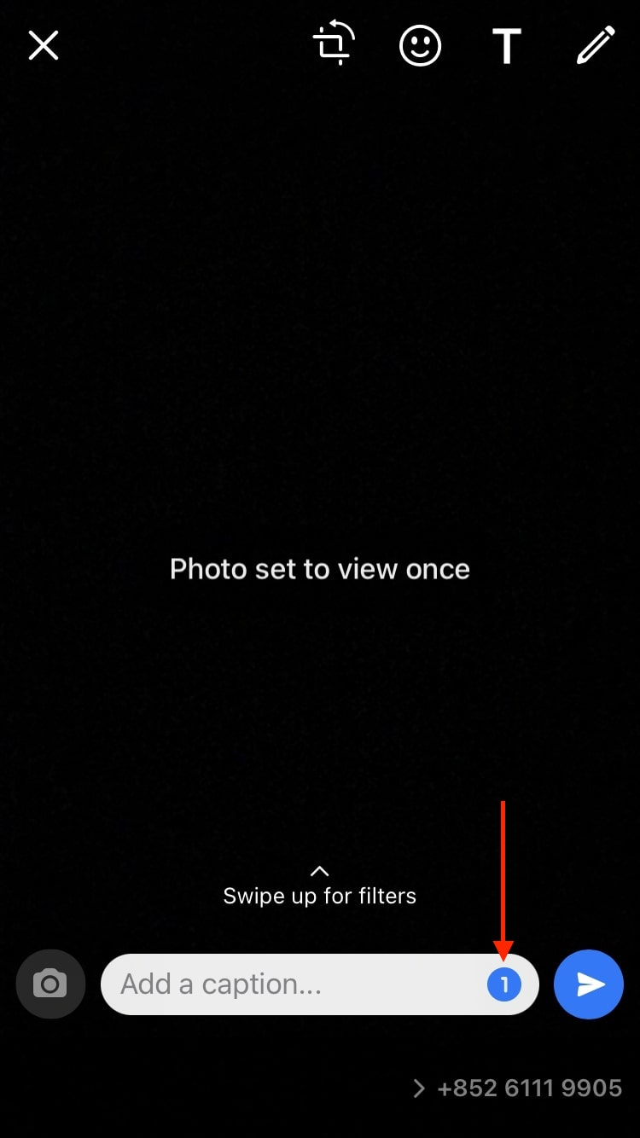
Handy functions: View Once Photos and Videos
WhatsApp lets you send photos and videos that disappear after being viewed, keeping your chats private and clutter-free.
Notes:
One of them is the "view once" feature for photos and videos. If you don’t want your phone to get cluttered with stuff you only need to see once, or if you want to keep things private, this function is perfect. When you turn it on, the pictures and videos you send can only be seen by the recipient once. After they look at it, it disappears and gets marked as "Opened" in the chat.

Slide 17

Handy functions: Speed Up Audio Playback
WhatsApp now lets you speed up voice messages to listen to them faster!
Notes:
Another handy function is speeding up audio playback. Some people like sending really long voice messages, but not everyone likes listening to them.
Good news for the second group – WhatsApp now lets you change how fast you hear voice messages. You can pick from three speeds: regular (1x), a bit faster (1.5x), or super fast (2x).

Slide 18
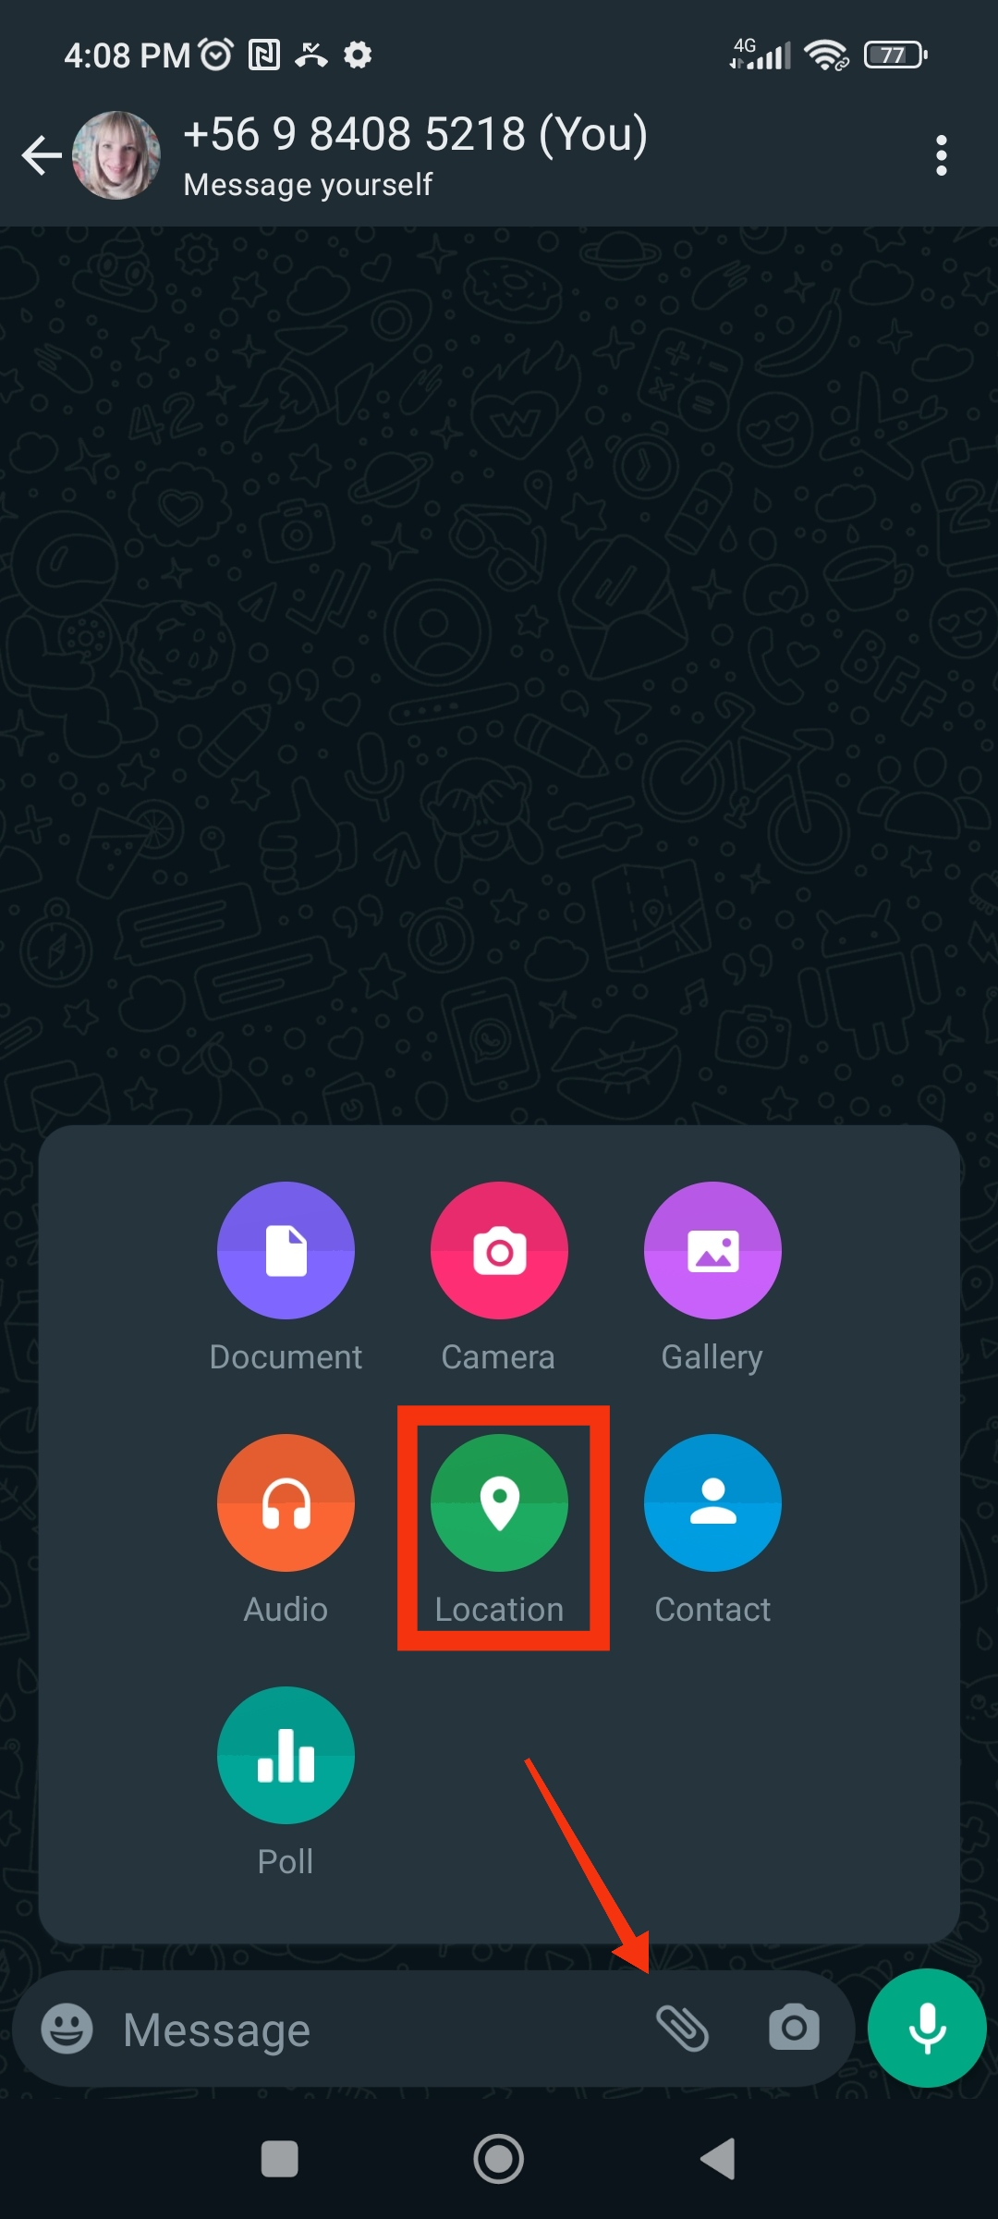
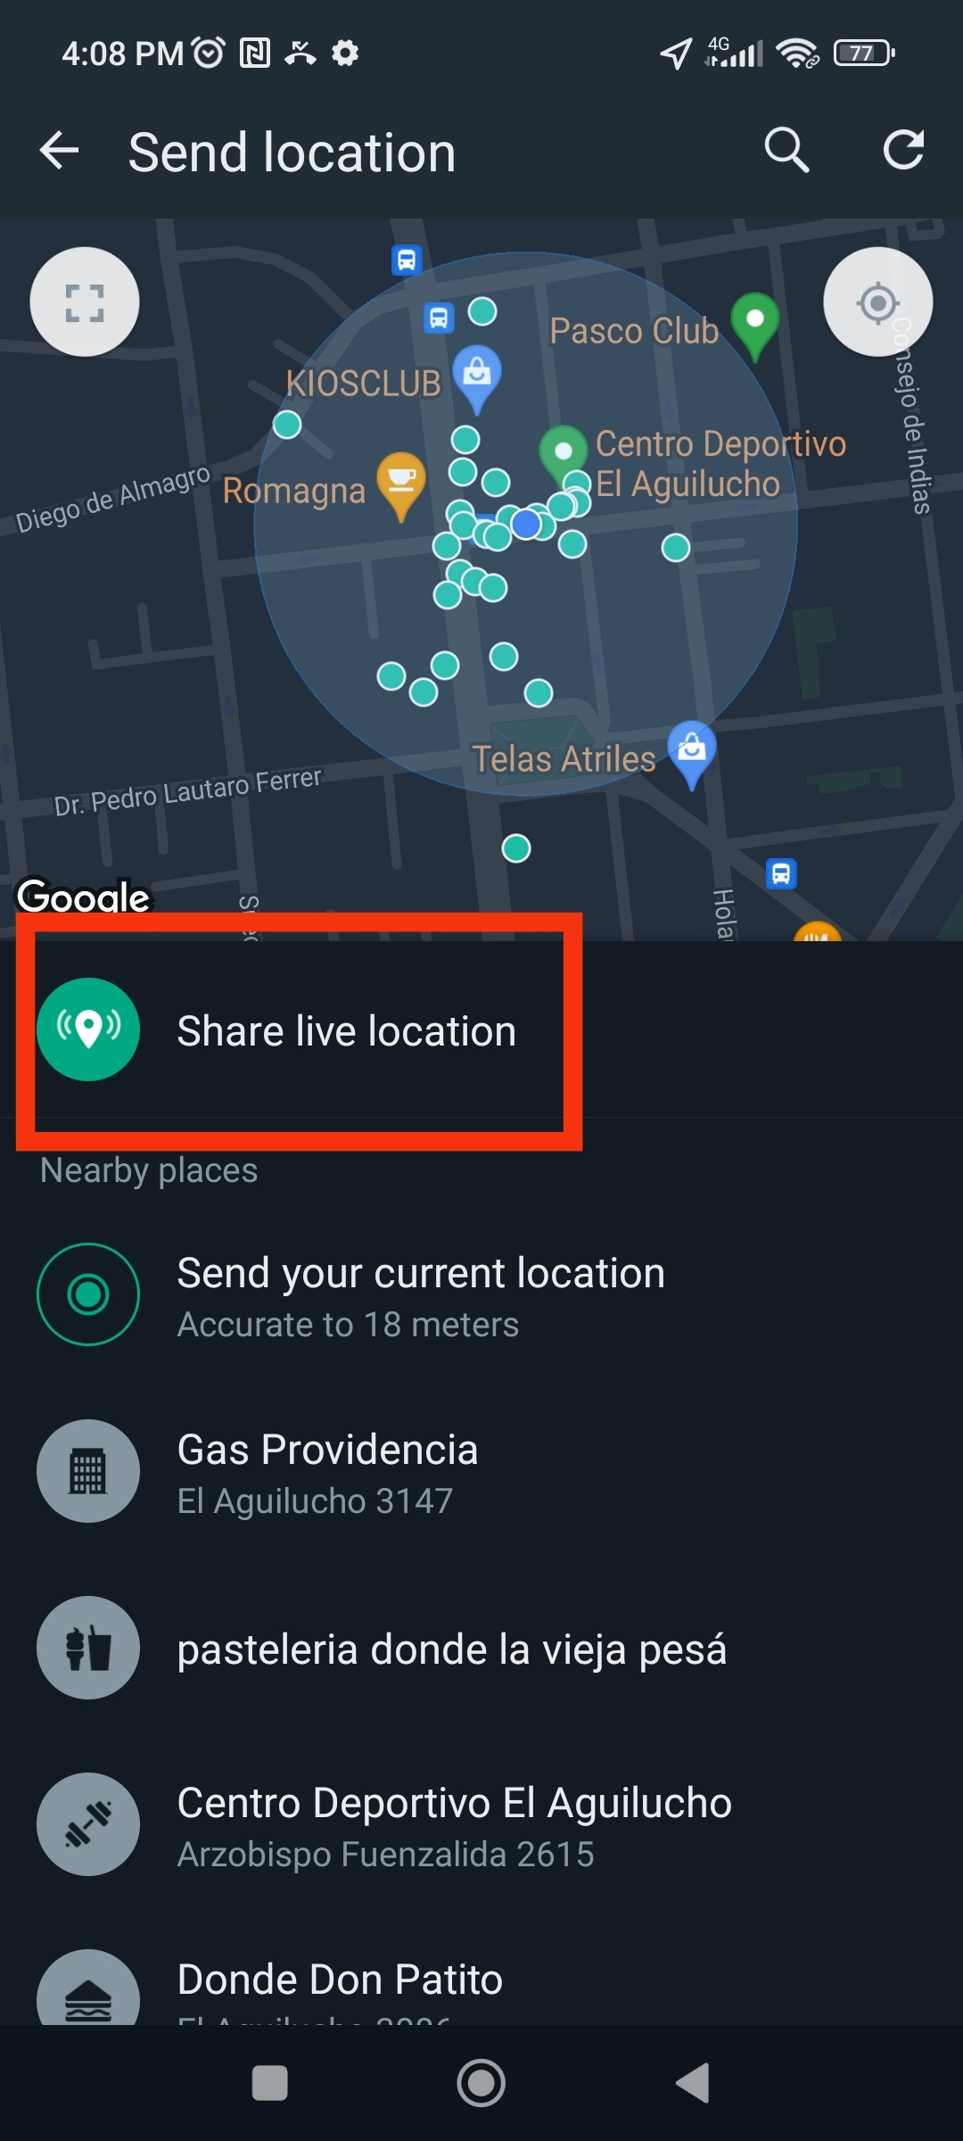
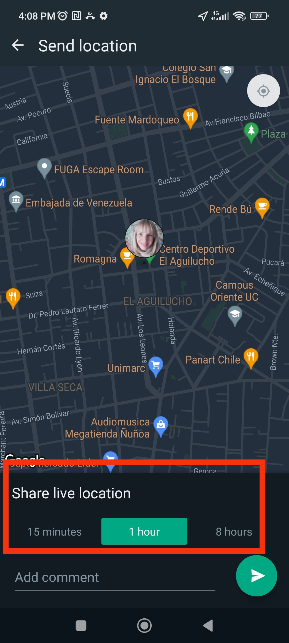
Handy functions: Real-time Location Sharing
Notes:
If you want to share your exact location with a friend or a family member, use the "Share Live Location" feature. This helps them find you or lets you guide them to where you are. You can send your exact location in real-time to someone for a specific time (15 minutes, 1 hour, or 8 hours).

Slide 19

Wrap-up
Understanding WhatsApp
Key features
Staying safe
Respect and Kindness
This Photo by Unknown Author is licensed under CC BY-SA-NC
Notes:
Alright everyone, we've reached the end of our WhatsApp training session. Let's quickly recap what we've learned:
Understanding WhatsApp: We covered the basics of what WhatsApp is and how it works. It's a messaging app that helps us stay connected with friends and family.
Key Features: We explored some cool features like group chats, voice and video calls, status updates, and sharing media.
Staying Safe: We discussed important safety tips, such as not sharing personal information with strangers, blocking or reporting users who bother us, and being cautious about what we share online. Remember, WhatsApp is a great tool for communication, but it's important to use it responsibly. If you ever feel unsure or uncomfortable, don’t hesitate to talk to a trusted adult.
Respect and Kindness: We talked about treating everyone with respect and kindness on WhatsApp, just as we would in real life. Thanks for participating! If you have any questions or need help with anything on WhatsApp, feel free to ask now or reach out later. Stay safe and have fun!

Slide 20

Now let’s practice!
This Photo by Unknown Author is licensed under CC BY-SA
Notes:
If possible, we recommend facilitators to conduct a short hands-on practice session.
In the next slides, we will introduce some simple exercises that you can give to the learners. To conduct these exercises, you will need at least a few smartphones (trainees can practice in groups) and to print the posters from the following set of handouts: https://www.gsma.com/solutions-and-impact/connectivity-for-good/mobile-for-development//wp-content/uploads/2022/01/GSMA-MISTT-WhatsApp-Bitesize-English.docx

Slide 21
Activity 1: Messaging one-to-one
Send a text message greeting
Send a selfie photo of the group
Send a voice message greeting
Notes:
Start this activity by showing the ‘How to use WhatsApp: 1-to-1 Messaging’ poster. Take your trainees through the steps on their shared
phones and explain that you can send text, images or voice messages.
Ask them to try sending messages to each other on the phones.
1. Send a text message greeting:
• Hold up the chat icon
for WhatsApp.
• Explain where to find it and
demonstrate how to use it
• Ask the trainees to send text
message greetings to each other
2. Send a selfie photo of their group:
• Hold up the camera icon
for WhatsApp.
• Explain about the camera, where to
find it and demonstrate how to use it.
• Ask the trainees to send these
photos to each other.
3. Send a voice message greeting:
• Hold up the microphone icon for
WhatsApp
• Explain about the microphone, where
to find it and demonstrate how to
use it
• Ask the trainees to send voice
message greetings to each other
• Explain: “When you send someone
a WhatsApp message, you can see if
it has been delivered to their phone
and if they have read it”. A) Sent = 1
grey tick B) Delivered = 2 grey ticks
C) Read = 2 blue ticks

Slide 22
Activity 2: Group messaging
Create a WhatsApp group
Send text or voice message to the group
Share a selfie to the group
Notes:
Show the ‘How to use WhatsApp: group Messaging’ poster. Demonstrate how to create a WhatsApp group and invite your trainees, on their shared phones, to all join one WhatsApp group (send invites using the numbers for the shared phones). Send a text or a voice message to the trainees’ WhatsApp group, asking the trainees to share their group selfies in the group chat.

Slide 23

Activity 3: Safety quiz!
What do you do if someone you don’t know bothers you?
What do you do if someone you don’t know or trust asks you for your personal information?
What do you do if you feel unsure or uncomfortable about something you see or experience on WhatsApp?
How should you treat people you interact with on WhatsApp?
Notes:
Show questions one by one and ask your trainees to respond:
- What do you do if someone you don’t know bothers you?
Possible answer: You avoid or ignore them, but if they keep insisting, you block them.
- What do you do if someone you don’t know or trust asks you for your personal information?
Possible answer: You don’t give out personal information to someone you don’t
know or trust because they may misuse it.
- What do you do if you feel unsure or uncomfortable about something you
see or experience on WhatsApp?
Possible answer: Tell someone you know and trust about what happened.
- How do you treat people you interact with?
Possible answer: You should be polite and respectful to people.

