Slide 1
Presentation for use by
public librarians offering online safety training for children and teenagers
Slides and notes for trainers compiled by Ugne Lipeikaite,
EIFL Public Library Innovation Programme
Based on eSafetykids https://www.esafety.gov.au/kid
2024
Notes:
This presentation, titled Survival in a Digital Jungle, is for use by public librarians to train children and teenagers in online safety. Librarians can adapt the presentation as needed, to accommodate needs of learners (in relation to knowledge and skills levels, language, technology used, etc.). It should take approximately an hour to complete.

Slide 2
SURVIVAL IN A DIGITAL JUNGLE
Notes:
TITLE SLIDE: Trainers can use this slide to introduce the topic by explaining to the learners about potential dangers and risks online, like for example, identity theft, cyberbullying and harassment, viruses and spyware. By following some simple rules one can protect themselves and others, and enjoy the benefits of the internet.

Slide 3
ENERGIZER
READ EACH SENTENCE AND CHOOSE IF YOU THINK IT IS TRUE OR FALSE
Notes:
The trainer can introduce an energizer that will get the children / youth focused on the topic. The energizer starts on the next slide, Slide 3 and goes on to Slide 8. The trainer reads out the questions, and gets the learners to answer, True or False. The trainer can also engage the young people in discussion during the energizer, asking the children to explain their answers.
Here are some alternative energizers for trainers to consider using
If your learners are sitting in front of a computer or have mobile devices, you can ask them to complete this quiz online: https://quiz-digital-incollables.playbac.fr/keep-your-private-life-a-secret-1/40
If neither you, nor the learners have access to digital devices, you can use conversation cards with them to start a discussion about online safety: https://www.esafety.gov.au/sites/default/files/2020-03/eSafety_Ed%20Conversation%20S%20%20Kids.pdf

Slide 4
Your phone number is “personal data”.
TRUE FALSE
Notes:
True: Just like your name, your photograph, and your fingerprints… your phone number is personal data that can be used to identify you.

Slide 5
A friend is allowed to post the selfie you took together on their Instagram account without your permission.
TRUE FALSE
Notes:
False: No-one should post a photo of you on the Internet without your permission, and without your and your parents' permission if you are under 16 years old.

Slide 6
You should never agree to meet up in real life with a stranger you’ve met on social media.
TRUE FALSE
Notes:
True: Even if the person you meet and talk to online seems nice, you can never be sure how they are in real life.

Slide 7
You can share or “like” a photo that makes fun of a friend.
TRUE FALSE
Notes:
False: We must always respect others - in real life AND on the internet / online.

Slide 8
All information published on the Internet is accurate and has been verified.
TRUE FALSE
Notes:
False: Some information published on the internet is accurate, and has been verified. But because anyone who has access to technology can publish online, a lot of information is either inaccurate because the author does not have good knowledge about the subject, or because someone is deliberately trying to misinform and mislead you. So if you have doubts, you must always check.
Thew trainer can then re-introduce the training, remaining the children what it is about -
Great job finishing the introductory quiz about online safety! Now, let's dive a bit deeper into these topics to help you stay safe online. In this training, we'll cover important things like privacy, cyberbullying, online scams and others, so you can have fun on the internet while keeping your information safe. Get ready to learn and become savvy online explorers!

Slide 9
WHAT IS ONLINE SAFETY
This Photo by Unknown Author is licensed under CC BY-ND
Online safety is the ability to understand and recognize threats that exist on the internet, as well as having the skills and knowledge to avoid these threats.
Notes:
First of all, let me explain what we mean by Online Safety. Online safety means taking steps to protect yourself and your information while using the Internet. Online safety includes things like protecting your personal information, staying away from cyberbullies, avoiding online scams, also respecting the privacy of others.
In a nutshell, online safety is about using the internet smartly and carefully, just like you would navigate the real world.

Slide 10
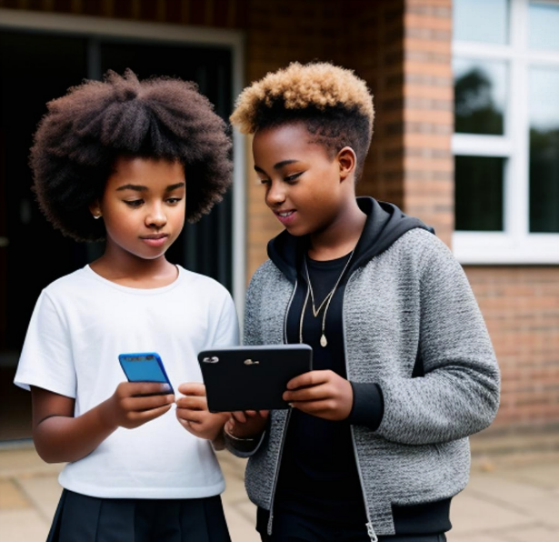
PROTECTING YOUR PERSONAL INFORMATION ONLINE
Your personal information includes your full name, address, phone number, email, which school you go to, usernames and passwords for online/email accounts, and any financial details about you or your family.
Steps to take:
Avoid using your full name online
Don’t lie about your age
Only friend or follow people you know
Keep your email and phone number private
Notes:
We will start with one of the most important aspects of online safety, which is personal information. Why is it so important? Personal information is as precious as the keys to your house. Giving these keys to the wrong person, even by accident, is like allowing a stranger into your house without you even knowing. Your personal information includes your full name, address, phone numbers, school you go to, date of birth, email address, and any financial details about you or your family. If someone has a lot of personal information about you, they could pretend to be you, find out where you live, or even use your personal information to create fake online accounts and buy things. To protect your personal information:
Choose an online name that does not include your real first or last name, use a nickname instead.
Don’t lie about your age — age limits for certain platforms are there because some of the content on these platforms is not safe for kids. Most social media apps have a minimum age limit of 13.
Only ‘friend’ or ‘follow’ people you know — if you receive a ‘friend request’ from someone you don’t know it is best to delete their request.
Keep your email and phone number private so that you don’t get bothered by unwanted texts, calls, or emails.

Slide 11
SHARING PHOTOS OR VIDEOS
Once you share something online it is very difficult to take it back so always think before sharing.
Tips for sharing:
Don’t share anything you wouldn’t want people to see in future
Check what you are sharing
Ask before sharing
Don’t share or forward something embarrassing
Notes:
Nowadays it is very popular to exchange and share photos and videos online. The problem is that once you share something online it is very hard to remove it as even if you delete it, it stays in the Internet archives and someone could have already downloaded it, copied it, and shared it without your consent. The general recommendation would be that if you are unsure about sharing something, it is best not to share it. However, if you do want to share photos or videos, please consider the following tips:
Let’s say you can post a video of you singing or dancing like crazy and it is funny now, but will it be cool in, let’s say, 5 years? It is now very popular to look for information online before hiring someone, would you feel comfortable if your future employer would see this video?
Check if a photo or video has anything in it that could show where you live or the school you go to. Does it show the front of your house or street? Are you in your school uniform?
Be respectful of other people’s personal information – if you want to share something about them, ask permission before you share. If they say no, then respect their decision. Also, If you have shared a photo or video and the person asked you to take it down, do it!
If someone sends you a photo or video that you know would be embarrassing for the person in it, don’t forward it or share it with other kids.

Slide 12
MEETING NEW PEOPLE ONLINE
Online friends should nicely talk to you, respect you, not make you feel bad or uncomfortable, and not ask you to do things you do not want to do.
Be cautious with:
Personal information requests
Inconsistent or hidden identities
Pressure or manipulation
Meeting online friends in real life
Notes:
The Internet is very often used for communication and meeting new people. Most people who contact you online just want to be friends or chat. The problem is that online people can also easily pretend to be someone else and that someone could pretend to be a kid your age, then harm you by tricking you into doing something inappropriate. First of all, online friends should be nice to you, respect you, not make you feel bad or uncomfortable, and not ask you to do things you do not want to do – for example keep a secret, disclose any personal details or share your photos or videos. What are the so-called red flags, or things that could indicate that something is not ok:
Be cautious if your online friend starts asking for too much personal information, such as your address, phone number, or financial details. Genuine friends respect your privacy, and it's important not to share sensitive information with someone you've only met online.
Pay attention to consistency in the information your online friend shares. If they frequently change details about themselves or keep their identity hidden, it could be a red flag. If your online friends is hesitant to share information about themselves or have a very limited online presence, it’s also worth being cautious.
Watch out for signs of pressure or manipulation. If your online friend is pushing you to do things you're not comfortable with, like sharing explicit photos or videos, or participating in activities that go against your values, it's time to stop this friendship.
You might make a friend online, but it is safer not to meet them in real life.

Slide 13
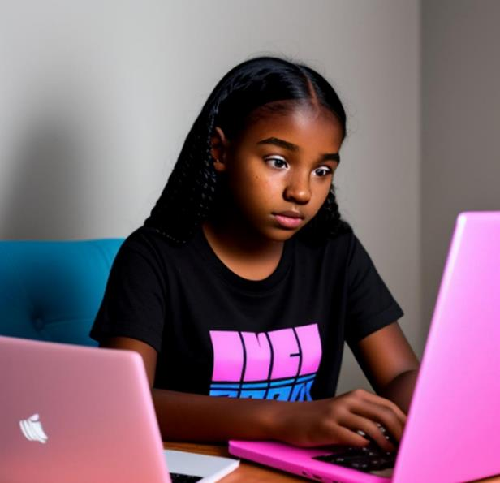
WHAT IF SOMEONE IS CONTACTING ME, AND I DON’T WANT THEM TO
Online message or contact from a stranger or someone you know, that makes you feel uncomfortable or unsafe is called unwanted contact.
Steps to take:
Do not respond
Block and report
Make your accounts private
Talk to someone you trust
Document the interaction
Notes:
When you are using various online platforms, you may experience a situation called unwanted contact. Unwanted contact is any online message or contact from a stranger, or even someone you know, that makes you feel uncomfortable or unsafe.
Here are some examples of unwanted contact:
Someone sends you messages from a private number on your phone and you don’t know who they are.
A stranger comments on a video or photo you shared online and it makes you feel uncomfortable.
Someone sends you messages through a messaging program or online gaming platform you don’t like or keeps contacting you or asks lots of personal questions, like where you live and your contact details.
What to do:
Avoid responding to the person's messages. Engaging into conversations with them may encourage further communication. By not responding, you make it clear that you are not interested in continuing the conversation.
Utilize the blocking and reporting features on the platform you're using. Blocking prevents the person from contacting you, and reporting brings their behavior to the attention of platform administrators who can take appropriate action.
Review and adjust your privacy settings on the platform. Ensure that your profile is set to private, limiting the information visible to others.
If you feel like you are not able to deal with the situation by yourself, talk to a trusted friend, family member, or adult. They can provide support and advise you on what to do.
Consider taking screenshots or saving the messages. This documentation may be useful if you need to involve authorities or escalate the issue to the platform administrators.
Remember, your safety and well-being are the top priorities. If the situation persists or escalates, don't hesitate to seek help. Online platforms often have tools in place to handle such situations, so make use of these tools to maintain a safe and positive online experience. More details at: https://www.esafety.gov.au/key-issues/esafety-guide

Slide 14
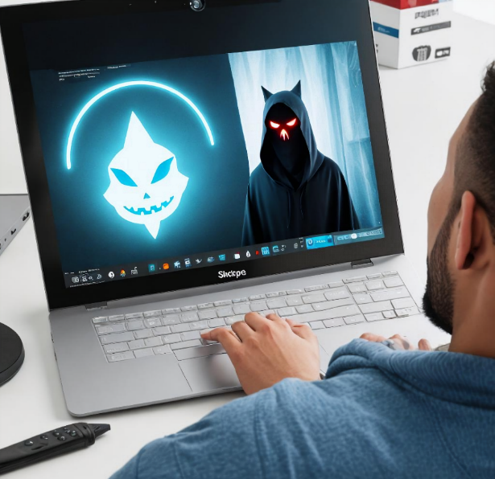
I SAW SOMETHING ONLINE I DIDN’T LIKE
Did someone send you an image or video that made you feel uncomfortable? Or maybe you clicked on a link and saw something you didn’t like?
Steps to take:
Switch it off
Talk to an adult you trust
Set up your device safety so you don’t see something like this again
Report the game, app, or website
Notes:
There are a lot of really fun and useful things online, but there are also some things that are not so nice. Maybe you clicked on a link and saw something you didn’t like. Perhaps someone sent you an image or video that made you feel bad. Or you saw something online that made you feel uncomfortable, unsafe or scared. First of all, remember that it’s not your fault if you see something you don’t like and the most important thing is to make sure you are OK.
If this happens to you, close the browser or turn off the screen. This will help you to feel more comfortable. You don’t have to look at anything that upsets you.
It’s more important that you talk to someone you trust about what you saw and how it made you feel.
They can help you to set up your device safety so you don’t see something like this again.
They can also help you to report it — either to the game, app, or website.

Slide 15
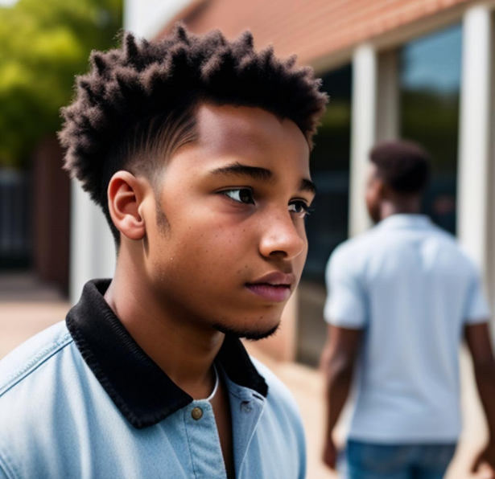
SOMEONE IS BEING MEAN TO ME ONLINE
Other kids can be mean when they are online. Bullying or hurting someone online is called cyberbullying.
Steps to take:
Try not to say anything back
Block the person to stop them from contacting you
Report to the game, app or website
Tell a trusted adult what’s going on
Notes:
Also, by communicating with people online you might experience mean behavior from others. No one deserves to be hurt online. If this has happened to you, be kind to yourself — it’s not your fault. Also be kind to others and not do anything online that might hurt their feelings.
Hurting someone online is called cyber bullying and examples of it include:
Hurtful messages, comments or images.
Messages, posts or comments that say someone will do something mean.
Spreading lies about you online.
Creating fake online profiles in someone’s name to trick you.
Threatening to share something online that will hurt you or make you feel bad.
If this had happened to you:
Try not to say anything back — it could make things worse.
You can block the person to stop them from contacting you. Most games and apps have a way to block or mute someone.
Report the messages to the game or app they were posted on.
Talk to someone you trust, this person can also help you to block, report or take evidence, like screenshot.

Slide 16
SECURITY AND PRIVACY FOR MY DEVICE
Online baddies are called cyber criminals. A cybercriminal could take your money, get into your or your family's bank accounts, use your info, pretend to be you on social media, and spread viruses online.
Steps to take:
Make sure all your passwords are strong, secret, and safe
Don’t open links or attachments that you are not familiar with
Don’t open emails or attachments offering you something free or saying you have won something
Notes:
Last important aspect of online safety that I wanted to cover today is avoiding online threats. Like in the real world, the online world unfortunately also has people who do bad things, like stealing money, pretending to be someone else in fake social media accounts, spreading computer viruses, and so on. Such people are called cyber criminals and they could be acting even without you seeing or knowing that something bad is happening.
What to do to keep your mobile phone, computer, or tablet safe from such people?
Make sure your passwords should are strong. What we mean by strong is that they should not be obvious and easy to guess like your name or 123. It’s also a good idea to use different passwords for different online accounts. Keep your passwords secret and don’t share them with anyone. Also it is not good idea to write them down and store them together with your device.
When you get an email or message, only open if you know the sender in real life — messages from people you don’t know could have a virus.
Don’t open emails or messages offering you something free or saying you have won something. It is probably a virus or a way to steal your personal information. Remember, if something sounds too good to be true, it probably is.

Slide 17
BE SHARP, BE SECURE & BE KIND
Notes:
With this, we come to the end of our session. Congratulations, you are now a safer and more confident explorer of the online world!
Please remember to always be Sharp thinking before sharing something online.
Be Secure and always safeguard your important information.
Be Kind – treat everyone online with kindness and do not tolerate bullies.

Slide 18
REFERENCES USED TO COMPILE THIS PRESENTATION, AND ADDITIONAL ONLINE SAFETY RESOURCES
https://www.esafety.gov.au/parents/children-under-5/picture-book-and-song/swoosh-glide-and-rule-number-5#read-the-book – online safety picture book (read/watch)
https://toolkits.childonlineafrica.org/online-with-sango-a-story-book-for-children-2/ - an engaging and interactive child-friendly online safety book.
https://www.esafety.gov.au/kids - an interactive child-friendly platform for children to learn about online rights and online safety and how to reach out for help related to online risks and harms.
https://www.esafety.gov.au/young-people - resources and information for young people to learn about online rights and online safety risks and harms.

Slide 19
REFERENCES USED TO COMPILE THIS PRESENTATION, AND ADDITIONAL ONLINE SAFETY RESOURCES
https://digiworld.theparentzone.co.uk – a curriculum designed to help children, aged between 5 and 16, develop the knowledge and skills they need to navigate the online world more safely and enjoyably. It includes an interactive game, quizzes, worksheets, and lesson plans.
https://quiz-digital-incollables.playbac.fr/keep-your-private-life-a-secret-1/40 - 60-question digital quiz to play online and test children’s and teenagers’ knowledge by level of difficulty.
https://www.itu-cop-guidelines.com/children - online, self-paced, interactive courses designed for children of three age groups: 9 to 12, 13 to 15 and 16 to 18, for them to gain insight into the various issues related to online harassment, privacy and mis/dis information.

