Slide 1


Checking for overlap in e-resource collections
How and why
Tatjana Timotijević
Head of Department of Scientific Information,
KoBSON country coordinator
National Library of Serbia
tatjana.timotijevic@nb.rs
December, 2017.

Slide 2
In this webinar
Brief presentation of KoBSON’s database of subscribed e-resource content, and how we can search it for content overlap
Discussion of different scenarios of when we check for content overlap between e-resources collections: when considering new content, renewals, etc.

Slide 3
KobSON’s database [EleČas - EleJour]
The database was built in 2002 by KoBSON IT colleagues
It is made on SQL server (currently 2014 version). It consists of a lot of related tables (for example 3 tables for E-journals, 3 for e-books and 3 for Impact Factor).
We import Excel spreadsheets or Access table received from publishers (with their list of titles) into our SQL server. Then we make a query based on different needs and purposes.

Slide 4
KobSON’s database [EleČas -EleJour]
For every journal we have information whether that journal has Impact Factor (IF) or not, whether it is available through some of subscribed publishers/vendors or not.
Let’s take a look…

Slide 5
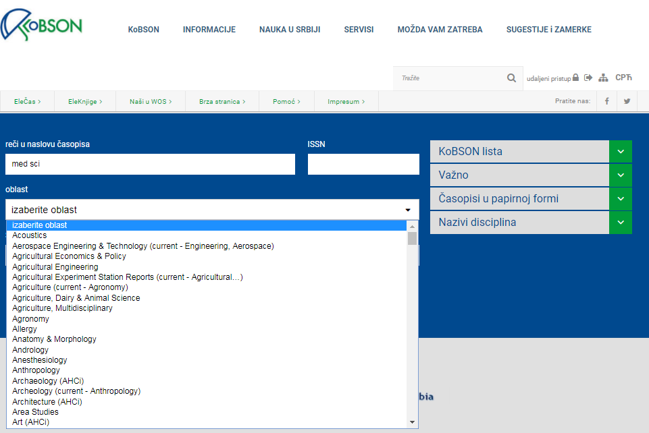
Journal search on KoBSON webpage:

Slide 6
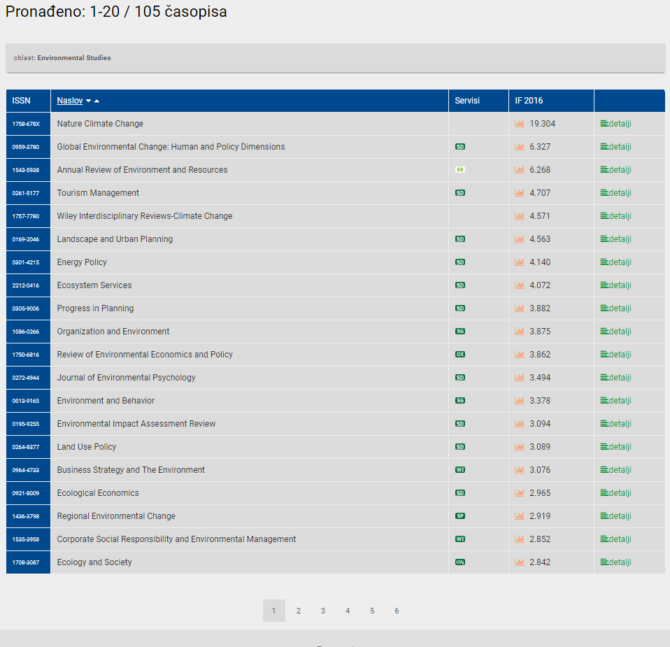
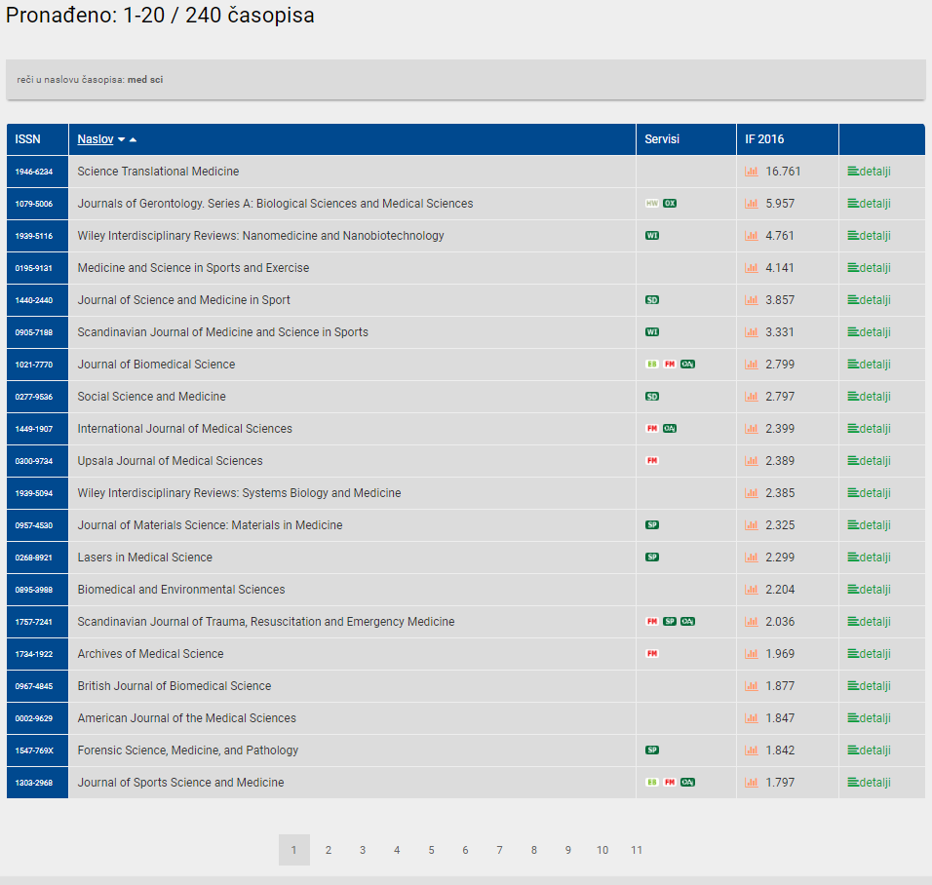
Journal search on KoBSON webpage:

Slide 7
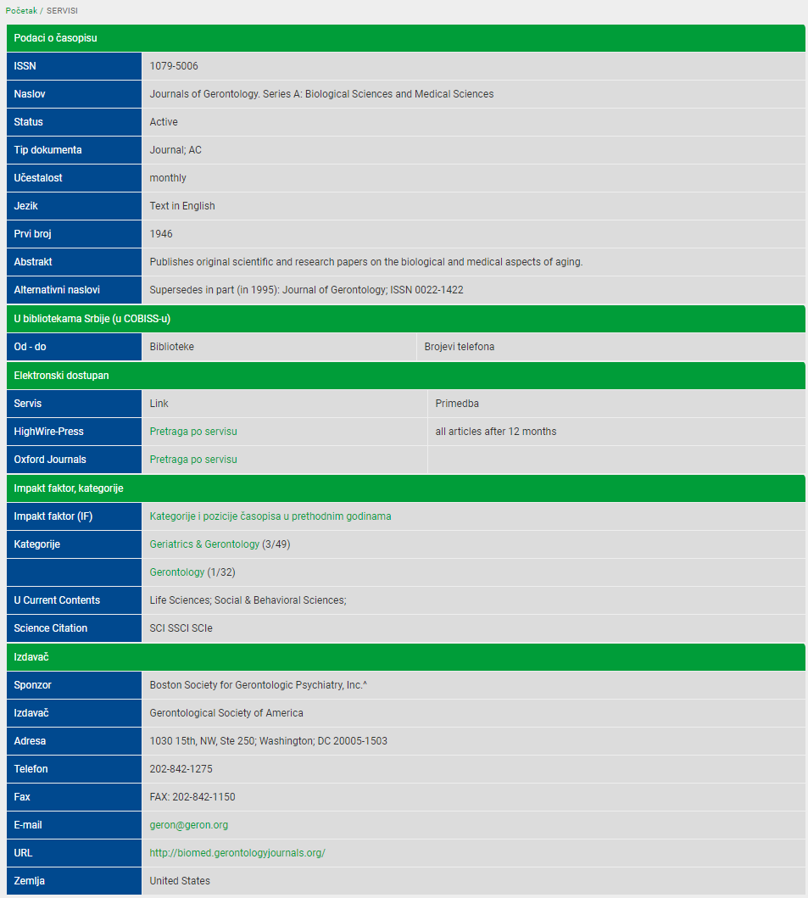
What is in the back end?
Journal title lists with detailed information (ISSN, abbreviated title, language, frequency…), data about its publisher, links, Impact Factor (IF) and JCR
(Journal Citation Report) category

Slide 8
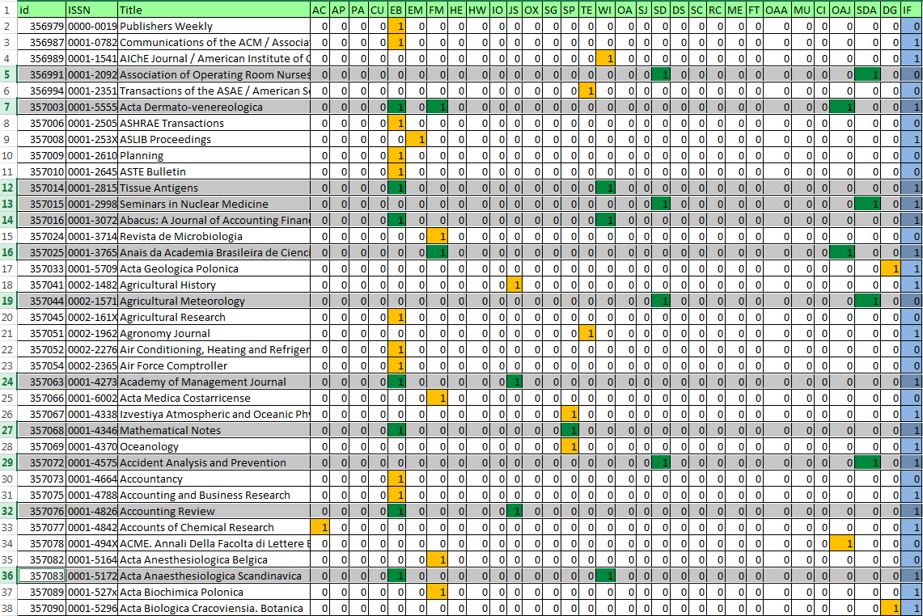
What is in the back end?

Slide 9
When do we check for overlap?
Scenario 1: When we get an offer from a publisher for new content.
For example: University of California Press Journals (23 titles)

Slide 10
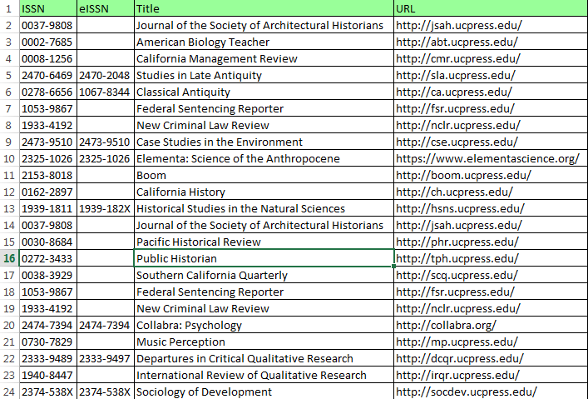
We receive this kind of a list:
Checking for overlapping is based on Journal ISSN not title
(ISSN is unique, Title can be named differently: The Finite/Indefinite Article, Punctuation marks…)
We make a query to find all journals from this list which are included in our current collections, through which service and whether they have IF.

Slide 11
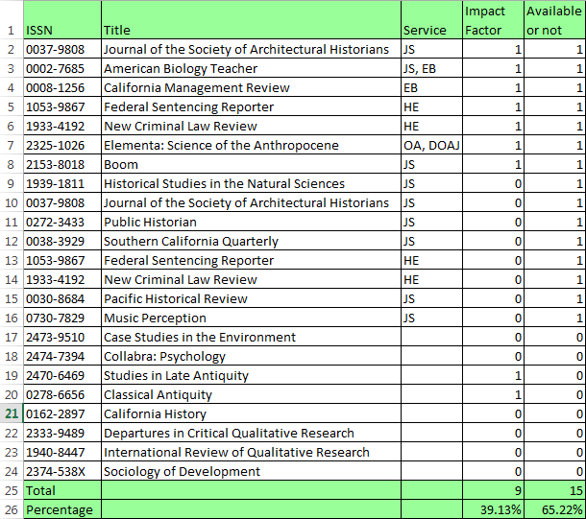
These are the search results:
From 23 journals, 9 titles have Impact factor (39.13%) which is high percentage, and shows great value of collections.
But, from that number of journals, 15 titles are already available in our subscriptions through EBSCO, JSTOR, Hein Online, or in Open Access (DOAJ).
Conclusion: the overlap is too high (65.22%).

Slide 12
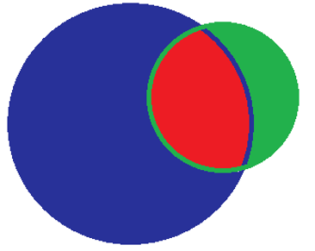
All Journals 29.735
UCP
Overlapping
UCP 23
All journals
Overlapping 15 (65.22%)

Slide 13

When do we check for overlap?
Scenario 2: if we have to cancel some subscriptions because of low usage statistics
In the past, we had a subscription to eBrary e-books; from 84.430 books our users used only 7.654 titles. We decided to change the collection and subscribe EBSCO e-books instead. We checked overlap and received these results:
Overlap 54.83%
EBSCO had more titles, and more unique titles – not included in eBrary (or other available collections)

Slide 14
When do we check for overlap?
We do the same also when we must cancel some subscriptions because of lack of money.
We had EBSCO and ProQuest Journals, we checked overlap. ProQuest had the higher overlap percentage, so and we cancelled that subscription.
The majority of ProQuest Journals were already covered by EBSCO, HighWire, Free Medical Journals, Open Access

Slide 15

When do we check for overlap?
It is of a great importance to have a valuable collection and to provide access to the most relevant literature, that’s why we check for overlap with journal titles which have Impact Factor.
That means that we provide our users access to the world’s most influential literature.

Slide 16
When do we check for overlap?
Scenario 3: When we prepare statistical data for our funders, the Ministry of Science.
Criteria for making decision whether we will renew some subscription or not - for every service/publisher we present the following data: how many journals are available (for aggregators - how many unique journals), how many of them have IF, how many articles Serbian authors published with that publisher, how many downloads we had in a previous year, and the price per article

Slide 17
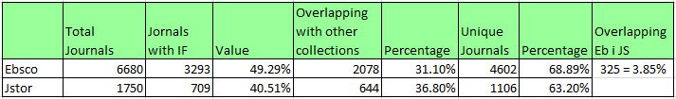

Slide 18
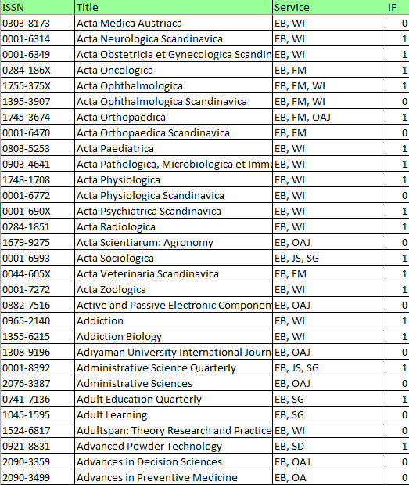
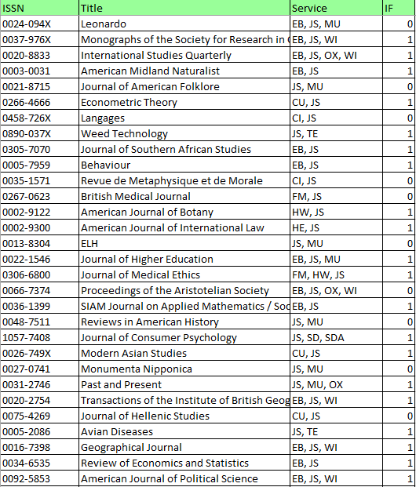
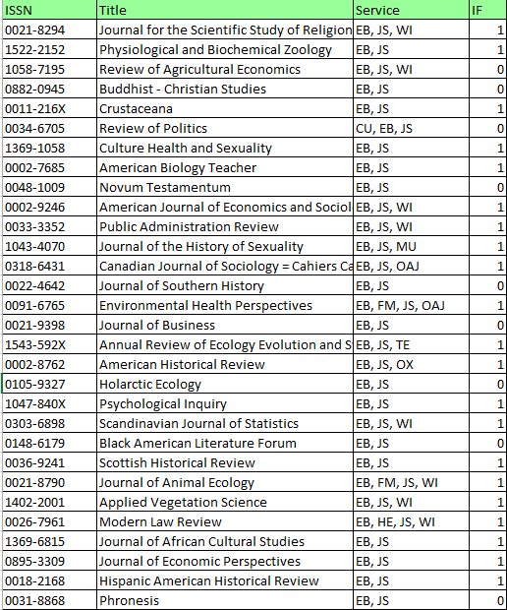

Slide 19
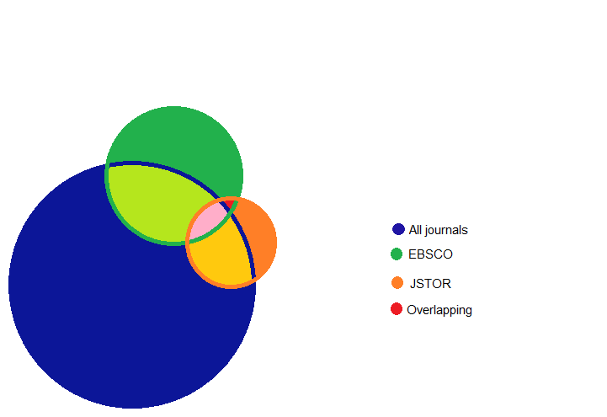
EBSCO
JSTOR
All journals

Slide 20

Thank you for your attention☺
Questions?
Website: www.kobson.nb.rs
E-mail: Tatjana.timotijevic@nb.rs

Slide 21
You can also follow us on:
Facebook → https://www.facebook.com/KoBSON-298844590828/
Twitter → https://twitter.com/kobson_twitty?lang=en

