Slide 1

Webinar:
Enrich your DSpace repository with customized tools

Slide 2



Hello!
I am Obrad Vučkovac
Librarian & Repository Manager
Vinca Institute of Nuclear Sciences
University of Belgrade

Slide 3

Ellena
In-house developed tool by the University of Belgrade Computer Centre (RCUB)

Slide 4
Ellena is used for:
Normalization control
(Jones, E. S. > Jones, Edward S.)
(Massive) metadata editing
Metadata import from CrossRef or other repositories
Massive metadata import with reference managers

Slide 5
The mass import process is simple and easy
Reference Manager
Ellena
Institutional Repository

Slide 6

Example of massive metadata import
Set alert on Scopus and Web of Science to keep track on every new document by your organization.

Slide 7
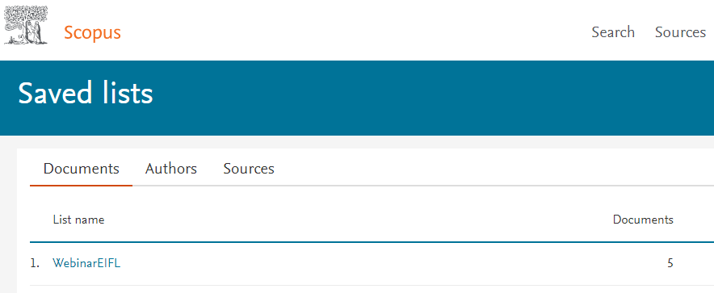
Example of massive metadata import
Save new documents in the lists...

Slide 8


Example of massive metadata import
… export list in the reference manager

Slide 9



Thanks!
Any questions?
You can find me at:
@obrad_vuckovac
obrad-vuckovac
obrad.vuckovac@vinca.rs

Slide 10
Credits
Special thanks to all the people who made and released these awesome resources for free:
Minicons by Webalys
Presentation template by SlidesCarnival
Photographs by Unsplash & Death to the Stock Photo (license)

