Slide 1


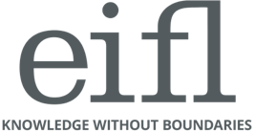
World Intellectual Property Day 2021
Libraries Mean Business
IP & SMES: Take your ideas to markets
April 21, 2021 - 16:00 CEST

Slide 2
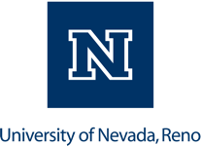

Patent and Trademark Resource Center
@ the University of Nevada, Reno
From patent searches to makerspaces:
How an academic library benefits the local
business community
Tara Radniecki
Head, DeLaMare Science & Engineering Library
Patent and Trademark Resource Center Librarian
tradniecki@unr.edu

Slide 3
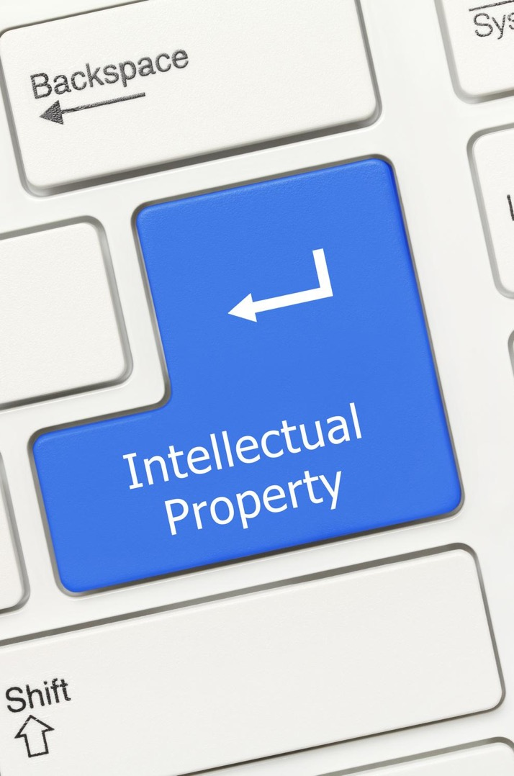
Presentation Outline
Who We Are
Who We Help
How We Help
UNR PTRC | World IP Day 2021

Slide 4
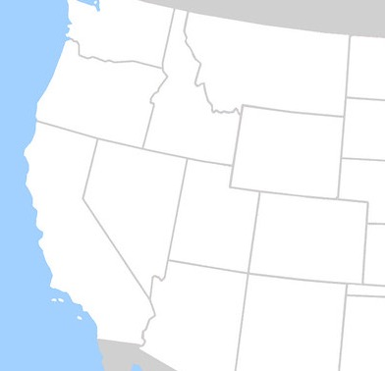

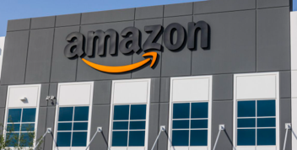
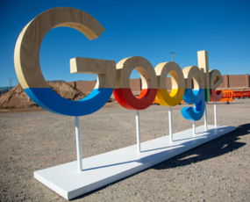
University of Nevada, Reno
145 academic majors
~21,000 students
Reno Area: 425,000
Key Industries: Tech, Adv. Manufacturing, Distribution & Logistics
Reno, Nevada
San Francisco: 218 miles
Las Vegas: 438 miles
Los Angeles: 472 miles
UNR PTRC | World IP Day 2021

Slide 5
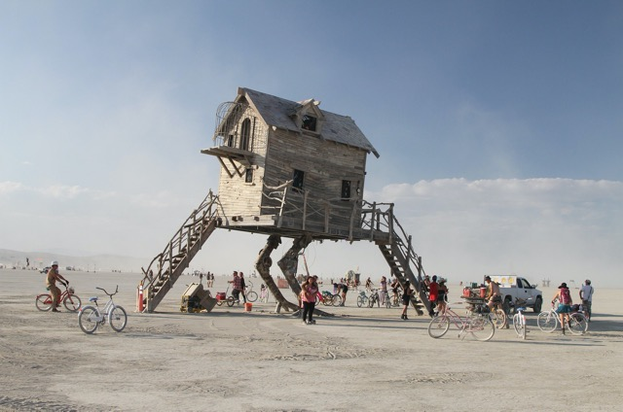
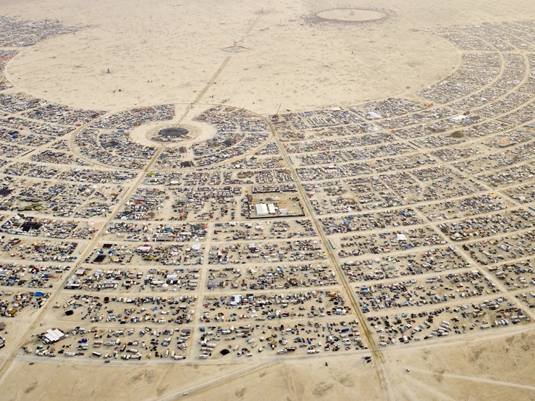
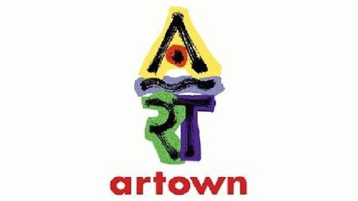
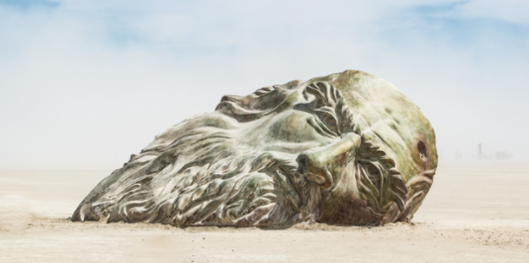
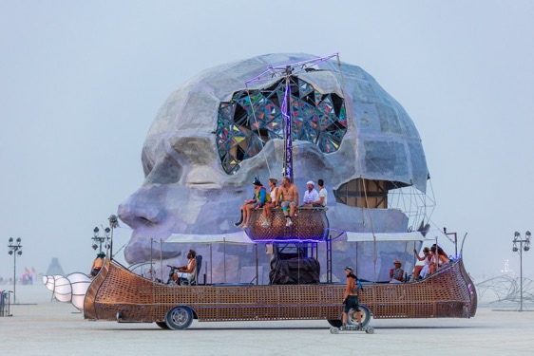
Arts & Culture
UNR PTRC | World IP Day 2021

Slide 6

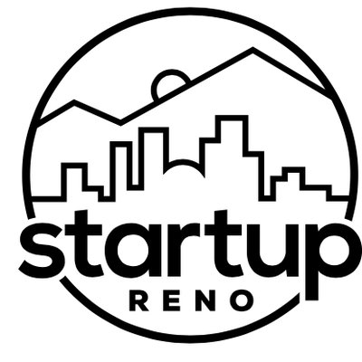
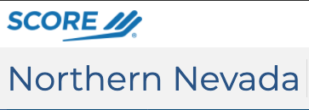
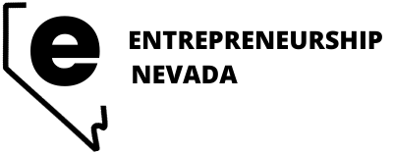
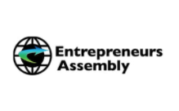

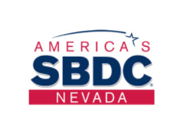


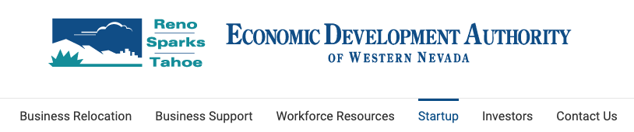
Startup Support Infrastructure
UNR PTRC | World IP Day 2021

Slide 7
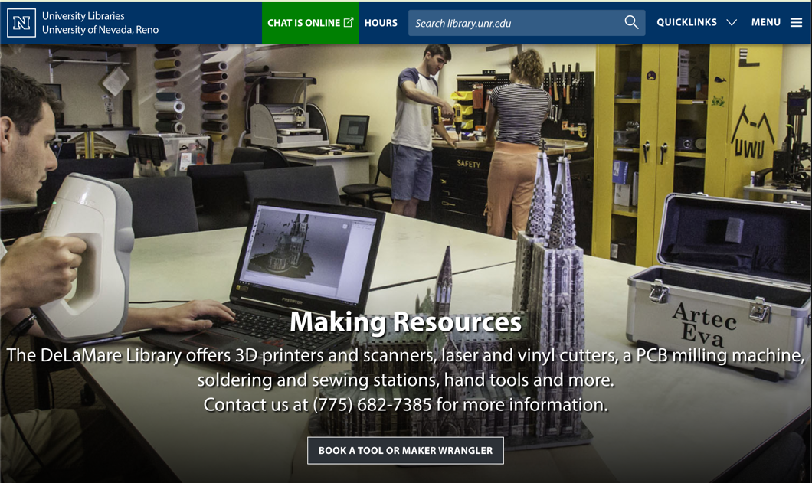
DeLaMare Science & Engineering Library
Collections serving geosciences, engineering, and the physical sciences
Makerspace that is open to all community members
Close relationship to local inventor/maker/entrepreneurial communities
UNR PTRC | World IP Day 2021

Slide 8
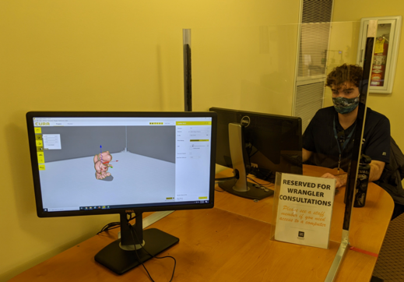
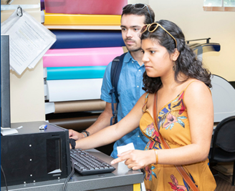
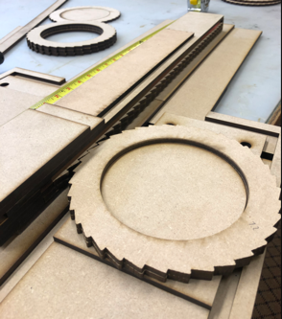
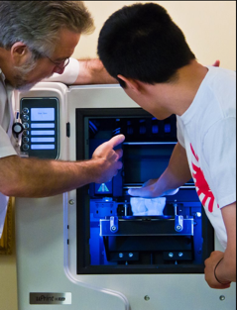
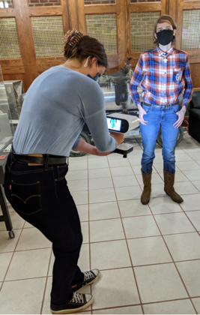
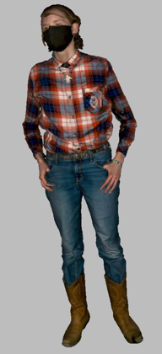
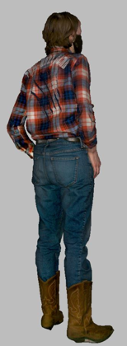
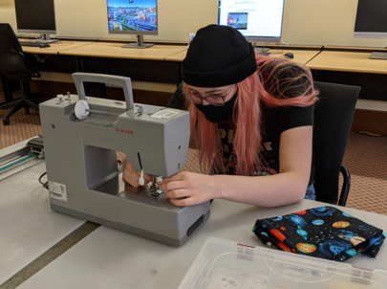
DeLaMare Makerspace
Free to access (we do charge for some consumables)
Equipment includes: 3D scanners, 3D printers, vinyl & laser cutters, pcb milling machine, hand tools, VR headsets, and much more.
Maker Wranglers: Expert student employees who will teach anyone how to use or create content for anything in our makerspace.
UNR PTRC | World IP Day 2021

Slide 9
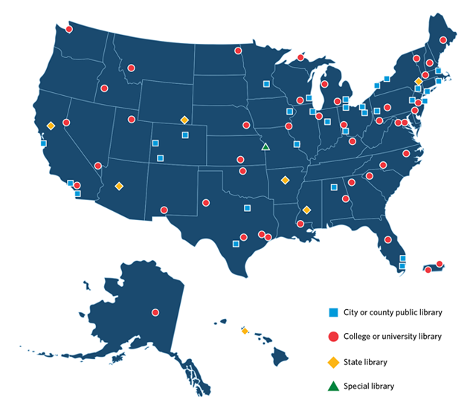
Patent & Trademark Resource Centers (PTRC)
Began in 1871 with patent depository program. Program greatly expanded in 1977.
Reno was designated in 1983.
Mission:
Disseminate patent and trademark information
Support diverse intellectual property needs of the public
We do NOT provide legal assistance
83 PTRCs in 47 states (including D.C. & Puerto Rico)
UNR PTRC | World IP Day 2021
Notes:
Patent and Trademark Resource Centers (PTRCs) are a nationwide network of public, state and academic libraries that are designated by the USPTO to disseminate patent and trademark information and to support the diverse intellectual property needs of the public. Accessing the patent and trademark information at a PTRC with the help of a trained specialist, users may be able to determine if someone else has already patented their invention or obtained a federal registration for a trademark on goods or services. PTRCs also have access to PubWEST and PubEAST, examiner-based search systems. PTRC librarians may also help you with specific questions regarding the patent and trademark processes, but they will not provide legal advice.

Slide 10
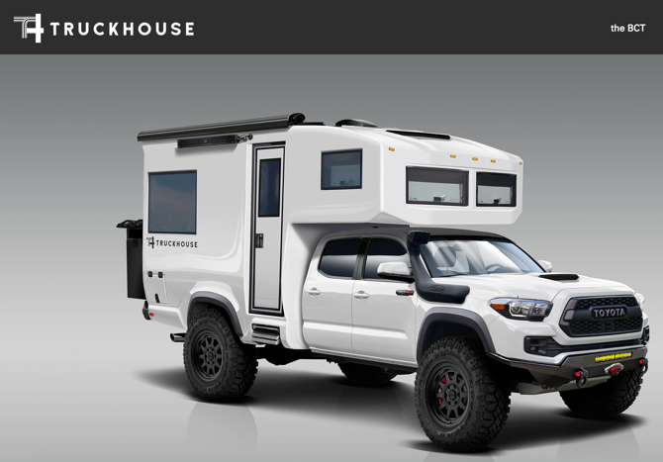
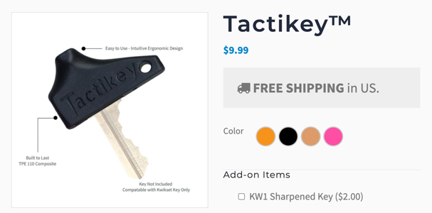
Who We Help
UNR Students, Faculty, & Staff – from a variety of disciplines
The Greater Northern Nevada Community
Historical Researchers
Small Business
Startups and Entrepreneurs
Independent Inventors / Makers
Artists
Incarcerated
UNR PTRC | World IP Day 2021

Slide 11
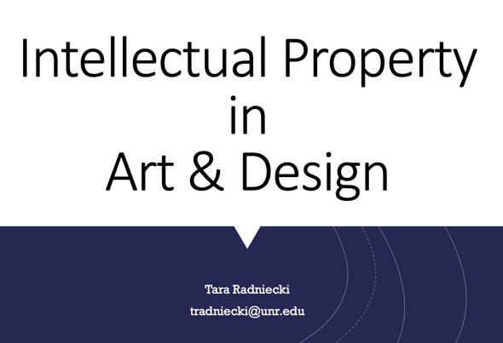
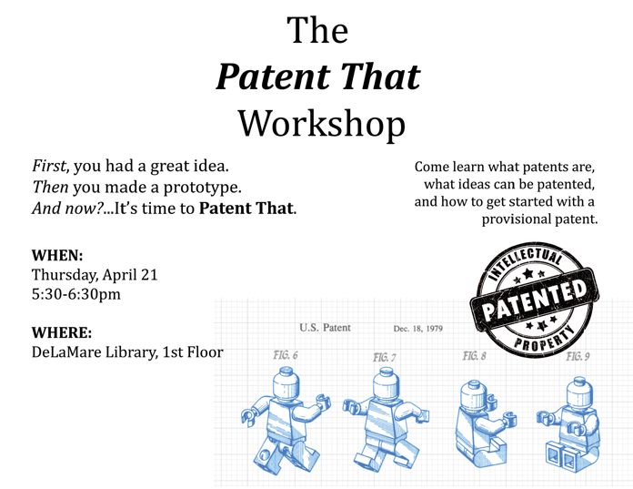
How We Help
Individual Consultations - 100 a year
Free Workshops and Classroom Instruction
Collaborative Outreach with other Entrepreneurial-Minded Groups
UNR PTRC | World IP Day 2021

Slide 12

The Consultation
Determine the real need/type of IP
Instruction on what IP is, what registration protects (& doesn’t), and how to obtain it.
Teach how to search existing IP
Answer non-legal questions and connect users to critical information (USPTO, NOLO)
Give referrals and information for next steps (Most often to the SBDC and Pro Bono Assistance Program)
UNR PTRC | World IP Day 2021

Slide 13
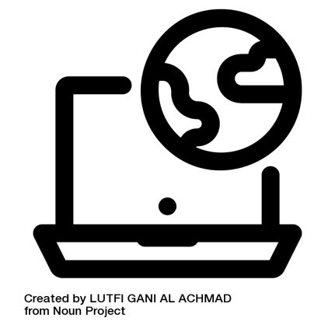
Resources We Use
Espacenet
USPTO PatFT, AppFT, PAIR, TESS
WIPO PATENTSCOPE
Google Patents
Common Key Concepts
CPC Classification Function and Hierarchy
Searching by Assignee/Applicant
How to Read a Patent
Access/Downloading
International Protection: PCT and Madrid Protocol
UNR PTRC | World IP Day 2021

Slide 14
We meet people wherever they are in their journey.
UNR PTRC | World IP Day 2021

Slide 15
When NOT Protecting IP Makes Sense
Who are they?
What are their goals?
What’s their product lifespan?
What are their resources?
UNR PTRC | World IP Day 2021
Notes:
An entrepreneur or an artist?
An app developer or a car manufacturer?
Goals: artists may want to share their work to gain more recognition, cutting edge companies may share to speed up innovation across the industry (tesla and Toyota)
There’s no patent police.

Slide 16
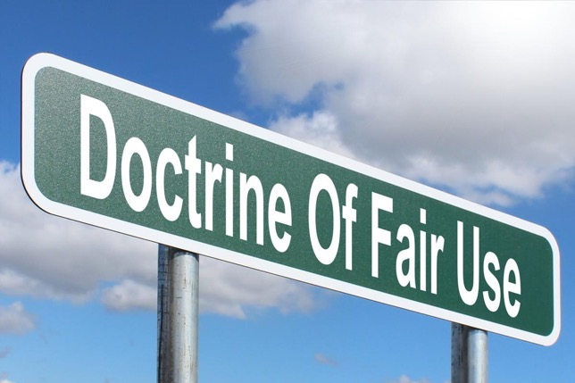
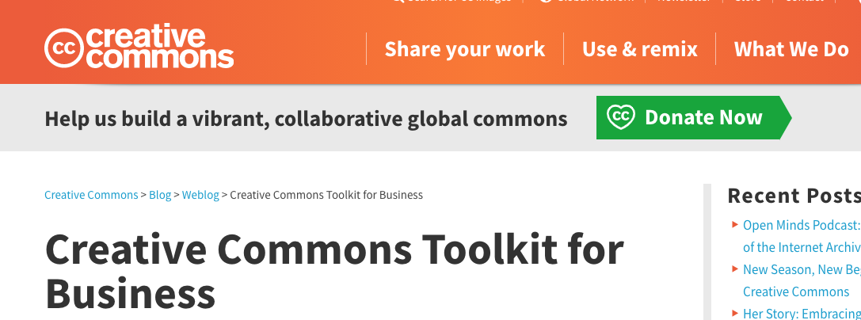
Creative Commons Licensing
Doctrine of fair use by Nick Youngson CC BY-SA 3.0 Alpha Stock Images
UNR PTRC | World IP Day 2021
https://business-toolkit.creativecommons.org/
Notes:
As Paul Stacey puts it, Creative Commons licenses amplify the affordances of digital technology and provide an enhanced means for social production in the networked economy. CC licenses do this by:
removing artificial scarcity constraints;
removing barriers to access;
enabling rapid distribution and use;
allowing for customization, personalization, adaptation, translation, and localization;
providing a means for mass participation: fellow creators, end users, customers, and partners can contribute their expertise, suggest improvements, add new features, make enhancements, create derivatives, and ensure currency;
distributing production, and making it possible to produce work faster, generate work of greater breadth and depth, innovate, and increase quality; and
creating materials that are part of a shared global commons from which resources can be extracted for local use and to which local resources can be contributed.
The 6 Economic Benefits Identified
The toolkit materials focus on the 6 economic benefits of using CC licenses that we have identified so far: 1) reduce production costs, 2) reduce transaction costs and legal uncertainty, 3) increase access to innovation and reduce marketing costs, 4) increase first mover advantage, 5) increase “opportunity benefits” and build a reputation, and 6) promote sustainability. We examine these benefit further in this document. They are a work in progress–we think there is still room for improvement and additional discussion. If you are interested on helping us continue developing these tools, please send us your feedback to creativecommons.pt@gmail.com.

Slide 17

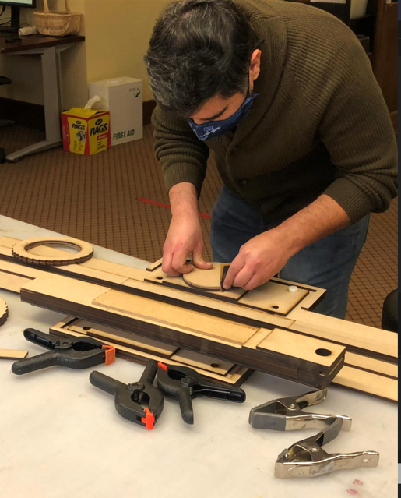
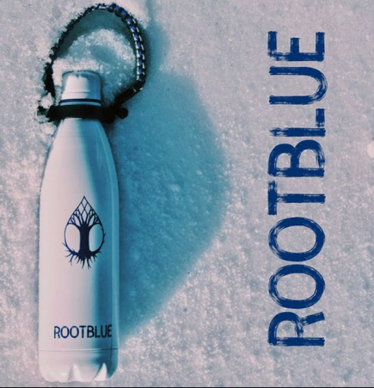
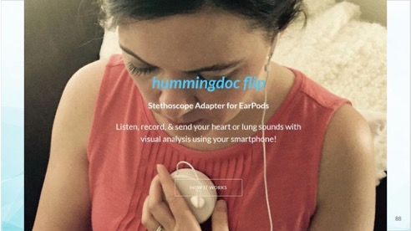
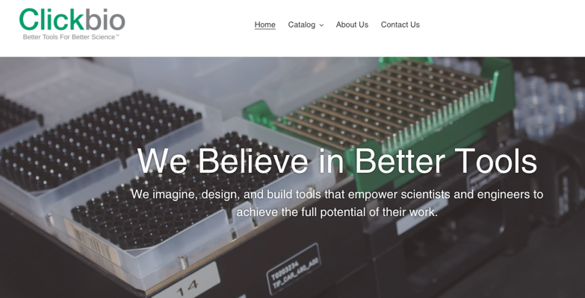
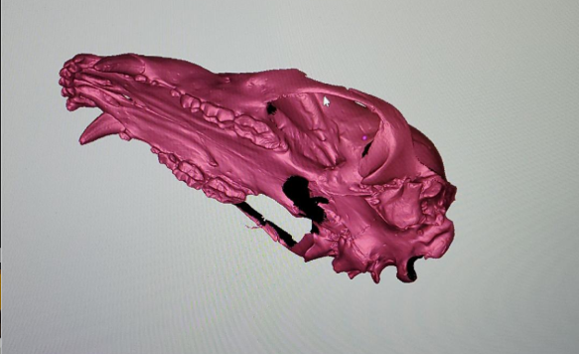
Who We’ve Helped
Your Agency or Department Name | World IP Day 2021
Notes:
As Paul Stacey puts it, Creative Commons licenses amplify the affordances of digital technology and provide an enhanced means for social production in the networked economy. CC licenses do this by:
removing artificial scarcity constraints;
removing barriers to access;
enabling rapid distribution and use;
allowing for customization, personalization, adaptation, translation, and localization;
providing a means for mass participation: fellow creators, end users, customers, and partners can contribute their expertise, suggest improvements, add new features, make enhancements, create derivatives, and ensure currency;
distributing production, and making it possible to produce work faster, generate work of greater breadth and depth, innovate, and increase quality; and
creating materials that are part of a shared global commons from which resources can be extracted for local use and to which local resources can be contributed.
The 6 Economic Benefits Identified
The toolkit materials focus on the 6 economic benefits of using CC licenses that we have identified so far: 1) reduce production costs, 2) reduce transaction costs and legal uncertainty, 3) increase access to innovation and reduce marketing costs, 4) increase first mover advantage, 5) increase “opportunity benefits” and build a reputation, and 6) promote sustainability. We examine these benefit further in this document. They are a work in progress–we think there is still room for improvement and additional discussion. If you are interested on helping us continue developing these tools, please send us your feedback to creativecommons.pt@gmail.com.

Slide 18
Conclusion
Nation-wide network of Patent and Trademark Resource Center
Makerspace
Who We Are
Who We Help
Everyone:
  Students, staff, faculty
  Community Members
  Small Businesses
  K12
How We Help
Meeting people where they are in their making and IP journey.
UNR PTRC | World IP Day 2021

Slide 19
Thank you!
For more information visit:
https://library.unr.edu/delamare
or https://bit.ly/usptoptrc
Tara Radniecki, MLIS
tradniecki@unr.edu

