Slide 1




Right to Research and Copyrighctual Property and Information Tec(CIPIT) 3
Rights Retention and Secondary Publishing Rights
Launch of EIFL Guide for Libraries
Milica Ševkušić
EIFL Open Access Programme
Online, 12 June 2024

Slide 2
Rights Retention

Slide 3
A typical publication agreement
“The Author and each Co-Author hereby assigns to the Owner, during the full term of copyright and any extensions or renewals, all copyright in and to the Contribution, and all rights therein, including but not limited to the right to publish; republish; transmit; sell; distribute; and otherwise use the Contribution in whole or in part in electronic and print editions of the Journal and in derivative works throughout the world, in all languages and in all media of expression now known or later developed, and to license or permit others to do so.
In addition, the Author and each Co-Author hereby grants to the Owner, during the full term of copyright and any extensions or renewals, the exclusive, worldwide, irrevocable and fully transferable right to use and exploit the Contribution in any manner, including: the rights to reproduce, to distribute (for example in any book format or any digital format), to exhibit, and to make available to the public; the recitation performance, and presentation rights; the broadcasting rights; the rights of communication by video or audio recordings; the rights of communication of broadcasts and of works made available to the public. “Contribution” means the article submitted by the Author for publication in the Journal (including any embedded rich media) and all subsequent versions.
If the Contribution was shared as a preprint or as an accepted manuscript, the Author and each Co-author hereby grants to the Owner exclusivity as to all rights retained by the Author and by each Co-author in the preprint or accepted manuscript.”
https://oa2020.org/wp-content/uploads/OA2020-Author-Rights-Schneider-2023-for-PDF.pdf
Misconceptions
Copyright to published works is always owned by publishers.
Authors who have signed off copyright cannot share their work.
Authors (must) sign off all rights if they wish to publish in a subscription-based journal.

Slide 4
What is Rights Retention?
When entering into a publication agreement with a publisher authors (or their institutions) retain copyright in their work
Purpose: to ensure that the work can immediately be made open access
Policy instrument
Various methods have been developed over the past 20 years
(https://docs.google.com/document/d/1ucmrAnkOSnZdnYBuZAiK2acih0dYyWz4HAt9MYuxnJ4/edit)

Slide 5
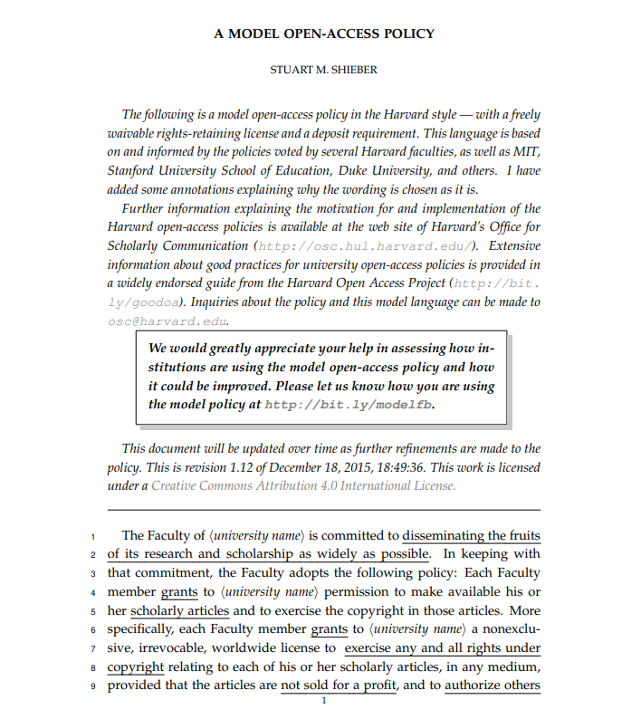
Harvard-style OA policies
“Each Faculty member grants to the University permission to make available scholarly articles available and to exercise the copyright in those articles
Each Faculty member will provide an electronic copy of the author’s final version of each article no later than the date of its publication at no charge to the appropriate representative of the Provost’s Office in an appropriate format (such as PDF) specified by the Provost’s Office.
The Provost’s Office may make the article available to the public in an open-access repository. The Office of the Provost will be responsible for interpreting this policy, resolving disputes concerning its interpretation and application, and recommending changes to the Faculty from time to time.”
Since 2008
“direct rights retention by institutions, and indirect rights retention by authors”
https://osc.hul.harvard.edu/assets/files/model-policy-annotated_12_2015.pdf

Slide 6
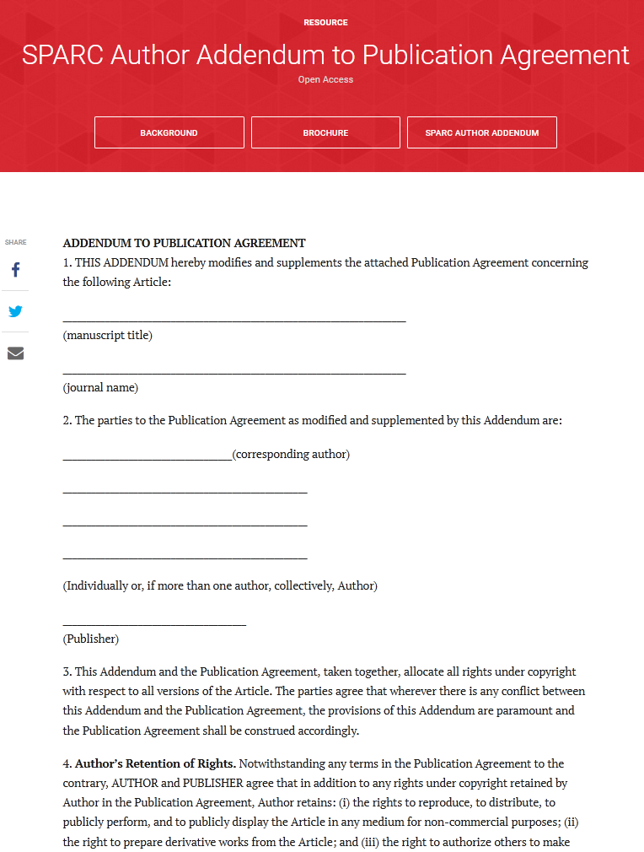
SPARC Author Addendum to Publication Agreement
“Author’s Retention of Rights. Notwithstanding any terms in the Publication Agreement to the contrary, AUTHOR and PUBLISHER agree that in addition to any rights under copyright retained by Author in the Publication Agreement, Author retains: (i) the rights to reproduce, to distribute, to publicly perform, and to publicly display the Article in any medium for non-commercial purposes; (ii) the right to prepare derivative works from the Article; and (iii) the right to authorize others to make
any non-commercial use of the Article so long as Author receives credit as author and the journal in which the Article has been published is cited as the source of first publication of the Article. For example, Author may make and distribute copies in the course of teaching and research and may post the Article on personal or institutional Web sites and in other open-access digital repositories.
“Acknowledgment of Prior License Grants. In addition, where applicable and without limiting the retention of rights above, Publisher acknowledges that Author’s assignment of copyright or Author’s grant of exclusive rights in the Publication Agreement is subject to Author’s prior grant of a non-exclusive copyright license to Author’s employing institution and/or to a
funding entity that financially supported the research reflected in the Article as part of an agreement between Author or Author’s employing institution and such funding entity, such as an agency of the United States government.”
https://sparcopen.org/our-work/author-rights/brochure-html/

Slide 7
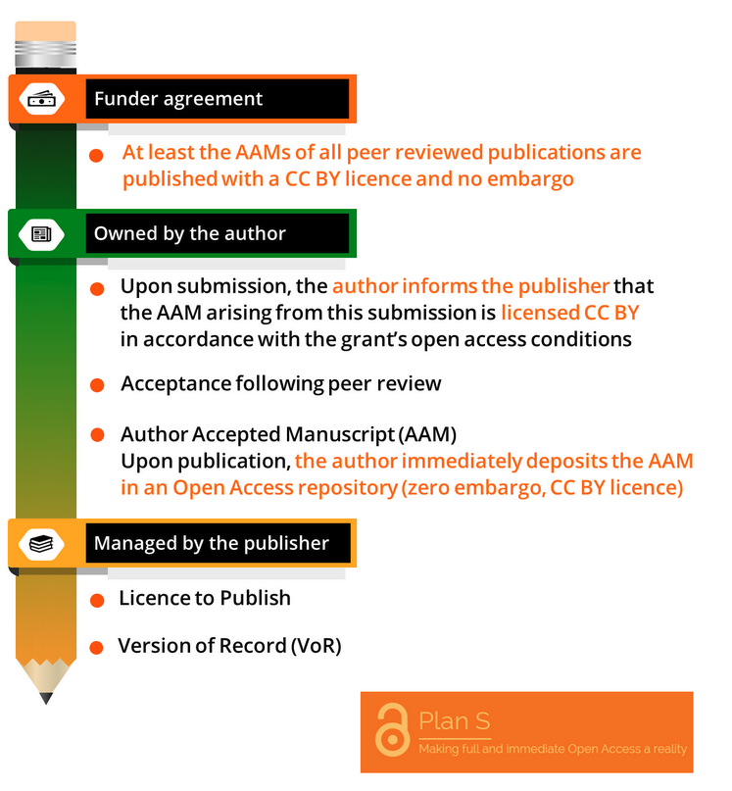
cOAlition S Rights Retention Strategy
Authors who publish in subscription-based journals should retain SUFFICIENT rights to be able to immediately (no embargo) self-archive at least AAM under the CC BY licence.
Exemption clause in the publishing agreement:
“[Insert publisher name] acknowledges that, notwithstanding any other terms or conditions in this agreement: Author Accepted Manuscript versions, which arise from submissions based on results from research funded fully or partially by cOAlition S Organisations, can be made freely available at the time of publication through any Open Access repository of the author’s choice;
the Author Accepted Manuscript can be shared under a CC BY or equivalent licence; CC BY-ND upon agreement by the cOAlition S Organisation).”
https://www.coalition-s.org/wp-content/uploads/2020/10/RightsRetentionGraphic.png, CC BY 4.0

Slide 8
How to retain rights
When submitting a manuscript, the author adds a statement:
informing the publisher of the source of funding and the need to comply with an OA policy (funder / institutional / national);
declaring that an open licence (preferably CC BY) will be applied to the submitted manuscript and to any Author’s Accepted Manuscript (AAM) arising from the submission;
once the manuscript is accepted, the author deposits the AAM in a repository e.g. an institutional repository, adding an open licence (preferably CC BY) to ensure that the manuscript is open access.
Alternative method: after manuscript acceptance, the author (or their institution) must ask for a modification to the publishing agreement retaining the rights needed to openly share and reuse the work.
retaining sufficient rights
legal precedence of a prior licence or agreed obligations

Slide 9
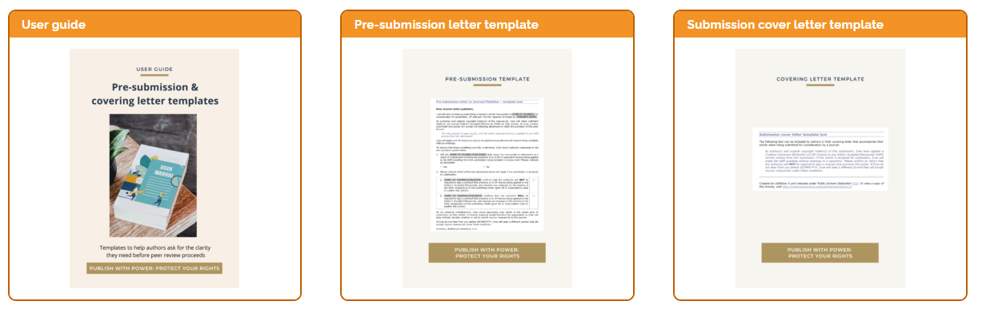
Informing the publisher (cOAlition S resources)
Templates prepared by cOAlition S: https://www.coalition-s.org/resources/rights-retention-strategy/

Slide 10
Benefits of Rights Retention?
Rights retention enables authors (or their institutions) to:
take control of their copyright and share their work under an open licence;
encourage further reuse and gain wide exposure for their work leading to increased citations and greater recognition;
publish in journals recognized for tenure and promotion and still comply with institutional open access policies;
comply with open access policies of major research funders, such as, World Health Organization, European Commission, Wellcome Trust, Bill & Melinda Gates Foundation.

Slide 11
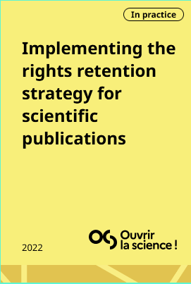
Examples: France
Implementing the rights retention strategy for scientific publications: Guide for researchers (France): https://www.ouvrirlascience.fr/wp-content/uploads/2023/02/RRS_Guide_for_Researchersupdated_basic_printingA5.pdf

Slide 12
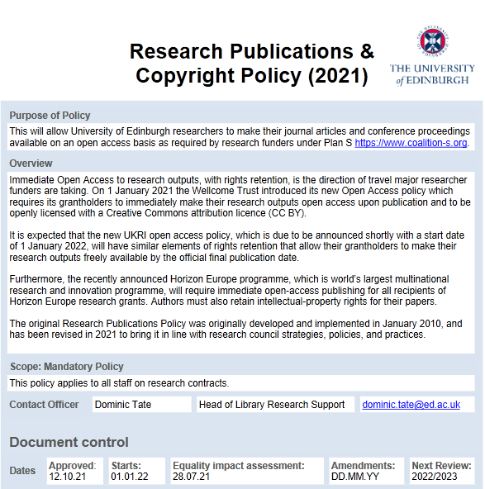
Examples: University of Edinburgh
„Many publishers have introduced restrictive publishing agreements which require embargo periods, and some publishers even assert that their licensing terms will supersede any other prior agreements. We dispute this and if challenged the University will be able to bring a legal claim against the publisher as they have willingly procured a breach of contract against our pre-existing rights.
For a claim of procuring a breach of contract to succeed it must be shown that the defendant knew about the prior contract and intended to encourage another person to break it. Our solicitors have prepared a sworn Affidavit confirming service on all the recipients which will be sufficient to confirm that all the named publishers were indeed advised of our position ahead of article publication and that they have subsequently asked an author to breach the terms of their employment contract by accepting a publishing licence.“
theo. 2022. ‘Rights Retention Policy: An Update after 9 Months’. Open Scholarship (blog). 14 October 2022.
Tate, D. (2022). Open Science Policies at the University of Edinburgh: Putting Policy into Practice. Septentrio Conference Series, (1). https://doi.org/10.7557/5.6759 + Recording

Slide 13
EIFL’s support to policy development
Malawi, Nigeria, Sierra Leone (draft)
immediate open access under an open licence (CC BY). machine-readable electronic copy of the published version or the final peer-reviewed manuscript accepted for publication of all peer reviewed publications produced in Malawi is deposited in a repository and the
full-text of all such publications be made openly available immediately
if there is a journal’s embargo – negotiate or find another journal.
researchers are required to retain ownership of copyright and to licence to publishers only those rights necessary for publication
Botswana (adopted)
Institutions and/or researchers shall retain sufficient intellectual property rights (IPR) to their research products so that they can implement the policy provisions.
Rights retention clauses

Slide 14
Take action!
Encourage your institution to adopt a policy on rights retention, if it doesn’t already have one (institutions can support authors by making publishers aware of institutional rights retention policies).
Raise awareness among researchers of rights retention policies, encourage authors to retain their copyright and make open licensing the default option for sharing research outputs (some are unaware of their rights).
Network with other institutions to share expertise and experience (some are unaware that researchers are giving away their copyright).
Advocate for legislative solutions to include rights retention in national open science and technology policies (that provides legal backing to help researchers ensure their work is available in open access).

Slide 15
Resources
SPARC Europe - Rights Retention Helper: https://tinyurl.com/5x8tj942
cOAlition S - Rights Retention resources: https://tinyurl.com/2u65n3kv
Knowledge Rights 21 - Knowledge Capsules (short videos): https://tinyurl.com/2s3er663
Suber, Peter. Methods of Rights Retention: https://bit.ly/MethodsRightsRetention
Suber, Peter. 2022. “Publishing Without Exclusive Rights.” The Journal of Electronic Publishing 25 (1). https://doi.org/10.3998/jep.1869
Eglen, S. J. (2021). Primer on the Rights Retention Strategy (v0.23). Zenodo. https://doi.org/10.5281/zenodo.4668132

