Slide 1
Research Assessment and Bibliometric in Research and Academic Environment
Iryna Kuchma, Open Access Programme Manager
EIFL and CARLIGH webinar
Attribution 4.0 International

Slide 2
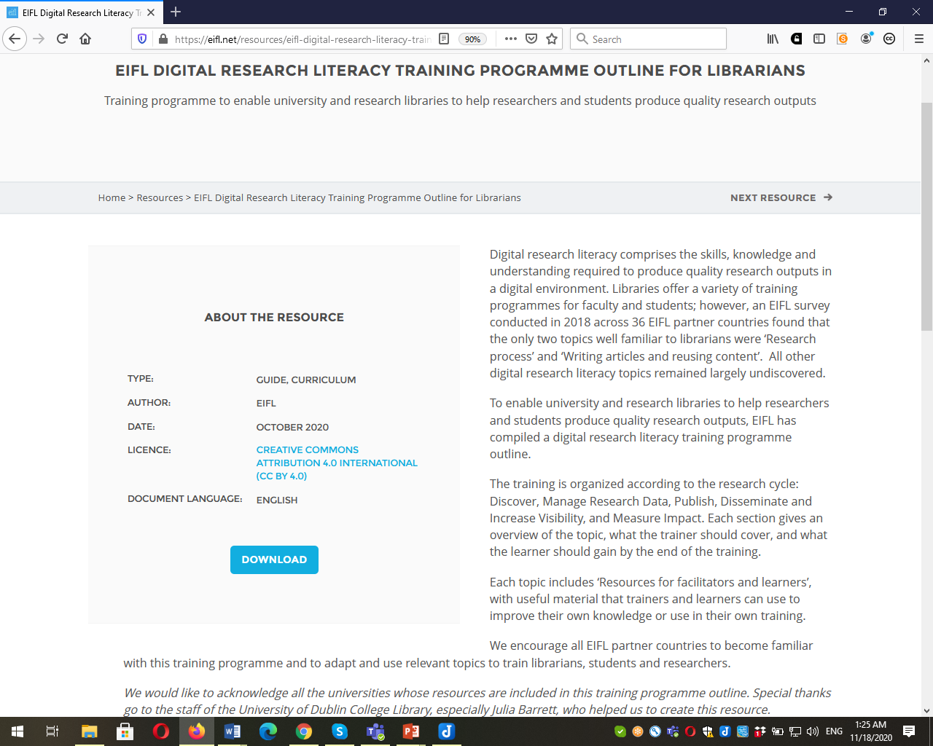
https://eifl.net/resources/eifl-digital-research-literacy-training-programme-outline-librarians

Slide 3
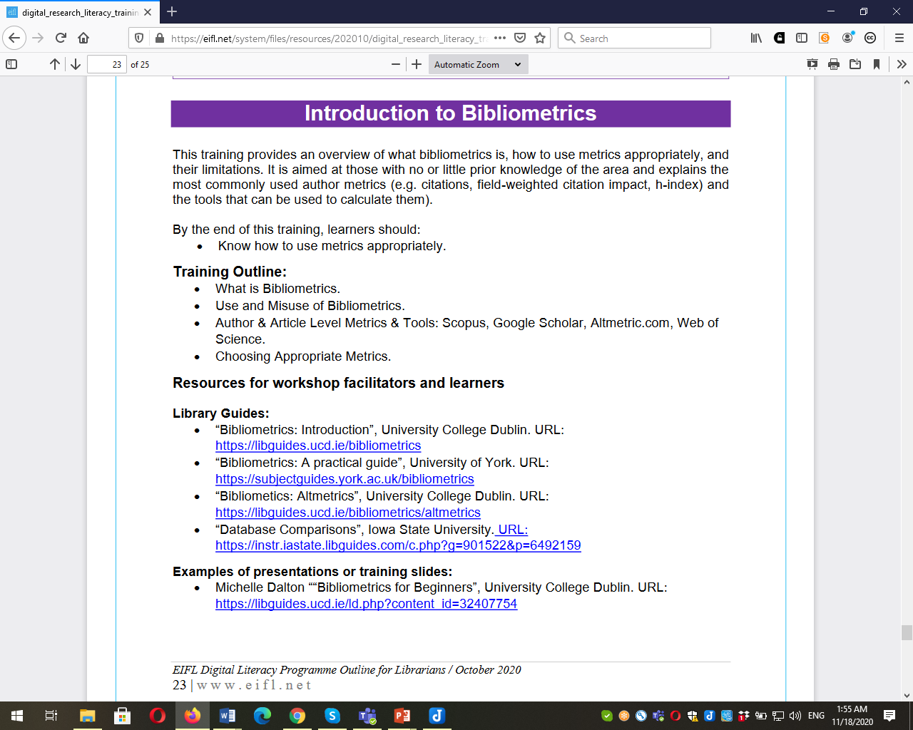

Slide 4
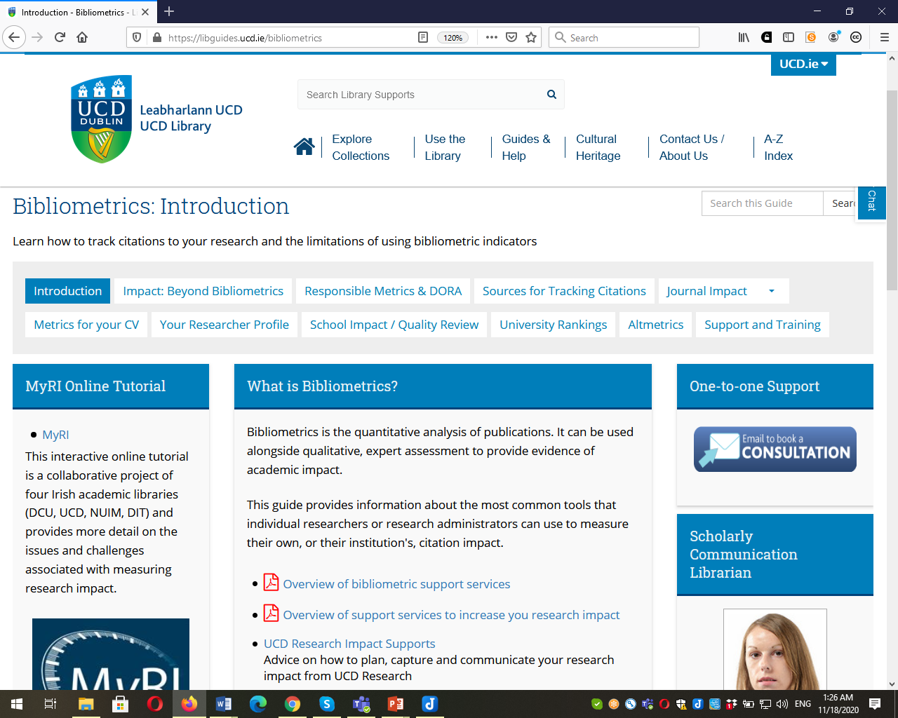
https://libguides.ucd.ie/bibliometrics

Slide 5
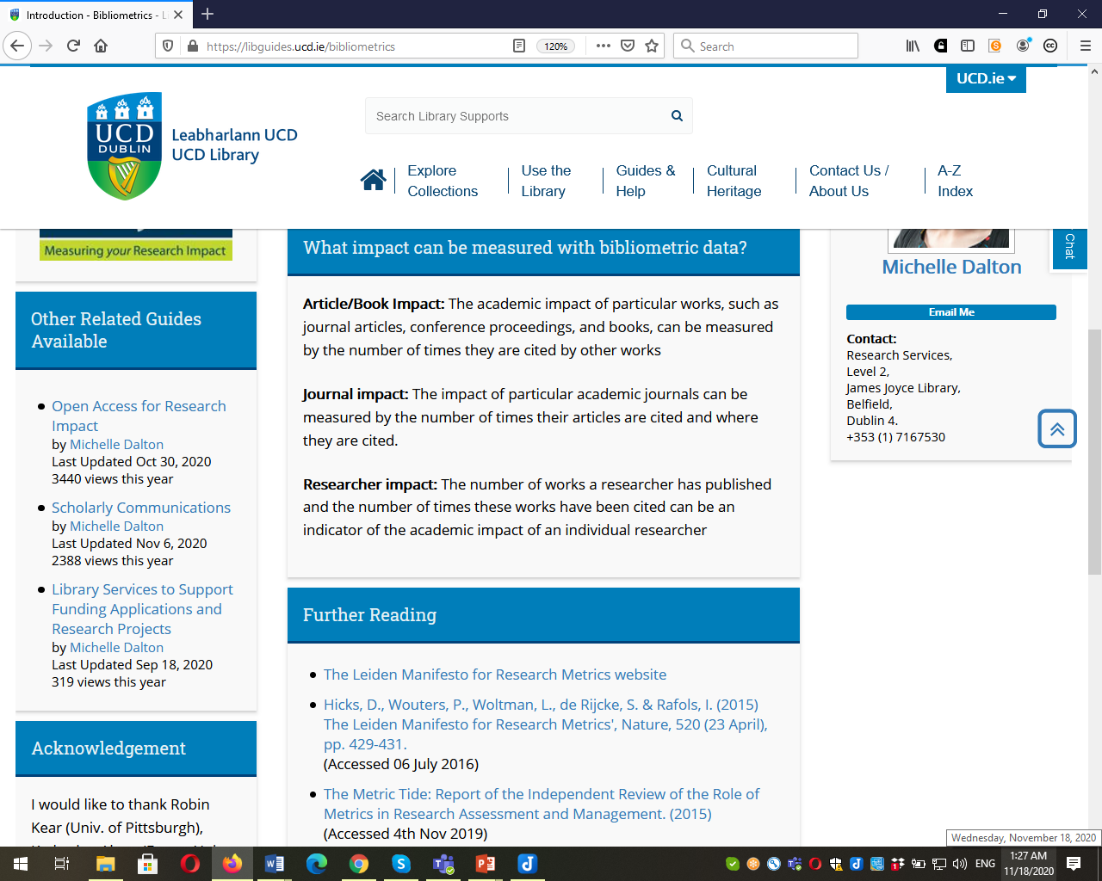

Slide 6
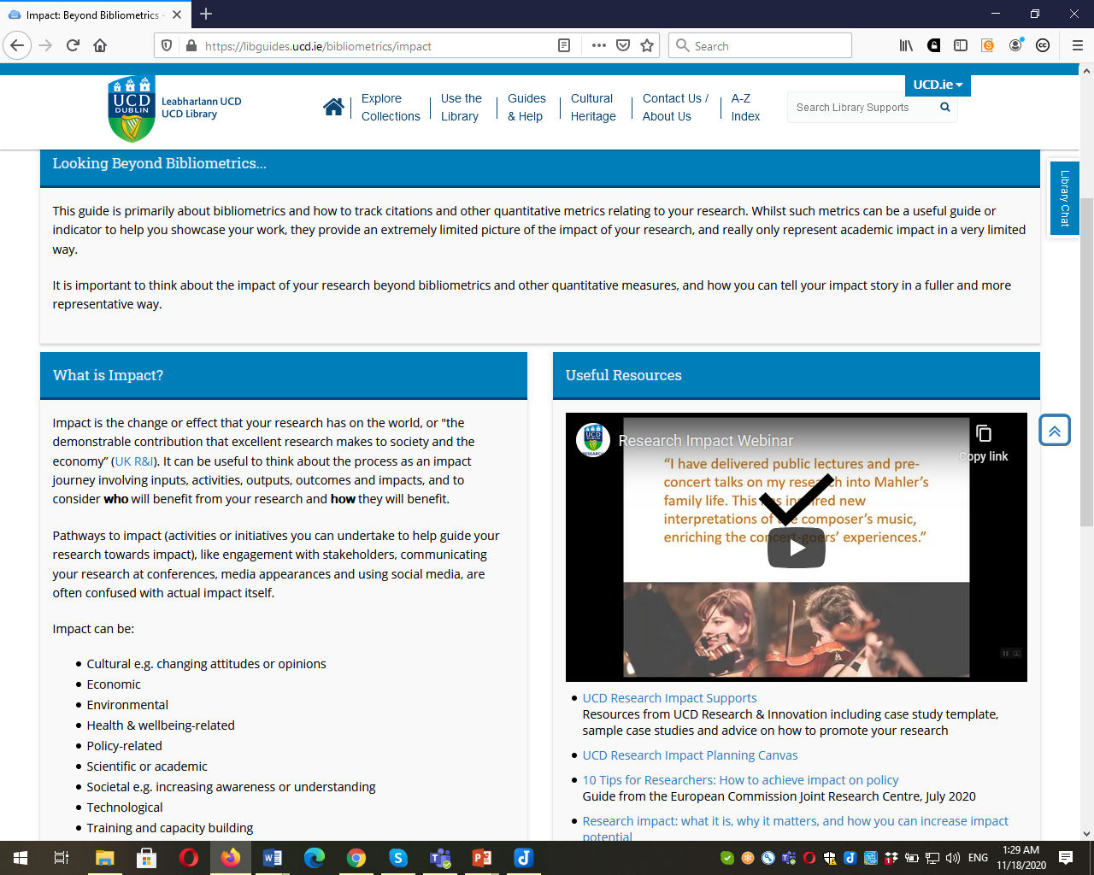
https://libguides.ucd.ie/bibliometrics/impact

Slide 7
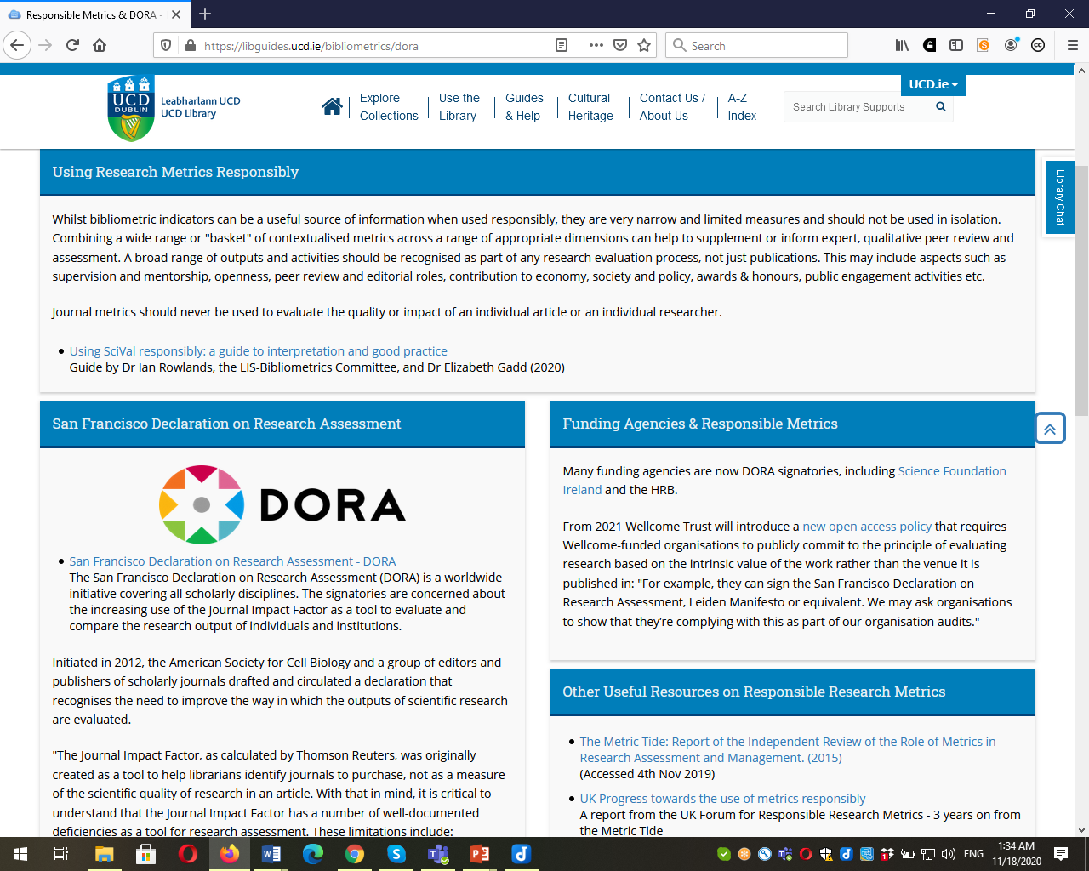
https://libguides.ucd.ie/bibliometrics/dora

Slide 8
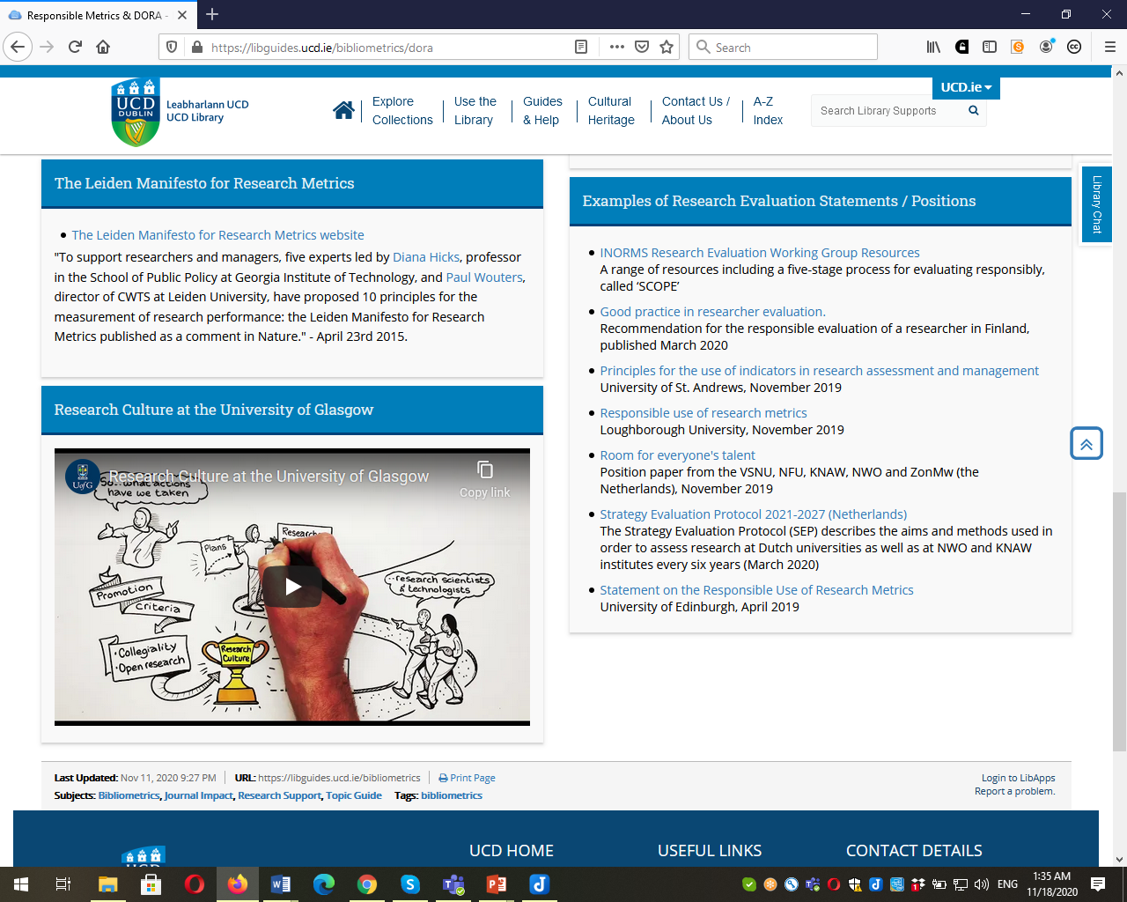

Slide 9
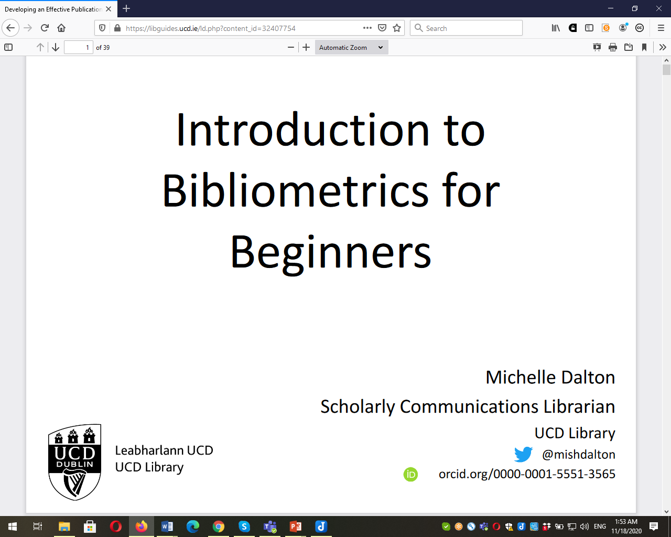
https://libguides.ucd.ie/ld.php?content_id=32407754

Slide 10
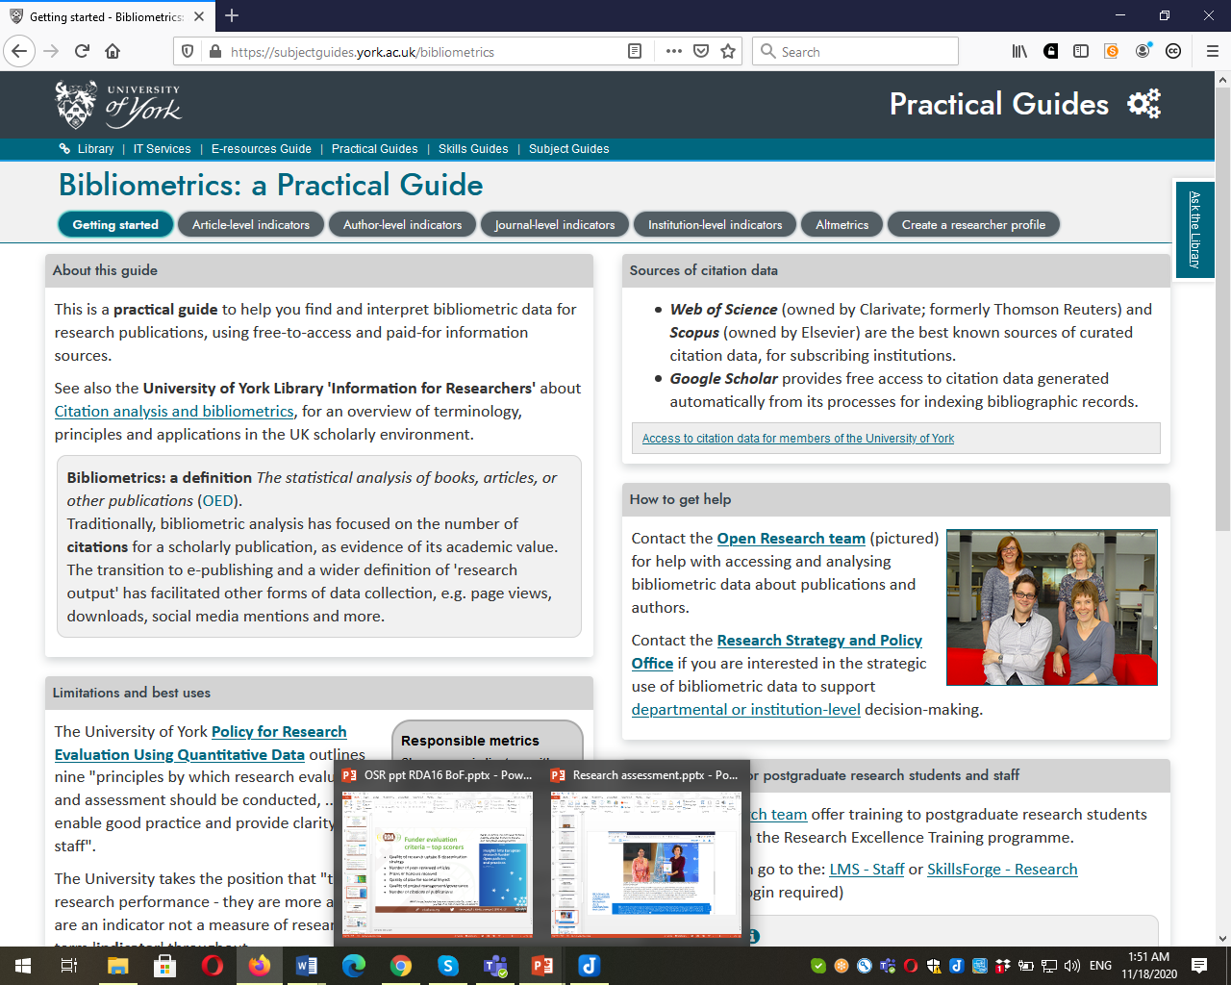
https://subjectguides.york.ac.uk/bibliometrics

Slide 11





Moving to a more holistic & balanced research evaluation system
sfdora.org
@DORAssessment
Signed by >2000 organizations and >16,500 individuals
Supporting organizations

Slide 12
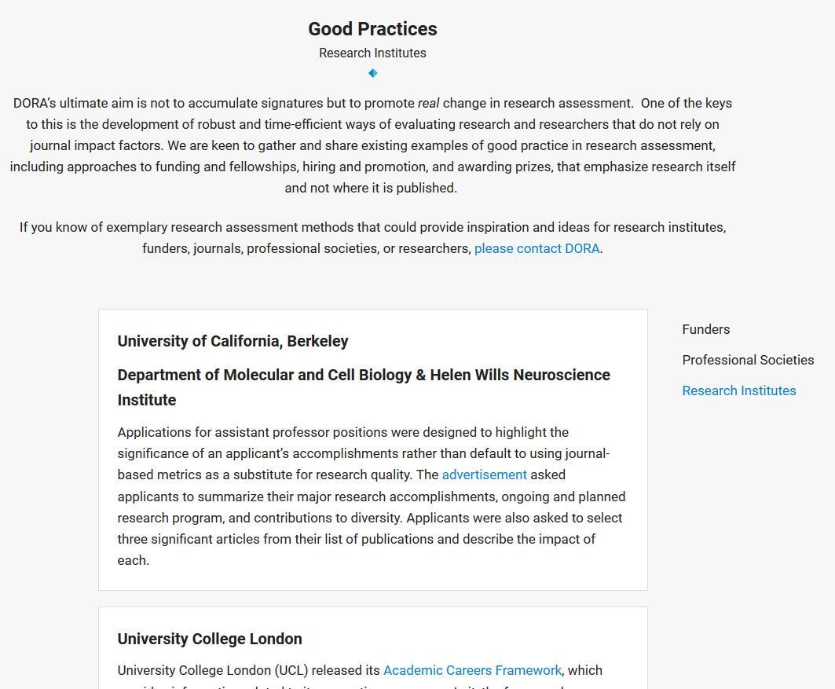
Examples include:
CRUK - describe significance and impact of 3-5 key research achievements: preprints, training delivered, contribution to consortia, patents, and sharing of key datasets, software, novel assays and reagents, and research publications
FWF - up to 10 most important scientific/scholarly research achievements – beyond publications: e.g. awards, conference papers, keynote speeches, important research projects, research data, software, codes, preprints, exhibitions, knowledge transfers, science communication, licenses, or patents.
NIH - Use bio-sketches: summary of impacts of contributions.
University Medical Center Utrecht Involve all career-stages to co-develop policies to measure societal impact / research excellence – signifies agreement to be judged by the criteria.

Slide 13
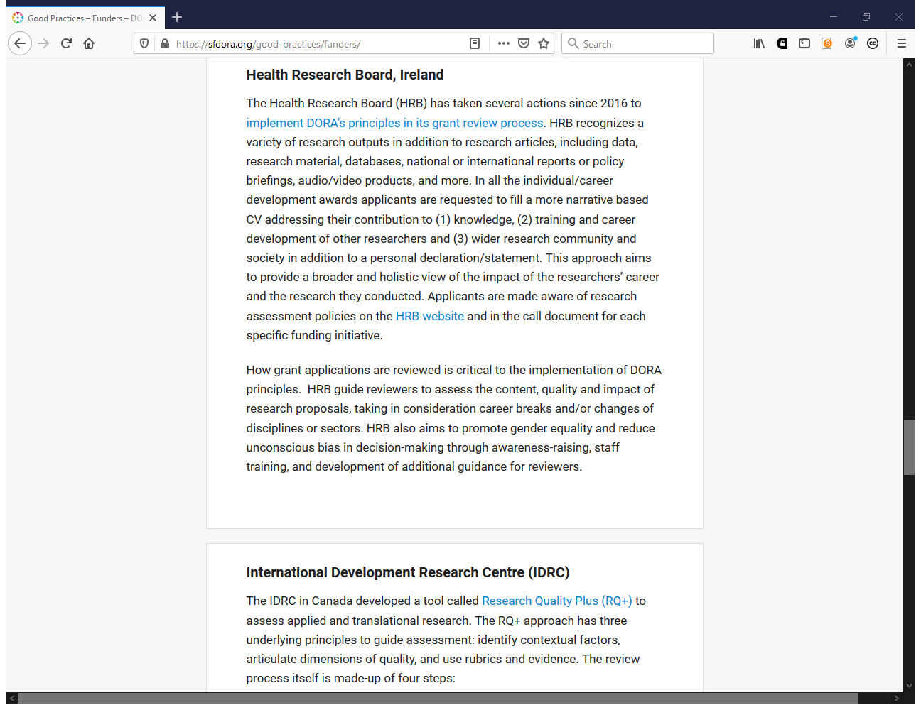

Slide 14
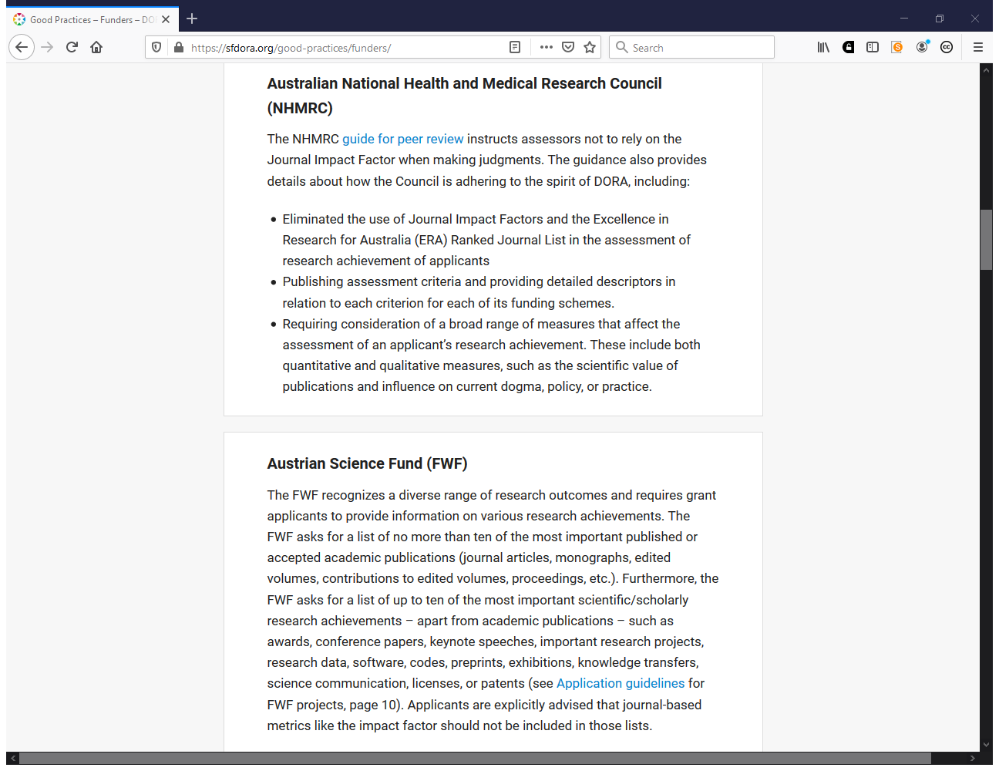
https://sfdora.org/good-practices/funders/

Slide 15
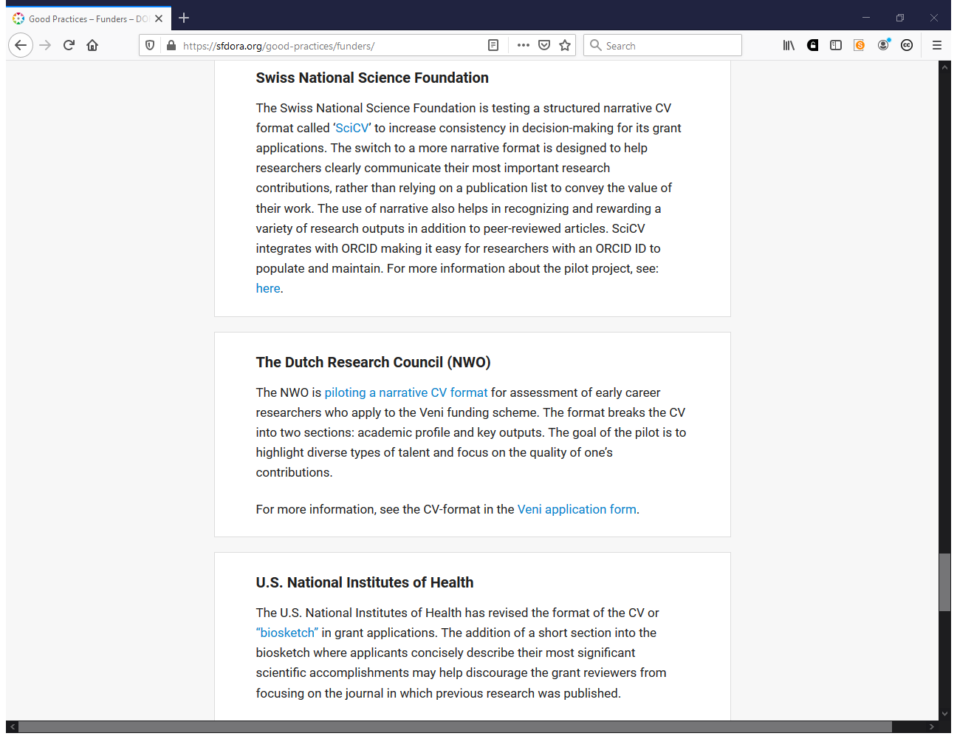

Slide 16
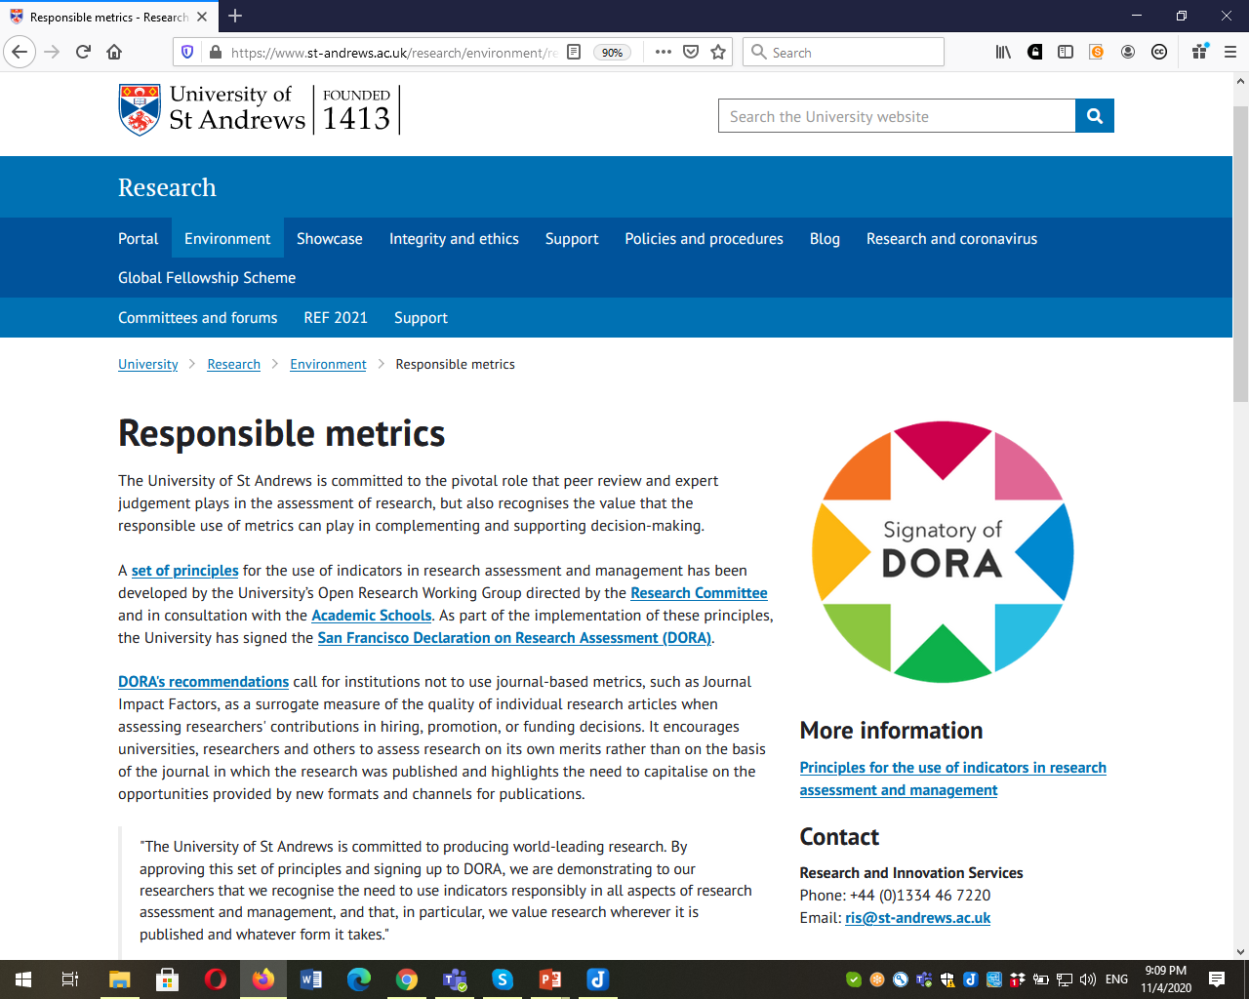
https://www.st-andrews.ac.uk/research/environment/responsible-metrics/

Slide 17
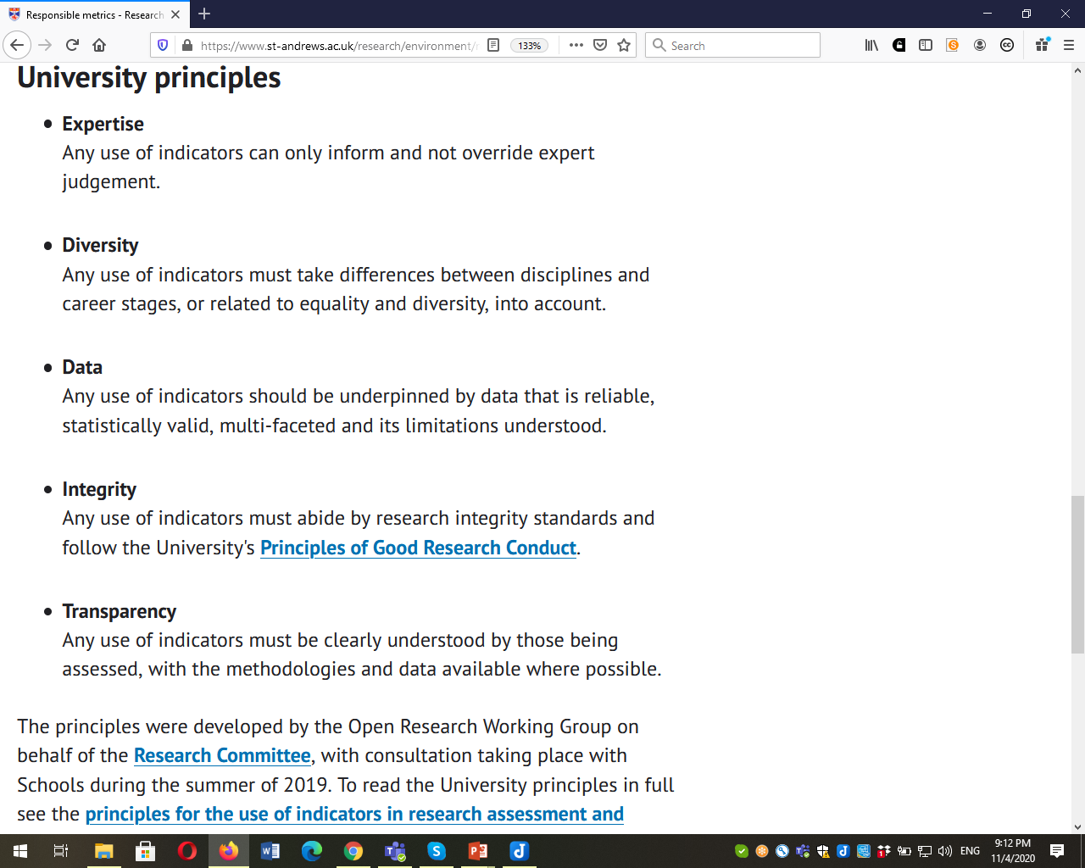

Slide 18
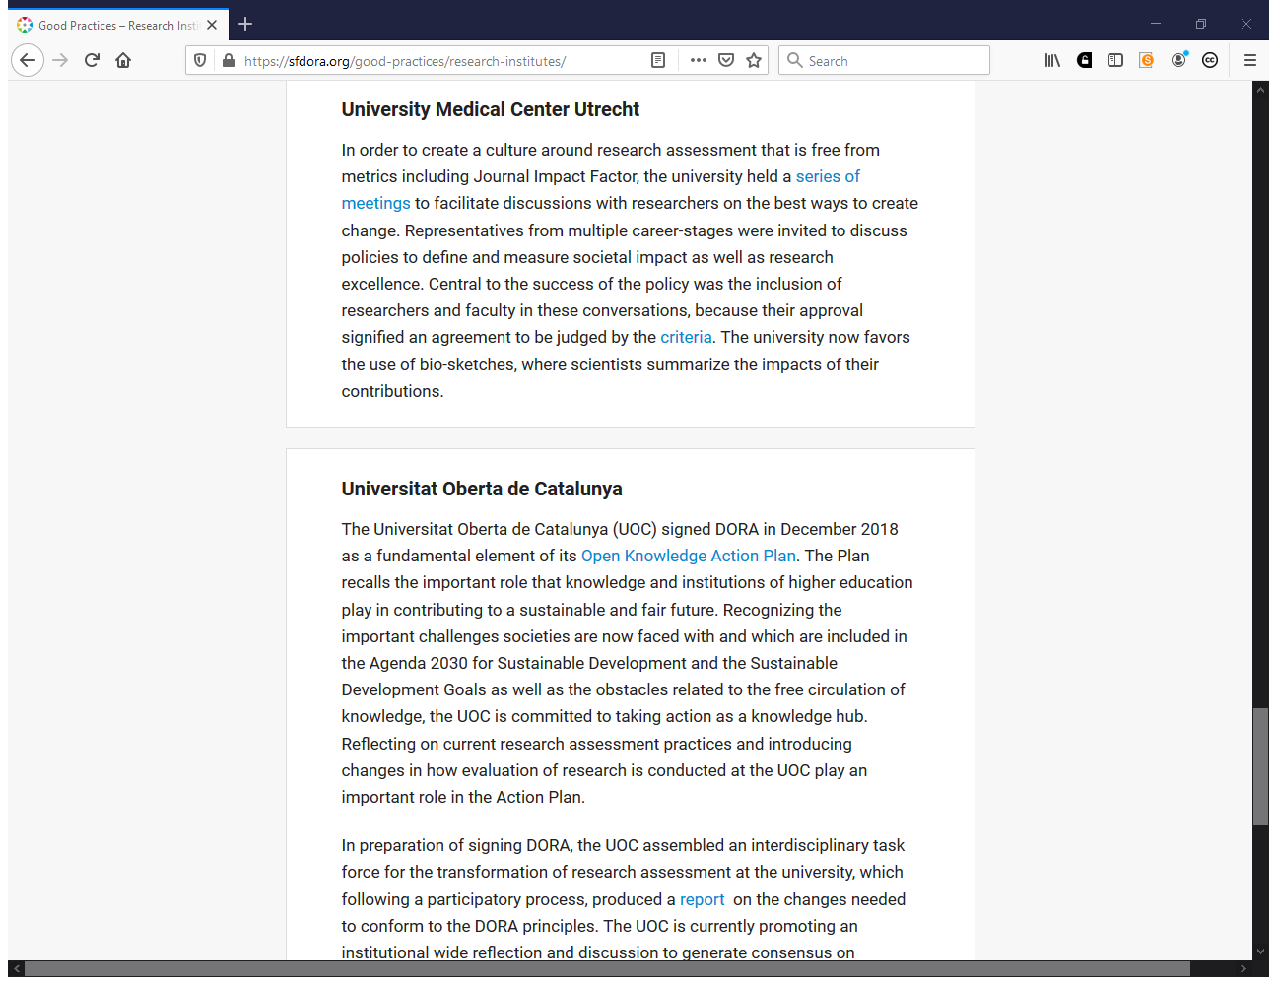

Slide 19
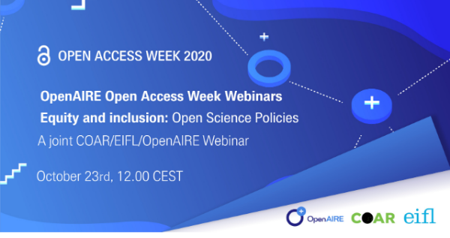
https://www.openaire.eu/item/equity-and-inclusion-open-science-policies

Slide 20

THE NEW RESEARCH ASSESSMENT REFORMS IN CHINA--- ERADICATING THE 'FIVE ONLY’ IN S&T MANAGEMENT
National Science Library, Chinese Academy of Sciences（CAS） Xiwen Liu, Yan Zeng, Junpeng Yuan

Slide 21

CLASSIFICATION ASSESSMENT
1
Basic Research
The assessment should focus on the innovation level and scientific value of the paper, and does not take related indexes of SCI papers as the direct judgment basis
Applied research and technological innovation
The key point of assessment is the actual contribution to solving the key technical problems in production practice, and the actual effect of realizing industrialization application of new technology, new product and new process work, rather than the paper as a single assessment basis
2
Source: The Ministry of Education and the Ministry of Science and Technology issued several Opinions on Standardizing the Use of Related Indexes of SCI Papers in Institutions of Higher Learning and Establishing Correct assessment Guidance

Slide 22
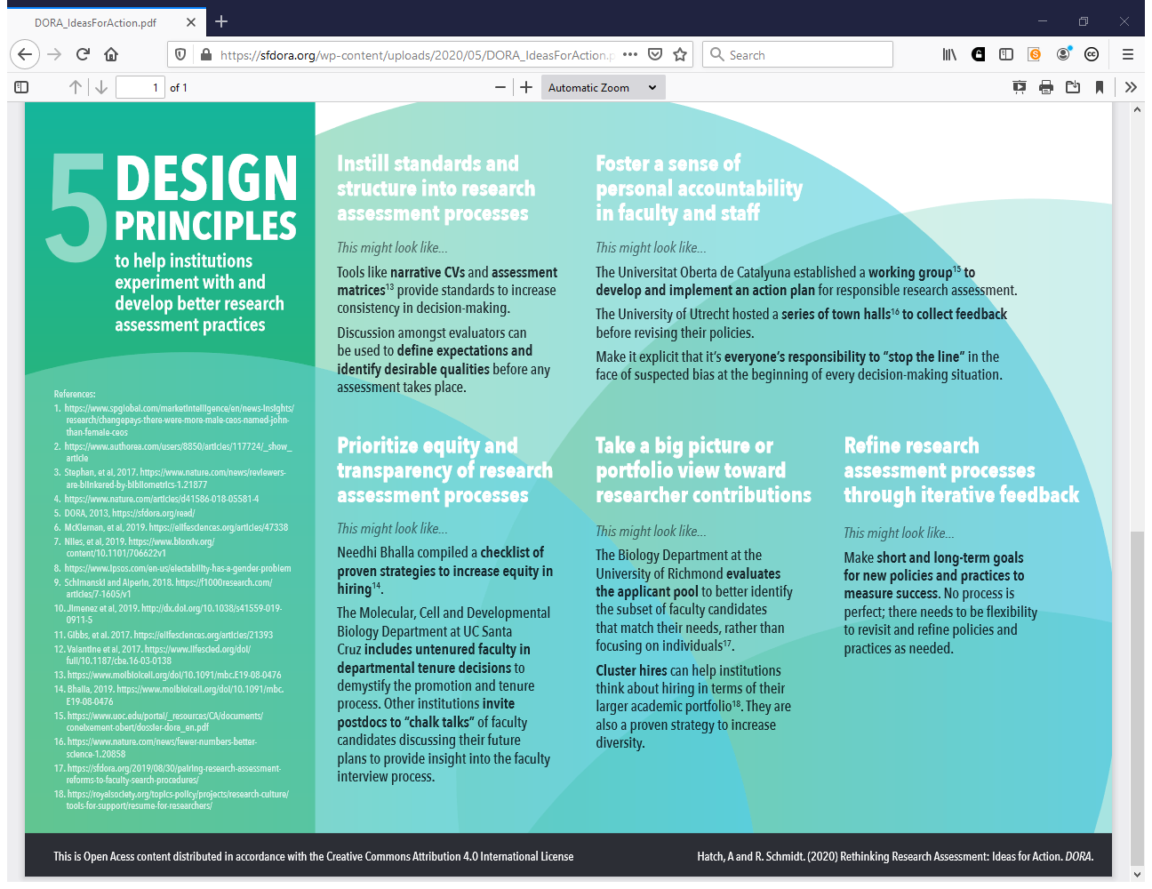
https://sfdora.org/wp-content/uploads/2020/05/DORA_IdeasForAction.pdf

Slide 23
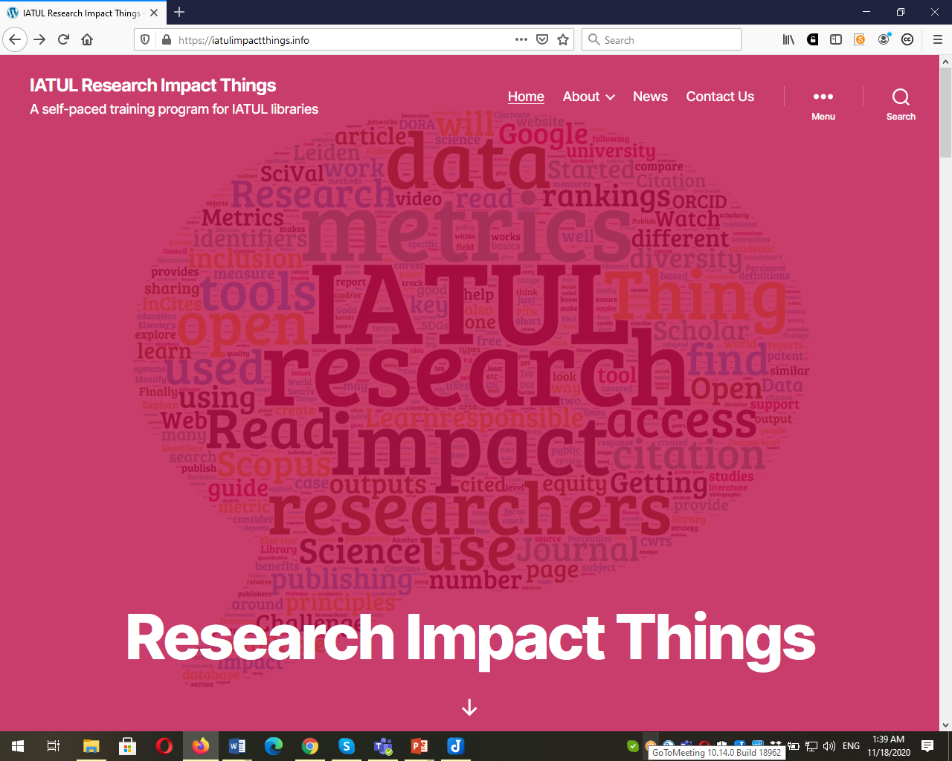
https://iatulimpactthings.info/

Slide 24
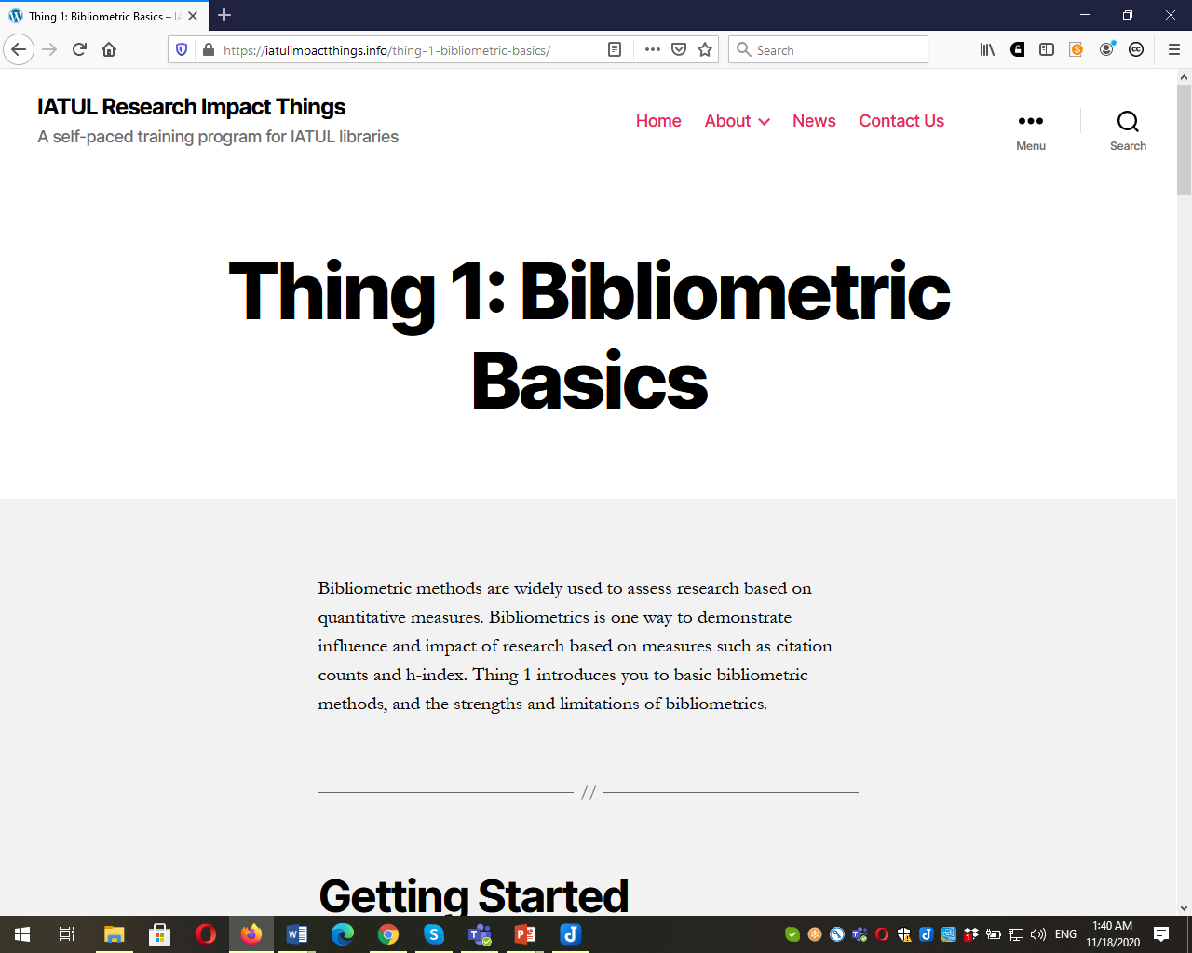

Slide 25
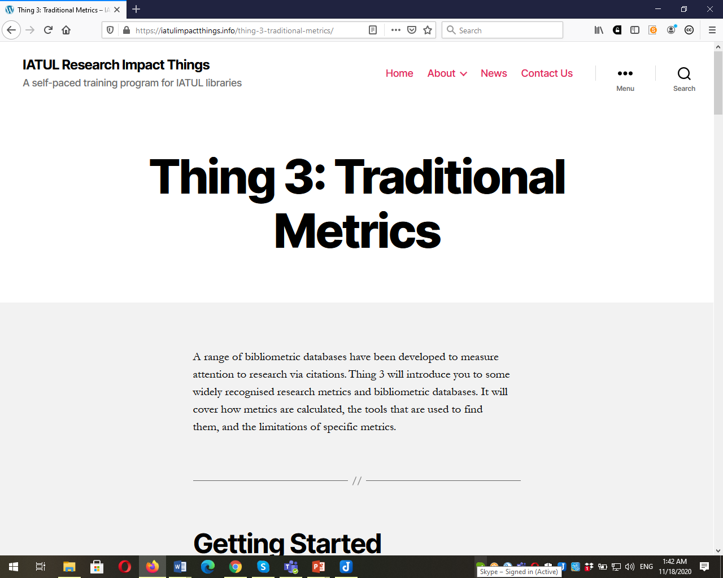

Slide 26
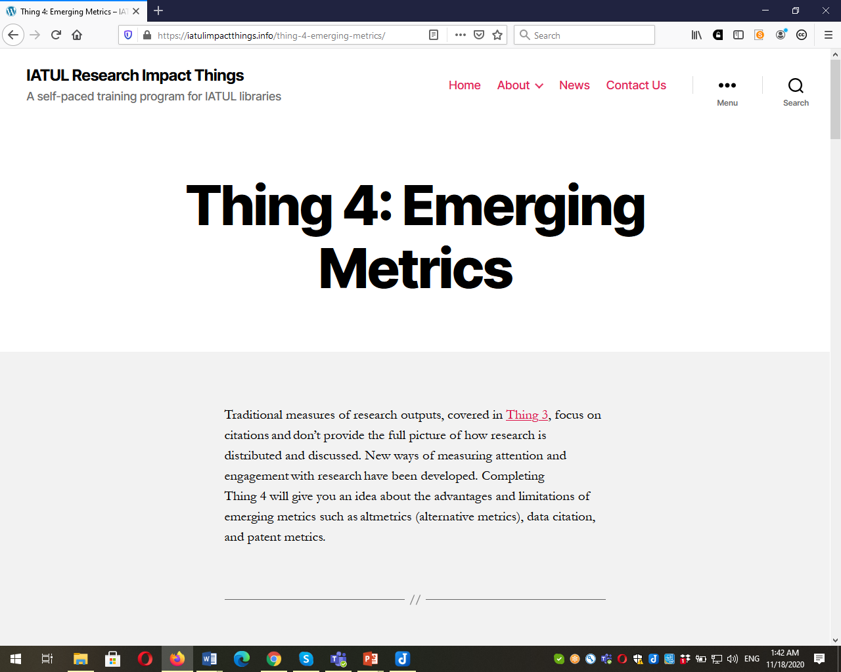

Slide 27
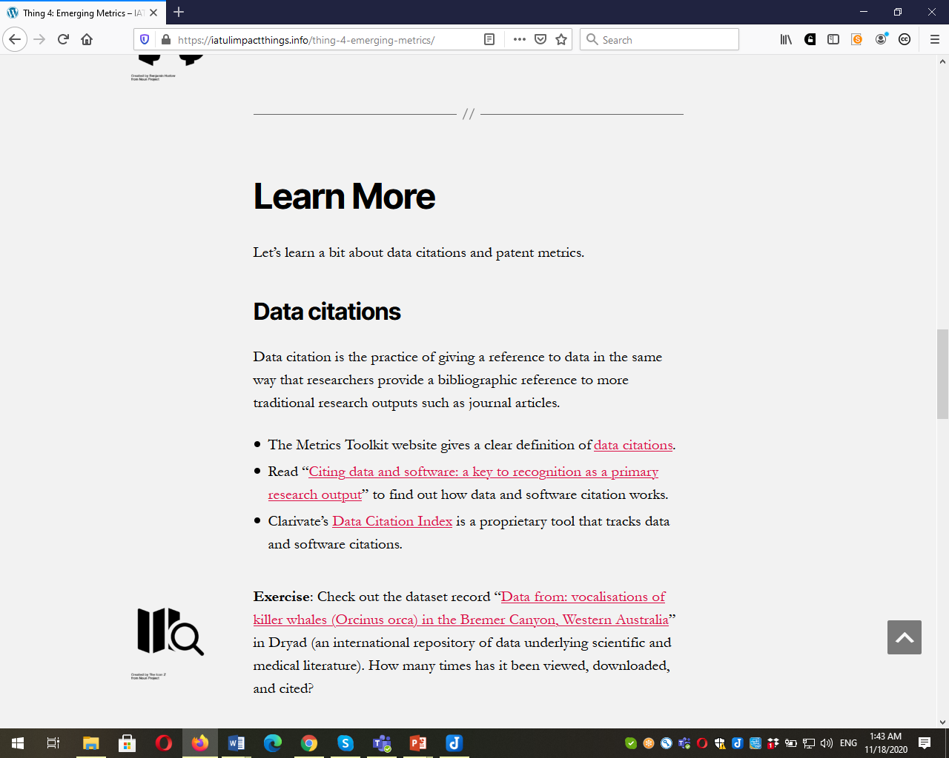

Slide 28
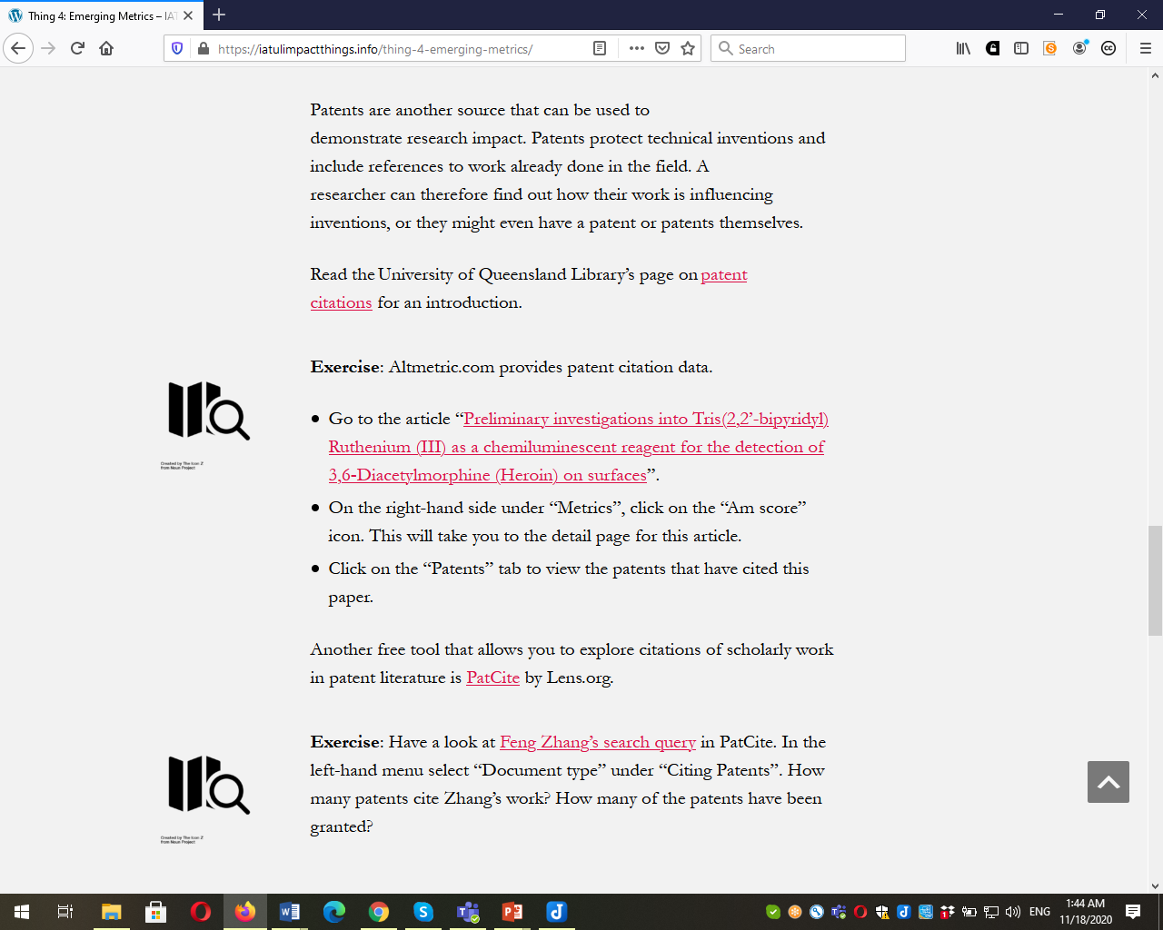

Slide 29
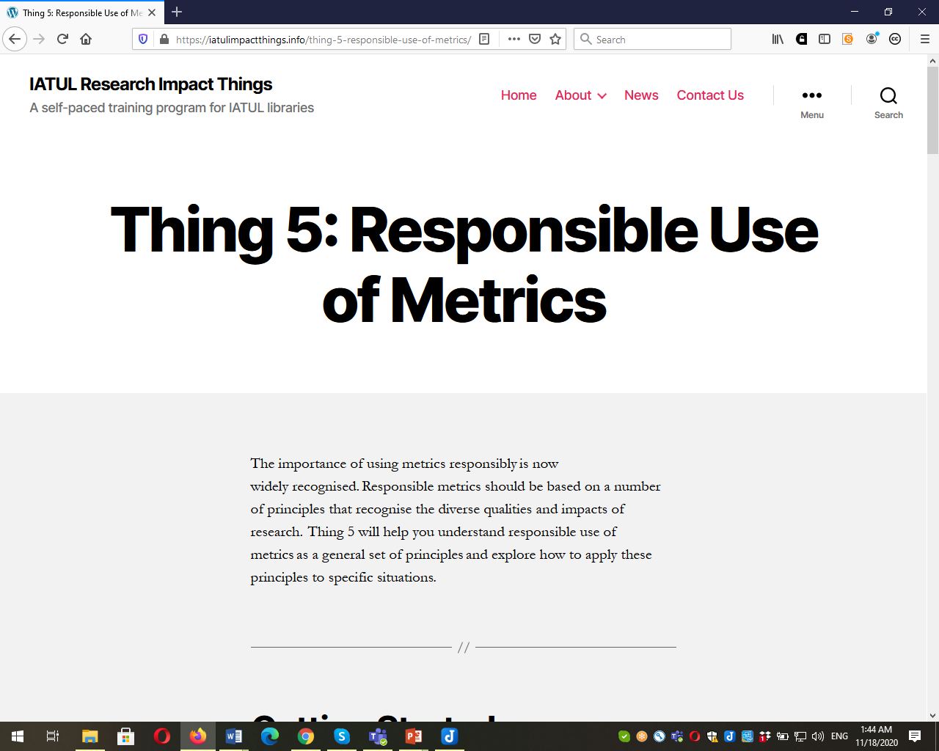

Slide 30
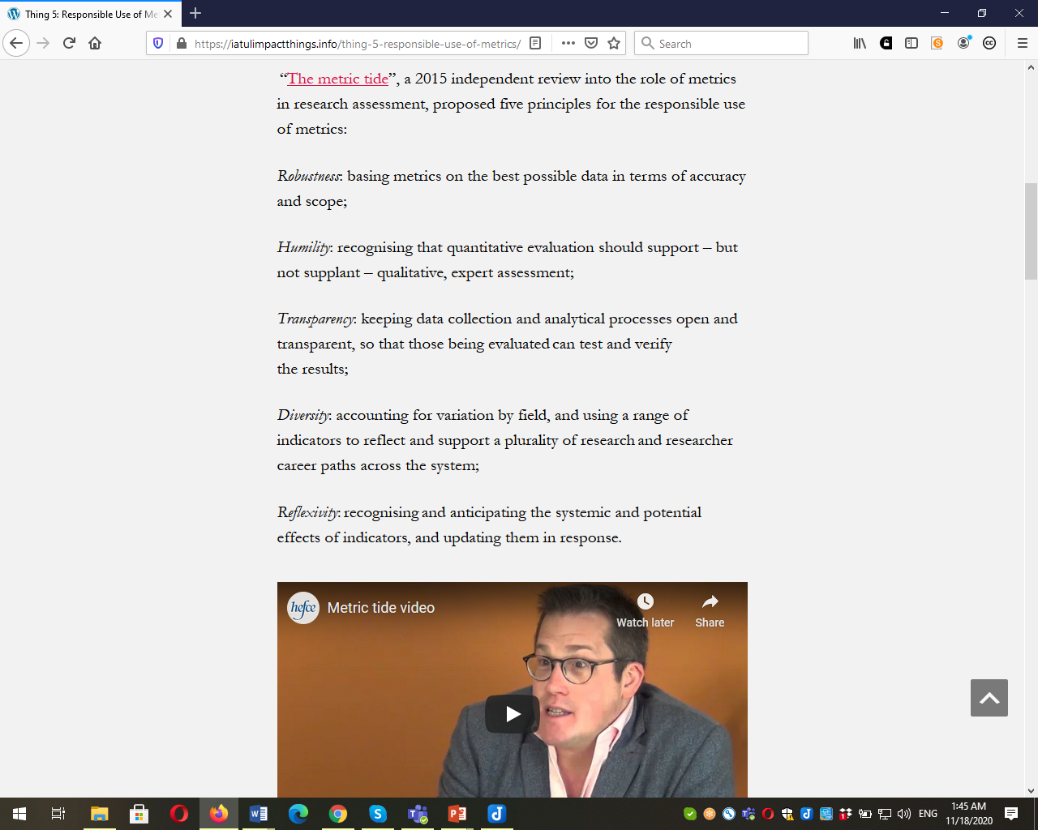

Slide 31
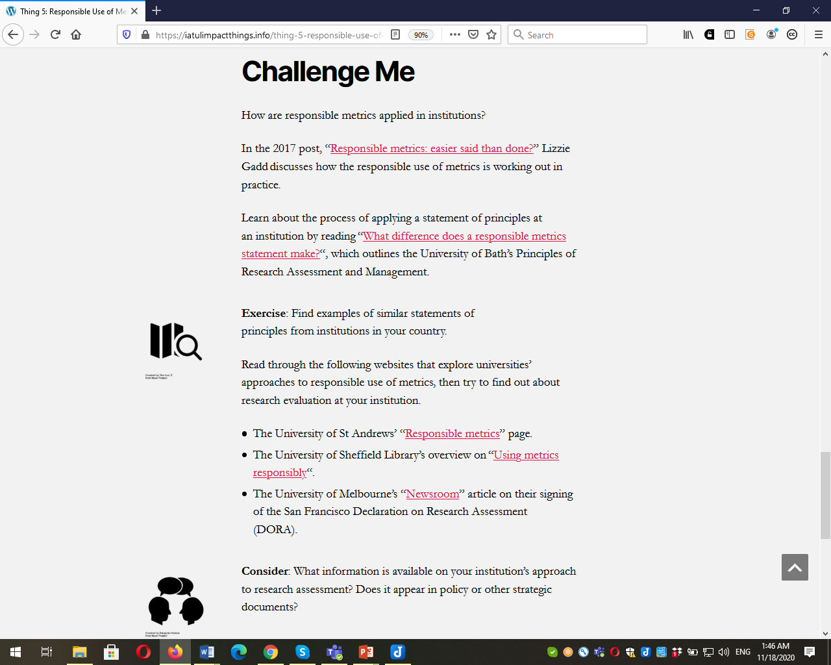

Slide 32
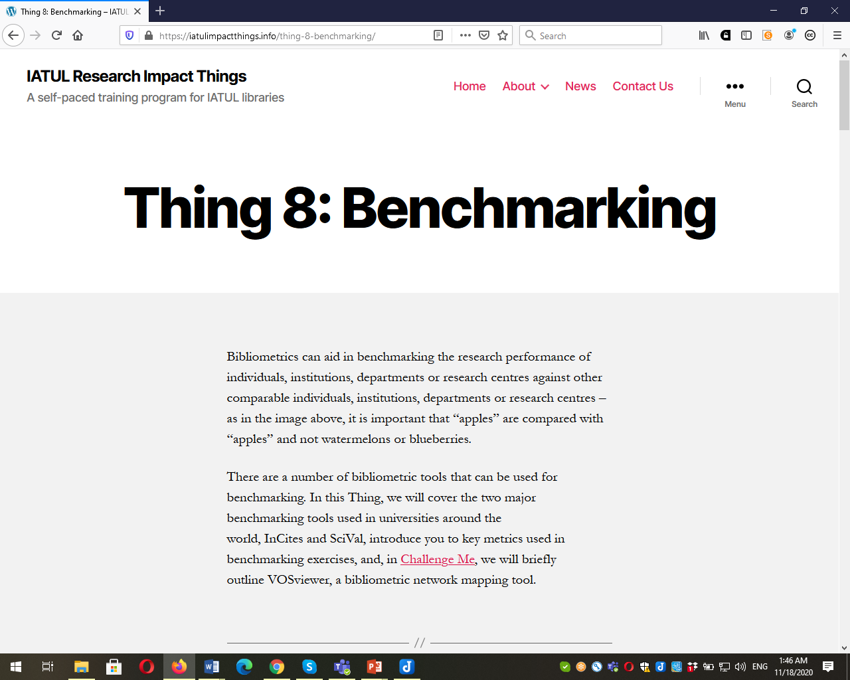

Slide 33
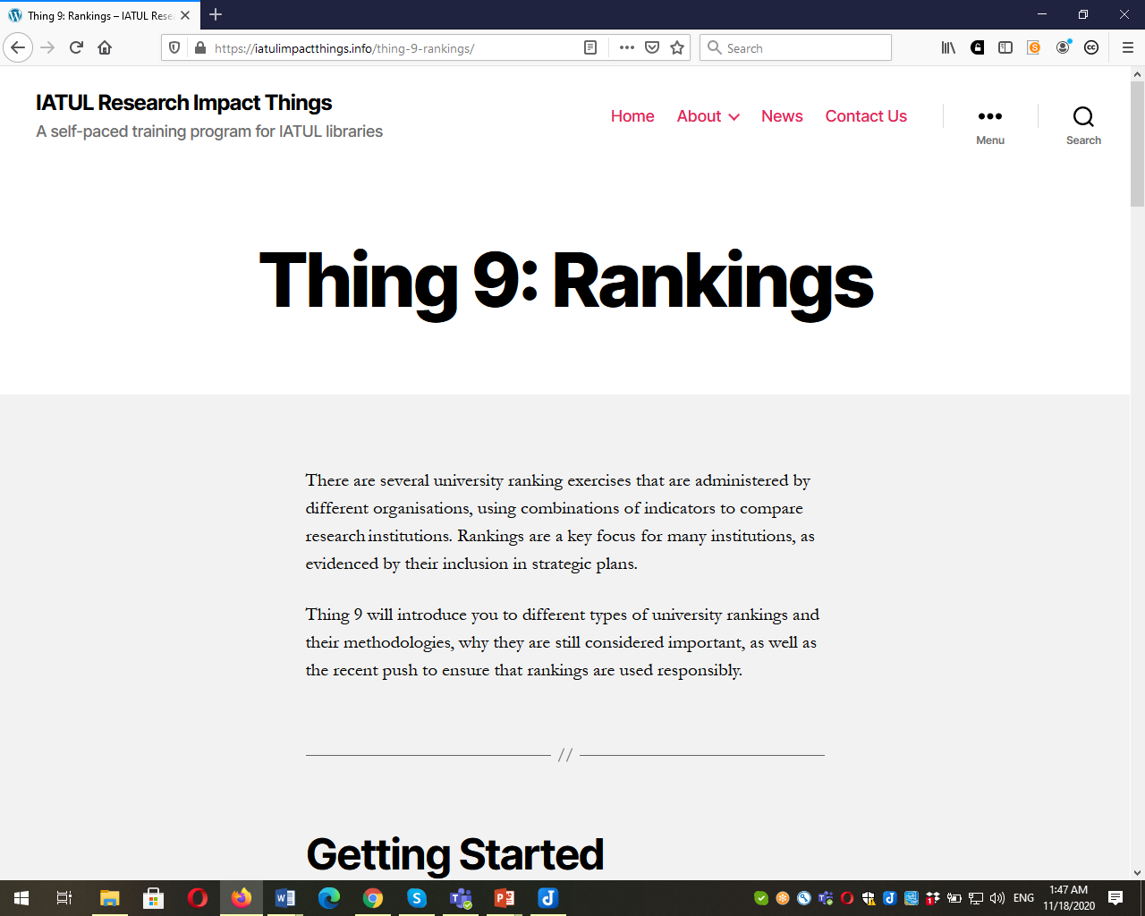

Slide 34
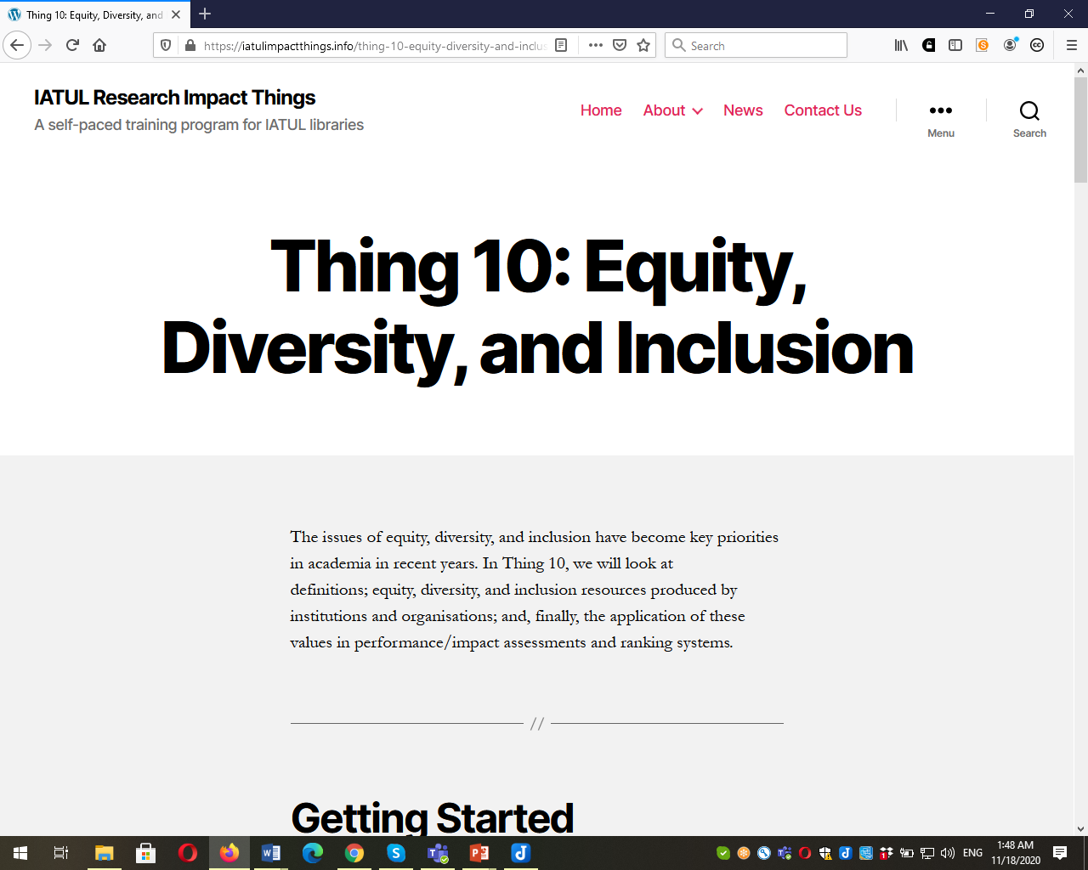

Slide 35
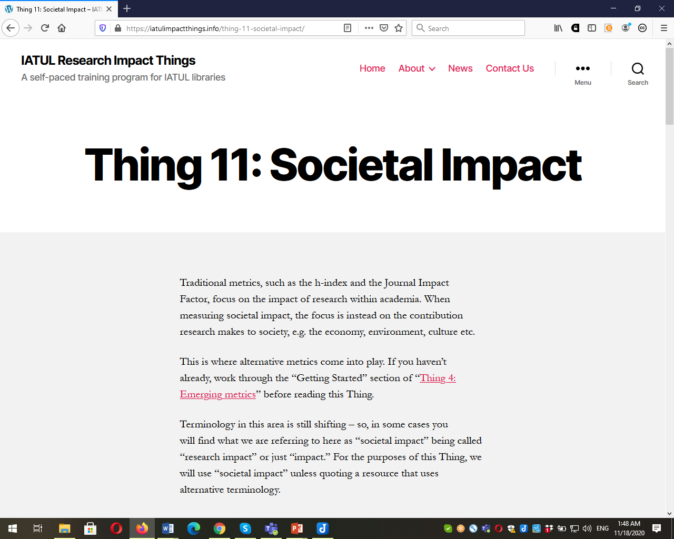

Slide 36
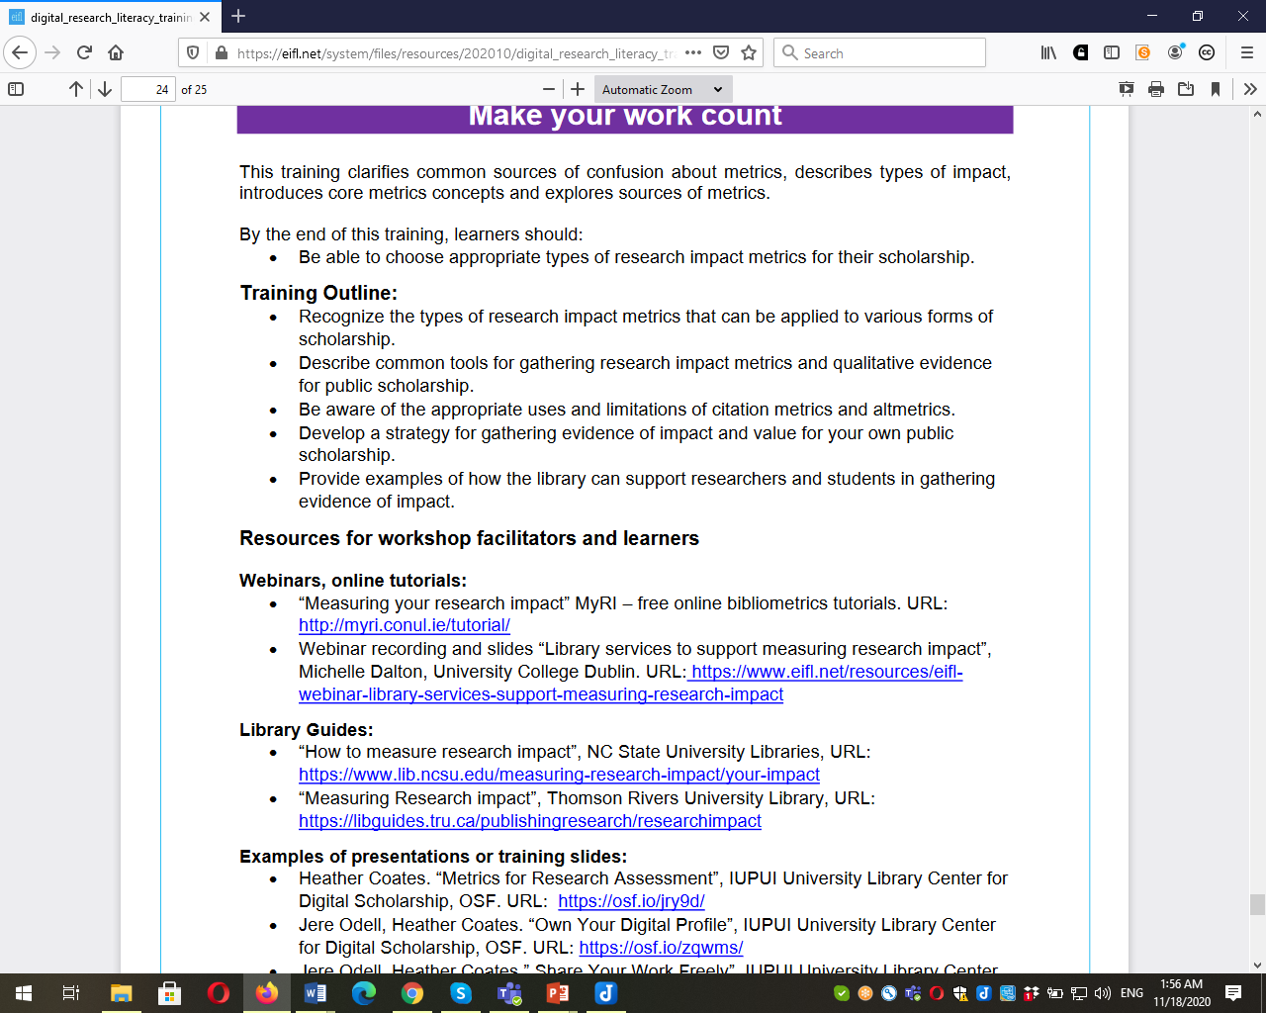

Slide 37
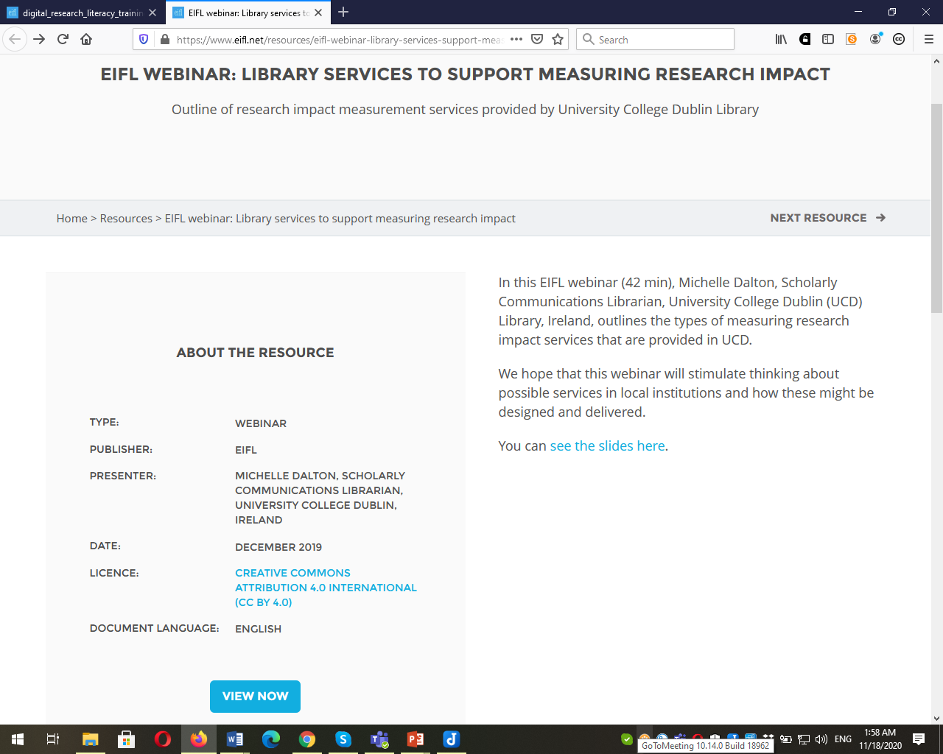
https://www.eifl.net/resources/eifl-webinar-library-services-support-measuring-research-impact

Slide 38
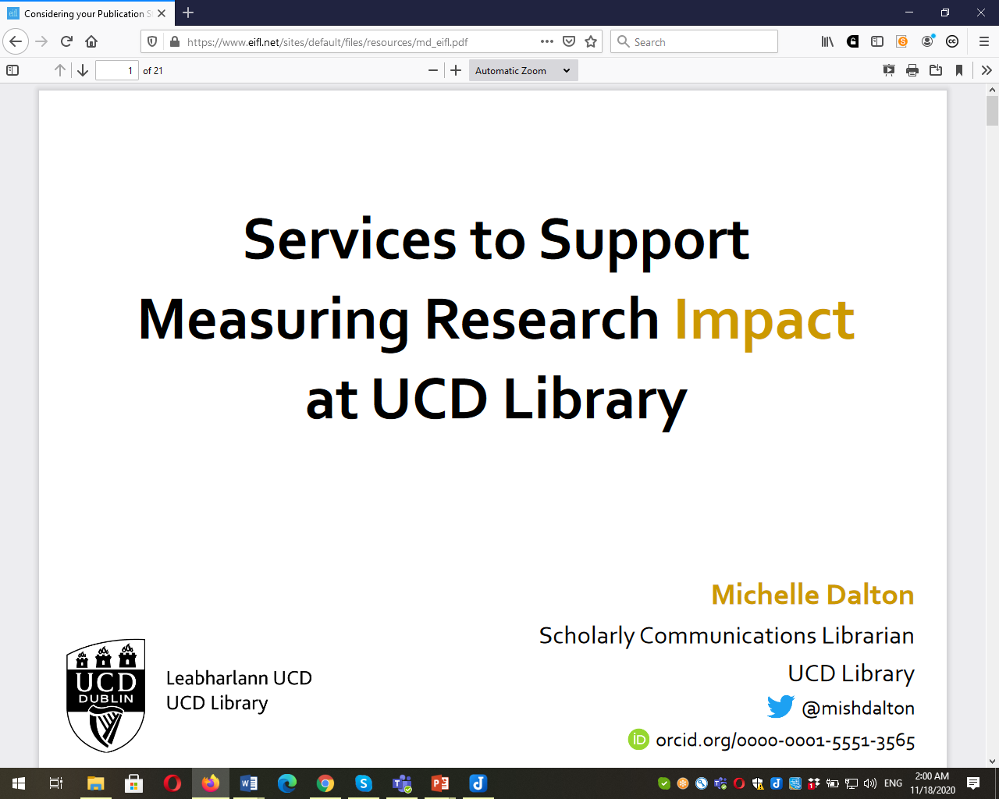
https://www.eifl.net/sites/default/files/resources/md_eifl.pdf

Slide 39
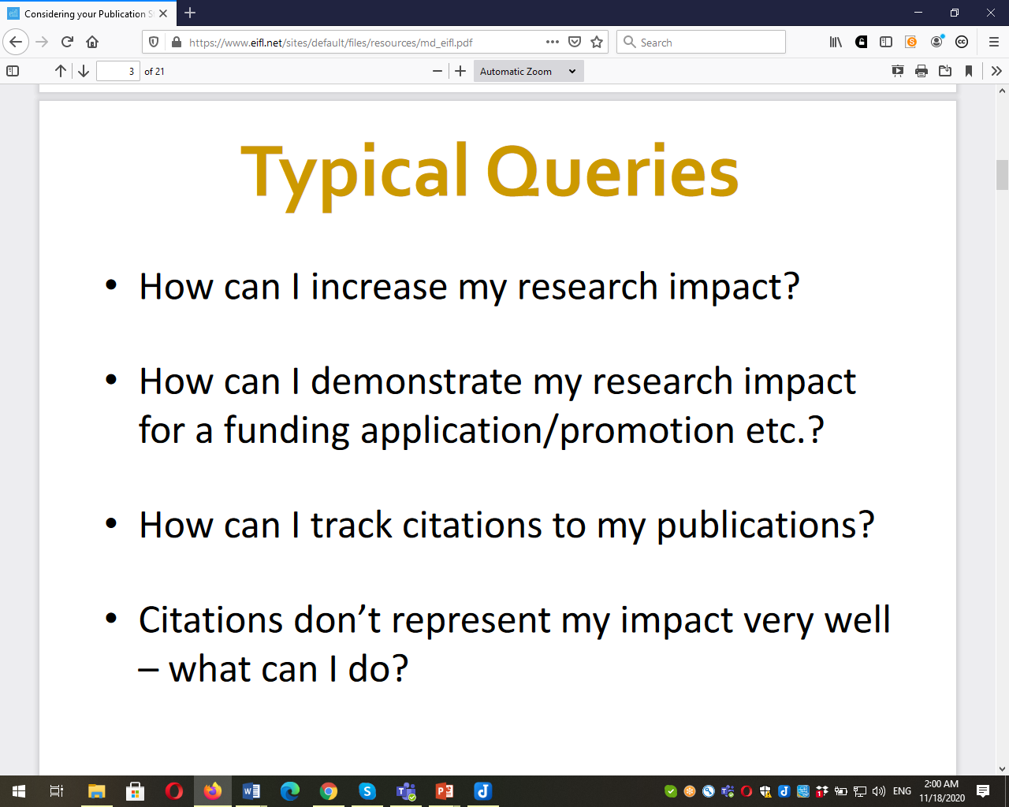

Slide 40
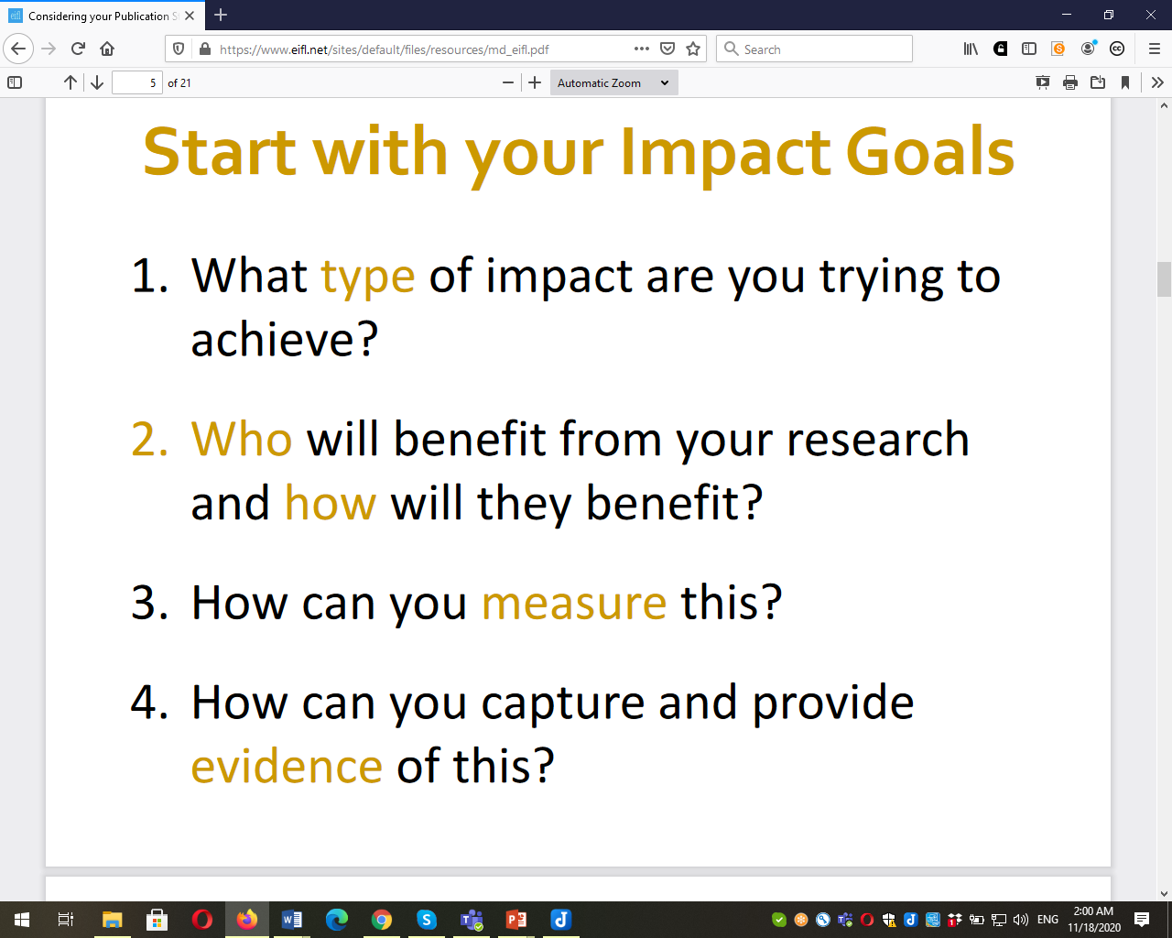

Slide 41
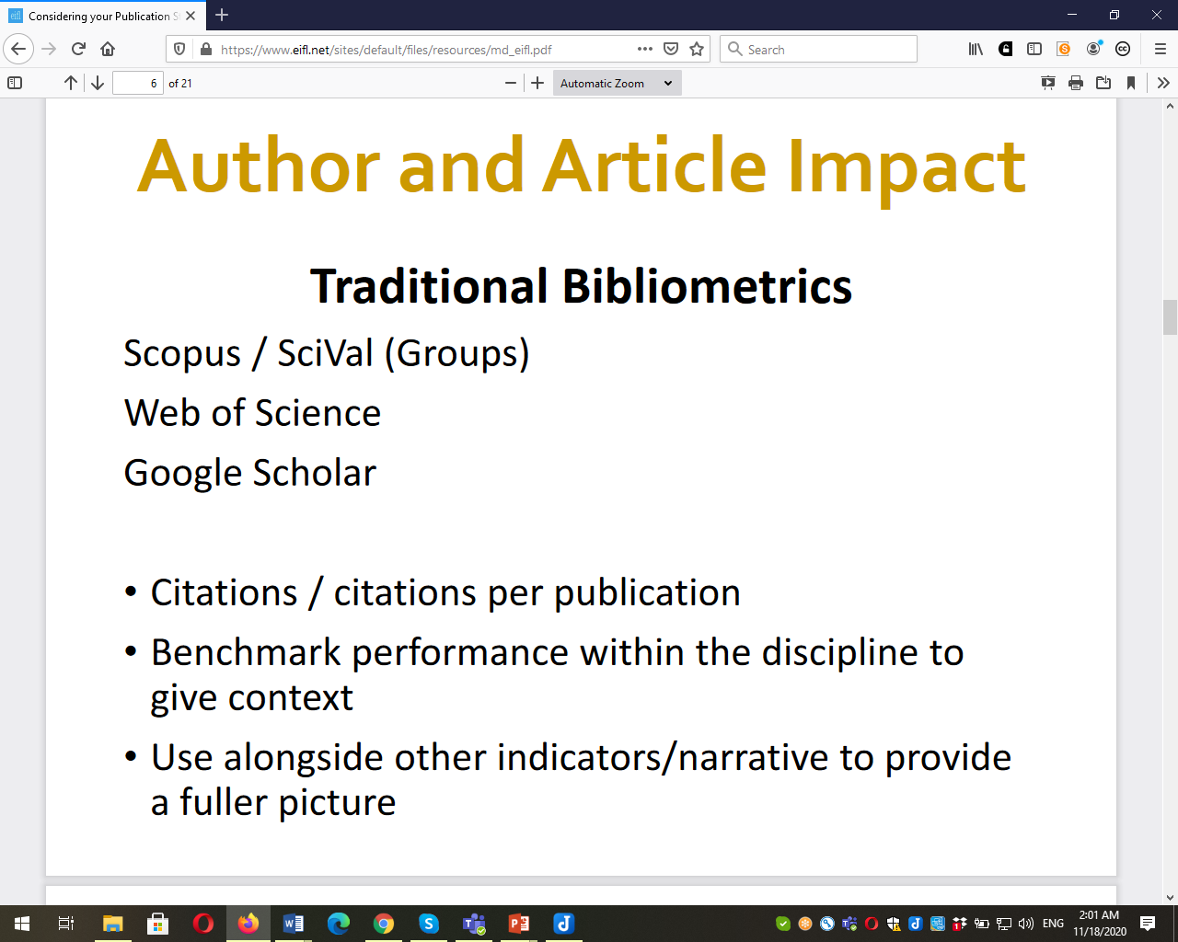

Slide 42
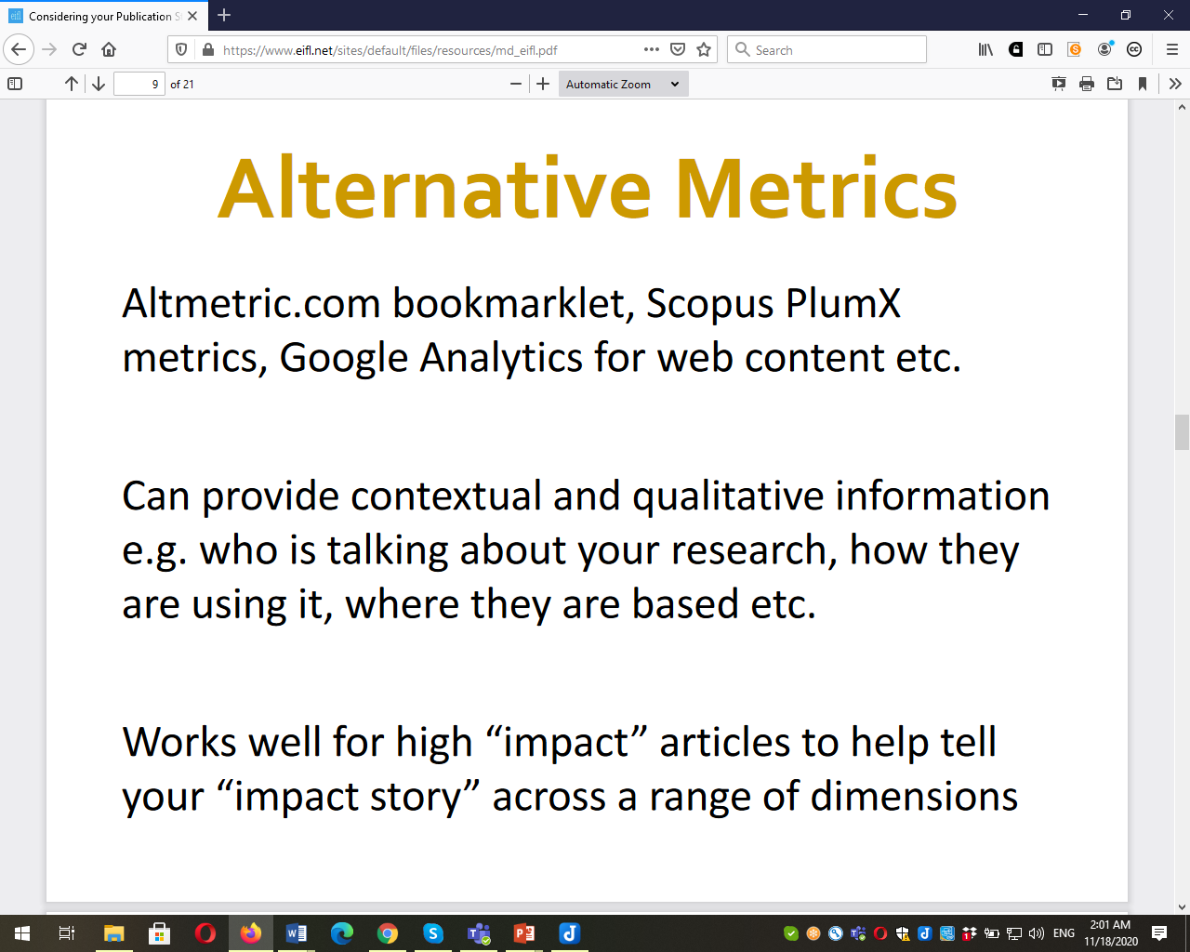

Slide 43
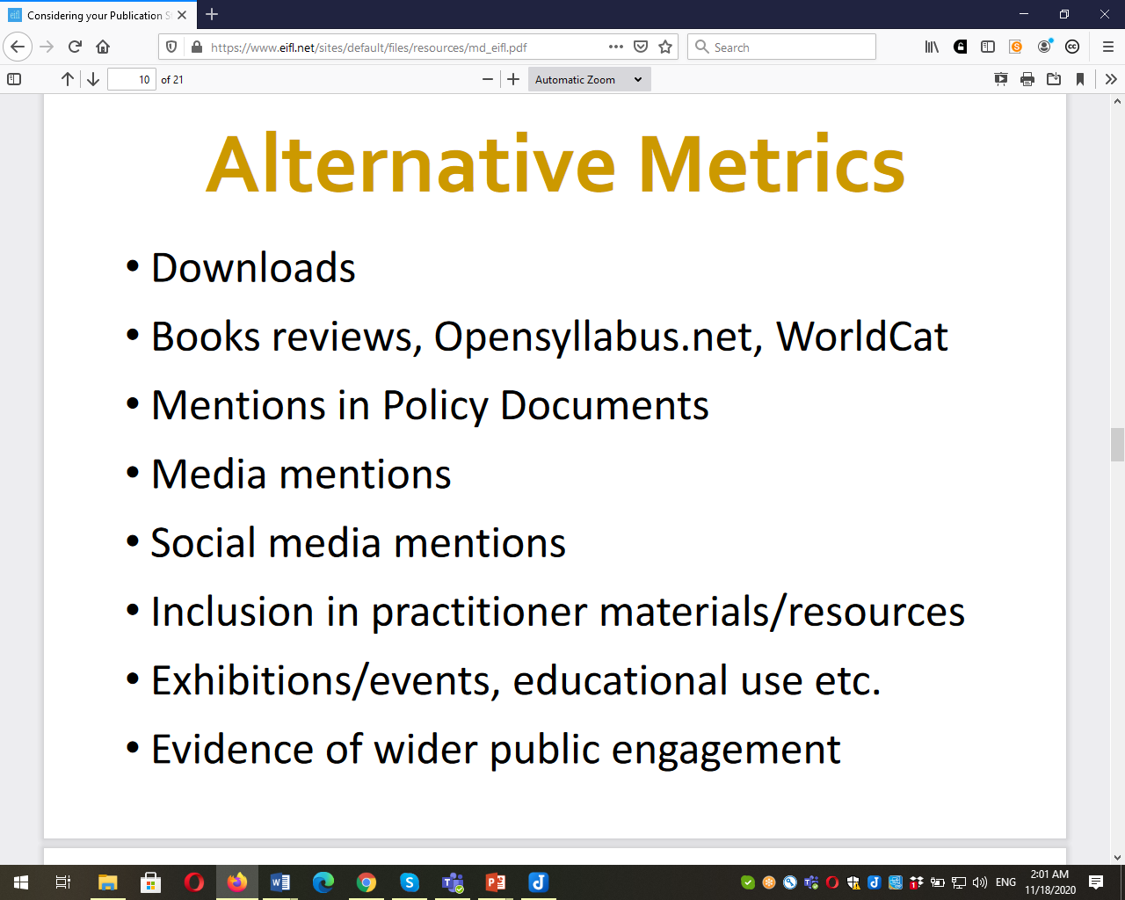

Slide 44
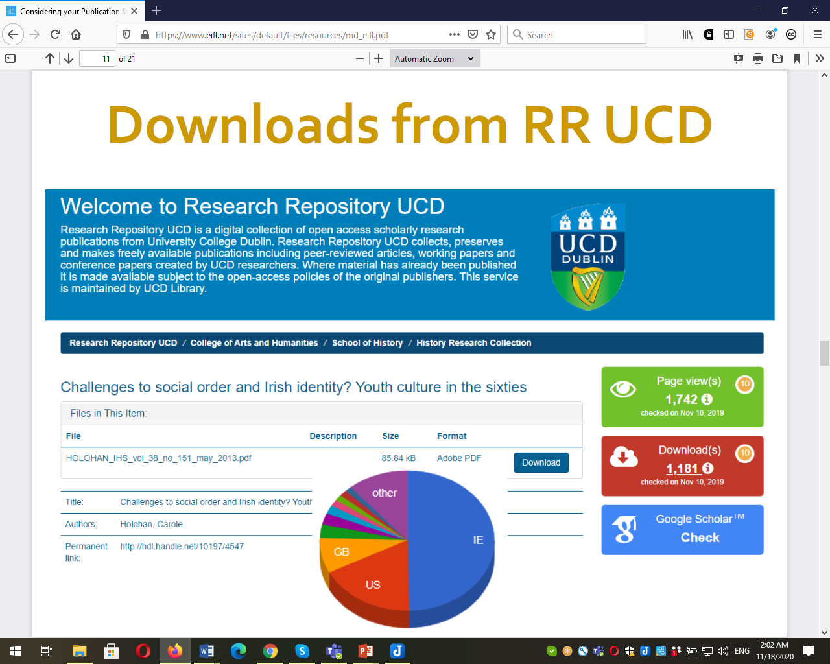

Slide 45
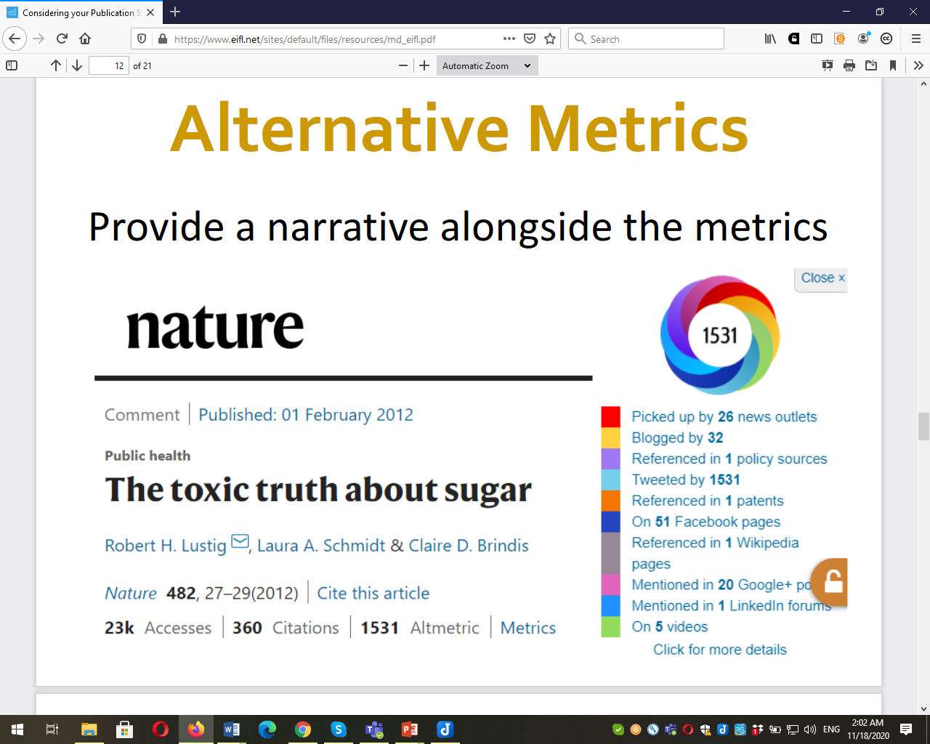

Slide 46
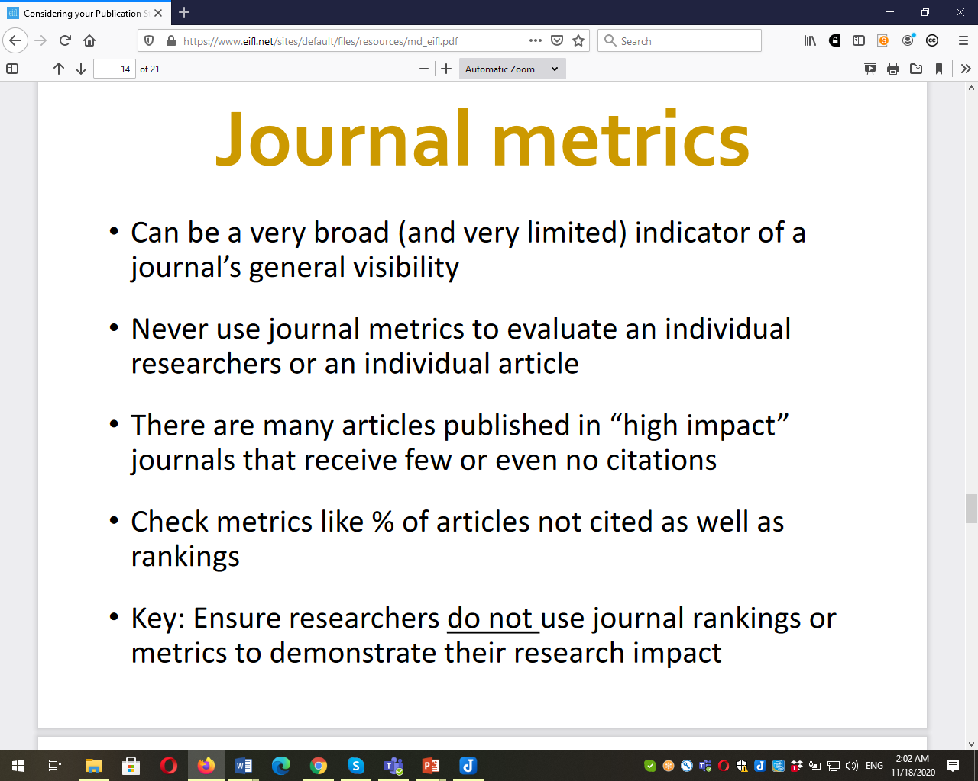

Slide 47
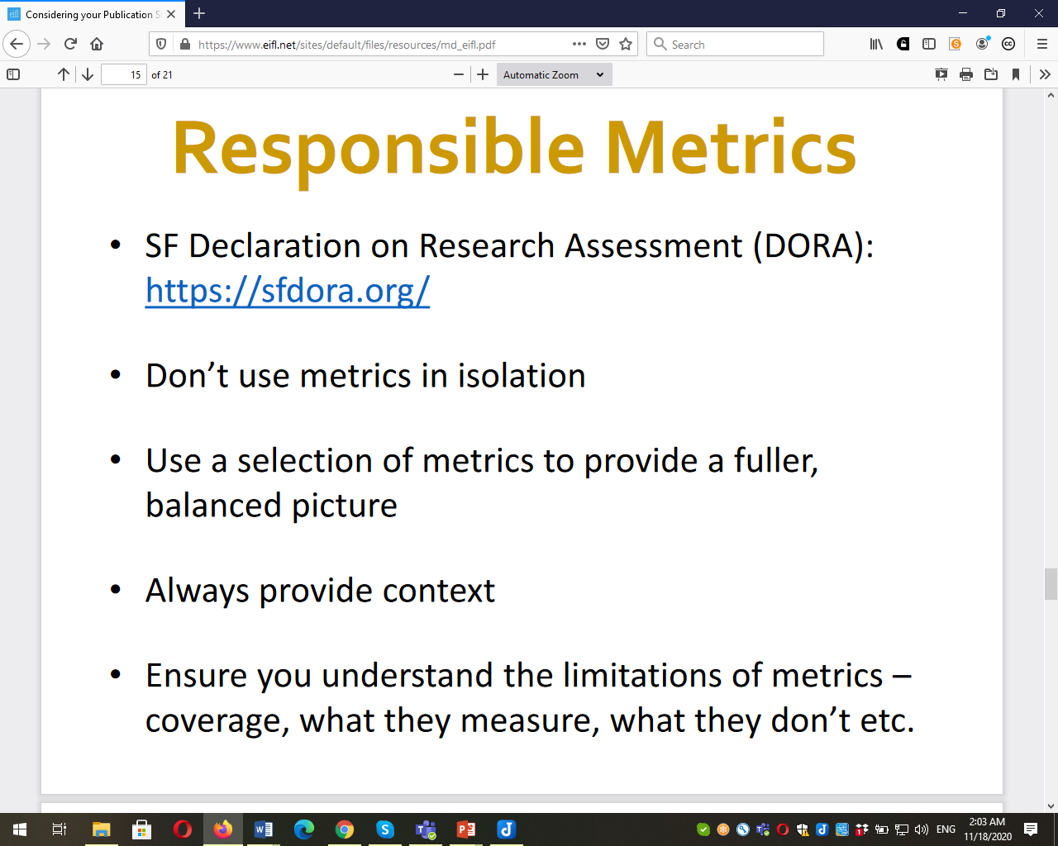

Slide 48
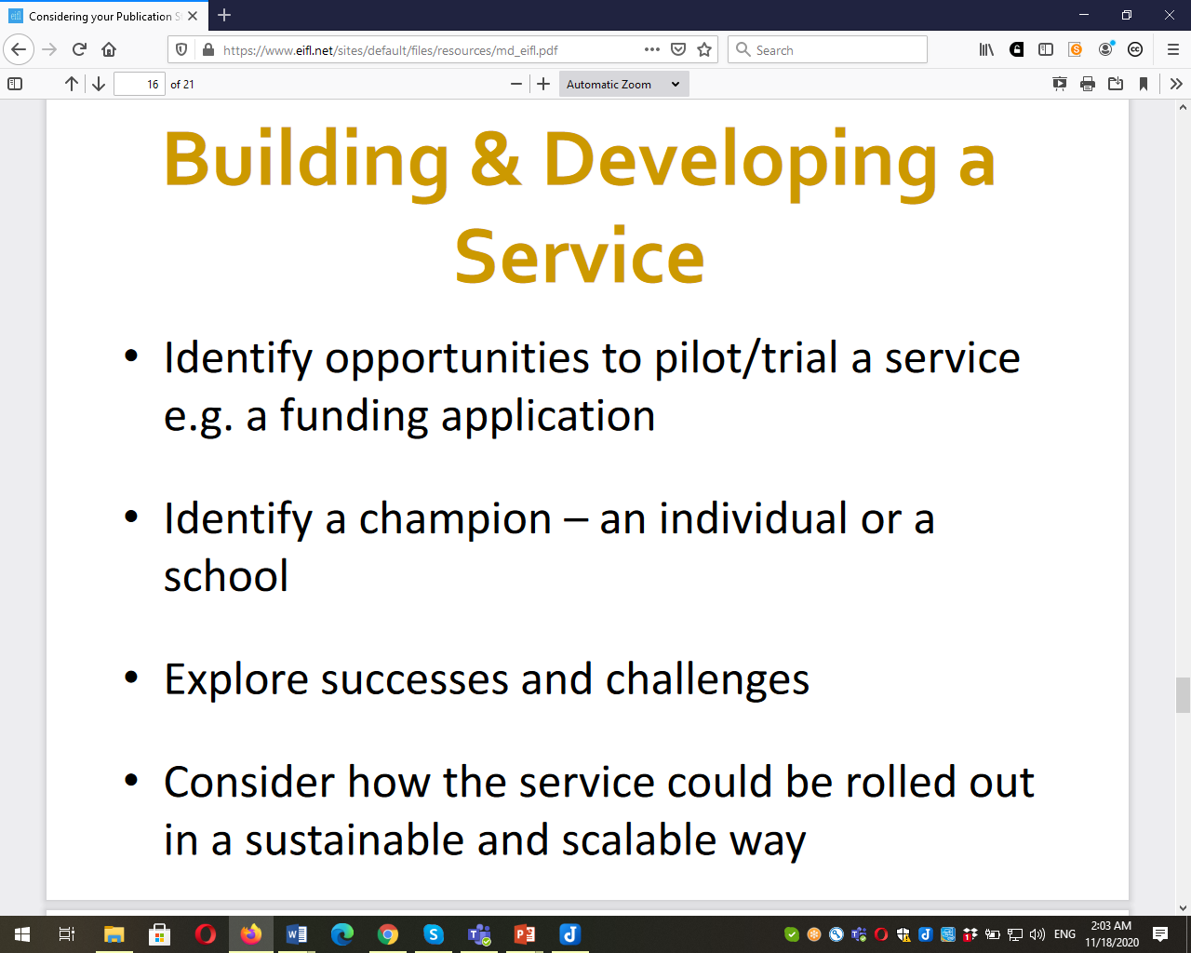

Slide 49
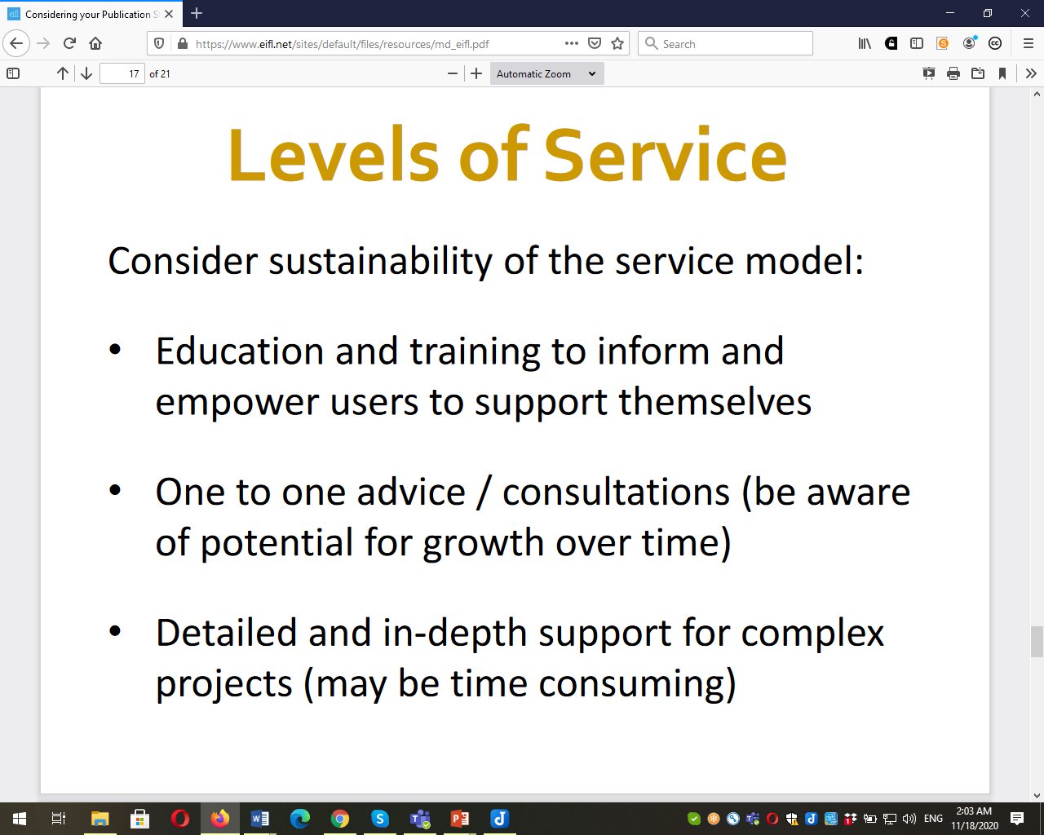

Slide 50
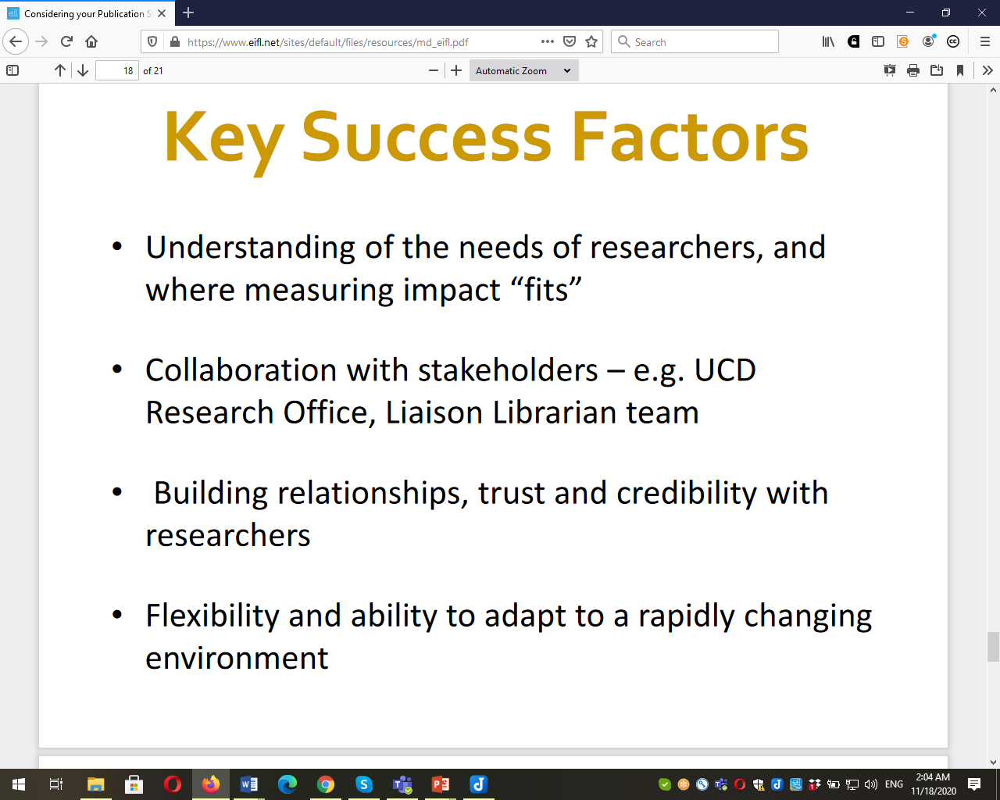

Slide 51
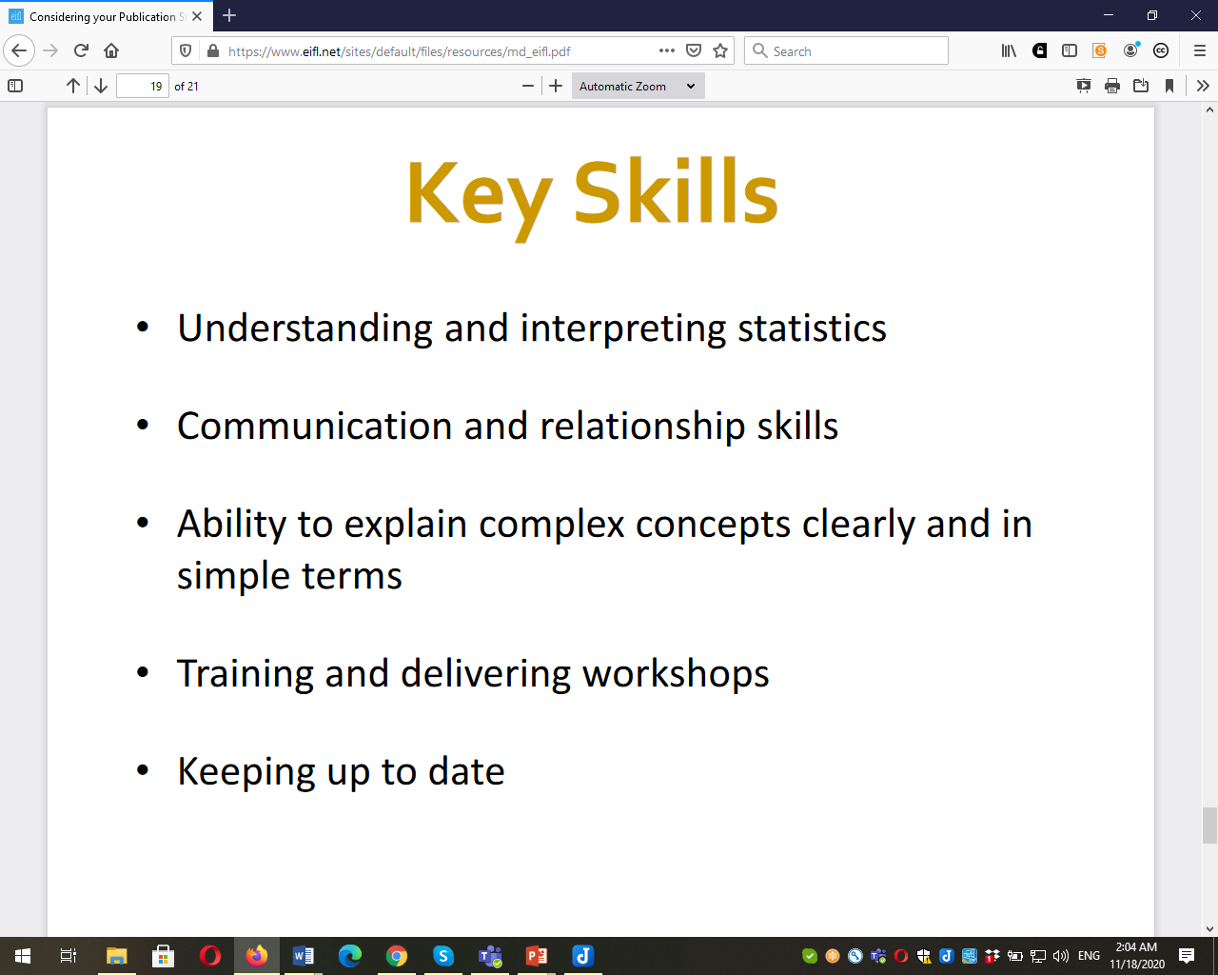

Slide 52
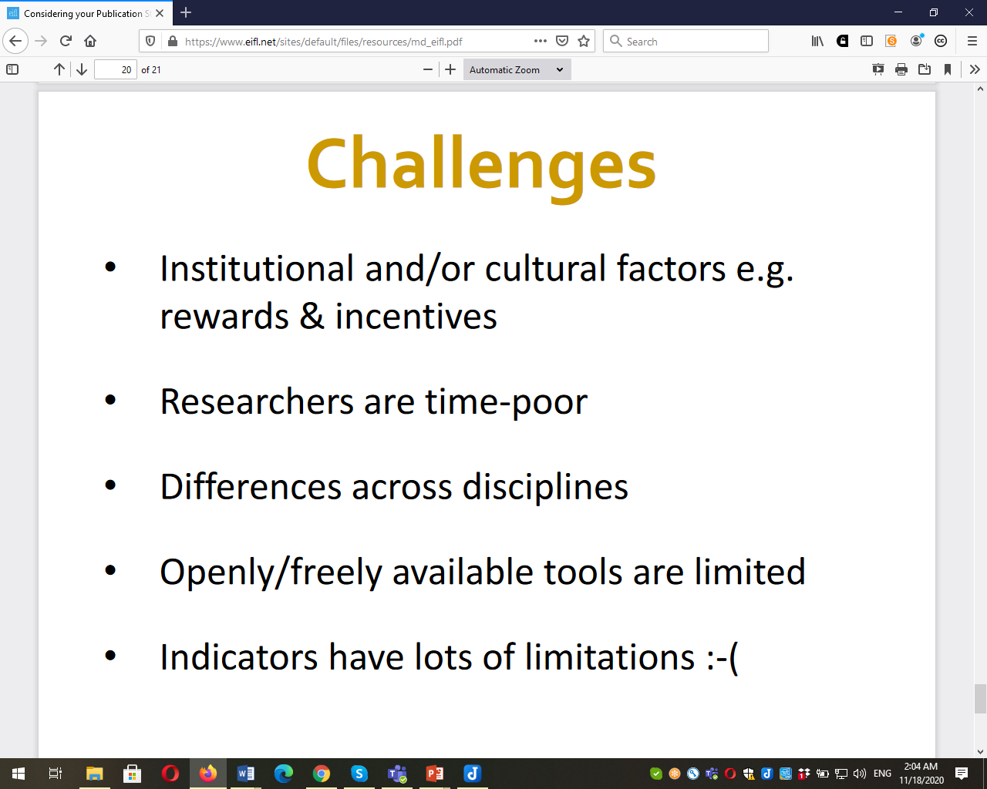

Slide 53
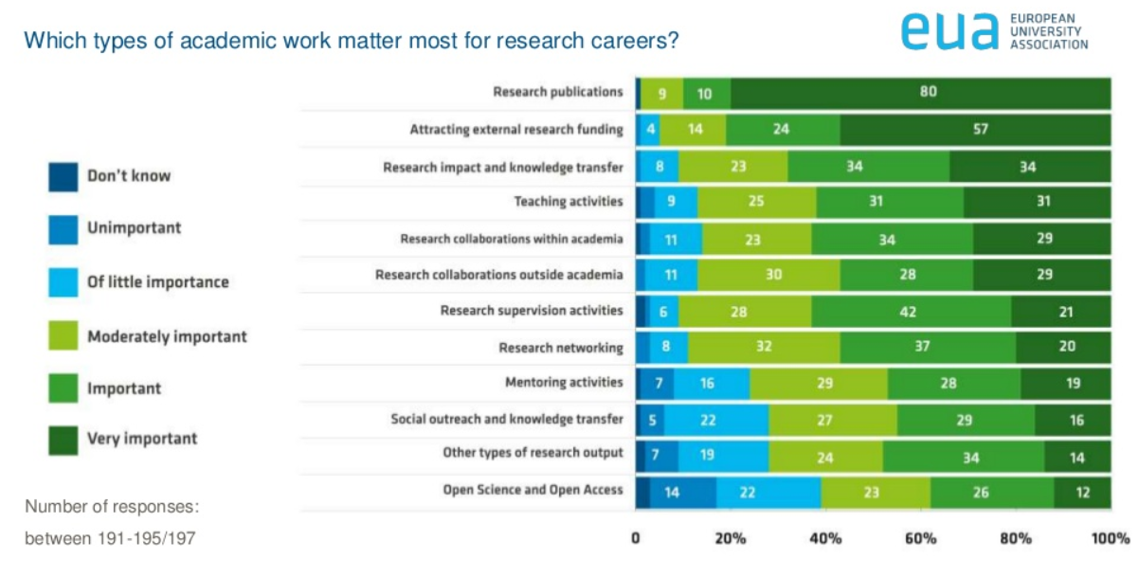
EUA survey Sep 2019: Research Assessment in the Transition to Open Science
https://www.slideshare.net/EurUniversityAssociation/2019-research-assessment-in-the-transition-to-open-science

Slide 54
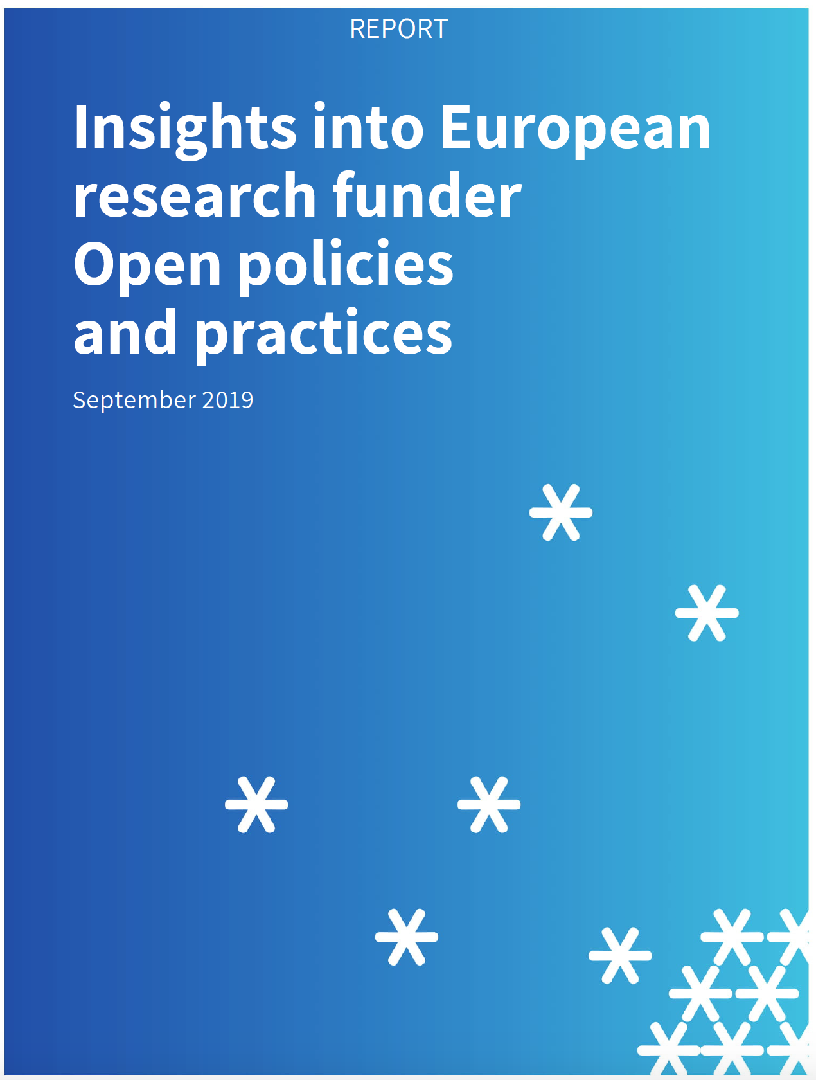
Funder evaluation criteria – top scorers
Goal: Growth in OA and Open Science policies amongst funders in Europe, and strengthen existing policies
Quality of research uptake & dissemination strategy
Number of peer-reviewed articles
Prizes or honours received
Quality of plan for societal impact
Quality of project management/governance
Number of citations of publications
SPARC Europe, Insights into European research funder Open policies and practices, 2019, DOI: 10.5281/zenodo.3401278

Slide 55

Use of Open Science criteria in grant evaluation
SPARC Europe, Insights into European research funder Open policies and practices, 2019, DOI: 10.5281/zenodo.3401278

Slide 56




Using research-related metrics responsibly
Several key reports and frameworks proposed
Manage and plan for unintended consequences and/or ‘steering’ effect of indicators
Don’t create incentives for only tokenistic / superficial change in behaviours
Tailor suite of indicators to field, project, type of entity measuring etc

Slide 57



https://ec.europa.eu/research/openscience/index.cfm?pg=rewards_wg

Slide 58

Creating the Open Science Registry on rewards and incentives
Hilary Hanahoe, Secretary-General, RDA
Eva Mendez, UC3M, OSPP chair
Michelle Barker, Director, Research Software Alliance
Rebecca Lawrence, Managing Director, F1000 Research
Catriona J MacCallum, Hindawi
Vanessa Proudman, Director, SPARC Europe
Anna Hatch, Program Director, DORA
RDA Plenary 16, 12 Nov 2020

Slide 59

https://en.unesco.org/news/milestone-unescos-development-global-recommendation-open-science

Slide 60


Slide 61


Slide 62
Thank you! Questions? iryna.kuchma@eifl.net
www.eifl.net

