Slide 1




Overview of Khulisa Journals
Presented by Ina Smith
Planning Manager ASSAf & DOAJ Africa Senior Ambassador
ina@assaf.org.za

Slide 2
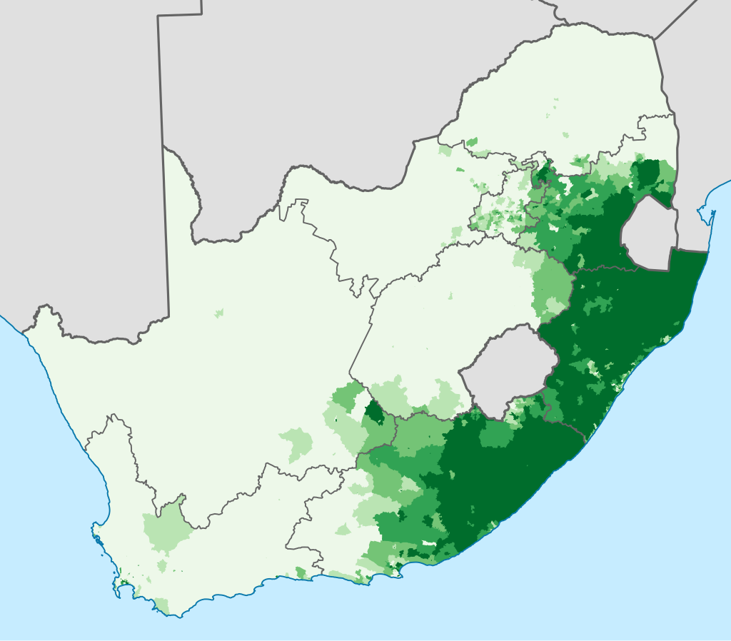

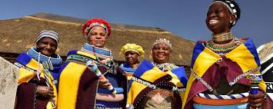
The word “Khulisa”
Khulisa (KHOO-lee-sa) is a word in Nguni languages (Xhosa, Zulu, Ndebele, and Swati) that are indigenous to southern and eastern Africa
“To grow or foster the development of a person or community”

Slide 3
Hosting Khulisa Journals
From 2014 – 2015 we ran a pilot project with 5 journals, using PKP OJS
KJ was officially established in 2016, using PKP OJS open source software (current PKP OJS version 3.4.0.6 – August 2024)(almost 10 years old)
Currently 17 SciELO SA journals, also on DOAJ, Google, Google Scholar
Dedicated server (with xneelo) & SLA with System Admin (outsourced)(Nason Bimbe)
Development work (bug fixes) outsourced (Lepidus)
Federated approach (1 OJS installation, unlimited journals)
Access at https://journals.assaf.org.za/

Slide 4
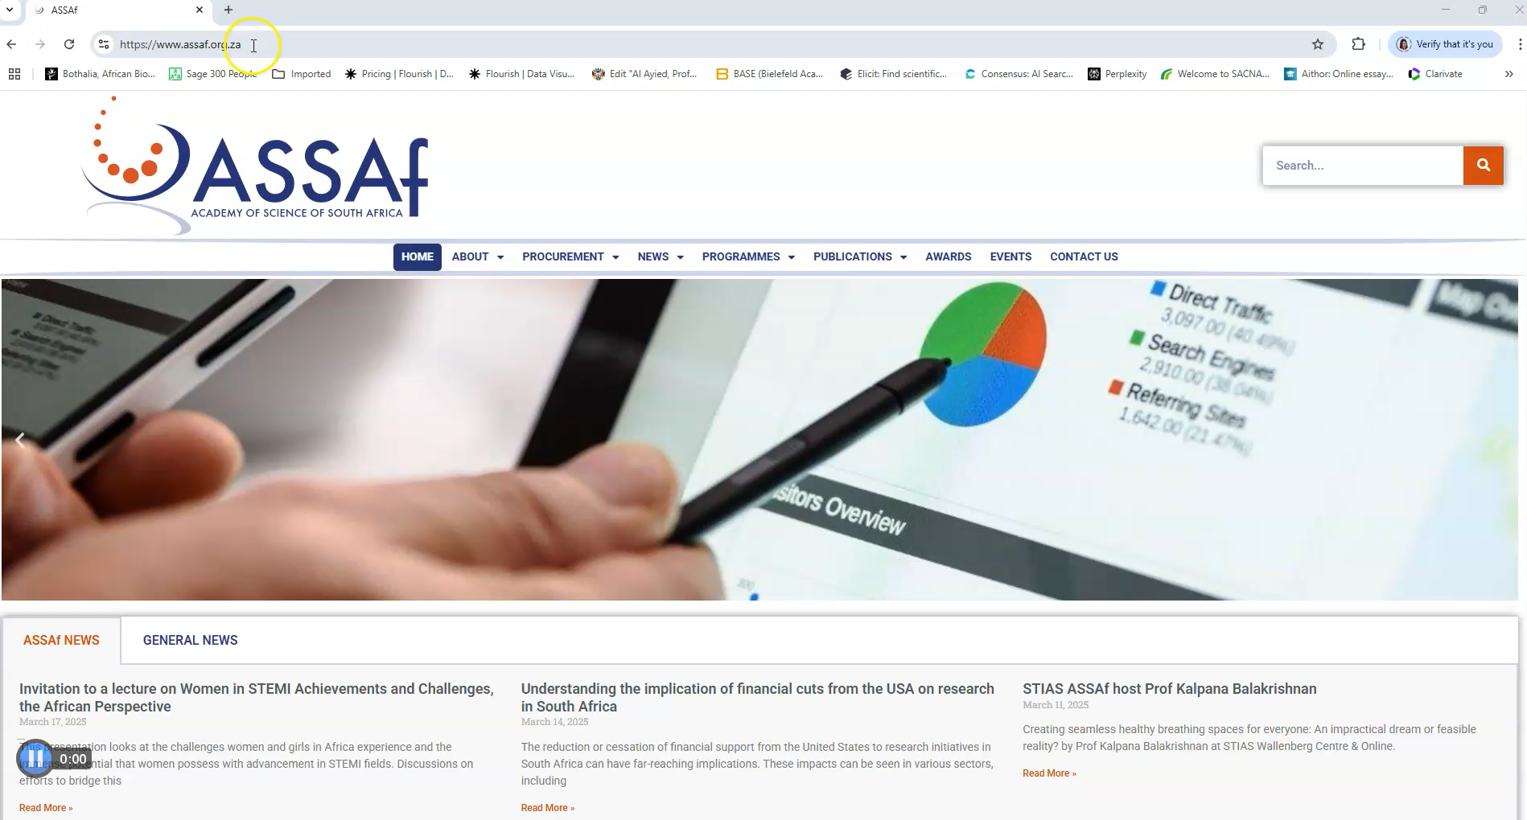

Slide 5
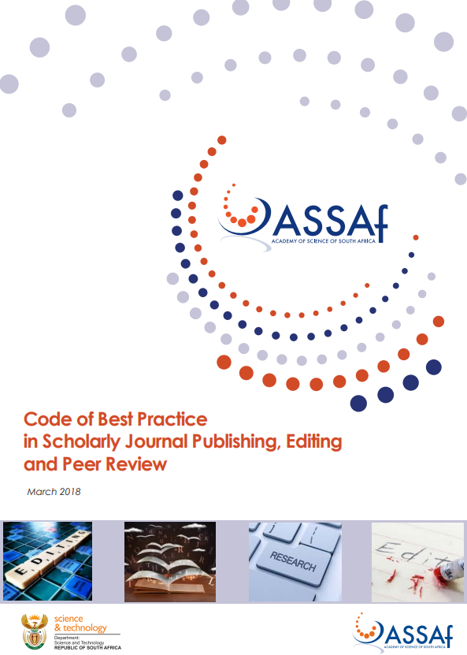

About the Journals
All fully open access, peer-reviewed & recommended South African indigenous journals, high quality, across disciplines
Adhere to DOAJ, SciELO SA, and Code of Best Practice criteria, EIFL, among others
Committed, dedicated Editors
Diamond OA journals (9 of 17):
  African Journal on Conflict Resolution
  Clean Air Journal
  Journal of Energy in Southern Africa
  South African Crime Quarterly
  South African Journal of Occupational Therapy
  South African Journal of Science
  The African Journal of Information and Communication
  The Independent Journal of Teaching and Learning
  Water SA

Slide 6
About the Journals
ASSAf KJ = host; journal owner = publisher
Each journal has own unique branding
Journal owner owns copyright of journal itself
Copyright for individual articles mostly belongs to author/s
CC BY license (Creative Commons Attribution)
Double blind peer-review process
Open Access policy
Articles uploaded in pdf (xml, epub are optional)
All research articles are assigned DOIs (Crossref)
Access to iThenticate to check for plagiarism (through Crossref)
All articles archived with Portico
Notes:
CC BY, or Creative Commons Attribution, is a license that allows others to share, use, and build upon a work, even commercially, as long as they credit the original creator.

Slide 7
About our Services & Support
Journal setup fee (once-off) – ZAR 10,000.00 ($548)
Annual hosting fee – ZAR 15,000.00 ($822) or ZAR 20,000.00 ($1096)
No increase since 2016
The more journals we host, the more affordable it will become
Above journal costs covered by:
  Government department
  Institution or University/Higher Education Faculty/Department
  Professional body member fees
  Advertisements
  Funding
  Article Processing Fees – Non-Diamond OA journals
Service Level Agreement with each journal
Extensive training & support; bi-monthly newsletter

Slide 8
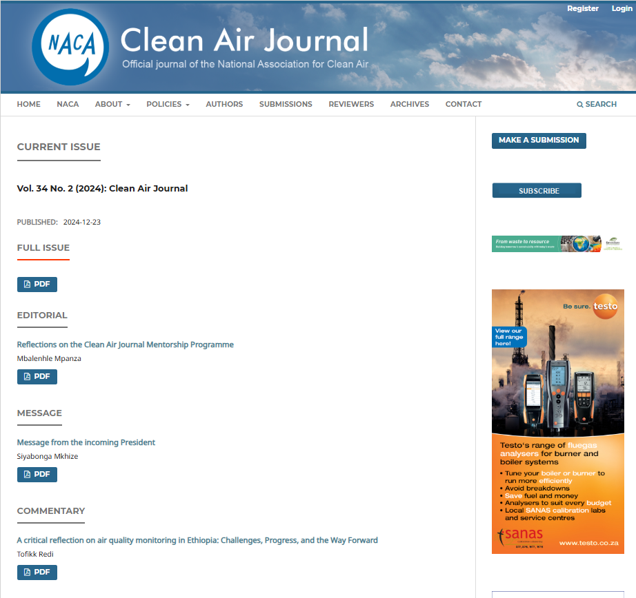
Clean Air Journal https://cleanairjournal.org.za/
Generate income through industry related advertisements
Advertising policy

Slide 9
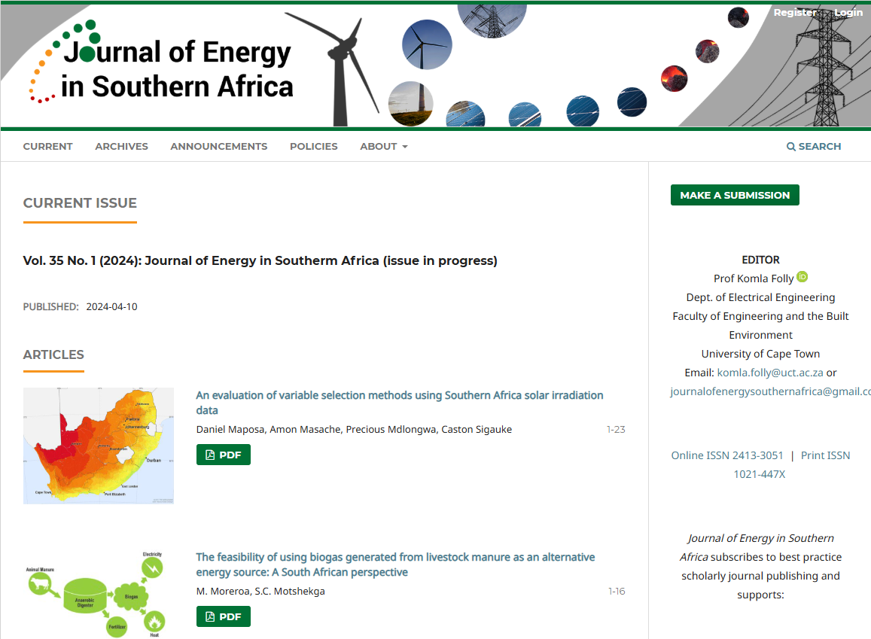
Journal of Energy in Southern Africa https://energyjournal.africa/
Rolling article publishing model as opposed to issue publishing
Publish articles as and when they are finalised (following peer-review, copyediting, layout editing, etc)

Slide 10

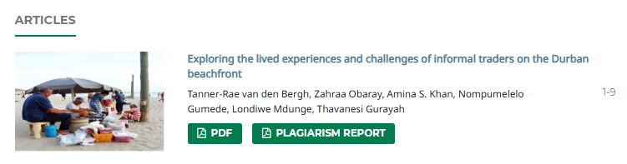
South African Journal of Occupational Therapy https://journals.assaf.org.za/index.php/sajot
Section on Continuous Professional Development (CPDs)
Additional file (plagiarism report) published

Slide 11
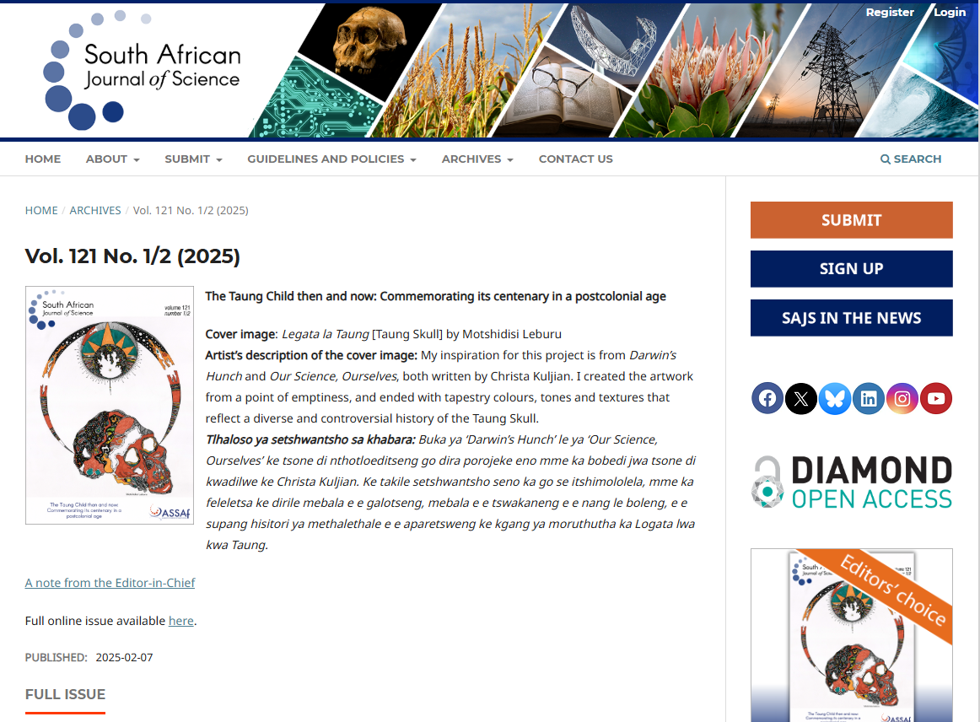

South African Journal of Science https://sajs.co.za/
120 years old (2024)
Full-text available as pdf, epub, xml
Research articles peer review history
Research articles abstracts in Setswana
AI and LLM policy
Inclusive language policy
Manuscript structure and templates
Editorial Team, Associate Editors, Associate Editor Mentees, Editorial Advisory Board
Reporting to editorial board

Slide 12
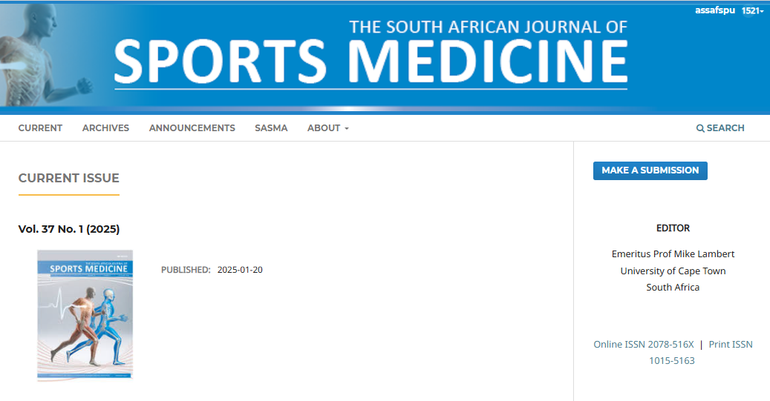
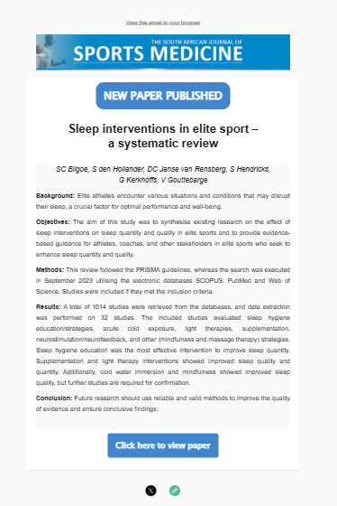
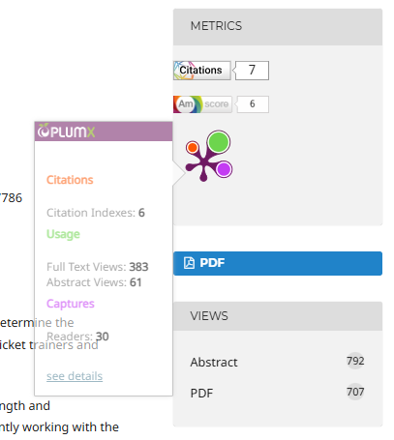
South African Journal of Sports Medicine https://journals.assaf.org.za/index.php/sajsm
Rolling article publishing model
Mailchimp to announce publication of a new article (and other 3rd party tools)
Alternative metrics
Altmetric.com
PlumX
OJS generated

Slide 13
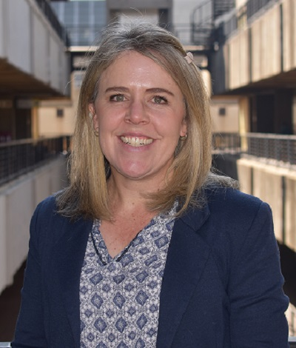
Clean Air Journal (CAJ) - Prof Kristy Langerman, 7 February 2025
"Perhaps the best part of being part of Khulisa Journals is the support from ASSAf. They make sure our publishing standards stay current, and they are unfailingly helpful, enthusiastic and innovative in the support they provide to journals."

Slide 14

South African Journal of Sports Medicine (SAJSM) - Prof Mike Lambert (Editor), 11 June 2024
"Our journal is doing so well. It would not be so if we did not get all the support from ASSAf."

Slide 15

Tydskrif vir Letterkunde (TL) - Prof Jacomien van Niekerk, 11 February 2025
"Being part of the Khulisa platform has been a privilege. They assisted us in making the transition to an online-only journal, and for many years now their excellent support have made our peer review and publishing processes far more efficient than before. We could never have done it without them!"

Slide 16
Next ….
Marketing video, flyer
Add more quality indigenous OA SA scholarly journals to platform
Create checklist for journals to evaluate themselves
Science engagement/communication https://notebooklm.google/
Depositing article metadata with DOAJ (for indexing by openAlex)
Generate JATS XML version for each published research article
Upgrade to OJS 3.5
Acknowledge work by individuals: Reviewer Credits, Publons, CPDs, ORCiD
Contingency planning (use Publisher Library for Agreements, Reports, etc)
Outstanding bug fixes, and many more
https://www.youtube.com/watch?v=oCBw2TciG3Y
https://info.orcid.org/documentation/workflows/peer-review-workflow/
Notes:
CC BY, or Creative Commons Attribution, is a license that allows others to share, use, and build upon a work, even commercially, as long as they credit the original creator.

Slide 17
Thank you
ina@assaf.org.za
Visit https://journals.assaf.org.za/
Visit scholpubtalk Google Group and request to join the group.

