Slide 1
Journal management - configuration of Open Journal Systems installation
LIBSENSE Workshop 8 March 2021
Lena Nyahodza
UCT Libraries
Scholarly Communication & Publishing
lena.nyahodza@uct.ac.za

Slide 2
Overview
About Open Journal Systems (OJS) & benefits
Configuration of your OJS installation – journal manager
  OJS navigation interface/dashboard
  Journal settings
  Website settings
  Workflow settings – configuration of editorial section
  The Distribution settings – visibility of your journal

Slide 3
About Open Journal Systems
Open source software – by Public Knowledge Project (PKP)
Highly flexible open source software
Customise to meet the needs of the publisher
Download for free and install on a local Web server- OJS 3 user guide provides server requirements
Single instance – support the operation of many journals
Managing and publishing scholarly articles online

Slide 4


About PKP Projects
Develops free, open source software and conducts research to improve the quality and reach of scholarly publishing.
Free Software?
Open Source?
Adopted from PKP

Slide 5
Benefits of OJS
Allows collaboration through multiple instances on a server
Automatically indexed in Google Scholar
Interoperates with third party systems – CrossRef, ORCID, DOAJ, etc.
Provides free preservation of OJS journals that meet a specific criteria through LOCKSS
Notes:
All journals can join the PKP PN provided they meet the following criteria: the journal must be running a compatible version of OJS, the journal must have an ISSN, and he journal must have published at least one article.

Slide 6
Benefits of OJS
Allows operational tasks such as: manuscript submissions, editorial & review process online
Provides an editorial history and tracks activities online
Email notifications of new tasks
Publishes content online in different formats

Slide 7
The role of a journal manager
Installation of OJS infrastructure starts with IT support as they download and install the software
The installation continues – journal manager’s role
  creates the journal
  works on the configuration/population of the journal
  journal manager support customisation of the journal
  support editorial process and trouble shooting

Slide 8
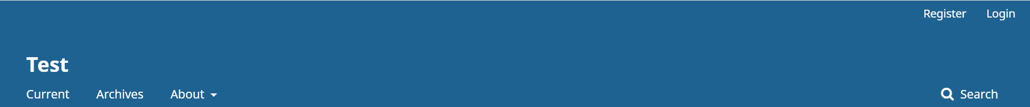
Establishing a new journal

Slide 9
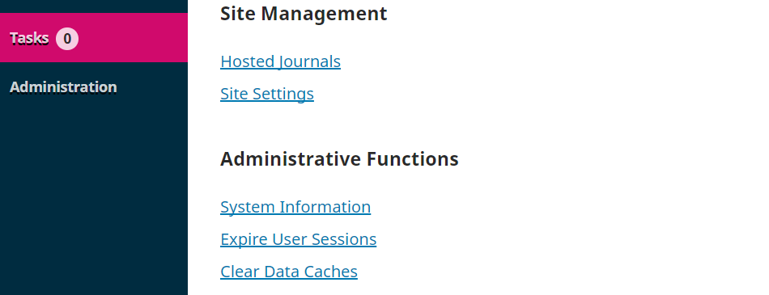
Establishing a new journal
Initial stage: new journal

Slide 10
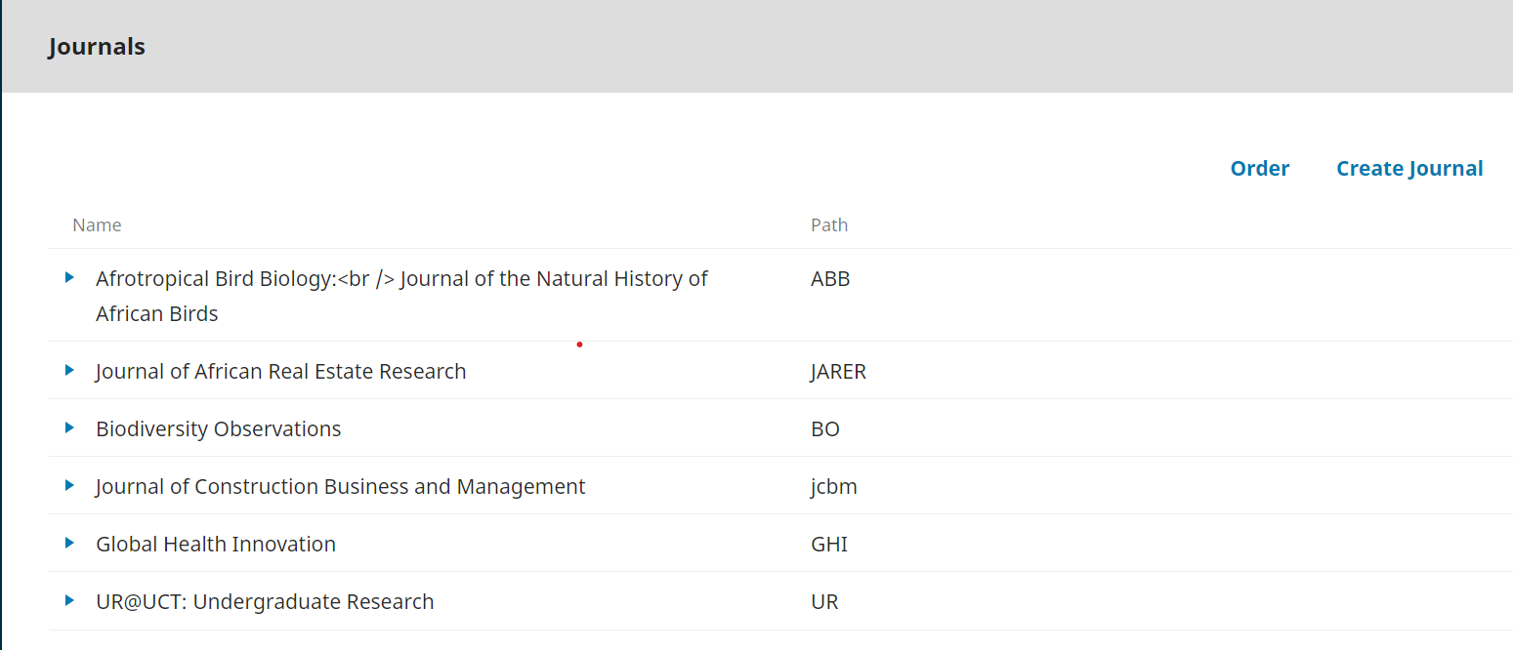
Establishing a new journal
A list of your journals & their short name will appear here

Slide 11
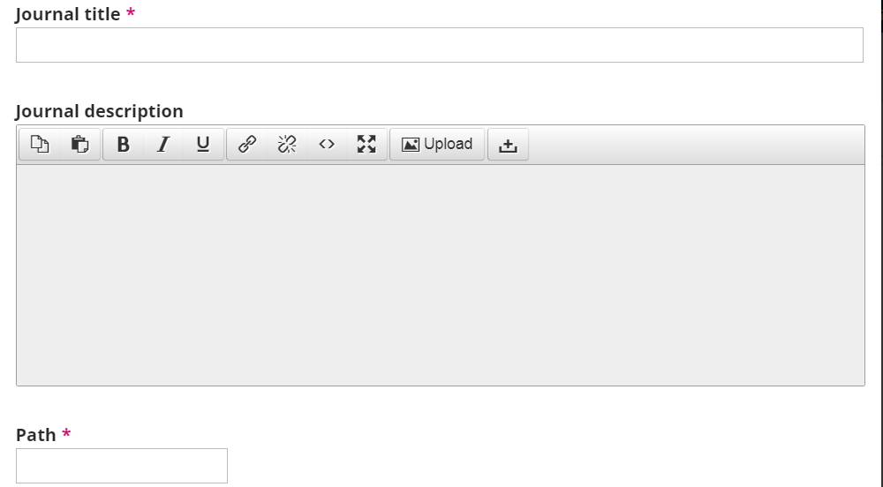
Establishing a new journal
Abbreviation of Journal

Slide 12
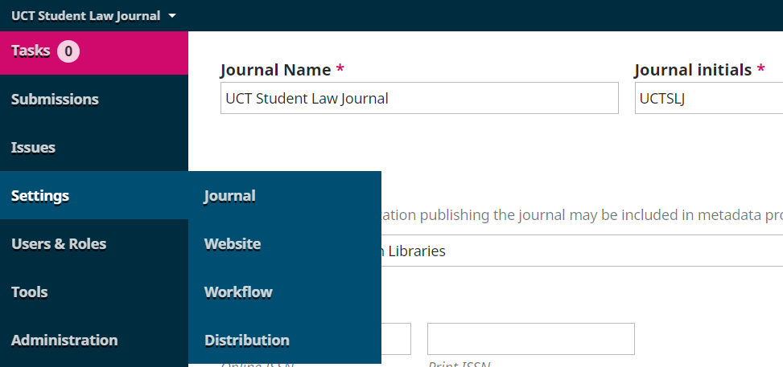
OJS navigation interface/dashboard

Slide 13
Journal setting
Journal setting gives journal managers access to:
Masthead
Contact
Sections
Categories

Slide 14
Website setting
Appearance
Information
Archiving
Languages
Plugins – add a specific feature
Announcements
Navigation Menus
Notes:
A plug in or add-in or add-on is a software component that adds a specific feature to an existing computer program, and this allows customisation

Slide 15
Workflow settings
Components – items to be submitted
Submission – guidelines and privacy statement
Review – guidelines for reviewers
Publisher Library – documents for the publishing team
Emails – activation of auto-emails

Slide 16
Distribution settings
Indexing – relating to search engines
Access – security-related options
Payments – (applies to gold and subscription journals)
Permissions – licenses and self-archiving specifications

Slide 17
Invitation to publish – continental platform
UCT libraries would like to invite academic libraries to publish scholarly output on the continental platform:
Open to any African academic institutions
Technical support is provided by the University of Cape Town for OJS and OMP (catalogue available here)
Training is provided to academics libraries, journal managers and editors by UCT Libraries
Access more news on the continental platform

Slide 18
Thank you

