Slide 1
EIFL/CARLIGH webinar for
IR Librarians
Attribution 4.0 International

Slide 2
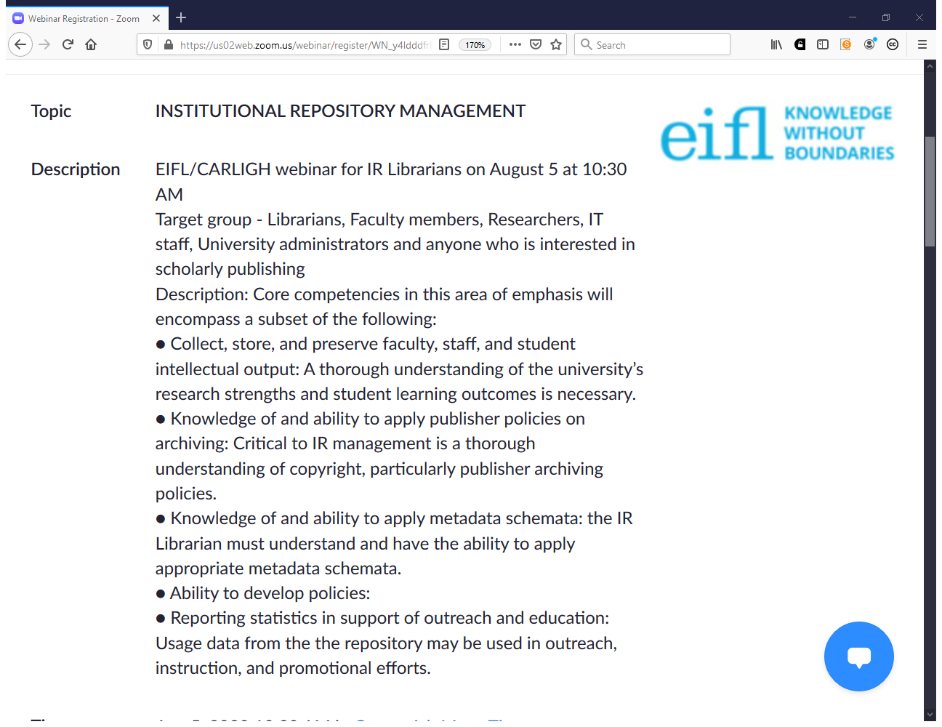

Slide 3
Repository Manager

Slide 4
Ability to
Manage the repository service by identifying goals and future strategies for improvement in the repository service
Develop a repository content policy and workflows to manage the capture, description and preservation etc. of repository outputs
Manage the day-to-day running of the repository including any mediated-deposit service (if required or possible) or self-archiving by authors

Slide 5
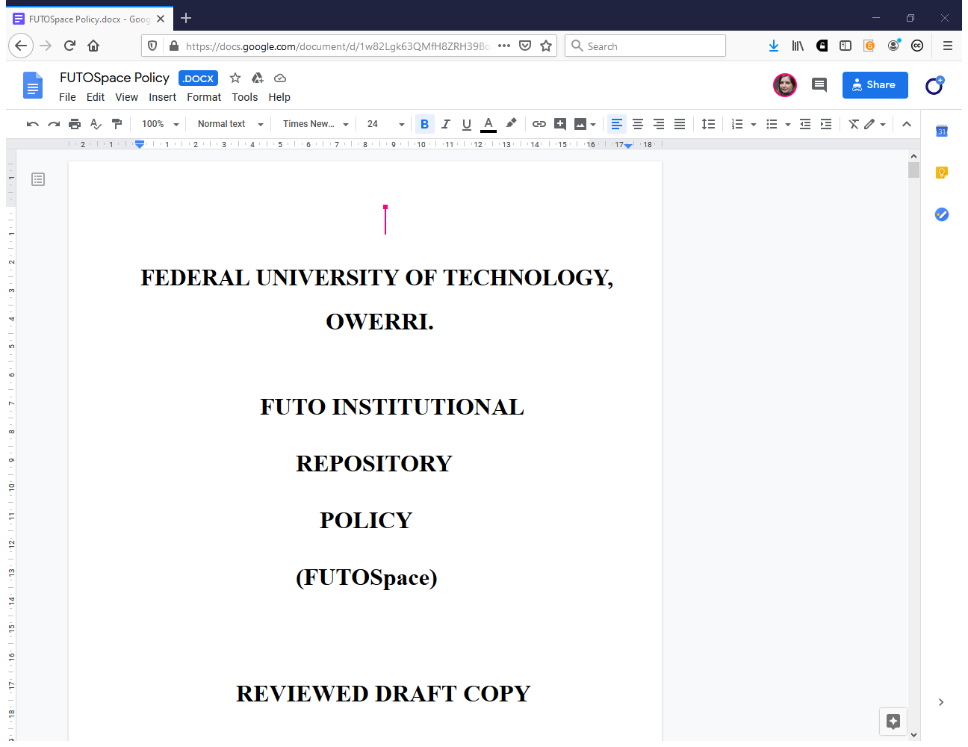

Slide 6
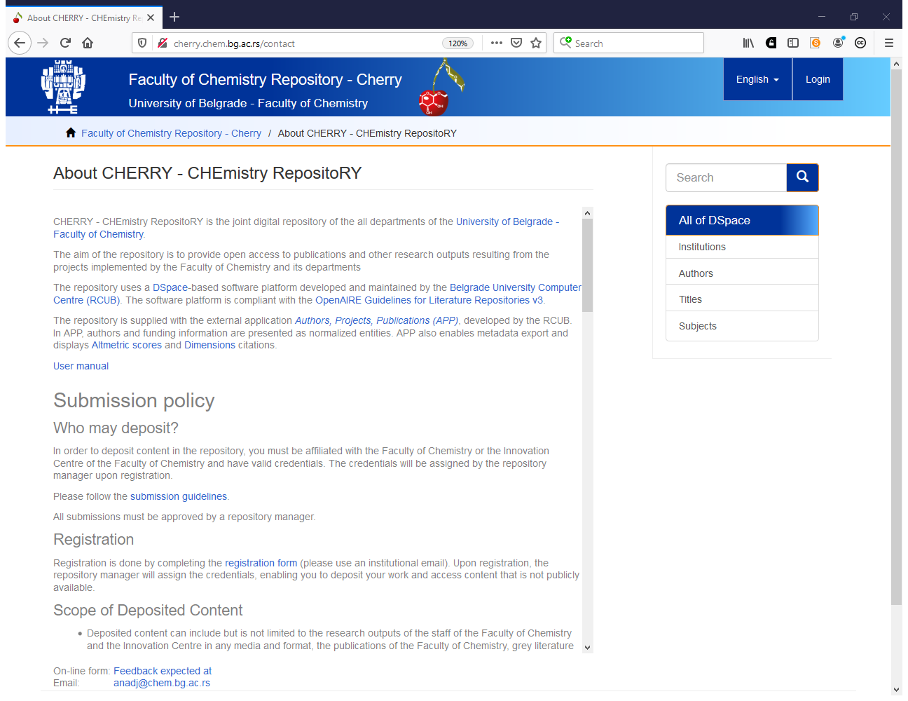
http://cherry.chem.bg.ac.rs/contact

Slide 7
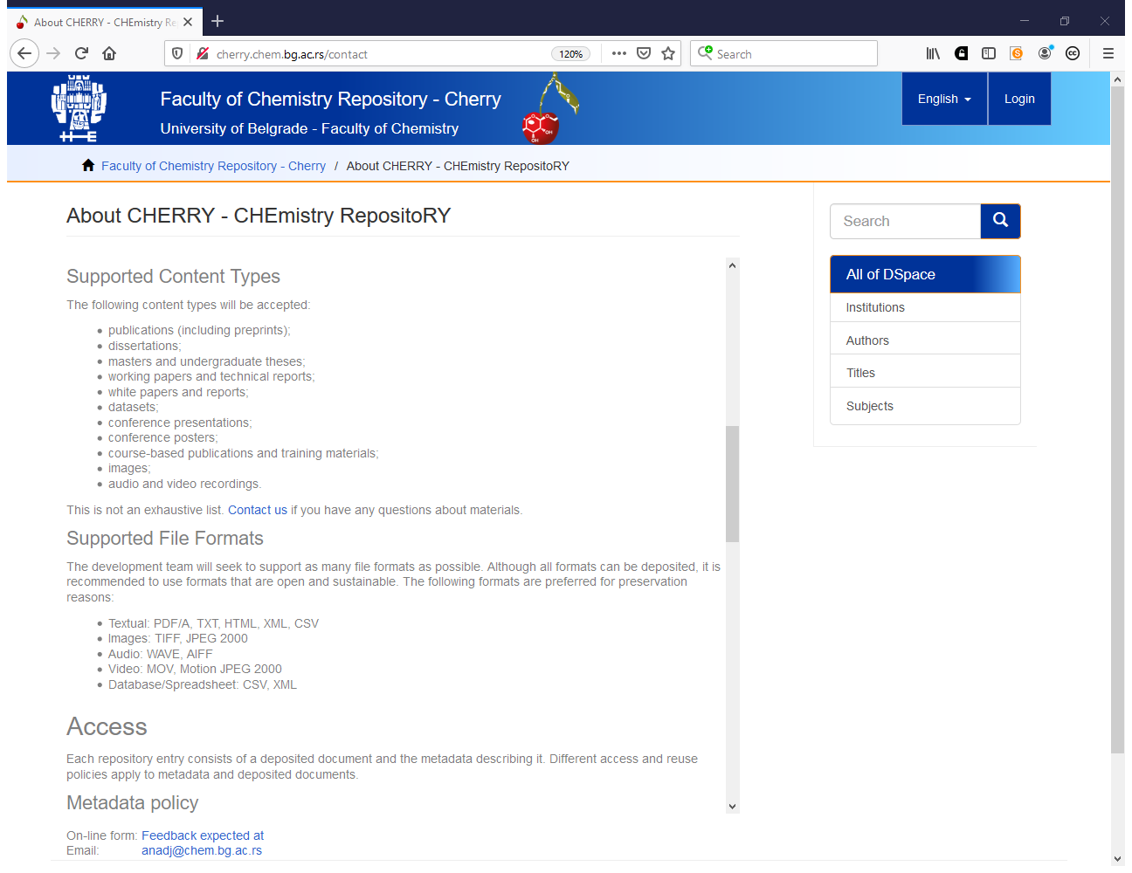

Slide 8
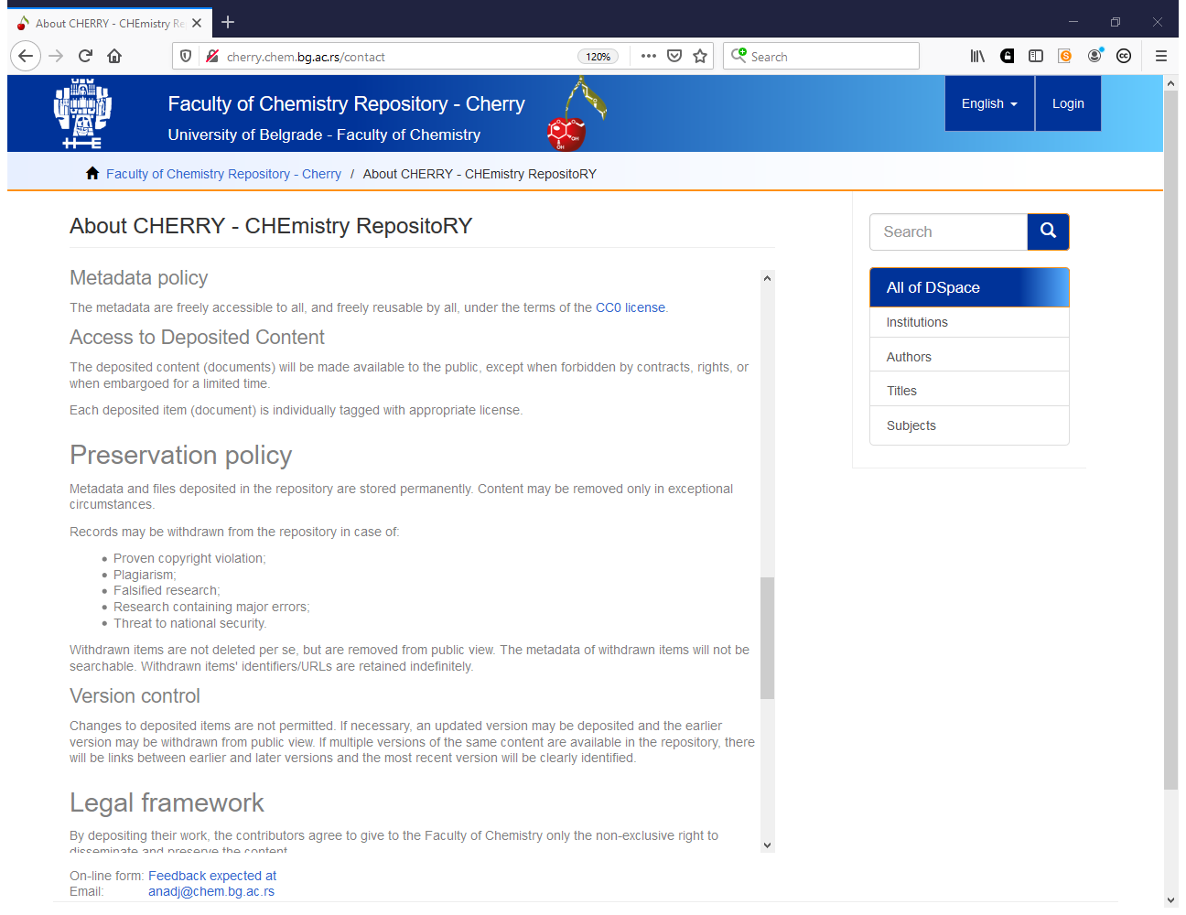

Slide 9
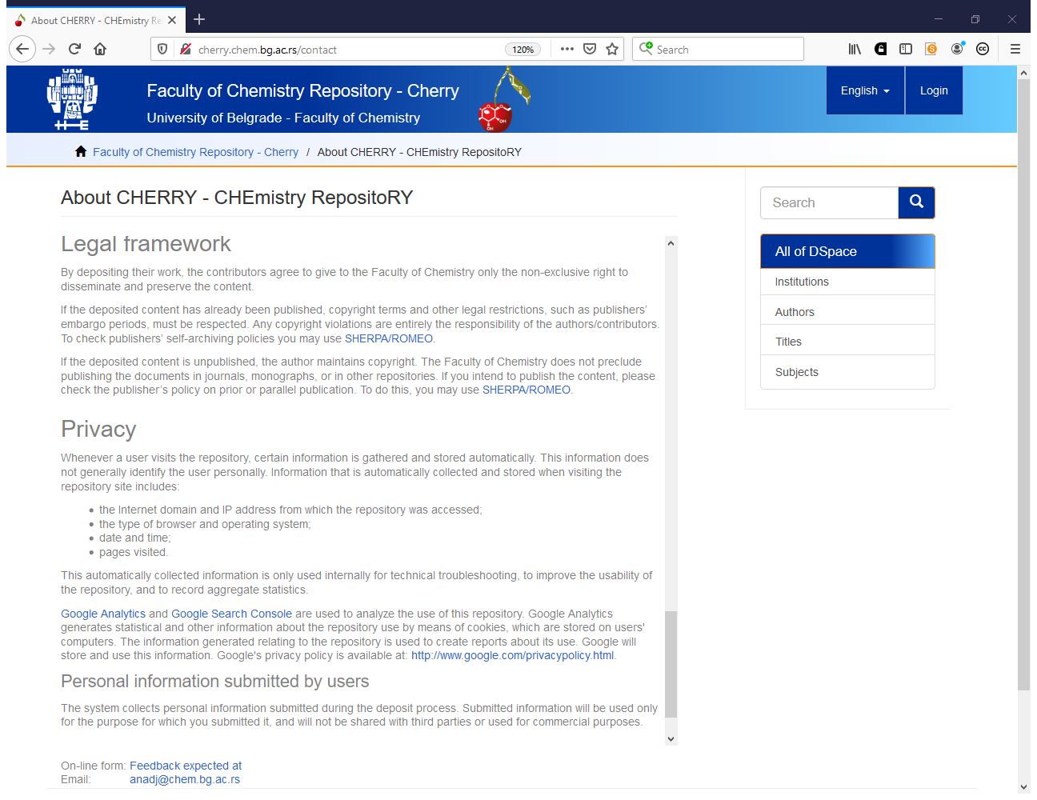

Slide 10
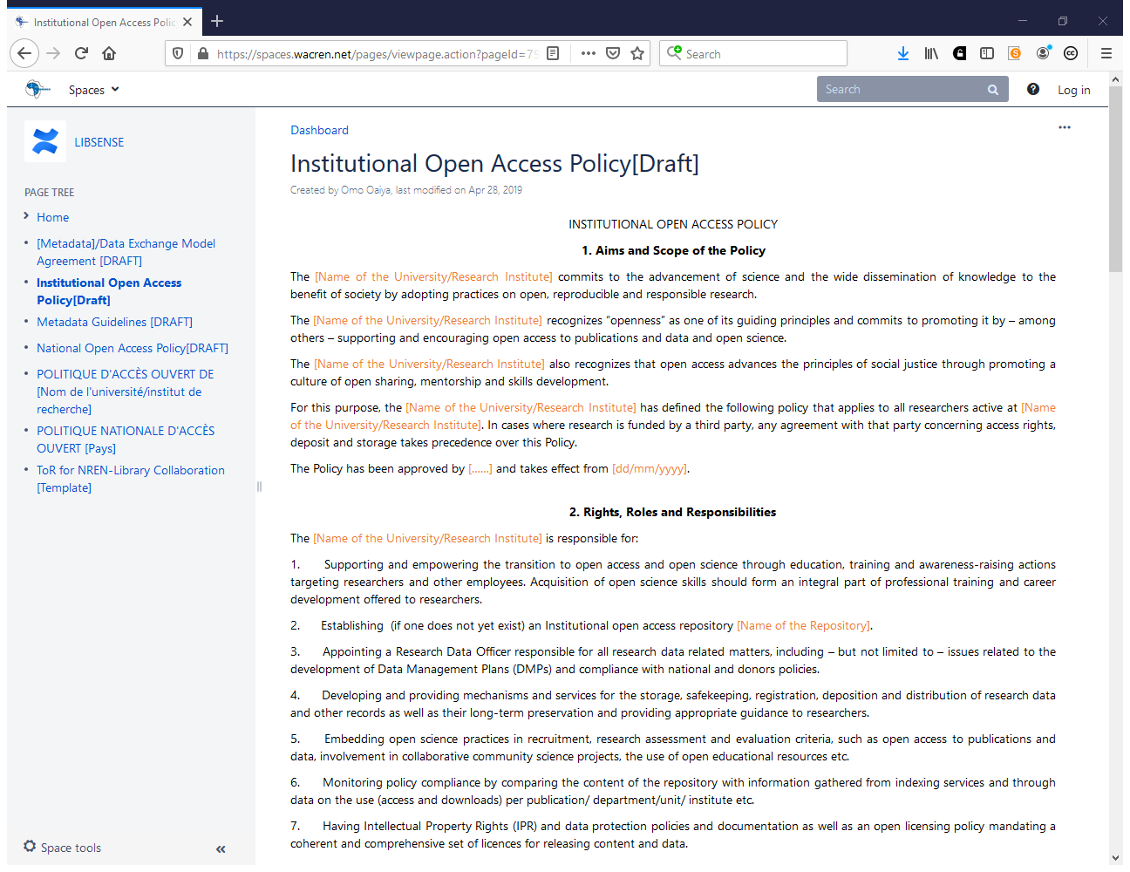
https://spaces.wacren.net/pages/viewpage.action?pageId=7929892

Slide 11
Who needs help with repository policies?

Slide 12
Ability to (2)
Coordinate and manage activities of repository personnel and coordinate repository development with associated departments
Increase the amount of items deposited in the repository by identifying suitable publications for deposit
Work with researchers on deposit of research outputs into the repository

Slide 13
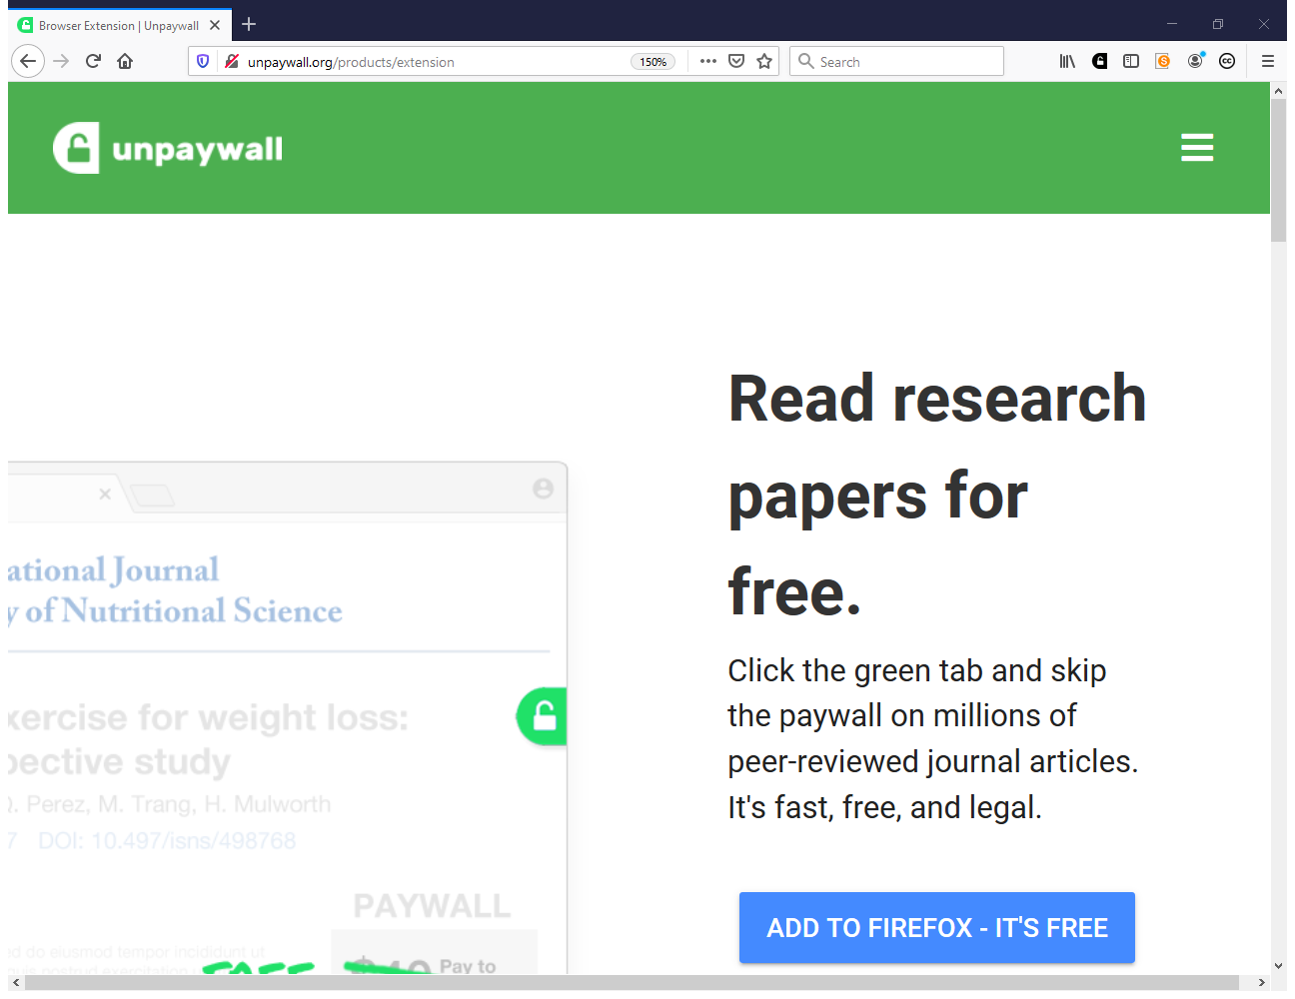
https://unpaywall.org

Slide 14
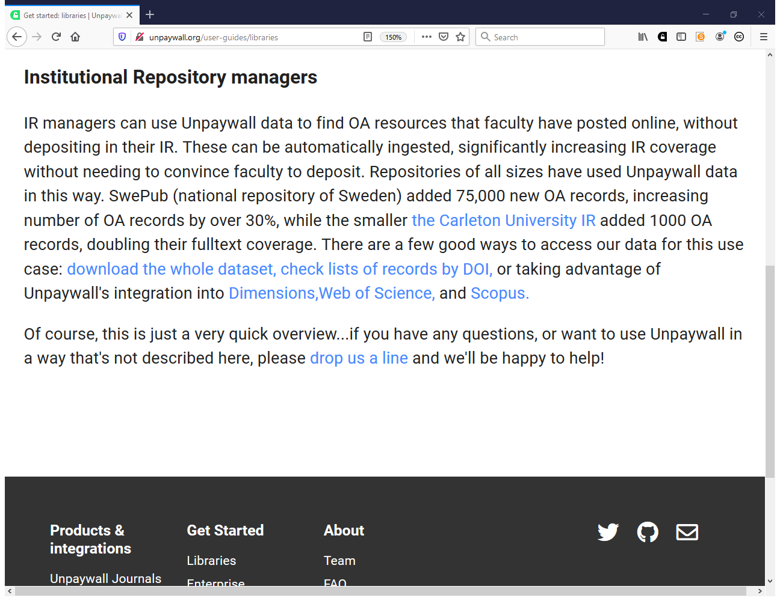
https://unpaywall.org/user-guides/libraries

Slide 15
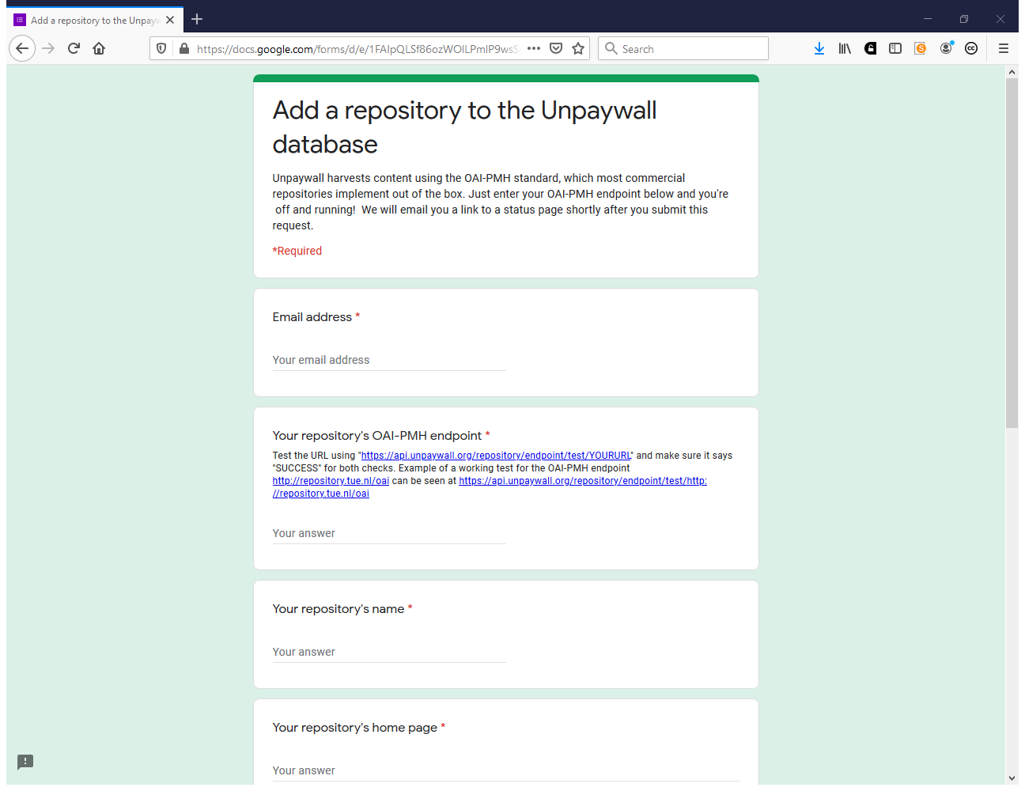
https://docs.google.com/forms/d/e/1FAIpQLSf86ozWOlLPmlP9wsSyL7LBdjn867ydLsbcEEAb_4wE1Ug2NQ/viewform
https://unpaywall.org/sources

Slide 16
How do you identify publications for deposit?

Slide 17
Ability to (3)
Liaise with publishers on issues relating to archiving policies including embargo periods
Monitor deposit, download and other usage indicators to identify the impact and success of the repository and areas for improvement in the service. Produce usage reports.
Manage user expectations to ensure that expected service delivery is achievable. Handle comments, complaints, relationships.

Slide 18
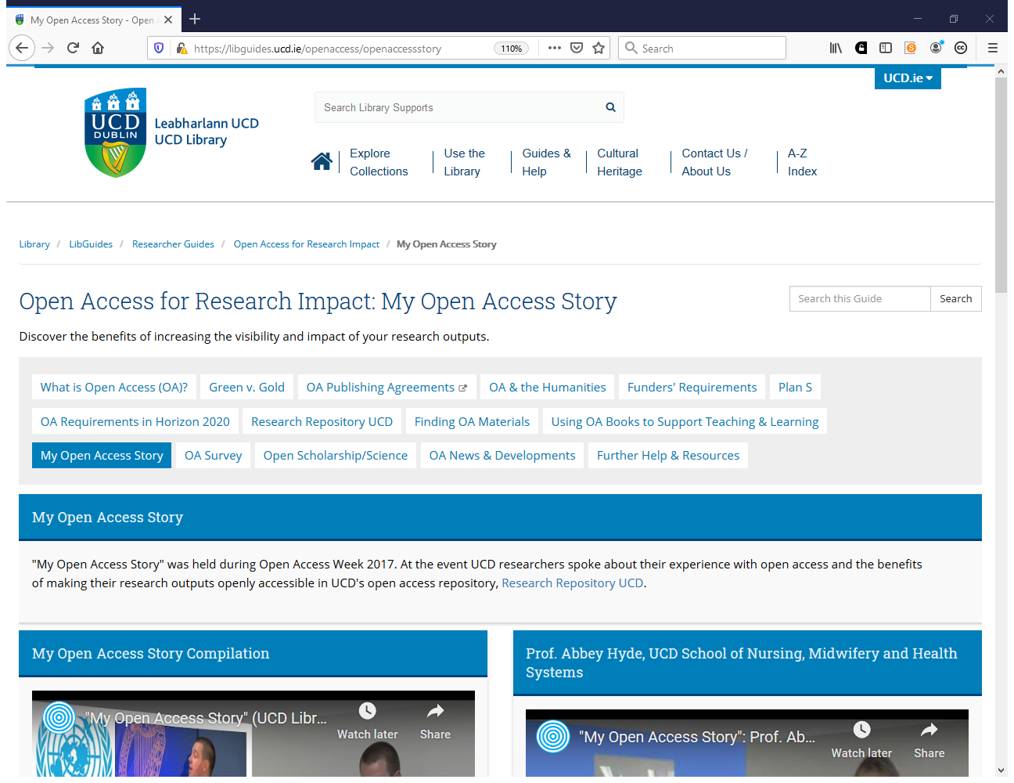
https://libguides.ucd.ie/openaccess/openaccessstory

Slide 19
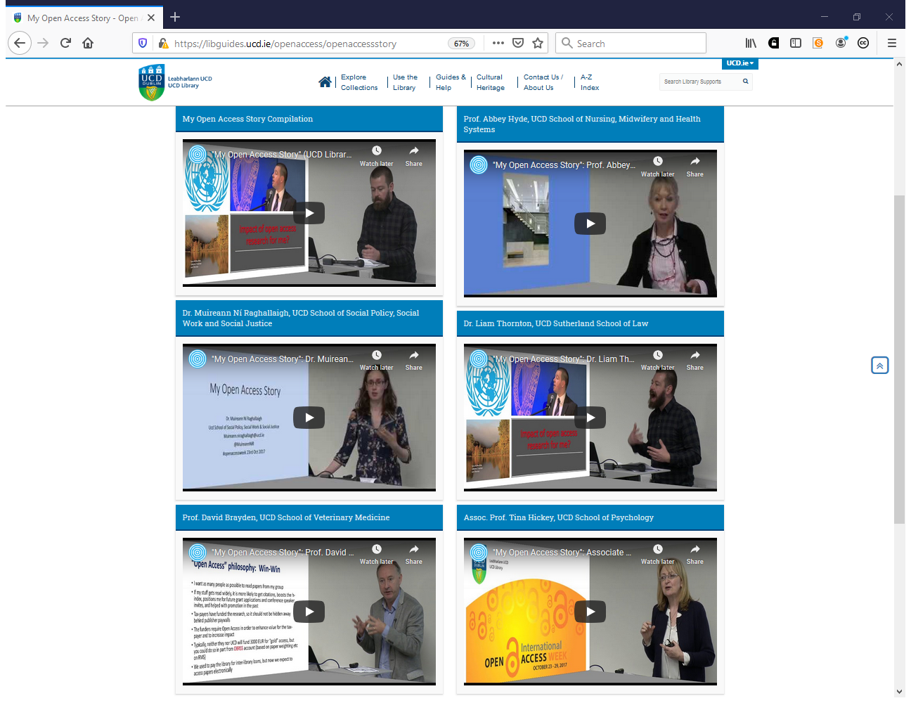
https://libguides.ucd.ie/openaccess/openaccessstory

Slide 20
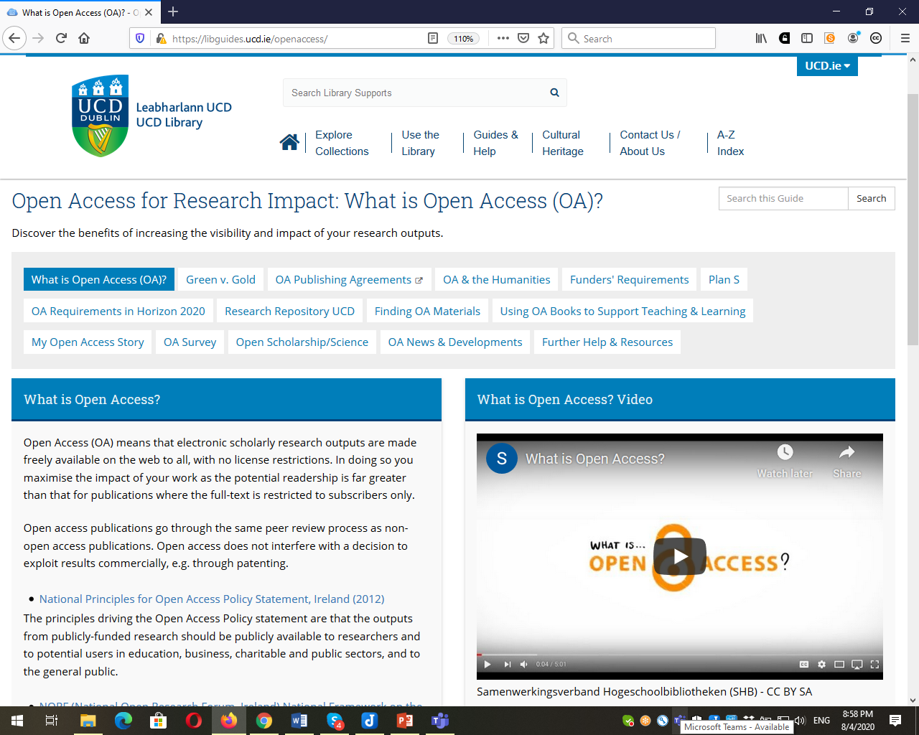
https://libguides.ucd.ie/openaccess

Slide 21
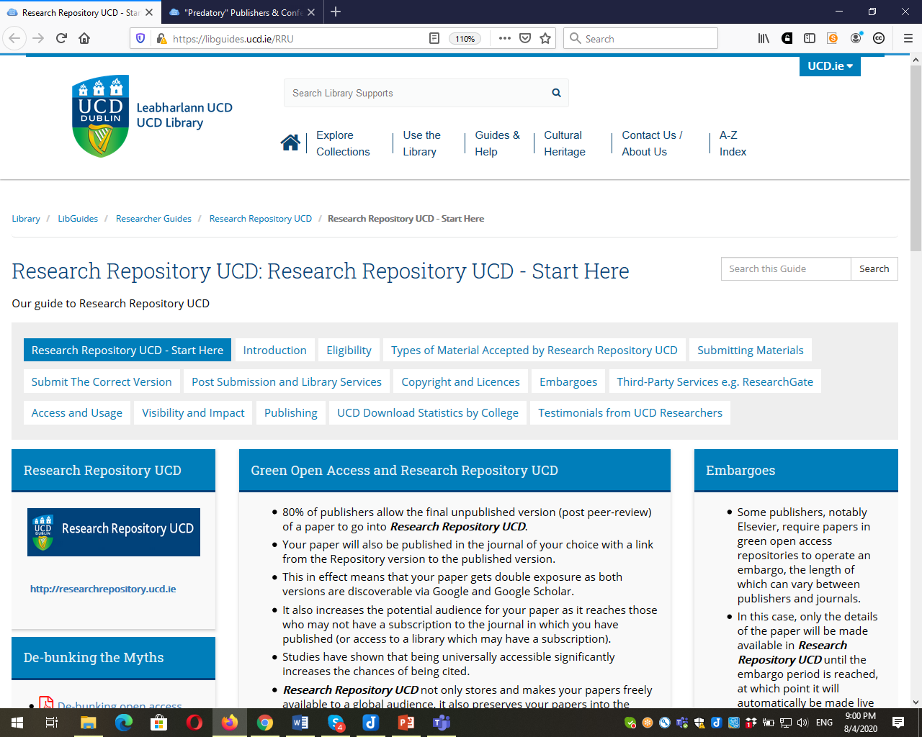
https://libguides.ucd.ie/RRU

Slide 22
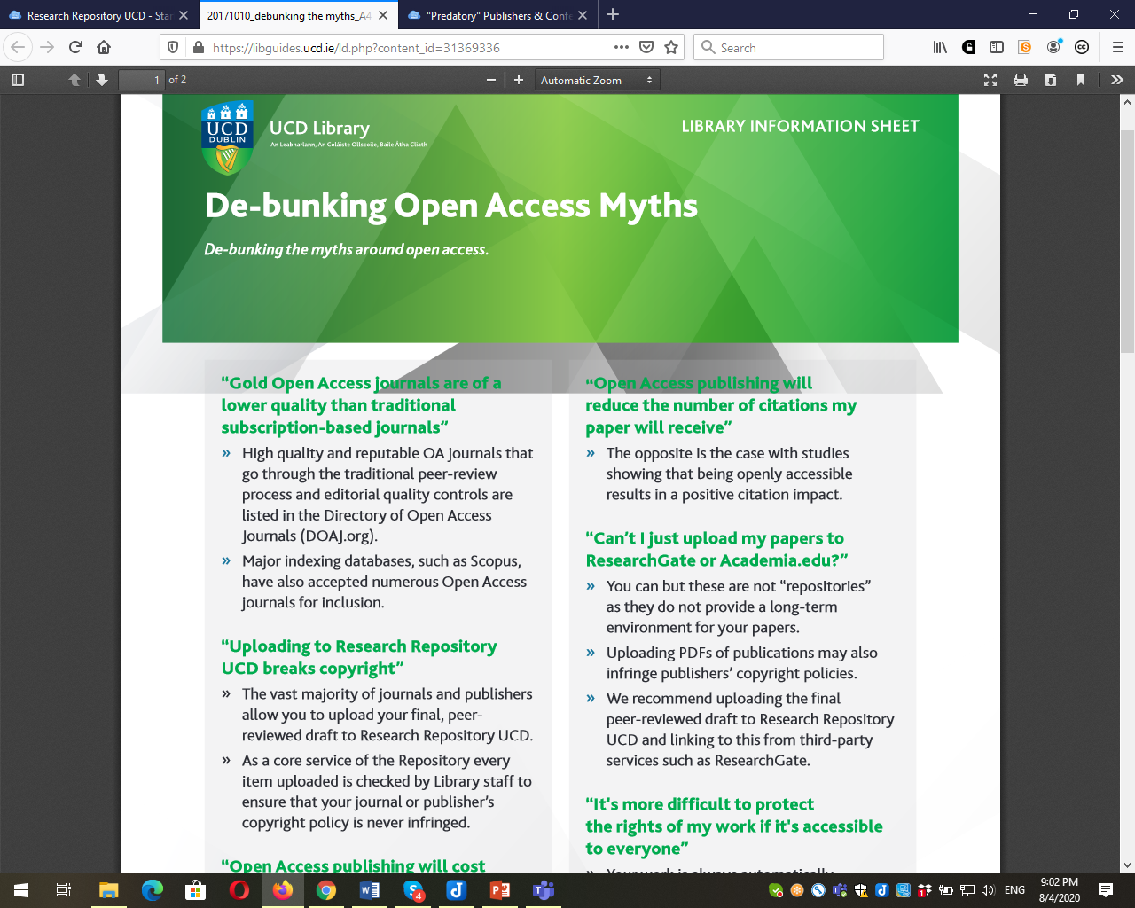
https://libguides.ucd.ie/ld.php?content_id=31369336

Slide 23
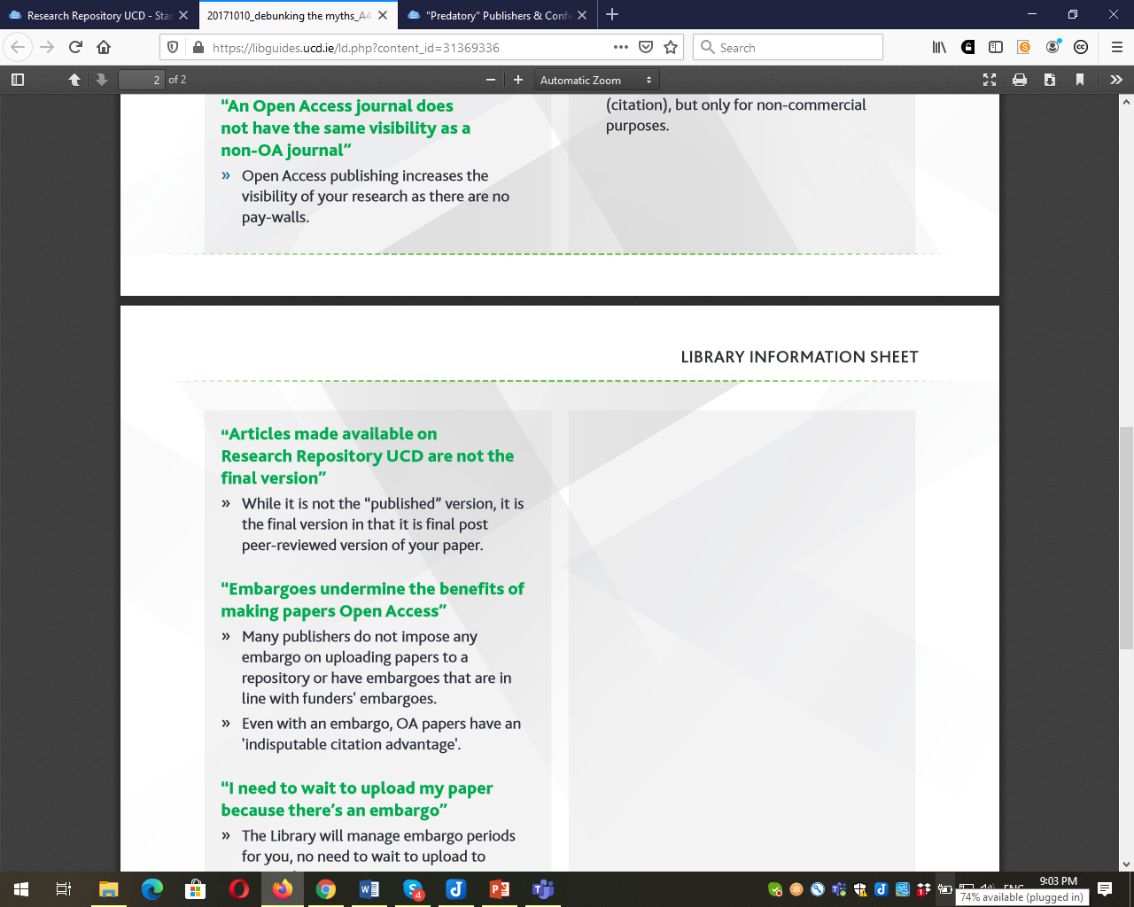

Slide 24
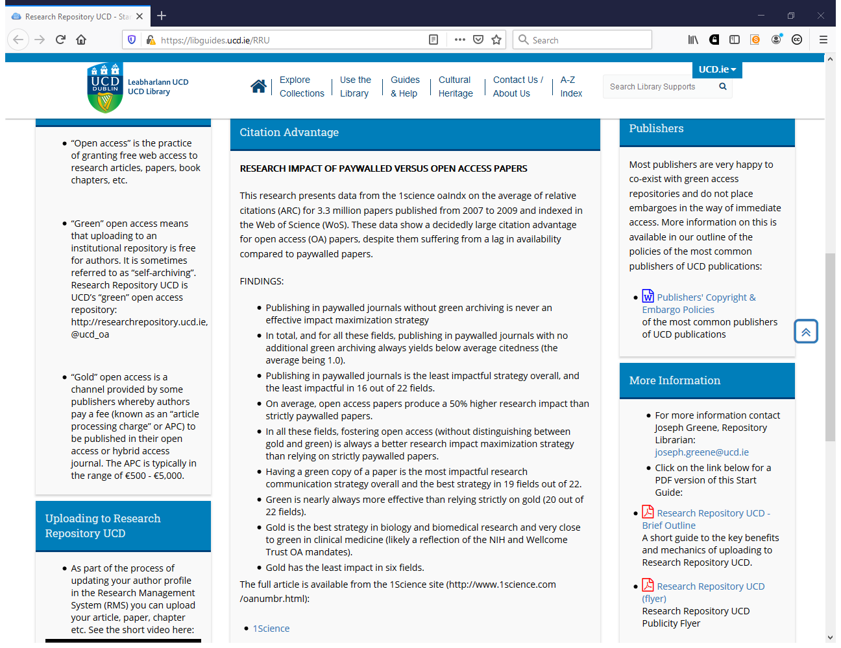

Slide 25
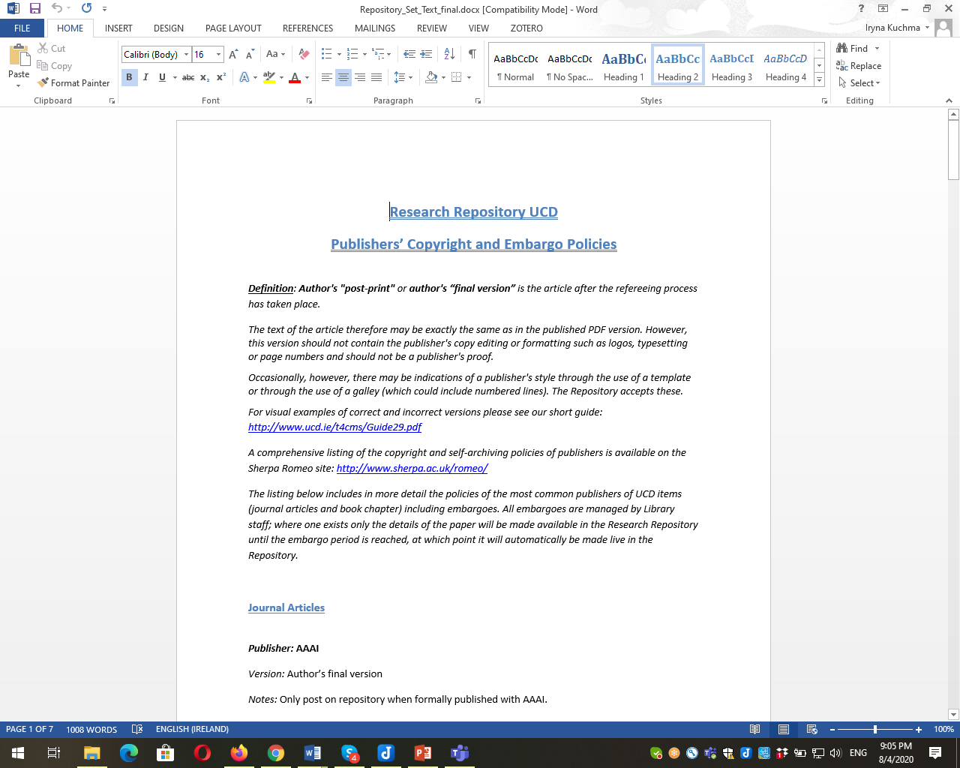

Slide 26
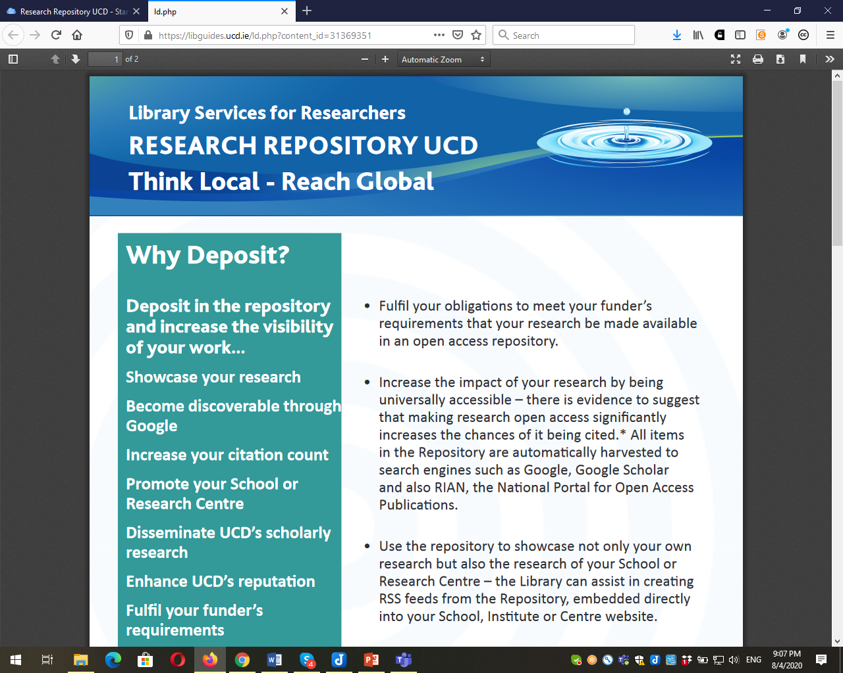

Slide 27
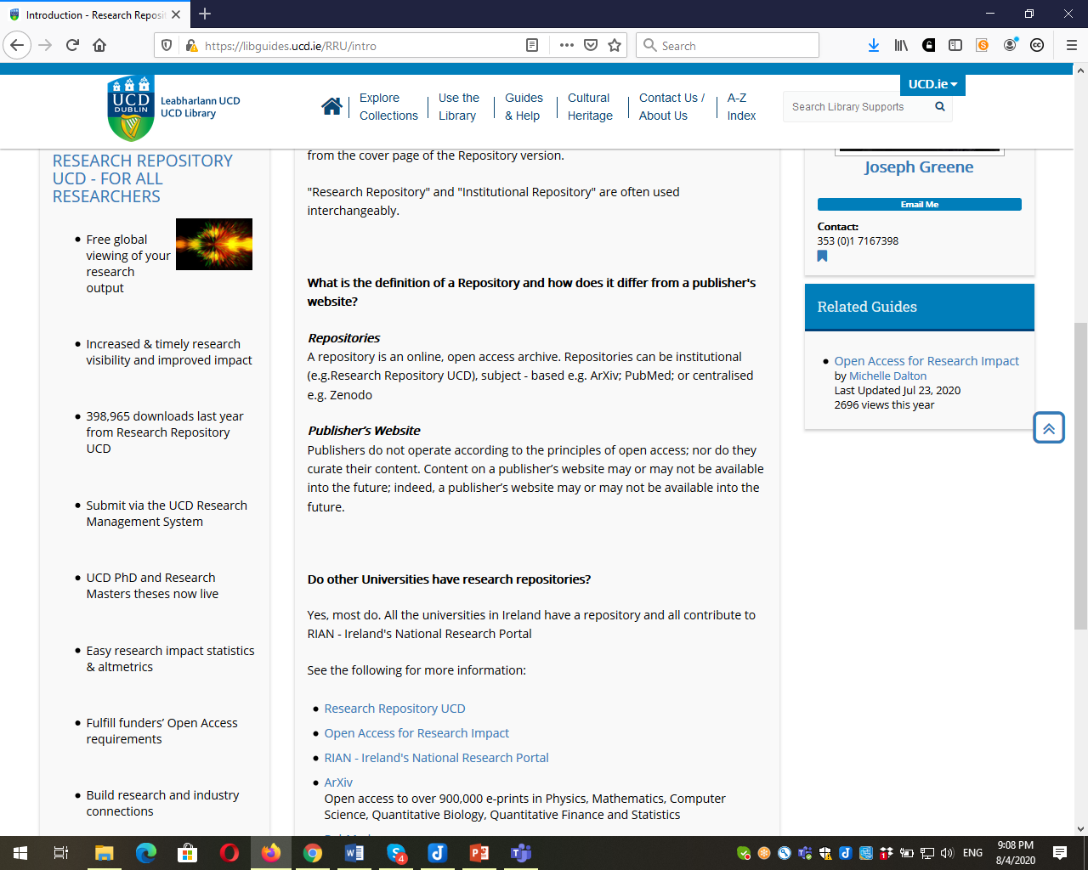
https://libguides.ucd.ie/RRU/intro

Slide 28
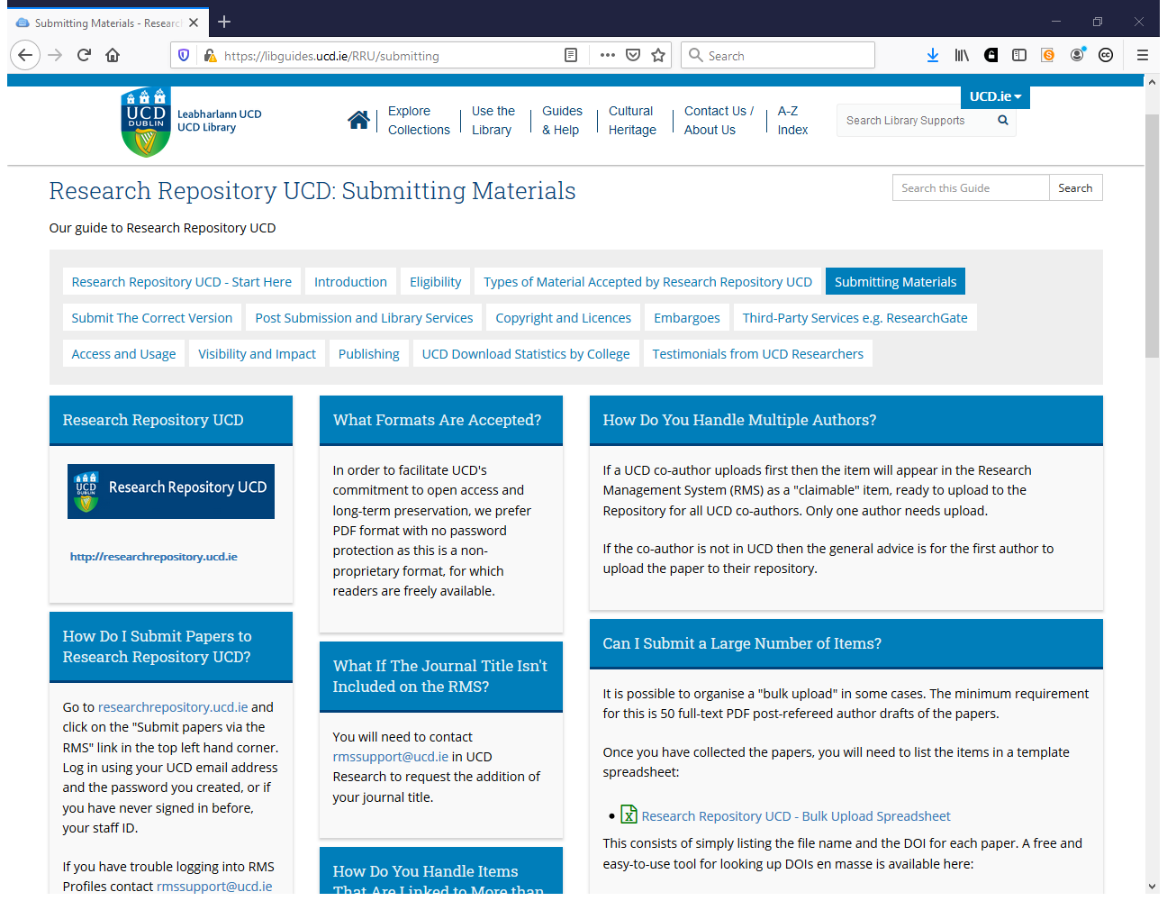
https://libguides.ucd.ie/RRU/submitting

Slide 29
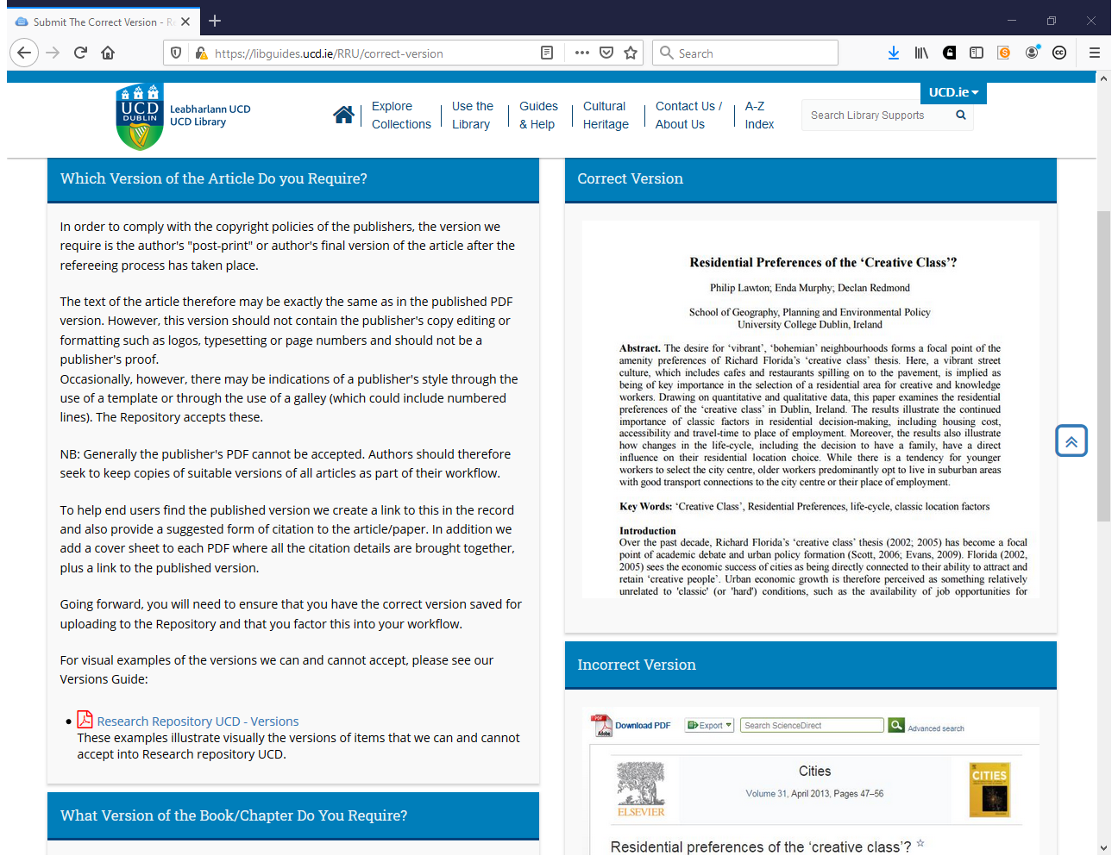
https://libguides.ucd.ie/RRU/correct-version

Slide 30
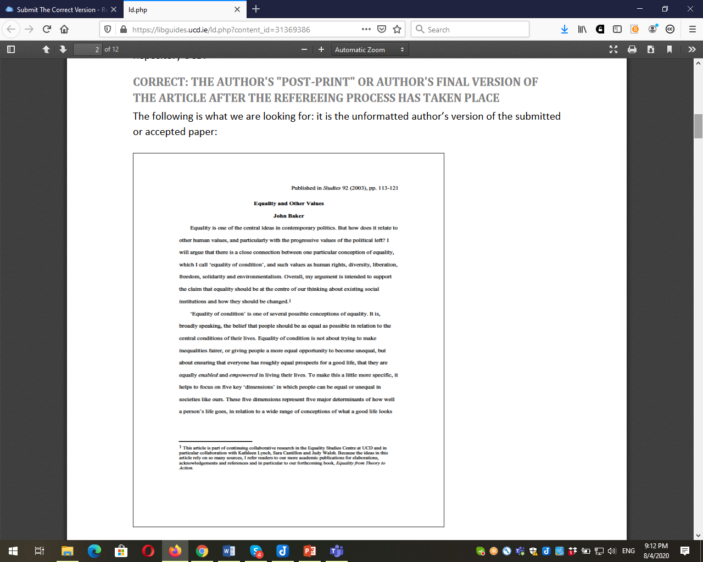

Slide 31
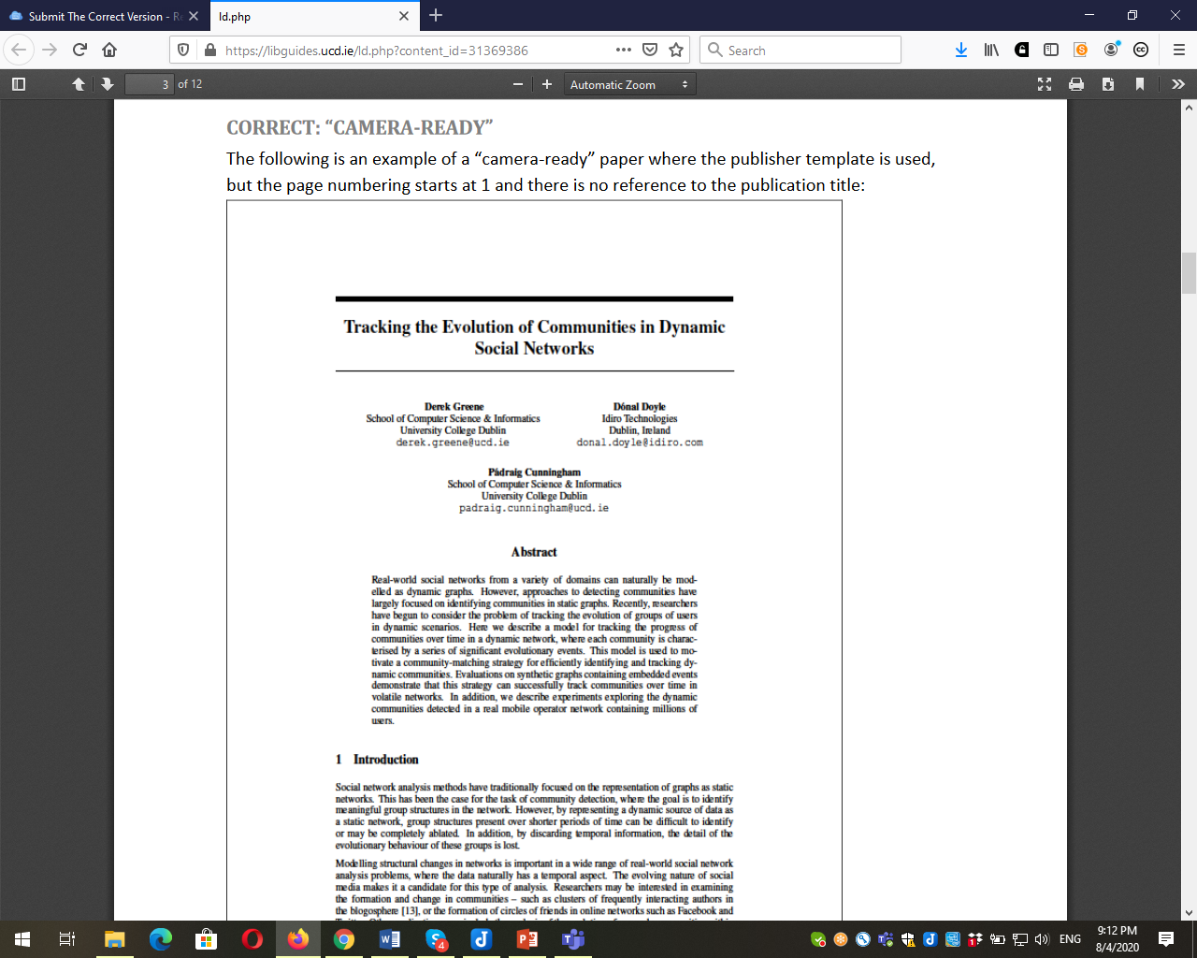

Slide 32
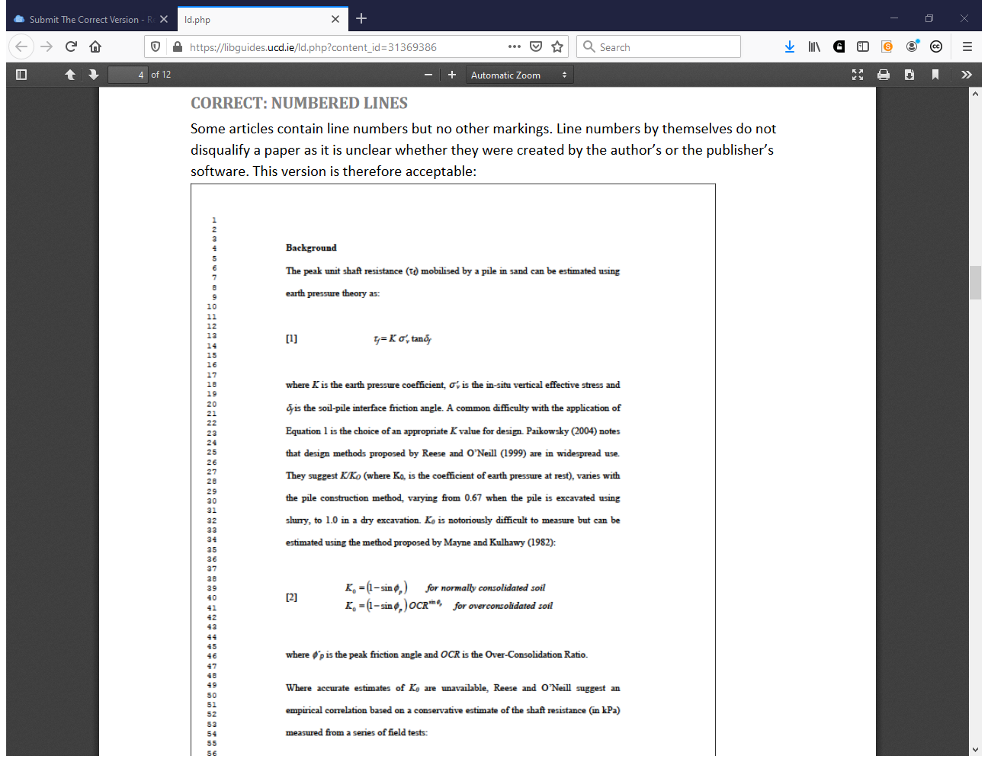

Slide 33
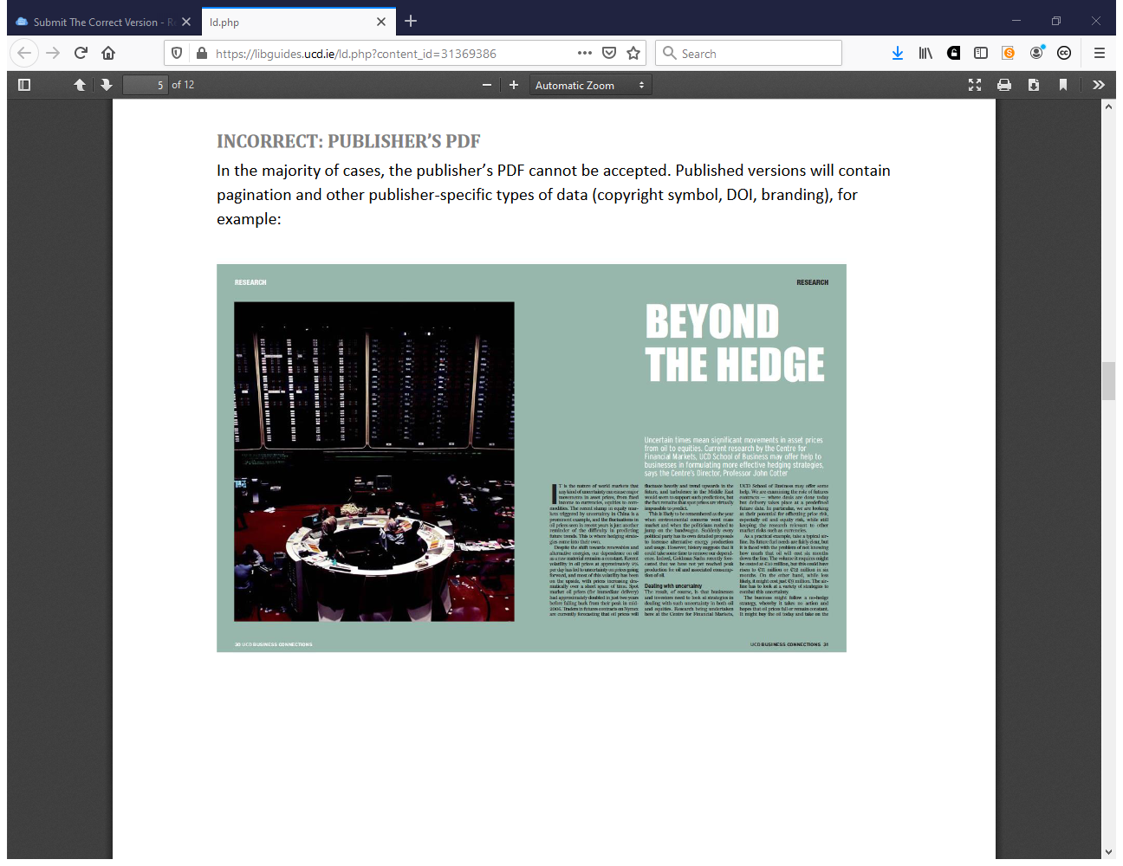

Slide 34
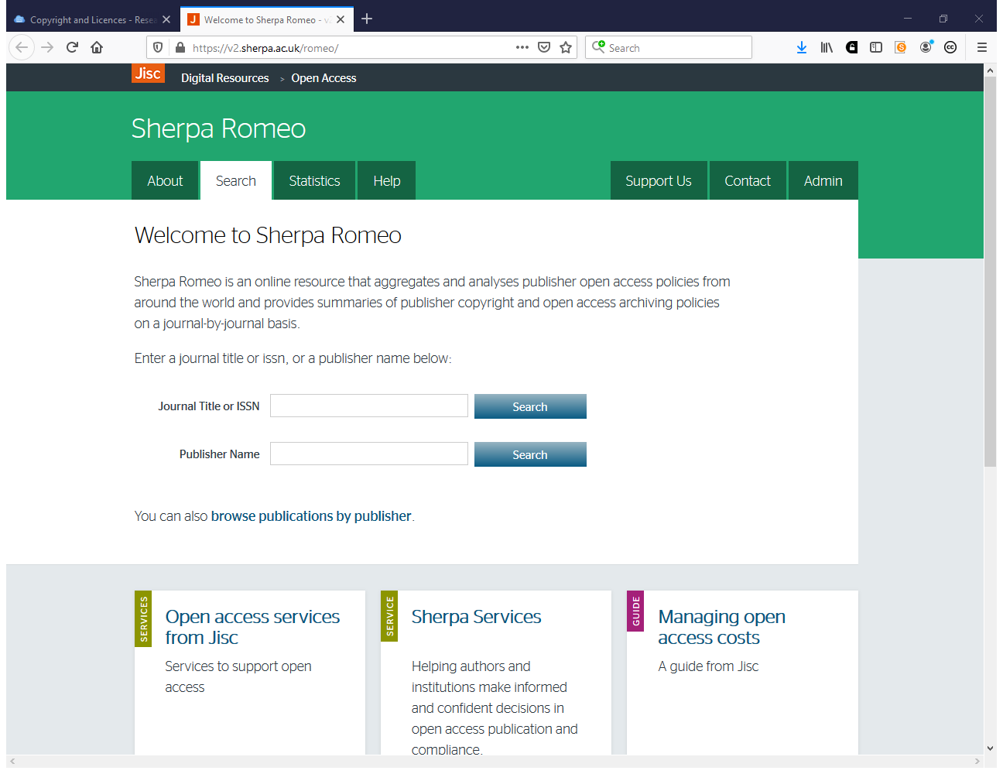
https://v2.sherpa.ac.uk/romeo/

Slide 35
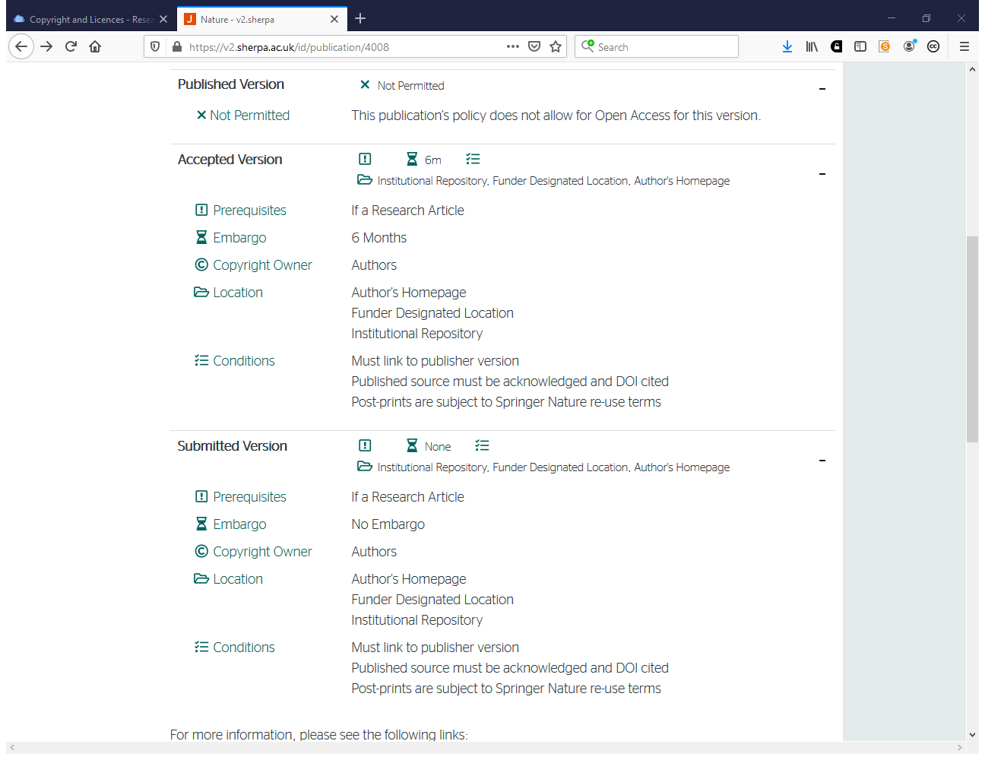

Slide 36
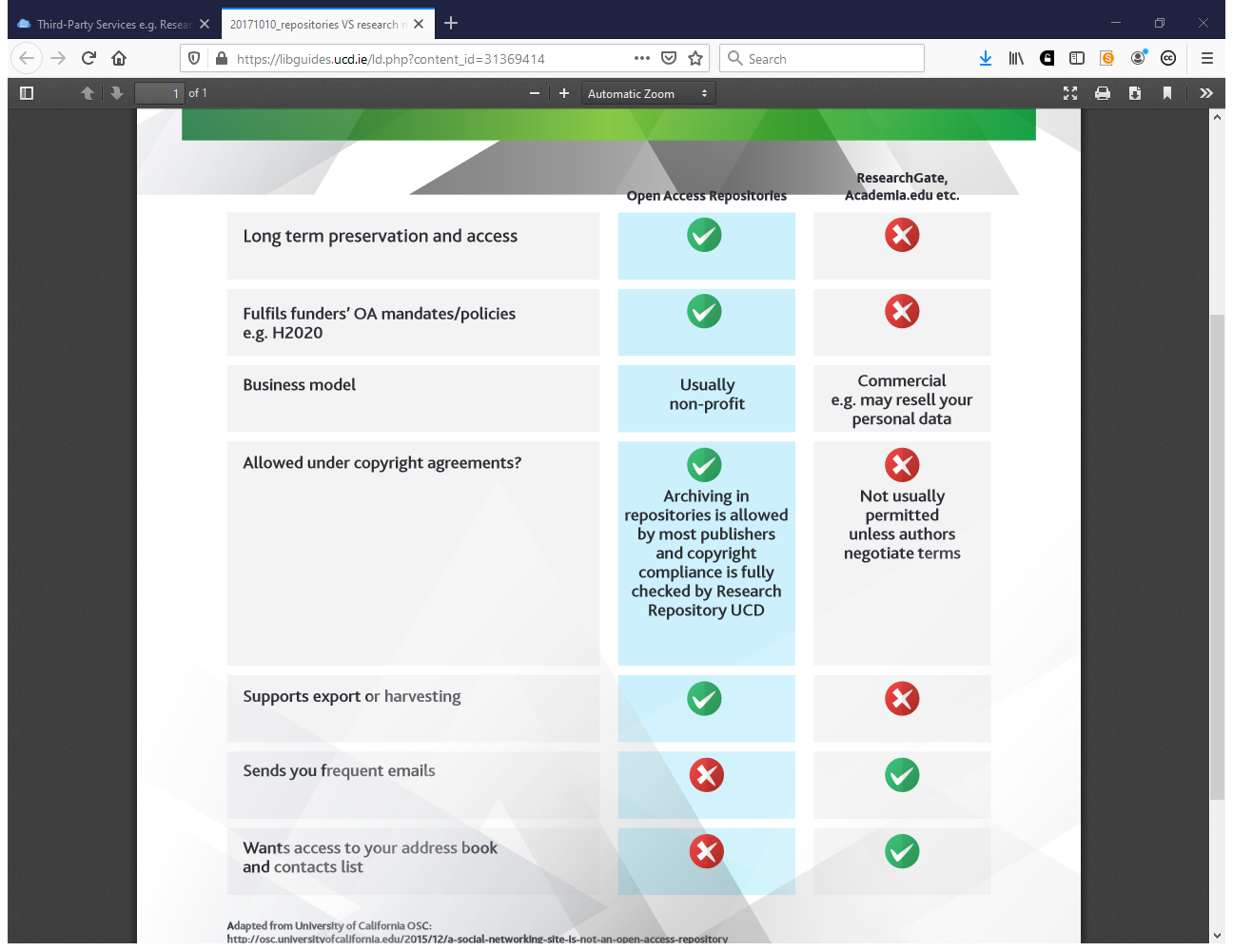

Slide 37
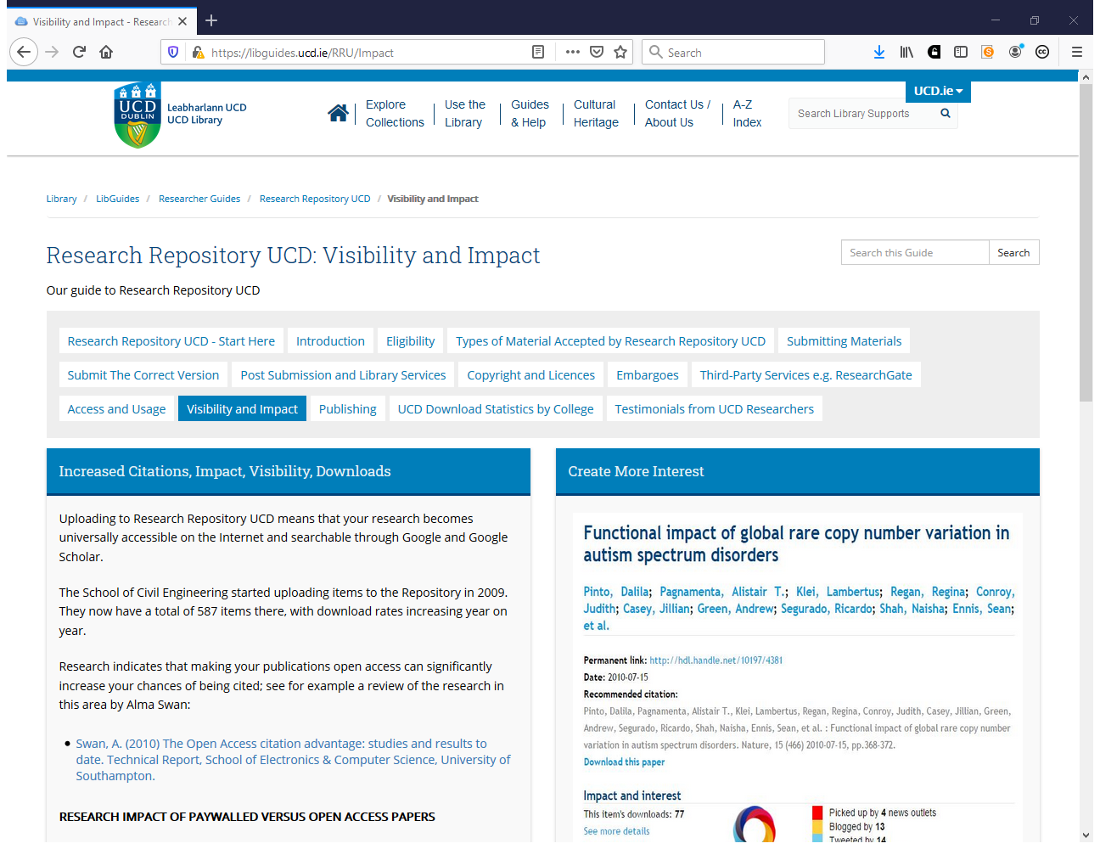
https://libguides.ucd.ie/RRU/Impact

Slide 38
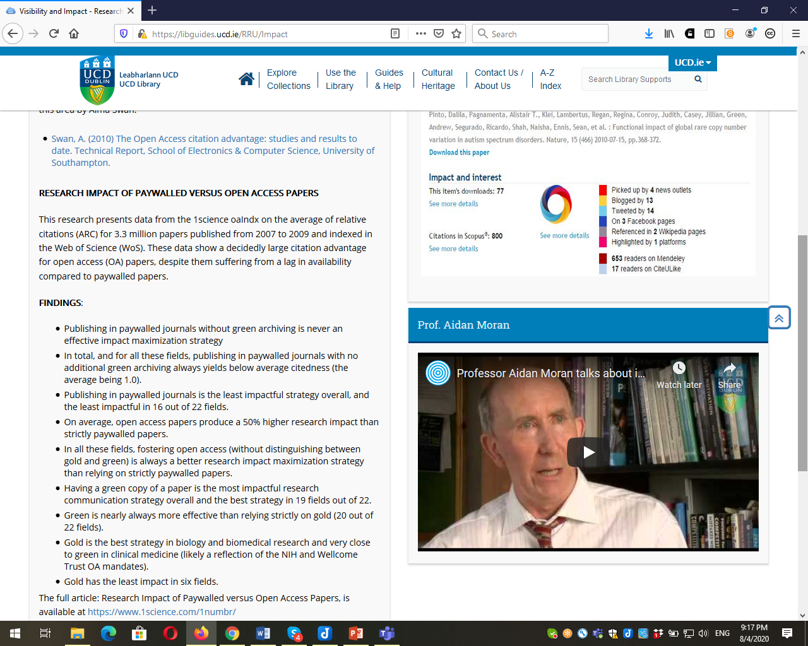

Slide 39
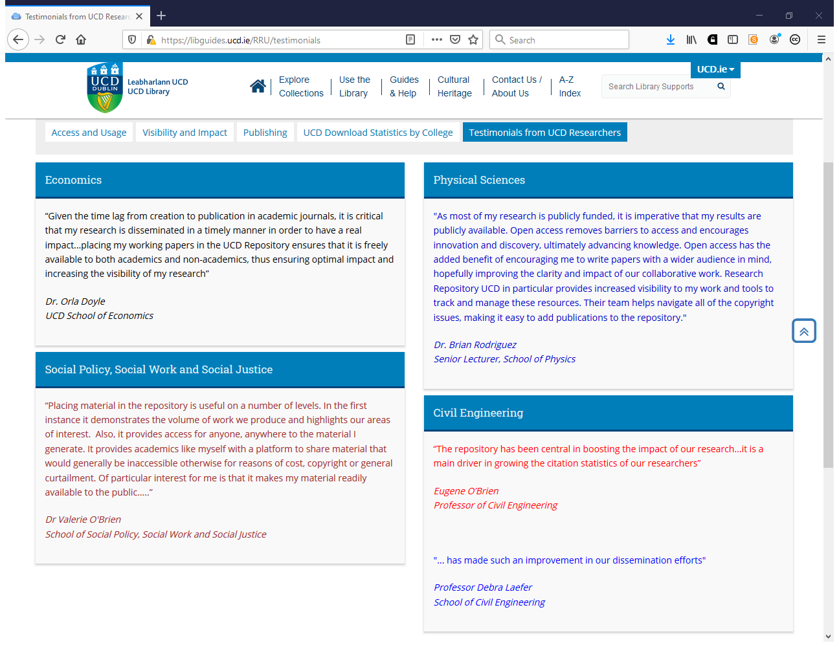
https://libguides.ucd.ie/RRU/testimonials

Slide 40
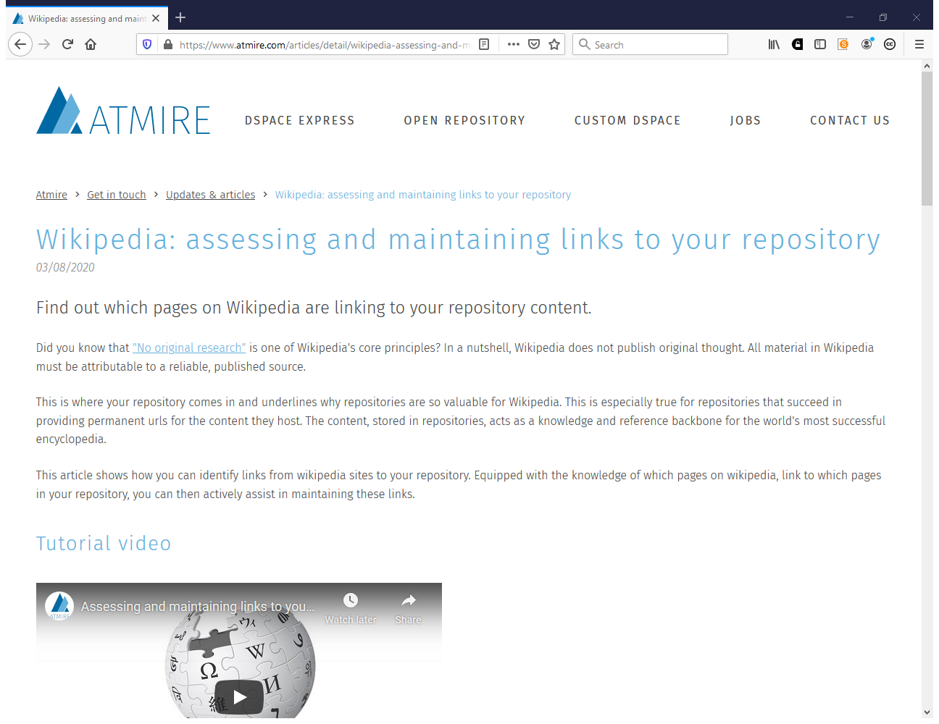
https://www.atmire.com/articles/detail/wikipedia-assessing-and-maintaining-links-to-your-repository?utm_source=twitter&utm_medium=social&utm_campaign=wikipedia

Slide 41
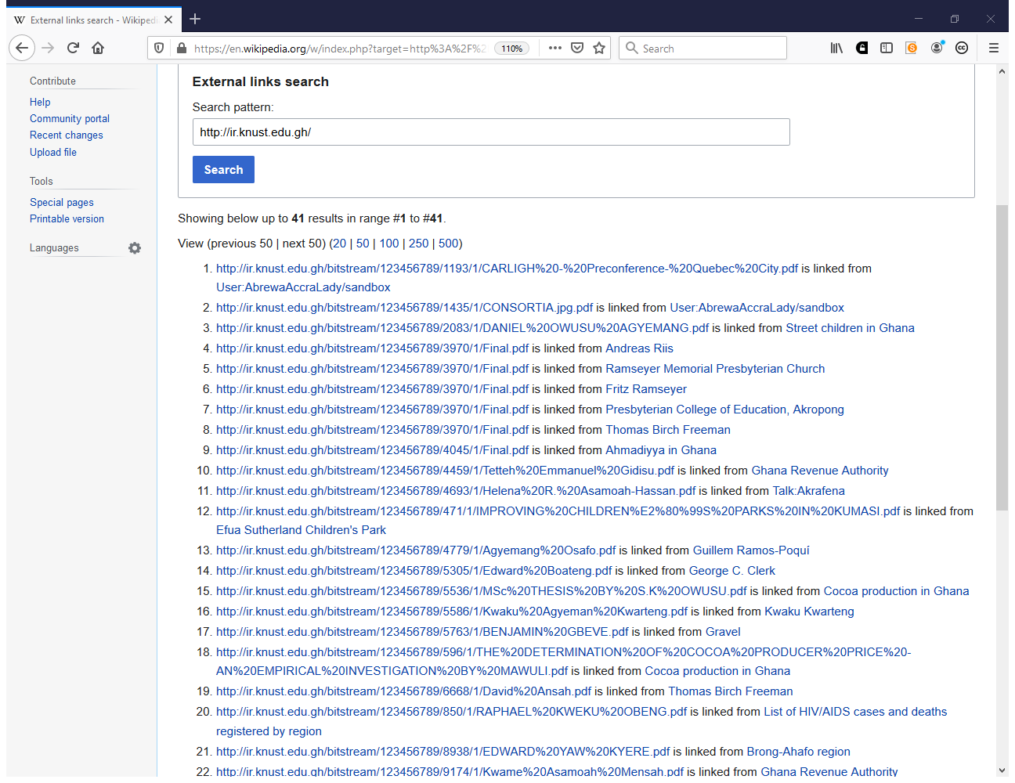

Slide 42
Ability to (4)
Ensure and monitor metadata quality on the ongoing basis
Develop an advocacy programme to create a broad culture of engagement within the institution. Develop advocacy and publicity materials for use within the institution e.g. webpages, guides, FAQs and presentations
Develop training programmes and materials

Slide 43
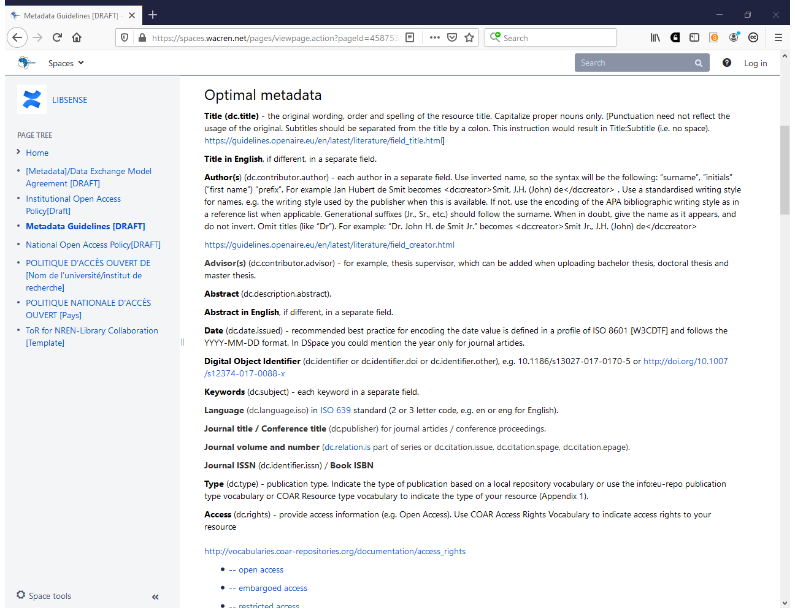
https://spaces.wacren.net/pages/viewpage.action?pageId=4587538

Slide 44
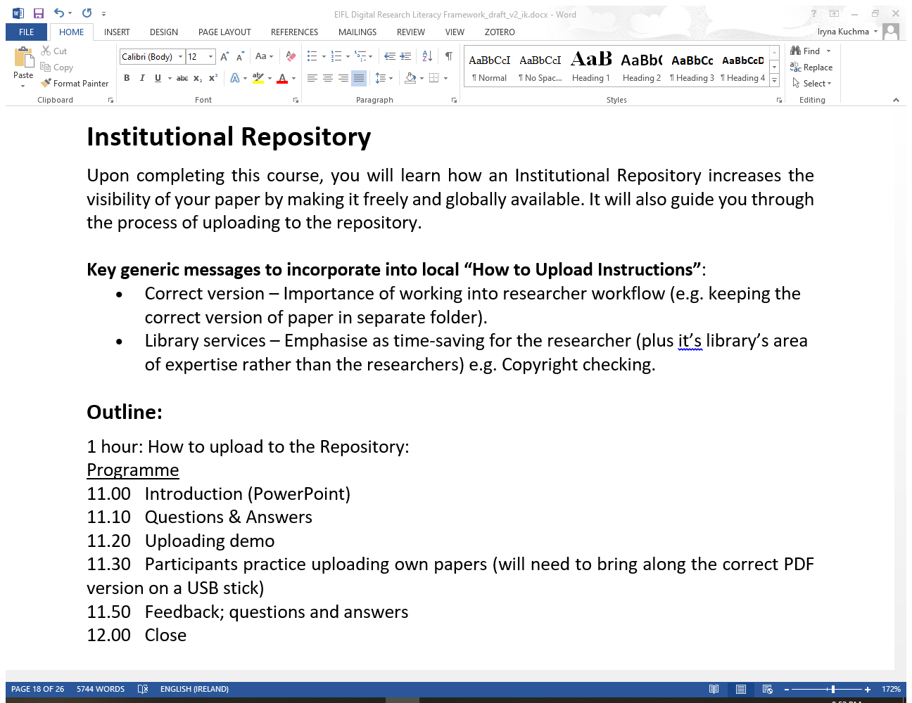

Slide 45
Your advocacy and training programme
What works? What doesn’t?

Slide 46
Ability to (5)
Develop practical policies and procedures to ensure the repository becomes embedded in the research processes of the institution
Liaise with the Graduate School to encourage/ensure deposit of e-theses and to identify and address any potential copyright issues

Slide 47
Ability to (6)
Promote the repository outside the institution as a showcase of the institution’s work
Support the repository community through sharing experiences and contributing to community discussions as appropriate

Slide 48
Repository Administrator

Slide 49
Ability to
Customize, deploy, manage and update repository and associated software over time
Design and develop repository interface, structure and tools
Work with IT Services on the use of their storage and on backup requirements and procedures

Slide 50
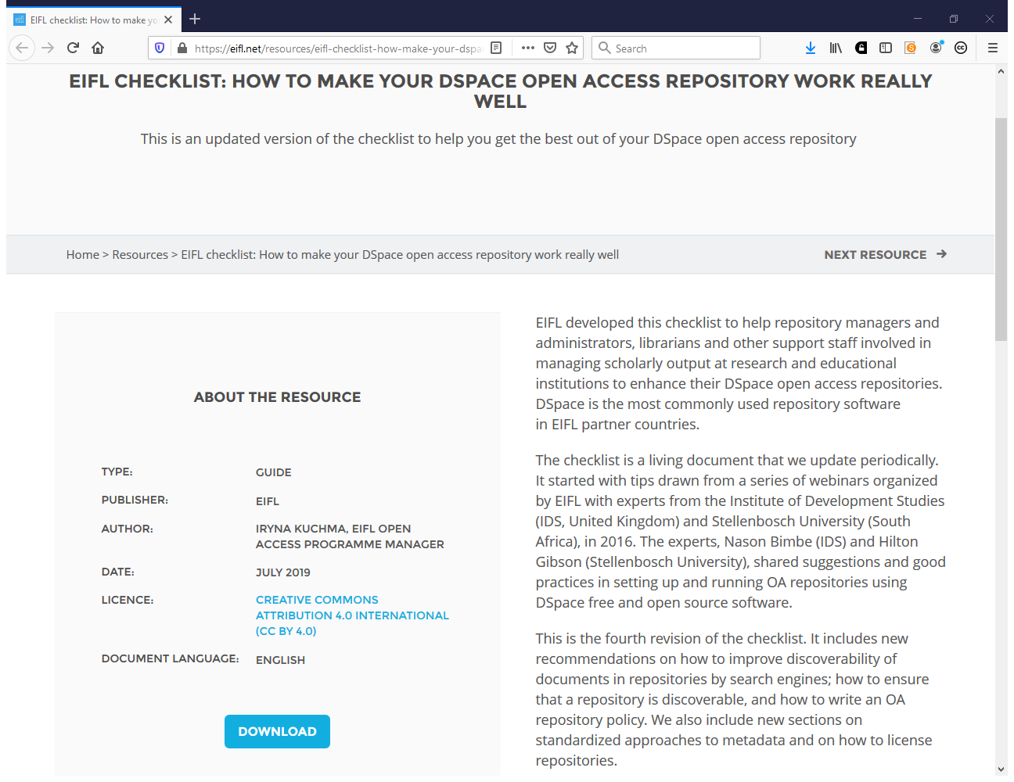
https://eifl.net/resources/eifl-checklist-how-make-your-dspace-open-access-repository-work-really-well

Slide 51
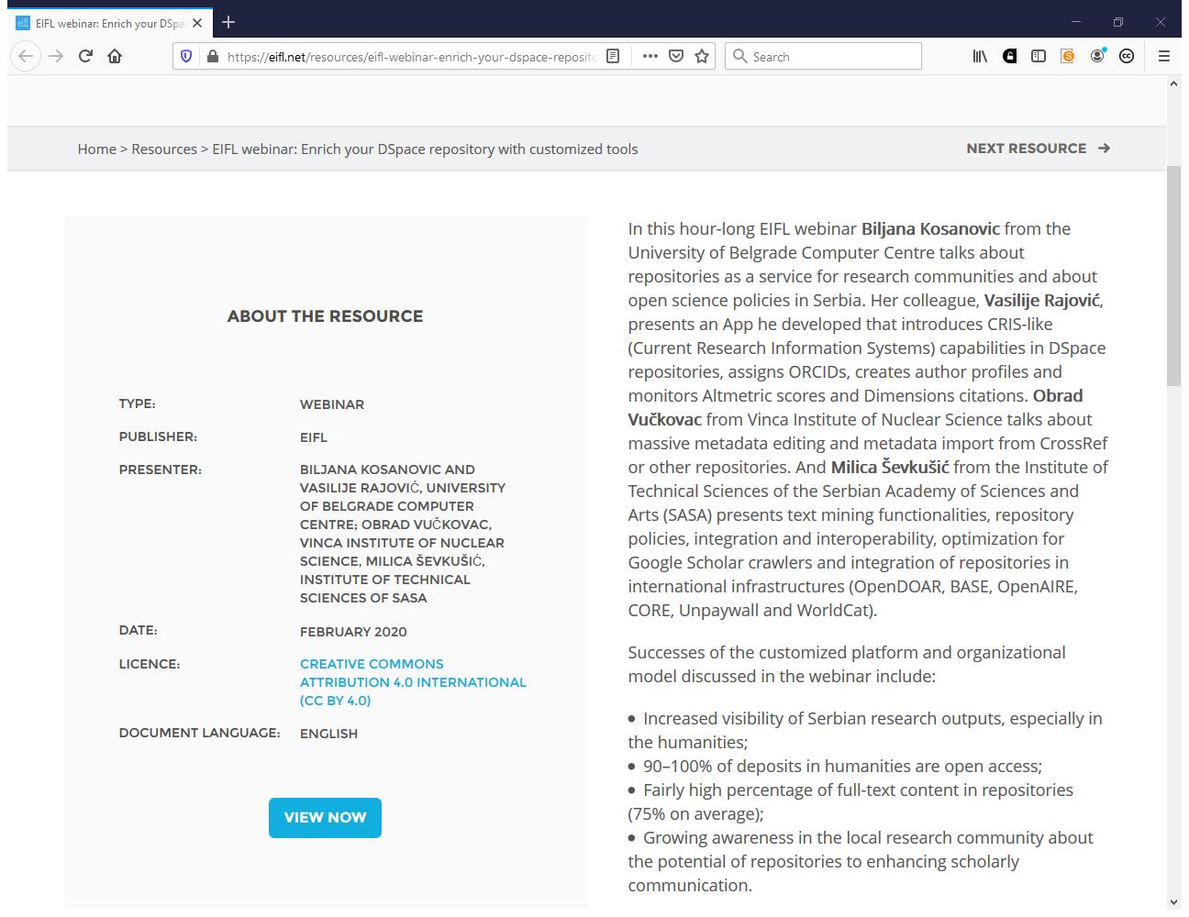
https://eifl.net/resources/eifl-webinar-enrich-your-dspace-repository-customized-tools

Slide 52
Ability to (2)
Work with IT services to maintain repository hardware and software, to achieve buy-in by IT services into the repository; explain the needs of the repository and to ensure the repository is integrated and aligned with other university systems to deliver services
Support the repository community through sharing experiences and contributing to community discussions as appropriate

Slide 53
Knowledge of:
Repository software, metadata standards, and discovery tools
Data formats, data management, data manipulation tools
Open access policies and requirements

Slide 54
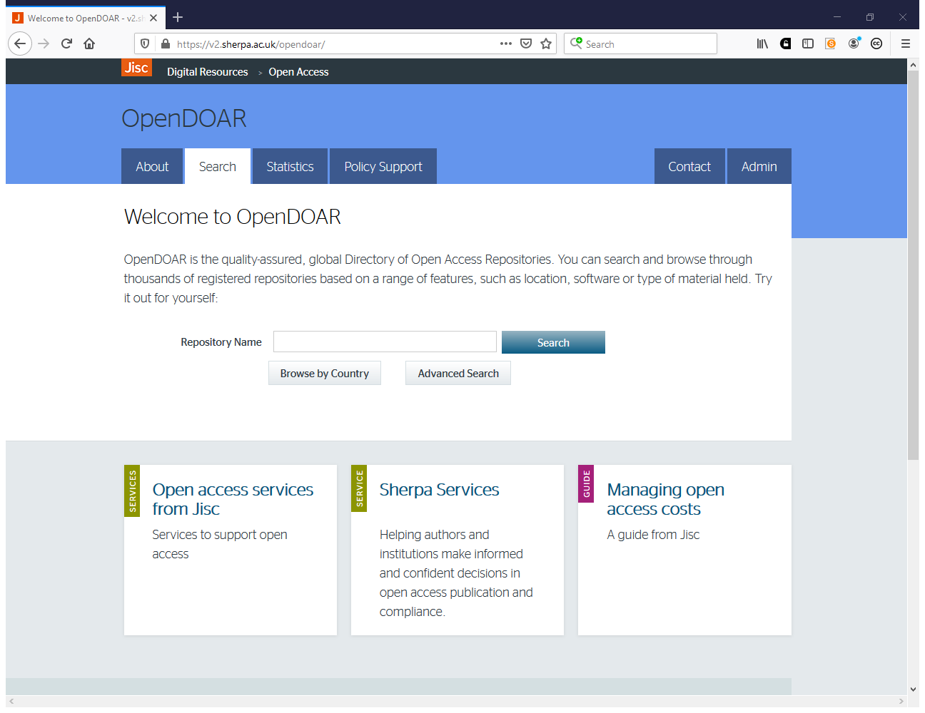
https://v2.sherpa.ac.uk/opendoar

Slide 55
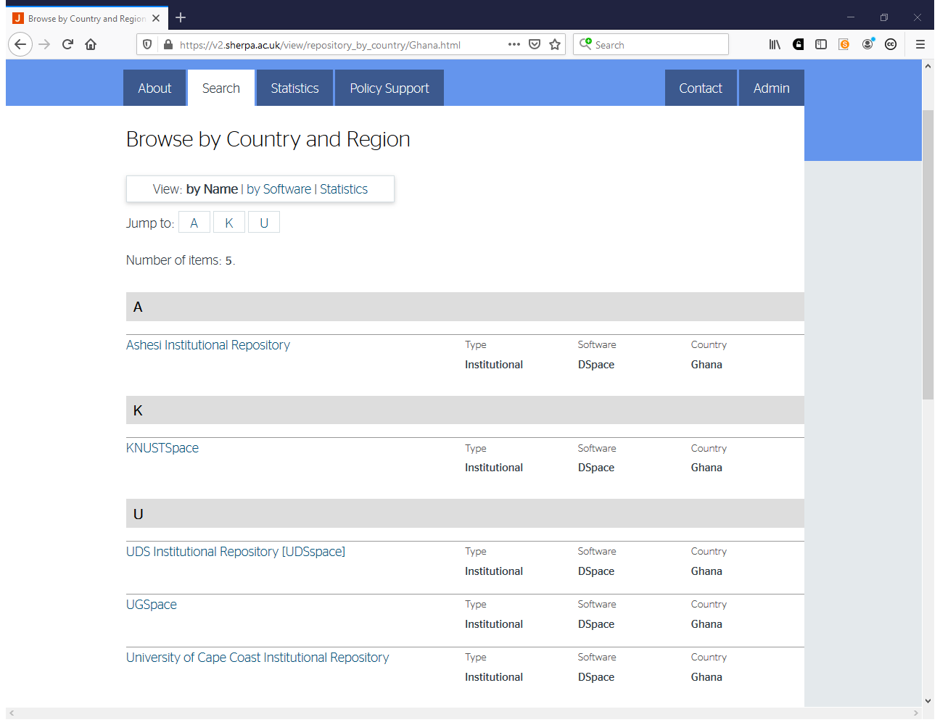

Slide 56
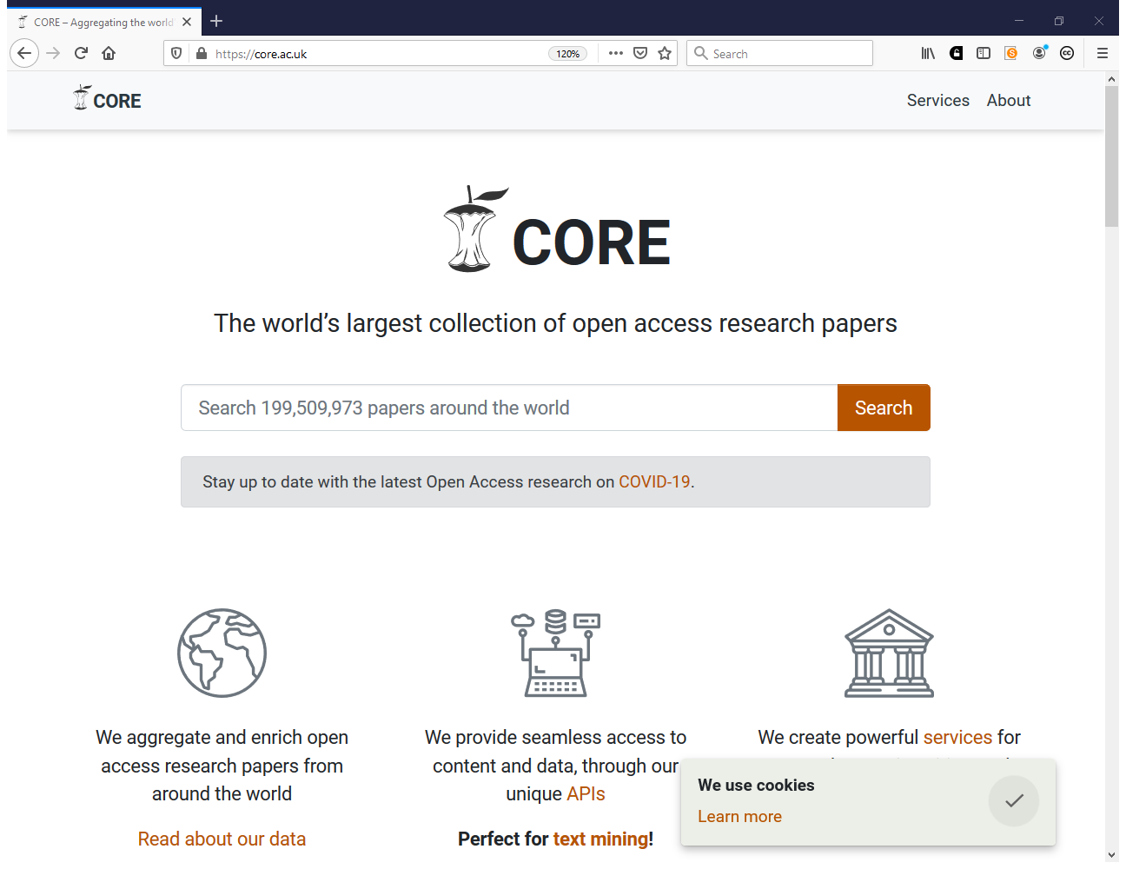
https://core.ac.uk

Slide 57
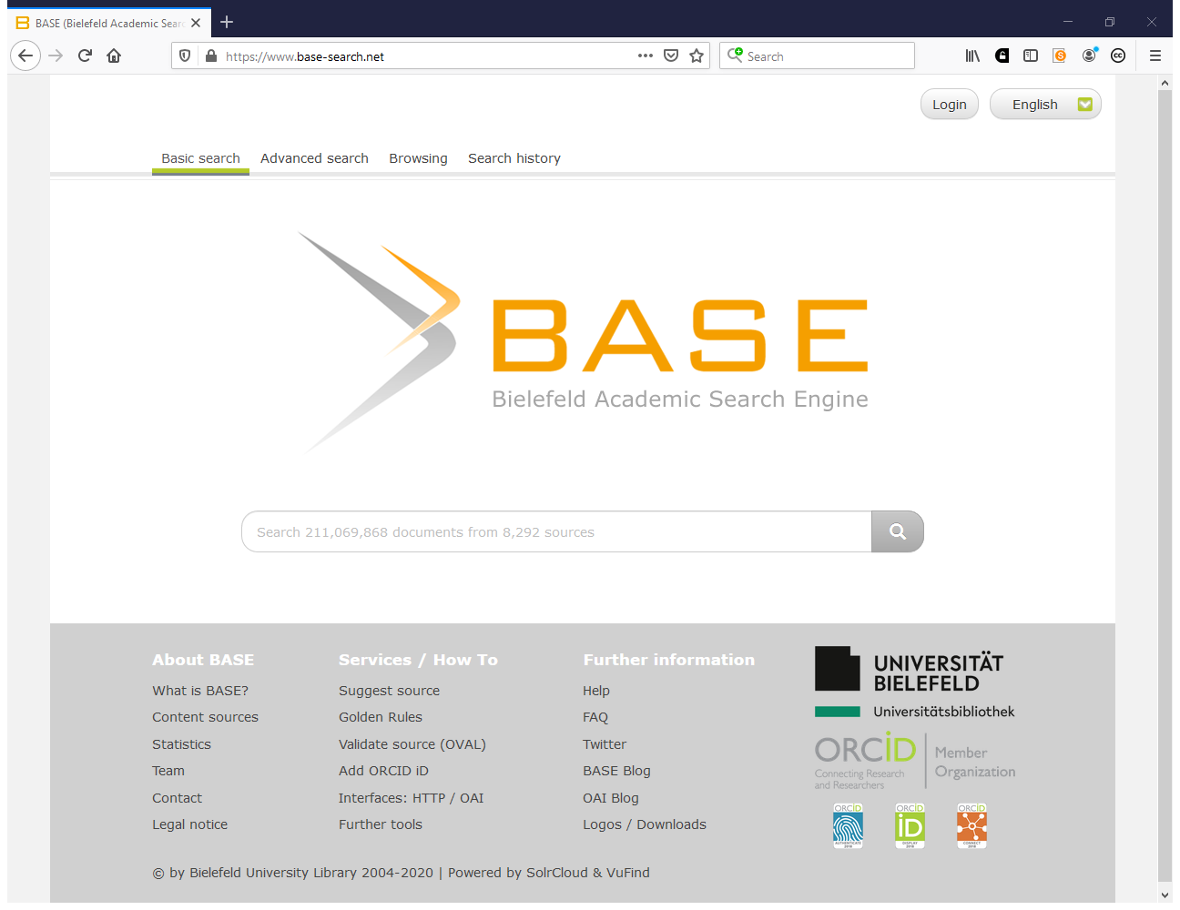
https://www.base-search.net

Slide 58
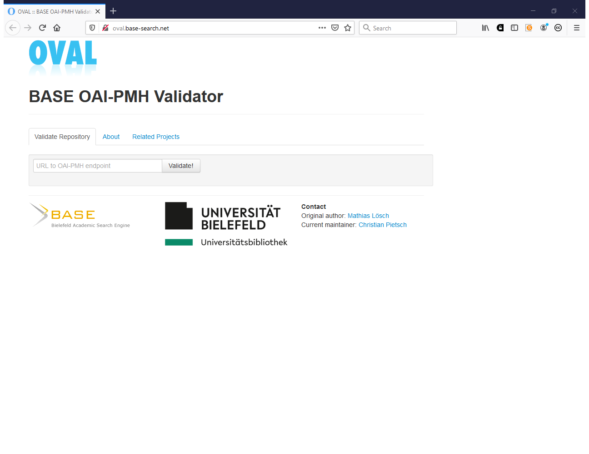
http://oval.base-search.net

Slide 59
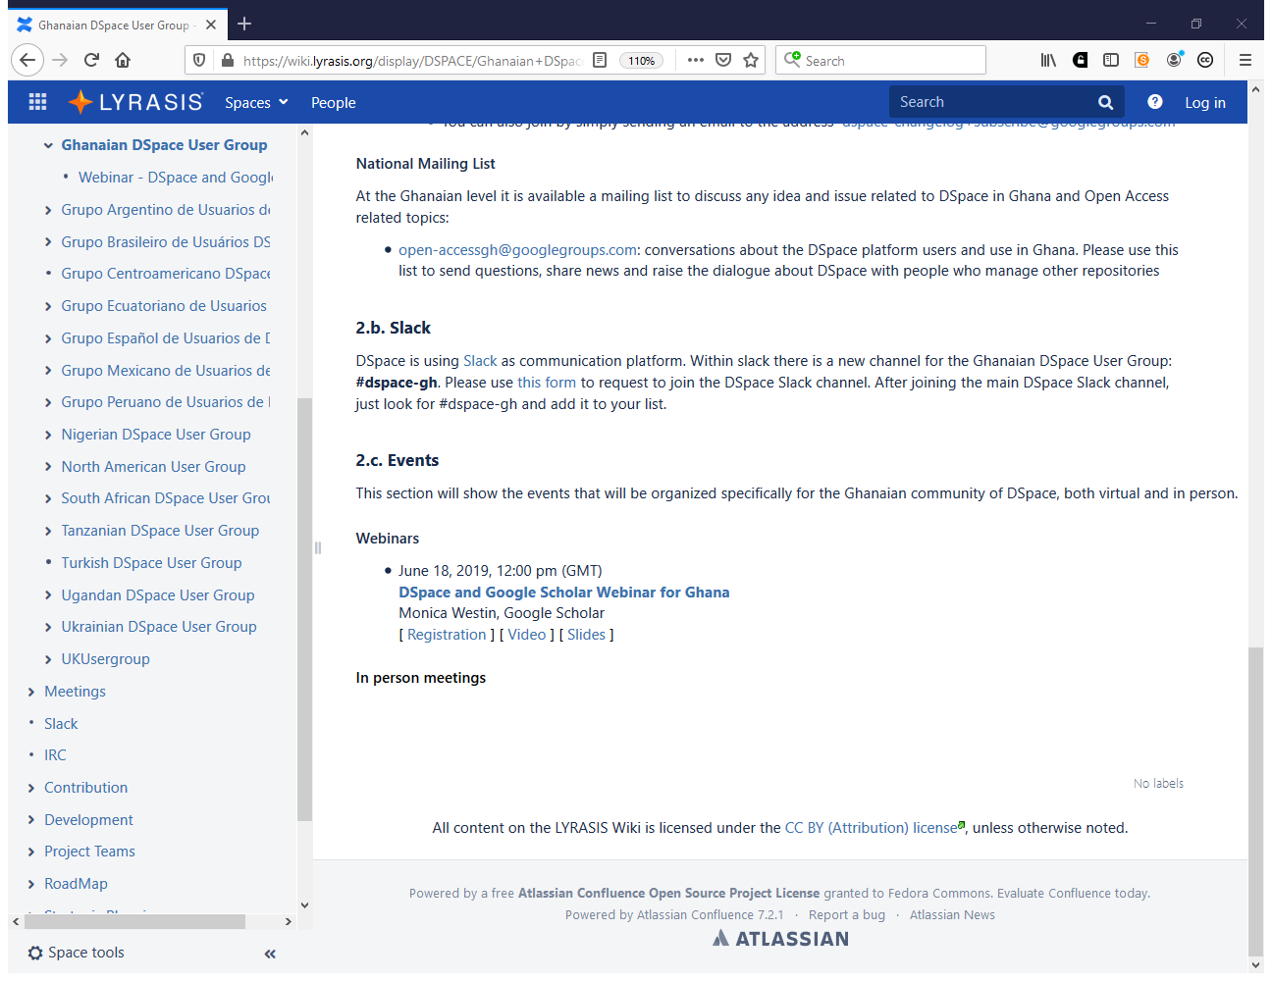
https://wiki.lyrasis.org/display/DSPACE/Webinar+-+DSpace+and+Google+Scholar+Webinar+for+Ghana

Slide 60
Who are the donors?
Do they have any open access policies/requirements?

Slide 61
Understanding of:
Current trends and issues in open access and scholarly communication
Copyright and licensing issues pertaining to scholarly content
Data curation, storage and preservation practices

Slide 62
Based on SHERPA Document
Institutional Repositories: Staff and Skills Set by Mary Robinson, University of Nottingham

Slide 63
Thank you!
Questions?
Contact: iryna.kuchma@eifl.net
www.eifl.net

