Slide 1






Introducing Copim’s work to support open access publishing
Joe Deville
Lancaster University / Open Book Collective
All slides CC BY
Open Book Futures is funded by

Slide 2


3.5 year project, funded by Research England & Arcadia; ended April 2023
3 year project, funded by Arcadia & Research England; to end April 2026
Addressing “the key technological, structural, and organisational hurdles […] standing in the way of the wider adoption and impact of Open Access books”
Deeping and extending the impact of COPIM
https://copim.pubpub.org/

Slide 3




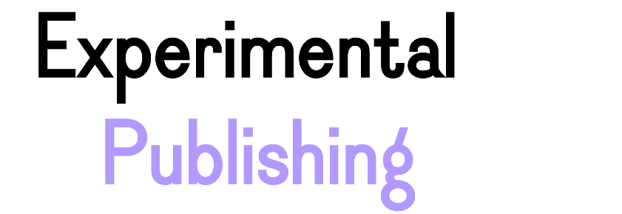
Creating a fairer, more sustainable future for OA books
A revenue model for established publishers transitioning to OA
An open metadata management and dissemination platform
Delivering more accessible
OA ebooks
New archiving & preservation solutions for OA books
Expanding the possibilities of OA academic books

Slide 4
Creating a fairer, more sustainable future for OA books
A revenue model for established publishers transitioning to OA
An open metadata management and dissemination platform
Delivering more accessible
OA ebooks
New archiving & preservation solutions for OA books
Expanding the possibilities of OA academic books

Slide 6
Generate new revenue streams for OA publishers & SPs
Support a model of OA book publishing not reliant on BPCs
Make it easier for librarians to support OA membership schemes
Issue small grants to emerging publishers
What we do
For publishers that are either 100% OA or can get up to 75% OA on new books
A registered charity
Community led
Supporting bibliodiversity
Ethos

Slide 7





Builds on & extends Diamond OA membership funding model
Securing non-BPC based OA funding via renewable memberships from dozens of universities

Slide 8
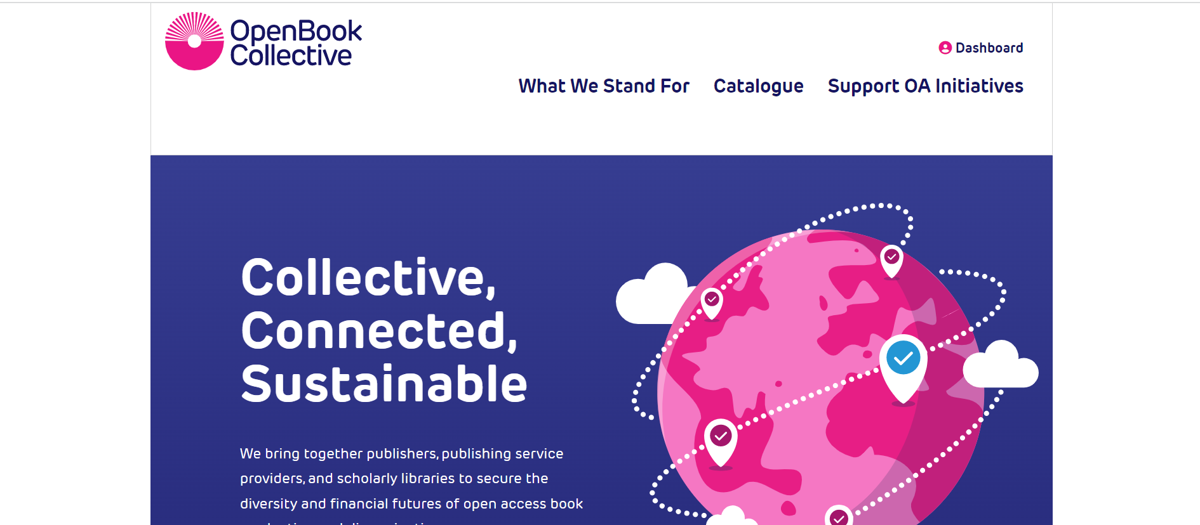








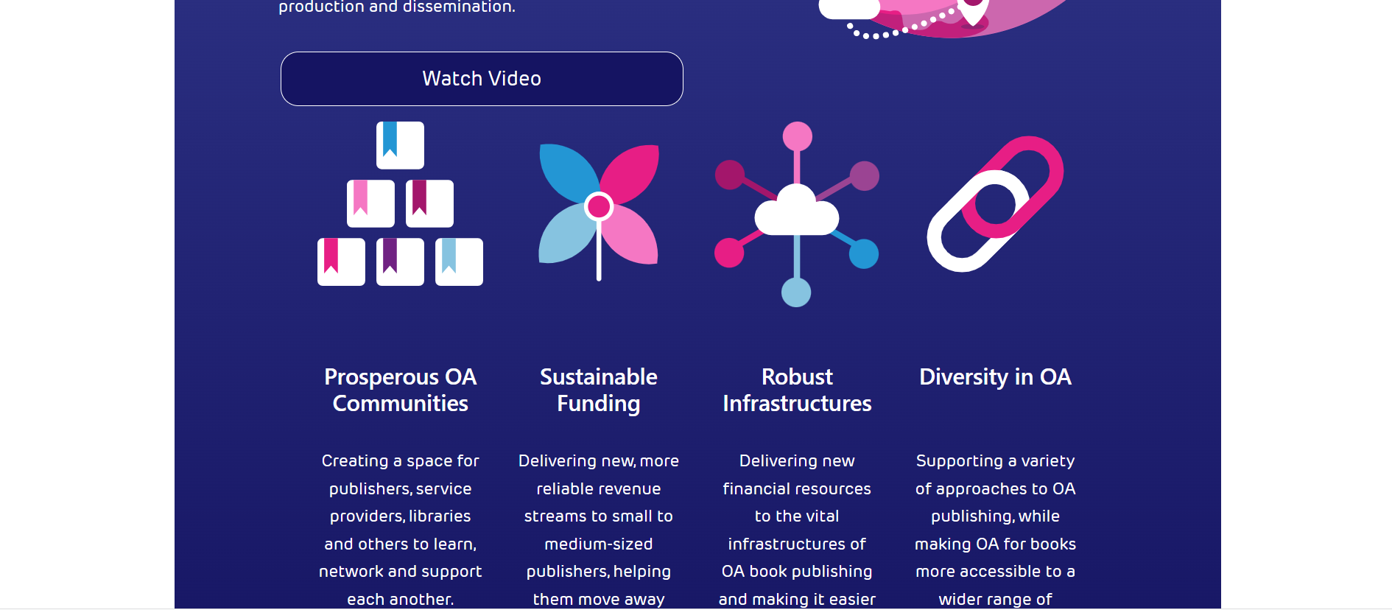






Slide 9
Progress so far
79 supporting members and growing
Over ₴40,000,000 (£750,000) raised so far, ≈90% of which goes to members
Plus 3 capacity building grants of approx. ₴2,000,000 (£40,000) to be issued soon
On track to become self-sustaining by 2026

Slide 10


Slide 11
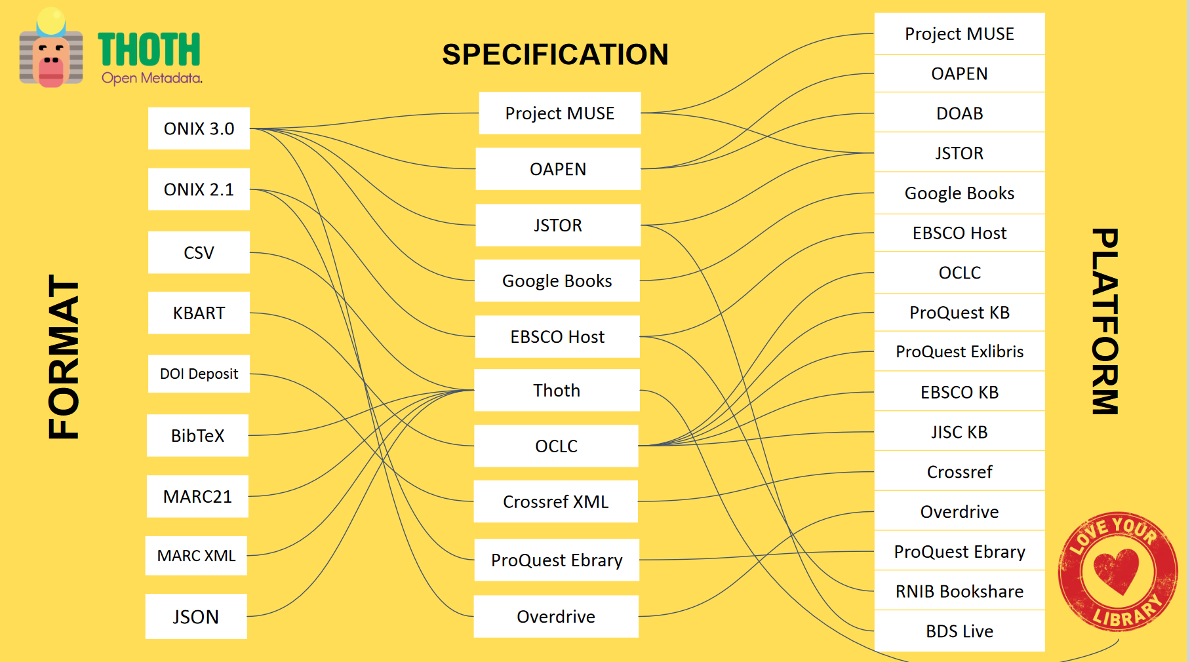

Slide 12
Help publishers easily manage their metadata
Easily exporting metadata in many industry standard formats
EITHER: use Thoth for free and manage this yourself
OR: join Thoth Plus, a low cost option where we do this for you
What we do
For small to medium-sized publishers
Open infrastructure
A registered non-profit
Creating a community of like-minded publishers
Ethos

Slide 13
Progress so far
Thoth website, catalogue, and Free/Plus service model established
Metadata for 2.2k books and 12k chapters from >45 publishers, and growing
Numerous data provision agreements signed (e.g. EBSCOhost, JSTOR, Project MUSE)
On track to become self-sustaining by 2026

