Slide 1
How to talk to your faculty about open access
Joint AfLIA, EIFL, WACREN and the LIBSENSE initiative community call

Slide 2
APCs and OA

Slide 3
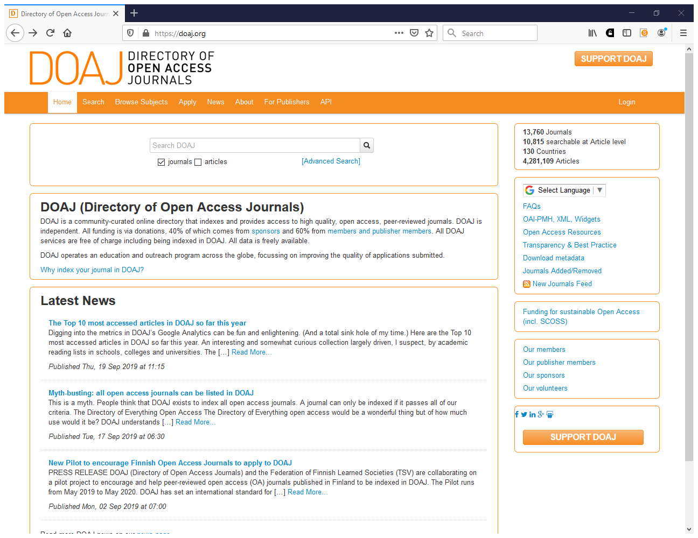
https://doaj.org

Slide 4
Over 70% of the journals listed by the DOAJ do not charge Article Processing Charges (APCs)
74%

Slide 5
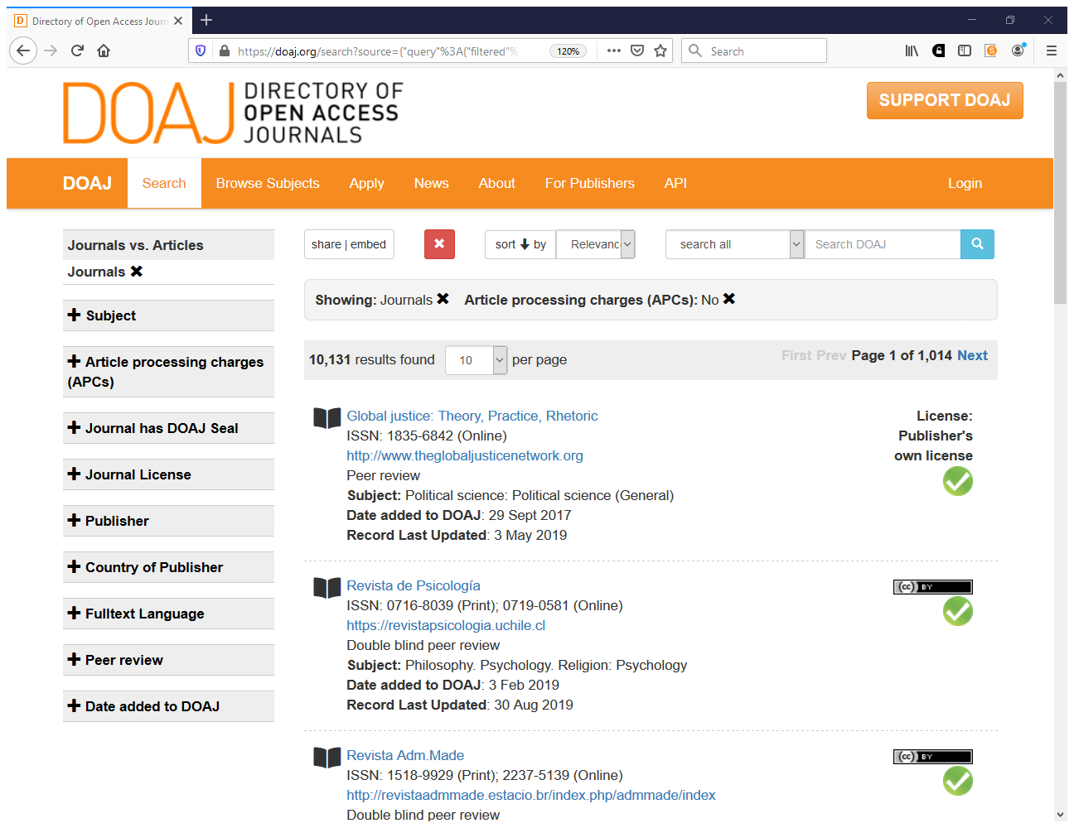

Slide 6
Your questions - How to convince researchers
How to convince our researchers that submission of their work to repositories and open access journals is important for their reputation and visibility? (Rachid Ayssi)
Talking about open access and publishing with members of the faculty (Deogratus Daniel)
Benefit of publishing on Open access (Amedeus Maro)
How to convince authors about open access (Aminath Shiuna)
What are the many ways to encourage authors to embrace publishing in open access outlets? (Michael-Onuoha Happiness)
How to convince faculty on the benefits of OA (Abigail Samunyanga)

Slide 7
How to convince scholars to participate in open science and open access? Or rather, how to motivate those seeking financial reward with their research output?
(Lea Ferguson)

Slide 8
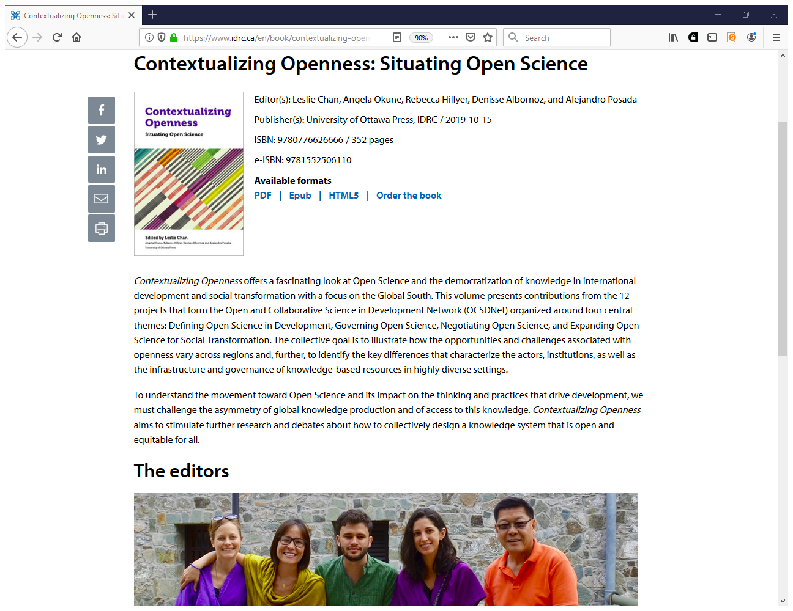
https://www.idrc.ca/en/book/contextualizing-openness-situating-open-science

Slide 9
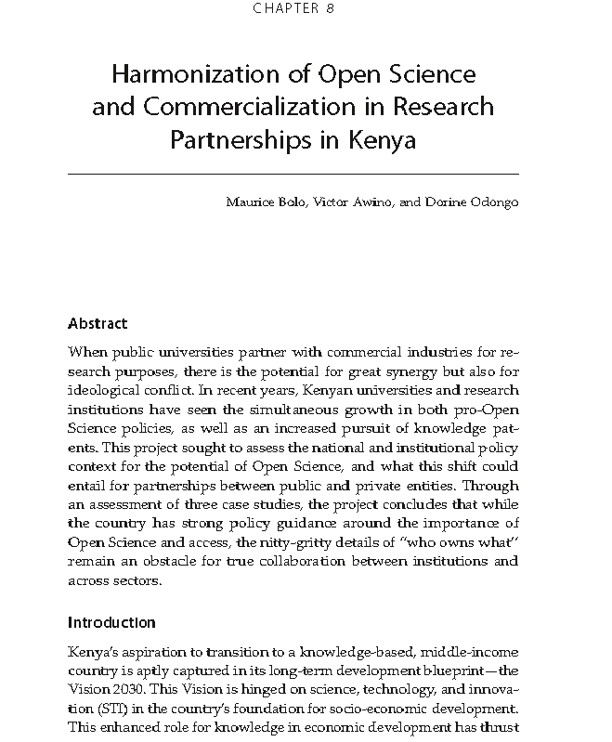

Slide 10
Harmonization of Open Science and Commercialization in Research Partnerships in Kenya
“In recent years, Kenyan universities and research institutions have seen the simultaneous growth in both pro-Open Science policies, as well as an increased pursuit of knowledge patents.”
“Our general observation is that (1) the national policy and legal environment is supportive of Open Science approaches, and government is encouraging increased openness in availability and access to information. Similarly, (2) openness is being embraced at the institutional level with universities adopting OA policies and establishing infrastructure to support wider dissemination of their research outputs.”

Slide 11
Harmonization of Open Science and Commercialization in Research Partnerships in Kenya (2)
“This embrace at the national level is being replicated at the institutional level with universities and public research institutes establishing and adopting OA policies, open repositories for their research outputs, and recognizing publications in OA journals. Trends in OA publishing show that public universities have been embracing OA journals as a preferred channel of publication. This is supported by changing institutional policies so that they favour OA and universities putting in place the requisite infrastructure, including OA repositories, and sensitizing their staff on the need to embrace open publishing.”

Slide 12
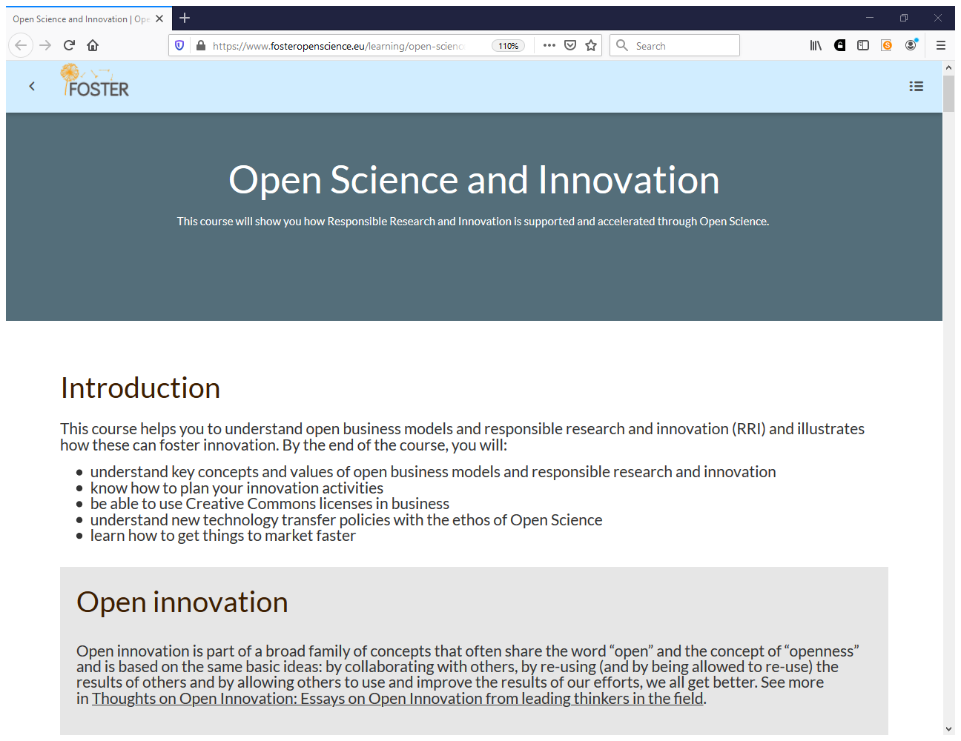
https://www.fosteropenscience.eu/node/2334

Slide 13
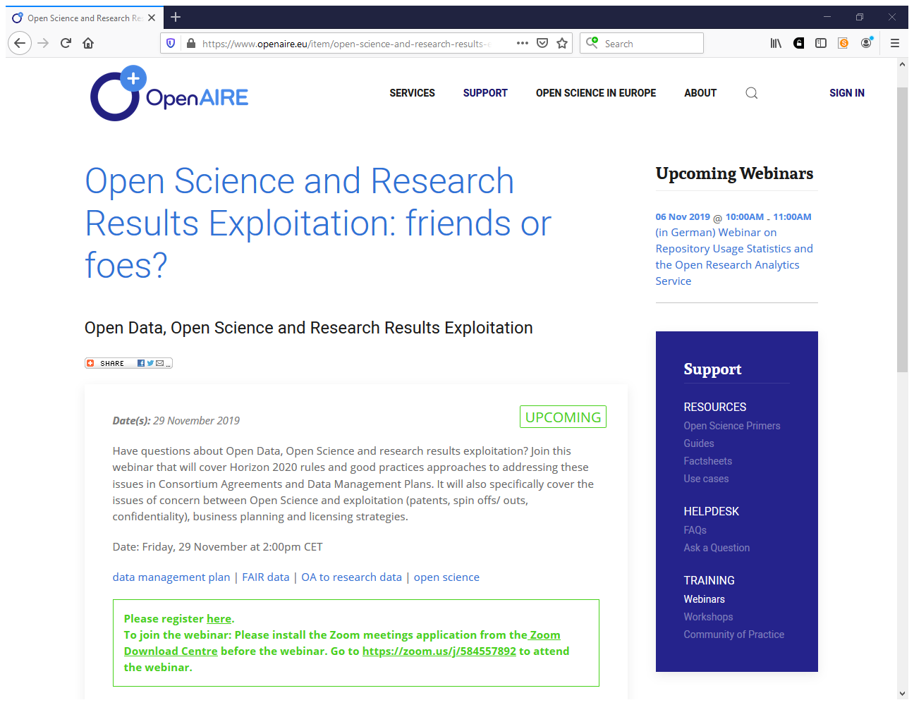
https://www.openaire.eu/item/open-science-and-research-results-exploitation-friends-or-foes

Slide 14
Your questions - How to convince communities/researchers
Talk and convince communities to engage them in the open access programme and activities (CECILE COULIBALY)
How to convince researchers and get them involved in OA movement (Saida MESSAOUDI)

Slide 15
OA repository project at Cheikh Anta Diop University of Dakar (UCAD)
Researchers and research administrators leading the OA movement
Vice Chancellor Pr Ibrahima Thioub, professor at the department of History, initiated digitizing and making available 463 theses and dissertations at his department, defended since 1963.
Commitment of distinguished researchers - Dr Abdou Salam Fall, Director of research, and coordinator of the research laboratory on economic and social transformations (LARTES), Dr Dieyi Diouf, researcher at EBAD (École de Bibliothécaires, Archivistes et Documentalistes) and Dr Bernard Dione, researcher and EBAD director, to practice OA and to advocate for it to other researchers.

Slide 16
Your questions - How to convince authors to publish under free license?
How to convince authors to publish under free license? (Souleymane Sogoba)
Copyright and licencing (Anna Leonard)

Slide 17
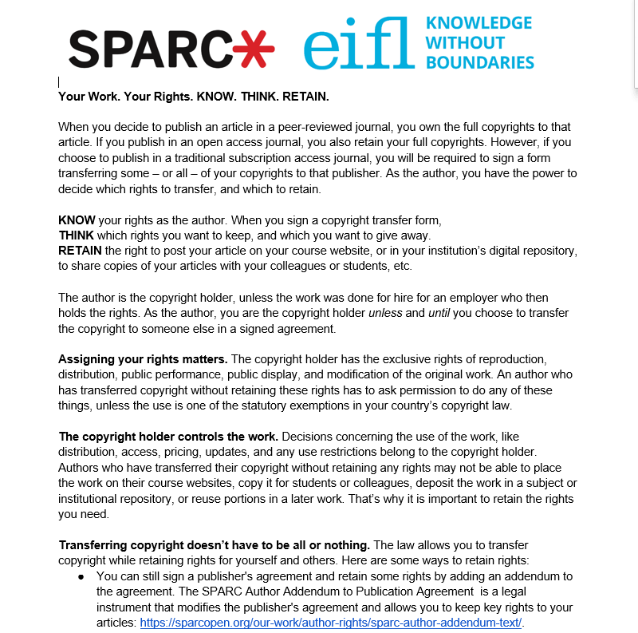

Slide 18
Your questions - Convincing Staff
How to make faculty members appreciate the fact that open access is vital for academic growth. (Mary Ann Alua )
Convincing Staff that open access is actually important (Eva Ainebyoona)
What is the individual benefit of depositing articles in an open access instead of making money out of paid downloads? (Murphy Tersoo Igbudu)

Slide 19
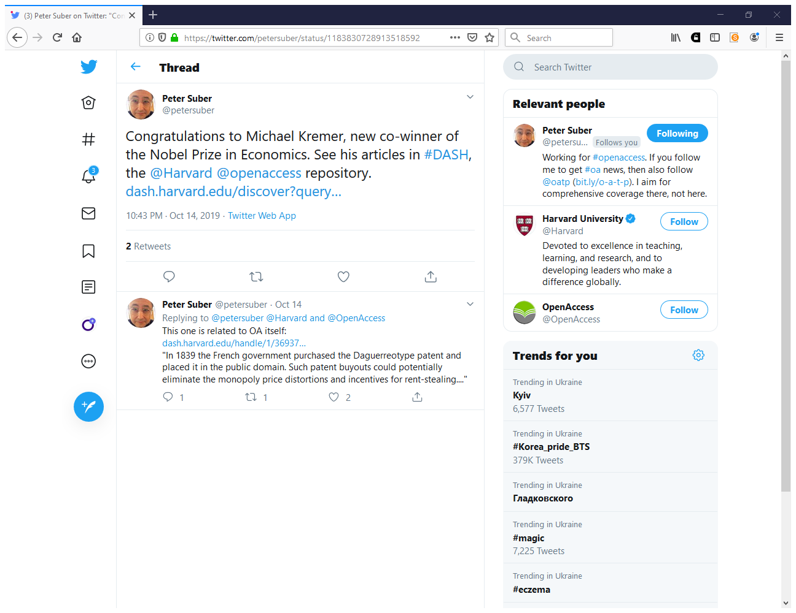

Slide 20
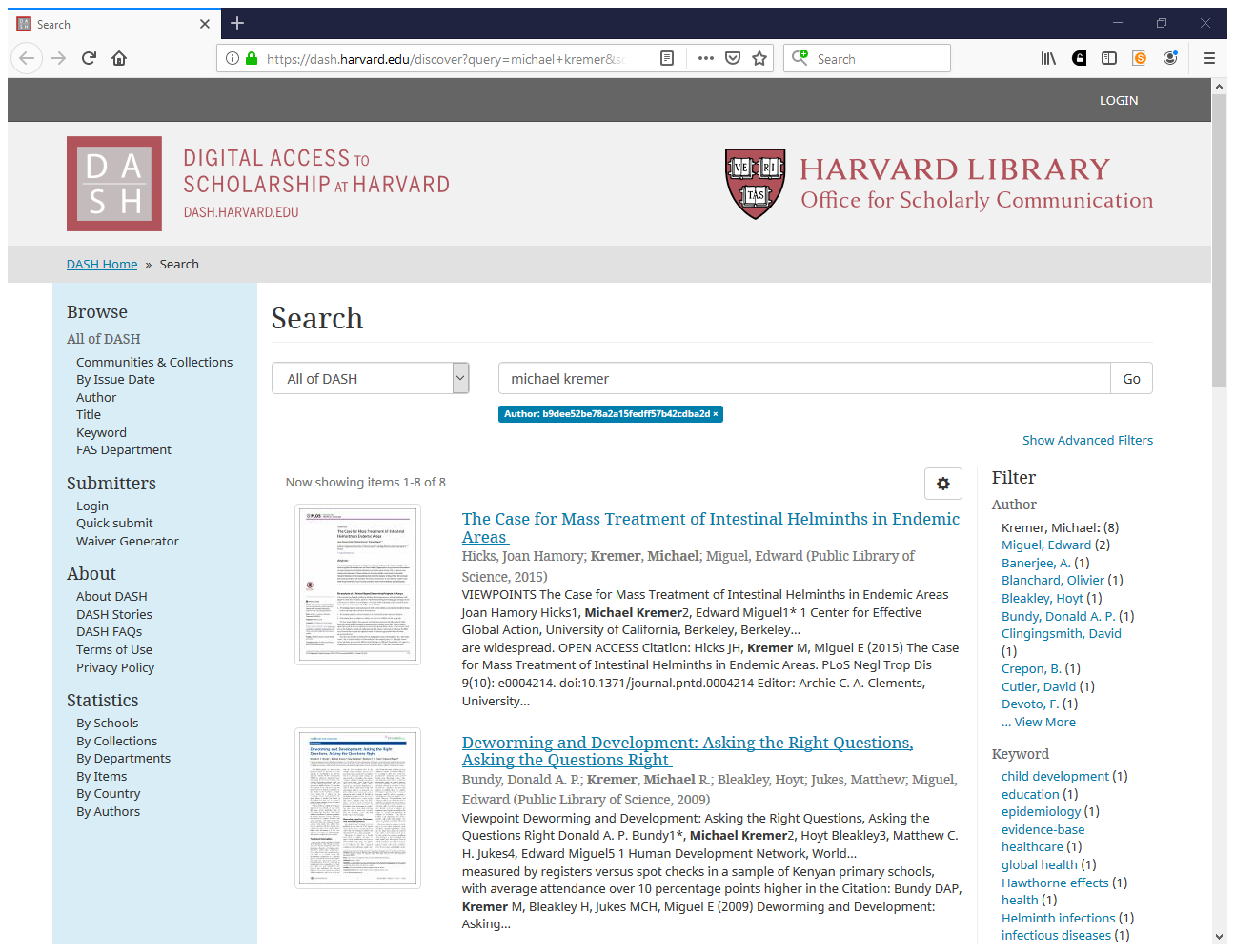

Slide 21
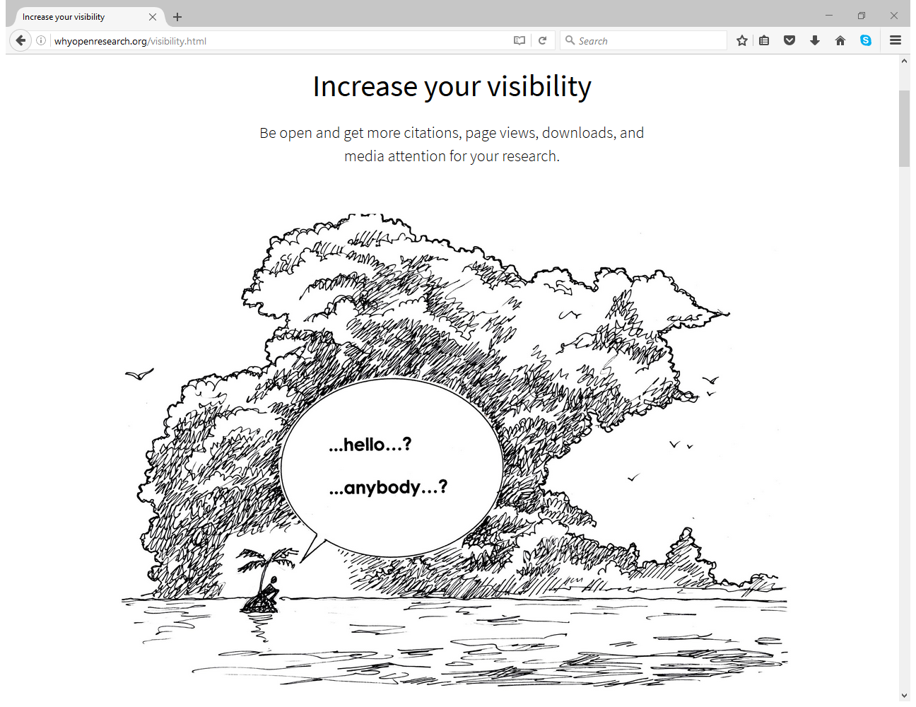
http://whyopenresearch.org

Slide 22
Be open → Get more citations!
Numerous studies have shown that publishing openly – whether in an OA journal, or self-archiving in an open repository – confers a citation advantage.
http://whyopenresearch.org

Slide 23
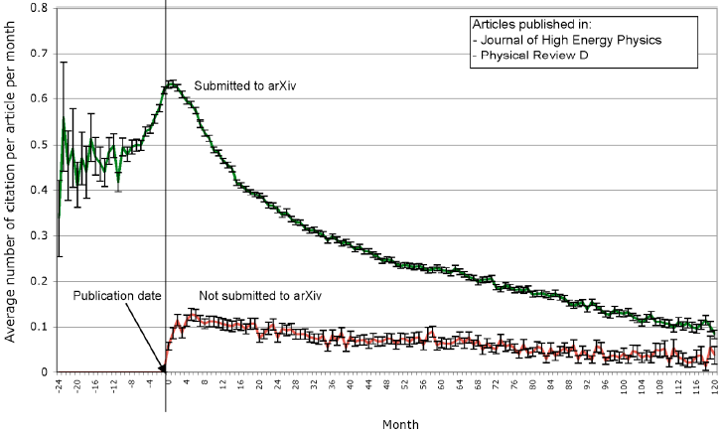
Source: Anne Gentil-Beccot, Salvatore Mele, and Travis Brooks. 2009. arXiv:0906.5418v2.
http://whyopenresearch.org/visibility

Slide 24
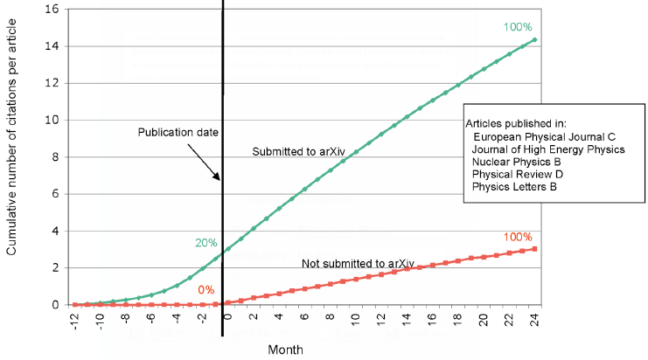
Source: Anne Gentil-Beccot, Salvatore Mele, and Travis Brooks. 2009. arXiv:0906.5418v2.
http://whyopenresearch.org/visibility

Slide 25
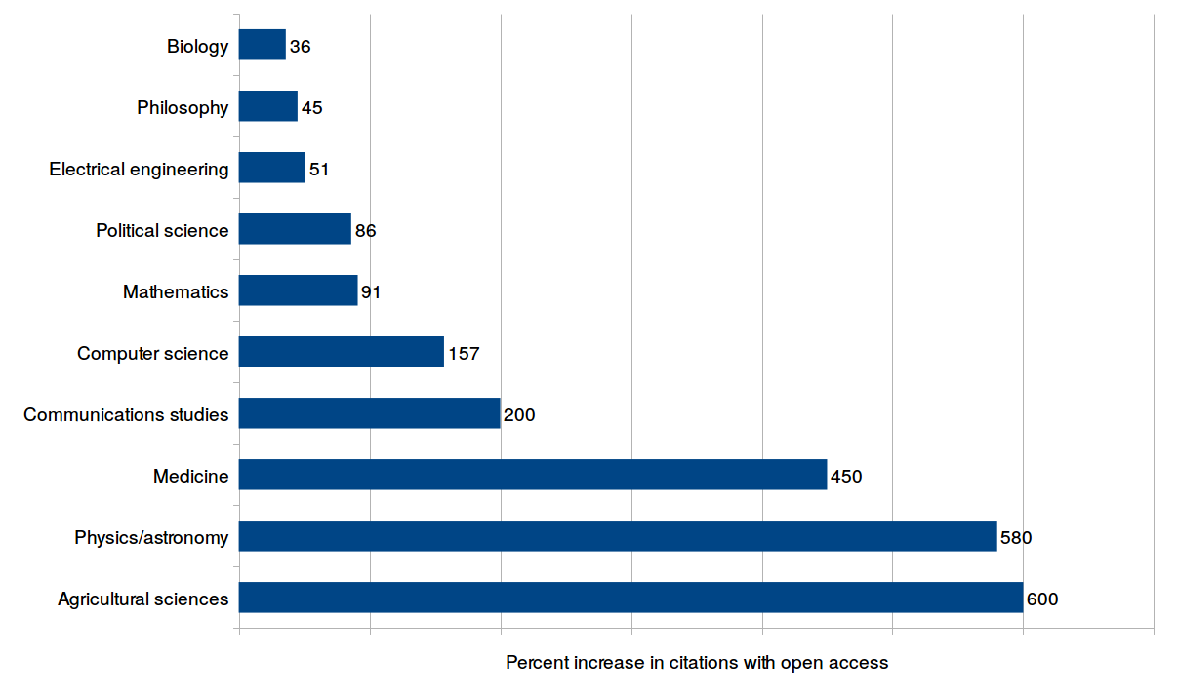
Source: Data from Alma Swan, 2010. Figure produced by E.C. McKiernan (CC BY).
http://whyopenresearch.org/visibility

Slide 26
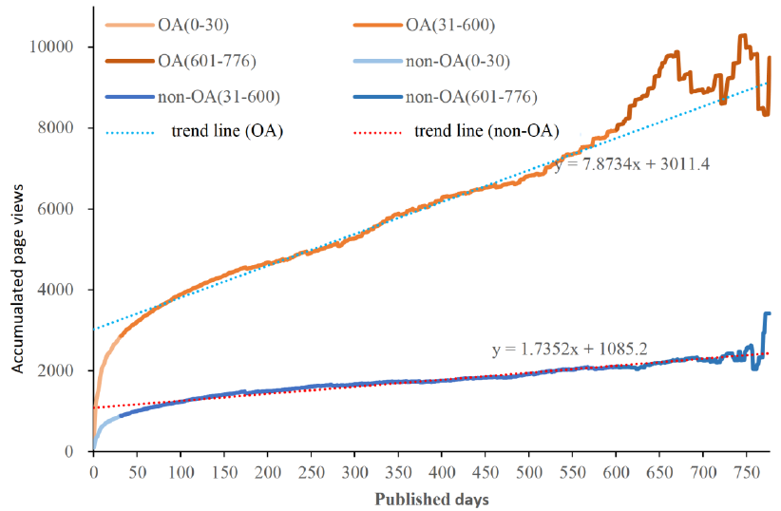
Source: Xianwen Wang, Chen Liu, Wenli Mao, and Zhichao Fang. 2015. arXiv:1503.05702.
http://whyopenresearch.org/visibility

Slide 27
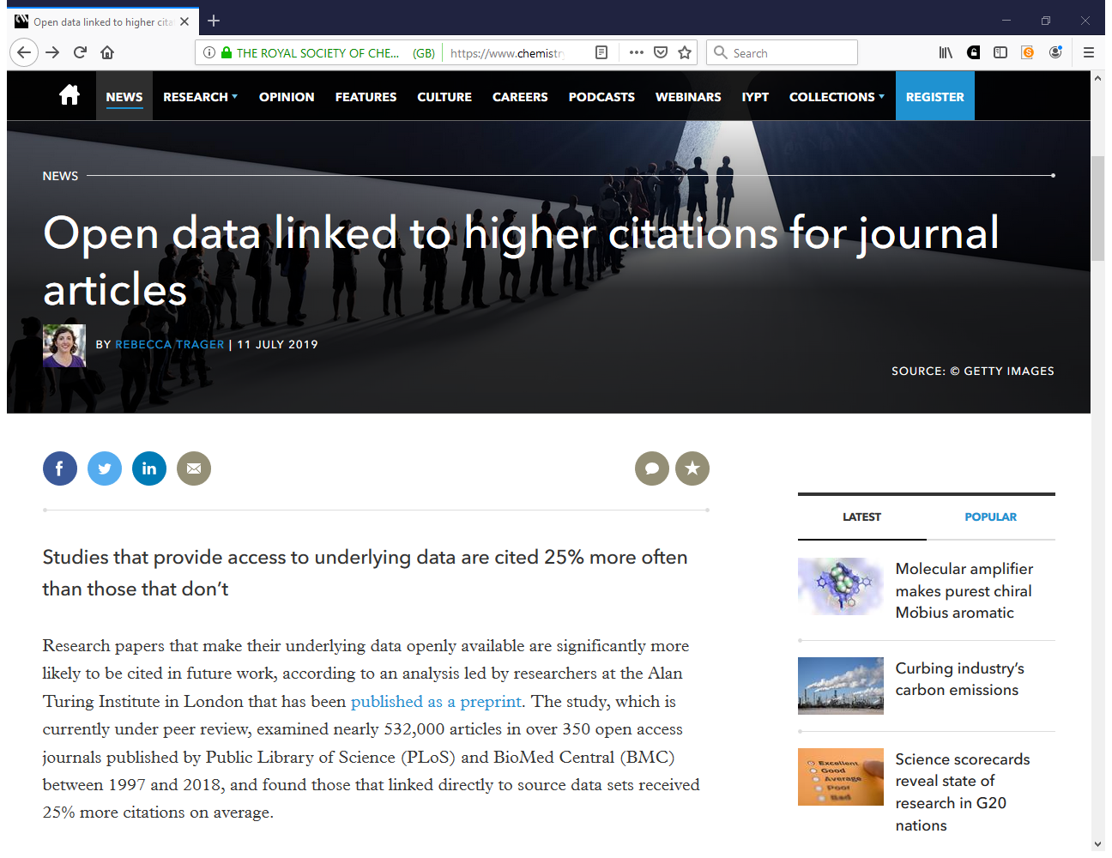
https://www.chemistryworld.com/news/open-data-linked-to-higher-citations-for-journal-articles/3010723.article

Slide 28
Your questions - Repositories
Our library does not own a repository. How do I advocate OA to my researchers when I do not provide them with tools? (Thalia Gonda)
Getting Faculty to self-archive in the institutional repository (Deborah Mwintierong Bumbie-Chi)
Are there any motivation/incentives on making researchers publish more in institutional repositories? (Obrad Vučkovac)
How to influence faculty on Institutional Repository set up for my institution and beyond (MCWILLIAMS HODZI)
How would librarians overcome the do face thereby increase deposit rates in their repositories? (Abubakar Sadeeq Isa)

Slide 29
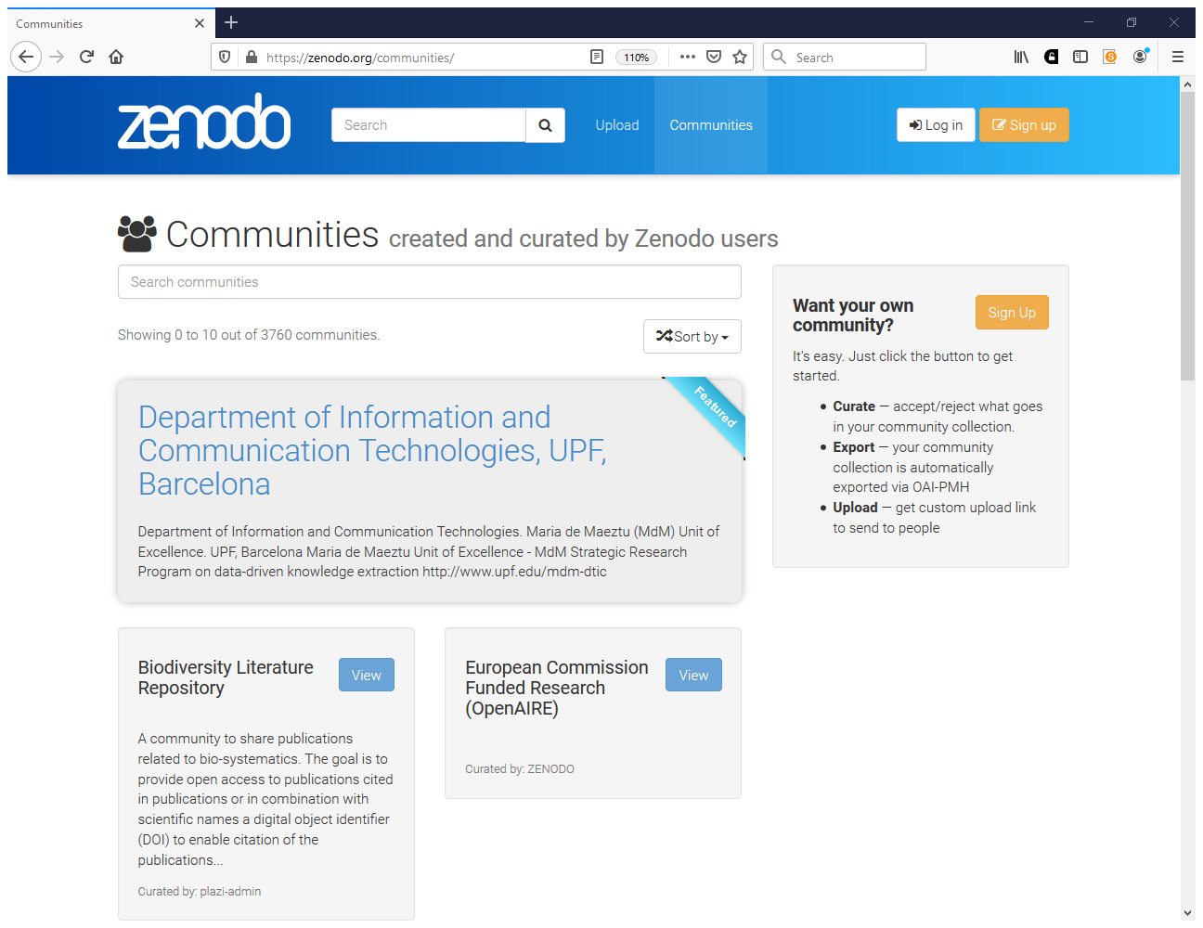
https://zenodo.org/communities

Slide 30
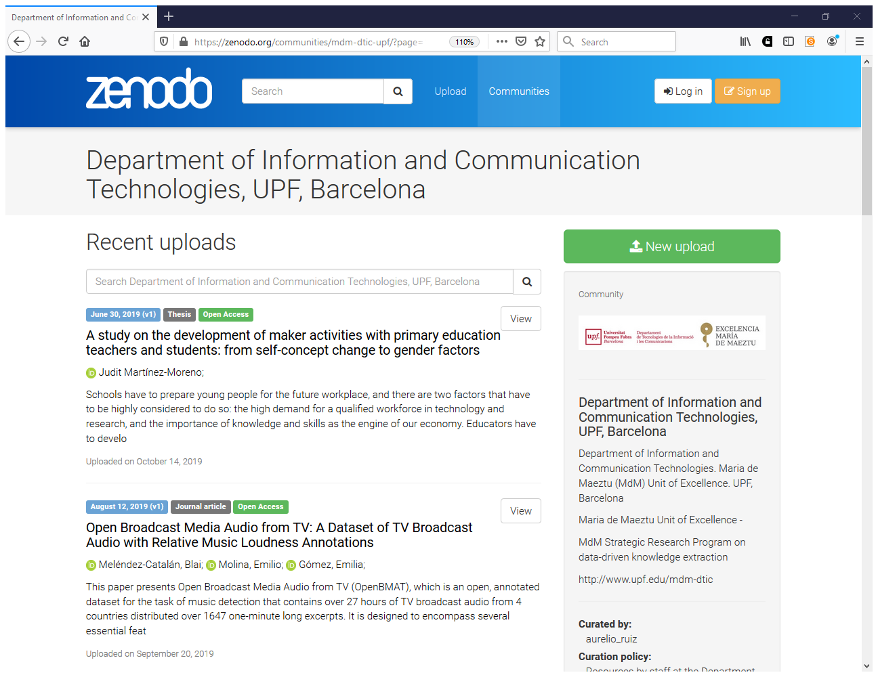

Slide 31
Link repository to assessment, evaluation, promotion, awards
On February 4, 2013, the Rector of UCAD issued Circular No. 721 addressed to Deans and Directors of research institutes inviting the candidates applying for evaluation and promotion at CAMES (Conseil africain et malgache pour l'enseignement supérieur) to register and deposit their articles and theses and dissertations in the digital library.

Slide 32
Strategies to encourage faculty to deposit their publications in institutional repositories
LESSONS FROM COVENANT UNIVERSITY
The University Management has made it mandatory for all faculty to deposit their scholarly and other intellectual outputs in the repository. This policy acts as an administrative impetus to stimulate awareness, increase and enrich content accumulation for the University’s repository (Nkiko, Bolu and Michael-Onuoha, 2014).
Consequently, faculty applying for promotion must first deposit copies of their scholarly works in the repository. Scholarly works that are not deposited in the repository will not be considered for promotion exercises.
By Ilo, Promise (PhD) and Ifijeh, Goodluck

Slide 33
Strategies to encourage faculty to deposit their publications in institutional repositories (2)
LESSONS FROM COVENANT UNIVERSITY (2)
The Covenant University Library consistently engages in awareness and advocacy programs geared towards encouraging faculty to deposit their works in the repository.
The library has also employed staff who are saddled with the responsibility of searching the internet for publications authored by Covenant University faculty and uploading same on the repository. However, only the abstracts of copyrighted (or subscribed) works are uploaded.
By Ilo, Promise (PhD) and Ifijeh, Goodluck

Slide 34
Your questions – Repositories (2)
How to react to the statement: "Preprints/postprints are not sufficient versions to use them in referencing list, I need access to published version for proper citing." (Pavla Rygelova)
A lot of colleagues prefer to cite their publications right than in open access. How do we encourage them the more to be open than closed (Michael-Onuoha Happiness)
Latest policies on management of repository by an academic library (ADETOMIWA BASIRU)

Slide 35
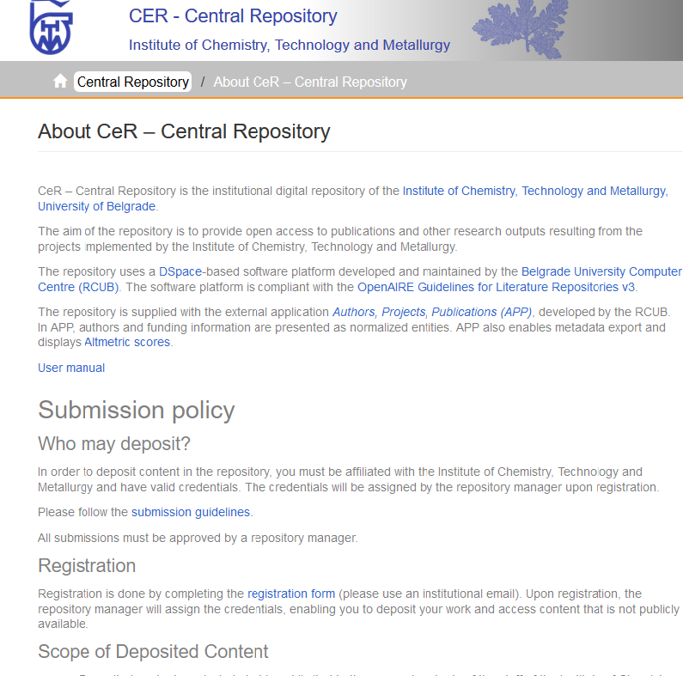
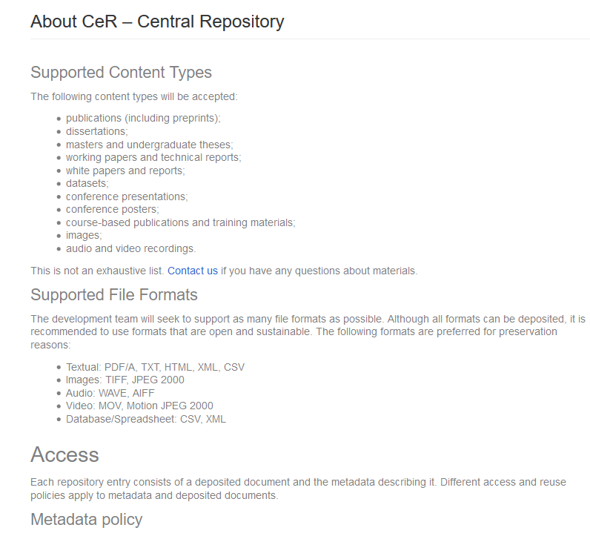
The metadata are freely accessible to all, and freely reusable by all, under the terms of the CC0 license.
http://cer.ihtm.bg.ac.rs/contact

Slide 36
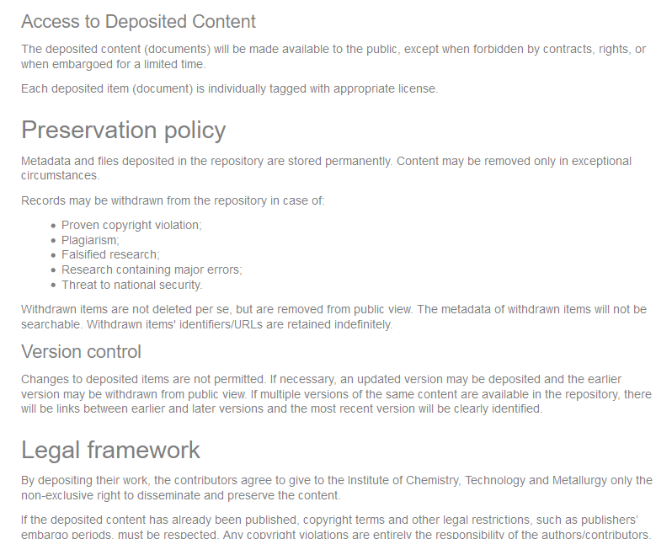
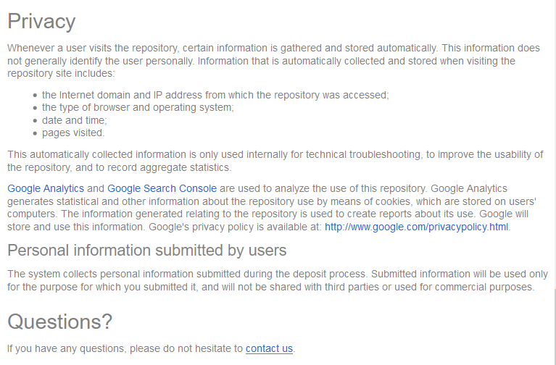
To check publishers’ self-archiving policies you may use SHERPA/ROMEO.
http://cer.ihtm.bg.ac.rs/contact

Slide 37
Your questions – How do I convince university management?
Convince top management to mandate OA (Abdrahamane ANNE)
How does the institutional repository increase on the university ranking? (Nuwajuna Dianah)
Lobbying / Advocacy strategies (Ganiyatu Tiamiyu)
How do I convince university management to accept and recognize open access publication during faculty promotion (Chinwe Anunobi)
How to convince management of university to support open access not only by words but also by strong policy and by money? What is the right argument for our university managers/politicians. (Tereza Simandlová)
How to convince top management on importance of institutional repository (IR) (Johnson Rugoye)

Slide 38
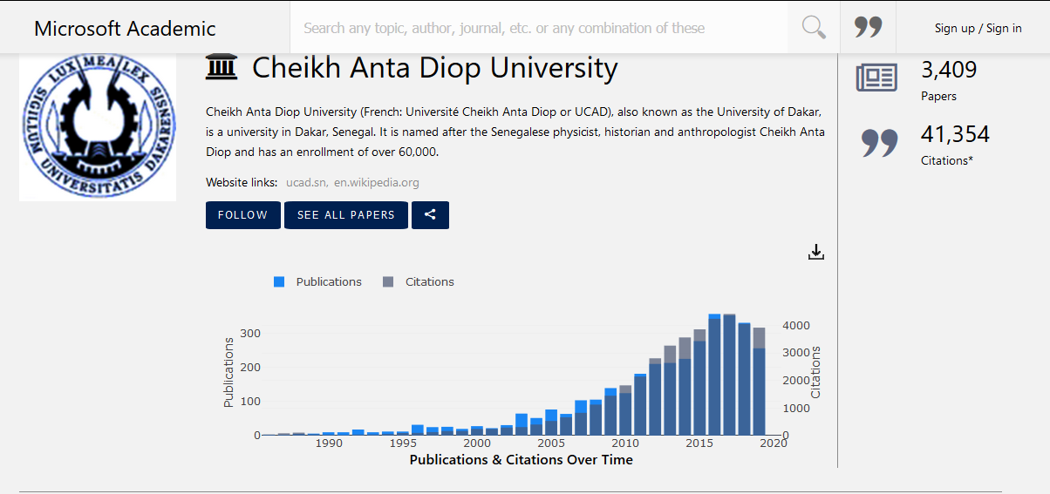

Slide 39
Your questions – Awareness raising/training
How to promote/encourage Open Access (Raed Al-Zoubi)
How to promote OA among our academic staff (Šárka Grofová)
How do I make Faculty members see the need to attend workshops/seminars organized by the Library on open access or related fields. (ANGELA ACHIAA AIKINS)

Slide 40
Finding a place for your training & messages in the competitive research landscape
What methods do you, and could you, use to drive attention to your training activities?
What methods do you, and could you, use to drive up attendance at your training activities - how can you turn REGISTRATION (i.e. interest) into ATTENDANCE (i.e. action) https://docs.google.com/document/d/1ohUqqST7Q23styDUlU6t25W2q7rvYpvbr_ZlsJxOfjA/edit

Slide 41
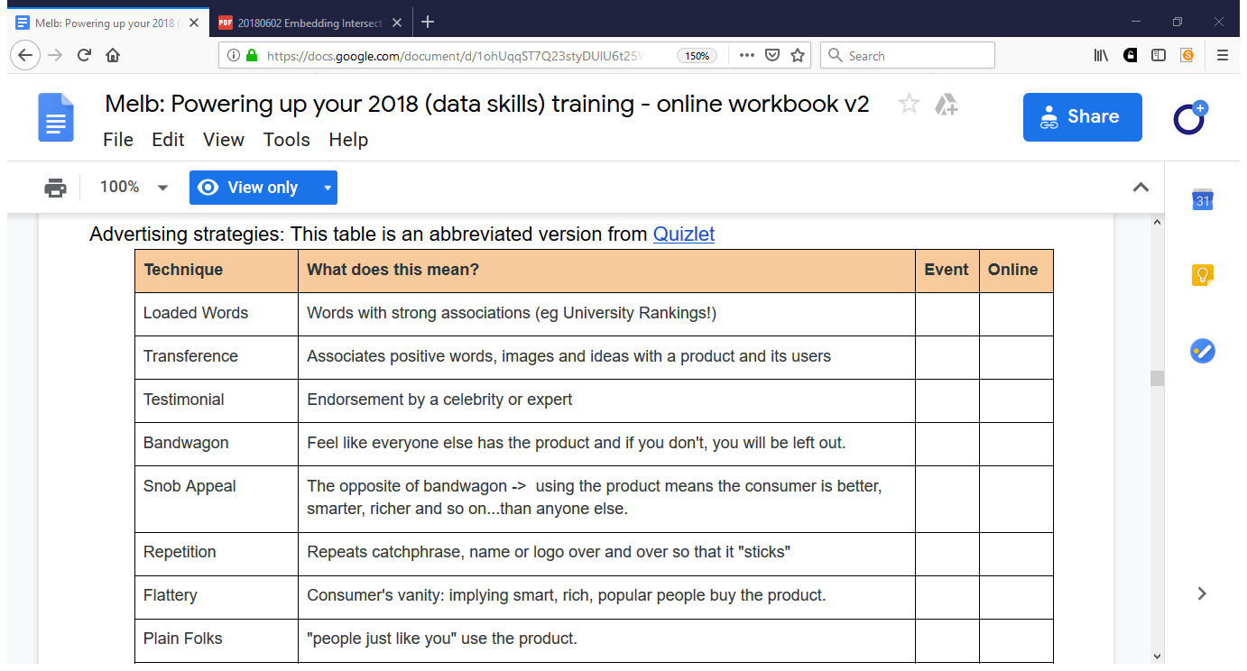

Slide 42
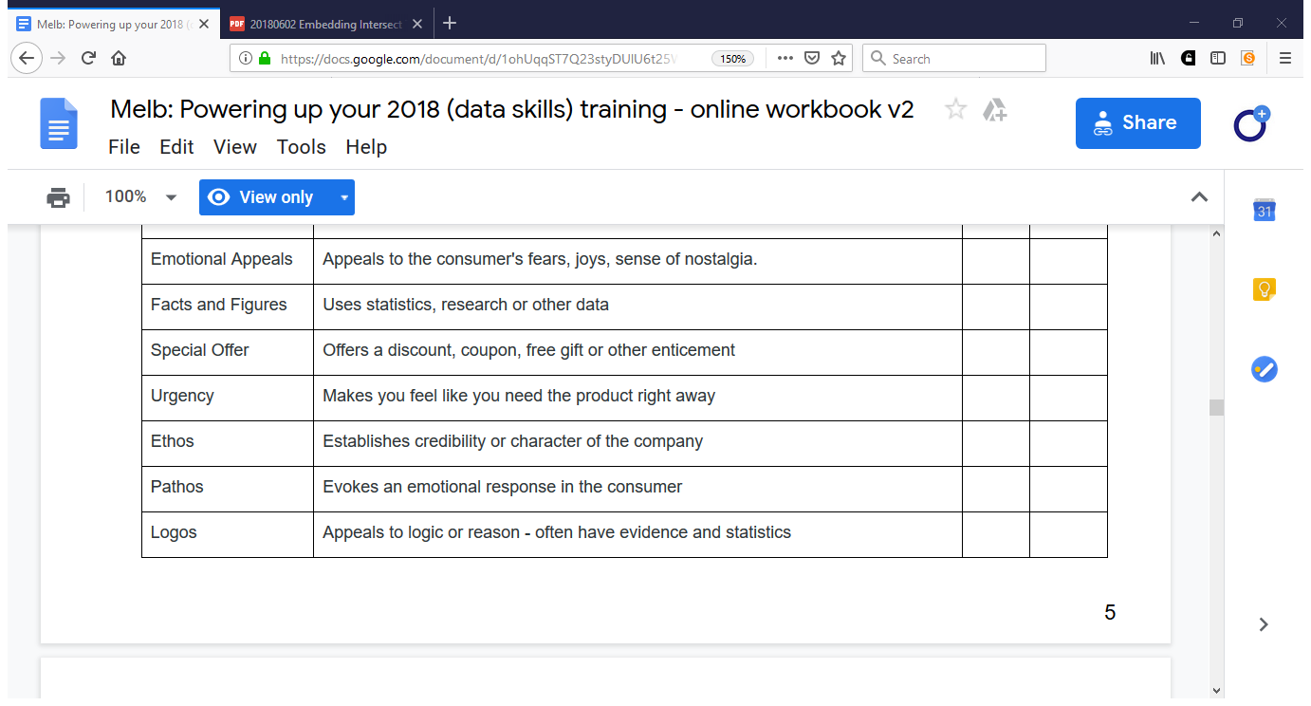

Slide 43
Your questions – OA books, textbooks
How free is open access?
For those textbooks that we are able to download "for free" online, is it okay to include them in the library catalogues of institutions? (Wilhemina Ofori)
Spreading the word about OA books and the benefits of OA to researchers - busting myths and persuading with a positive message. (Lucy Barnes)

Slide 44
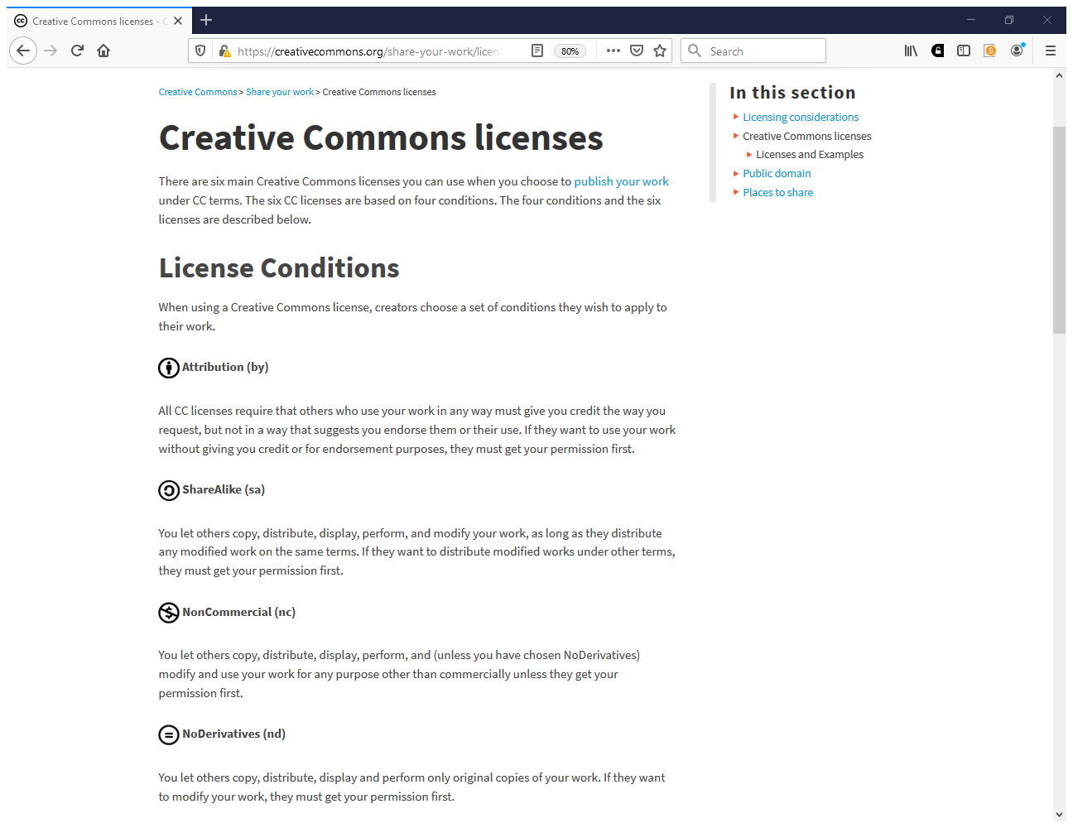
https://creativecommons.org/share-your-work/licensing-types-examples

Slide 45
How to engage students more in the open science endeavour (from the library's perspective and within the possible scope of action here)?
(Lea Ferguson)

Slide 46
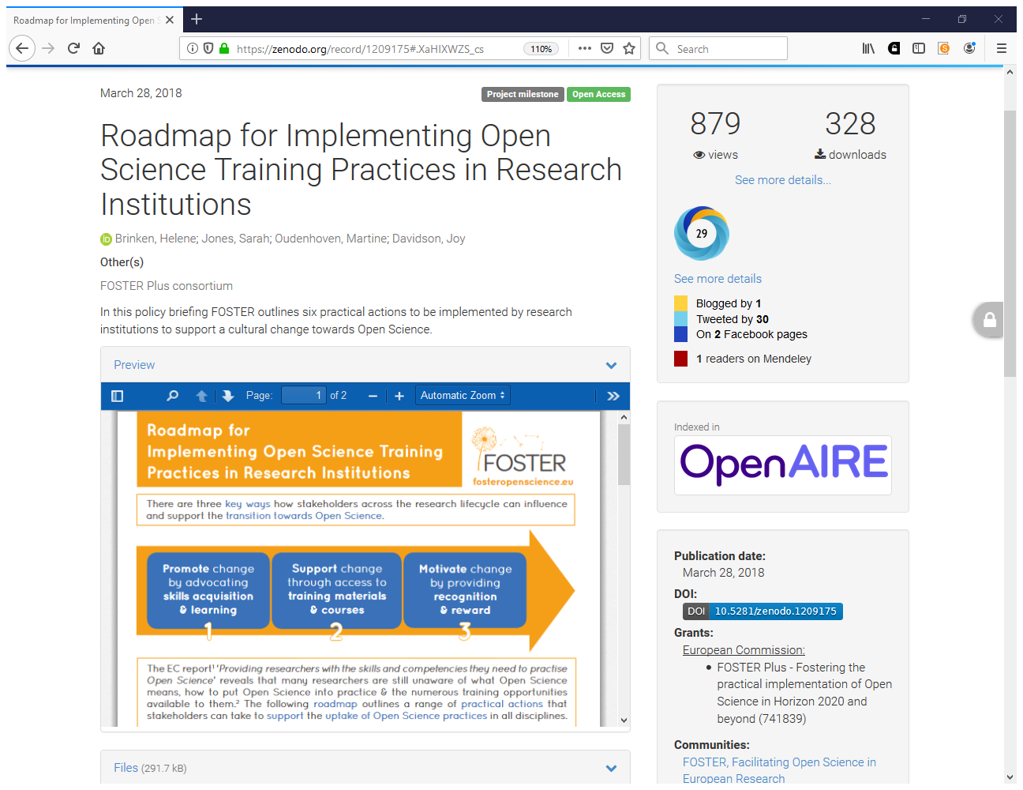
https://zenodo.org/record/1209175#.XaHIXWZS _cs

Slide 47
Roadmap for Implementing Open Science Training Practices
Integrate open science content in researcher training by embedding training modules focused on practical skills into ongoing educational programmes on a regular and standardized basis from as early as possible.
Tailor open science resources to research disciplines.
10.5281/zenodo.1209175

Slide 48
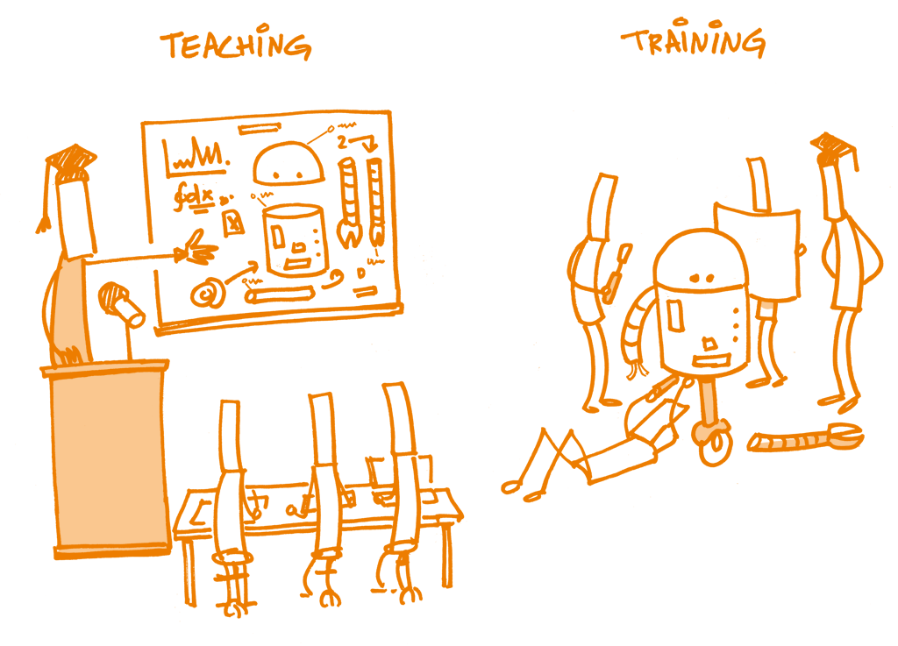
Hands-on & interactive

Slide 49
Roadmap for Implementing Open Science Training Practices (2)
Support and promote open science skills acquisition. The young generation of scientists and researchers is a major audience for training. Supervisors and researchers guide their mentees and are therefore an important target group to recognize the value of open science training, too.
10.5281/zenodo.1209175

Slide 50
Roadmap for Implementing Open Science Training Practices (3)
Recognize and reward open science skills. Students and researchers are more likely to make an effort to gain skills if these are deemed relevant for their career progression. Stakeholders across the research lifecycle should reward early career researchers by including open science practices in evaluation processes and awarding efforts with credits or other formal certificates.
10.5281/zenodo.1209175

Slide 51
From a public library system, how do we best deal with issues to do with OA? What value can we add to this?
(Sharon Munshya)

Slide 52
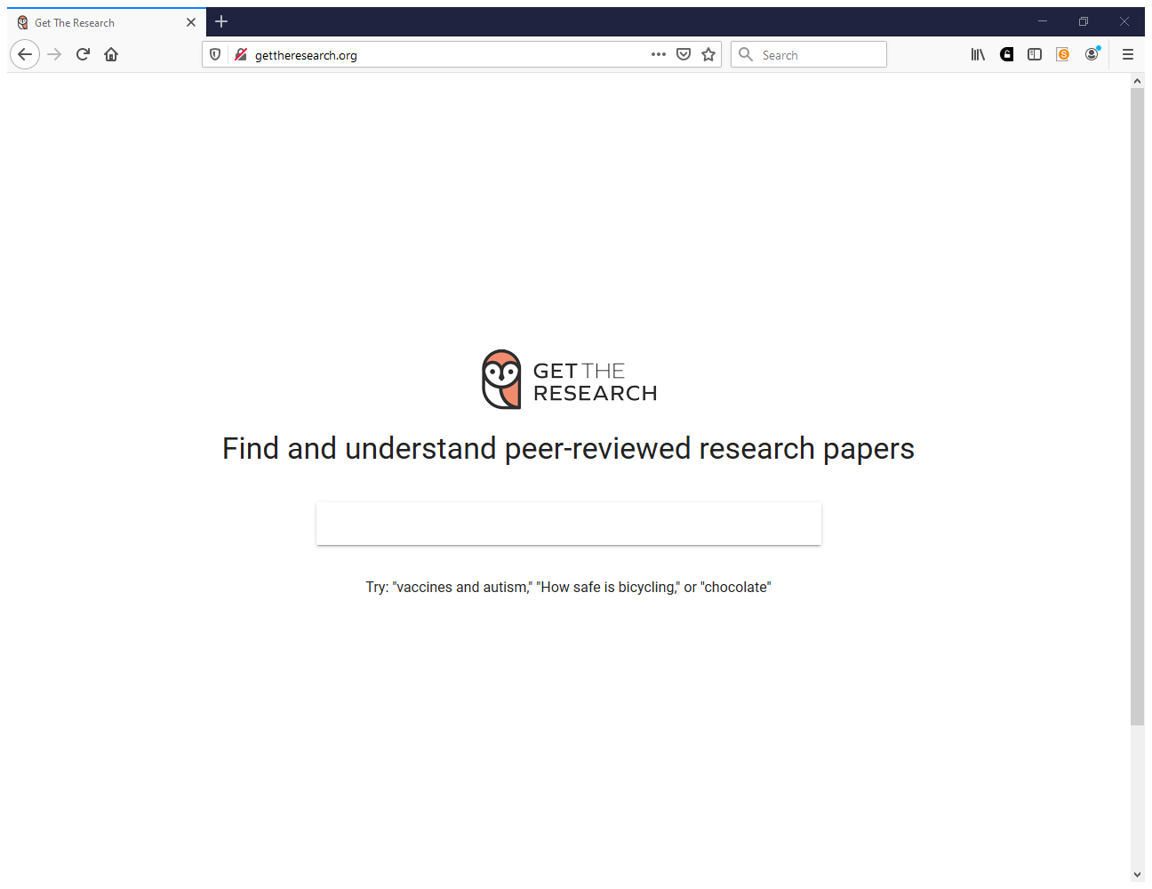
http://gettheresearch.org

Slide 53
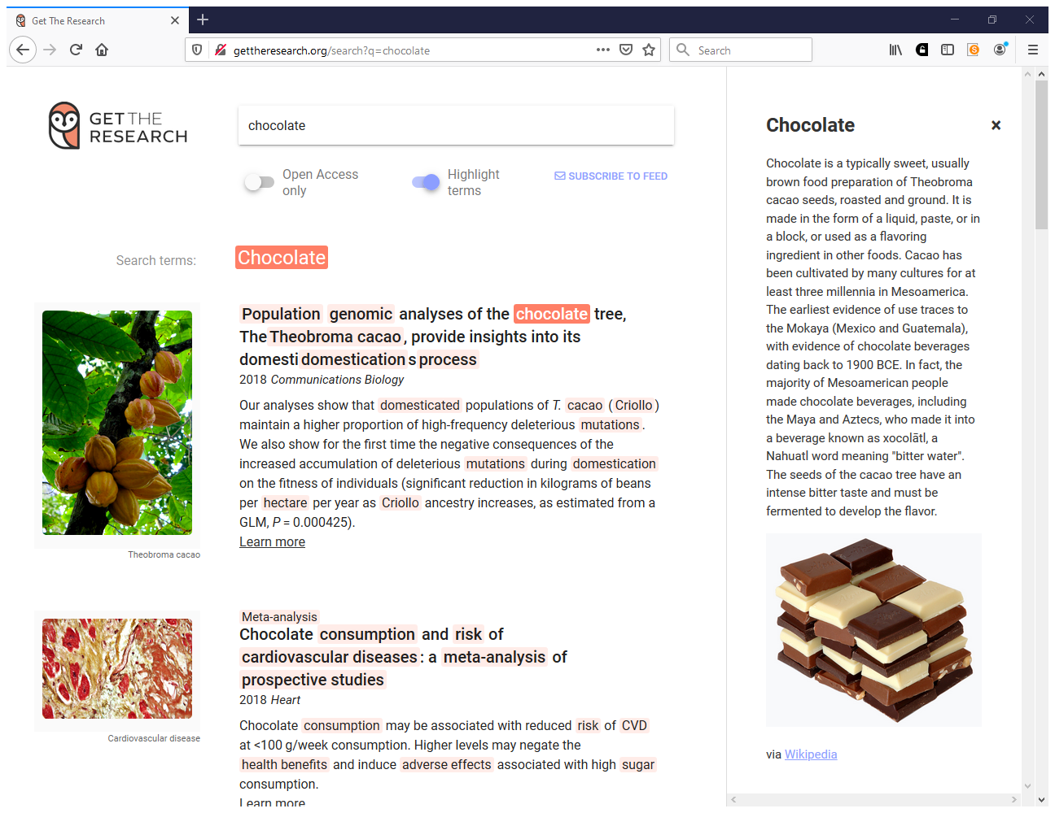

Slide 54
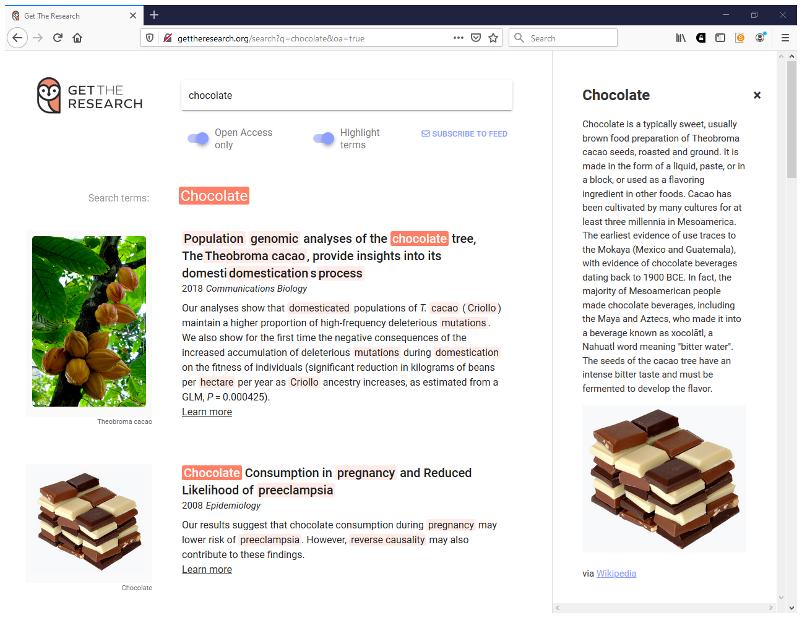

Slide 55
Your questions
Building open access institutional repository (KAKPO ADJOH HORTENSE ÉPSE OUATTARA)
How to involve policy makers (Souleymane Sogoba)
OA in Africa (Khaled Mettai)
Link between open access and social justice (Nkem Osuigwe)
Why don't some lecturers bother to do research? (Izaruku Ronald)
How to convince my colleagues to write and submit their papers in journals? (Elizabeth Bitegela)

Slide 56
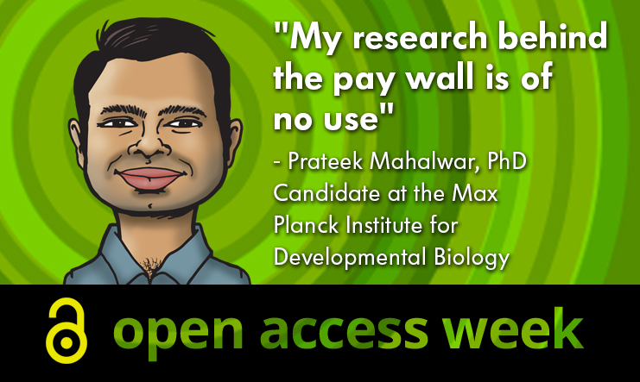

Slide 57
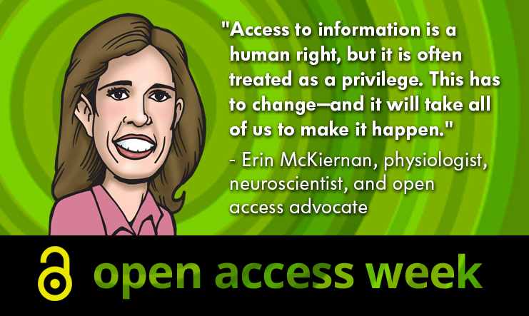

Slide 58
Limited content or submissions and poor research environments
“The indifference of researchers submitting their work to the repository and prefer to submit it to other academic social media platforms such as ResearchGate and Academia is still a problem. The poor research ecosystems which cannot fund, monitor, collect easily, plan for dissemination of research in our institutions are a fundamental problem. It was difficult for several librarians when some researchers told them that the institutions did not fund their research; so they couldn’t feel the motivation to submit it to the institutional repository. From this, however, most institutions have focused on submitting electronic theses and dissertations (ETDs).” David Bukenya, UCU about “OA policy development in Uganda to make more digital content available” project

Slide 59
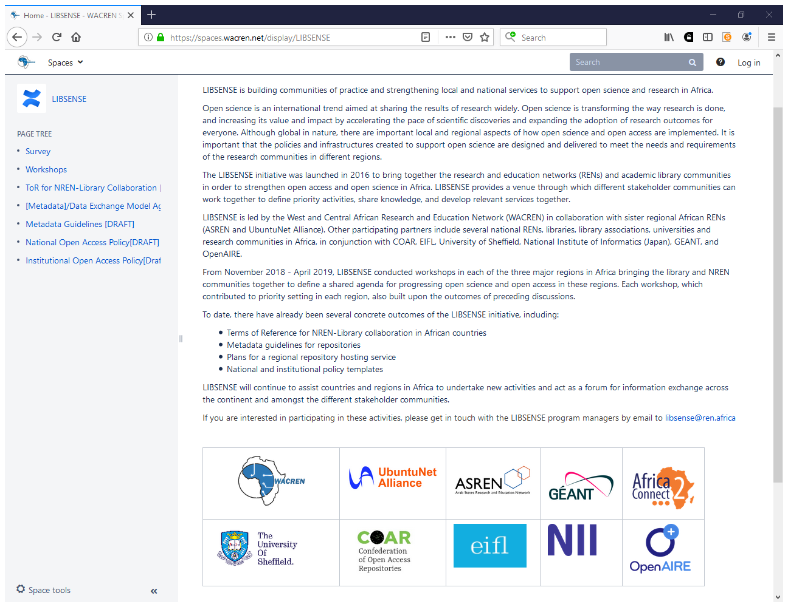
https://spaces.wacren.net/display/LIBSENSE

