Slide 1

Global Outlook::Digital Humanities
Brian Rosenblum (University of Kansas, brianrosenblum@ku.edu, @blros)
Quinn Dombrowski (Stanford University, qad@stanford.edu, @quinnanya)

Slide 2
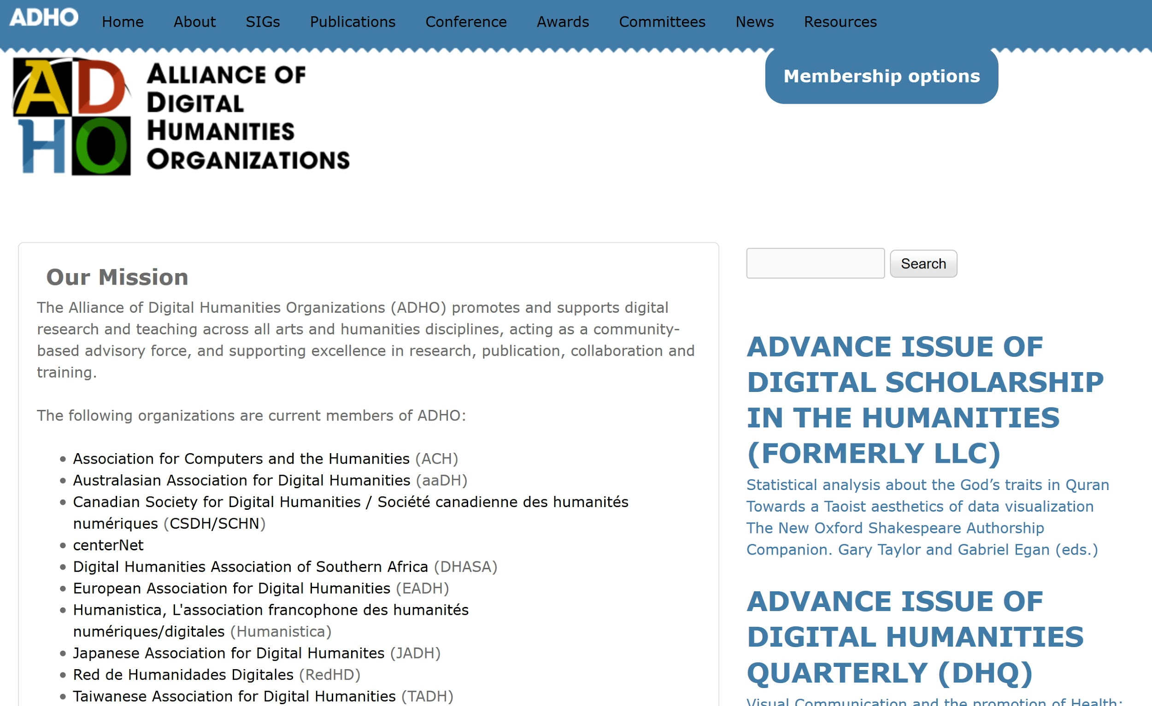
http://adho.org

Slide 3
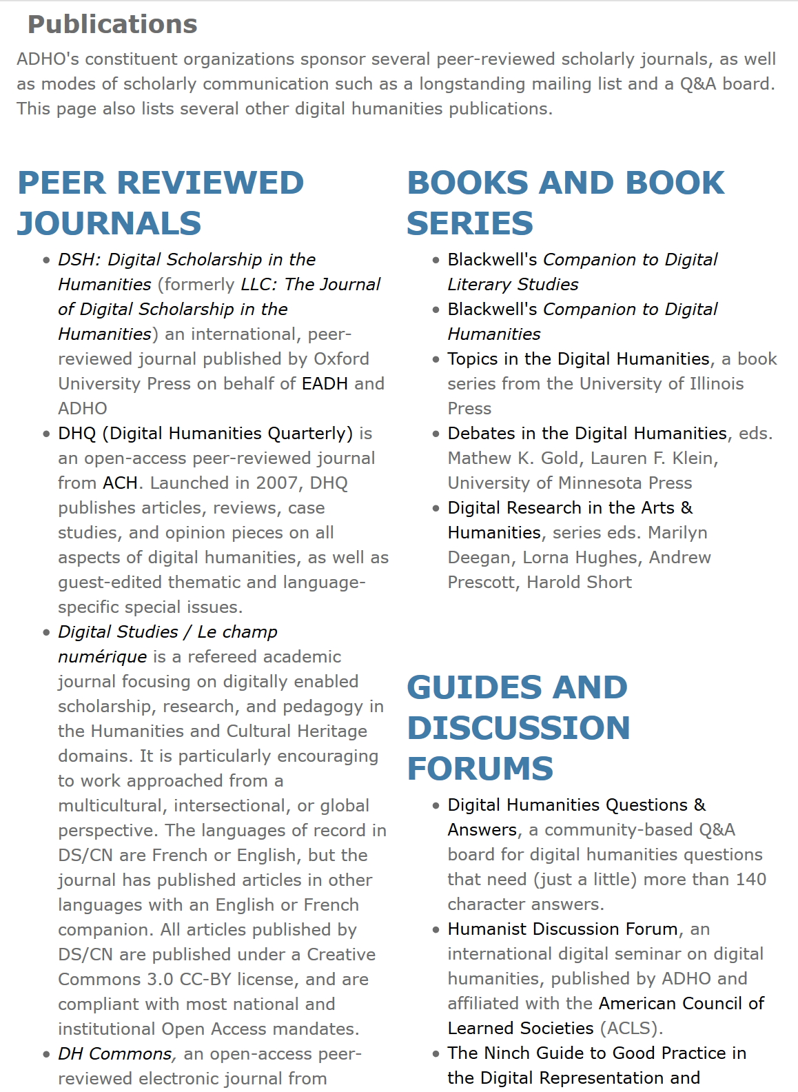

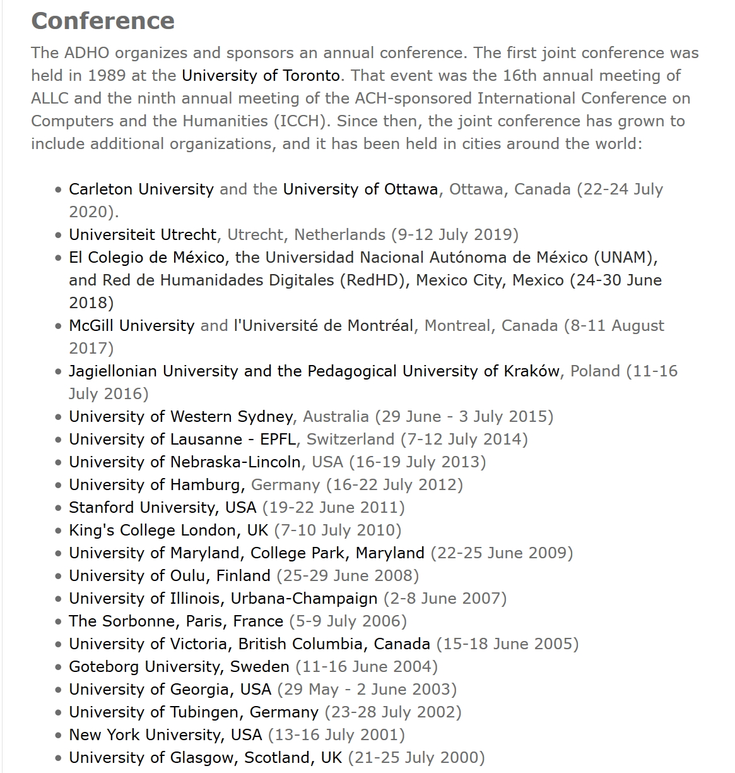
ADHO Publications, Conference, Special Interest Groups

Slide 4
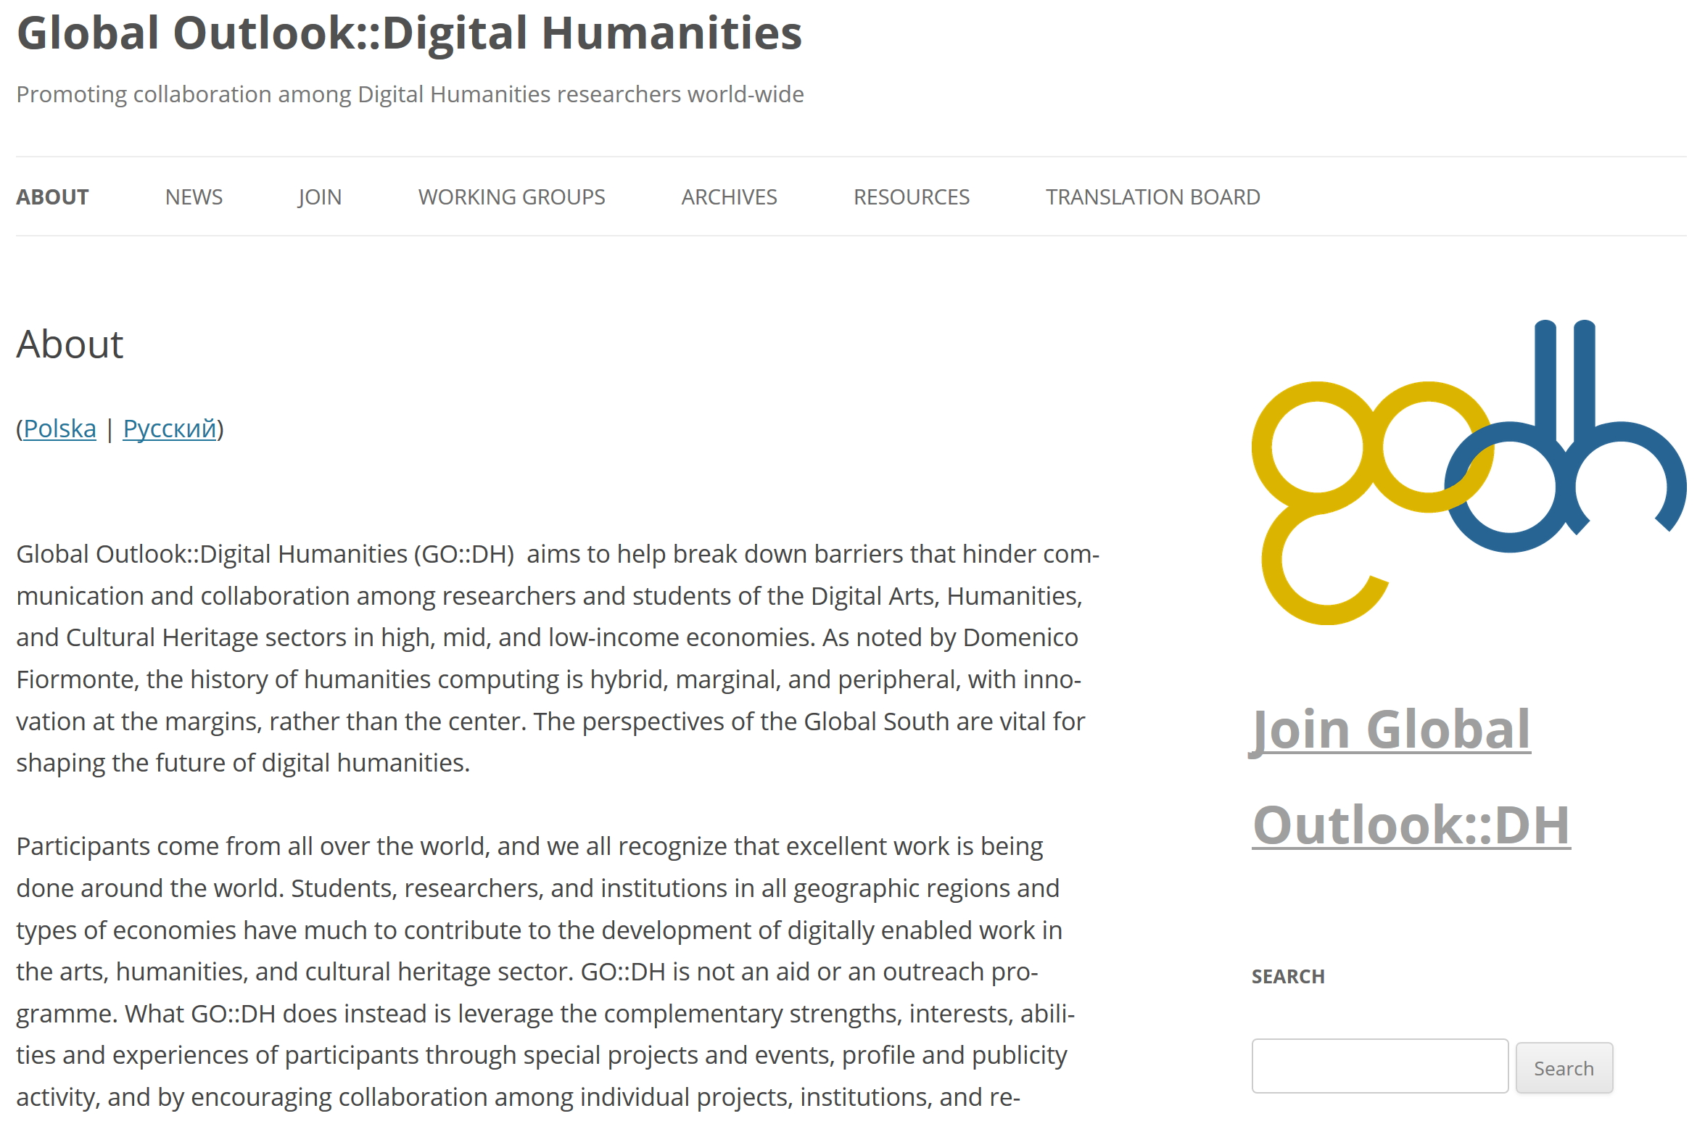
http://globaloutlookdh.org

Slide 5
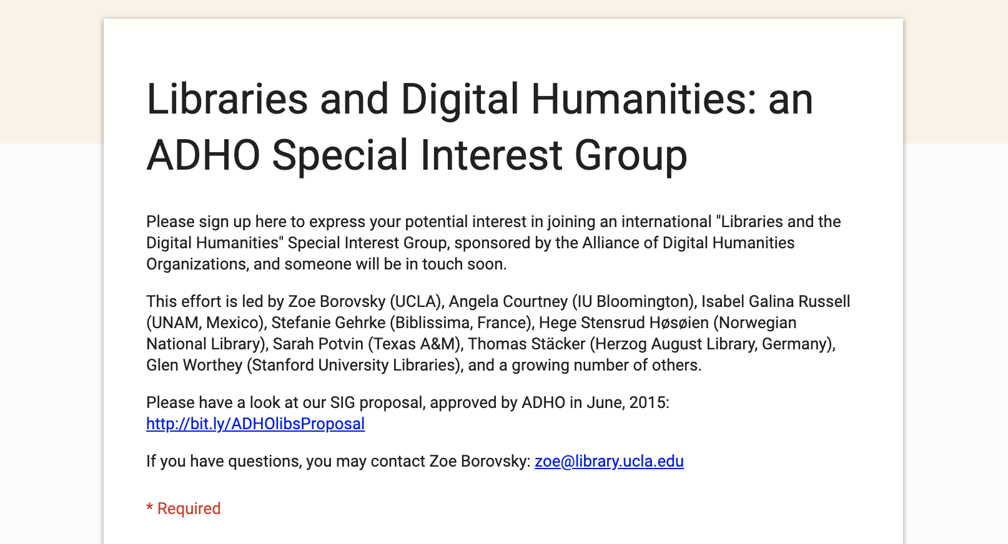
Libraries and DH special interest group
http://tiny.cc/adholibsig

Slide 6
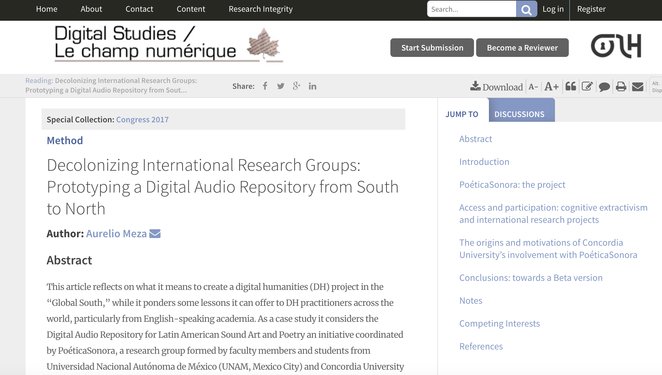
Digital Studies / Le Champ Numerique series
http://tiny.cc/godhpub

Slide 7
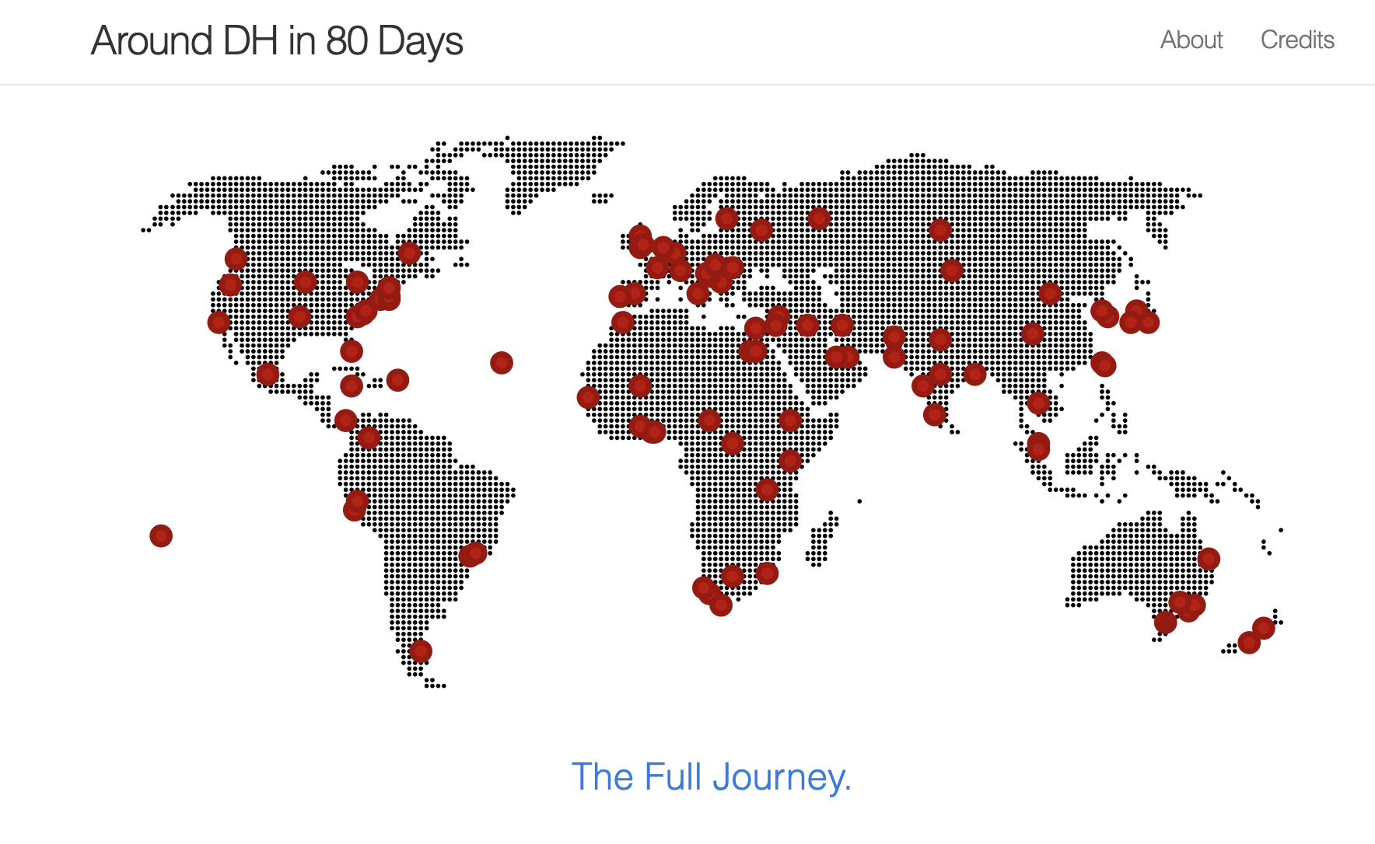
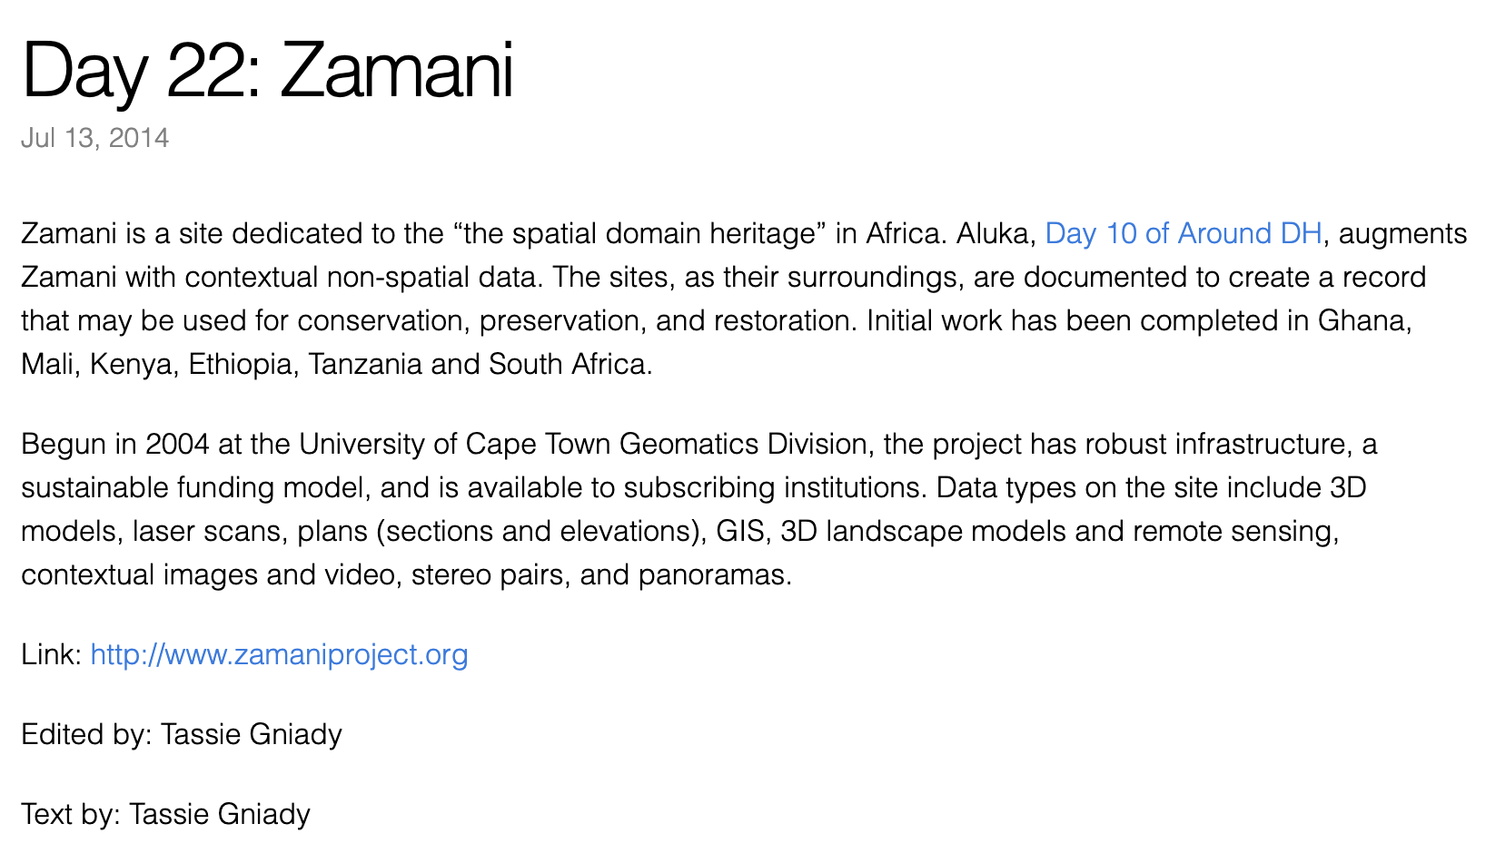
Around DH 2020
http://tiny.cc/arounddh2020

Slide 8
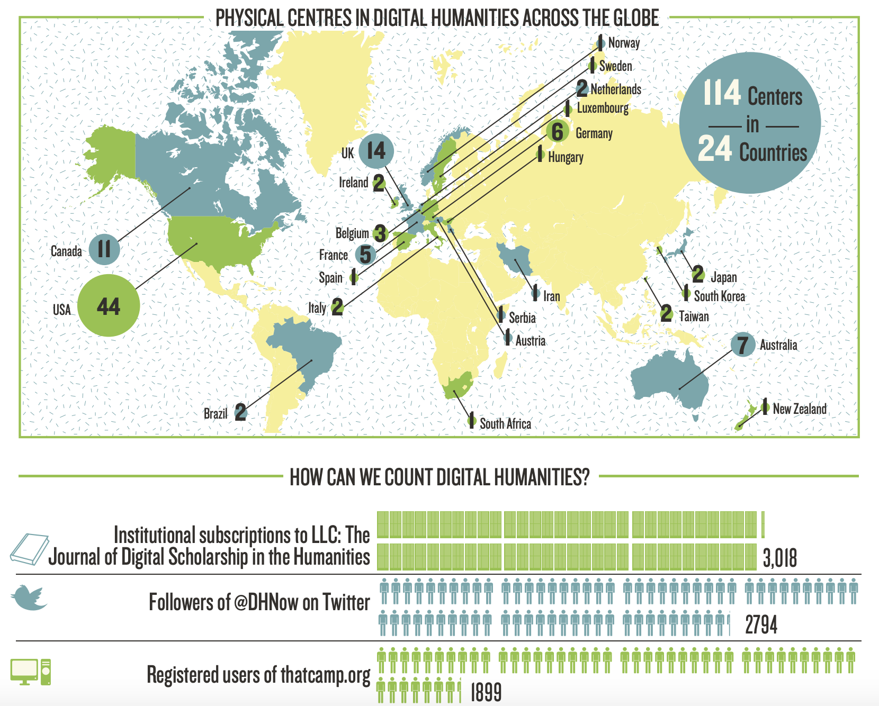
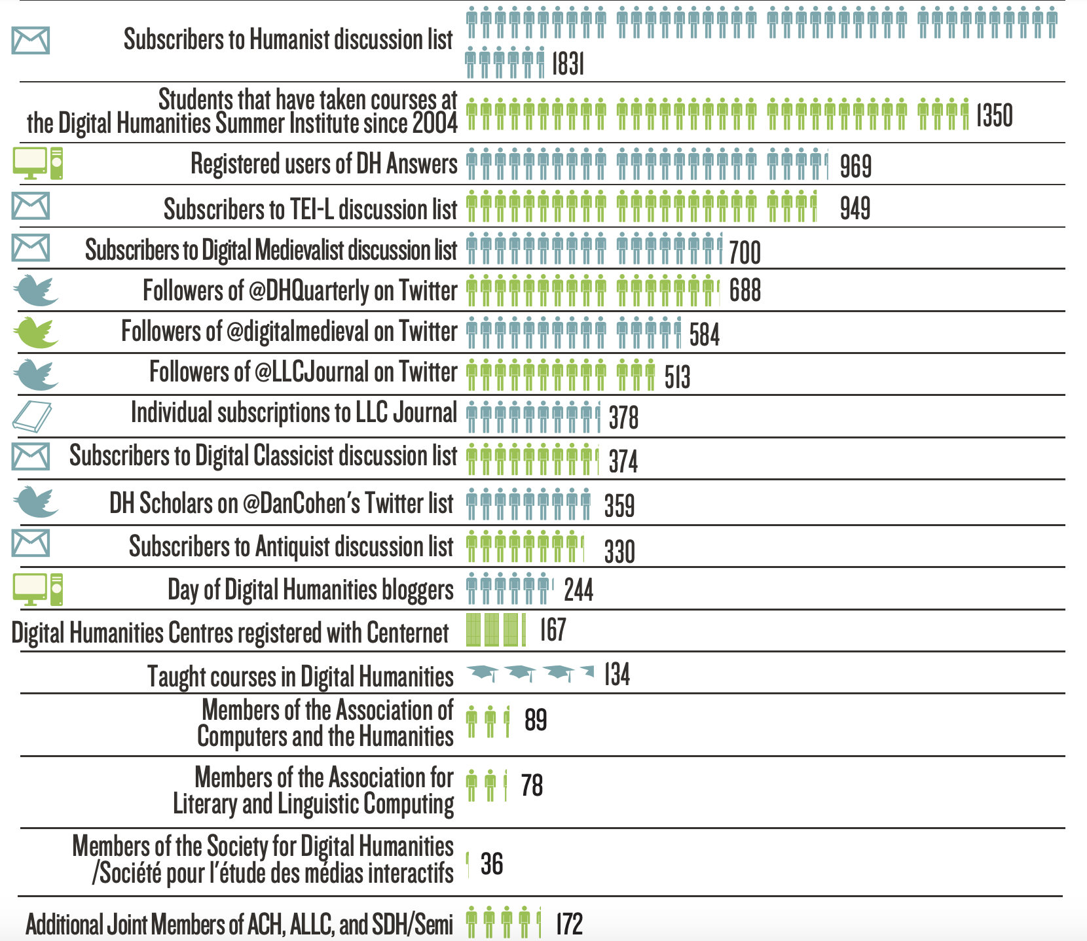
“Quantifying DH” infographic revisited
http://tiny.cc/arounddh2020

Slide 9
Some ways to get involved in GO::DH right now!
1. Sign up for the email list at: http://globaloutlookdh.org/join
2. After you join, if you want, send a message to the list introducing yourself, share your interests, questions, projects…..
3. Tell your friends and colleagues and encourage them to sign up
4. Follow on Twitter (@GlobalOutlookDH) & Facebook (https://www.facebook.com/globaloutlookdigitalhumanities)
5. Suggest projects you are involved with for Around DH 2020 (http://tiny.cc/arounddh2020)
6. Submit articles to the Digital Studies cluster (http://tiny.cc/godhpub)
7. Suggest your own project ideas
8. Run for GO::DH exec board
Notes:
So, we’d like to end by encouraging you to join GO::DH, to get involved as much as you want, by signing up for the email list, sharing ideas and resources, asking questions, proposing initiatives, becoming involved on the GO::DH board.
1. Sign up for the email list at: http://globaloutlookdh.org/join.
Membership simply consists of signing up for the email list, which allows you to participate in discussions as well as to vote and be eligible to serve on the GO::DH steering committee and participate in other initiatives.
2. After you join, if you want, send a message to the list introducing yourself, letting the community know of your interests, questions, projects, connections.
3. Spread the word to your friends and colleagues and encourage them to sign up. Librarians in particular, if you are working with scholars at your institutions who are doing digital humanities work or are interested in it, please let them know about GO::DH as a place to connect with other practitioners and resources.
4. Follow GO::DH on twitter or facebook
5. Suggest projects you are involved with for Around DH 2.0 project that Quinn mentioned. There will be more information about that forthcoming.
6. Propose your own ideas and initiatives……!
7. Serve on the GO::DH steering committee (next round of elections will take place in January).
8. ??? Anything you want..you have the opportunity to make GO::DH your own organization. It is what the members make of it, and it needs you!
9. Finally, if anyone is interested in organizing further webinars, training, or other kinds of conversations between your local institutions and communities and GO::DH, or between EIFL and GO::DH, please get in touch with any one of us, or with Iryna, and let us know. We would be happy to talk further. I know Adam Crymble is interested in developing the same relationships for Programming Historian, so I’m now going to turn it over to him. Thank you all!

