Slide 1


CORE : free services for libraries
Tuesday 24 March 2020
Nancy Pontika
Big Scientific Data and Text Analytics Group
Knowledge Media Institute, The Open University

Slide 2
OA Aggregations and BOAI 2002
By "open access" to this literature, we mean its free availability on the public internet, permitting any users to read, download, copy, distribute, print, search, or link to the full texts of these articles, crawl them for indexing, pass them as data to software, or use them for any other lawful purpose, without financial, legal, or technical barriers other than those inseparable from gaining access to the internet itself …
Budapest Open Access Initiative, 2002

Slide 3
OA Aggregations and BOAI 2002
“To achieve open access to scholarly journal literature, we recommend two complementary strategies.
Self-Archiving: First, scholars need the tools and assistance to deposit their refereed journal articles in open electronic archives, a practice commonly called, self-archiving. When these archives conform to standards created by the Open Archives Initiative, then search engines and other tools can treat the separate archives as one. Users then need not know which archives exist or where they are located in order to find and make use of their contents.
…”
Budapest Open Access Initiative, 2002

Slide 4
Global network of repositories
“A single scientific repository is of limited value, real benefits come from the ability to exchange data within a network …
… interoperability allows us to exploit today's computational power so that we can aggregate, data mine, create new tools and services, and generate new knowledge from repository content.”
Confederation of Open Access Repositories (COAR)

Slide 5

CORE’s mission
Aggregate all open access research articles worldwide …
… enrich this content and provide seamless access to it through a set of data services …
https://core.ac.uk/about/#mission

Slide 6

Types of content providers
CORE harvests from everywhere:
Repositories
  Institutional
    Includes repository and CRIS platforms
  Disciplinary
Journals
  Pure Open Access
  Gold Open Access
  Hybrid Gold Open Access

Slide 7
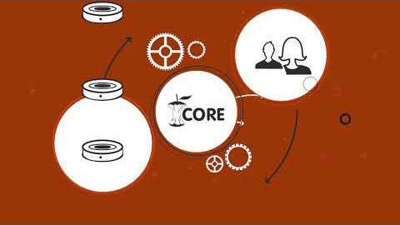
Introducing CORE

Slide 8
CORE videos
Introducing CORE
https://core.ac.uk/about/#mission
Access to raw data
https://core.ac.uk/services/#access-to-raw-data
CORE content and discovery
https://core.ac.uk/services/#content-discovery

Slide 9
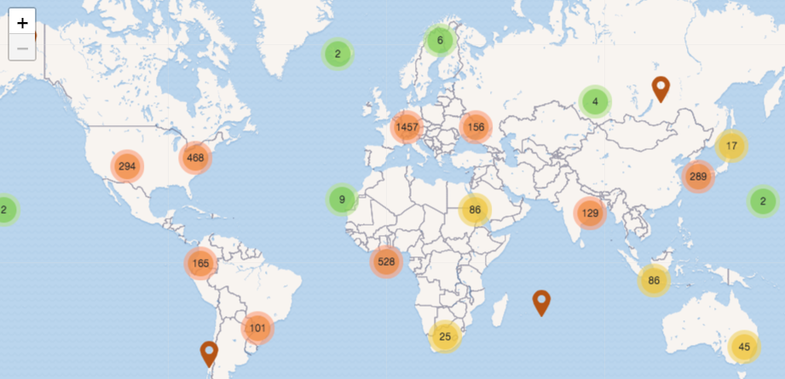
World’s largest dataset of Open Access full texts
Access to free to read full texts
24,936,921
Hosted full texts
19,027,223
Metadata records
177,444,117
Data providers
9,868
List of content providers https://core.ac.uk/data/providers/

Slide 10
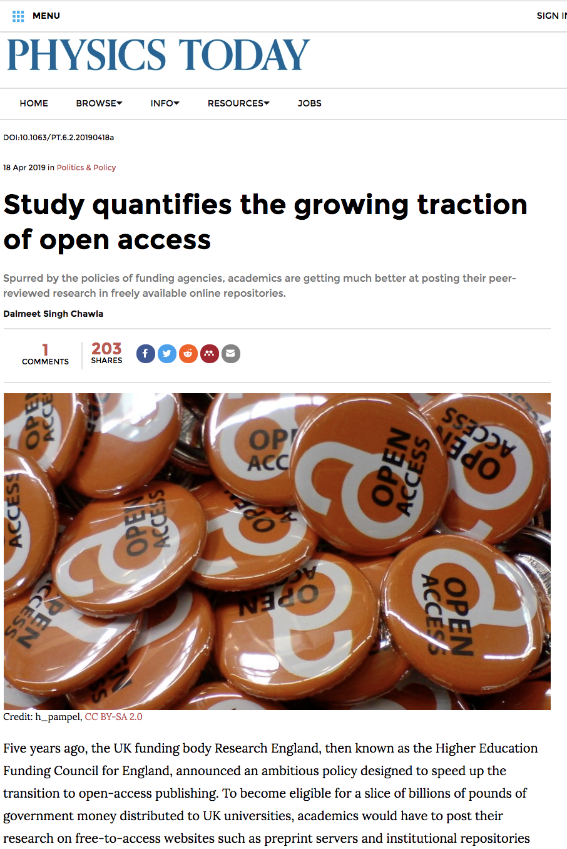
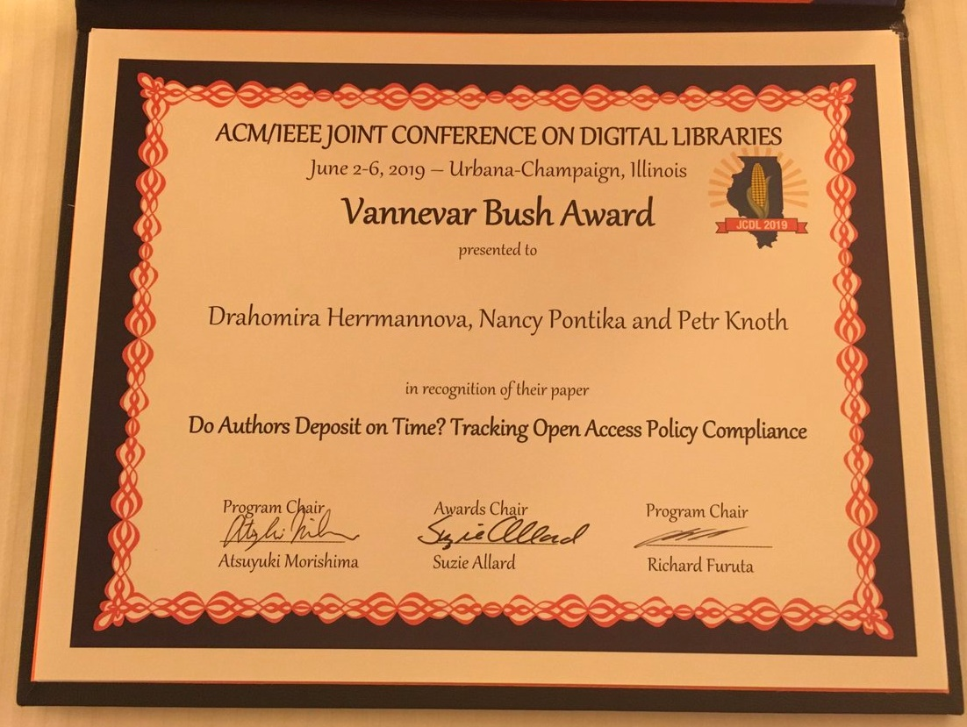
Papers OA sooner and sooner
JCDL 2019 Best Paper Award
https://physicstoday.scitation.org/do/10.1063/PT.6.2.20190418a/full/

Slide 11
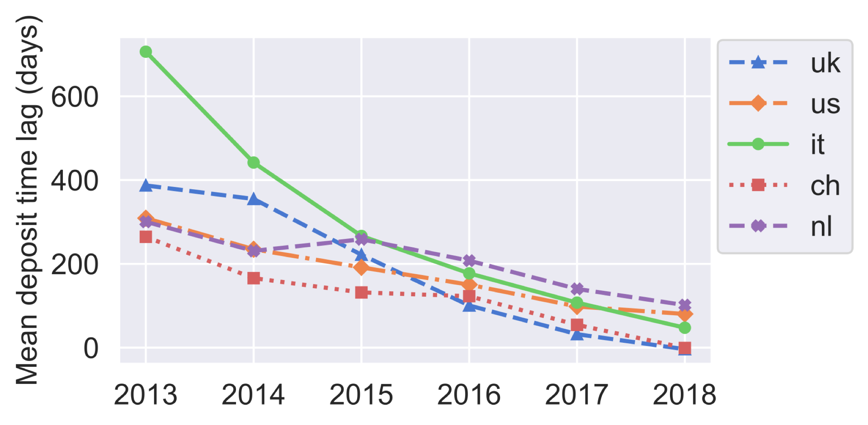
Papers OA sooner and sooner
The delay between publication and OA availability decreasing globally
Herrmannova, Drahomira; Pontika, Nancy and Knoth, Petr (2019). Do Authors Deposit on Time? Tracking Open Access Policy Compliance. In: 2019 ACM/IEEE Joint Conference on Digital Libraries, 2-6 Jun 2019, Urbana-Champaign, IL

Slide 12
Faster open access makes repository infrastructure more important

Slide 13
We don’t need just open access
we need fast open access

Slide 14
This study was only possible to conduct because of repositories and aggregators working together

Slide 15
Need for more interoperability across systems

Slide 16
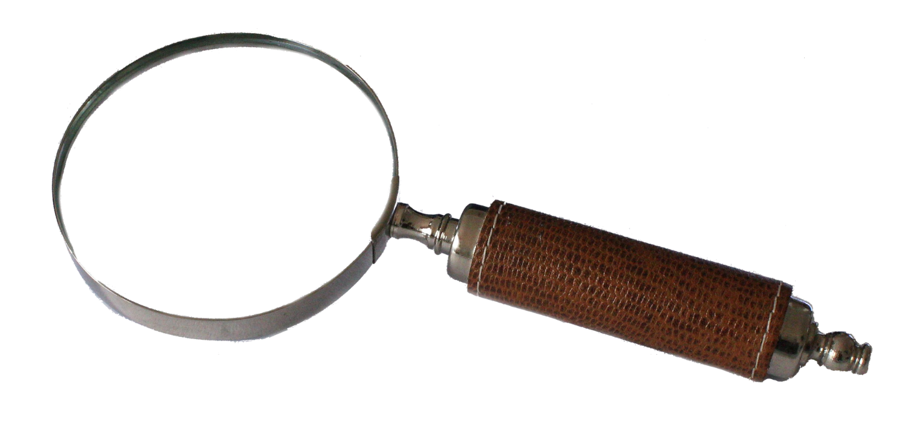
Discovery landscape
Search services
  Title, author, keywords, etc.
  And integrations into them
Recommender services
  Similar resources
OA Discovery/Delivery services
  Overcoming publishers’ paywalls by discovering open access versions of papers

Slide 17
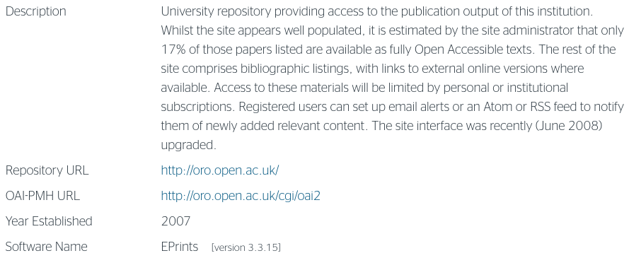
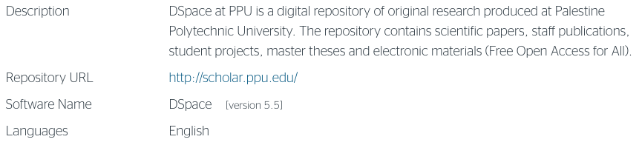
OpenDOAR
???

Slide 18
Call to action: OpenDOAR record
Ensure that oai base url is saved in OpenDOAR

Slide 19
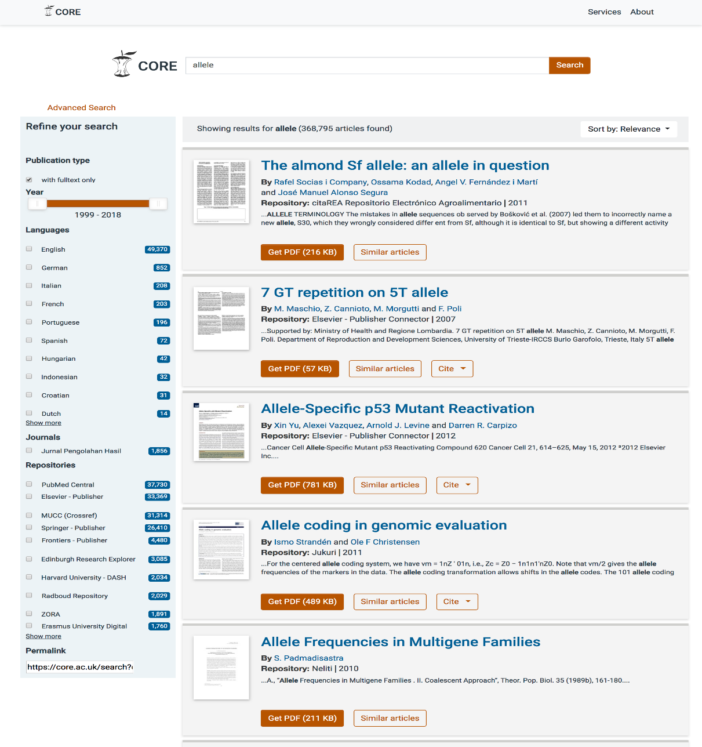
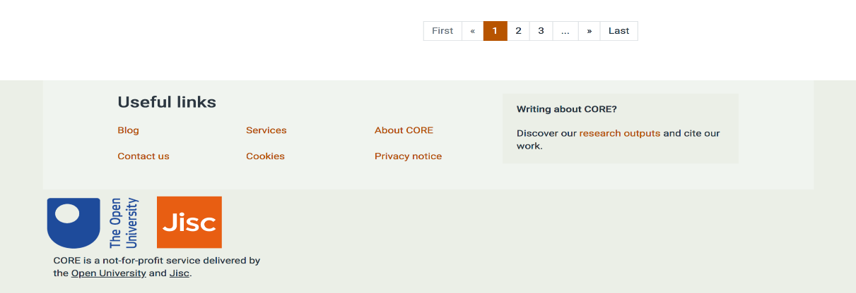
CORE Search
Full text search for OA content
Faceted searching
What you find is what you get
Real change of data providers wanting to be included

Slide 20
Call to action: CORE Search
Add CORE Search in the library pages and guides

Slide 21
Introducing CORE Discovery
High coverage of freely available content
Free service for researchers by researchers. No company controlling the pipes.
Best grip on open repository content.
Repository integration
Discovering documents without a DOI.
https://core.ac.uk/services/discovery/

Slide 22
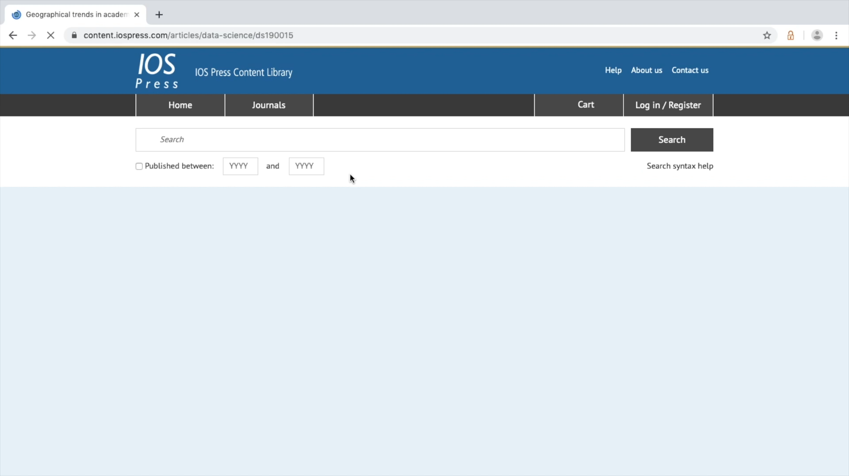
CORE Discovery demonstration

Slide 23
Call to action: CORE Discovery
Spread message about CORE Discovery to library users
Install CORE Discovery to library computers

Slide 24
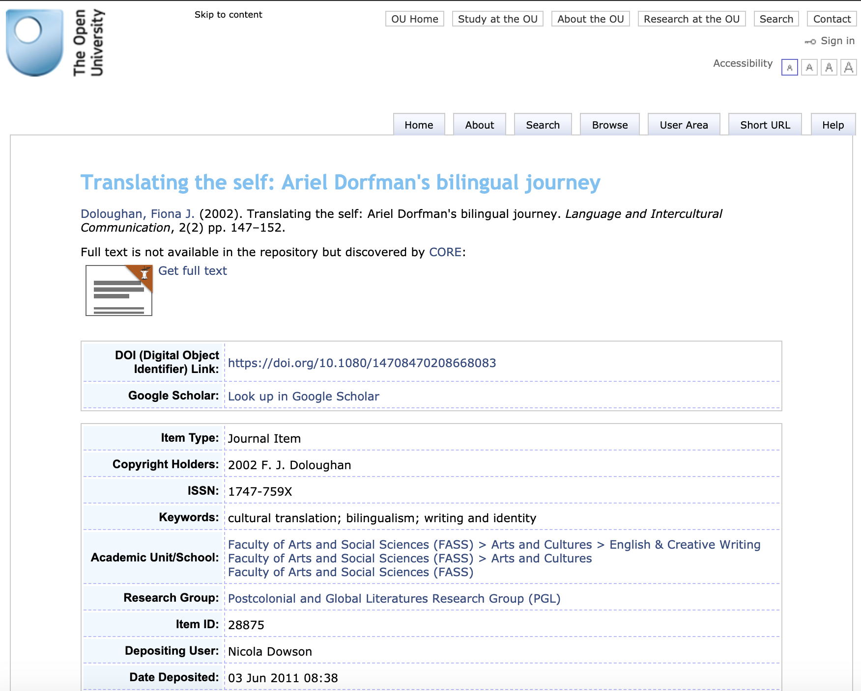
CORE Discovery Repository integration
Majority of articles in repositories metadata only.
CORE Discovery repository plugin:
  turns dead ends of user journeys into journeys fulfilling users’ information needs
  makes repository content more discoverable.
https://core.ac.uk/services/discovery/

Slide 25
Call to action: CORE Discovery Repository Plug-in
Install CORE Discovery Repository Plugin to your repository

Slide 26
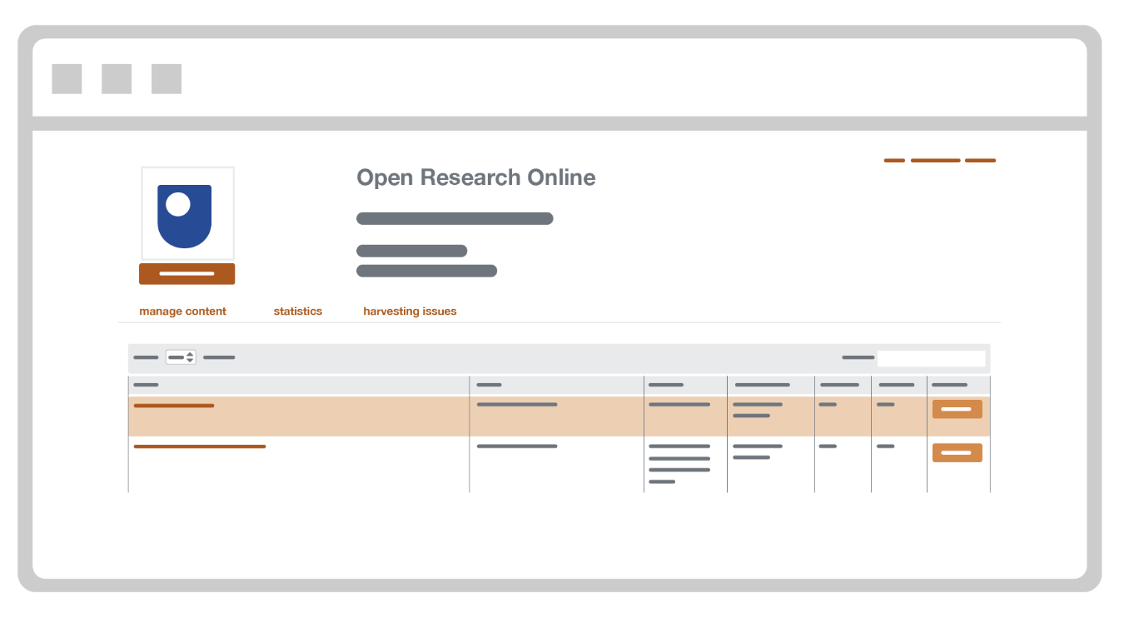
CORE Repository Dashboard
Access to the content harvested from the repository.
Enables content management, by requesting metadata updates or managing take down requests.
Access to all detected technical issues and suggestions for improving the efficiency of harvesting and the quality of metadata.
Statistics regarding the repository content.
https://core.ac.uk/services/repository-dashboard/

Slide 27
Call to action: CORE Repository Dashboard
Contact us for an account to the CORE Repository Dashboard
theteam@core.ac.uk

Slide 28
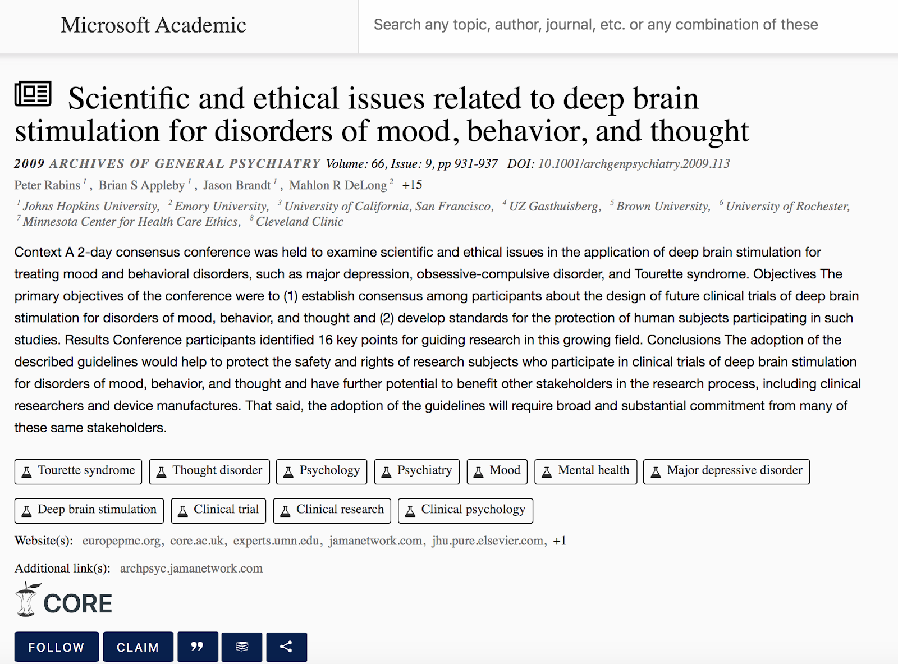

Example integrations with existing library systems
CORE is integrated with Microsoft Academic Search

Slide 29


Ongoing integrations …
Ontochem, Wheesbee and others
  CORE articles searchable from within specialised search engines
PMC LinkOut
  Full texts of CORE articles to be discoverable from within PMC.
ProQuest Summon and Primo
  Singed contract and awaiting from technical work to be commenced
Lean Library
  Recent integration with Lean Library’s content.

Slide 30
Types of collaborations
Companies
HEIs
Funders
https://core.ac.uk/about/endorsements/

Slide 31
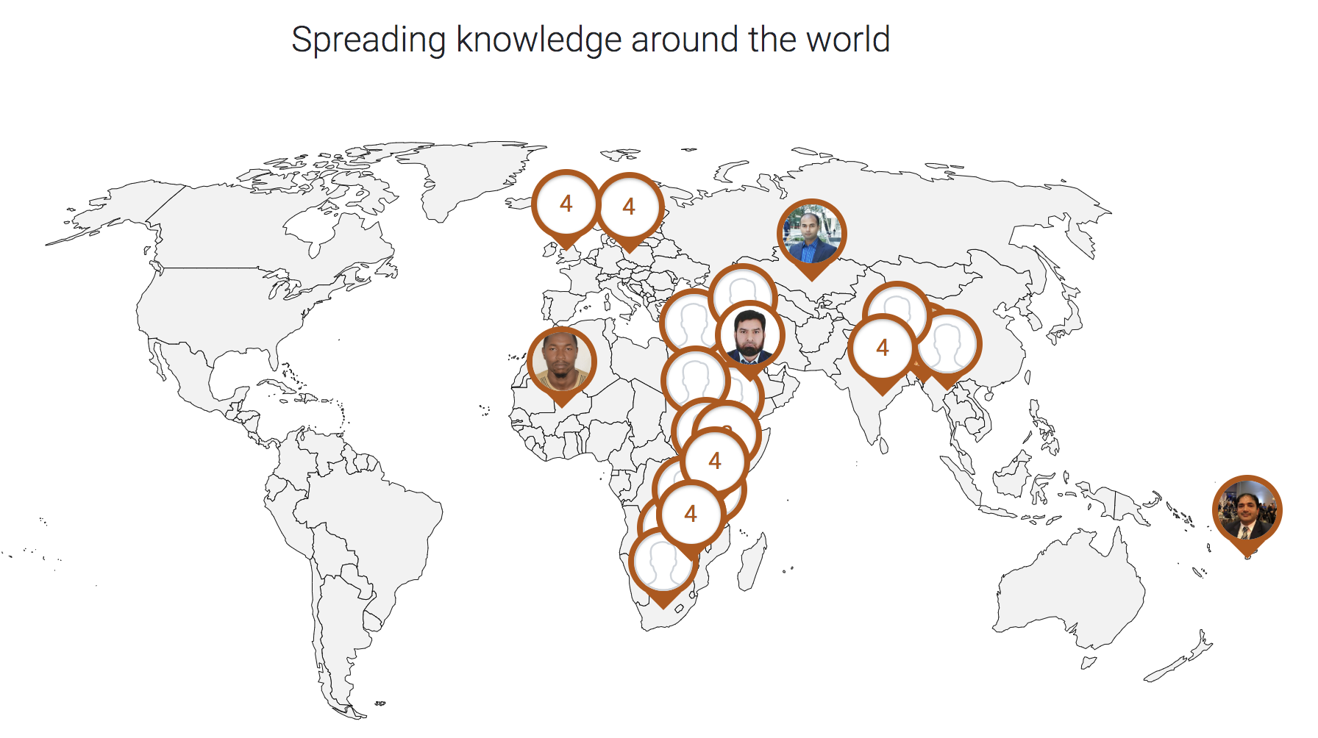
CORE looks for Ambassadors
http://bit.ly/COREambassadors

Slide 32
Call to action: CORE Ambassador
Contact us to become a CORE Ambassador
theteam@core.ac.uk

Slide 33
Thank you!
Website: core.ac.uk
Email: theteam@core.ac.uk
Twitter: @oacore

