Slide 1
The SAGE Open Access Portal
Author Journey
Notes:
Asked to talk to you about the SAGE Open Access Portal or SOAP as it is known internally.
For those of you that don’t know me, I’m Hannah and I’m the OA Operations Manager and sit within open access editorial.

Slide 2
Country-based Waivers
Author Journey

Slide 3
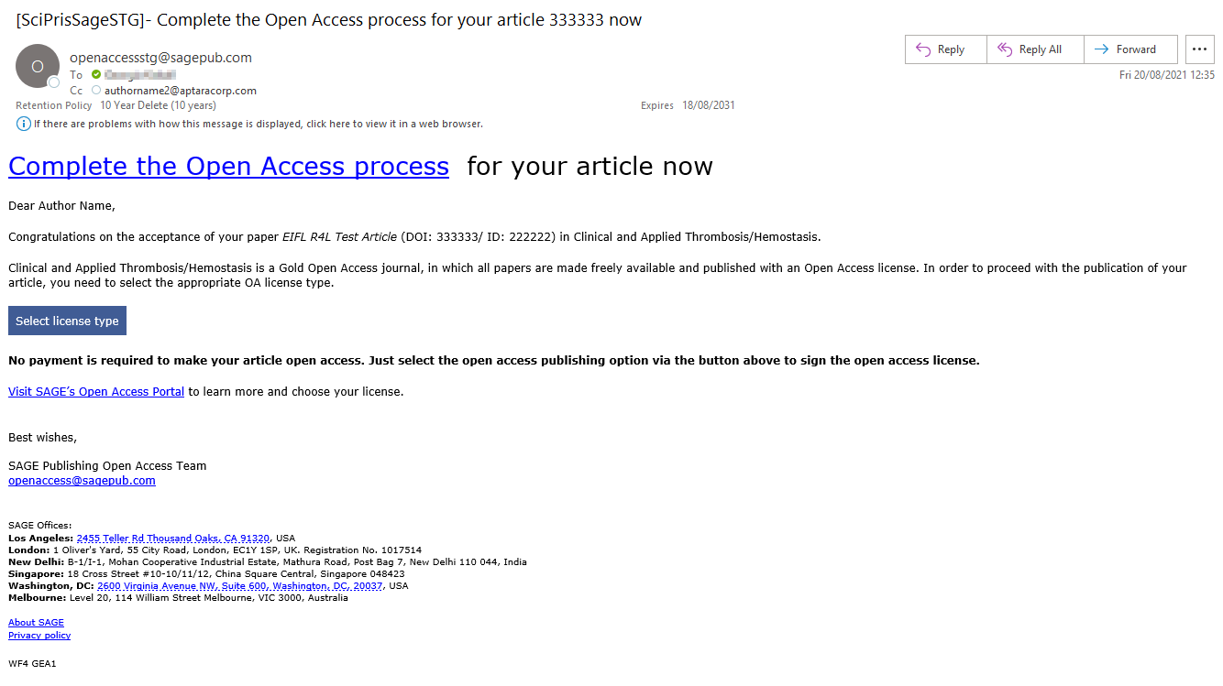
Notes:
Authors are notified by email that their paper has been accepted and asked to select a licence type by clicking the link which takes them to the SAGE Open Access Portal. They are informed that no payment will be required.

Slide 4
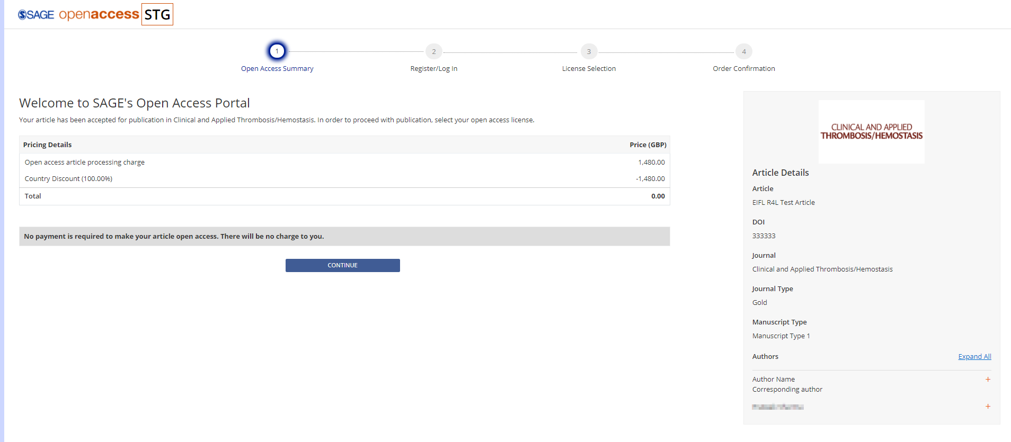
Notes:
Stage 1 “Open Access Summary”:
The author is shown a breakdown of the Article Processing Charge including the 100% Research4Life discount.

Slide 5
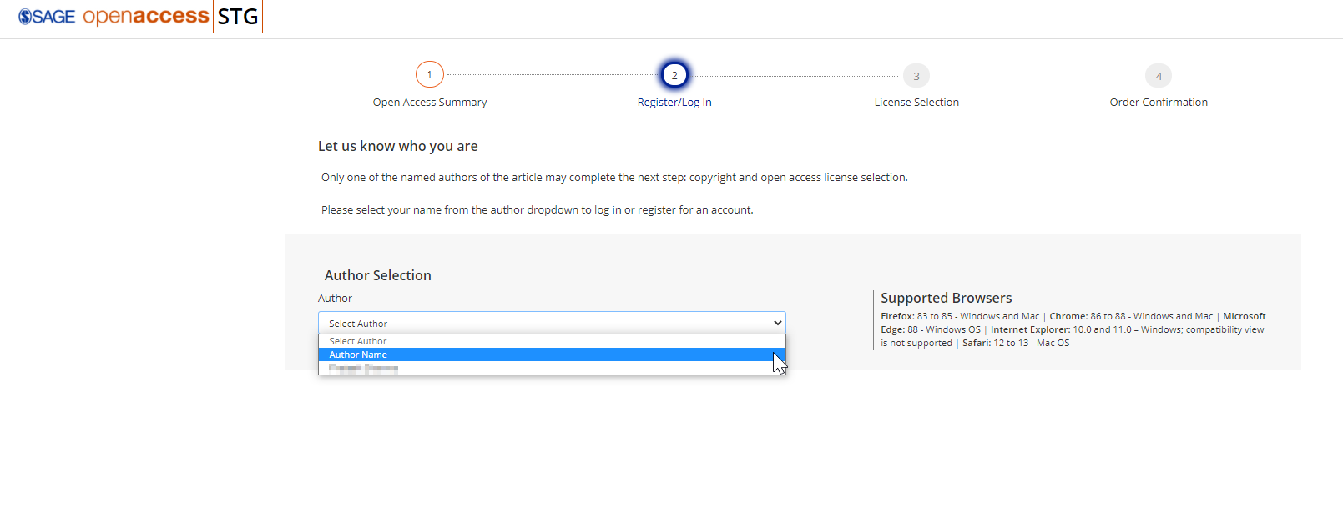
Notes:
Stage 2 “Register/Log in”:
The author will select their name from the drop-down box. All author names will be displayed.
The author will proceed to create an account in the portal.

Slide 6
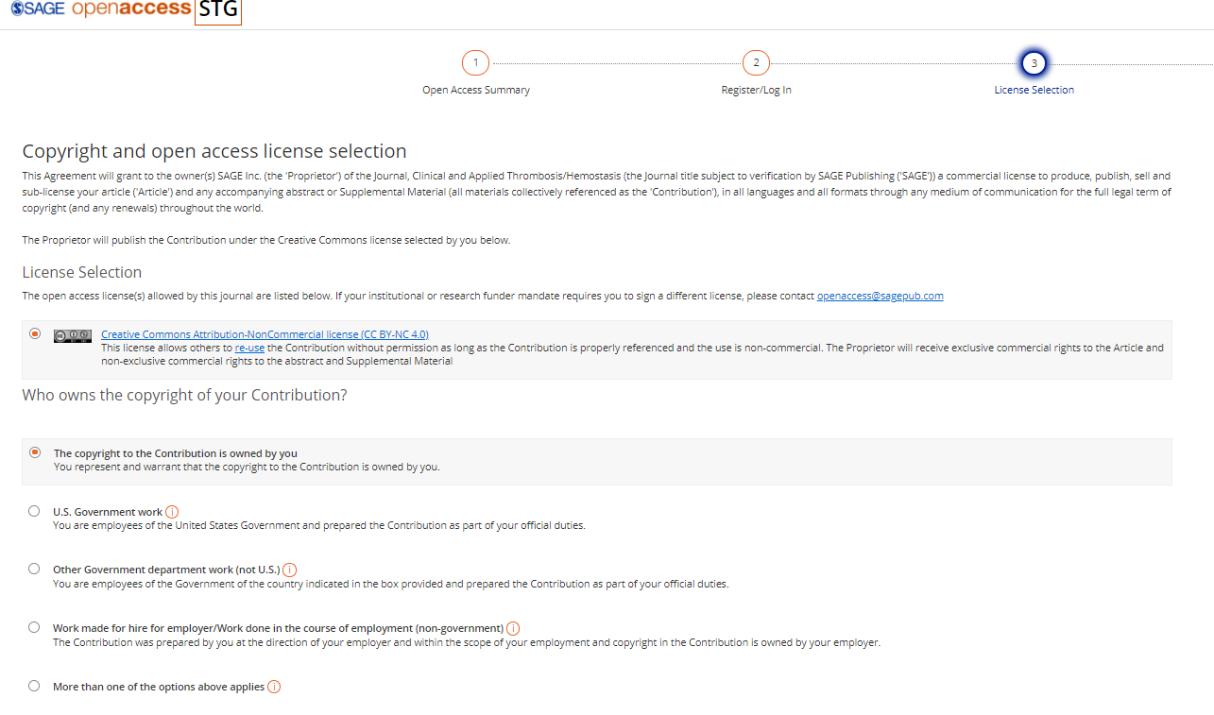
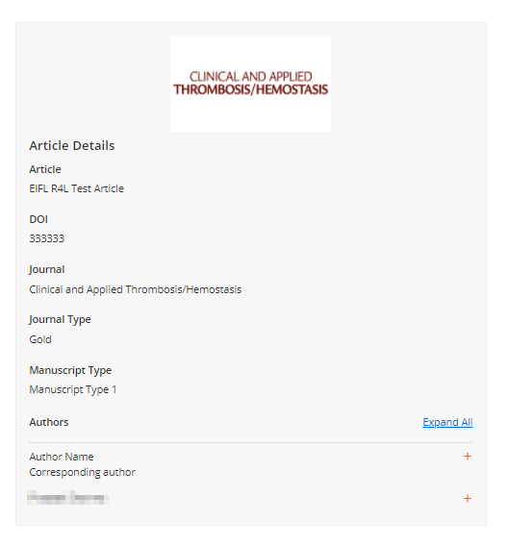
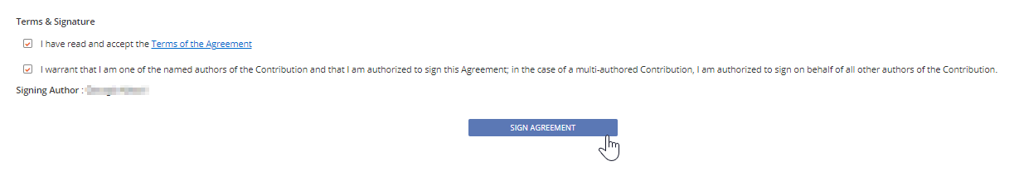
Notes:
Stage 3 “Licence Selection”:
The author selects a licence type and copyright contribution – the licence options given are dependent upon the journal.
Before signing the licence, the author is asked to read and accept the terms of agreement

Slide 7
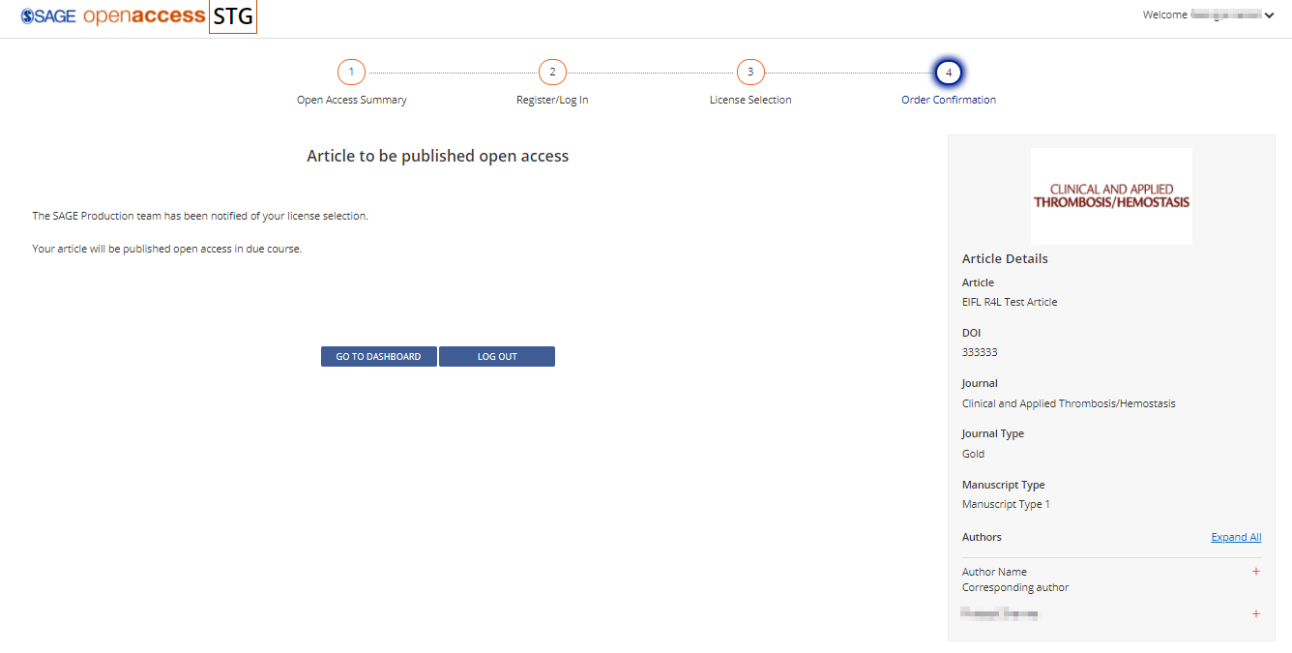
Notes:
Stage 4 “Order Confirmation”:
End of author journey in the portal.

Slide 8
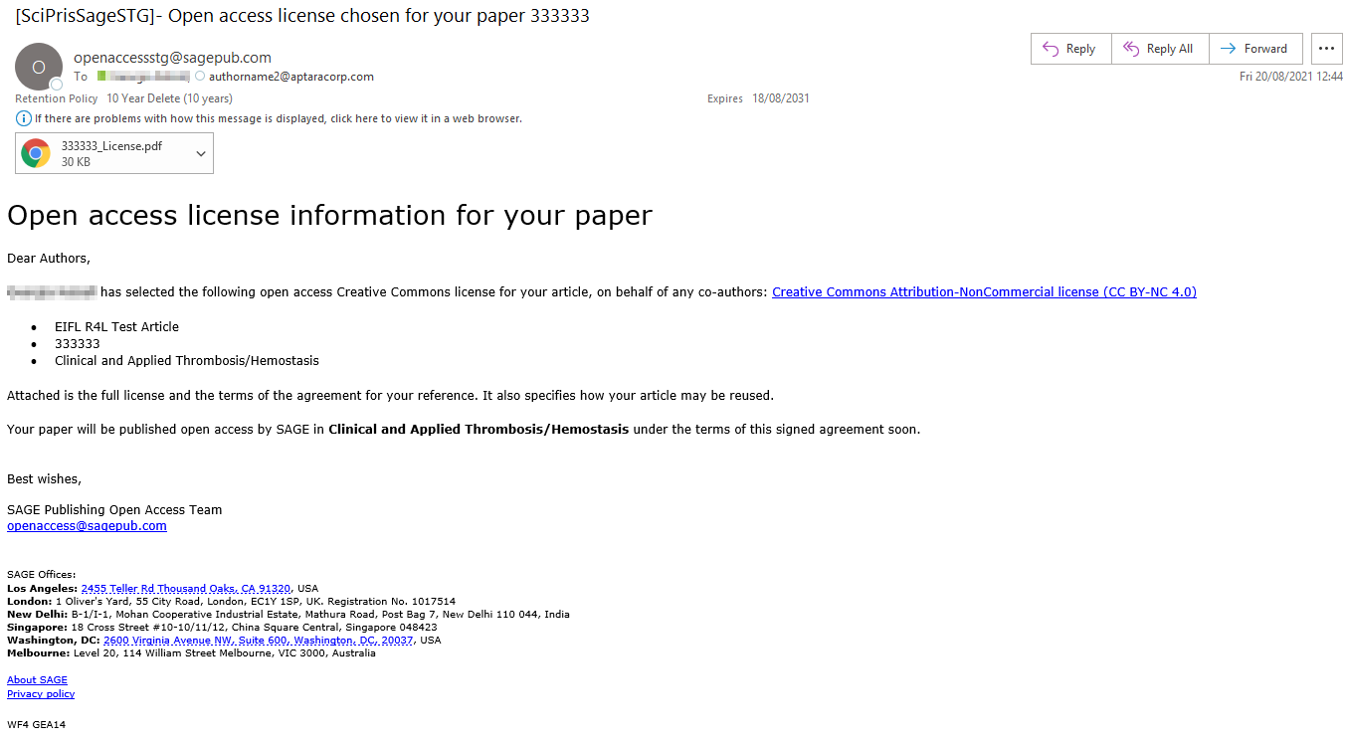
Notes:
All authors are notified by email that the transacting author has signed the licence. A PDF copy of the signed licence will be attached.

Slide 9
Gold Discounted Articles
Author Journey

Slide 10
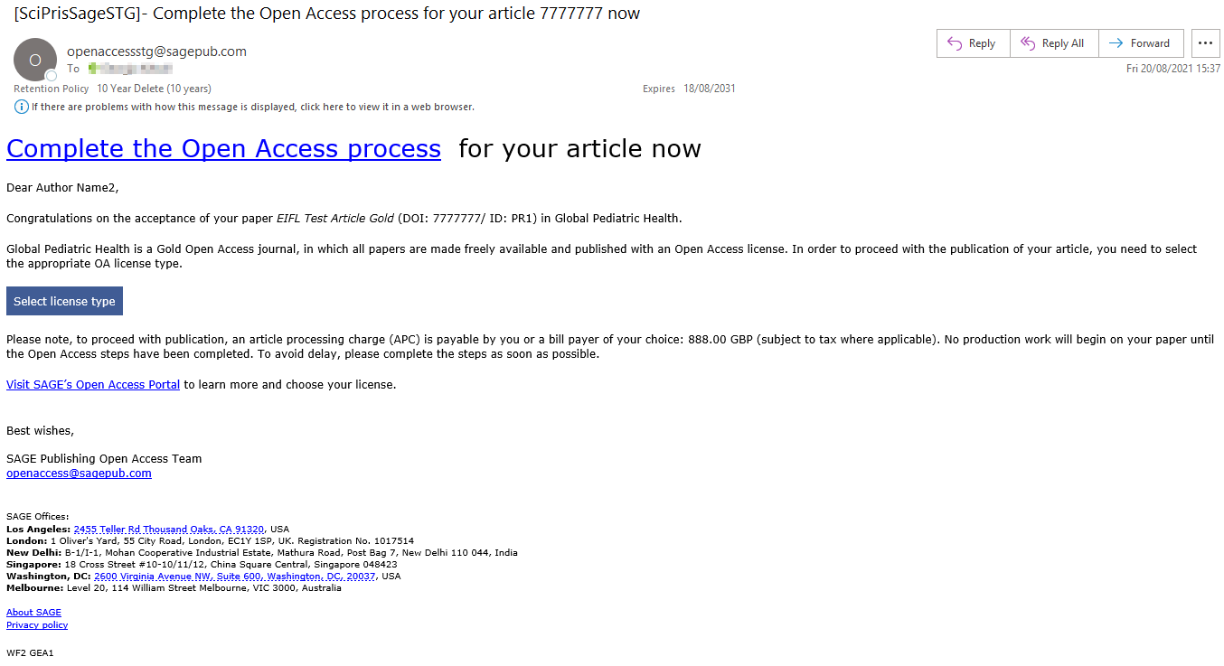
Notes:
Authors are notified by email that their paper has been accepted and asked to select a licence type by clicking the link which takes them to the SAGE Open Access Portal. The discounted APC amount is included in the email.

Slide 11
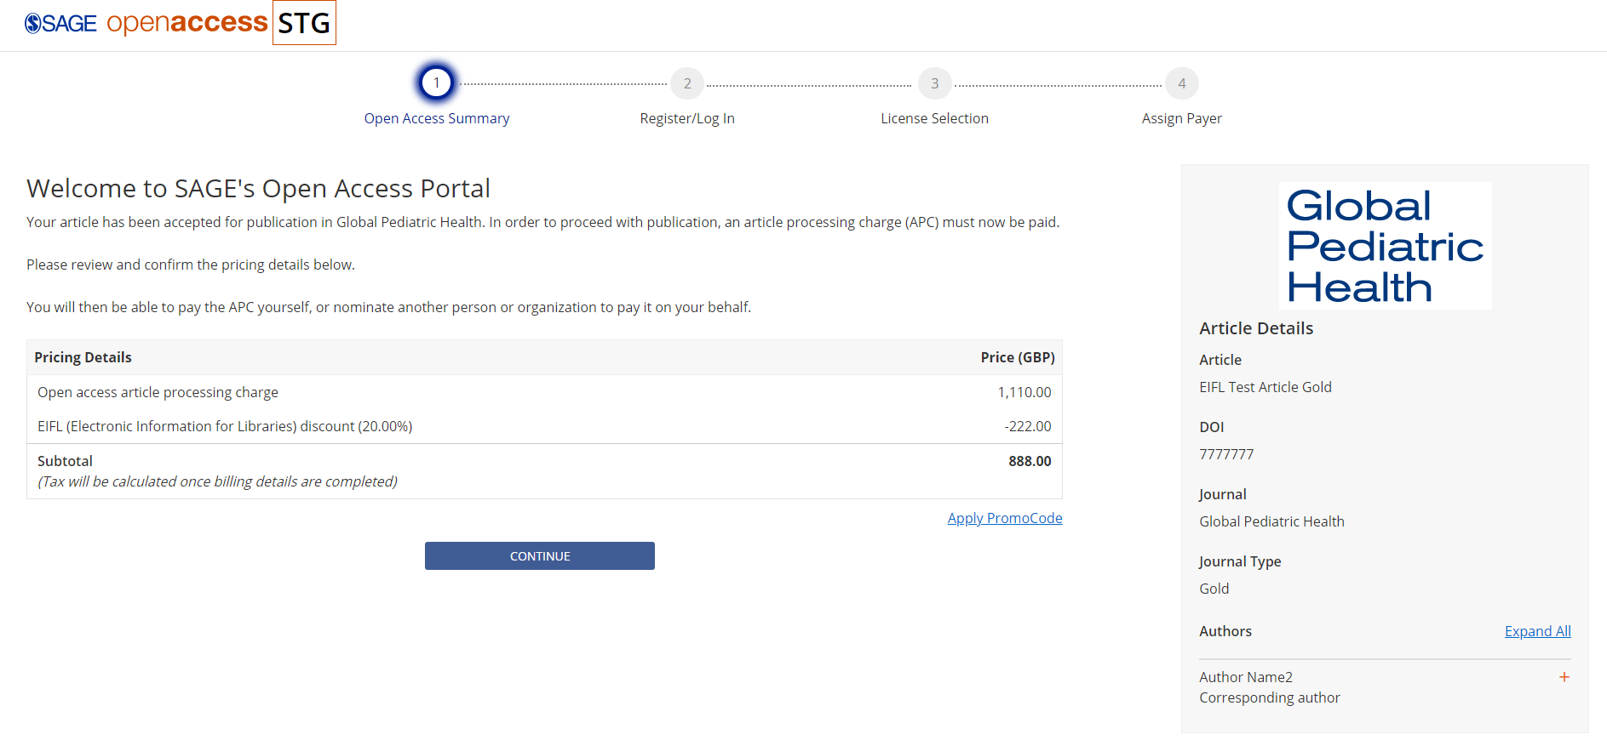
Notes:
Stage 1 “Open Access Summary”:
The author is shown a breakdown of the APC (before tax) including the 20% Gold deal discount.

Slide 12
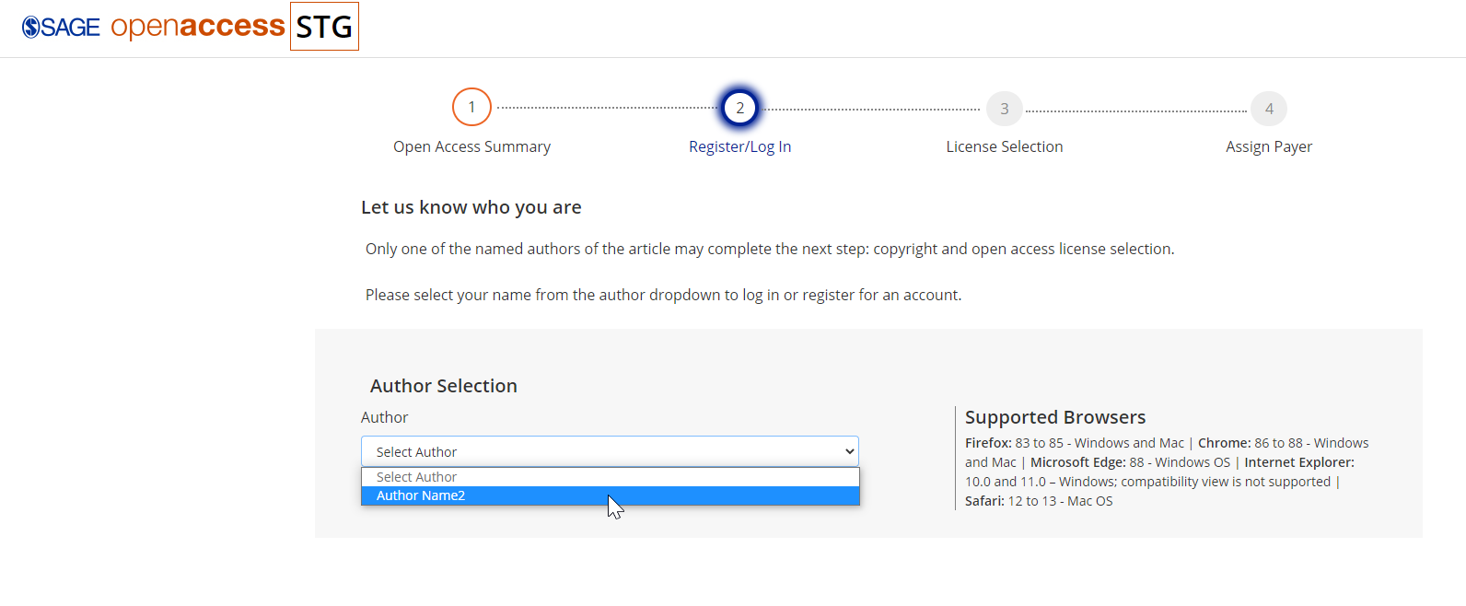
Notes:
Stage 2 “Register/Log In”:
The author will select their name from the drop-down box. All author names will be displayed.
The author will proceed to create an account in the portal.

Slide 13
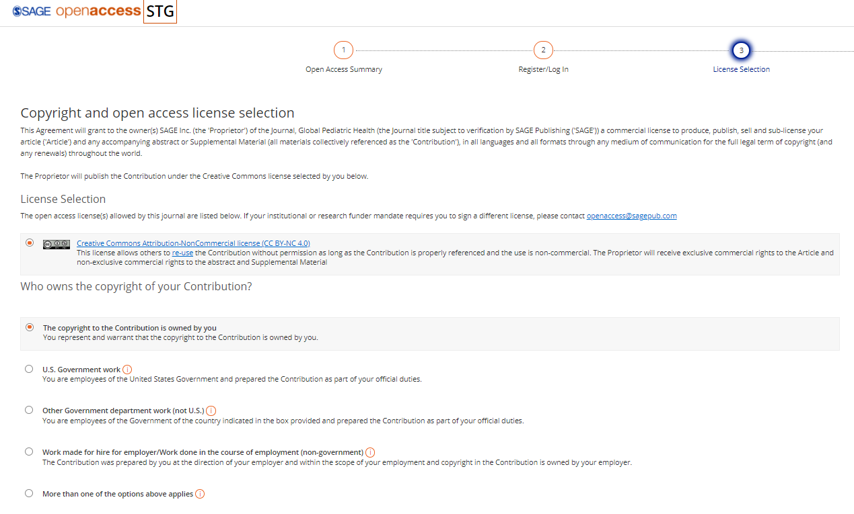
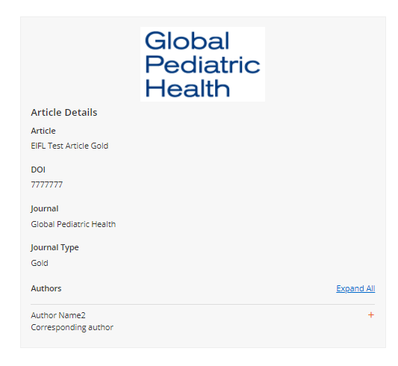
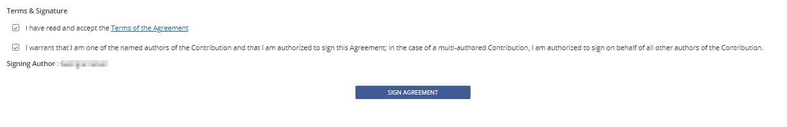
Notes:
Stage 3 “Licence Selection”:
The author selects a licence type and copyright contribution – the licence options given are dependent upon the journal.
Before signing the licence, the author is asked to read and accept the terms of agreement

Slide 14
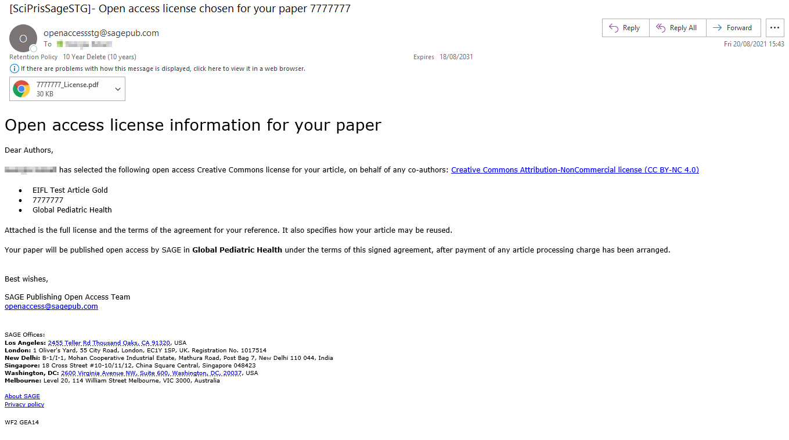
Notes:
All authors are notified by email that the transacting author has signed the licence. A PDF copy of the signed licence will be attached.

Slide 15
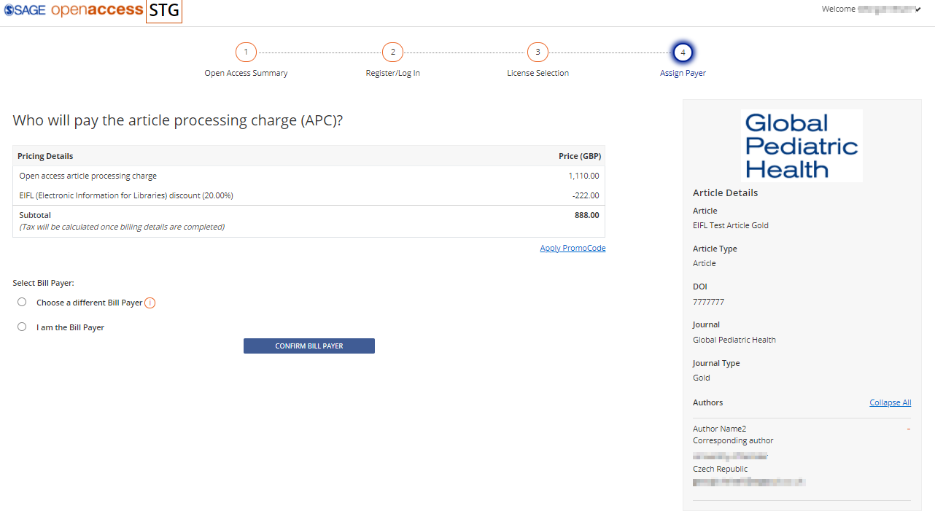
Notes:
Stage 4 “Assign Payer”:
The author can select to be the bill payer of the APC or assign another bill payer.

Slide 16
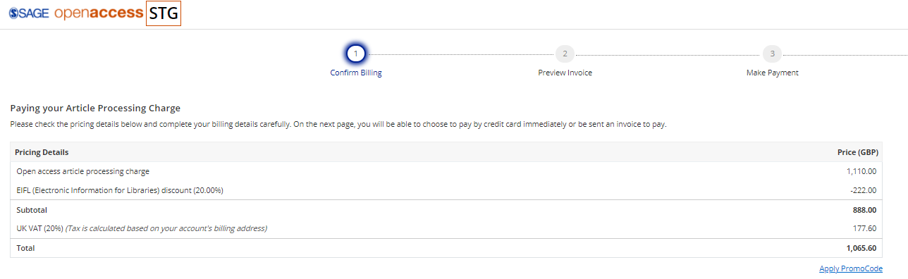
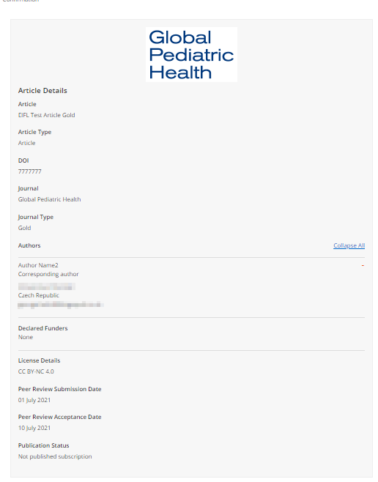
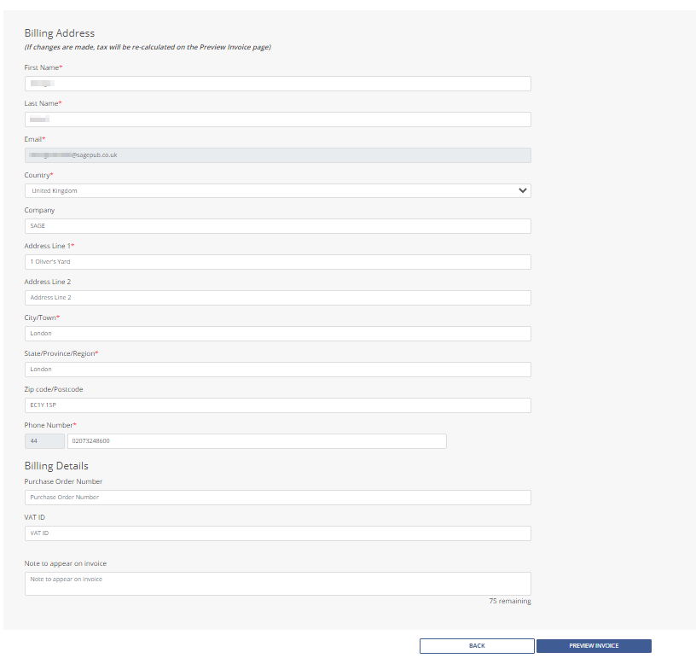
Notes:
If the author chooses to be the bill payer, they are shown a price breakdown including VAT. The author is asked to enter their billing address and billing details to preview the invoice.

Slide 17
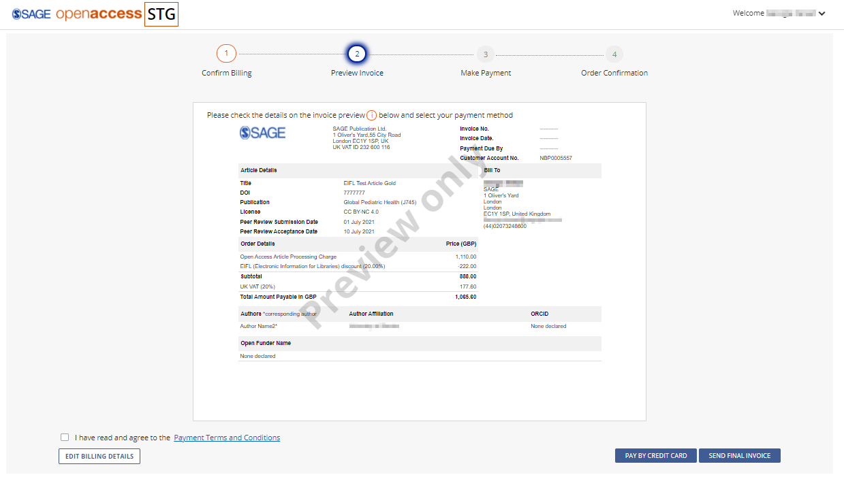
Notes:
The author is asked to read and agree to the payment terms and conditions. They are given the option to send a final invoice or pay by credit card.

Slide 18
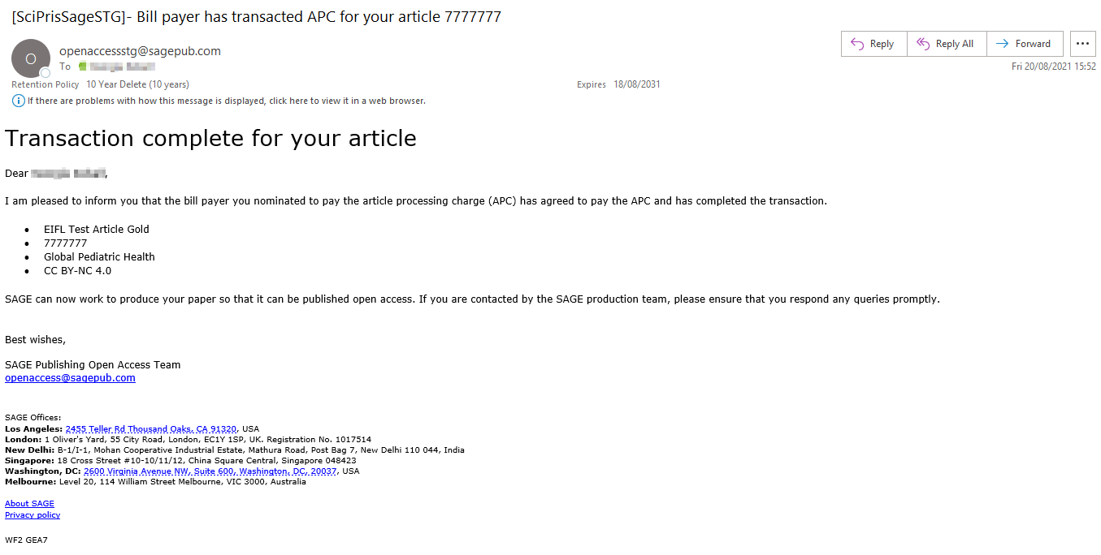
Notes:
All authors are sent an email notifying them that the author/bill payer has accepted to pay the APC.

Slide 19
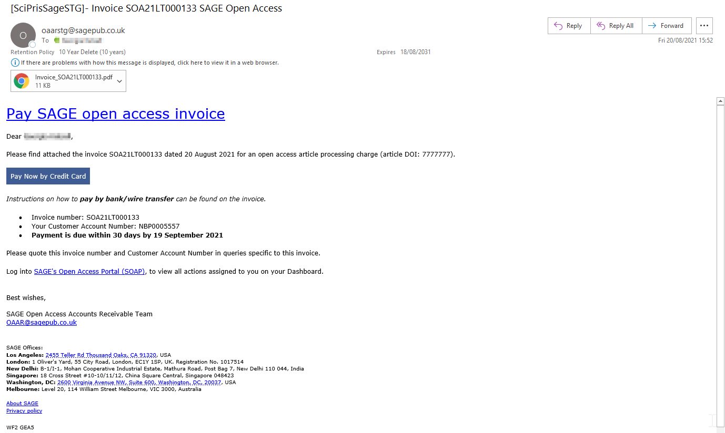
Notes:
The transacting author is sent the invoice by email and asked to pay the APC.

Slide 20
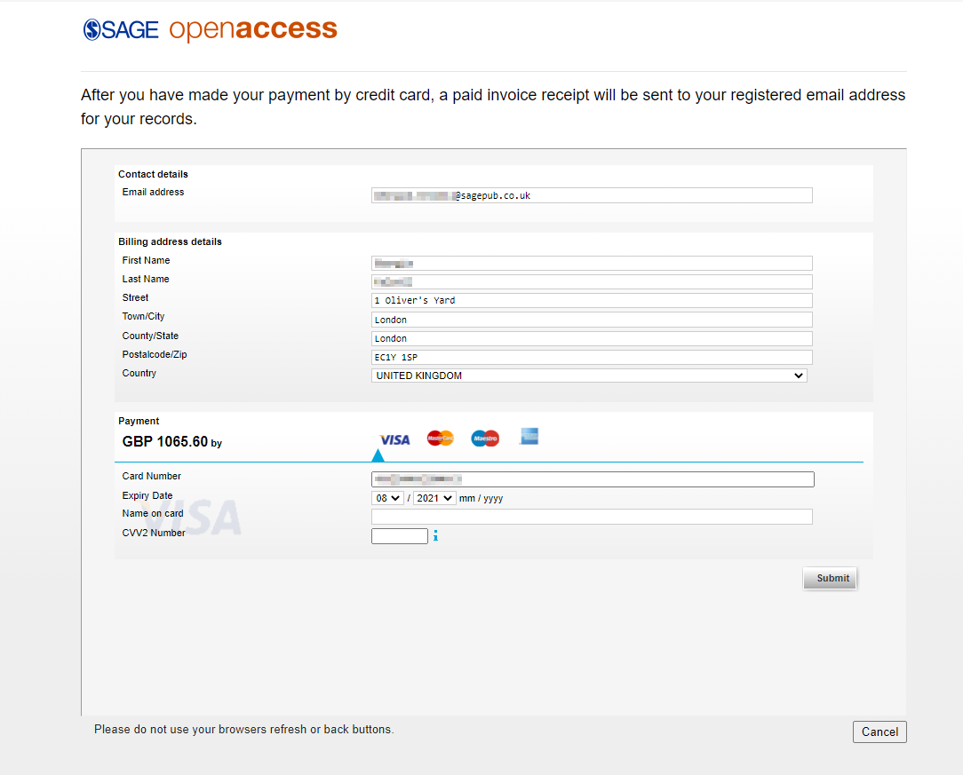
Notes:
Transacting author enters their payment information and makes the payment of the APC. They will then receive a confirmation email.

Slide 21
Bill Payer Journey
Gold Articles

Slide 22
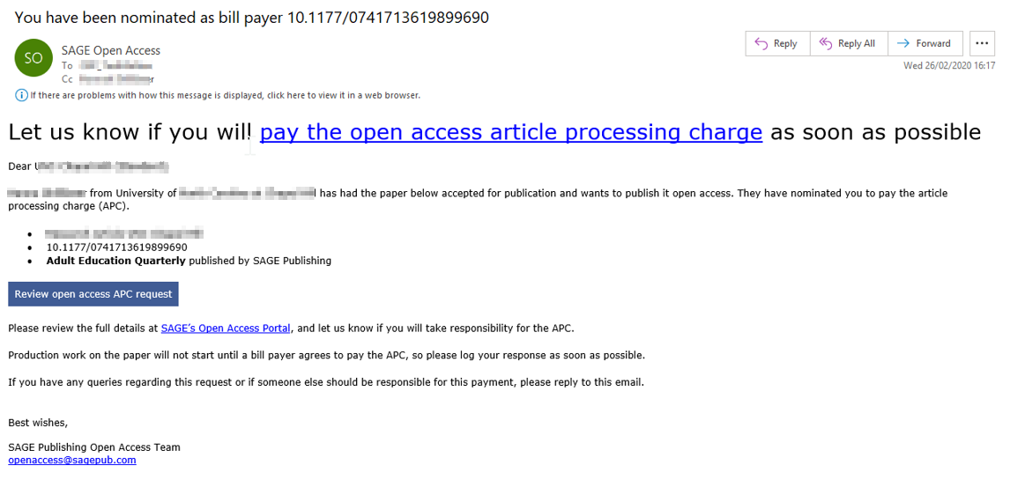
Request for payment
Notes:
If the author chooses to assign a different bill payer, the nominated bill payer will be notified by email. The NBP can accept or decline to pay the APC by clicking the “review open access APC request” button which takes them to the portal.

Slide 23
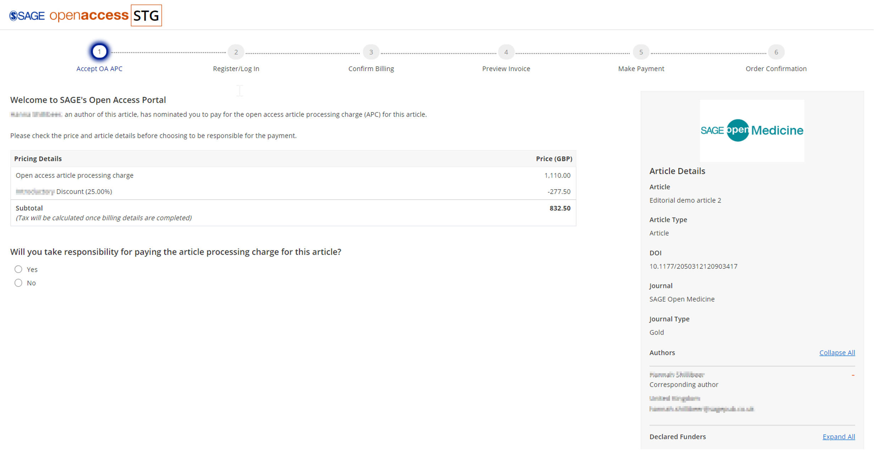
Accepting to pay
Notes:
The NBP is shown a price breakdown, including the deal discount, and is asked to accept or decline to pay the APC. If they accept, they will continue in the portal. If they decline to pay, the authors are notified by email and asked to select another bill payer.

Slide 24
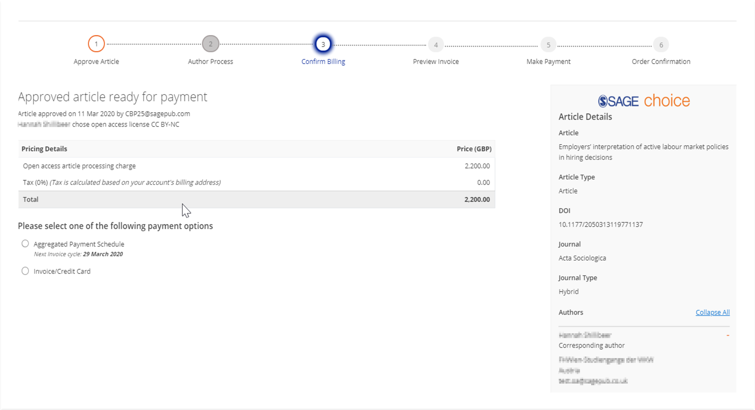
Billing Options
Notes:
The NBP can choose to pay by invoice/credit card or an aggregated payment schedule. They will then proceed to enter their payment details, preview the invoice, and make the payment. The authors will be notified by email once the transaction is complete.

Slide 25
Hybrid Waived Articles
Author Journey

Slide 26
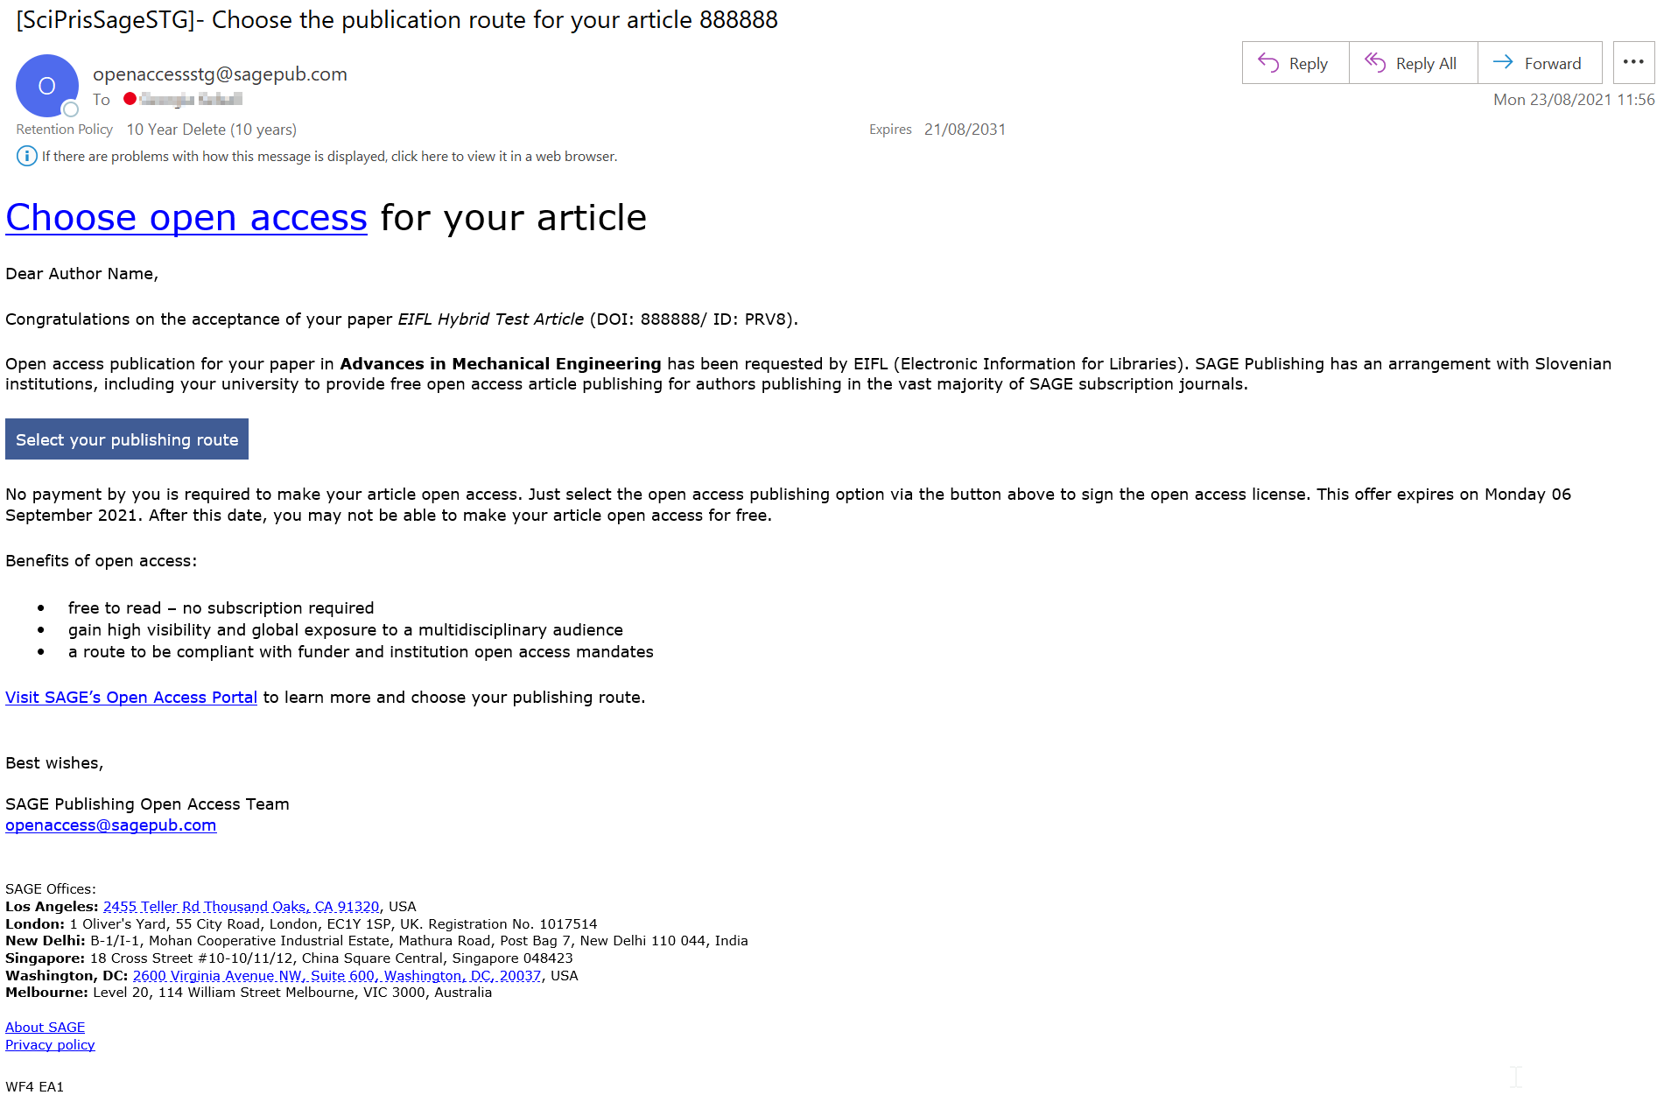
Notes:
Authors are notified by email that their paper has been accepted and asked to select a publishing route by clicking the link which takes them to the SAGE Open Access Portal. They are informed that there will be no payment required to make their article open access due to the deal between SAGE and EIFL. The offer expiry date is also included.

Slide 27
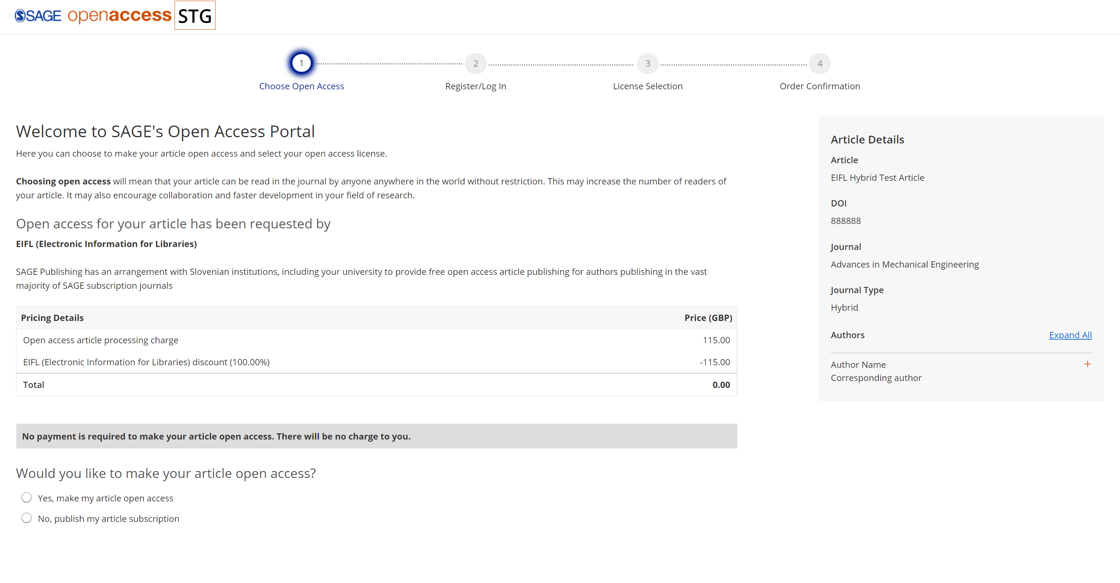

Notes:
Stage 1 “Choose Open Access”:
The author is shown a breakdown of the APC (before tax) including the 100% Hybrid deal discount.
The author is asked if they would like to make their article Open Access. If they select “yes”, they will proceed with steps in the portal. If the author selects “no”, the author journey in the portal will end and the article will be published subscription only.

Slide 28
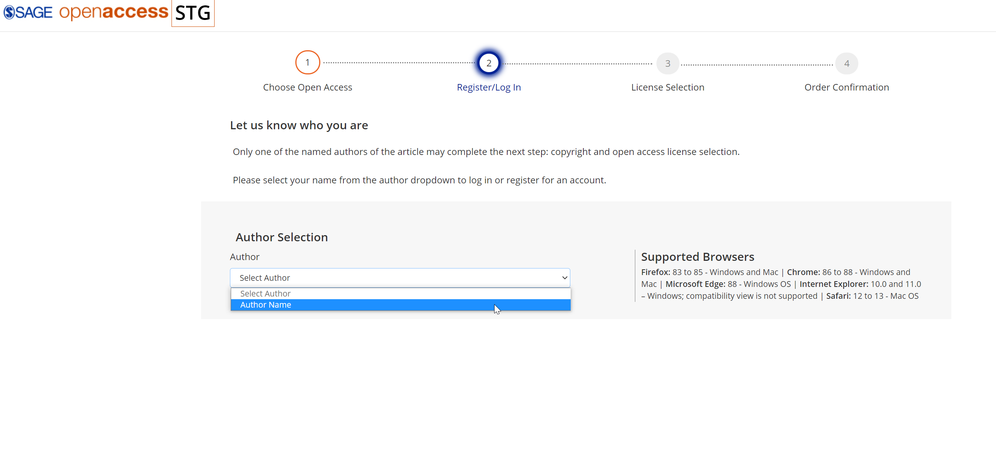
Notes:
Stage 2 “Register/Log In”:
The author will select their name from the drop-down box. All author names will be displayed.
The author will proceed to create an account in the portal.

Slide 29
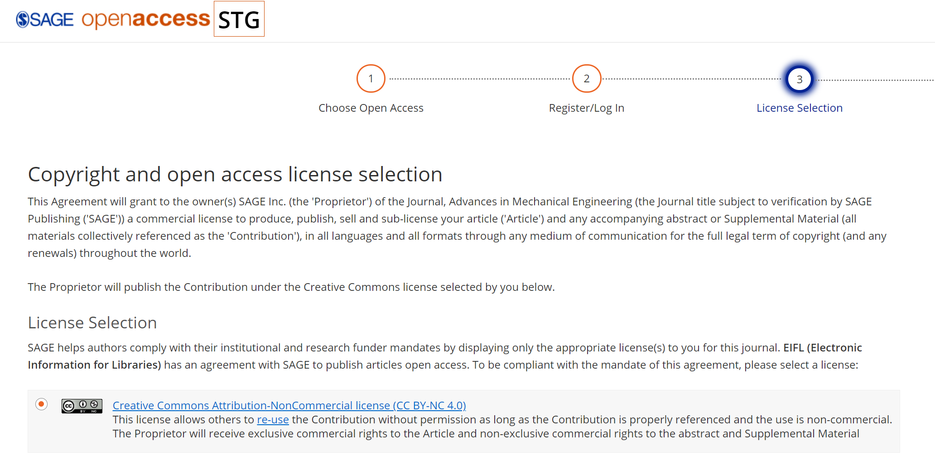
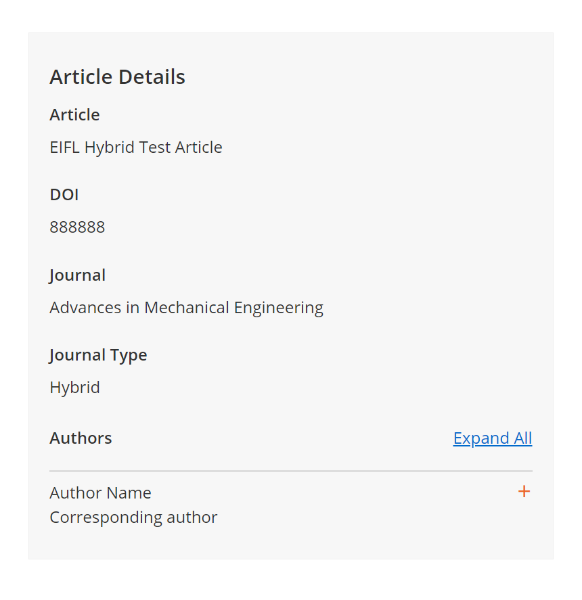
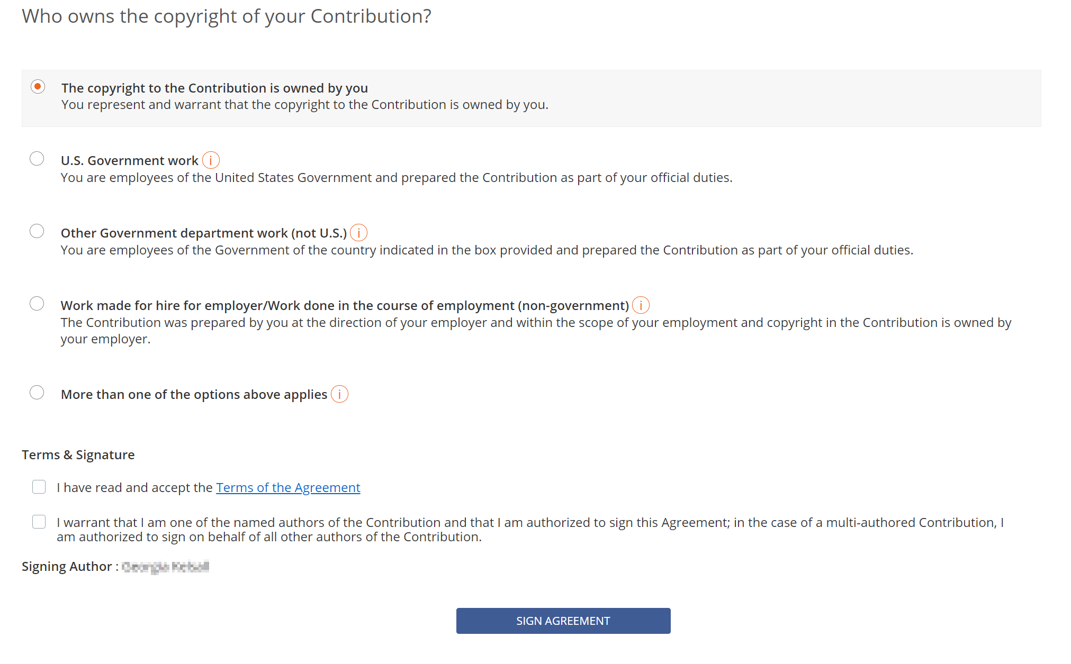
Notes:
Stage 3 “Licence Selection”:
The author selects a licence type and copyright contribution – the licence options given are dependent upon the journal.
Before signing the licence, the author is asked to read and accept the terms of agreement

Slide 30
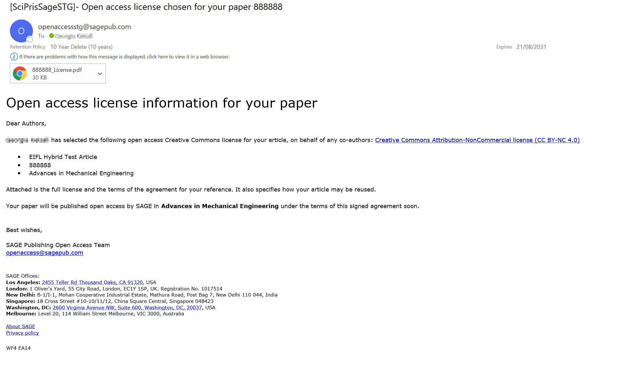
Notes:
All authors are notified by email that the transacting author has signed the licence. A PDF copy of the signed licence will be attached.

Slide 31
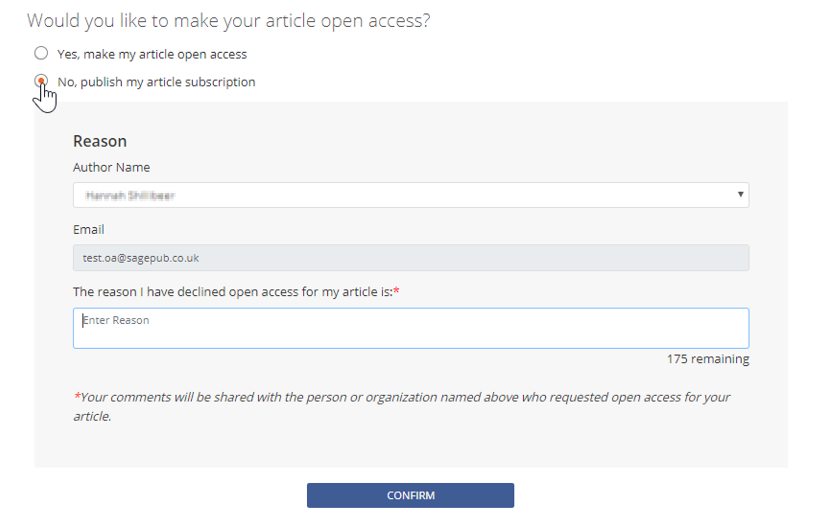
Declining an Open Access Offer
Notes:
If the author declines the Open Access offer, they will be asked to enter a reason.

