Slide 1

SSHOC
Setting up Dataverse repository for
research data
Slava Tykhonov, Senior Information Scientist
DANS-KNAW, The Royal Netherlands Academy of Arts and Sciences
LIBSENSE webinar
10 March 2021

Slide 2
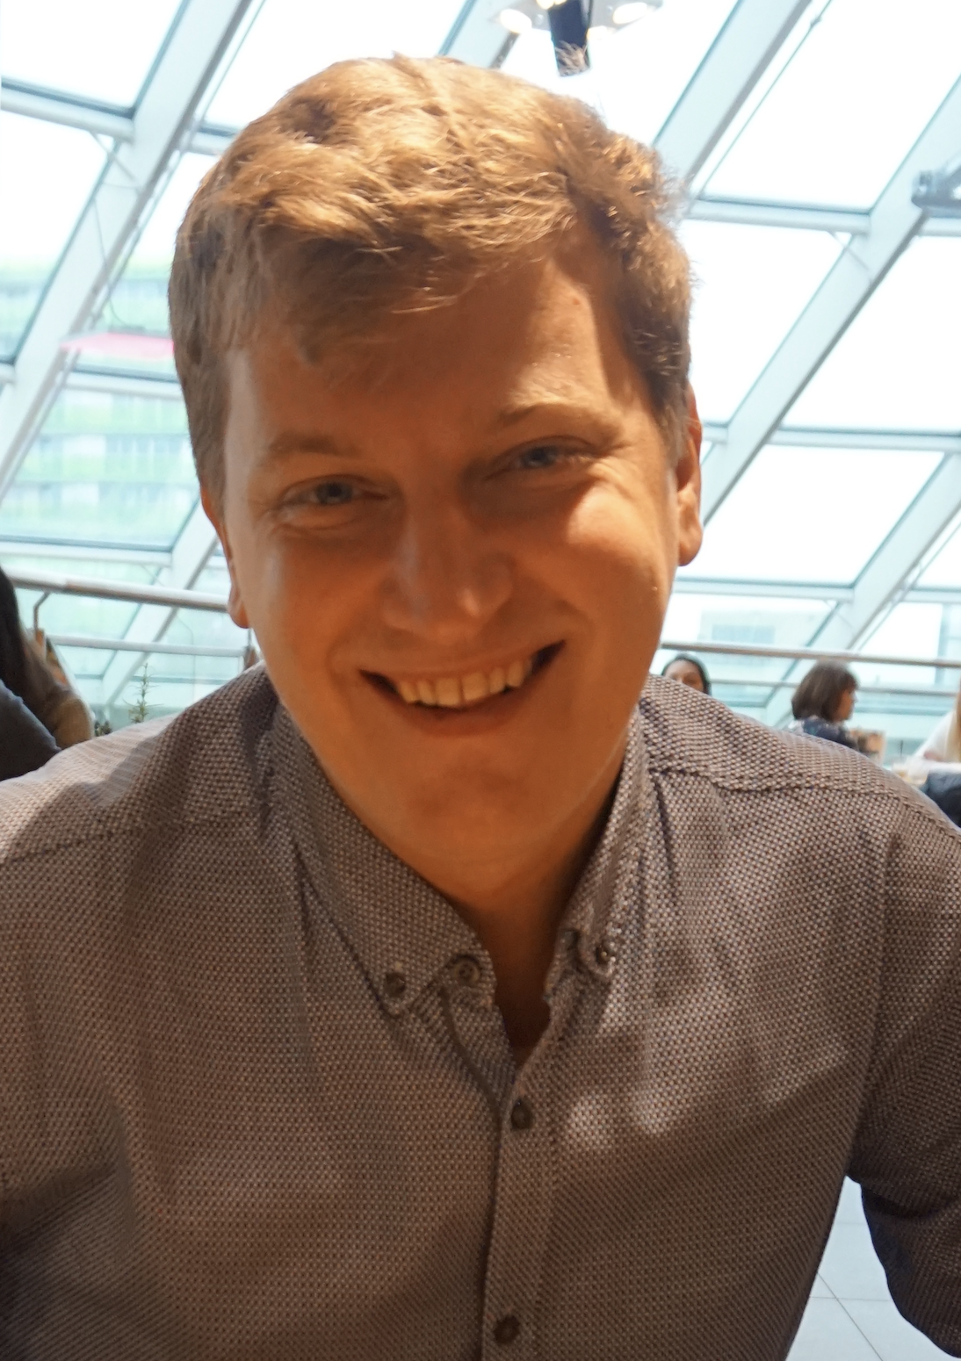
About me: DANS-KNAW projects (2016-2021)
CLARIAH+ (ongoing)
EOSC Synergy (ongoing)
SSHOC Dataverse (ongoing)
CESSDA DataverseEU 2018
Time Machine Europe Supervisor at DANS-KNAW
PARTHENOS Horizon 2020
CESSDA PID (Personal Identifiers) Horizon 2020
CLARIAH
RDA (Research Data Alliance) PITTS Horizon 2020
CESSDA SaW H2020-EU.1.4.1.1 Horizon 2020
Source: LinkedIn

Slide 3

About DANS-KNAW
DANS is the Dutch national centre of expertise and repository for research data. We help researchers make their data available for reuse. This allows researchers to use the data for new research and makes published research verifiable and reproducible. With more than 150,000 datasets and a staff of 60, DANS is one of the leading repositories in Europe.
Three pillars of DANS 2021-2025 programme: ‘Focus on FAIR”
•Centre of expertise for FAIR research data
•Versatile data repository: DANS data stations
•Active collaborator

Slide 4
What is Dataverse?
Open source project developed by IQSS of Harvard University and published on github
Great product with very long history (from 2006)
Very dynamic and experienced development team working in the Agile environment (community call scheduled once in two weeks)
Clear vision and understanding of research communities requirements, public roadmap
Strong community behind of Dataverse is helping to improve the basic functionality and develop it further
Dataverse has been selected as a data repository infrastructure by countries from all continents
Well developed architecture with rich API endpoints to build application layers around Dataverse

Slide 5
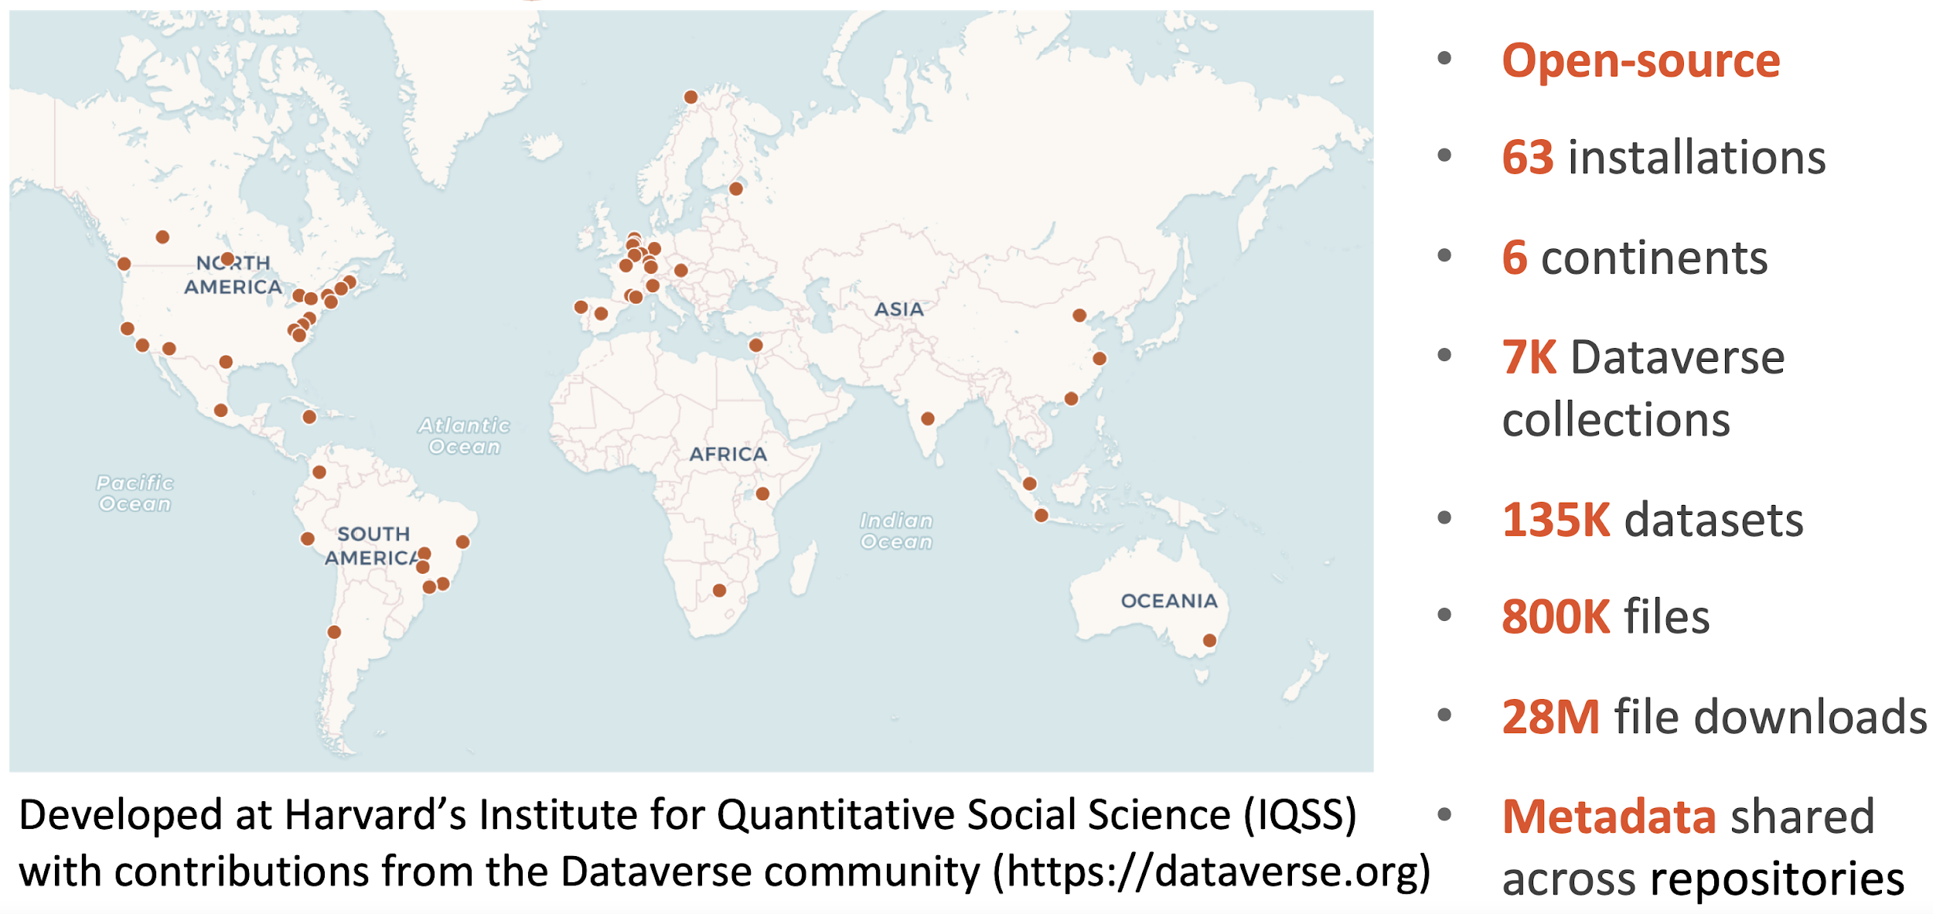
Federated Dataverse data repositories worldwide
Source: Merce Crosas, Harvard Data Commons

Slide 6
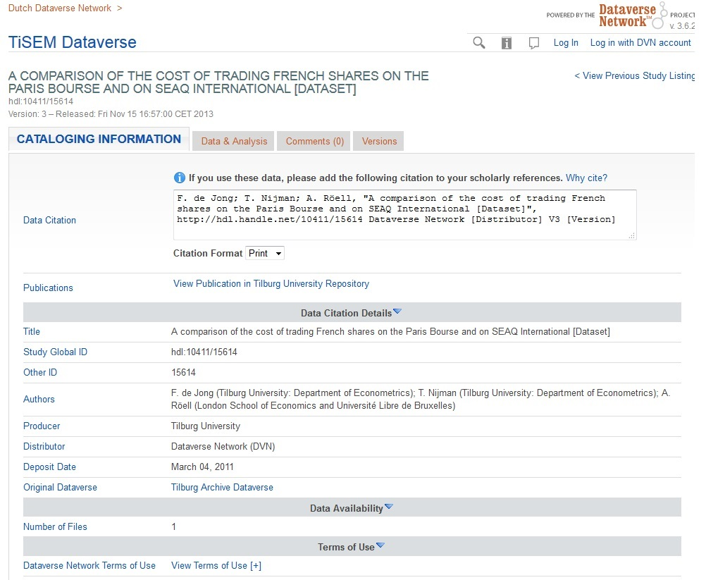
DANS Dataverse 3.x migration (2016)
Basic DataverseNL services:
• Federated login for Netherlands institutions
• Persistent Identifier Services (DOI and handle)
• Integration with archival systems
Applications:
• Modern and historical world maps visualisations
• Data API and Geo API services for projects with data
• Panel datasets constructor
• Time series plot
• Treemaps
• Pie and chart visualizations
• Descriptive statistics tools

Slide 7
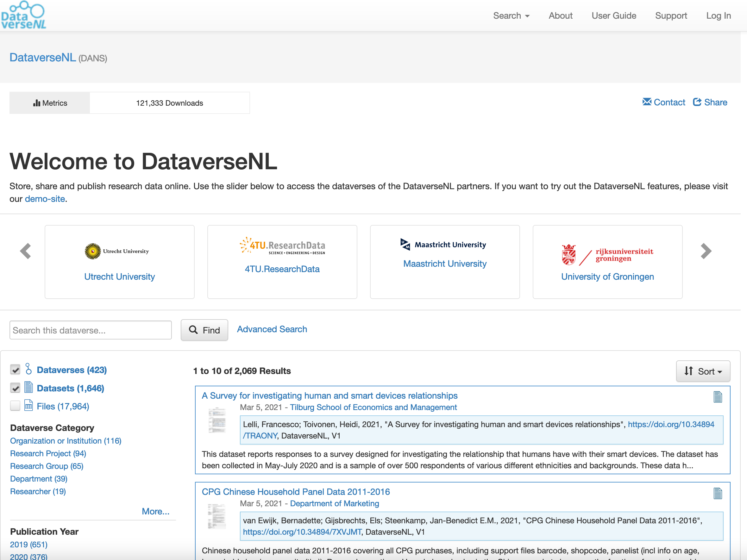
DataverseNL collaborative data network
Source: https://dataverse.nl

Slide 8
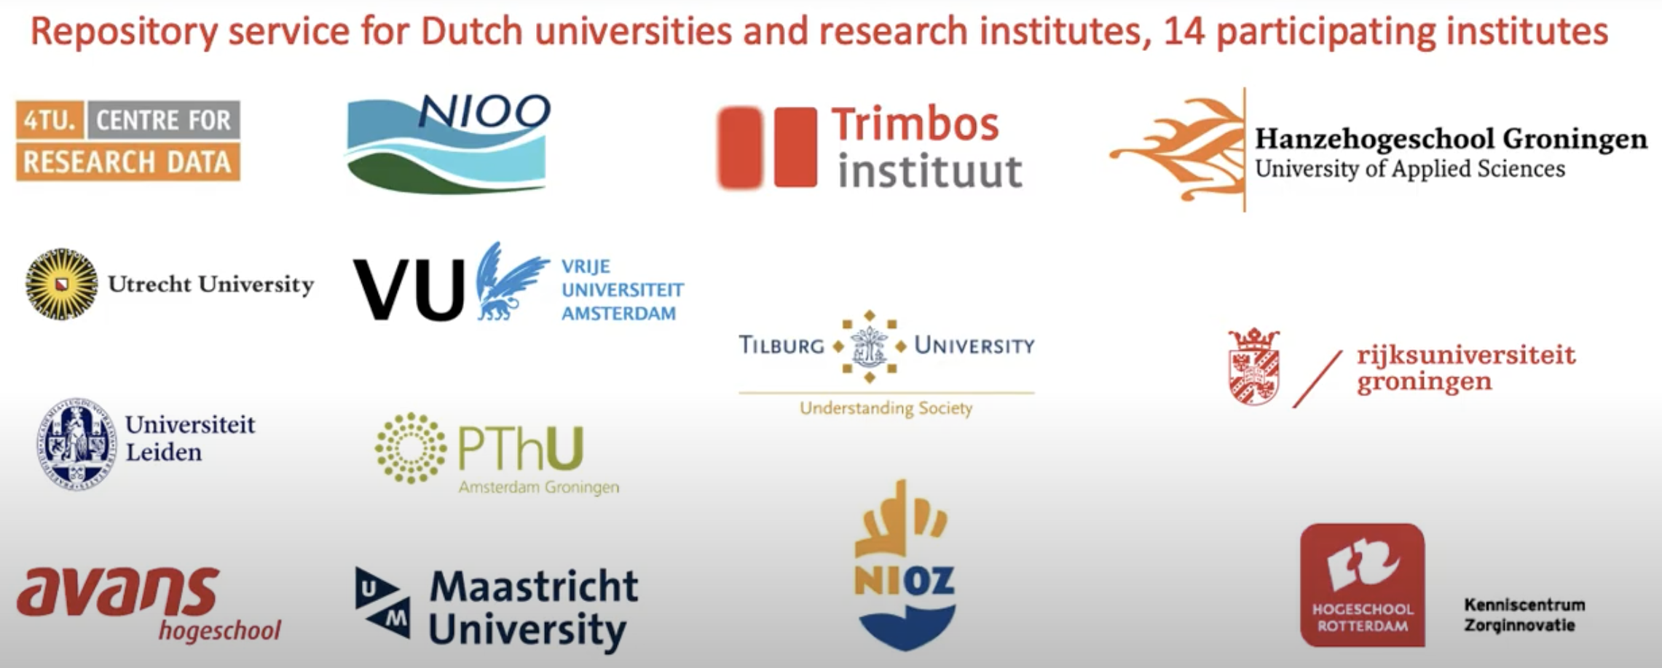
DataverseNL partners

Slide 9
Cooperative Model DataverseNL
DANS provides and manages the system & storage, organizes the meetings (back-office)
•Research institutions run their own RDM-support for their researchers /end users (front-office)
•Every partner institute is responsible for their own data
•Shared costs (service membership + storage)
•Advisory Board consisting of partner representatives decides on the general policy
•Administrators committee to discuss technical and functional issues
•Cooperation agreement, Service Level Agreement, Processor agreement (GDPR), General Terms of use (end users)
Source: Marion Wittenberg, DataverseNL

Slide 10
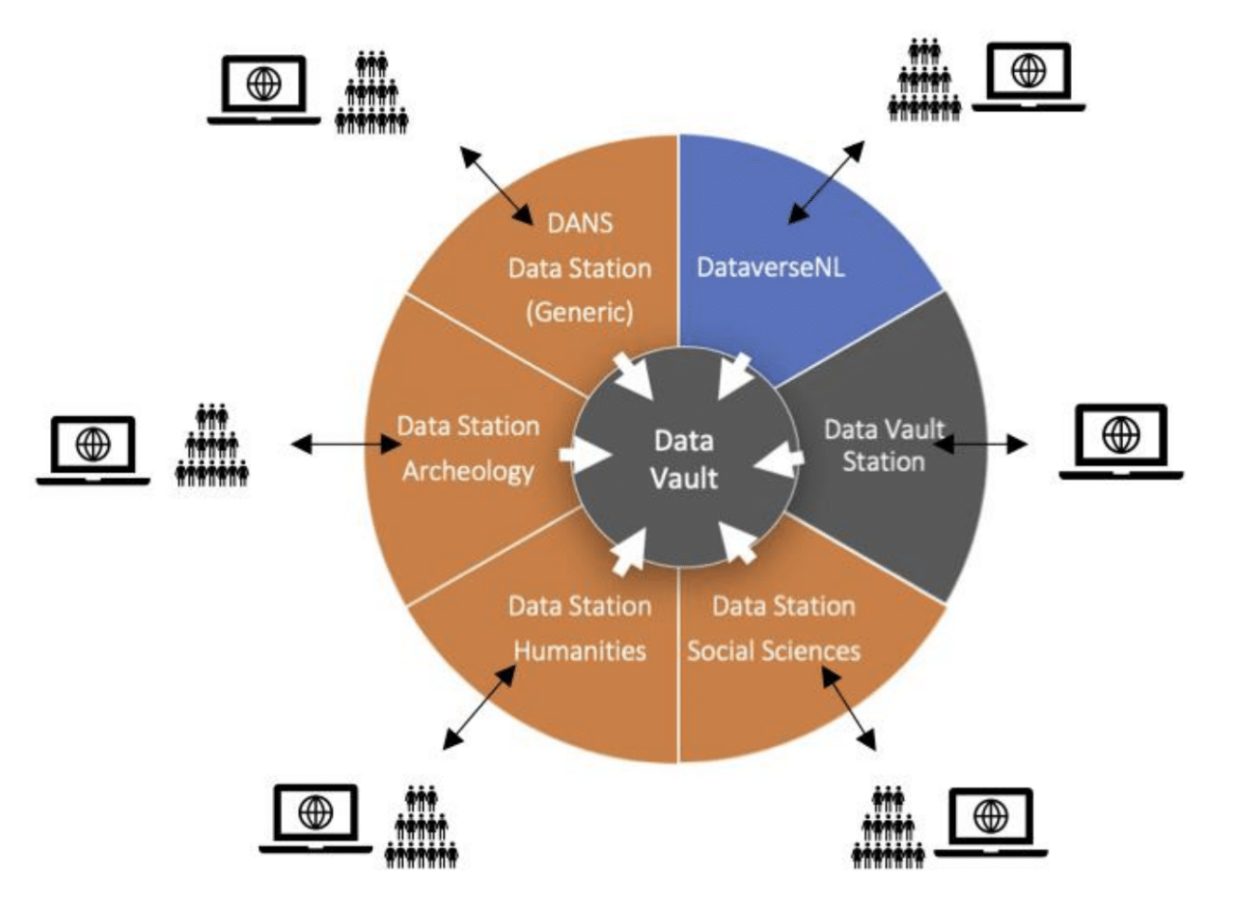




DANS Data Stations - Future Data Services
Dataverse is API based and a key framework for Open Innovation!

Slide 11
Major challenges to provide services for researchers
Maintenance concerns - who will be in charge after project is finished?
Infrastructure problems - how to install and run tools for researchers?
Various Interoperability issues - how to leverage data exchange between different systems and services
Software updates and bug fixing, licences, technical staff training, legal aspects and so on...

Slide 12
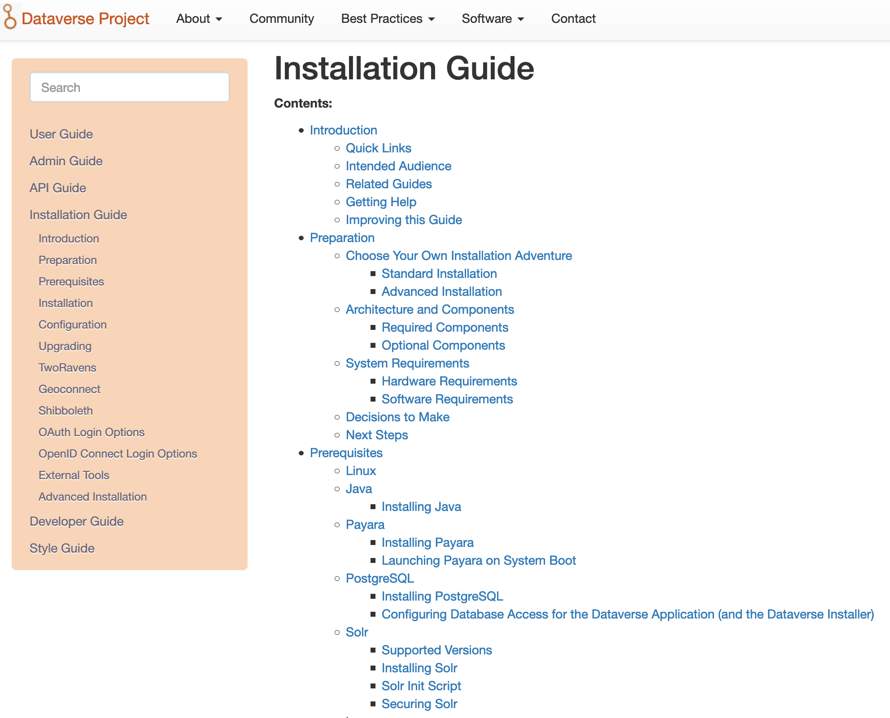
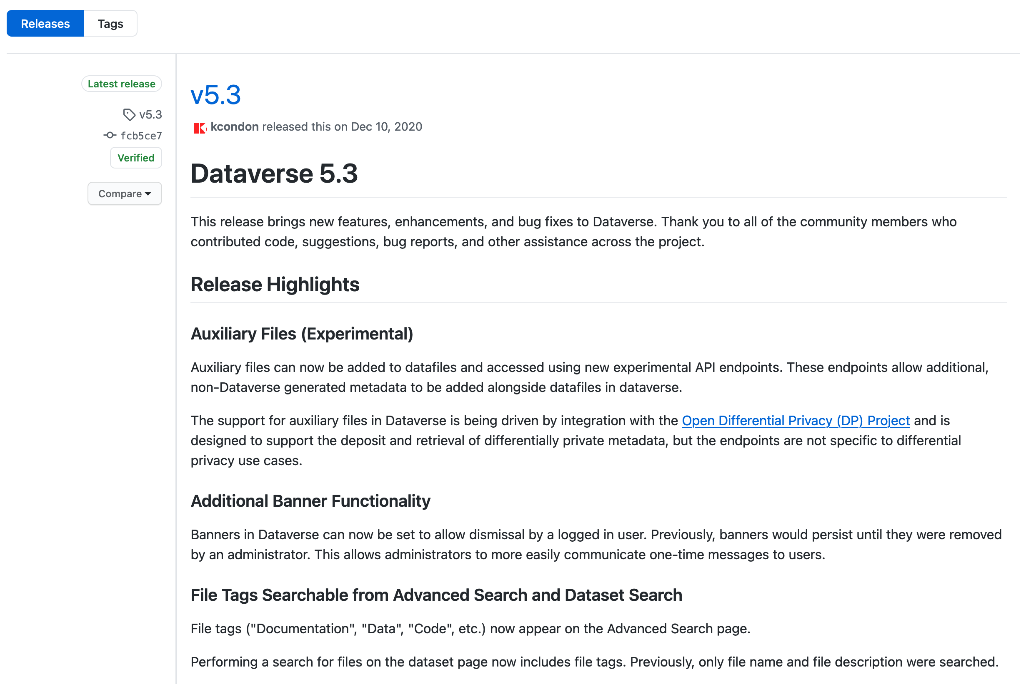
Dataverse Installation Manual
https://guides.dataverse.org/en/latest/installation/index.html

Slide 13
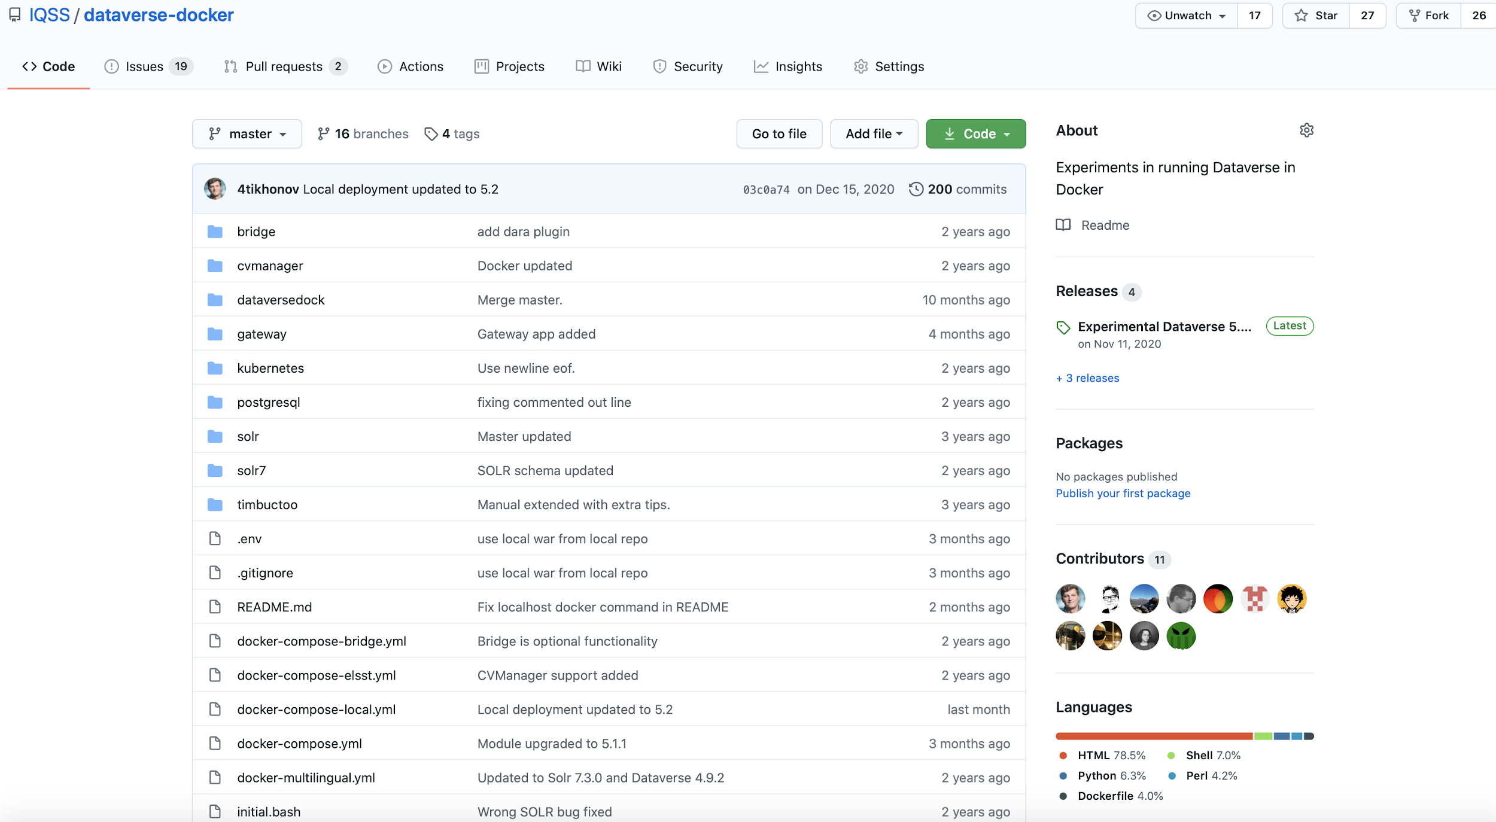
Dataverse Docker module (CESSDA Dataverse, 2018)
Source: https://github.com/IQSS/dataverse-docker

Slide 14

Dataverse Kubernetes
Project maintained by Oliver Bertuch (FZ Julich) and available in Global Dataverse Community Consortium github (GDCC)
Google Cloud, Amazon AWS, Microsoft Azure platforms supported
Open Source, community pull requests are welcome
http://github.com/IQSS/dataverse-kubernetes

Slide 15
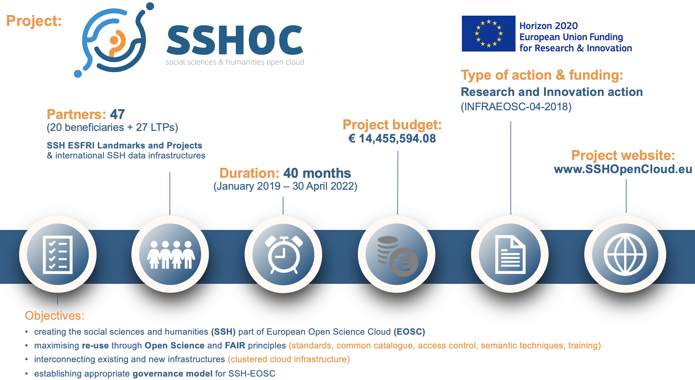

Slide 16
SSHOC project task 5.2 Hosting and sharing data repositories
Makes use of Dataverse software
4 ERICs: DARIAH, CLARIN, EHRIS and CESSDA
Building mature infrastructure based on requirements of involved communities
Developing external applications integrated with Dataverse (Dataverse Store)
Investigating sustainable governance models
Training Service Providers and institutes how to use Dataverse as a service

Slide 17
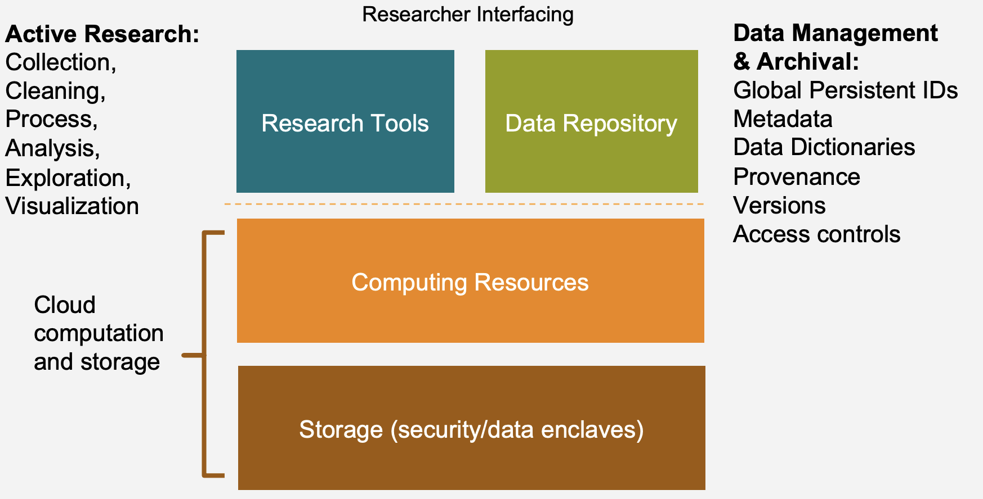
Data Commons is essential for integrations
Source: Merce Crosas, “Harvard Data Commons”

Slide 18
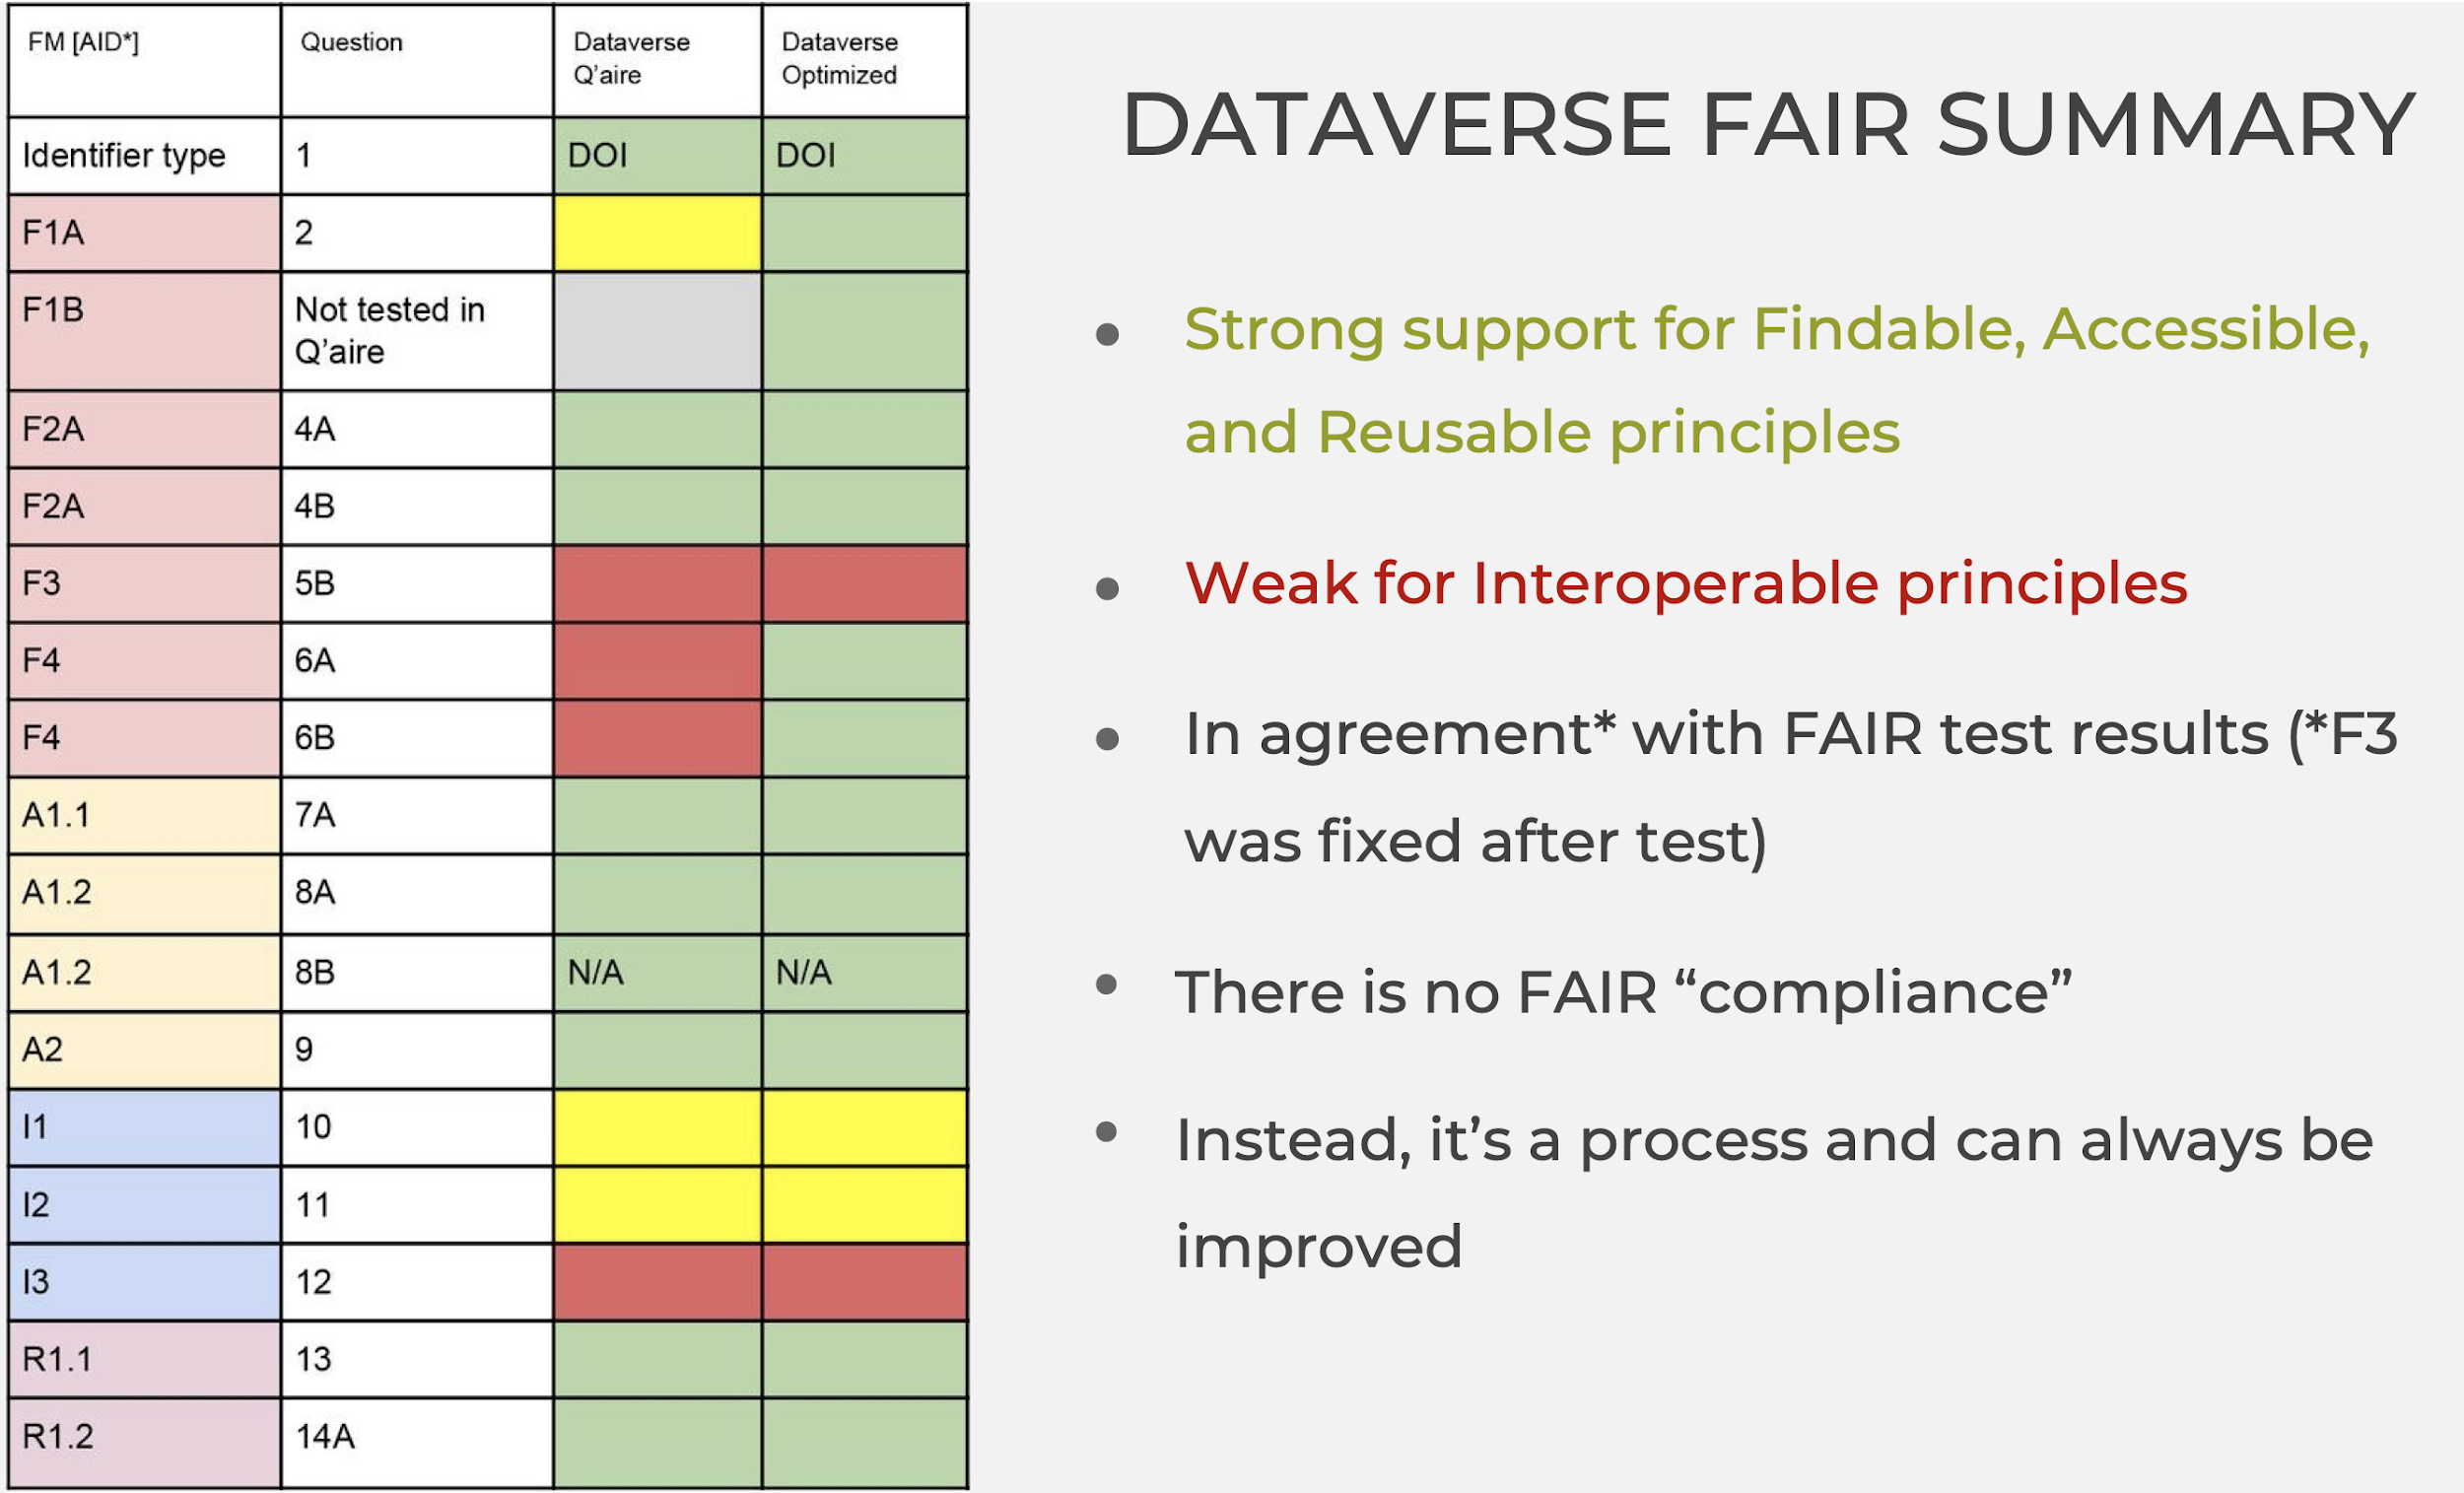
FAIR Dataverse
Source:
Mercè Crosas,
“FAIR principles and beyond: implementation in Dataverse”

Slide 19
Our goals to increase Dataverse interoperability
Provide a custom FAIR metadata schema for European research communities:
CESSDA metadata (Consortium of European Social Science Data Archives)
Component MetaData Infrastructure (CMDI) metadata from CLARIN linguistics community
Connect metadata to ontologies and CVs:
link metadata fields to common ontologies (Dublin Core, DCAT)
define semantic relationships between (new) metadata fields (SKOS)
select available external controlled vocabularies for the specific fields
provide multilingual access to controlled vocabularies

Slide 20
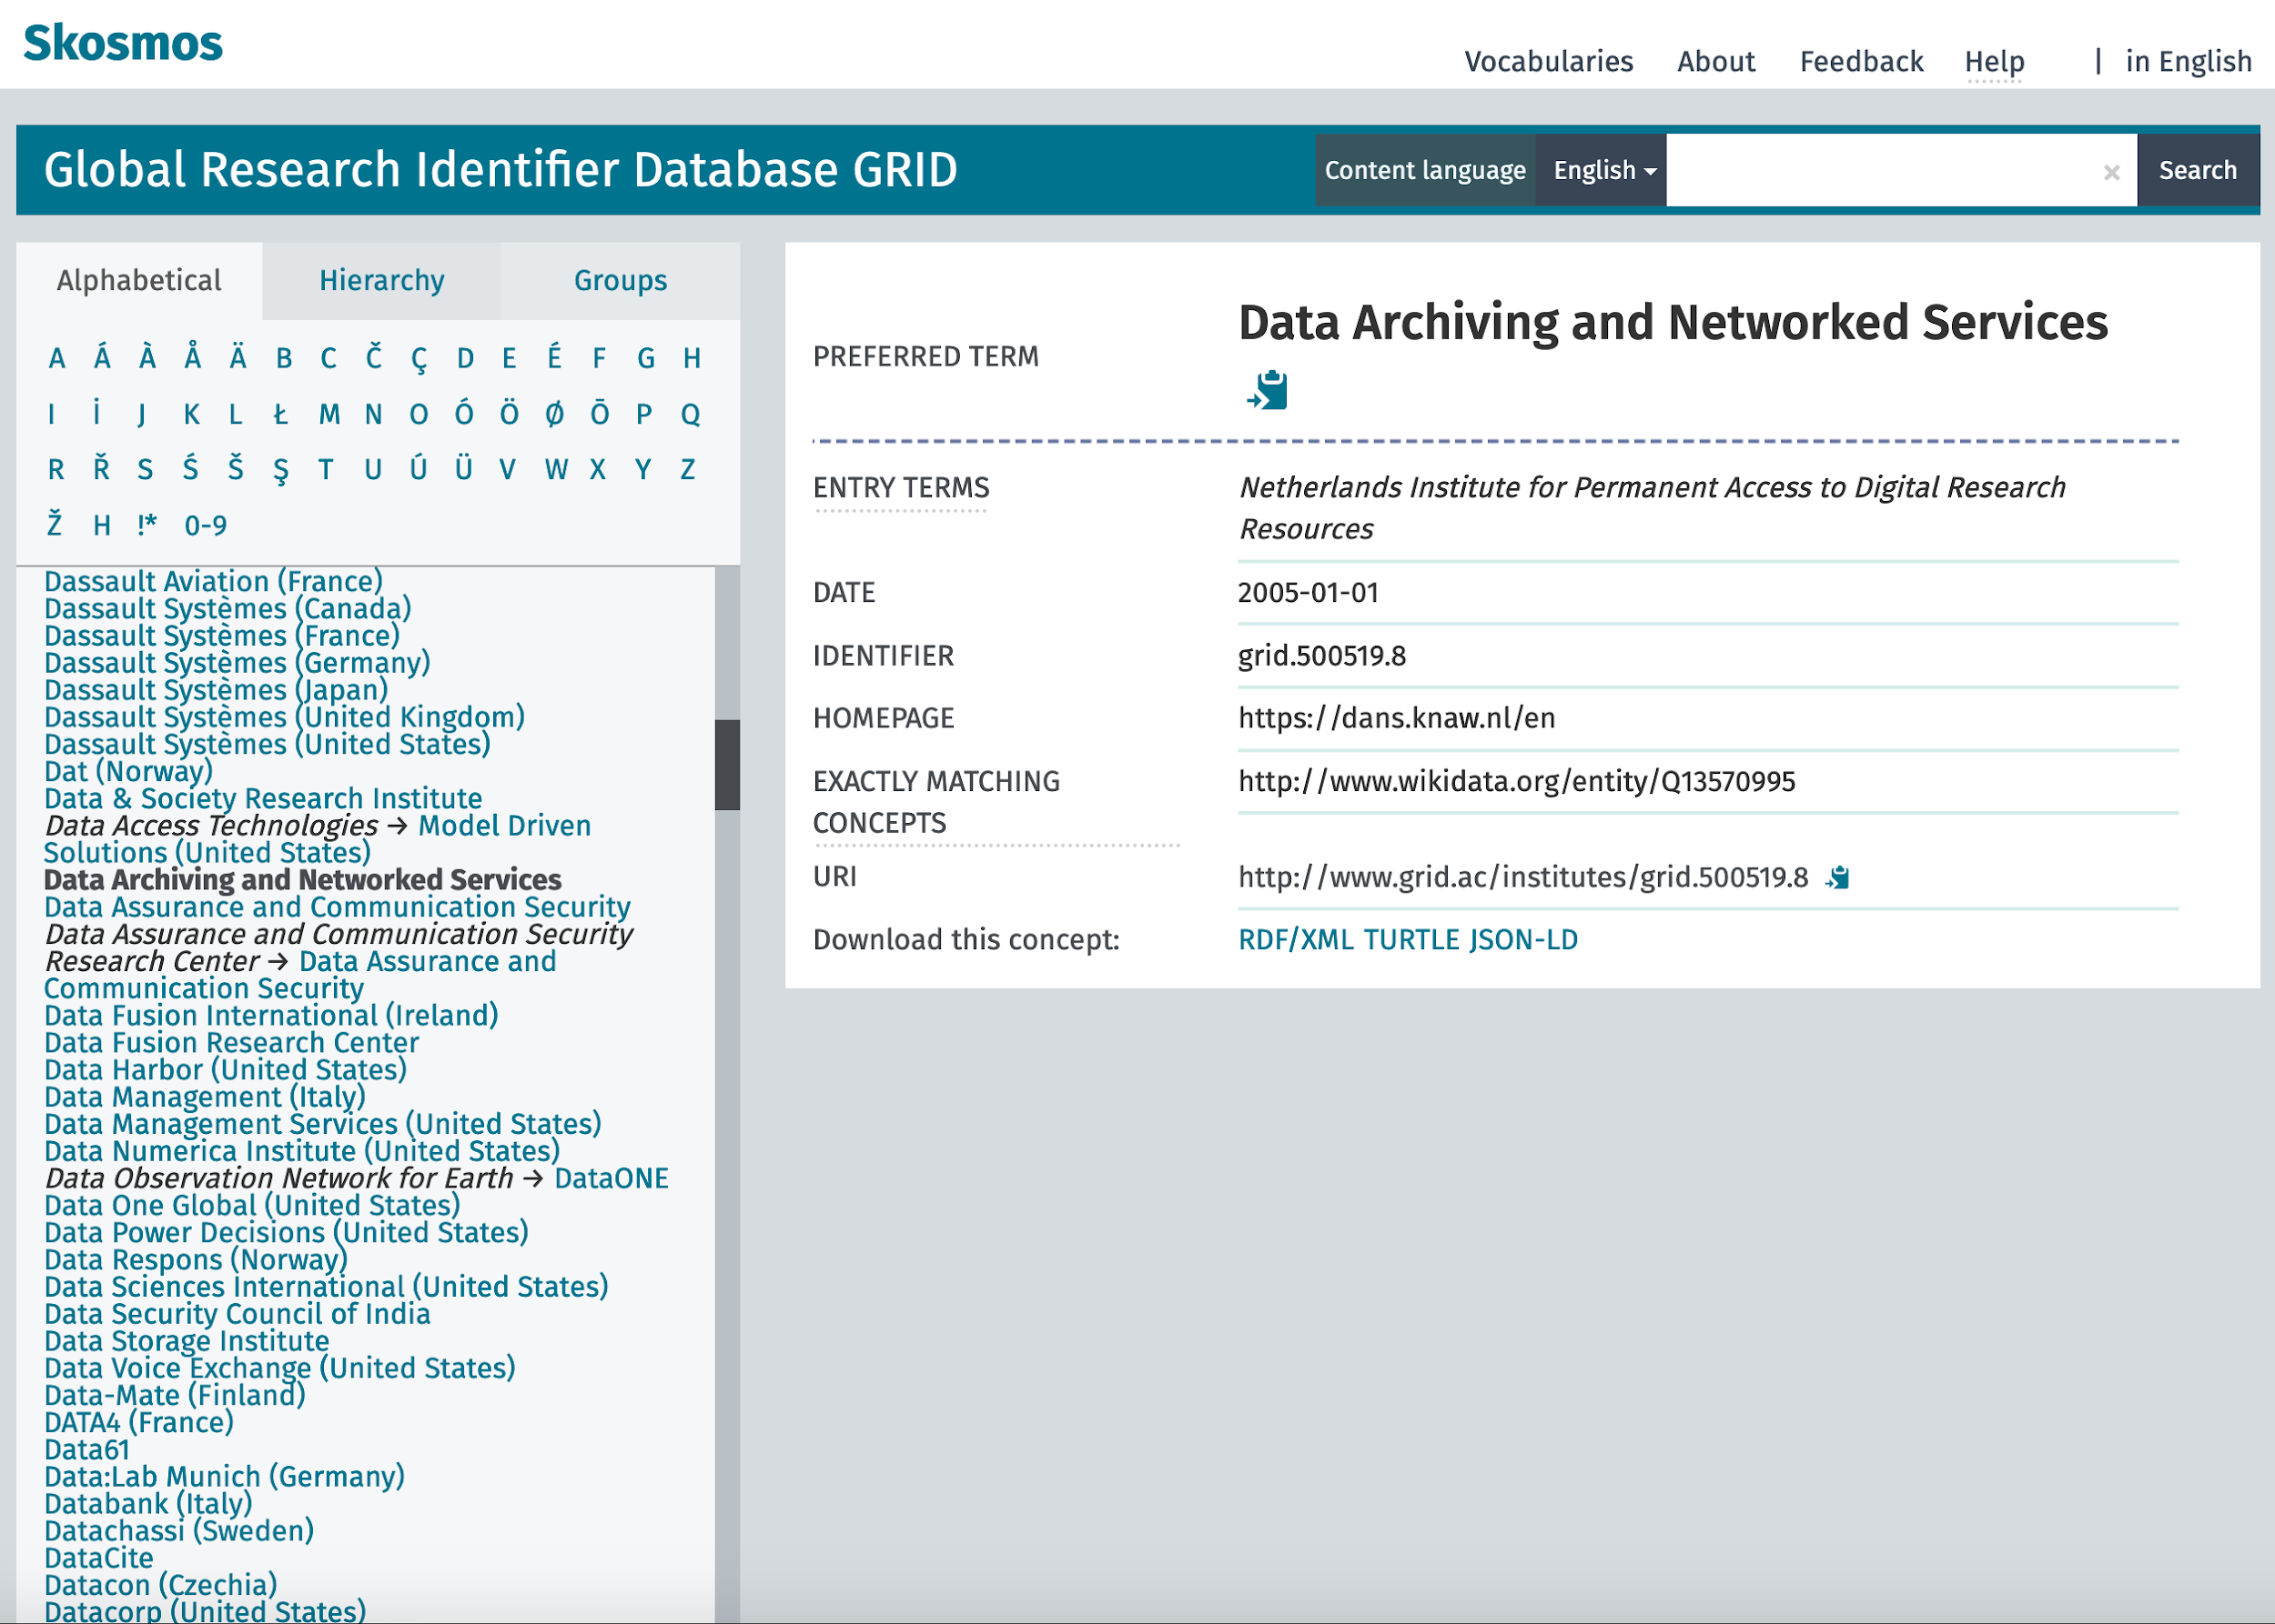
SKOSMOS framework to discover ontologies
SKOSMOS is developed in Europe by the National Library of Finland (NLF)
active global user community
search and browsing interface for SKOS concept
multilingual vocabularies support
used for different use cases (publish vocabularies, build discovery systems, vocabulary visualization)

Slide 21
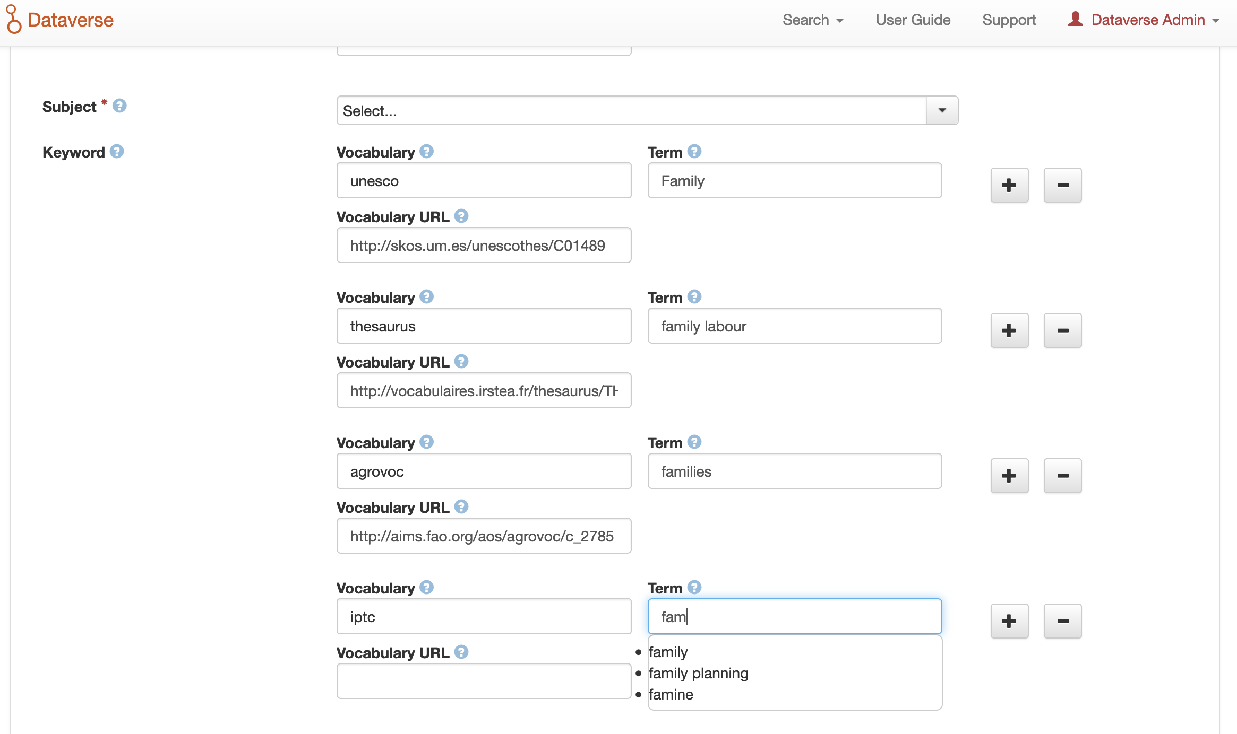
External CV support: metadata field could be linked to many ontologies
Language switch in Dataverse will change the language terms!

Slide 22
Dataverse App Store
Let’s build different services out of tools!
Data preview: DDI Explorer, Spreadsheet/CSV, PDF, Text files, HTML, Images, video render, audio, JSON, GeoJSON/Shapefiles/Map, XML
Interoperability: external controlled vocabularies (CESSDA CV Manager)
Data processing: NESSTAR DDI migration tool
Linked Data: RDF compliance (FAIR Data Point)
Federated login as a service (OAuth/Shibboleth in the same installation)

Slide 23
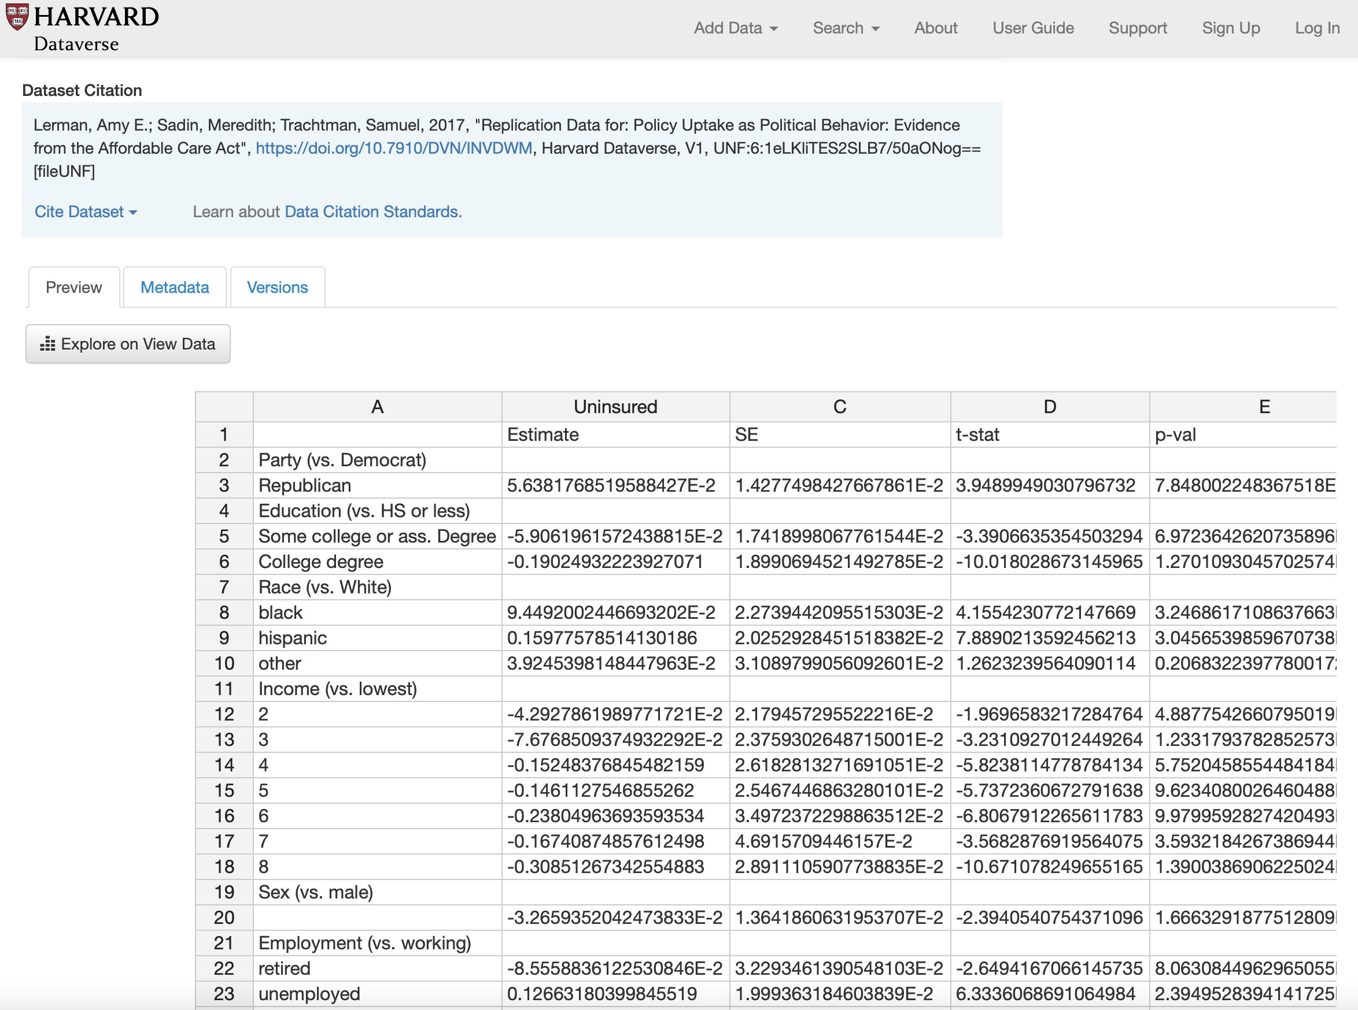
Dataverse Spreadsheet Previewer

Slide 24
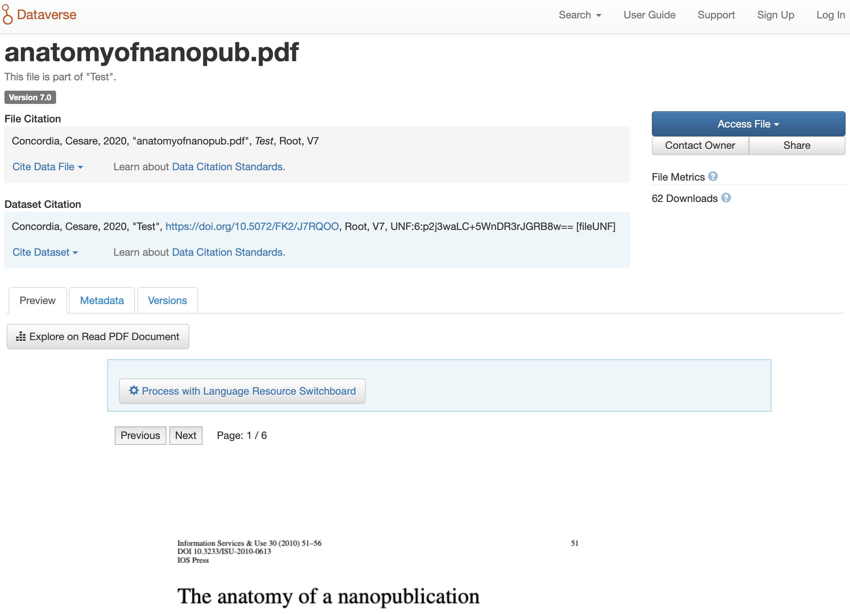
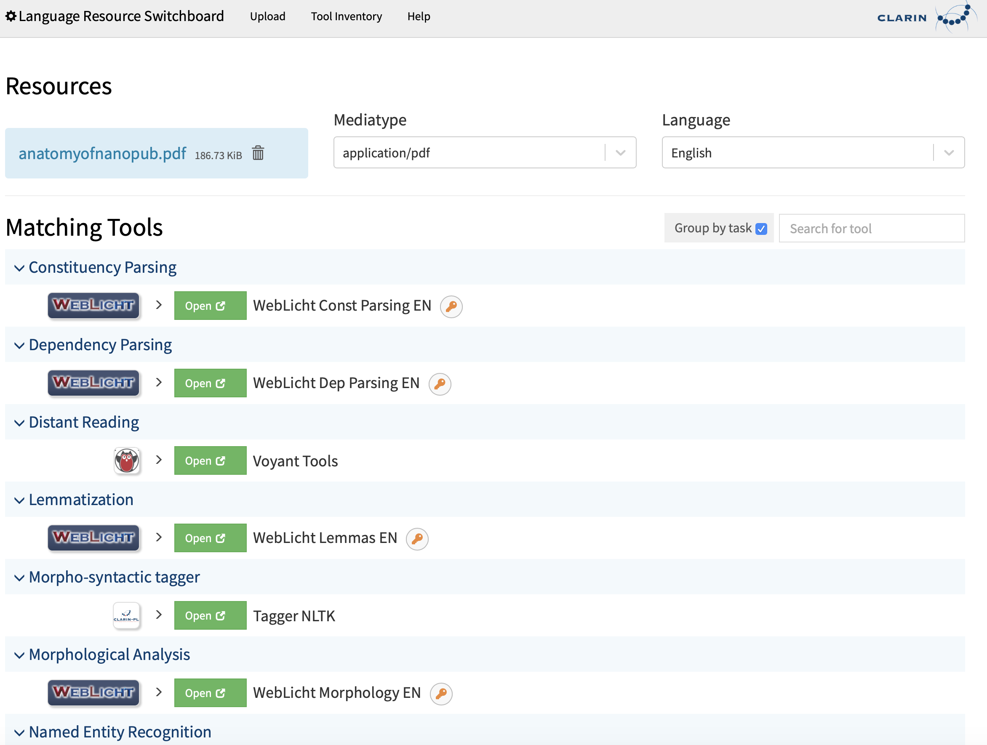
Dataverse and CLARIN tools integration

Slide 25
Make Data Count metrics
Make Data Count is part of a broader Research Data Alliance (RDA) Data Usage Metrics Working Group which helped to produce a specification called the COUNTER Code of Practice for Research Data.
The following metrics can be downloaded directly from the DataCite hub for datasets hosted by Dataverse installations:
Total Views for a Dataset
Unique Views for a Dataset
Total Downloads for a Dataset
Downloads for a Dataset
Citations for a Dataset (via Crossref)
Dataverse Metrics API is a powerful source for BI tools used for the Data Landscape monitoring.

Slide 26
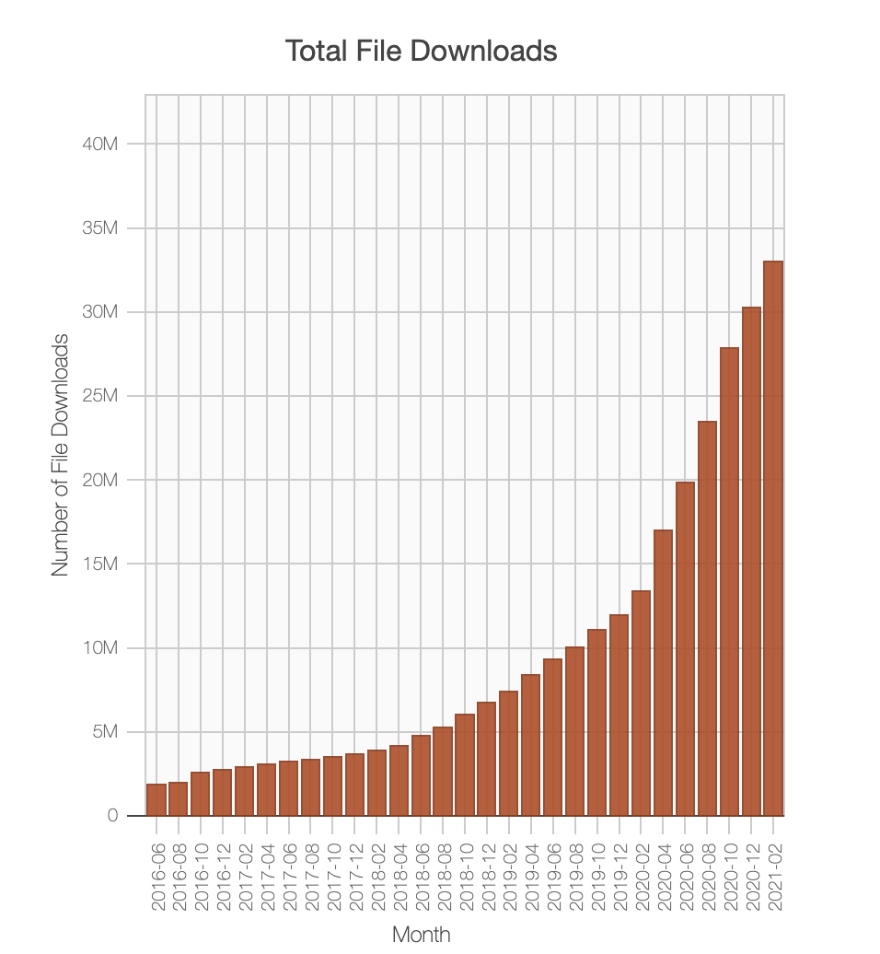
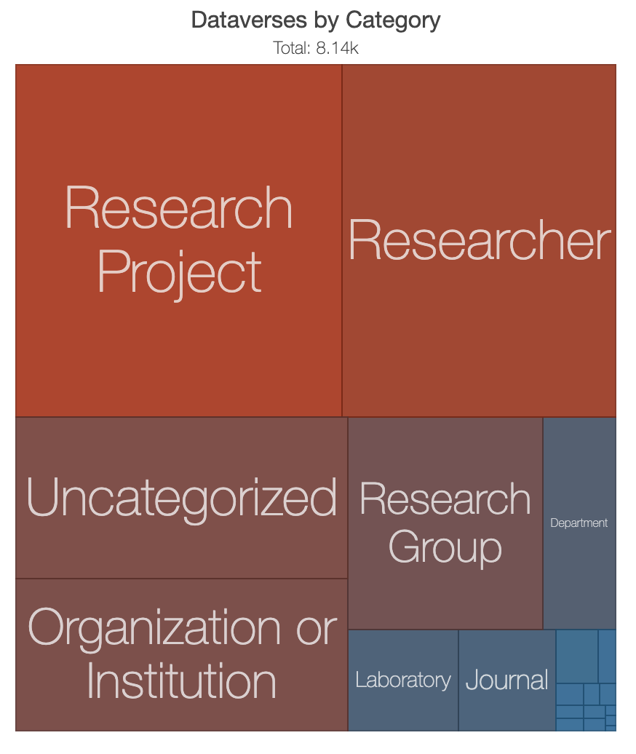
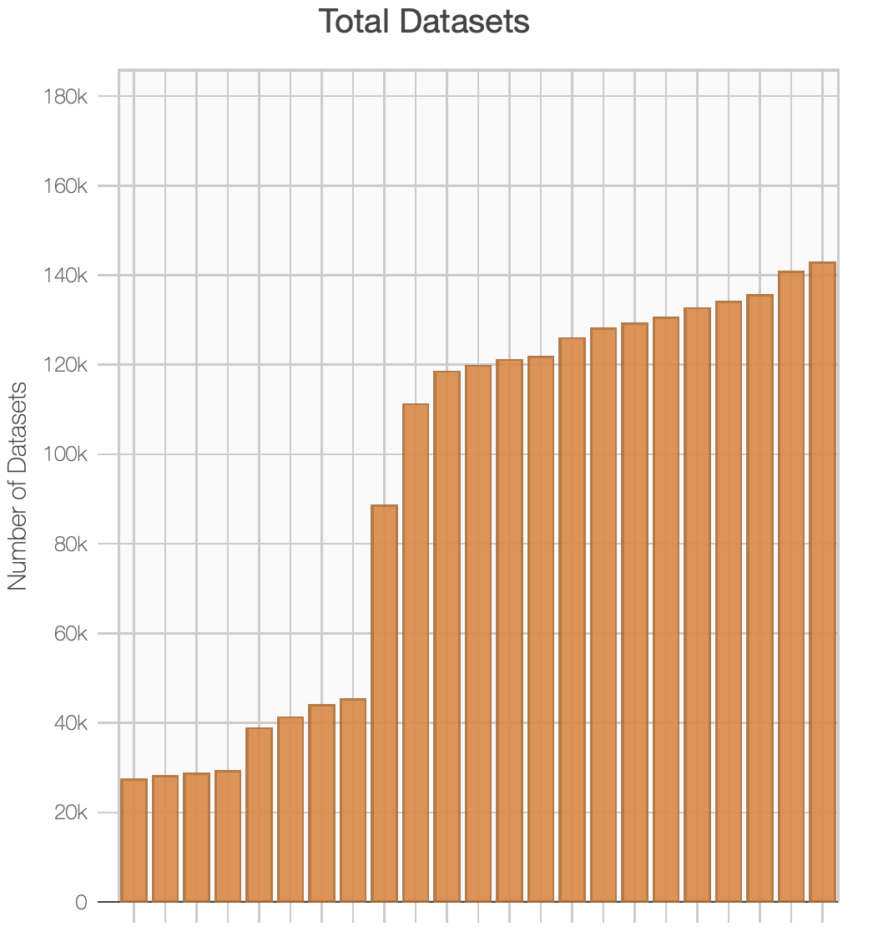
Dataverse Metrics from 30+ repositories
Source: Metrics

Slide 27
Multilingual support
Dataverse SSHOC will run Weblate as a service for the user interface, metadata schema and SOLR translation.
We’ve developed an experimental but adjustable pipeline for multilingual support that allows to download and synchronize all translations available in Dataverse Consortium github and provides easy access for translators to keep all properties up-to-date.

Slide 28
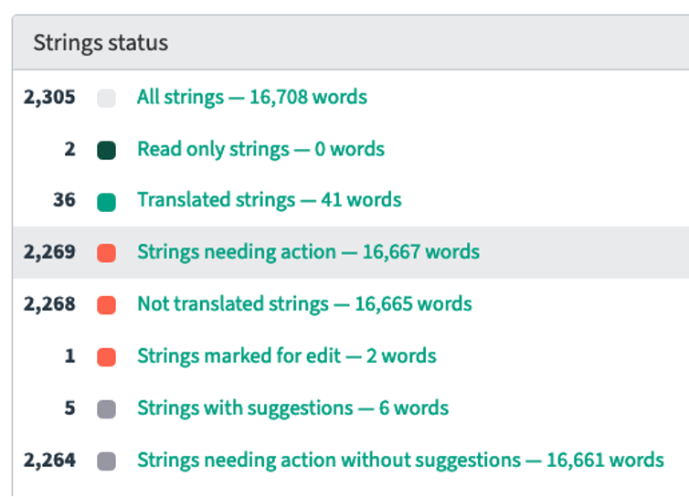
Dataverse localization with Weblate
service to connect files to Weblate in order to translate them in a structured way
several options for project visibility: accept translations by the crowd, or only give access to a select group of translators.
Weblate indicates untranslated strings, strings with failing checks, and strings that need approval.
when new strings are added with an upgrade of Dataverse, Weblate can indicate which strings are new and untranslated.

Slide 29
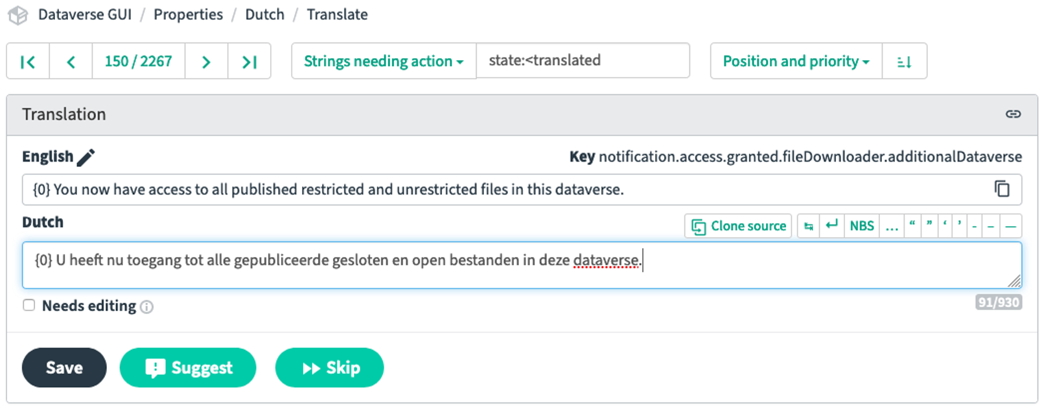
GUI translation with Weblate as a service
Source: SSHOC Weblate

Slide 30
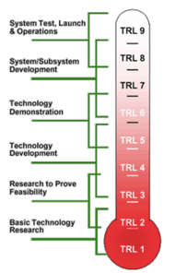
Services in European Open Science Cloud (EOSC)
EOSC requires the level 8 of maturity (at least)
we need the highest quality of software to be accepted as a service
clear and transparent evaluation of services is essential
the evidence of technical maturity is the key to success
the limited warranty will allow to stop out-of-warranty services

Slide 31
Applications maturity level
Every software package should follow the same CESSDA Maturity Model to be accepted as a service.
Must have: k8s infrastructure with upstream Docker images, warranty statement, documentation, unit tests, Selenium tests, jenkins pipeline
Running demonstration service will allow to create the connection to your own Dataverse.

Slide 32



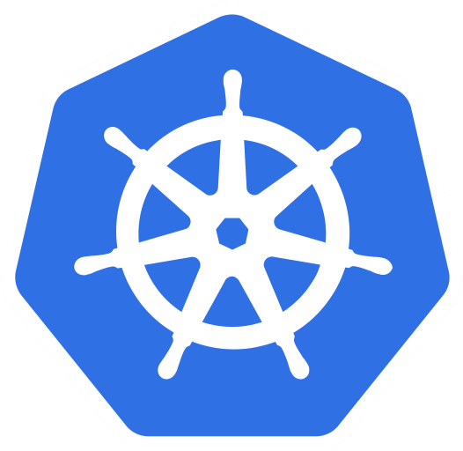


CI/CD pipeline with SQAaaS (S)
Developer pushes code to GitHub
Jenkins receives notification - build trigger
Jenkins clones the workspace
(S) Runs SQA tests and does FAIRness check
(S) Issuing digital badge according to the results
(S) SQAaaS API triggers appropriate workflow
Creates docker image if success
Pushes new docker image to container registry
Updates the kubernetes deployment
2
webhook
1
3
git clone
git push
Jenkins pipeline (Jenkinsfile)
Run SQA
Create docker image
Push GCP container registry
Kubernetes Deployment
S
7
8
9
Source: EOSC Synergy project

Slide 33
Who is going to benefit from SSHOC Dataverse project?
(SSH) institutes and researchers will be offered a Dataverse installation on the cloud
(SSH) institutes will be offered a Dataverse archive in a box solution for their own purposes
Many of the features to be developed in SSHOC will benefit also other Dataverse installations / communities
All developments will be available for Dataverse community members!

Slide 34
Questions?
Slava Tykhonov (DANS-KNAW)
Senior Information Scientist
vyacheslav.tykhonov@dans.knaw.nl
Co-Chair:
Dataverse Working Group (WG) on Controlled Vocabularies and Ontologies
Dataverse WG on Registries
dataverse.org

