Slide 1
Marrakesh Treaty for Persons with Print Disabilities
Opportunities & Experiences
1st National Workshop To Design
The National Disability Strategy Plan (NDSP)
2019-2023
Phnom Penh, 11-12 December 2018
Wanna Net
Hun Sen Library, Royal University of Phnom Penh
Country Coordinator Cam-eIFL

Slide 2
Cam-eIFL & EIFL
Contents
EIFL and Marrakesh Treaty​​
Marrakesh Treaty: Most popular treaty in the history of WIPO
Countries ratified Marrakesh Treaty
Benefits of Marrakesh Treaty
Libraries key to the success of the Treaty
Implementing Marrakesh Treaty: Strategies for success
After Implementation: Moving from policy to practices
Resources on​ Marrakesh Treaty

Slide 3

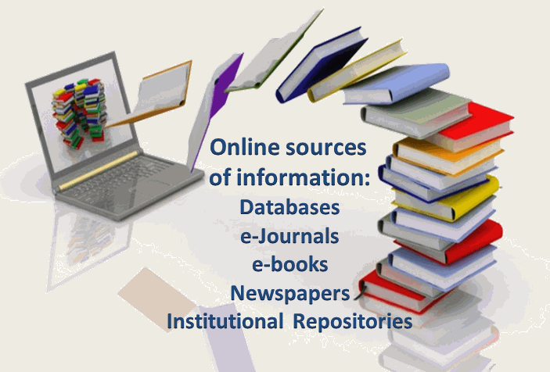






Slide 4
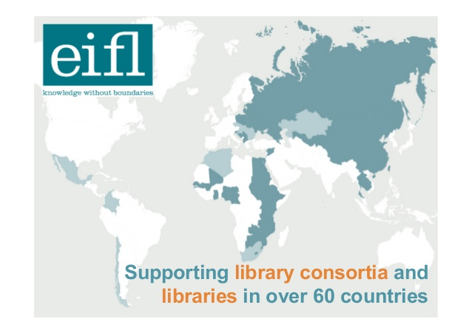




Slide 5
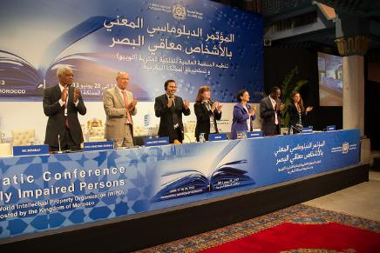




EIFL និង​សន្ធិ​សញ្ញា Marrakesh ​
Supported negotiations over 5 years at WIPO in Geneva.
Attended Diplomatic Conference in Marrakesh that adopted the treaty (2013).
Now working to support ratification and national implementation.
14 EIFL partner countries have joined Marrakesh.

Slide 6
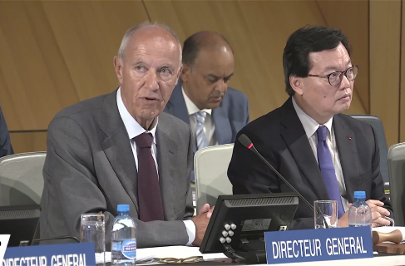
Marrakesh: WIPO’s most popular treaty
74 countries (23 November 2018)
Update 2018
“The fastest moving of the WIPO treaties, not only in the past year, but most probably in the history of the Organization”.
Francis Gurry, Director General, WIPO Assemblies, 24.9.2018

Slide 7
Countries that have ratified include:
Australia, Canada, Europe (28 Members)
North Korean, South Korean, India, Japan, Kyrgyzstan, Mongolia, Sri Lanka, Singapore
Full list of ratifications: www.wipo.int/treaties/en/ShowResults.jsp?lang=en&treaty_id=843
Ratification Process Advanced: Thailand & USA
We hope ​CAMBODIA soon joins to share the benefits!

Slide 8
Benefits of the Marrakesh Treaty
Enables people in Cambodia to access hundreds of thousands of accessible books in other Marrakesh countries (including English and French titles).
Allows accessible books in Khmer to be sent to Khmer speakers in other Marrakesh countries (and vice versa).
Improves library services to people with print disabilities - more books, faster delivery, reduced costs.
Encourages cooperation and partnerships to share accessible resources.
Opens opportunities for government and donor funding to support services permitted by the new legal framework.

Slide 9








Benefits of the Marrakesh Treaty
A
A
braille
audiobook
large print

Slide 10


Libraries key to the success of
the Treaty
A
A
braille
audiobook
large print
NGOs
Libraries
Authorized entities

Slide 11
Success Stories
Countries that have joined Marrakesh (1/2)
Vision Australia and Canadian Accessible Library Service (35,000 titles): new agreement to share book collections.
India: Daisy Forum India online library now has 342,000+ books in 13 languages and 7 formats; Bookshare India serving 10,000+ new members.
Kyrgyzstan: 1st international book transfer in April 2017 (from Canada). Titles: “Mahatma Ghandi” (in Russian) for Member of Parliament, “The Lean Start-up” for MBA student. Delivered by Dropbox and USB stick.

Slide 12
Success Stories Countries that have joined Marrakesh (2/2)
Argentina: Tiflolibros online library (56,000 titles) now used by 2,180+ users from 16+ Marrakesh countries.
Ecuador: National Federation of Blind library (20,000 digital books, 800 audio books) exchanged titles with Tiflolibros to grow both their collections (Spanish).
Uruguay: first Accessible Digital Library created through alliance between National Union of Blind of Uruguay (UNCU) and University of the Republic (UDELAR).

Slide 13

Success Story from Vision Australia 2/2
A Boy Named William
Early 2018, 17-year old William starting final school year.
Vision Australia didn’t have a copy, it was not available to purchase in accessible audio format, nor to produce the audio book in the time needed.
Canadian National Institute for the Blind (CNIB) had a DAISY version and it was available for exchange.
The book was received overnight and was in William’s hands the next day.
Without Marrakesh, it would not have been possible to provide William with this book so quickly or easily.

Slide 14
Marrakesh implementation:
strategies for success
Political support: commitment by government to ratify.
Strong civil society partnerships: blind & disability groups, libraries, human rights, IGOs, NGOs ➔Right to Read campaign.
Multi sectorial working group: All relevant stakeholders
Knowledge & evidence: who needs the treaty and why, obligations & rights granted, process for ratification.
Marrakesh champions & media: government official (India), parliamentarian (Kyrgyzstan), blind activist (Argentina), librarian (Mongolia), author or musician (Senegal); newspapers and TV.

Slide 15
After implementation:
Moving from policy to practice
Work in partnership: Dept of Copyright and Related Rights (Min of Culture), government agencies, UNDP, libraries, blind groups, publishers, authors.
Raise awareness: factsheets for the blind community, libraries, schools and universities.
Develop best practice guidelines for authorized entities and publishers: e.g. technical standards, metadata for discovery, accessible publishing.

Slide 16
Resources on Marrakesh Treaty
The Marrakesh Treaty: an EIFL Guide for Libraries
Implementation of the Marrakesh Treaty: EIFL FAQs
Getting Started. Implementing the Marrakesh Treaty for persons with print disabilities. A practical guide for librarians. Co-published by EIFL.
Available at www.eifl.net/resources/

Slide 17
Thank you

