Slide 1

Quality and best practice in OA journal publishing

Slide 2
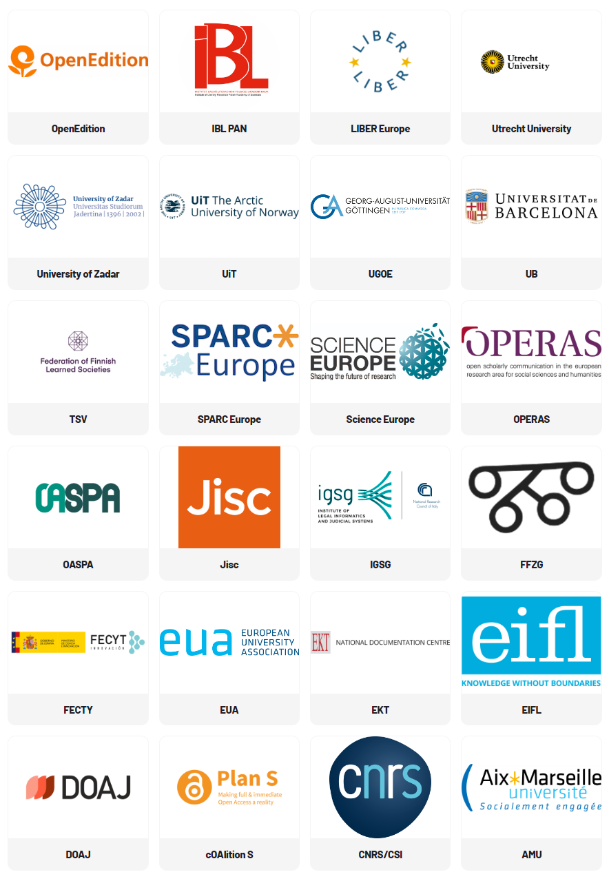
Overview
Period: 2022 - 2025
Starting date: September 2022
Participants: 23 public service scholarly organizations from 12 European countries

Slide 3
Project Objectives
Provide the research community with an aligned, high-quality, and sustainable OA scholarly communication ecosystem, capable of implementing OA as a standard publication practice across the ERA.
Create a community, supporting services, and non-technical infrastructure for Institutional Publishing Service Providers (IPSPs) that adopt common standards, guidelines, and best practices.
Common standards, guidelines, and best practices will be co-created and adopted as an Extensible Quality Standard for Institutional Publishing (EQSIP).

Slide 4
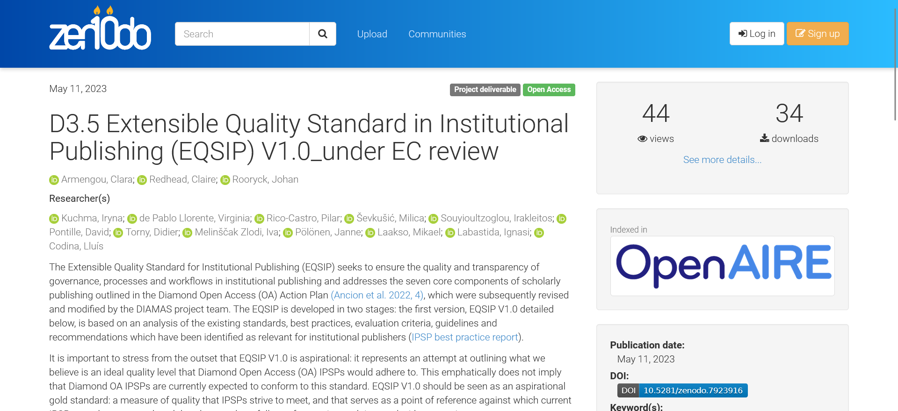
https://doi.org/10.5281/zenodo.7923916

Slide 5
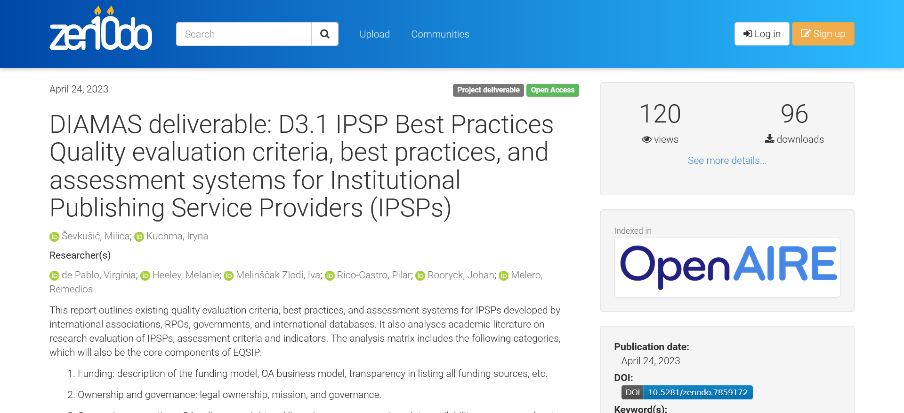
https://doi.org/10.5281/zenodo.7859172

Slide 6
Funding: Transparency and conflict of interest policies
Having a clear OA policy that covers the OA business model and compliance with funders and institutional OA policies (if they exist); and indicating on the publication homepage its funding sources, in case it receives funds from outside the publishing institution, are among the current good practices analysed.
You should be transparent about your types of revenue streams. When you are recipients of commercial sponsorships, this should be clearly indicated (i.e., to preempt relevant questions about the objectivity of the published content). The same principle applies to the funding of special and thematic issues and supplements: journal and supplement editors must not accept personal favours or direct remuneration from sponsors of such special issues and supplements.

Slide 7
Funding: Transparency and conflict of interest policies (2)
A consistent workflow allowing authors, editors and reviewers to disclose financial conflicts of interest (in the Conflict of Interest statement and in the metadata) and disclose all sources of funding (in the Funding acknowledgments/statements and in the metadata).
Submission and publication should not be conditional in any way on the payment of a fee from the author or their employing institution, or on membership of an institution or society.
Business models or revenue sources (for example, reprint income, supplements, special issues, sponsorships) should not influence editorial decision making. Editors-in-chief should have the final say in decisions about which advertisements or sponsored content, including supplements, the publication will and will not carry, and they should have the final say concerning the use of the publication brand and on overall policy regarding the commercial use of content.

Slide 8
Funding: Transparency and conflict of interest policies (3)
Formal, explicit, written policies for advertising in both print and digital versions.
Paid editions, such as a print on demand edition, should appear simultaneously or follow the OA version; and the OA version should be made available on the publication service's website, if applicable, together with printed versions made available for a fee.
Non-profit and collaborative publishing models which preferably do not involve Article Processing Charges (APCs) or Book Processing Charges (BPCs)

Slide 9
Transparent ownership structure, community governance
A controlling scholarly organization, not a commercial publisher, should own the journal title, so that a change of the service provider can be achieved without changing the title. Be careful when entering into different contracts in order not to lose control over the journal title.
Information about the ownership and management should be clearly indicated on the website, i.e. “the publisher name must be clearly defined, and a verifiable, physical address (not P.O. Box) for the publisher’s business offices must be provided. If there is a society affiliation or ownership, this should be stated, and verifiable contact information must be provided.” (‘Web of Science Journal Evaluation Process and Selection Criteria’ 2022); “clear definition of governance institutions, their objectives, relationships and ways of functioning” (‘Exemplarity Criteria for Funding from the National Open Science Fund through Platforms, Infrastructures and Editorial Content’ 2019).

Slide 10
Direct lines of communication
Full contact details should be specified: a full name of contact, full name of the publishing institution or organisation, city and country of publication, institutional email, i.e. “the name of the journal’s publishing body or institution, which must be in good academic standing, as well as its full postal and e-mail address, must be provided in a visible place on the journal.” (‘Latindex - Sistema regional de información en línea para Revistas científicas de América Latina, el Caribe, España y Portugal: Metodología del Catálogo 2.0’ 2022)

Slide 11
Community governance
The composition and constitution of the journal's/platform's editorial bodies should be defined and publicly displayed: the names, functions and roles of all members of the editorial team; as well as the names of the members of the Editorial Board and their affiliations. PIDs (such as ORCID) and links to institutional profiles may be provided to specify the identity and affiliation of the editorial staff.
Procedures for the selection of members of the governance and editorial bodies should be open and publicly available. A regular renewal of editorial bodies is recommended, i.e. the editor or editor-in-chief of the journal should have a term of service of four to five years (some recommend it to be renewable only once); all members of the journal bodies should also have a limited term of service. Editorial boards should consist of at least five people and include members from different institutions and preferably from different cities and countries as well (or there should be another international body - e.g. international editorial committee).

Slide 12
Editorial freedom
Editors-in-chief have full authority over the entire editorial content of their journal and the timing of publication of that content. Editors and IPSPs, sponsoring societies, or journal owners should have signed contracts to ensure proper editorial freedom and responsibility. To secure editorial freedom in practice, the editor should have direct access to the highest level of journal ownership, not to a delegated manager or administrative officer. Journal owners should not interfere in the evaluation, selection, scheduling, or editing of individual articles either directly or by creating an environment that strongly influences decisions.

Slide 13
Content ownership
Reviewers should retain copyright of their reviews, and editorial bodies and institutions retain ownership of all correspondence and mailing lists compiled on the electronic submission system put at their disposal by the publisher (if commercial publishers are involved).
Relations between authors and the publishing entity taking the intellectual responsibility for the publication content should be regulated and formalised (i.e. in the form of a contract and the licensing policy).
Authors should be allowed to retain copyright without restriction and use Creative Common licences (e.g. CC-BY) to ensure reuse of publications.

Slide 14
Open science practices
Clear open science/OA policies
rights retention and content reuse (e.g. CC-BY) ;
good data sharing practices and data availability policies following FAIR principles;
experimenting with open peer review;
supporting preprints sharing;
publishing negative results;
research protocols and methods sharing and publishing, open research software
enabling open citations; open abstracts, open metadata

Slide 15
Research data sharing and data availability policies
Policies on data availability and the use of reporting guidelines and registration of clinical trials and other study designs according to standard practice in their discipline.
Data underlying publications should be available to editors and reviewers when the manuscript is submitted for review, and to all others by the time of publication at the latest. Data should be made available under FAIR principles with necessary metadata. Exceptions to data sharing are justified when it comes to personal and sensitive data, when no consent has been obtained for sharing, for reasons of protection of intellectual property, or to avoid revealing endangered areas, groups or species. In these cases, it is possible to share the data in an anonymised manner, or under conditions of controlled and regulated access. Exceptions and specifics for access to data should be explained by the author in the accompanying Data Availability Statement and publicly available metadata.

Slide 16
Open peer review
Open peer review is one of the recommended open science practices: “Promoting, as appropriate, open peer review evaluation practices including possible disclosure of the identity of the reviewers, publicly available reviews and the possibility for a broader community to provide comments and participate in the assessment process.” (‘UNESCO Recommendation on Open Science’ 2021)

Slide 17
Preprints
Allow posting of manuscripts in preprint repositories: “Promoting open science from the outset of the research process and extending the principles of openness in all stages of the scientific process to improve quality and reproducibility, including the encouragement of community-driven collaboration and other innovative models, for example preprints, and respecting the diversity of scientific practices, in order to accelerate dissemination and encourage rapid growth in knowledge.”.(‘UNESCO Recommendation on Open Science’ 2021)

Slide 18
Publication and sharing of negative scientific results
“Encouraging and valuing publication and sharing of negative scientific results and those that do not conform to the results expected by the researchers who carried them out, and data associated with them, as these results also contribute to the advancement of scientific knowledge.” (‘UNESCO Recommendation on Open Science’ 2021)

Slide 19
Research protocols and methods sharing and publishing
Making associated research protocols and methods available is a good open science practice that allows others to replicate and build on work published.
Open research software
Encourage the sharing of research software available through an open repository

Slide 20
Open citations, open abstracts, open metadata
Bibliographic references should be openly available according to the standards of the Initiative for Open Citations (I4OC). The aim of this initiative is to promote the availability of data on citations that are structured, separable, and open - freely accessible and reusable.
Join initiatives supporting the exchange of open metadata, such as I4OC and the Initiative for Open Abstracts (I4OA), and make sure that the metadata provided via commonly used metadata exchange protocols are available under the CC0 Public Domain Dedication.

Slide 21
TOP guidelines (Transparency and Openness Promotion)
TOP Guidelines include eight modular standards: 1) Citation standards, 2) Data transparency, 3) Analytic methods (code) transparency, 4) Research materials transparency, 5) Design and analysis transparency, 6) Study preregistration, 7) Analysis plan preregistration and 8) Replication, each with three levels of increasing stringency: Disclosure – the article must disclose whether or not materials are available; Requirement – the article must share materials when possible; Verification – third party must verify that the standard is being met. Journals select which of the eight transparency standards they wish to implement for transparency and reproducibility in published research and select a level of implementation for each. These features provide flexibility for adoption depending on disciplinary variation, but simultaneously establish community standards. Journal policies can be evaluated based on the degree to which they comply with the TOP Guidelines - TOP factor, which is a metric that reports the steps that a journal is taking to implement open science practices. It helps to assess journal qualities, and is an improvement over traditional metrics that measure mean citation rates.

Slide 22
Incentives and rewards
“Combining efforts of many different stakeholders, including research funders, universities, research institutions, publishers and editors, and scientific societies across disciplines and countries, to change the current research culture and to recognize researchers for sharing, collaborating and engaging with other researchers and society, and to support, in particular, early-career researchers in particular to drive this cultural change”;
“Encouraging funders, research institutions, journal editorial boards, learned societies and publishers to adopt policies that require and reward open access to scientific knowledge, including scientific publications, open research data, open software, source code and open hardware” (‘UNESCO Recommendation on Open Science’ 2021)

Slide 23
Editorial quality, editorial management
Editor roles and responsibilities (towards authors, reviewers, readers and the scientific community, journal and platform owners, public) should be clearly described, but at the very least editor roles include the selection of reviewers for the papers assigned to them, providing the authors with advice on how to improve their paper, and negotiating disagreements between authors and reviewers. These crucial aspects of the peer review process cannot be left to publication technicians or AI.
Written editorial policies, including a written job description, specifically detailing components of editorial freedom, including the degree of control regarding editorial content, acceptance and publication, and advertising content; a mechanism to prevent inappropriate influence on the editor by others and to handle conflicts in an objective and transparent manner with the goal of conflict resolution and maintenance of trust.

Slide 24
Editorial quality, editorial management (2)
A policy on publication ethics (for example, COPE’s Core Practice guidance), addressing authorship and contributorship, handling complaints and appeals, handling allegations of research misconduct, conflicts of interest, data sharing and reproducibility, ethical oversight, intellectual property, post-publication discussions, corrections and retractions. Policies should address plagiarism, citation manipulation, and data falsification/fabrication, among others.
Publicly available clear and detailed author guidelines. Clear policies that allow for transparency around who contributed to the work and in what capacity should be in place for requirements for authorship and contributorship, as well as processes for managing potential disputes, applying the CRediT taxonomy. Full names and affiliations of each author/contributor should be displayed; author information should be complete and unambiguous, and name abbreviations are not recommended.

Slide 25
A policy regarding chatbots
A policy regarding chatbots and other writing assistance tools to help authors understand how the use of chatbots might be attributed in their work. The IPSP should require authors to declare whether chatbots or other writing assistance tools were used in writing their outputs, and inform them that chatbots do not meet authorship criteria and cannot be considered authors. Authors should be considered responsible for the work performed by writing assistance tools. Authors must be able to assert the accuracy of the content, that there is no plagiarism, that all sources of information used by writing assistance tools are appropriately cited, and that relevant views omitted by chatbots are found, reviewed and included in the output (Zielinski et al. 2023).

Slide 26
Editorial quality, editorial management (3)
Criteria for the acceptance of papers, books, preprints, and other contributions should be clearly defined and displayed on the website.
Allowing for deposit of the "Version of Record" or the "Publisher Version" in repositories.
Metrics based on bibliometric data should be used responsibly, avoiding misleading implications regarding their connection with the quality of the published content; focus on the quality of the published content, avoid promoting inappropriate metrics like the Journal Impact Factor, and strive to diversify indicators improving the quality of editorial work and alignment with Open Science practices (e.g. Open Science Badges, preregistration, reporting guidelines, data sharing, open peer review, usage of persistent identifiers, alternative metrics).
A publicly displayed archival, digital preservation policy.

Slide 27
Rigorous, timely, transparent and ongoing peer review
Reviewer roles and responsibilities should be clearly described. A review framework and guidelines are provided to reviewers and published on the journal website with the process outline and evaluation criteria.
Except for preprints, manuscripts should be subject to evaluation by more than one person, preferably one of the forms of anonymised peer review (reviewer identity is not made visible to author, author identity is not made visible to reviewer, reviewer and author identity is visible to (decision-making) editor) or open peer review (Ross-Hellauer 2017) by at least two reviewers.
Peer reviewers should be external. Handling editors cannot at the same time be peer reviewers of the papers they are handling. Conflicts of interests between authors, editors, and reviewers (e.g. working at the same institution, previous co-authorships, hierarchical dependencies) should be avoided.

Slide 28
Rigorous, timely, transparent and ongoing peer review (2)
Endogeny (i.e. papers being reviewed by a closed circle of people who are well acquainted with each other or work in the same institution) should be minimized; strive to minimise the share of publications where at least one of the authors is an editor, editorial board member or reviewer. According to some guidelines, it should not exceed 25%. Other guidelines also set a minimum of the published works that should come from authors who are external to the publishing entity (from one third to at least 50%).
DOAJ is now checking for endogeny in either of the latest two issues vs all the articles in the latest two issues

Slide 29
Rigorous, timely, transparent and ongoing peer review (3)
Introduce various types of reviewer recognition and rewards, i.e. by publishing annually and/or making publicly available a list of reviewers (updated at least once a year). Additionally, a journal peer review system can be configured to solicit permission to share review data and export it in the reviewer recognition services, e.g. Publons.
Dates of submission and acceptance should be displayed on publications - at least basic statistics should be published annually on the website, covering in particular the number of submissions, the number of reviews requested, the number of reviews received, the approval rate, and the average time between submission and publication.
Maintain the registry of submitted manuscripts, the archive of author statements, reviewer guidelines, list of reviewers and the registry of peer-review reports. It is recommended to employ open/transparent peer review and publish review reports in open access whenever possible. Reviewers should be allowed to self-archive the reports in the open access repository or reviewers' recognition service.
Have a policy in place to address complaints and appeals regarding rejected manuscripts and withdrawn and retracted publications - and help resolve these issues.

Slide 30
Research integrity
Compliance with generally accepted reporting guidelines (i.e SRQR, CONSORT, PRISMA)
Describe the standards or codes of ethics you use, which may be international, institutional or your own.
Ethical oversight should include, but should not be limited to, policies on consent to publication, publication on vulnerable populations, ethical conduct of research using animals, ethical conduct of research using human subjects, preregistration of the study, handling confidential data and ethical business/marketing practices.
Research integrity control procedures ("similarity checks", checks for falsification and fabrication of data, image manipulation, etc.) should be in place, and responsible reporting guidelines should be provided to authors to enable reproducibility, replicability and repeatability of the published research results. Editors and an organization are responsible for ensuring the integrity of the scholarly literature in their publications and should ensure they outline their policies and procedures for handling such issues when they arise. These issues include plagiarism, citation manipulation, and data falsification/fabrication, among others.

Slide 31
Research integrity (2)
Authors, reviewers and editorial staff are required to provide transparent declarations of conflict of interests, and editorial staff should ensure that conflicts of interests are handled adequately, following journal policies and guidelines and standardised procedures, such as correction or retraction of papers, sanctioning of researchers who engage in misconduct, and appropriate steps towards prevention in the future.
Editors have a responsibility to maintain the integrity of the literature by publishing errata or corrections identifying anything of significance, retractions, and expressions of concern as quickly as possible; and consider publication versioning, with a clear description of what has been changed.
Guidelines to help authors, editors, and reviewers recognise the use of language and images that are inclusive and culturally sensitive (e.g. following the Guidelines on Inclusive Language and Images in Scholarly Communication)

Slide 32
Thank you!
Questions?
iryna.kuchma@eifl.net

