Slide 1
Depositing AAMs in IRs
Lorraine Estelle, EIFL Licensing Programme Manager
Iryna Kuchma, Open Access Programme Manager
Attribution 4.0 International

Slide 2

Versions of an article
Author’s accepted manuscript (AAM)
This is the version of an article after peer-review but prior to publisher typesetting.
The version of record (VoR)
This is the version of an article after the publisher’s typesetting and made available from the journal website.

Slide 3
Why the AAM is important
If an article is published in closed access the AAM is the only version of the peer-reviewed article that can be made available in open access.
Most publishers allow the AAM, to be deposited into an institutional or disciplinary repository where it will be available open access.
This maximises its visibility and impact.

Slide 4
How can an author get their accepted manuscript?
An author may be able to download it from the journal’s submission system as soon as they receive notification of acceptance for publication.
Publishers vary in how long they keep AAMs in their systems.
If an author cannot find their AAM, they can contact the journal and request it.

Slide 5

Top tip!
We advise authors to retain the final version of the article they uploaded into the journal’s submission system.

Slide 6
Seven steps to get the AAM
1. You write an article and plan to submit it to a journal. This first version is called a preprint and many publishers allow this to be uploaded in a preprint repository.
2. You submit your article to a journal.
3. The editor and referees peer-review your article.
4. You amend your article according to the reviewer’s comments and resubmit it to the journal.
5. Your article is accepted for publication. This is your AAM and can be retained for depositing in a repository for open access.
6. The publisher copy edits and formats your article for publication in the journal.
7. Your article is published in the journal. This version is called the version of record (VoR)

Slide 7
Embargo periods
The author can pass the AAM immediately to the repository manager for deposit in the institutional repository / self-archive
Some publishers allow the AAM to be made available in the repository immediately, but some publishers only allow this after an embargo period.
You can check journal embargo periods using the SherpaRomeo service at https://v2.sherpa.ac.uk/romeo.

Slide 8
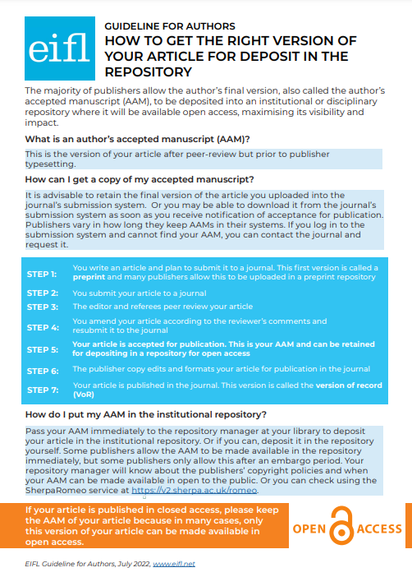
Share our guidelines for authors
https://www.eifl.net/resources/authors-how-get-right-version-your-article-deposit-repository

Slide 9
EIFL partner publishers policies

Slide 10

ACM - AAMs
ACM published authors retain the right to post the pre-submitted (also known as "pre-prints"), submitted, accepted, and peer-reviewed versions of their work in any and all of the following sites:
Author's Homepage
Author's Institutional Repository
Any Repository legally mandated by the agency or funder funding the research on which the work is based
Any Non-Commercial Repository or Aggregation that does not duplicate ACM tables of contents
EIFL-ACM agreement includes a direct deposit in the IR option https://www.acm.org/publications/openaccess#green

Slide 11
ACM – AAMs (2)
For the avoidance of doubt, an example of a site ACM authors may post all versions of their work to, with the exception of the final published "Version of Record", is ArXiv. ACM does request authors, who post to ArXiv or other permitted sites, to also post the published version's Digital Object Identifier (DOI) alongside the pre-published version on these sites, so that easy access may be facilitated to the published "Version of Record" upon publication in the ACM Digital Library.
https://www.acm.org/publications/openaccess#green

Slide 12

Brill - AAMs
All authors receive a letter upon publication, which informs them of the archiving policy
No embargo period

Slide 13
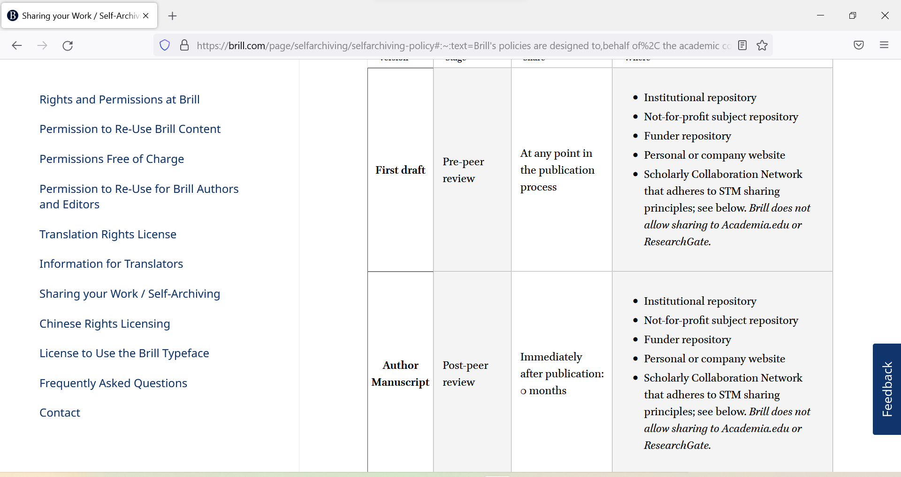
Brill
https://brill.com/page/selfarchiving/selfarchiving-policy#:~:text=Brill's%20policies%20are%20designed%20to,behalf%20of%2C%20the%20academic%20community

Slide 14
Cambridge University Press - AAMs
Funders and other organizations often require research articles funded by them to be made freely available online. Our Green OA policy helps authors to comply with these requirements by making pre-final versions of journal articles accessible in non-commercial websites.
6 months after publication for science, technical and medical journals
On acceptance for humanities and social science journals
https://www.cambridge.org/core/services/open-access-policies/open-access-journals/green-open-access-policy-for-journals

Slide 15
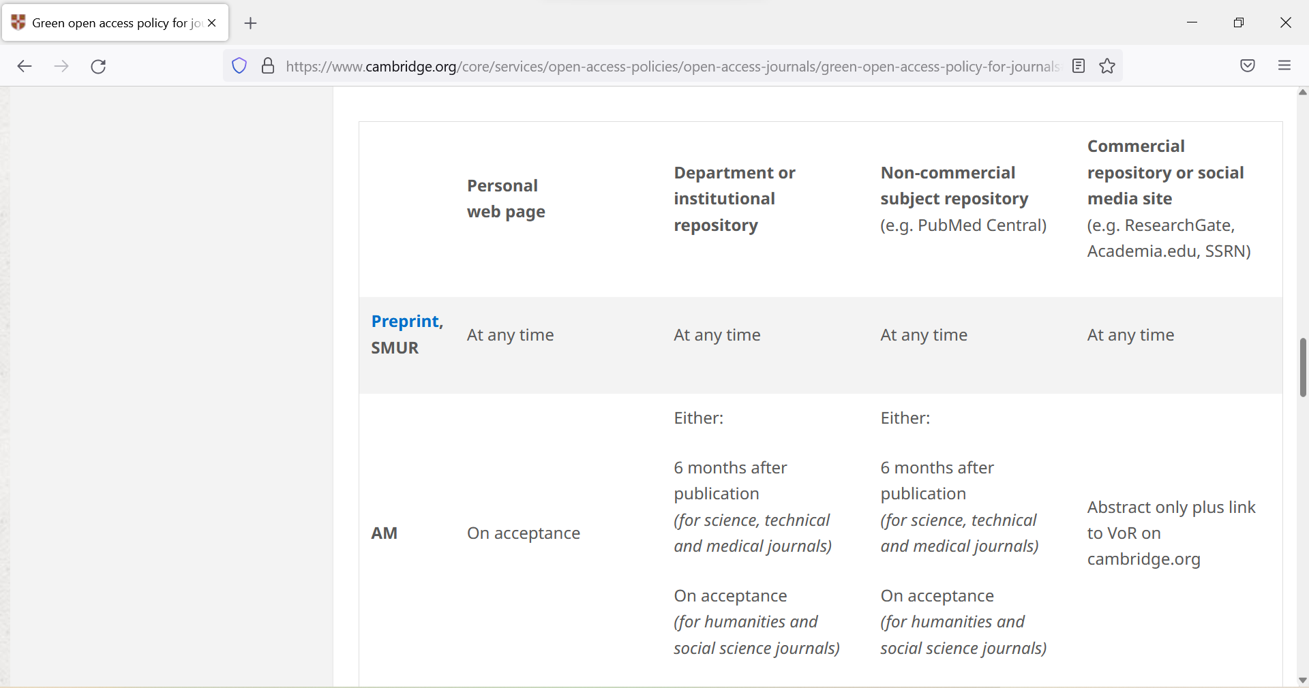
Cambridge University Press

Slide 16
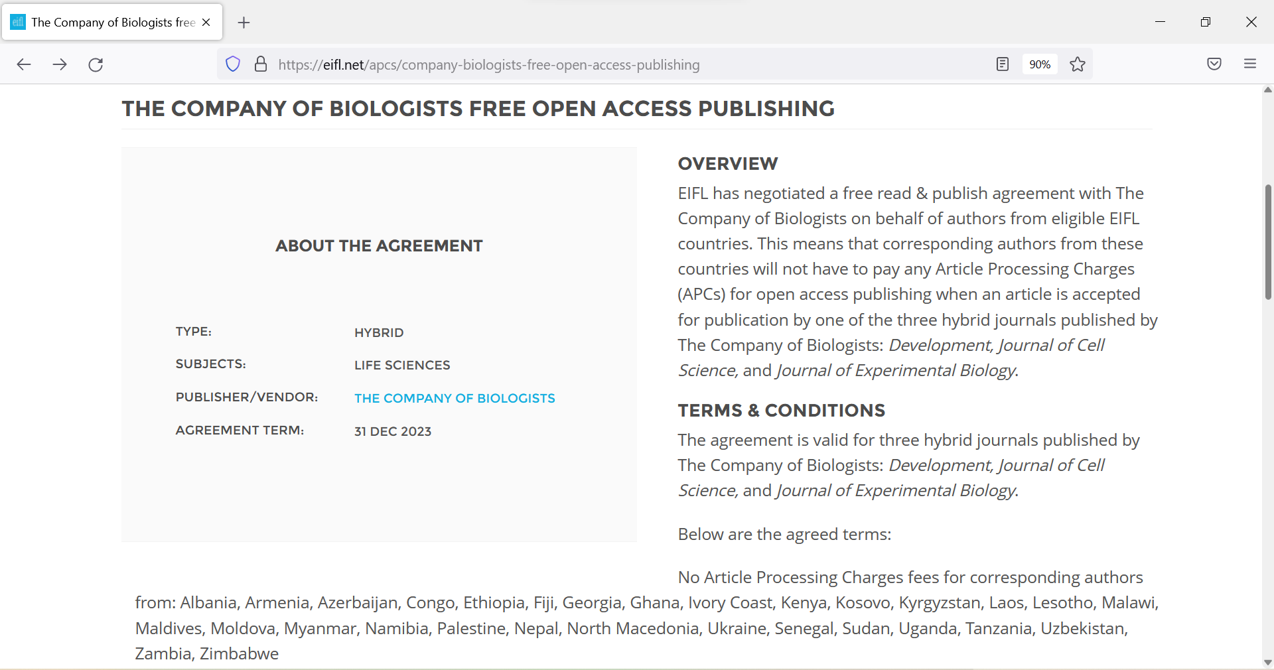
The Company of Biologists
Authors can publish OA and will receive their final PDF for the repository
https://eifl.net/apcs/company-biologists-free-open-access-publishing

Slide 17
De Gruyter – publisher PDFs
De Gruyter allows authors the use of the final published version of an article (publisher pdf) for self-archiving (author's personal website) and/or archiving in an institutional repository (on a non-profit server) after an embargo period of 12 months after publication.
The published source must be acknowledged and a link to the journal home page or articles' DOI must be set.
https://www.degruyter.com/publishing/services/rights-and-permissions/repositorypolicy

Slide 18
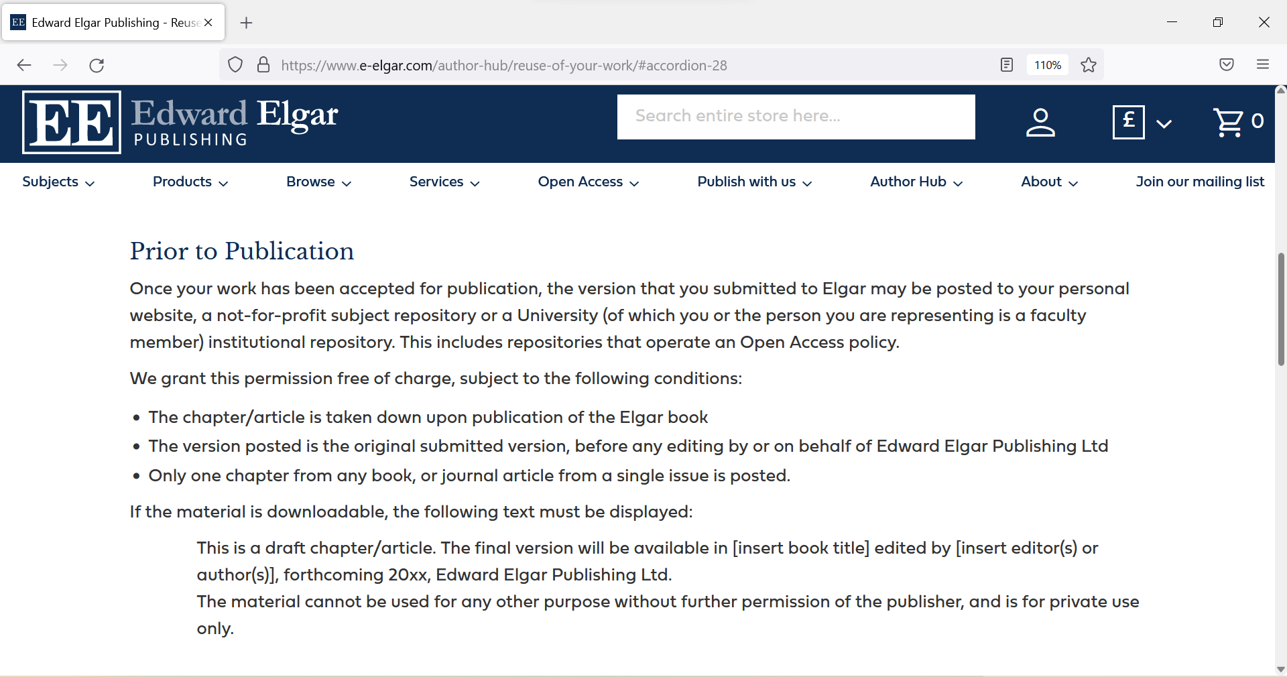
Edward Elgar

Slide 19
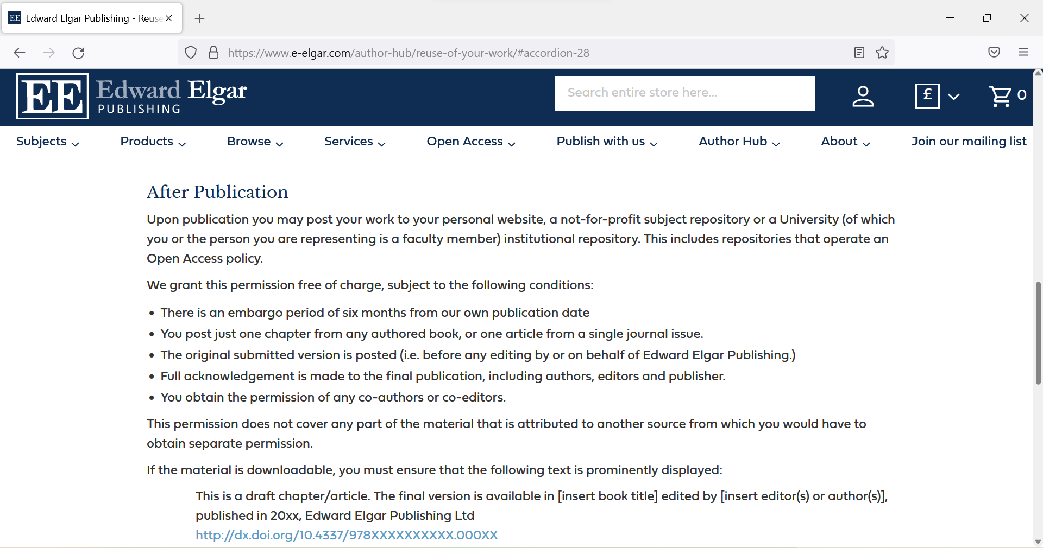
Edward Elgar (2)

Slide 20
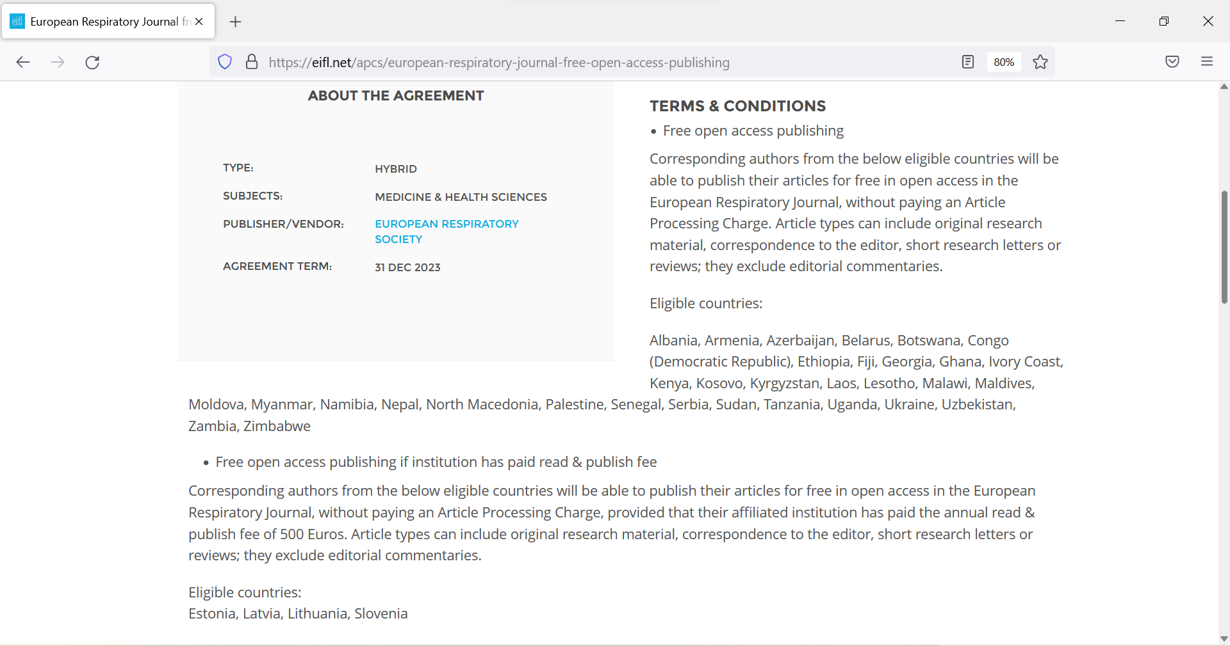
European Respiratory Journal
https://eifl.net/apcs/european-respiratory-journal-free-open-access-publishing

Slide 21
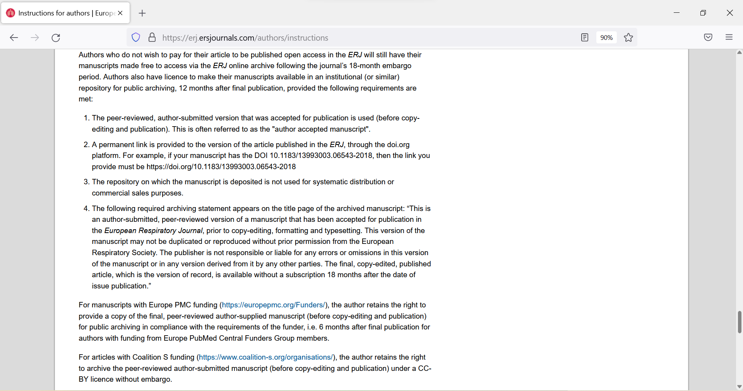
European Respiratory Journal (2)
https://erj.ersjournals.com/authors/instructions

Slide 22
IOP Publishing
Researchers who choose to publish their work on a subscription basis can self-archive a copy of the accepted manuscript in a publicly-accessible repository after a 12-month embargo period. https://publishingsupport.iopscience.iop.org/author-rights-policies/#:~:text=Researchers%20who%20choose%20to%20publish,with%20funders'%20rights%20retention%20policies

Slide 23
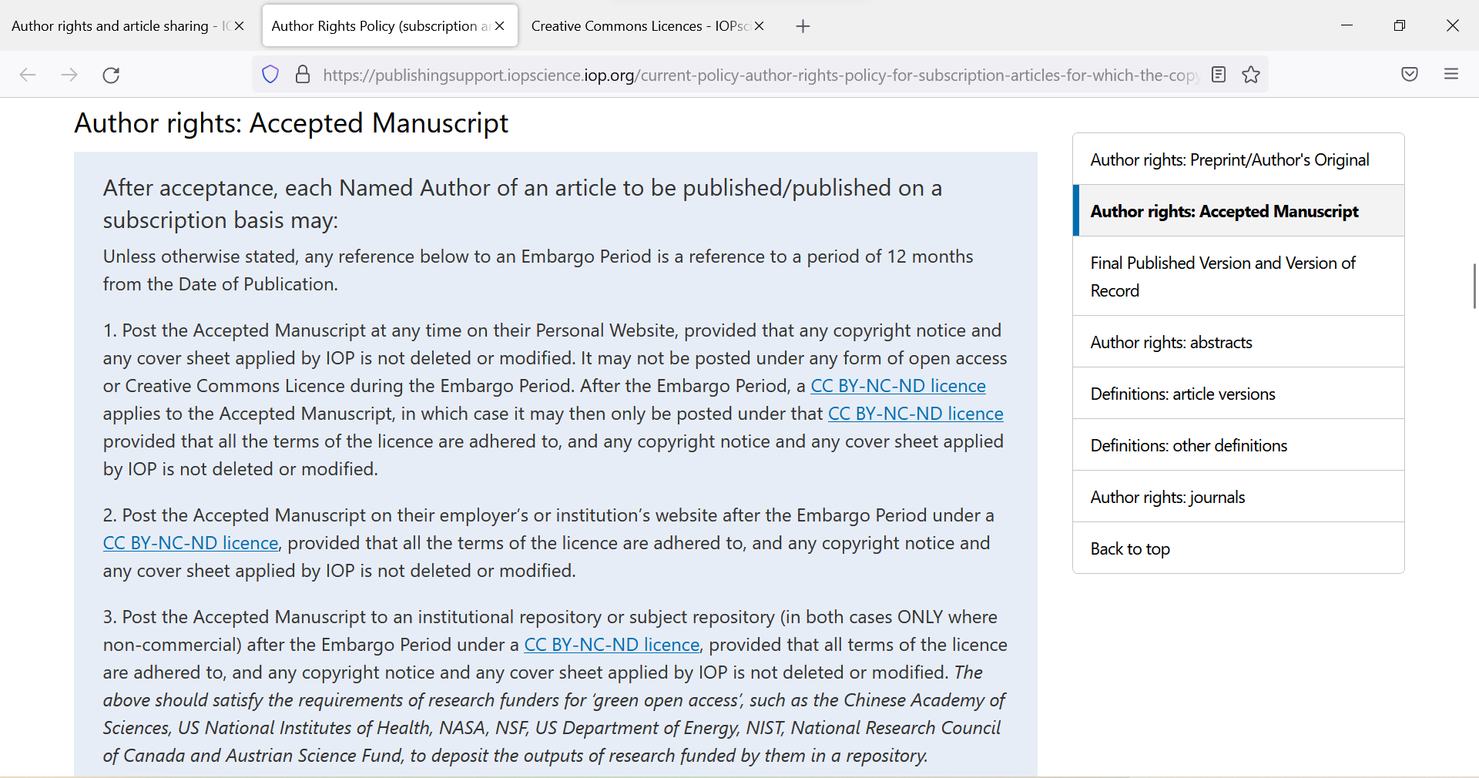
IOP Publishing (2)

Slide 24
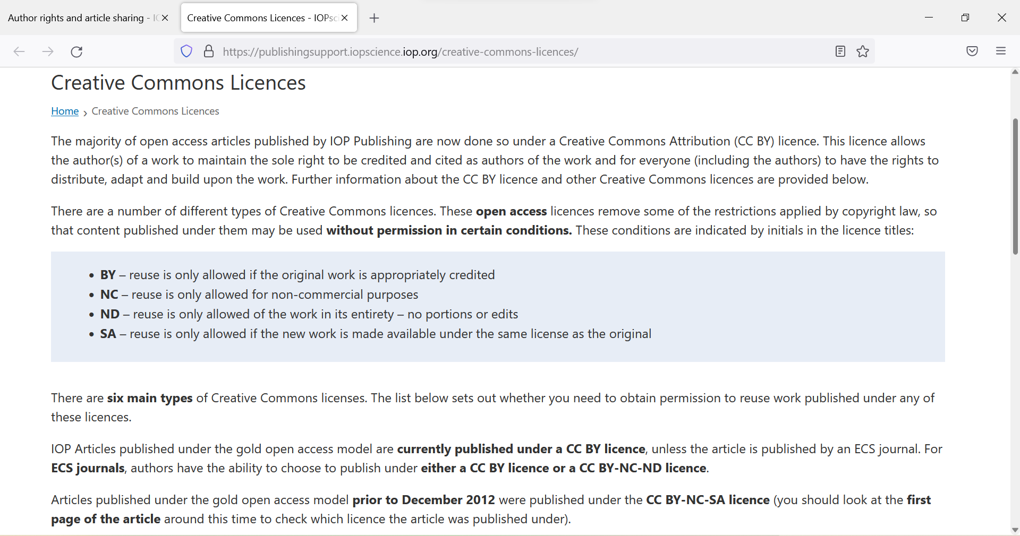
IOP Publishing (3)

Slide 25
IWA
If your paper is published under an OA CC BY 4.0 or CC BY NC-ND 4.0 license (or earlier versions of these licenses), you can archive the final published version of your paper according to the terms of the respective license. For more information on this, see here.
If your paper was published prior to 1 January 2021 and is not licensed under a CC BY license, IWA Publishing allows you to self-archive the submitted version of your manuscript at any point and the author accepted version after a 12-month embargo period. To make sure you are complying with our archiving policies, please make sure you read all of the information here. https://iwaponline.com/open_access/pages/options

Slide 26
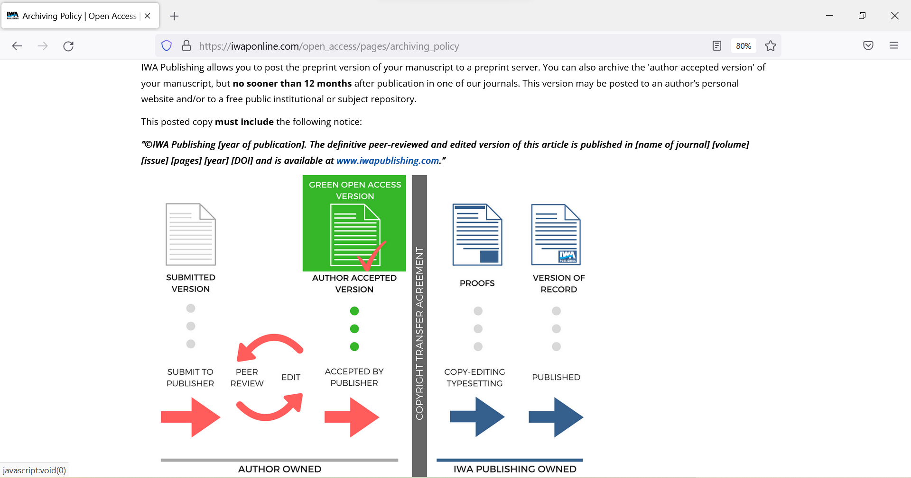
IWA (2)

Slide 27
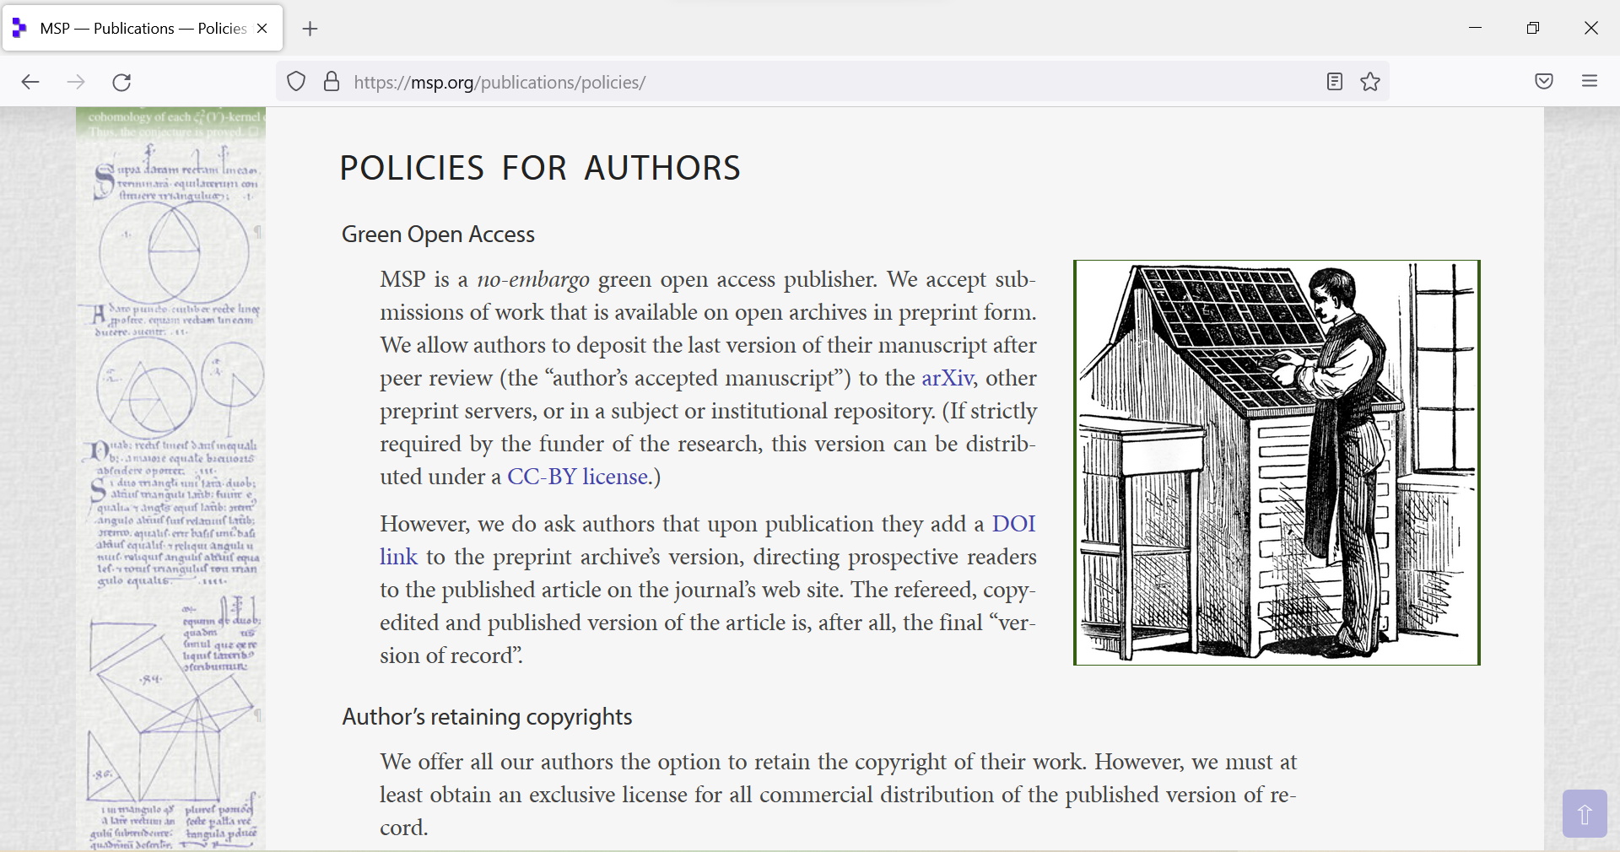
MSP
https://msp.org/publications/policies/

Slide 28
Oxford University Press - AAMs
Authors may immediately upload their AAM to their institutional or other non-commercial subject based repositories (on the proviso that it is not made publicly available until after the specified embargo period) https://academic.oup.com/journals/pages/access_purchase/rights_and_permissions/author_self_archiving_policy
12 months embargo for most. SSH has 24 months. https://academic.oup.com/pages/open-research/open-access/charges-licences-and-self-archiving/accepted-manuscript-embargo-periods

Slide 29
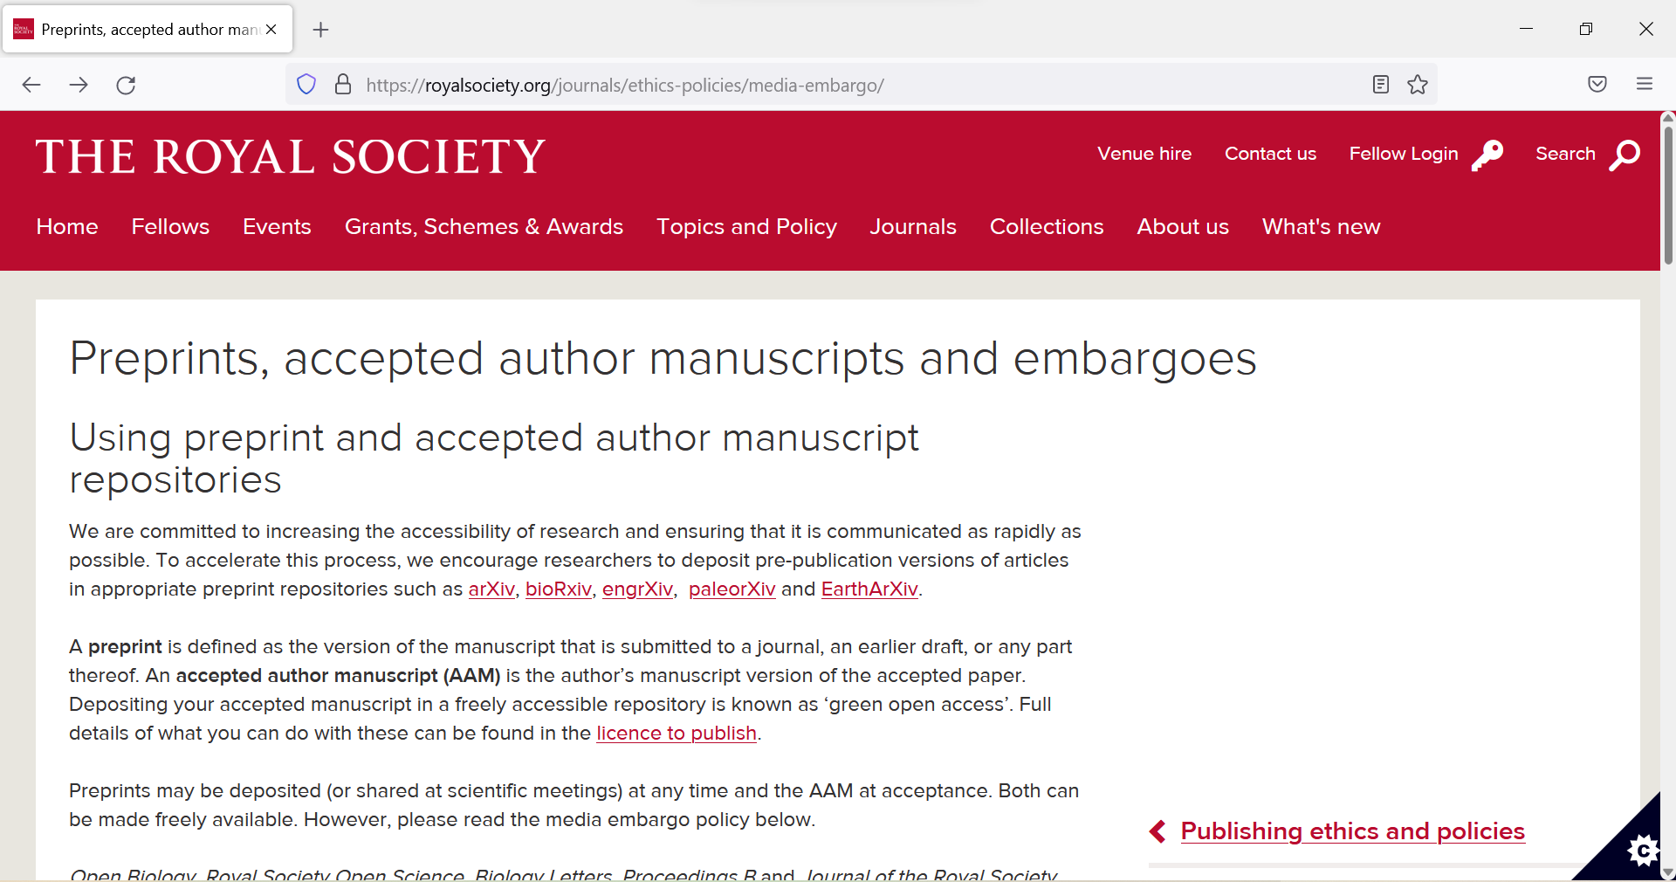
The Royal Society
https://royalsociety.org/journals/ethics-policies/media-embargo/

Slide 30
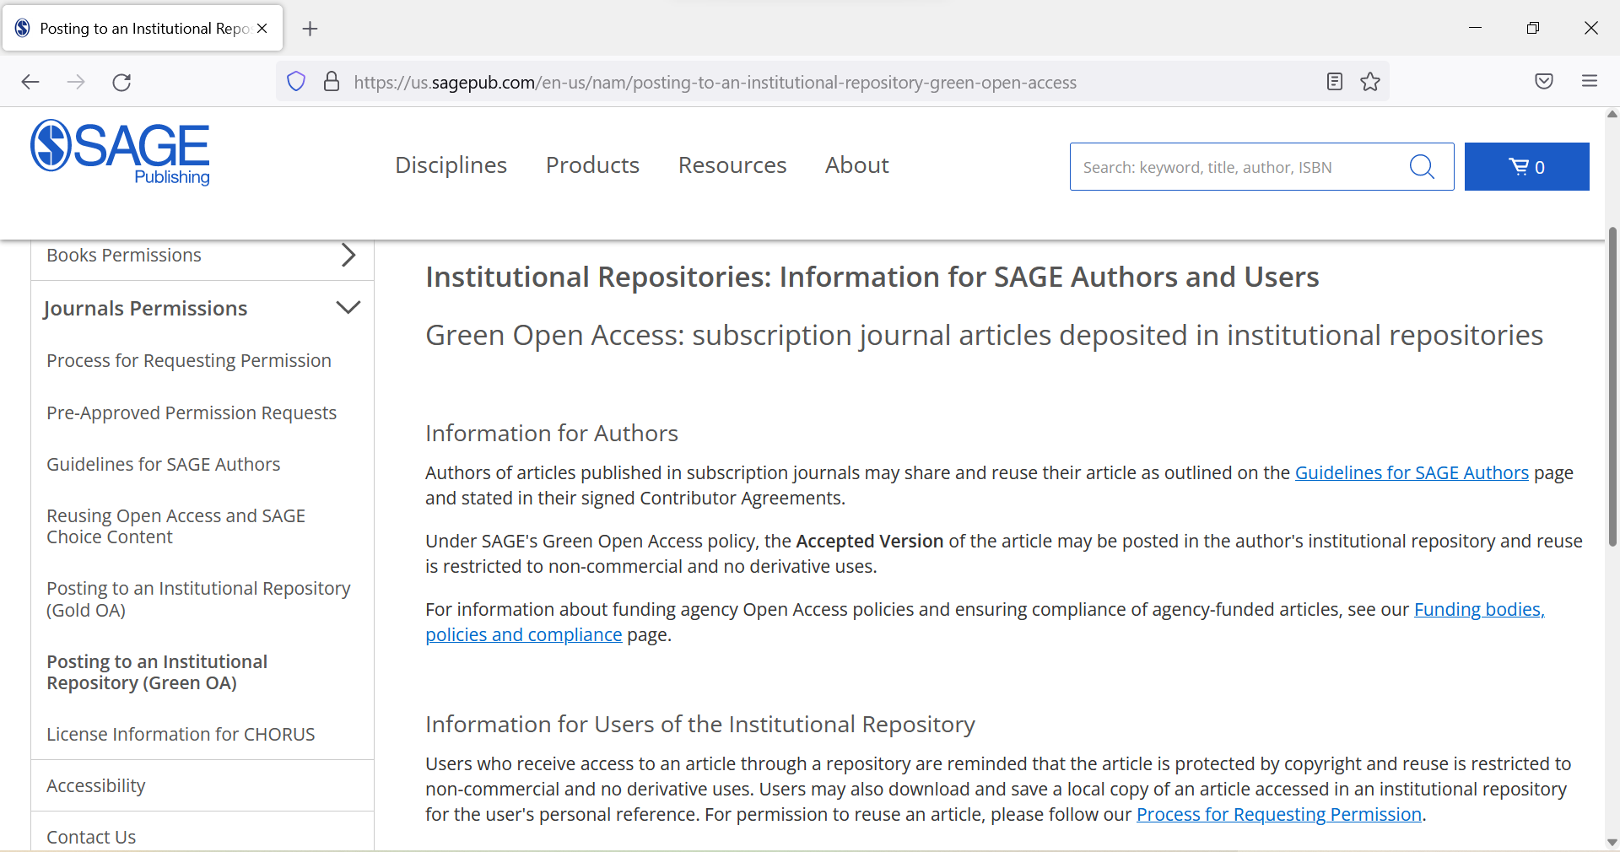
SAGE - AAMs
https://us.sagepub.com/en-us/nam/journal-author-archiving-policies-and-re-use

Slide 31
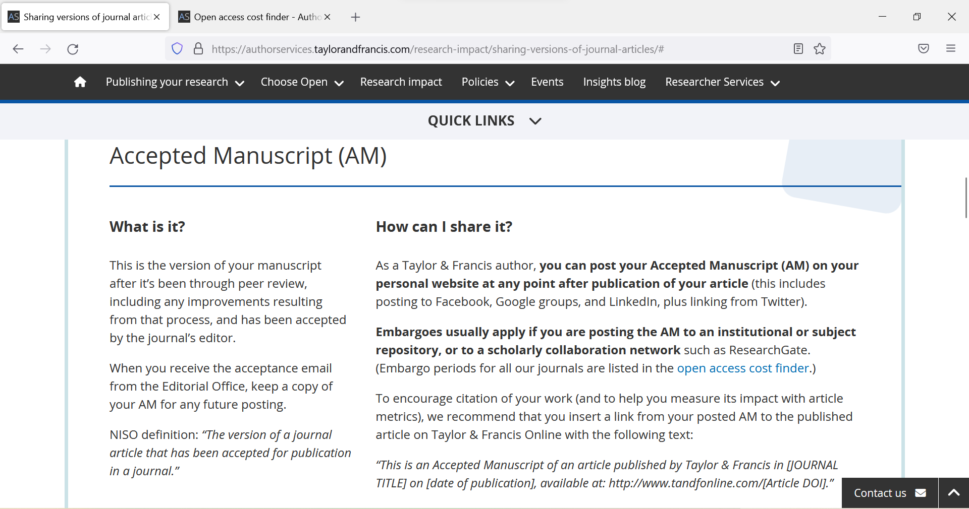
Taylor & Francis - AAMs
https://authorservices.taylorandfrancis.com/research-impact/sharing-versions-of-journal-articles/#
https://authorservices.taylorandfrancis.com/publishing-open-access/open-access-cost-finder/

Slide 32
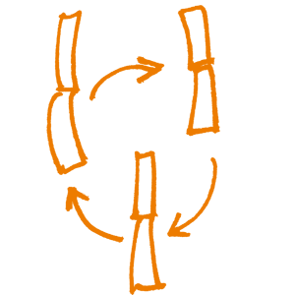
Taylor & Francis – publisher PDFs
EIFL - Taylor & Francis Journals Licence Agreement allows depositing publisher PDFs for institutions that are a part of this agreement

Slide 33
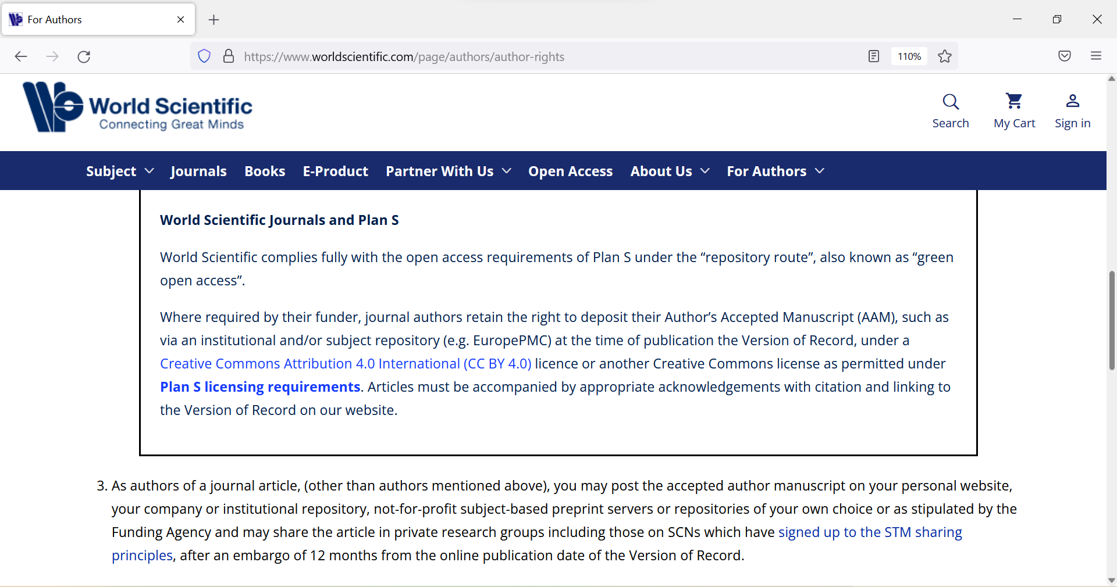
World Scientific - AAMs
https://www.worldscientific.com/page/authors/author-rights

Slide 34
World Scientific – retrieving AAMs
The AAM (i.e. source files uploaded by author) will be retained for a year after final disposition has been set. They will be removed thereafter. The pdf that the system builds will be available permanently. Only the corresponding author has access to the submission system.

Slide 35
Other publisher policies

Slide 36
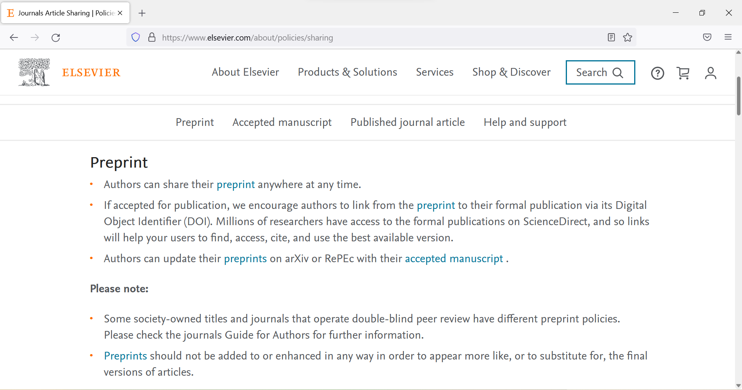
Elsevier
https://www.elsevier.com/about/policies/sharing

Slide 37
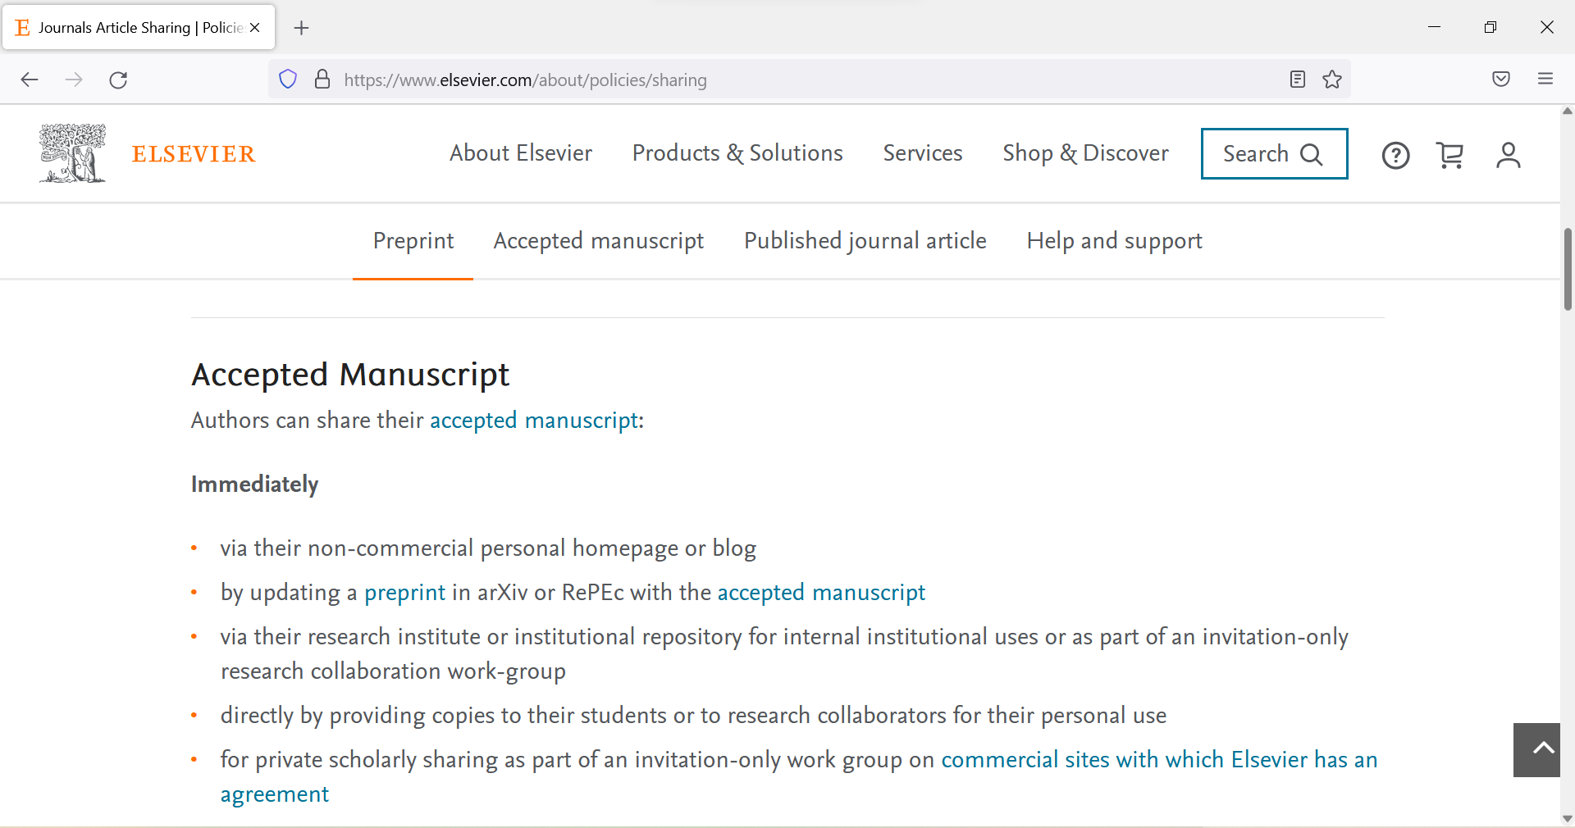
Elsevier (2)
https://www.elsevier.com/about/policies/sharing

Slide 38
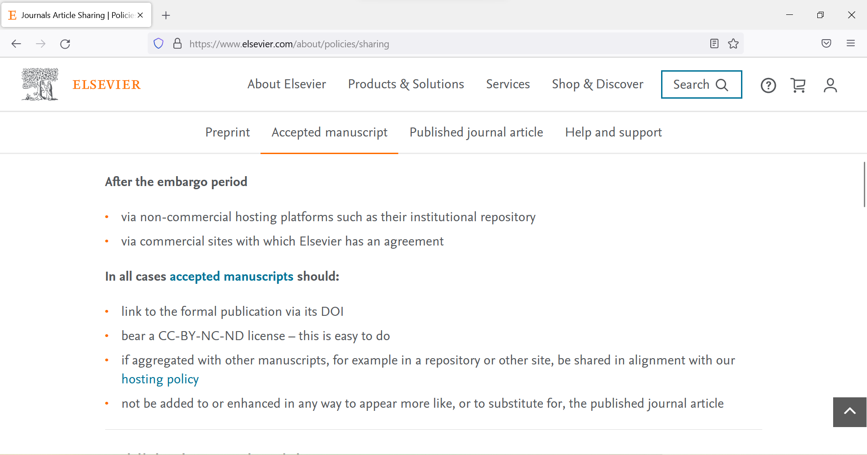
Elsevier (3)
see individual journal policies
https://www.elsevier.com/about/policies/sharing

Slide 39
Tips for support staff
Create a list of journals where your researchers publish and check publishers’ copyright and embargo policies
Make this list available to your researchers
Adopt a policy that requires AAMs depositing
Set up alerts – Google Scholar, Scopus, Web of Science, etc.
Congratulate your researchers when their articles are published, ask for AAMs to deposit

Slide 40
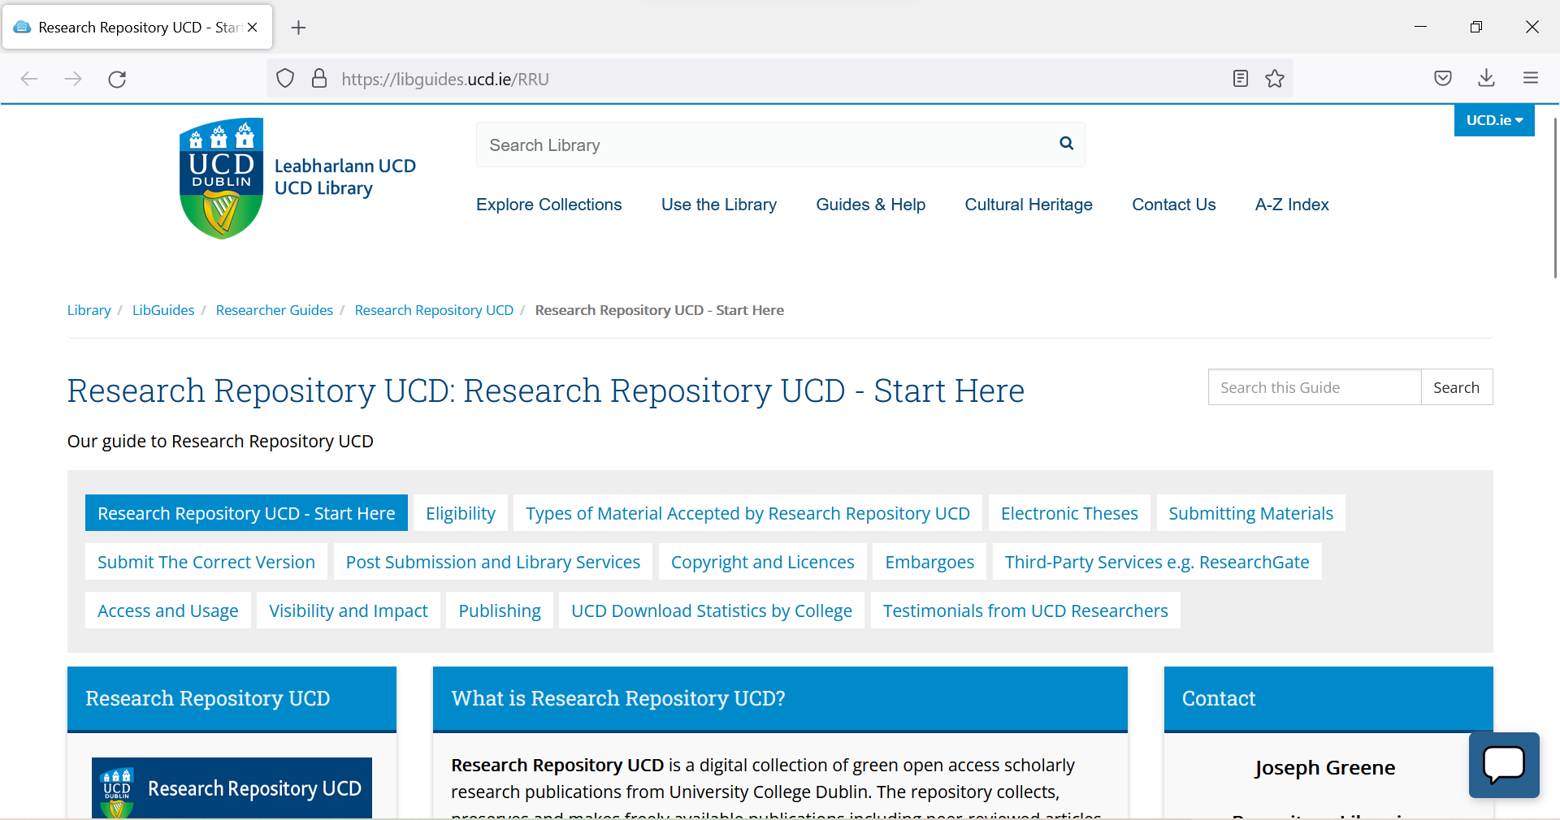
https://libguides.ucd.ie/RRU

Slide 41
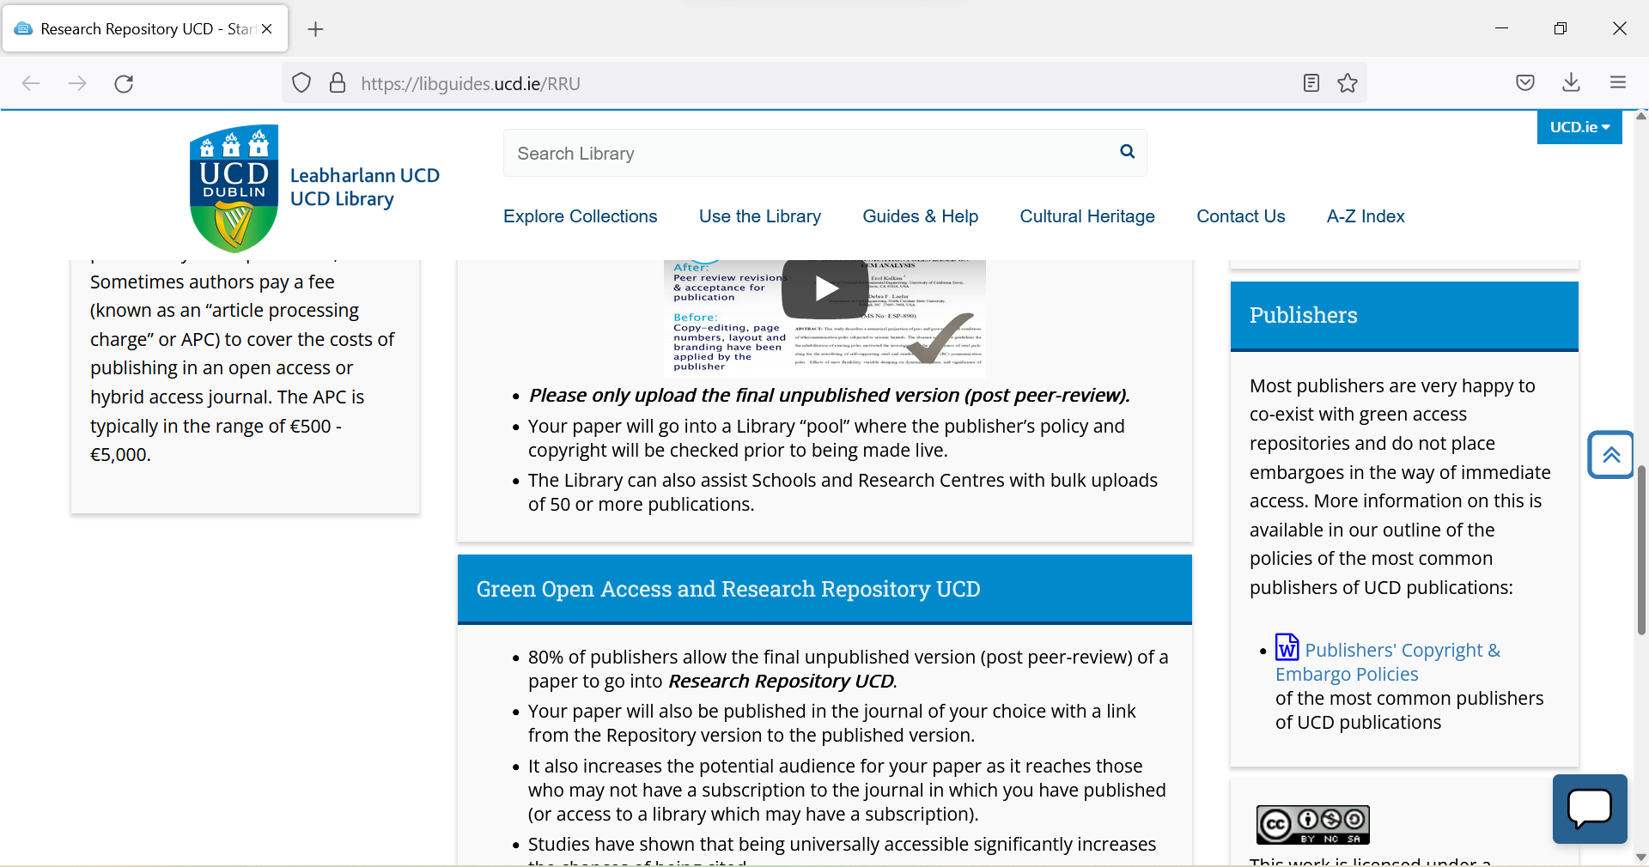
https://libguides.ucd.ie/RRU

Slide 42
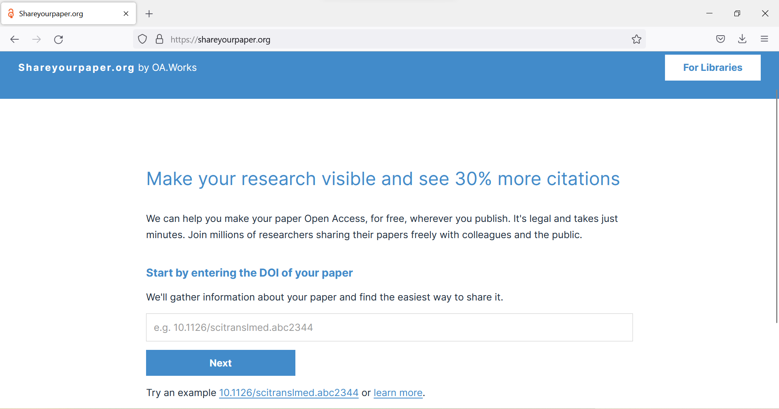
If you are not sure which version of the article you have
https://shareyourpaper.org/
https://eifl.net/resources/eifl-webinar-how-use-shareyourpaperorg-automate-repository-deposit-workflows-journal

Slide 43
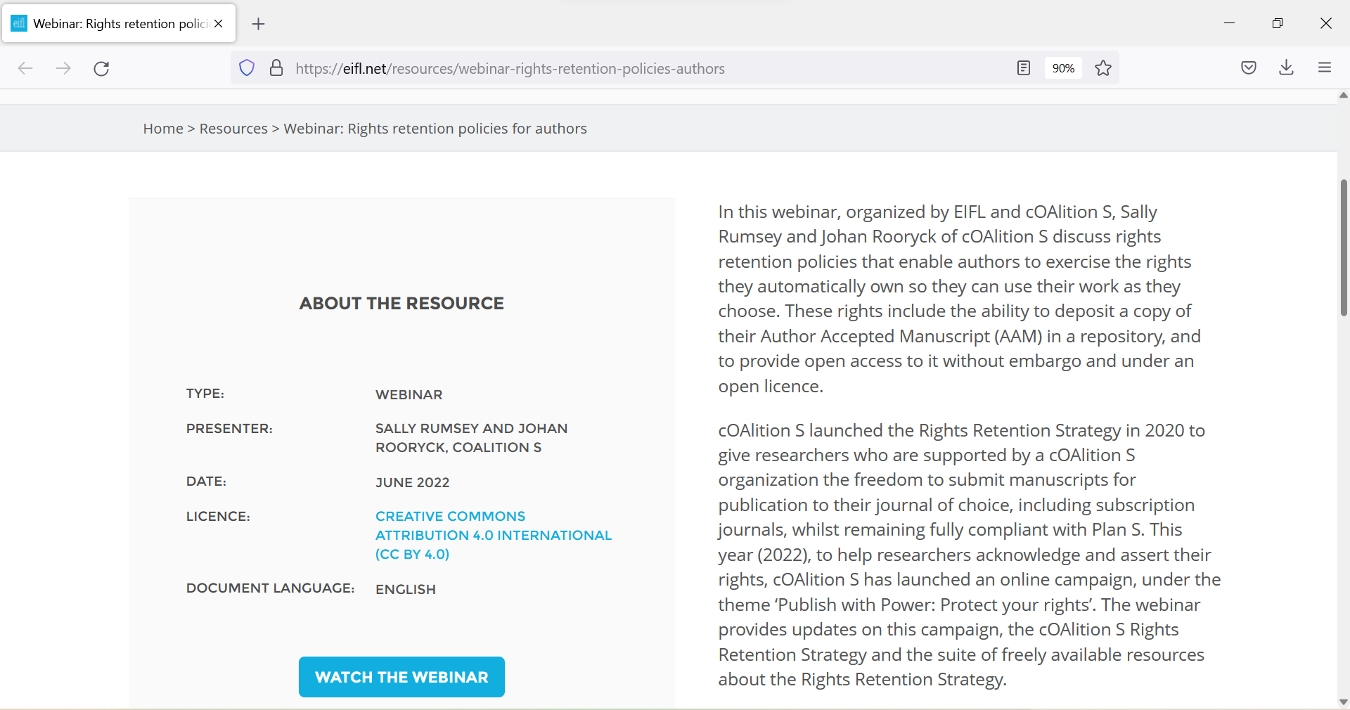
Consider adopting the Rights Retention policy
https://eifl.net/resources/webinar-rights-retention-policies-authors

Slide 44
What are your strategies to get and deposit AAMs in repositories?

Slide 45
Thank you! Questions?
Contact:
lorraine.estelle@eifl.net
iryna.kuchma@eifl.net
www.eifl.net

