Slide 1

DSpace-CRIS introduction
^{EIFL, 2017 Nov. 17th}
www.4science.it

Slide 2
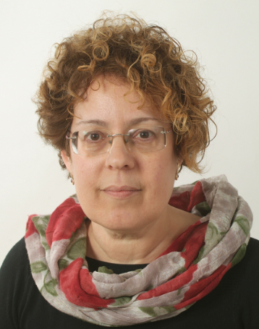
Susanna Mornati
International reputation in the Open Access and Open Science communities.
Director of two Italian national projects in 2015:
  implementing DSpace-CRIS at 67 Italian HE and research institutions
  ORCiD adoption involving over 60,000 researchers
Enthusiastically working with DSpace since 2003.
Head of Operations at 4Science since the launch in 2016.

Slide 3

DSpace and “extended” DSpace
DSpace is the most popular free open-source Digital Asset Management System in the world, used for Institutional Repositories to manage publications…
…but more and more HE and Research Institutions are asking for Research Information & Data Management tools
Why not using an “extended” version of DSpace to meet these two relevant needs?

Slide 4
DSpace-CRIS: what?
In 2009, the team now at 4Science led by Susanna Mornati and Andrea Bollini, together with the team at Hong Kong University led by David T. Palmer, created DSpace-CRIS
https://wiki.duraspace.org/display/DSPACECRIS/DSpace-CRIS+Home (documentation)
DSpace-CRIS is an “extended” version of DSpace, with a powerful and flexible data model to describe not just publications, but all the entities that populate the research environment and their meaningful links
https://dspace-cris.4science.it/ (demo)

Slide 5









An integrated view of the research ecosystem
www.cineca.it

Slide 6


DSpace-CRIS: why?
Buying a commercial platform to manage Research Information (a CRIS or RIMS) is expensive and binds your institutions to a proprietary system
DSpace-CRIS is free, open source, compliant with open standards, and provides your institution with a sustainable and effective tool to manage research information such as researchers’ profiles, department pages, project grants & awards, research outputs, metrics, reports and statistics

Slide 7
DSpace-CRIS: why?
DSpace-CRIS extends the use of DSpace where more sophisticated management of the entities that populate a specific domain is needed:
  E.g. Researchers as authors for publications
  E.g. Departments as aggregation level
(no need to implement full functionality of a CRIS to benefit from its advantages in several use cases)
DSpace-CRIS is particularly useful also for institutions that have already implemented a CRIS with a commercial tool, so they can expose some CRIS information as public and exploit the dissemination power of DSpace-CRIS to achieve visibility

Slide 8
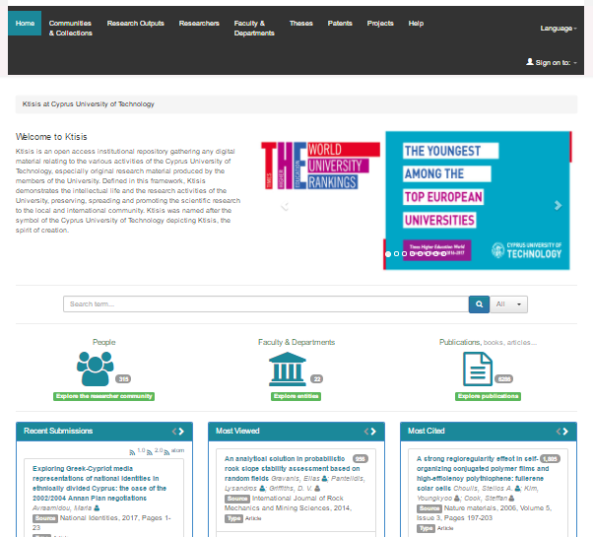
DSpace-CRIS: make it beautiful
State-of-art technology for your UI (next: version 7 with AngularJS UI)
Adaptive, responsive
Icons for intuitive exploration
Widgets for most viewed, most cited, etc.

Slide 9
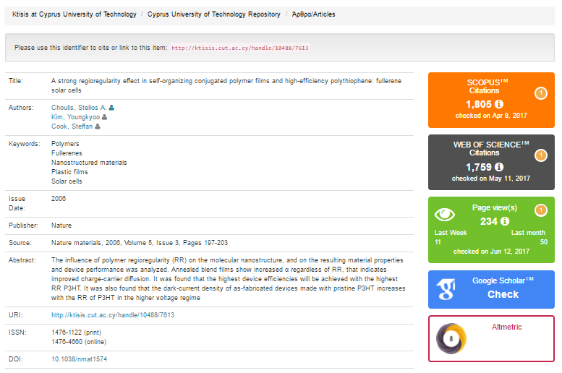
DSpace-CRIS use cases: an item

Slide 10
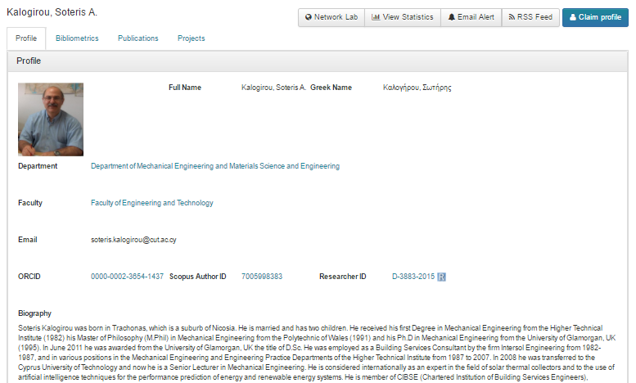
DSpace-CRIS use cases: a researcher

Slide 11
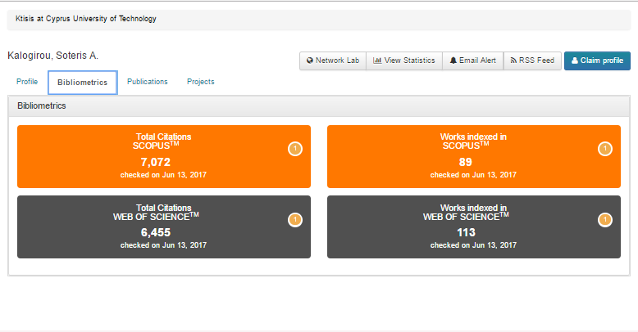
DSpace-CRIS use cases: metrics

Slide 12
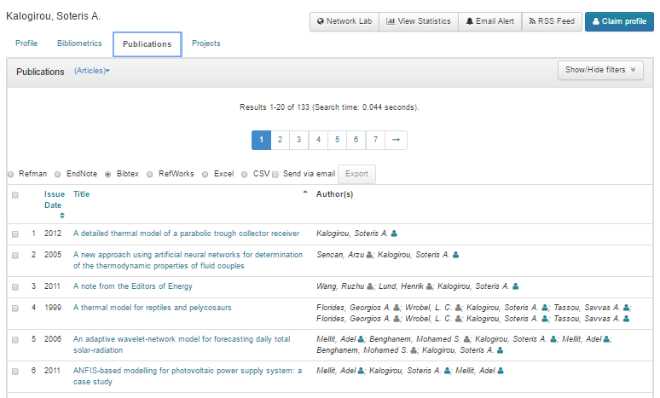
DSpace-CRIS use cases: publications

Slide 13
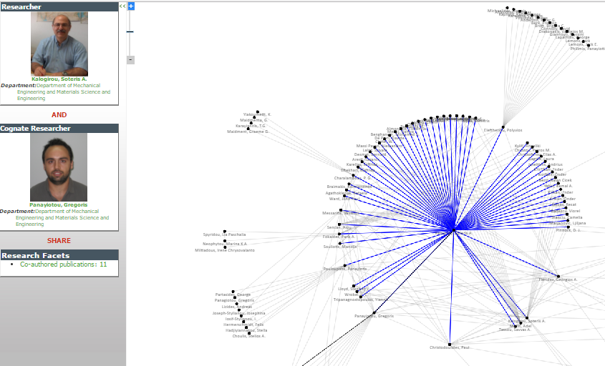
DSpace-CRIS use cases: network

Slide 14
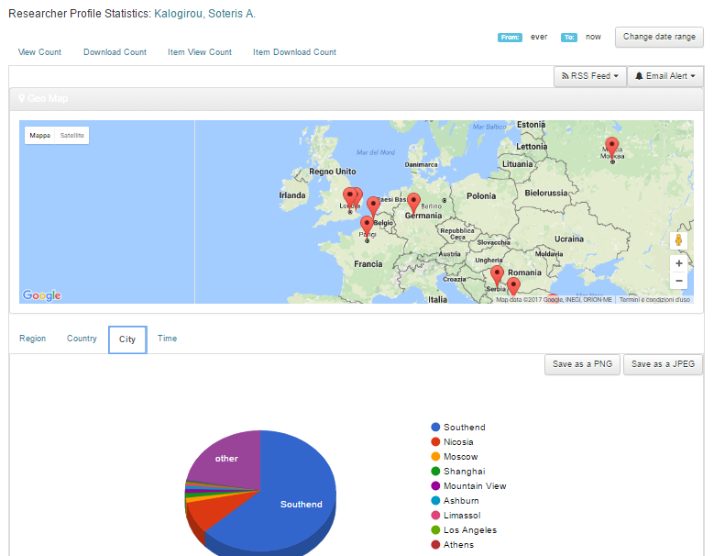
DSpace-CRIS use cases: statistics

Slide 15
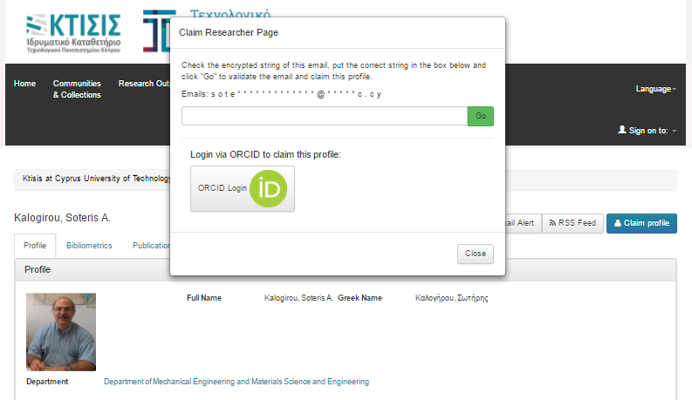
DSpace-CRIS use cases: ORCID v.2

Slide 16
DSpace-CRIS use cases: Research Data
Recently at 4Science we released, free and open source, an integration with CKAN, the world's leading open-source data management platform
Using an extensible viewer framework you can now offer data discovery, exploration, preview, sampling and visualization from your DSpace-CRIS repository just by adopting the CKAN add-on!
CKAN makes open webservices for tabular data available: https://ckan.org/
DSpace-CRIS & DSpace-CKAN add-on: https://github.com/4Science/dspace-ckan

Slide 17

DSpace-CRIS use cases: Research Data
Using DSpace and CKAN together you can make your research data FAIR:
https://www.force11.org/group/fairgroup/fairprinciples

Slide 18
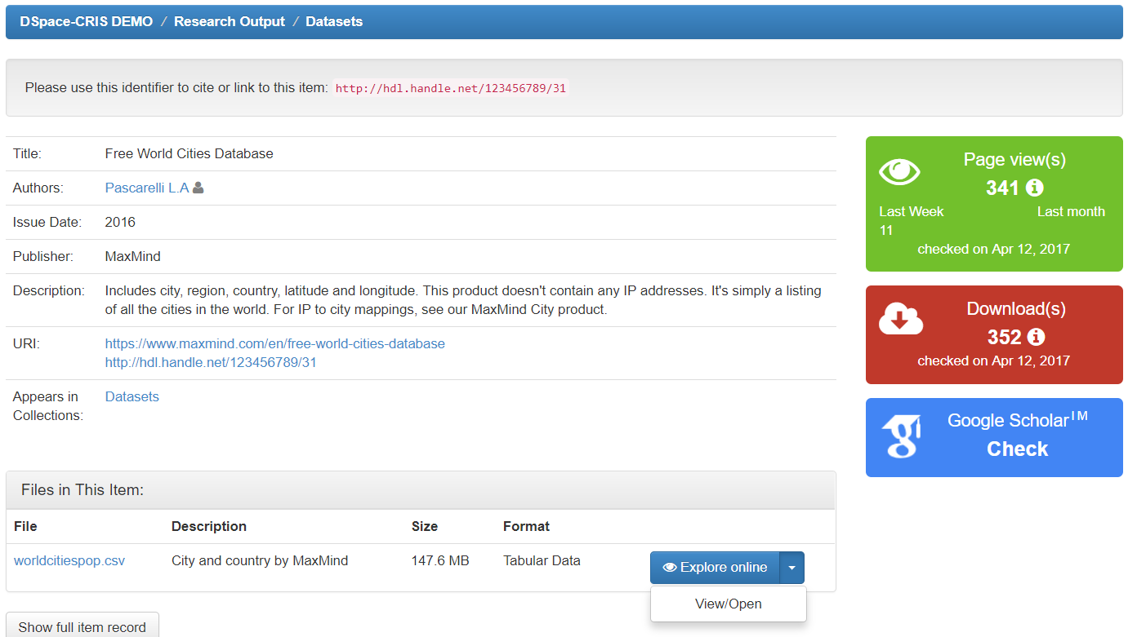
DSpace-CRIS use cases: Research Data

Slide 19
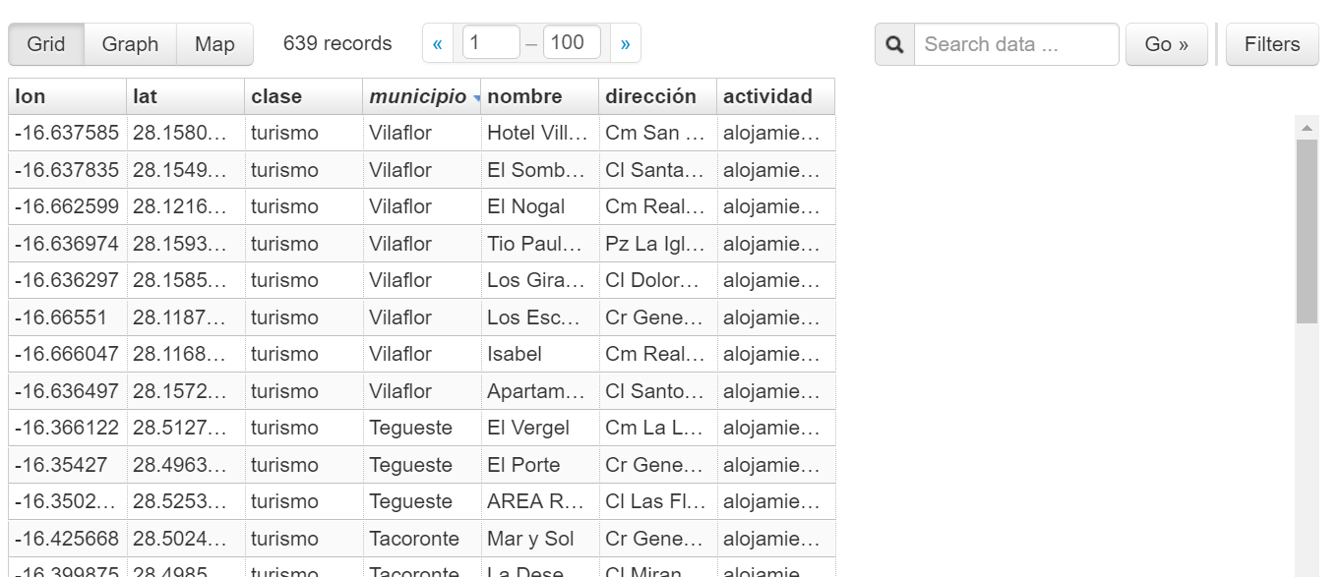
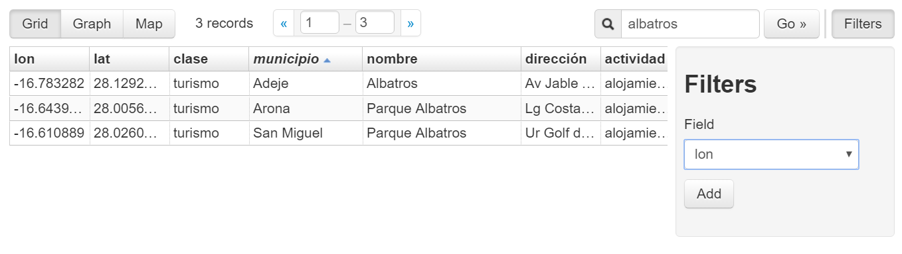
CKAN Add-On Module: preview tabular & geospatial data
Paginated and filterable

Slide 20
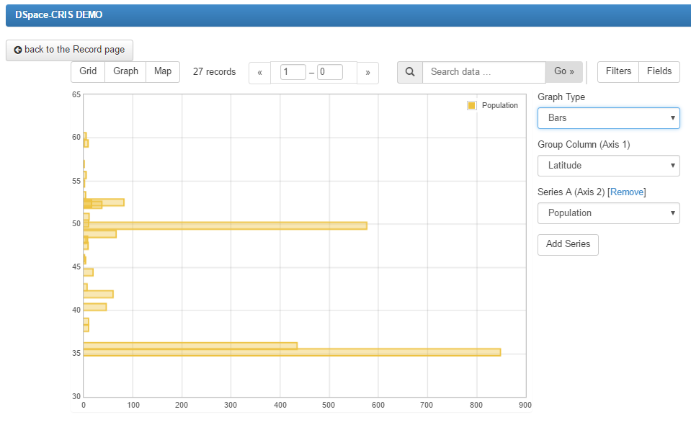
CKAN Add-On Module: preview tabular & geospatial data
Graph visualization

Slide 21
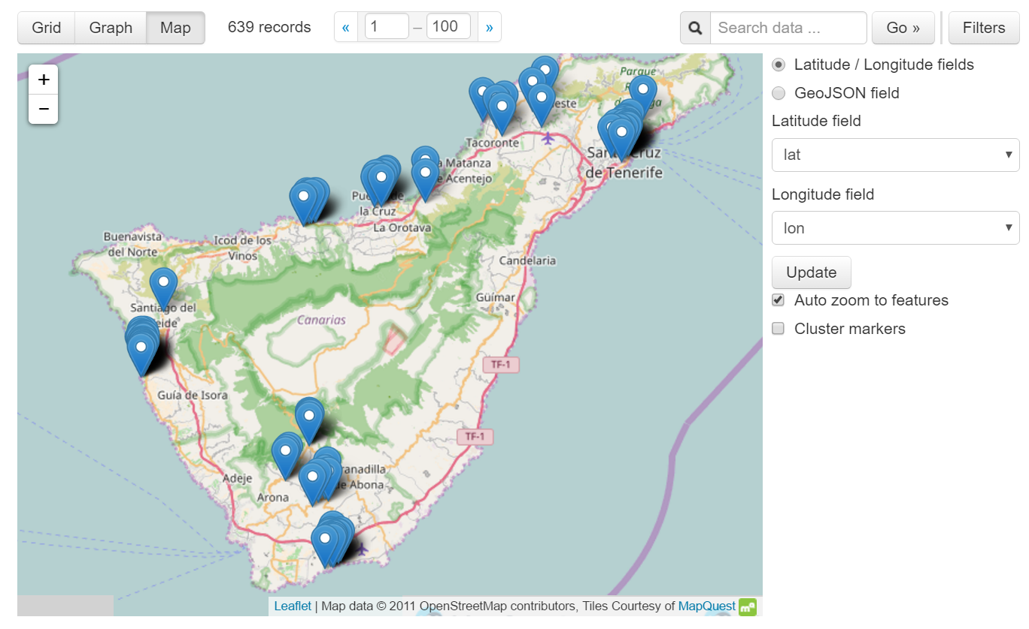
CKAN Add-On Module: preview tabular & geospatial data
Interactive map visualization

Slide 22






CKAN Integration Add-On: architecture
Can be integrated with LTP strategy
Open access
Embargo
Restricted
proxing
backend
Open Source, get it from GitHub!

Slide 23
DSpace-CRIS use cases: beyond publications
The same requirements apply to audio and video content:
Streaming
Internal structure
Annotation / commenting / transcript
Adopt an open standard: the MPEG-DASH format allows adaptive streaming over simple html client with full support for multiple tracks, ToC, subtitles

Slide 24
DSpace-CRIS add-ons
The IIIF Image Viewer, Document Viewer,
OCR & Transcription, Video/Audio Streaming
are add-on modules presently distributed by
4Science with an innovative business model:
contribute to make them open source soon!
http://www.4science.it/en/dspace-add-ons/

Slide 25
DSpace-CRIS priorities
Interoperability (bi-directional)
Open standards
Persistent Identifiers
Research data (integration with CKAN for data visualization and analysis)
Digital libraries for Cultural Heritage

Slide 26
DSpace-CRIS: where?
https://wiki.duraspace.org/display/DSPACECRIS/DSpace-CRIS+Users
Universities and Research Centers will obviously benefit from a platform that can collect, manage, preserve and disseminate all information about research and its performance.
GLAM (Galleries, Libraries, Museums, Archives) can likewise benefit from DSpace-GLAM, a “flavour” of DSpace-CRIS specially configured to provide a rich context to digital assets of the Cultural Heritage

Slide 27
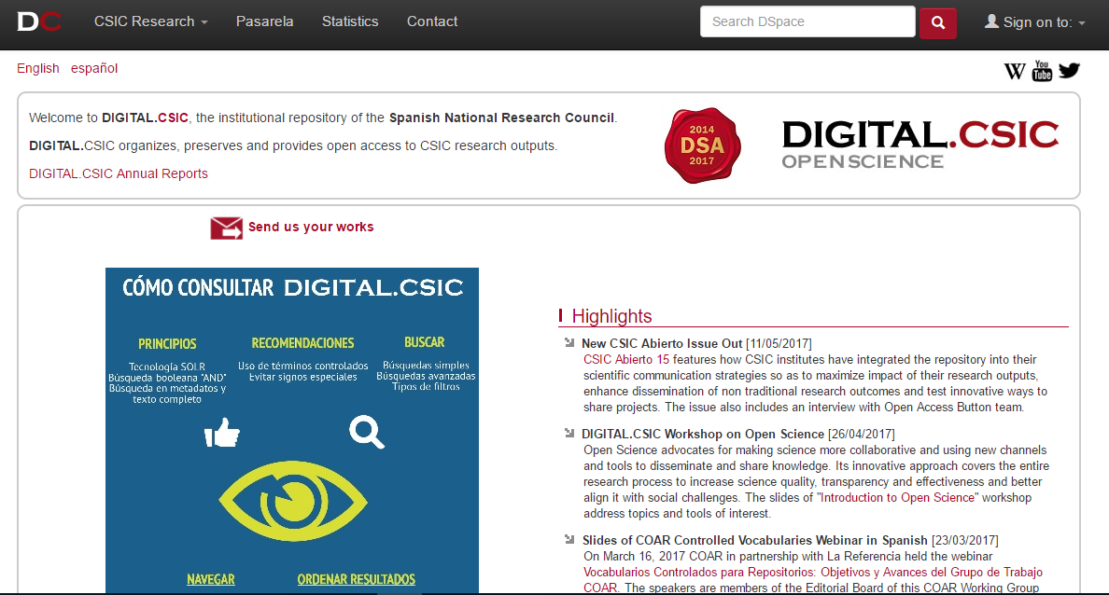
DSpace-CRIS: https://digital.csic.es/
Integrated with an internal CRIS

Slide 28
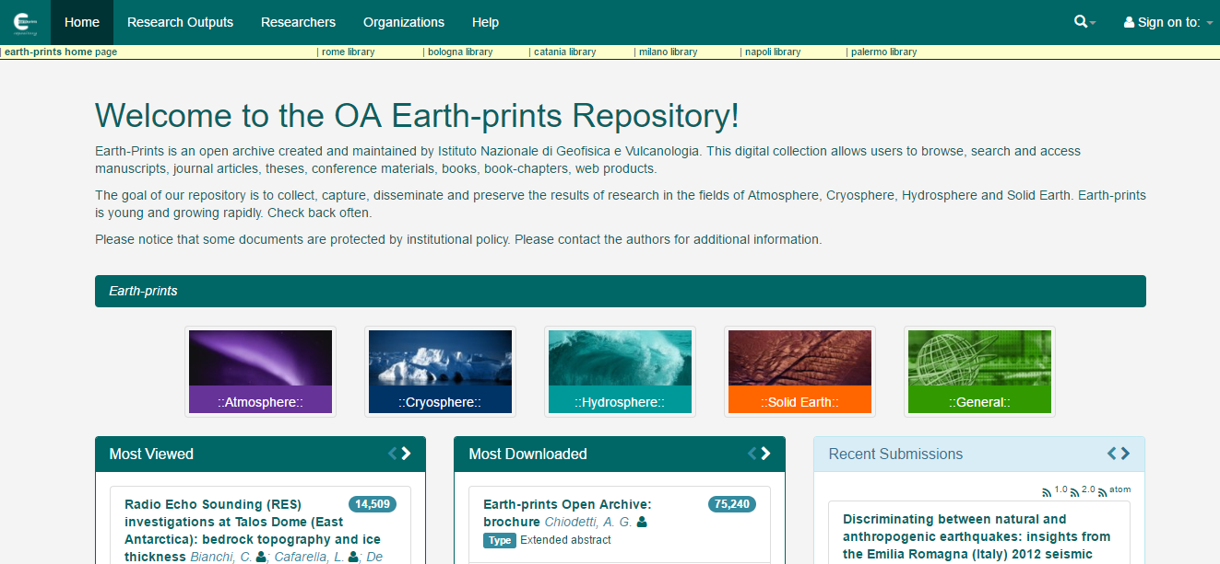
DSpace-CRIS: http://www.earth-prints.org/
Ontological approach

Slide 29
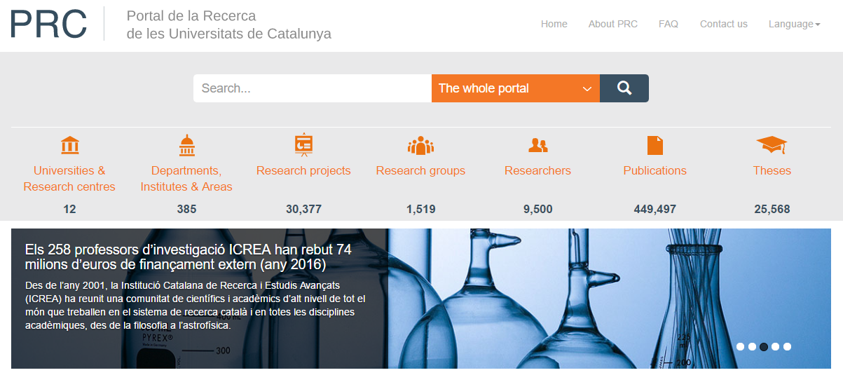
DSpace-CRIS as a National Portal in Catalunya: http://portalrecerca.csuc.cat/
http://ira.lib.polyu.edu.hk/
Collecting data about researchers, organizations, projects, publications from all the Catalan Universities
Run by the Consorci de Serveis Universitaris de Catalunya as a national service to raise visibility and awareness about Catalan Research

Slide 30

DSpace-CRIS: current architecture
DSpace-CRIS .
UI .
DSpace UI
DSpace-CRIS .
API .
DSpace API
Existing gap of functionalities implemented in DSpace-CRIS but useful for any kind of DSpace repository: better statistics, deduplication, feed from Scopus, WoS, PubMed, etc.

Slide 31


DSpace-CRIS 7: architecture
Contribute back general features to enrich the base DSpace (logic & UI)
Create extension points to nicely integrate (plugin) additional CRIS functionalities
Angular CRIS
UI
Angular UI
REST API
CRIS API

Slide 32
DSpace-CRIS: how?
Every institution can upgrade their DSpace installation to DSpace-CRIS, extending the management of research publications by creating new entities such as Researchers and Projects
Your publications will be safely managed as before, adding the advantage of linking them to relevant information such as authors, datasets, projects, metrics, networks, statistics and much more

Slide 33
DSpace-CRIS: when?
Now: every moment is appropriate to enhance your repository, to support your research community and make your service more relevant for the institutional strategy
Upgrading from DSpace to DSpace-CRIS or installing a brand-new “extended” repository does not take much extra effort and it is largely rewarded by the extraordinary results that you can get
As an extra security DSpace-CRIS does not alter the structure of the current objects managed by DSpace, so you can go back from DSpace-CRIS to DSpace at any time just dropping (a lot of) extra tables… but we are confident that you will not want to do that ☺

Slide 34


DSpace-CRIS in a nutshell
Publications
People Organisations Projects
..more
Better interaction, reputation, dissemination
Versions 5.8 & 6.2 available on GitHub
Almost 100 DSpace-CRIS installations worldwide:
https://wiki.duraspace.org/display/DSPACECRIS/DSpace-CRIS+Users
The only open-source CRIS, maintained in the context of
a vast and authoritative worldwide community.
Documentation and software available on the DSpace Wiki:
https://wiki.duraspace.org/display/DSPACECRIS/DSpace-CRIS+Home

Slide 35








4Science: a DSpace Registered Service Provider, with two DSpace Committers and the Lead of the REST API sub-team for DSpace 7
A longtime commitment in open source, open standards, interoperability, contributing to the most relevant international communities.

Slide 36
Where to find us next?
euroCRIS
Fall Meeting 2017
Bratislava
20-22 Nov
Open Repositories 2018
Bozeman
4-7 Jun
Thanks for your attention!
CRIS 2018
Umea
June
And more
to come!
Susanna Mornati
susanna.mornati@4science.it
skype: susanna.mornati
linkedin: susannamornati
orcid: 0000-0001-9931-3637
www.4science.it

