Slide 1

Presented by:
Roxanne Marmion, Sales Representative

Slide 2
Today’s Session
About HeinOnline
HeinOnline EIFL Agreement
Using HeinOnline
Key HeinOnline Content not Included in the EIFL Package
aall2014

Slide 3
About HeinOnline

Slide 4
HeinOnline
A product of the William S. Hein & Co., Inc.
  Serving the library community for 50 years as a legal publisher, periodicals subscription agent and distributor
Online database with more than 120 million pages of legal history
In more than 3,200 locations in over 175 countries
all2014

Slide 5
HeinOnline
Fully-searchable, image-based format
  Exact page images of documents in PDF format, just as they appear in the original print copy
  All charts, graphs, tables, pictures, and notes appear the same as in original print copy
Includes historic material not available in other databases
  Content in HeinOnline is available from the publication’s inception
  Includes more than 9 centuries of legal history
  Material dating back to the 1500’s

Slide 6
HeinOnline EIFL Agreement

Slide 7
HeinOnline Core Collection EIFL
World Constitutions Illustrated
  Includes current constitution for every country in its original language with an English translation
  Substantial constitutional histories for many countries
  Additionally includes constitutional periodicals, World Fact Book, classic books and bibliographic references

Slide 8
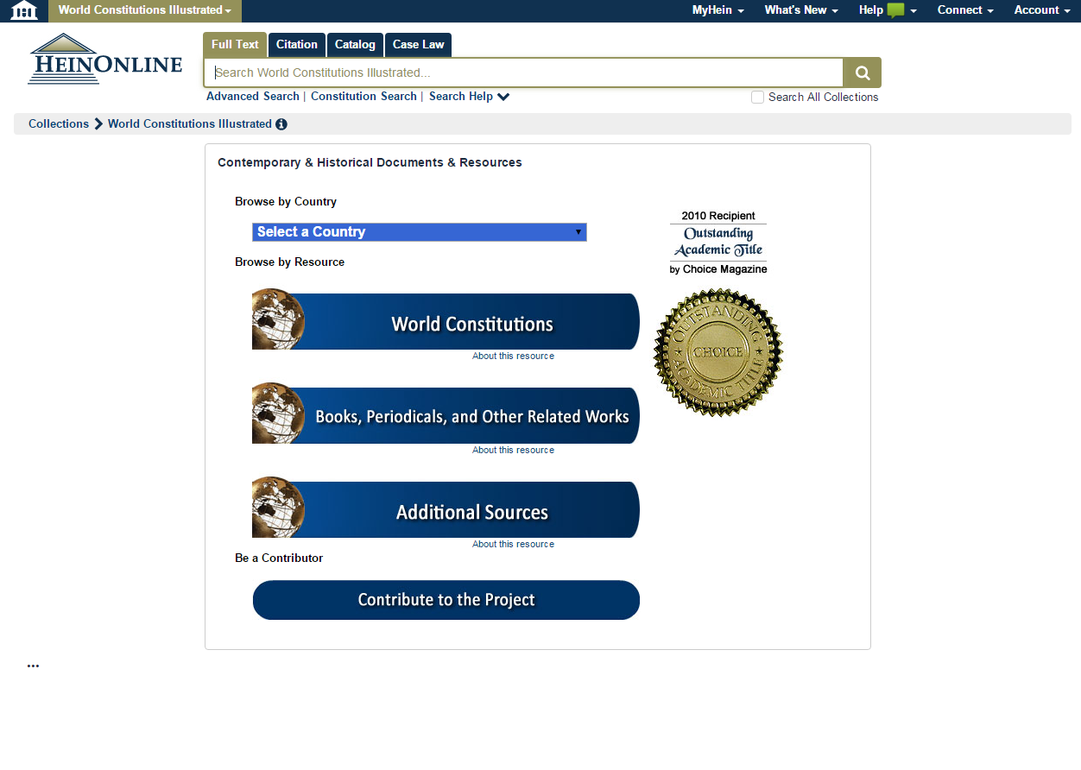

Slide 9
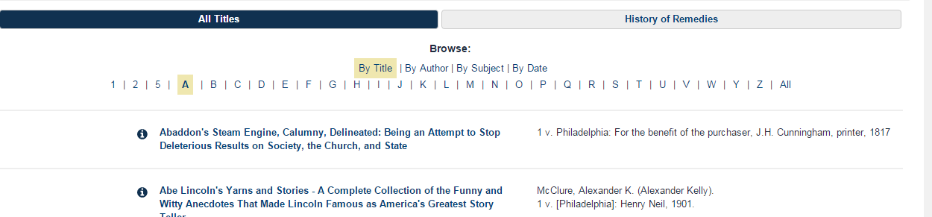
HeinOnline Core Collection EIFL
Legal Classics Library
  More than 6,000 works from some of the greatest legal minds in history
  Authors include Joseph Story, Jeremy Bentham, William Blackstone, Benjamin Cardozo and Frederick Maitland
  Material dating back to the 1500’s

Slide 10
HeinOnline Core Collection EIFL
History of International Law
  Includes publications dating back to 1690 on subjects such as War & Peace, International Arbitration, Law of the Sea and Nuremberg Trials
  Publications include classic books, significant serials, plus much more
English Reports Full Reprint (1220 – 1867)
  Delivers exact page images of the original bound reprint edition, containing more than 100,000 cases, together with the Indexes and Book of Charts.

Slide 11
HeinOnline Core Collection EIFL
United States Statutes at Large
  The official source for both public and private laws passed during a session of congress
  Also includes concurrent resolutions, reorganization plans, proposed ratified amendments to the Constitution, and proclamations by the President
United States Code
  Contains the current laws of the United States
  Organized by subject into 53 titles
  Published every 6 years with yearly supplements published between official volumes
United States Supreme Court Library
  Including the United States Reports, which are the official record (law reports) of the rulings, orders, case tables and other proceedings of the Supreme Court of the United States
  Also includes books and periodicals about the court and justices

Slide 12
Index to Foreign Legal Periodicals
  The preeminent multilingual index to articles and book reviews appearing in over 500 legal journals published worldwide
  Provides in-depth coverage of public and private international law, comparative and foreign law, and the law of all jurisdictions
  Includes more than 320,000 index records
  Analyzes the contents of approximately fifty individually published collections of legal essays, Festschriften, Mélanges, and congress reports each year.
  Search the Index by the language of the article or review, country of publication, author, subject, plus more

Slide 13
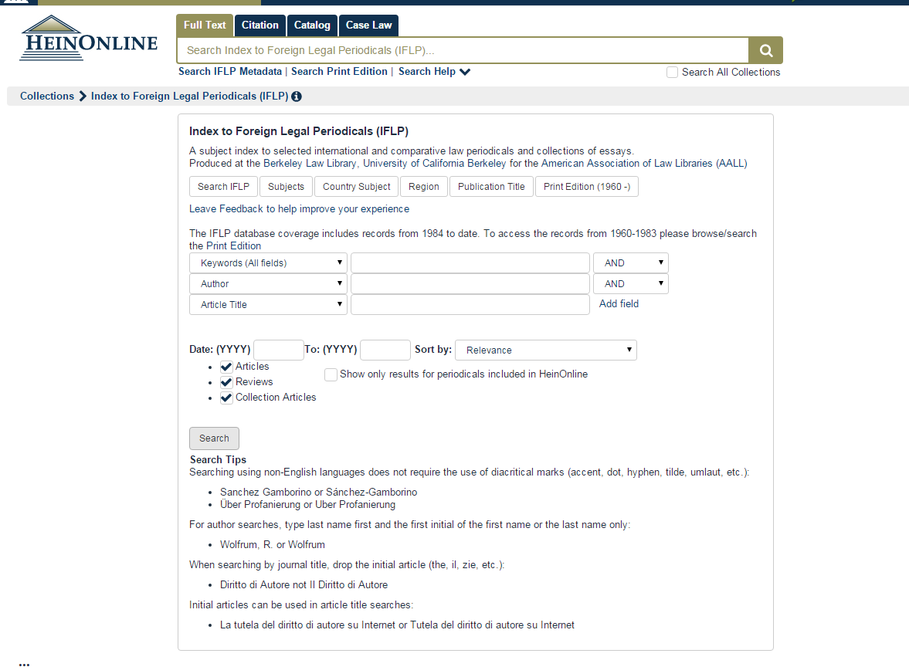

Slide 14
Using HeinOnline

Slide 15
Welcome Page
View subscribed collections by both category and name
Click the more information link next to any collection to see a brief description of the collection’s content or to download a full list of available titles
Click on the name of a collection to visit the home page for that library
The main search bar has four search options under separate tabs: full text, citation, catalog and case law

Slide 16
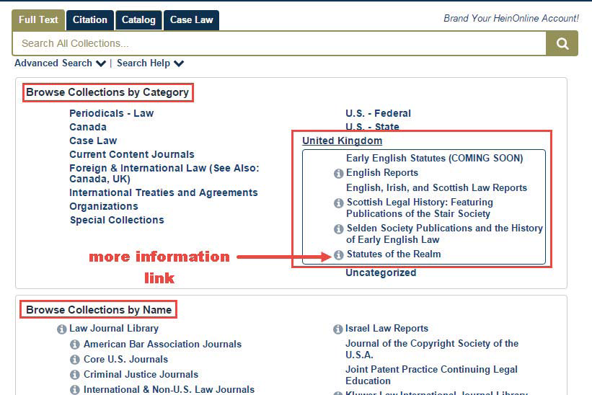

Slide 17
Full Text Searching
Use the full text search tab to search across all subscribed collections, including both full text and metadata of all documents
Click Advanced Search to access multiple search fields and pre-select a date range
Click Search Help to produce a list of the most commonly used search syntax

Slide 18
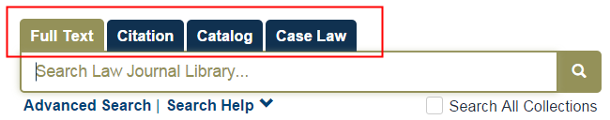
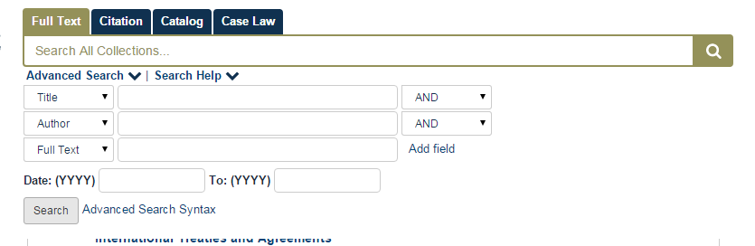

Slide 19
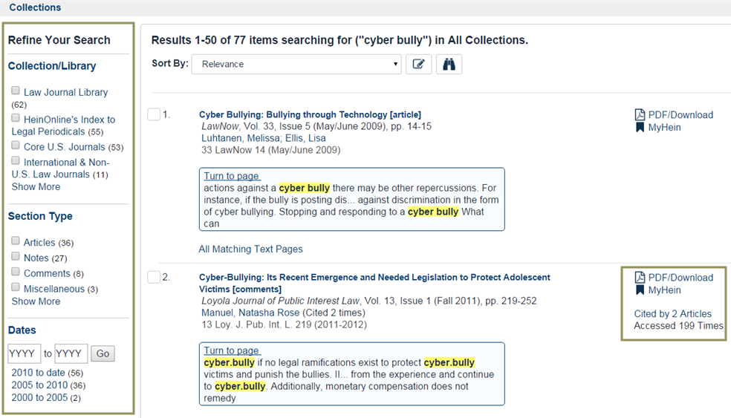
Search Results Page
Facets available on left to refine search results.
List of results with highlighting.
Available options & citation information grouped together to the right of each result.

Slide 20

Citation Finder
Use citation search option to quickly retrieve a document using its citation.
Use Citation Format Guide to retrieve documents when the citation is unknown
  Citation format guide will provide an a to z list of publications in HeinOnline

Slide 21

Catalog Search
Use to find a publication title in HeinOnline
This will search the entire HeinOnline catalog
Advanced Catalog Search to search for an author, publication title, subject, ISSN number

Slide 22
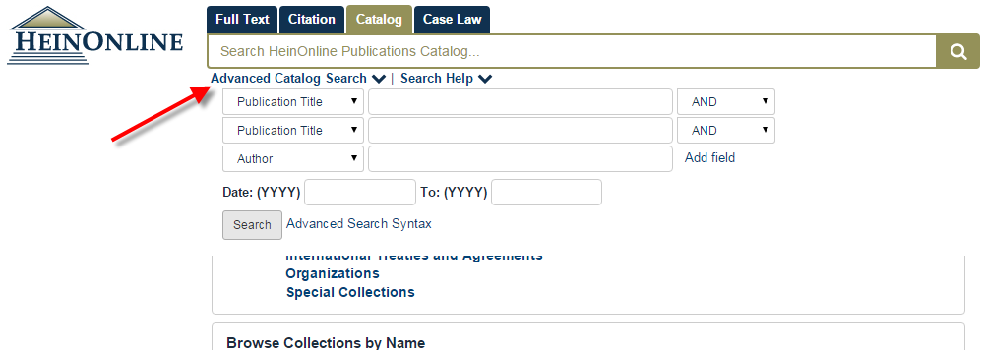
Catalog Search

Slide 23
ScholarCheck
ScholarCheck is a series of tools integrated throughout HeinOnline that allow users to view documents that have a strong influence on the subject being researched
Sort search results by the number of times cited by articles and number of times accessed over a rolling 12 month period
Records and displays the number of times an article has been cited by articles and the number of times accessed

Slide 24
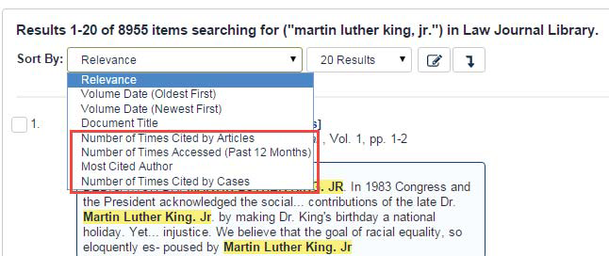
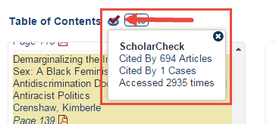

Slide 25
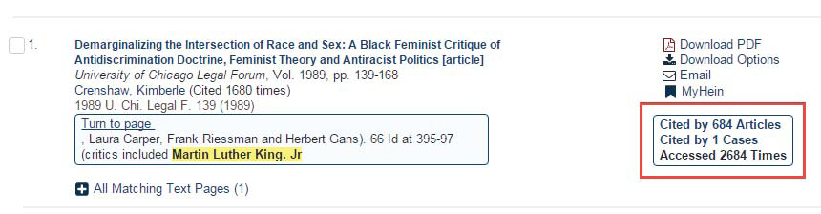
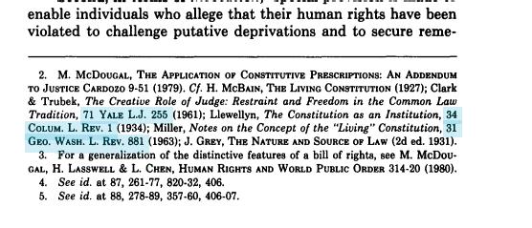
ScholarCheck
Link to articles that have cited that document (available with a subscription to the Law Journal Library)
Link between documents by clicking blue highlighted hyperlinks from inside HeinOnline documents

Slide 26
Printing and Downloading Documents
Multiple options for printing and downloading documents
  Click the red PDF icon from the image toolbar, the table of contents of a document or from the search results to generate an instant PDF
  Click the download icon from either search results or from the image toolbar to access print and download options
  Email PDFs of the document with one click using the envelope icon in the image toolbar

Slide 27
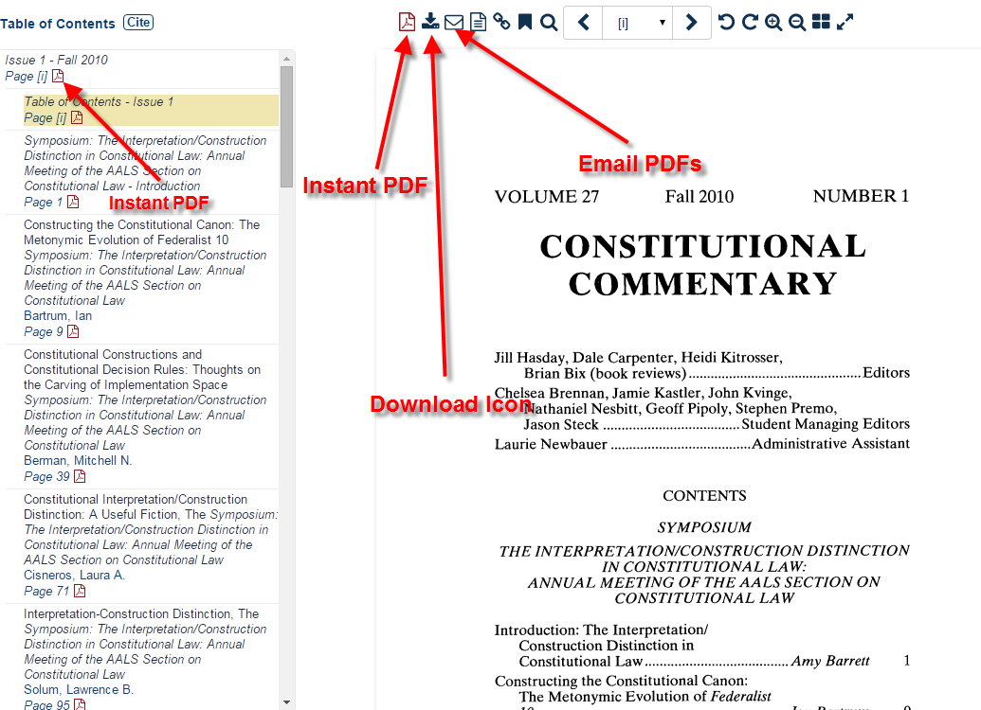

Slide 28
MyHein Personal Bookmarking and Research Tool
All HeinOnline users may set up individual MyHein accounts
Bookmark articles & save search queries
  Add tags, notes, and organize
  Email links to bookmarked articles & saved search queries
  Export bookmarked articles to CSV, RefWorks, or EndNote
Create electronic table of contents (eTOC) alerts
Save to MyHein account directly from search results

Slide 29
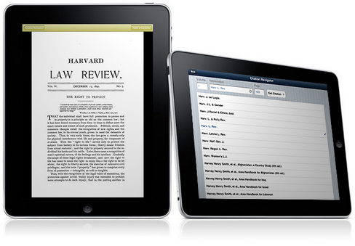
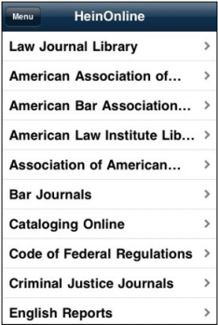
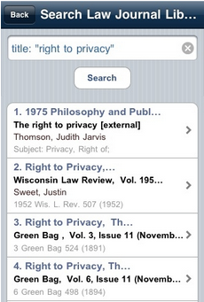
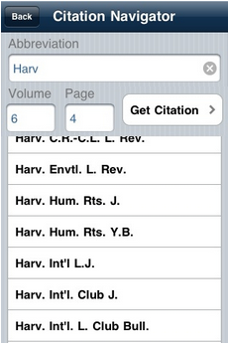
HeinOnline iPad/iPhone App
Free App available in the iTunes app store
View the image-based PDFs, access content by citation, browse by volume, navigate a volume with the electronic table of contents, and use full advanced searching techniques.
Username/password & 30 day IP authentication token!

Slide 30
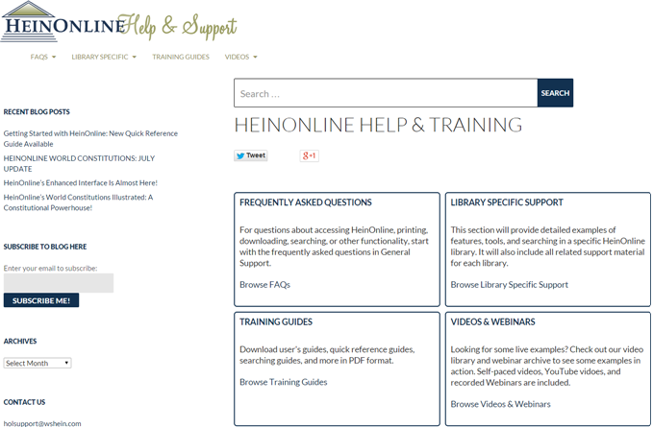
HeinOnline Help Page
help.heinonline.org
Help page now
incorporates our
HeinOnline blog
Help page & blog
are fully searchable
User-friendly layout

Slide 31
Key HeinOnline Content not Included in the EIFL Package

Slide 32
Law Journal Library
Contains the full text of more than 2,100 journals, 48,000 volumes and 28,500,000 pages
92.5% of the journals are available through the most current issue or volume
More than 800 international journals published from more than 50 countries
Contains legal periodicals covering over 90 subject areas
Coverage for all journals starts at volume 1, so content is from inception

Slide 33
World Treaty Library
HeinOnline has changed treaty research forever
Monumental collection of all original, major treaty sets,
with more than 180,000 treaty records identified.
Bringing together the works of Rohn, Dumont, Wiktor, Bevans, Martens, League of Nations, United Nations, and U.S. Treaties and Agreements together into one database
Treaty index search across U.S. & international treaties
In-depth indexing of all treaties and cross-citation linking

Slide 34
United Nations Law Collection
Contains major United Nations legal publications including:
  Complete collection of the United Nations Treaty Series
  League of Nations Treaty Series
  United Nations Commission on International Trade Law publications
  United Nations Yearbooks
  United Nations Serials
  International Tribunal for the Law of the Sea
  International Court of Justice publications

Slide 35
Foreign & International Law Resources Database
Contains more than 1,500,000 pages and 3,000 volumes
Worth over $100 million in hardbound
  Over 90 International Yearbooks and Periodicals including American Society of International Law Publications
  U.S. Law Digests
  International Tribunals/Judicial Decisions including Hague Permanent Court of International Justice
  Court of Justice of the European Communities

Slide 36
Law in Eastern Europe
Greatest collection of books on the rule of law in Eastern Europe
More than 60 books published by Brill, collection available for the first time digitally
Fully searchable & browsable
Includes catalog records featuring deep-linking and all records are fully customizable
Add-on collection only Available to Foreign & International Law Resources Database (FILRD) subscribers

Slide 37
Women and the Law
Nearly 500,000 pages of contemporary and historical works related to the role of women in society and law
Notable works include: History of Woman Suffrage (1881-1922), Documentary History of the Legal Aspects of Abortion series, and a collection of biographies of famous women
More than 70 titles from Emory University Law School’s Feminism and Legal Theory project, which provides a platform to view the effect of law and culture on the female gender

Slide 38
Thank you for your time!
If you have questions, comments, or feedback about HeinOnline, please contact us!
rmarmion@wshein.com
(800) 828-7571
(716) 882-2600
http://heinonline.org
http://help.heinonline.org

