Slide 1
Google Custom Search Engine as a simple tool for multiple site searching
Irakli Garibashvili
Director, National Scientific Library in Georgia

Slide 2
Plan of a webinar
Google Custom Search Engine (CSE) – technology insight
How to create simple engine in 2 steps
Multiple site search
Searching through digital libraries (OPACs, Repositories, eJournals, etc.)
OpenDOAR CSE

Slide 3
Goal
To learn how to construct a simple search engine which will help to find information through
  A specific site
  Multiple sites
And how to use the created CSE on your library website

Slide 4
Starting a CSE
Go directly to a https://cse.google.com/cse/
OR search for “Google Custom Search”
Login freely using your Google account

Slide 5
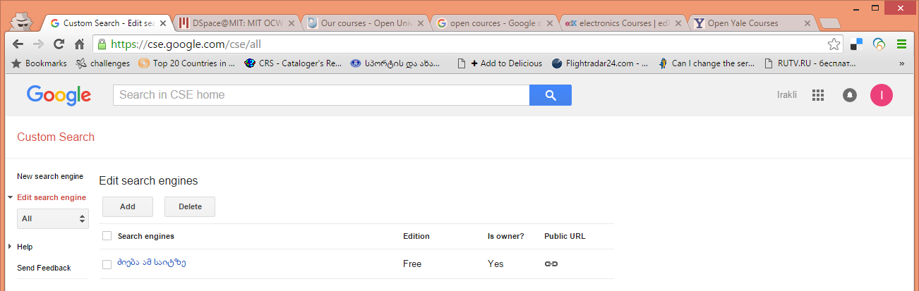
Starting page
Click on Add button to create a first sample engine

Slide 6
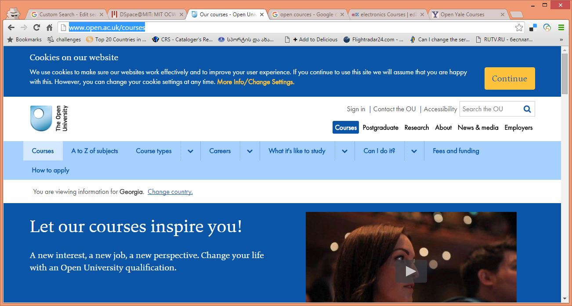
Searching for an open course at Open University UK

Slide 7
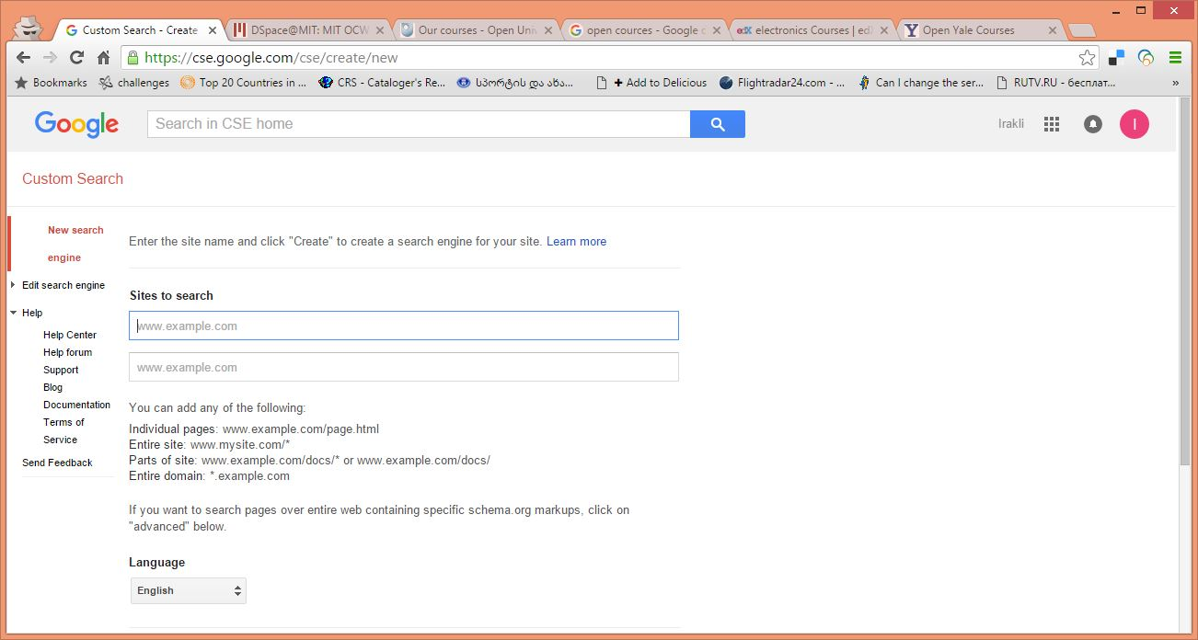
Specify a URL of a site to search

Slide 8

Think about a proper pattern of URL - http://www.open.ac.uk/courses

Slide 9
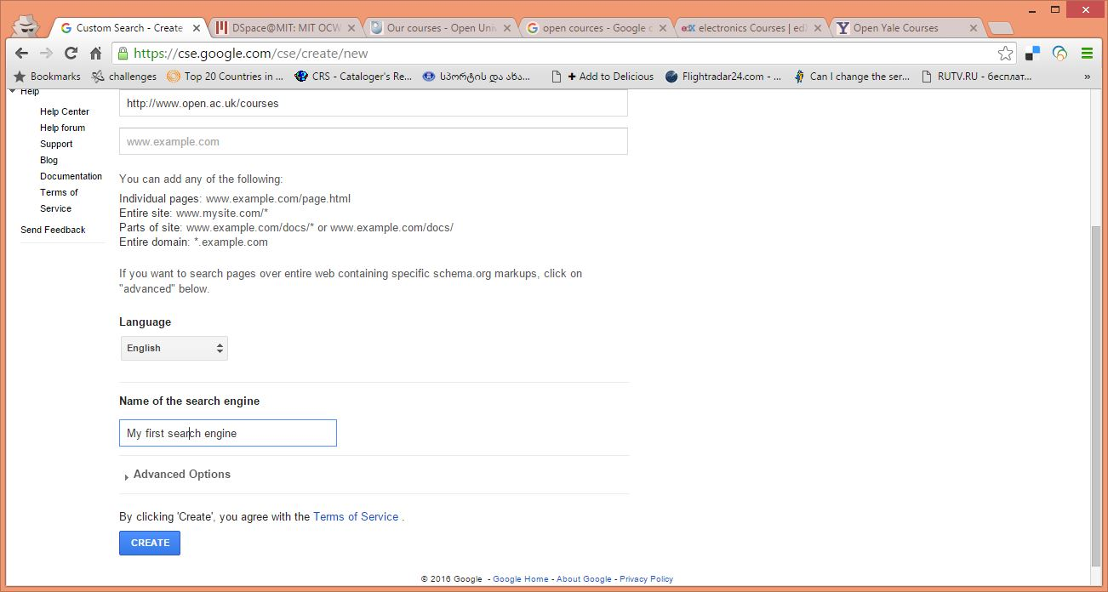
Indicate a Language and Title of a CSE and just click “Create”

Slide 10
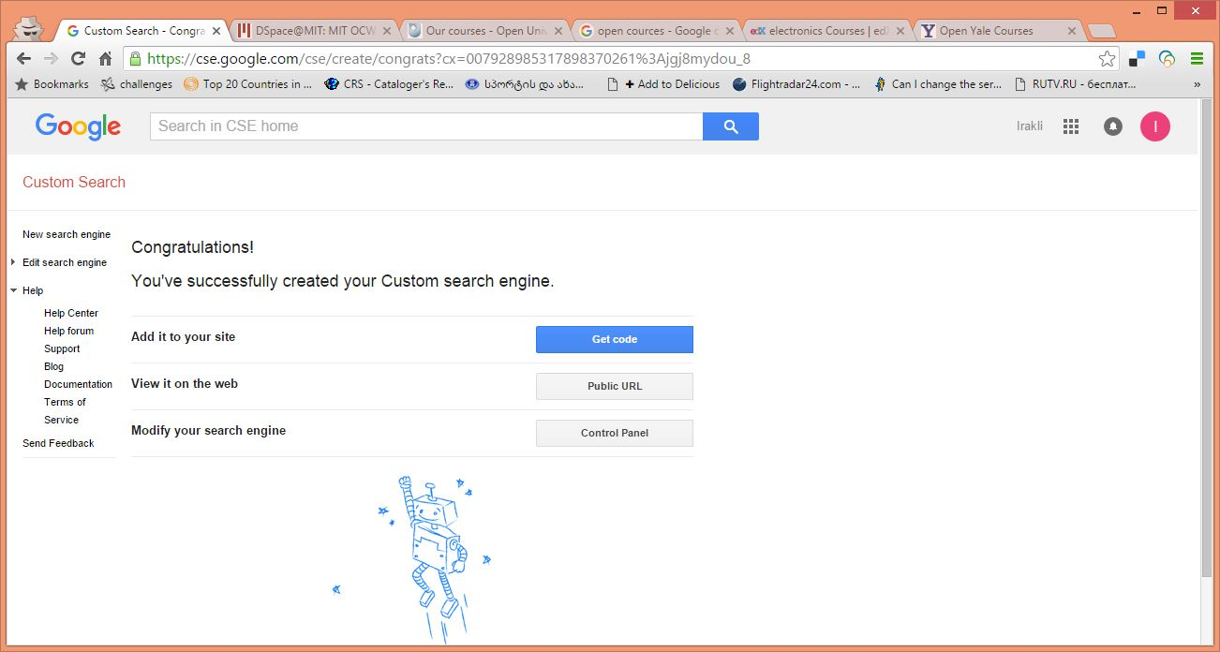
Result

Slide 11
Result
Congratulations! You have done it.
Three options here:
Public URL – link to a search box (go there and start searching)
Code – simple code which can be embedded to your web page and produce search from your site
Control panel – lets you to modify or refine your engine

Slide 12
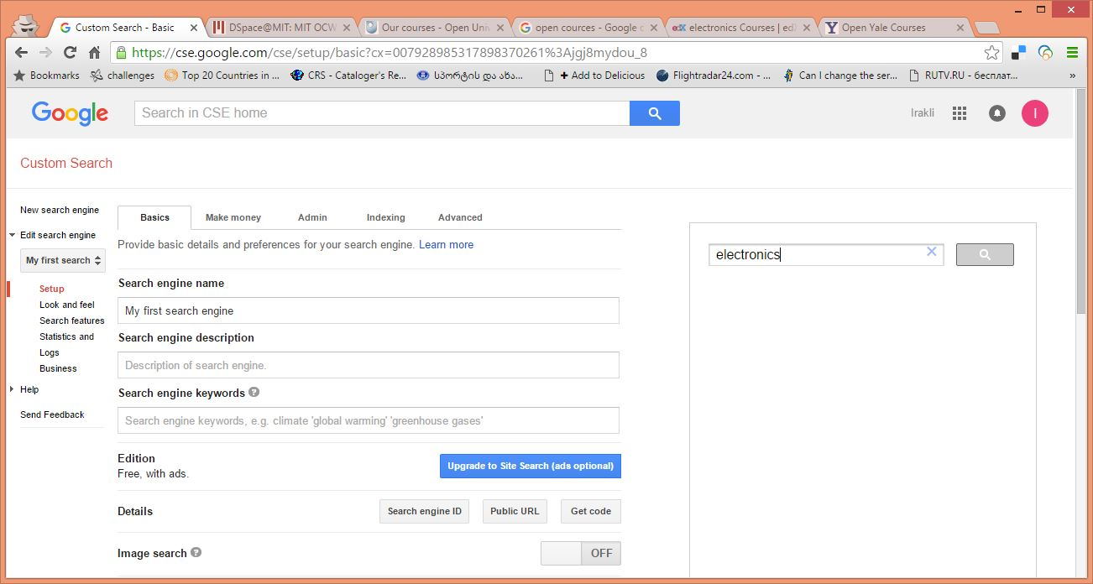
Control Panel

Slide 13
Control panel
A control panel includes
Tools for modification of your engine – on the left
Demo search box, where you can make searches and test various modification options – on the right

Slide 14
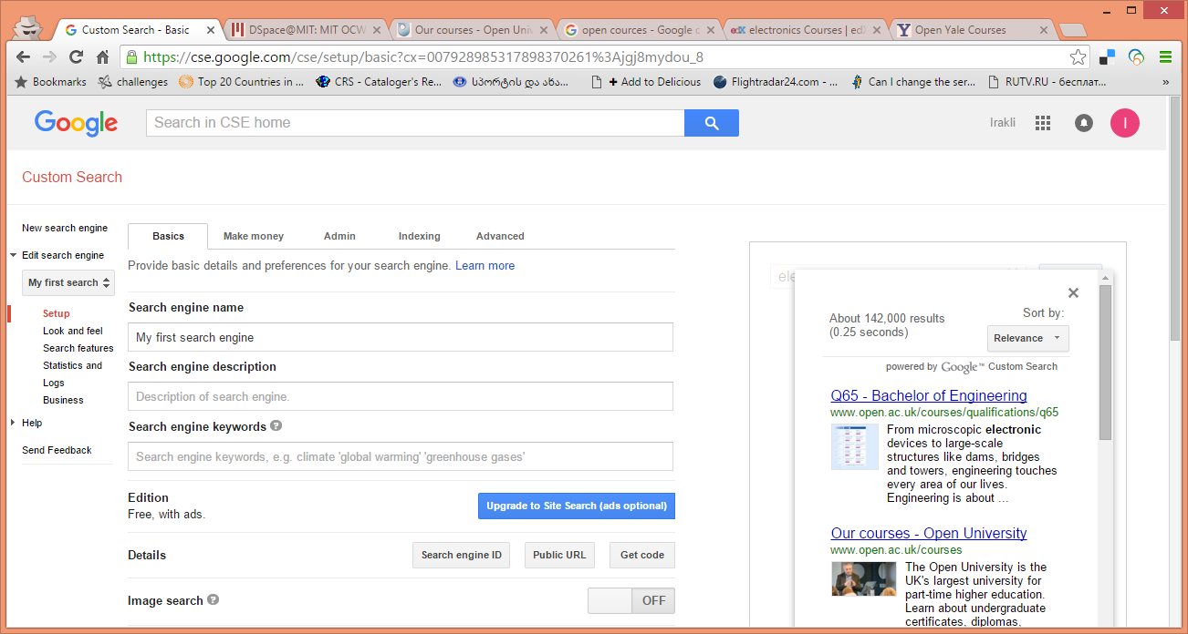
Demo – just enter a search term and try

Slide 15
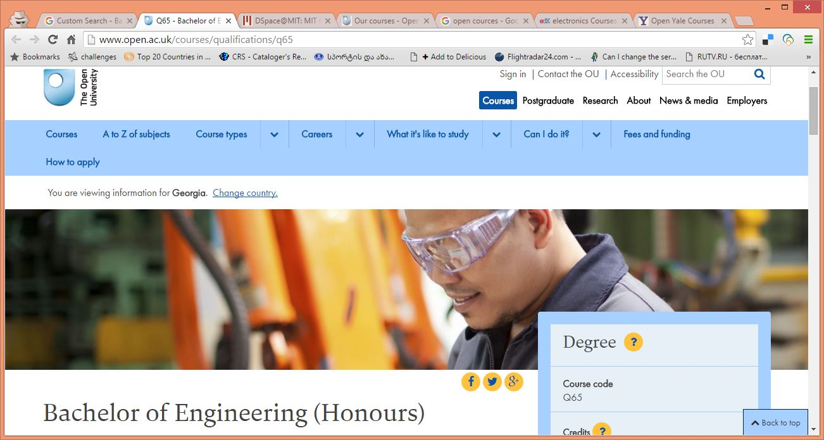
A result page

Slide 16
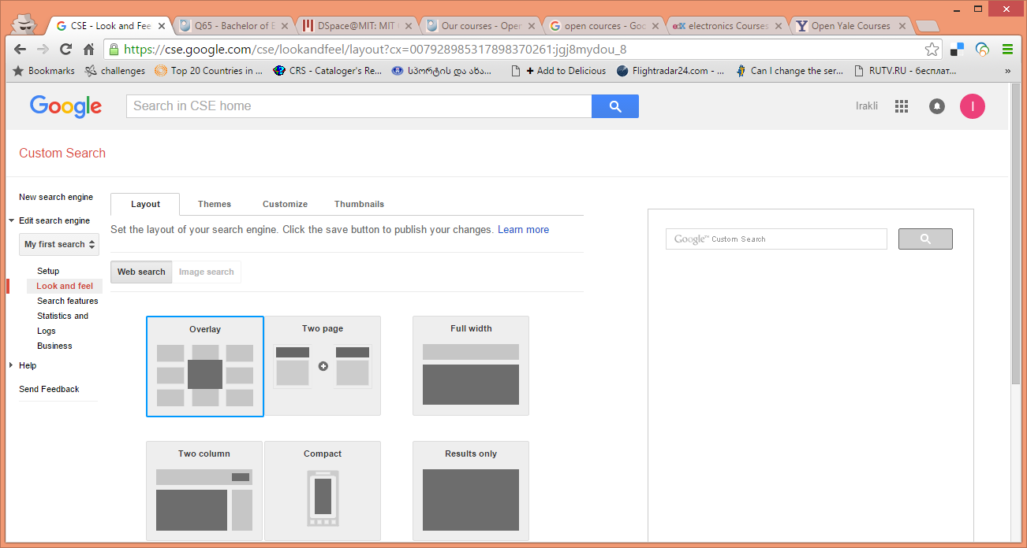
Modification of results layout – the left menu - “Look and feel”

Slide 17
Look and feel
Gives you several options how the results will be shown:
On top of a search box
In a new browser Tab
  Opens a new Tab and keeps your site open
  Opens a result screen in the same Tab
In another page of a site
Etc.
You can choose any option and test results on the right side of the Control Panel page
When you are finished (found an option which best suits to your goals) put it you’re your website to let users make searches.

Slide 18
How to put a resulting CSE on your website
Public URL – just put a link with a proper place and text
Embed a code to your website to let users make searches directly from your site

Slide 19
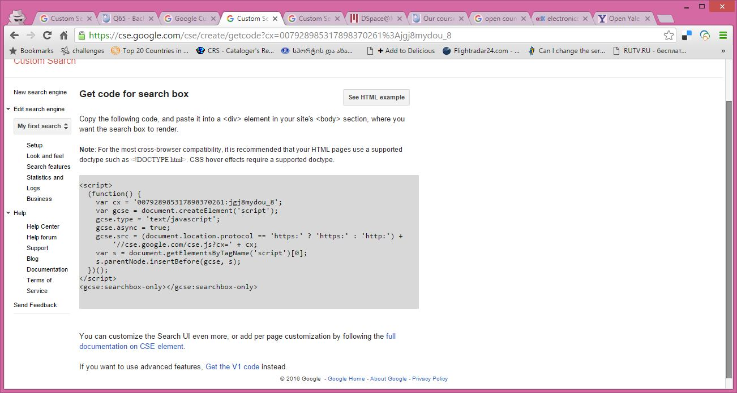
Get code – click on a button to find the code

Slide 20
Embedding a code
Just copy the code
Note two versions of a code V1 & V2 – you have to chose a one which will work properly on your site
The version depends on your CMS and you can just test both of them.

Slide 21
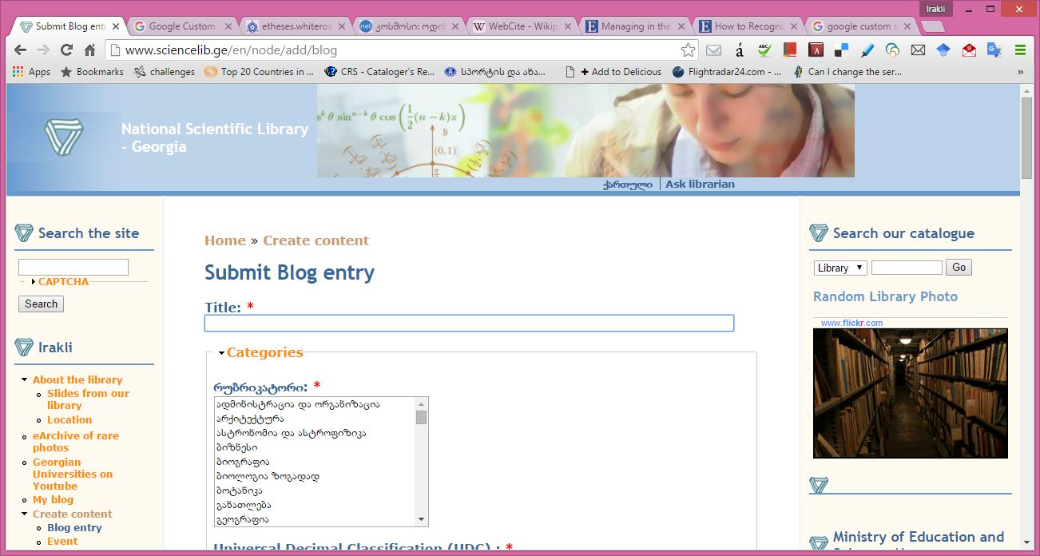
Sample – embedding a code to my site – to a blog entry

Slide 22
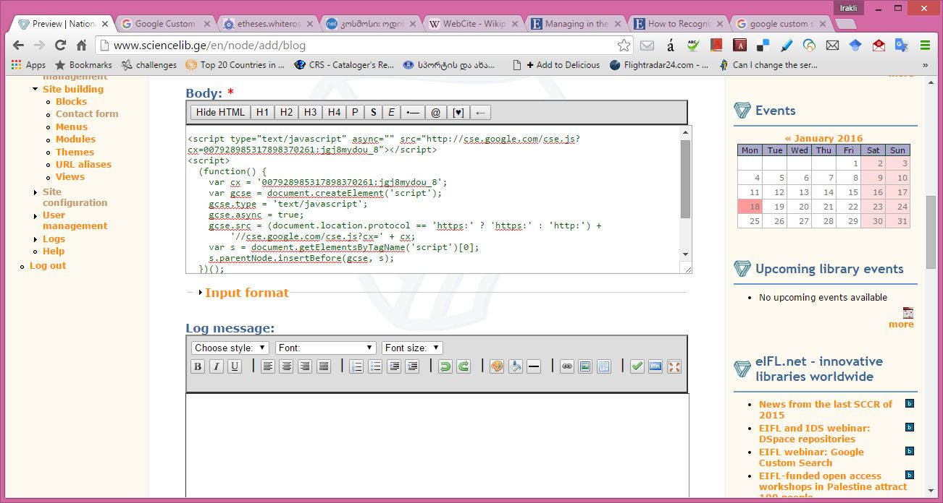
Embedding…

Slide 23
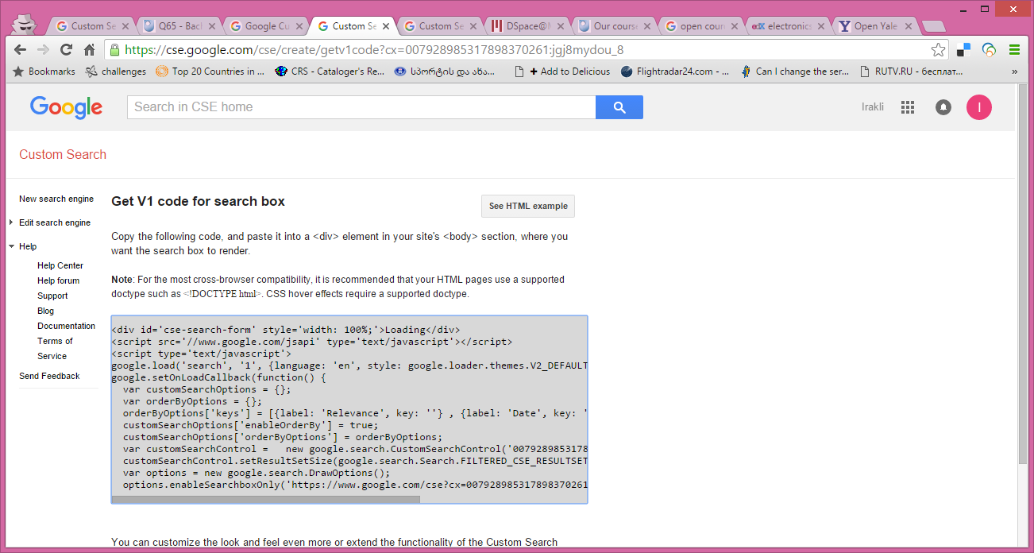
Code V2

Slide 24
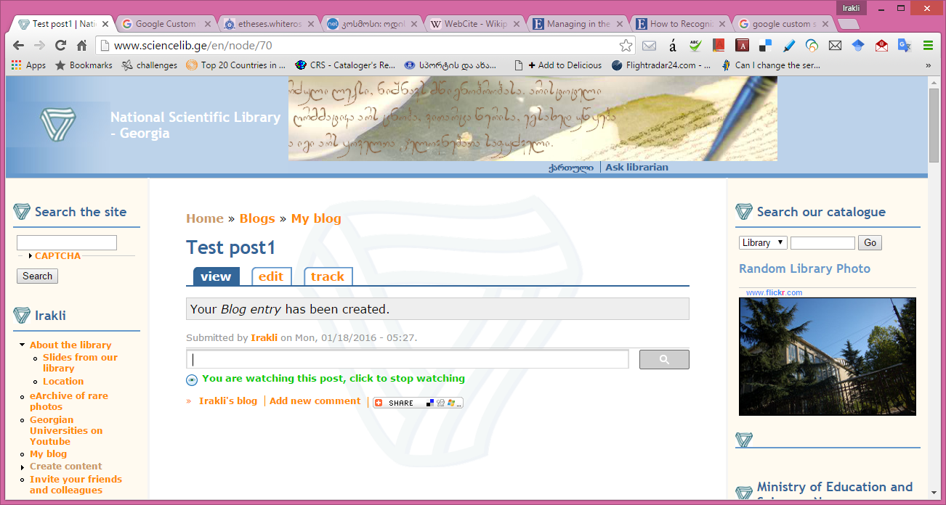
Resulting page with a CSE search box

Slide 25
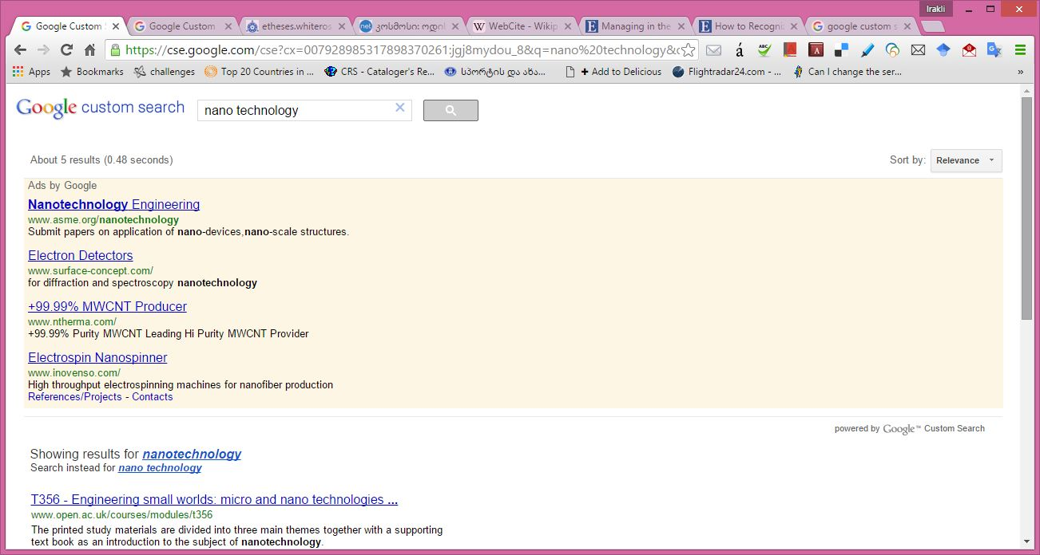
Results of a search - “nano technology”

Slide 26
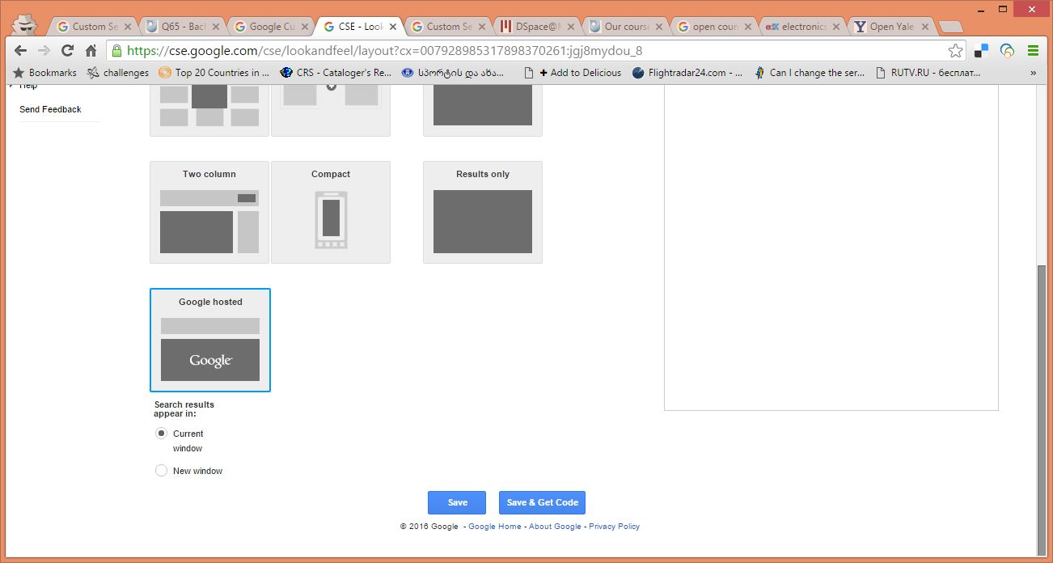
Re-modifying your engine

Slide 27
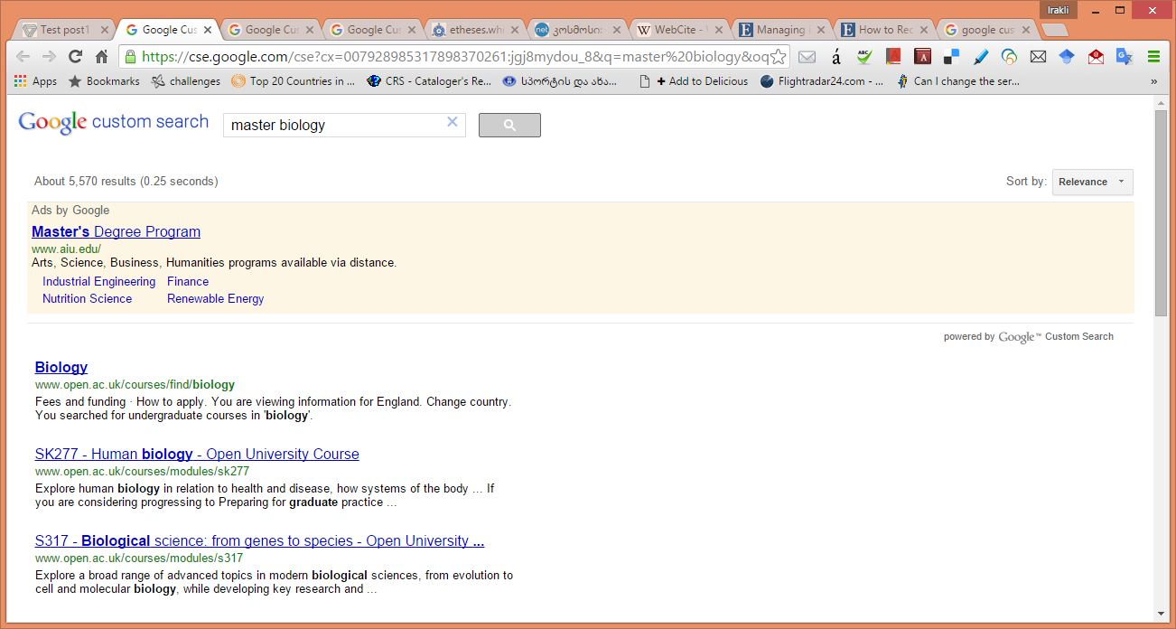
Now results are in a new Tab

Slide 28
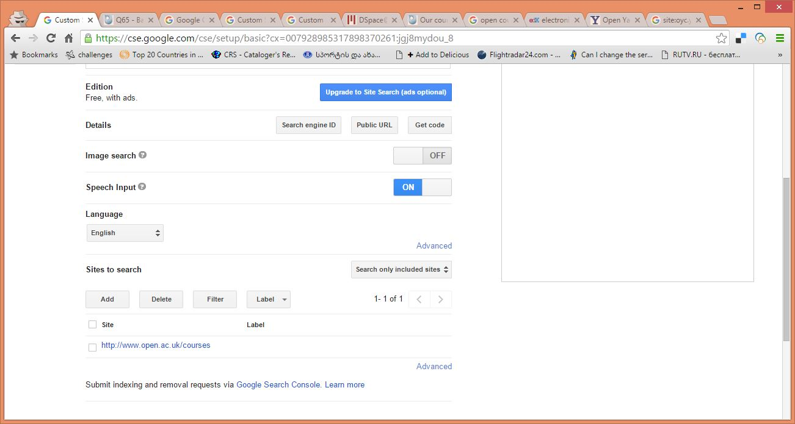
Adding a site for search from the CSE Control panel – “Add” button

Slide 29
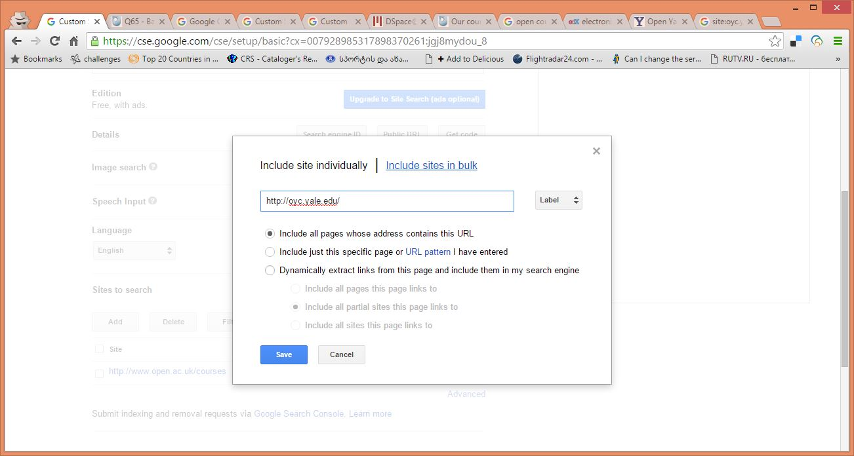
Adding a URL

Slide 30
Adding a URLs
Several options:
Including each URL separately or adding a list in bulk
Add a page with specified address
Add a pattern specifying a group of pages
Extracting links from a specified page (good for online list of publications, where you can extract each of them individually)
CSE has some Help documentation and you can just start with very basic options testing everything on your Control Panel before you put the results online

Slide 31
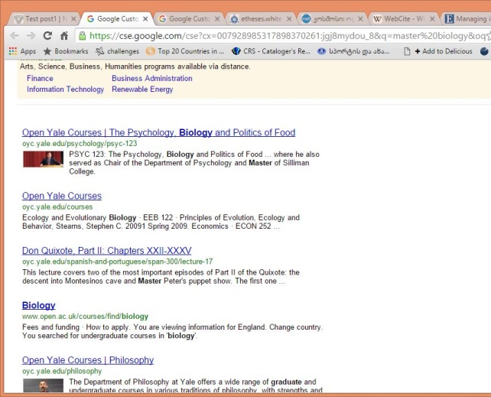
Result
Now our CSE is searching in multiple sites indicated in the list – e.g. open courses from various Unis

Slide 32
Another sample
Goal: CSE searching through e-journals from various publishers

Slide 33
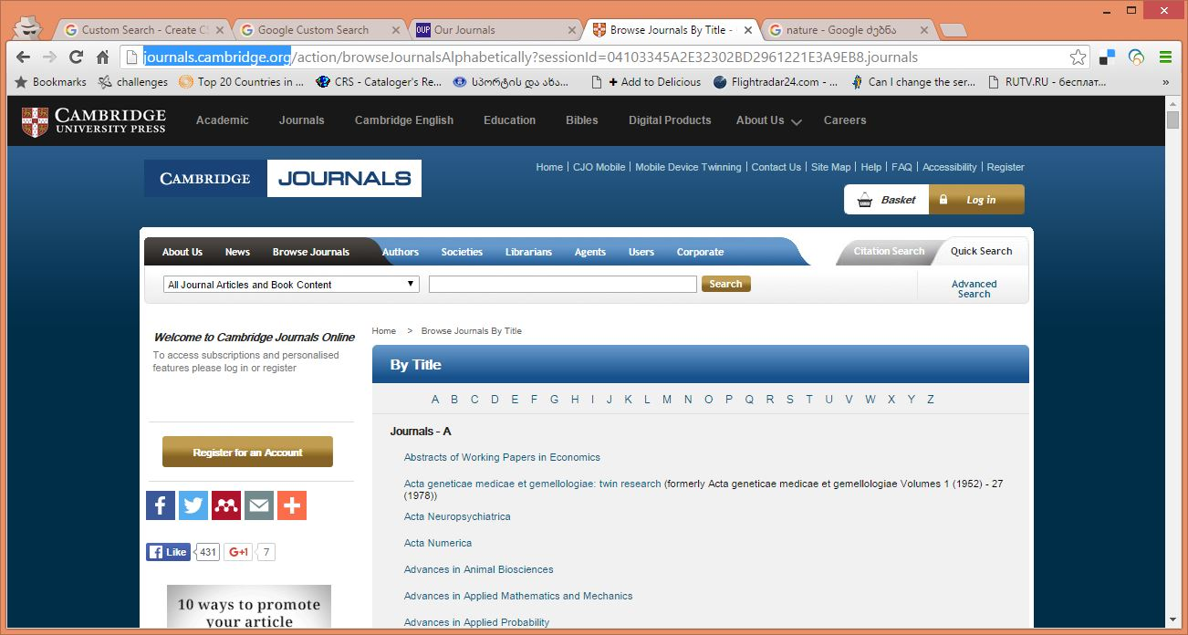
Oxford journals – see a proper pattern

Slide 34
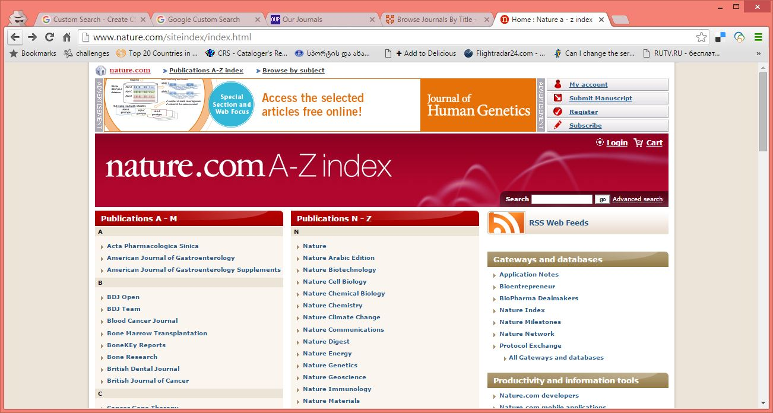

Slide 35
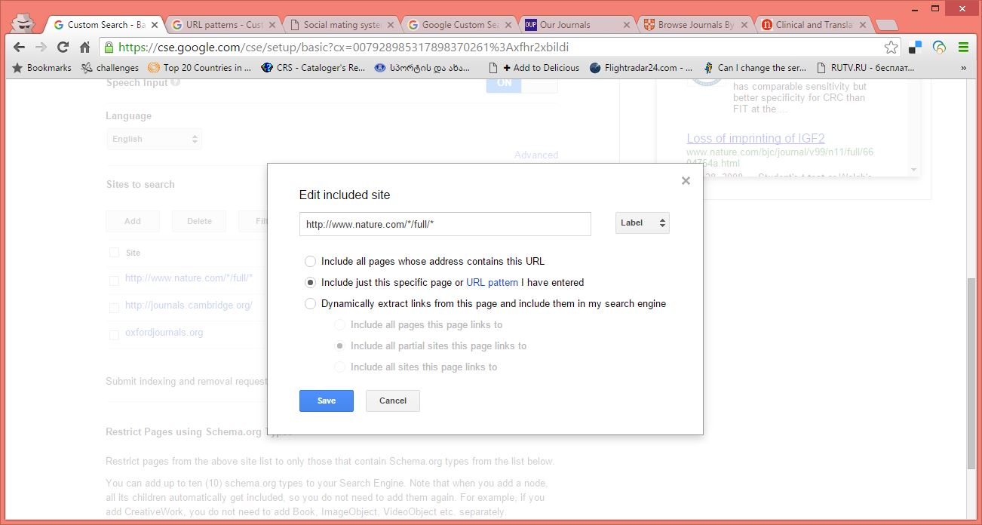
Adding URLs

Slide 36
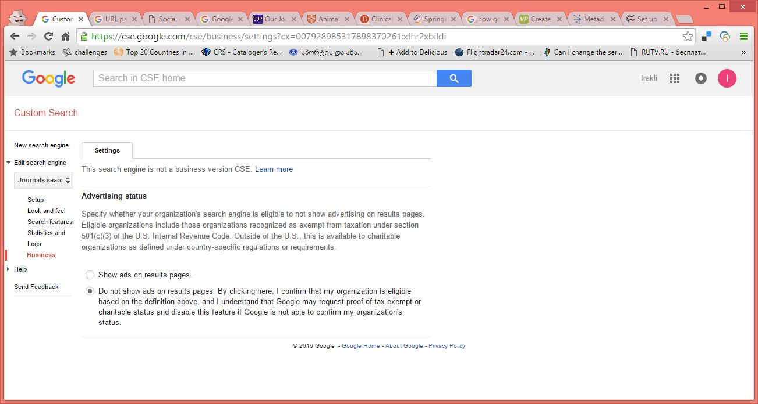
A new option – you can switch off advertising from results

Slide 37
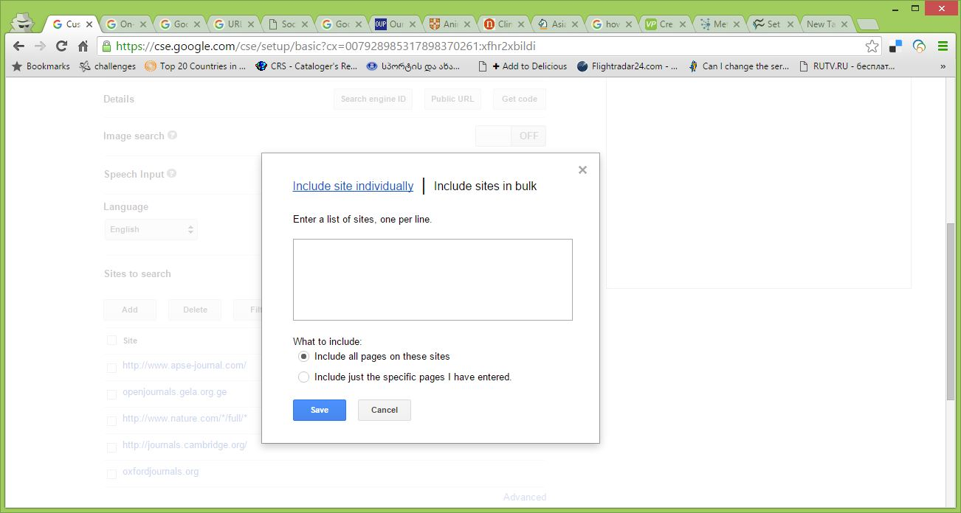
Adding URLs in bulk

Slide 38
Several tips for note
CSE is not expanding a general Google search but limiting it to a specific sites
CSE is producing not very accurate results – meaning that it does not eliminate entirely junk results but is minimizing results to ones which are more practical to you – eventually you have to make decision which one you choose
CSE cannot search in specified metadata fields (at least in the way described above), but it is searching through all metadata (unlike engines of ILSs or Digital repository software)
CSE normally does not recognize truncations (which might be useful for specific languages in specific software systems). E.g KOHA can search for truncated terms (like phys or math), Dspace can search for phys* or math* .

Slide 39
Some more thoughts
Searching through Websites (meaning a combination of web pages) is more or less intuitive – you have specify a pattern carefully
But CSE also makes possible to search through Websites produced via various databases (CMSs, ILSs, etc..)
For example you can create a search through Drupal sites or Wikipedia pages
Or you can search through OPACs of various ILSs (not all)

Slide 40
Searching Koha OPACs
You can create a search engine producing results of searches through multiple online catalogues produced via KOHA ILS (which is popular in EIFL countries and libraries)
As a result you can have on your website single search box through all KOHA OPACs in your country
All you need is just to create a standard CSE and add URLs like opac.library1.com, opac.library2.com, opac.library3.ge, etc.
We could even create a union OPAC of EIFL libraries this way.

Slide 41
CSE in Open repositories or Open e-journals
CSE works well also in software systems like Dspace or Open Journal Systems, which are also popular in EIFL countries and libraries
In these cases the engine is searching through metadata as well as through full text files.

Slide 42
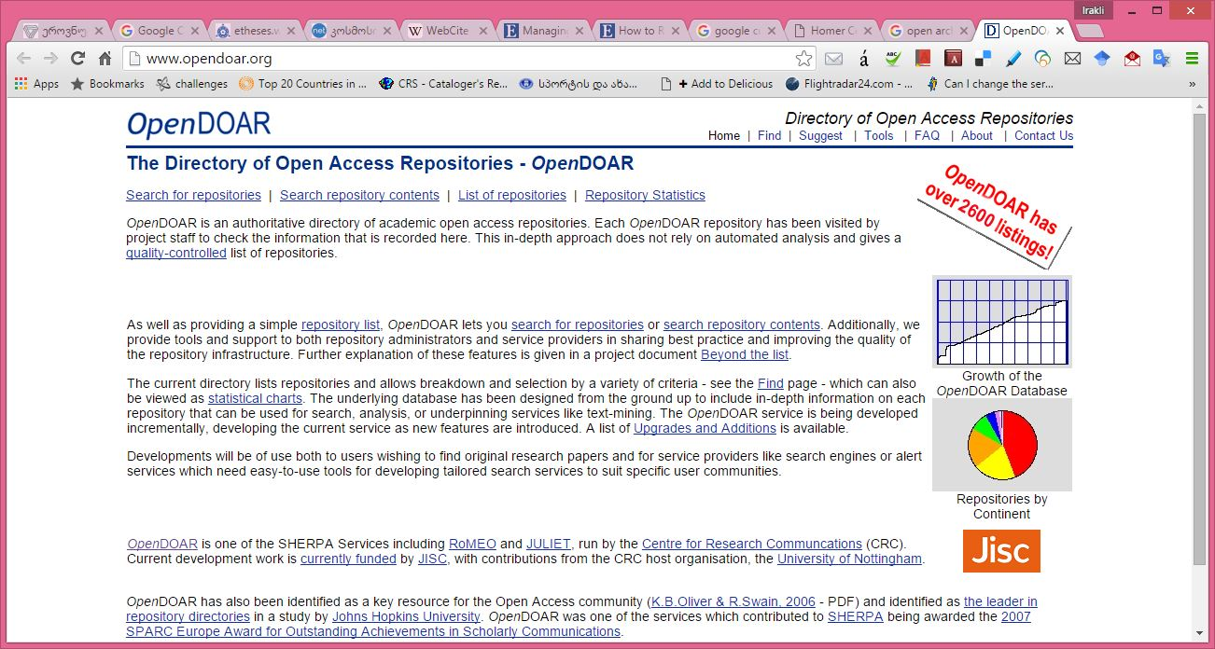
OpenDOAR CSE

Slide 43
OpenDOAR
OpenDOAR is a Directory of Open Repositories including thousands of OA repositories of Universities, scholarly societies, etc. worldwide.
More than hundred countries
Several languages (English, French, Russian,..)
It includes searching for repositories (where you can find OA repositories worldwide by your interest)
As well as CSE for searching through all these databases

Slide 44
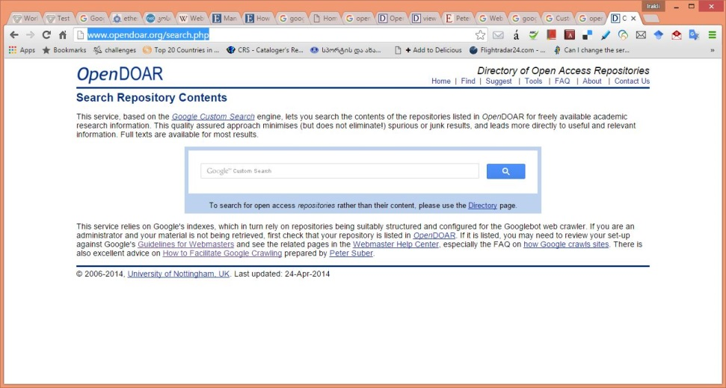
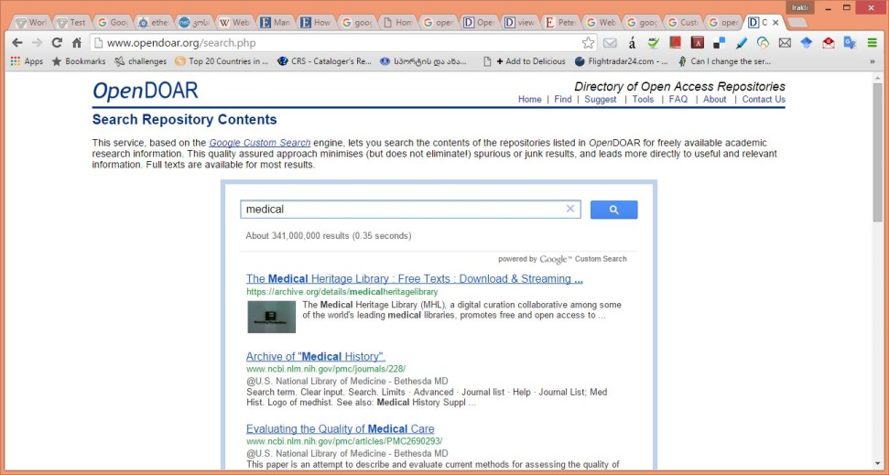
Direct Link to OpenDOAR CSE http://www.opendoar.org/search.php

Slide 45
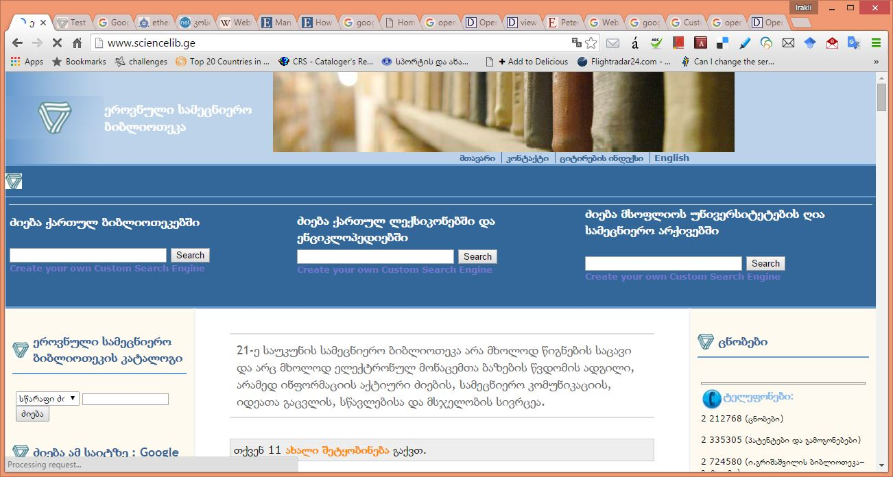
Or you can embed a code to your library website

Slide 46
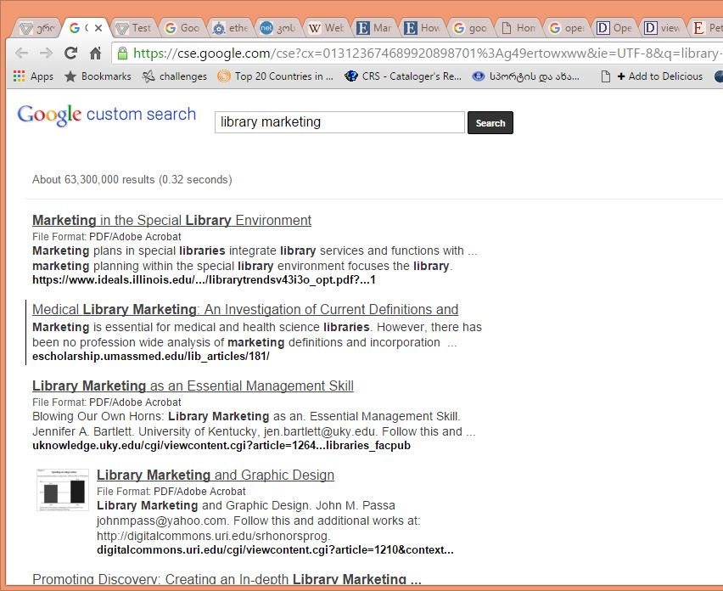
A result screen
The code can be produced from OpenDOAR CSE page with just a basic knowledge of software design
Or I can share it with you

Slide 47
Thank you!
Questions?
Irakli Garibashvili igar@hotmail.com

