Slide 1



Directory of Open Access Books
EIFL Webinar
11 March 2015
Ronald Snijder
OAPEN Foundation

Slide 2
Contents
DOAB and OAPEN Library
OAPEN Library
Directory of Open Access Books
OA books gaining momentum
OAPEN Library vs. DOAB
DOAB growth & visitors
Search DOAB

Slide 3
DOAB and OAPEN Library

Slide 4

OAPEN Library
Available at: www.oapen.org
Dedicated to OA books
OAPEN Library
  Hosting full text collection of OA books (+ chapters)
  Only peer reviewed content
  80+ publishers, 2300+ books
  Increasing visibility, discoverability, usage
Main focus areas:
  Quality assurance
  Aggregation and Deposit
  Discovery and Dissemination

Slide 5
Directory of Open Access Books
Available at: www.doabooks.org
Discovery service for OA books:
  Searchable index to metadata of peer reviewed monographs
  Link to OA publication
  Links to webshop and vendors
Goals:
  Increase discoverability of OA books
  Provide ‘authoritative list’ of OA book publishers
  Support quality assurance and standards
  Promote OA book publishing

Slide 6
OA books gaining momentum
Worldwide attention for OA monographs
OA monograph workshops and seminars everywhere
Platforms and services supporting OA books:
  OMP, OpenEdition, OAPEN, DOAB, SciELO
Established book publishers adopting OA:
  Palgrave Macmillan, Springer, OUP, De Gruyter, Brill
New OA start ups: Amherst Press, Anvill Academic
OA publication funds supporting books: WT, FWF, NWO
OA mandates including books: H2020, ERC, ARC
KU conducted first pilot for OA books

Slide 7

Deposit service
Full text
Free + OA
Focus on HSS
Aim:
Deposit service for OA books
Discovery service
Metadata only
OA only
All disciplines
Aim:
Authoritative list of OA book publishers

Slide 8
DOAB growth (1/2)

Slide 9
DOAB growth (2/2)
  Books Publishers
  2011 487 15
  2012 1189 34
  2013 1554 51
  2014 2482 79
  2015 2781* 94*
* Numbers per 02-03-15

Slide 10
DOAB visitors

Slide 11
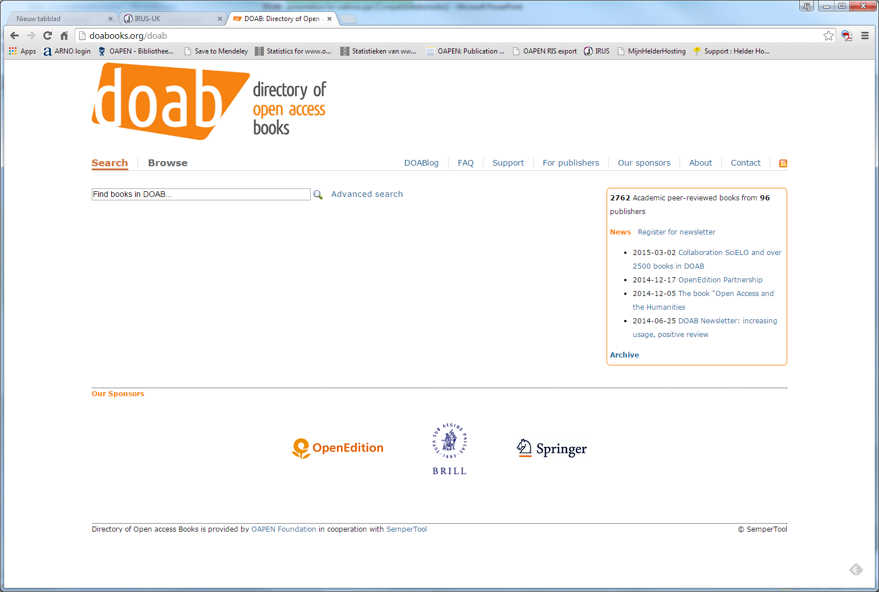
Search DOAB (1/8)

Slide 12
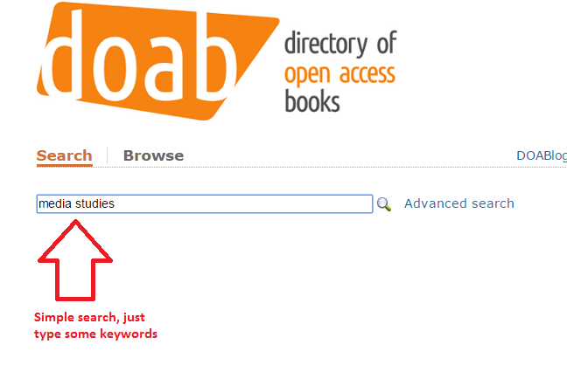
Search DOAB (2/8)

Slide 13
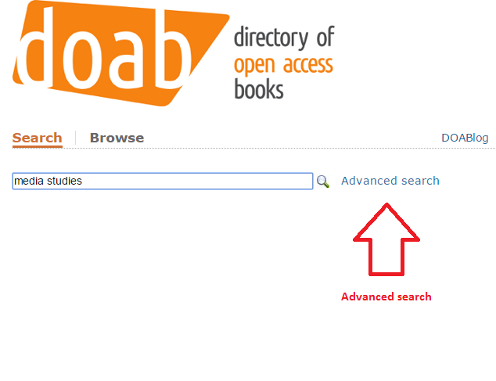
Search DOAB (3/8)

Slide 14
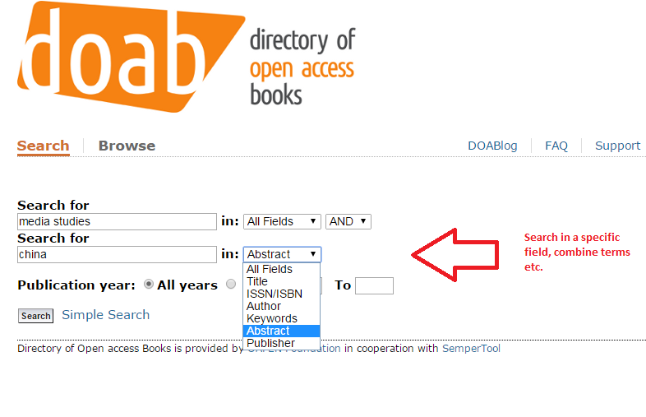
Search DOAB (4/8)

Slide 15
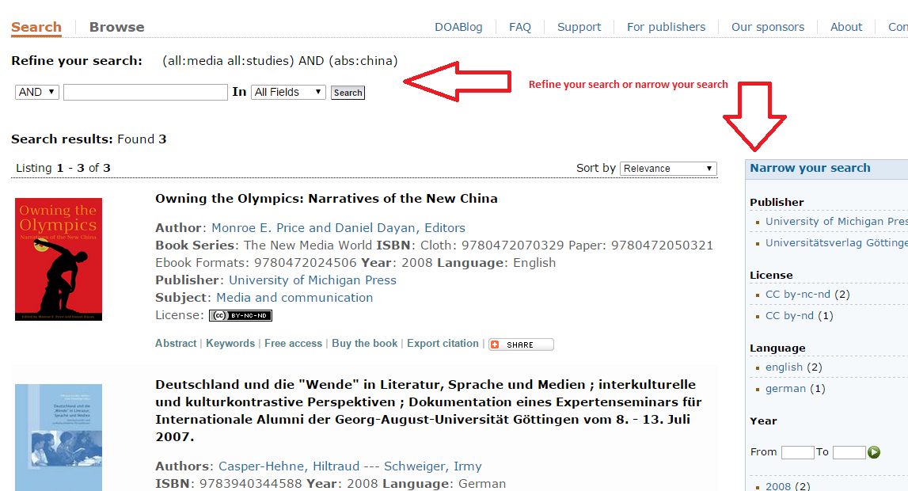
Search DOAB (5/8)

Slide 16
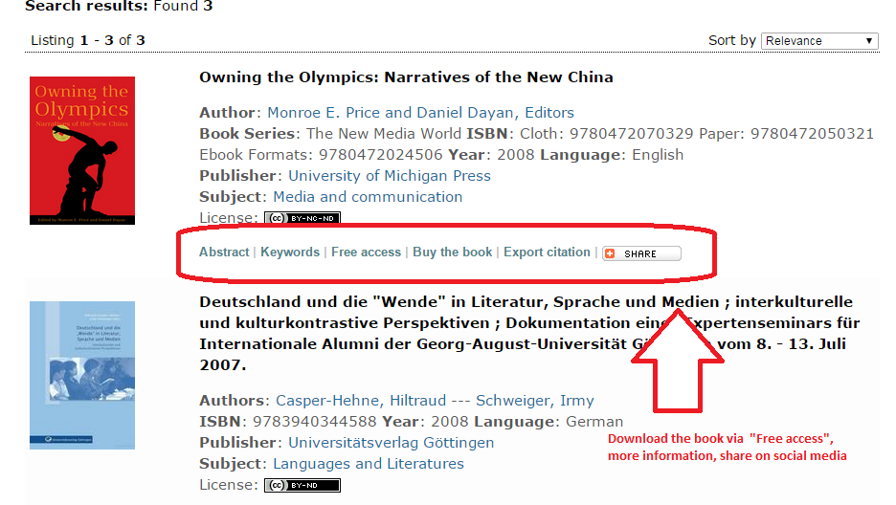
Search DOAB (6/8)

Slide 17
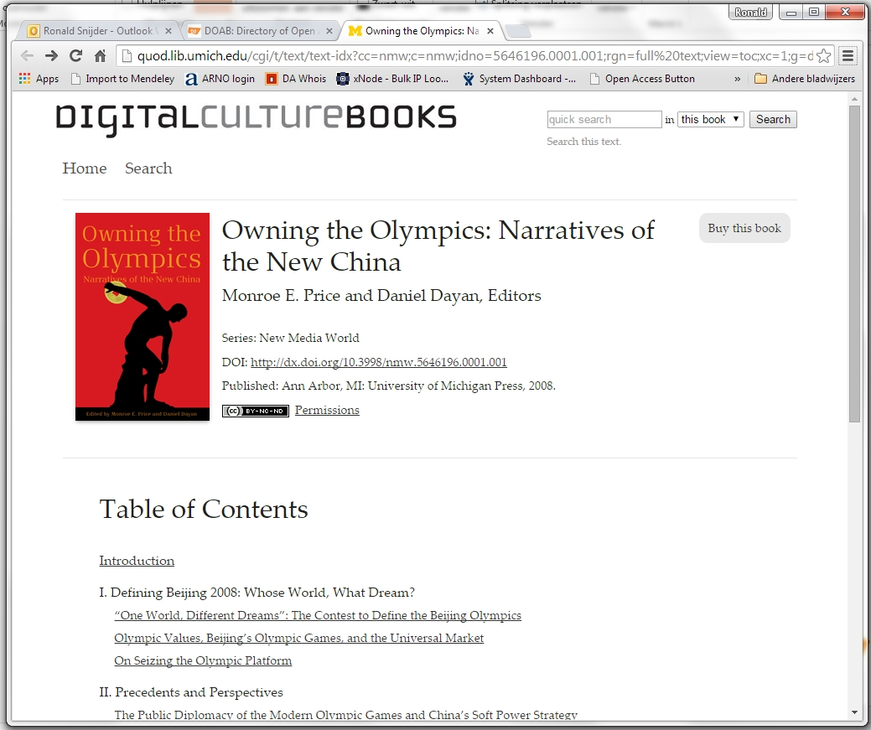
Search DOAB (7/8)

Slide 18
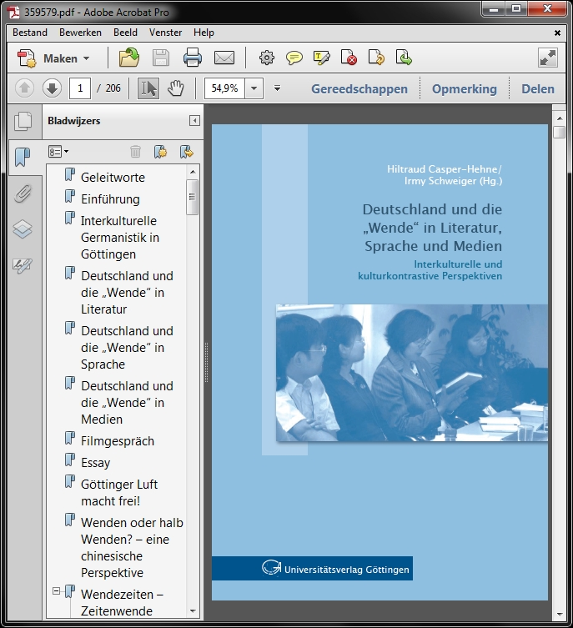
Search DOAB (8/8)

Slide 19
More tips & tricks
Search tips:
http://doabooks.org/doab?func=loadTemplate&template=faq&uiLanguage=en#searchingDOAB
Library access and metadata:
http://doabooks.org/doab?func=loadTemplate&template=faq&uiLanguage=en#libraryaccessandmetadata
DOAB search box on your website:
http://doabooks.org/doab?func=about&uiLanguage=en#searchBox

Slide 20
Questions?
Ronald Snijder
  r.snijder@oapen.org
  www.oapen.org
  www.doabooks.org

