Slide 1
Assessing user needs
Case of Kaunas University of Technology
Aistė Pranckutė
Chief Information Manager

Slide 2
University information needs depend on
Study programs
Research areas
Type of users

Slide 3
Library collection policy
Printed materials
Electronic resources
  Subscribed
  Open-access

Slide 4
KTU experience on subscribing e-resources
First subscription – 1999 (EBSCO Publishing)
Nowadays:
    58 DBs: subscription through
    the Lithuanian Research Library Consortium
    6 DBs: individual subscription

Slide 5
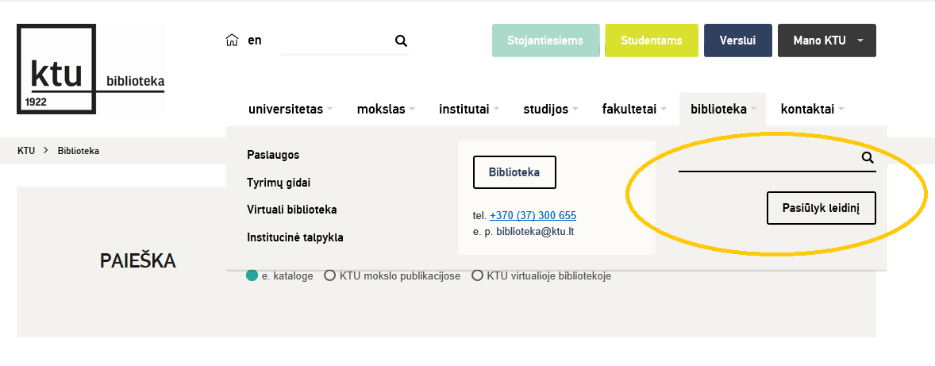
How we get information on new/needed e-resources:
From teachers and researchers of the University – MOST IMPORTANT
    survey
    direct contact
From the Lithuanian Research Library Consortium
    trials
    seminars
From publishers/providers

Slide 6
Scenario 1: Library gets a request of e-resources from teachers or researchers
Analyse the content
Compare with subscribed resources. Inform the user about similar resources
Trial access
Inform the community about the trial
Analyse usage reports
Get feedback
Contact the target group directly or by e-mail for their experiences and evaluation of the resource
Provide trainings for users about DBs
Make a decision
Get the prices and check the budget
Make a decision: subscribe / not subscribe
If content is new/unique, inform the potential users about it
Notes:
Analyse the content of e-resource
If the Library has the resource with quite similar content, researcher is suggested to use it.
If the content of e-resource is unique and high quality, librarians inform about it all potential users within the University.
Request a trial
Send information on trial to the target groups
Analyse usage reports after the trial period
Contact target group again to get the feedback.
If there is interest:
Get the prices and check with budget
Make decision subscribe / not subscribe

Slide 7
Scenario 2. Library gets an offer from the Consortium or publishers:
Does the content meet the needs of the University?
Send the trial request
Promote and train the University community
no
Do not start the trial
Check the content overlapping
Analyse usage
Ask for price
yes
Inform Consortium/Publisher about the decision
Notes:
Check the content of the e-resources if it meets the needs of the University
If yes,
Send the trial request
Promote the trial to the University community
Check the content overlapping with subscribed resources
Analyze usage
If the is no or very little overlapping and university’s community interested in the content
Ask for the price
Inform Consortium/Publisher about the decision (subscribe / not subscribe)

Slide 8
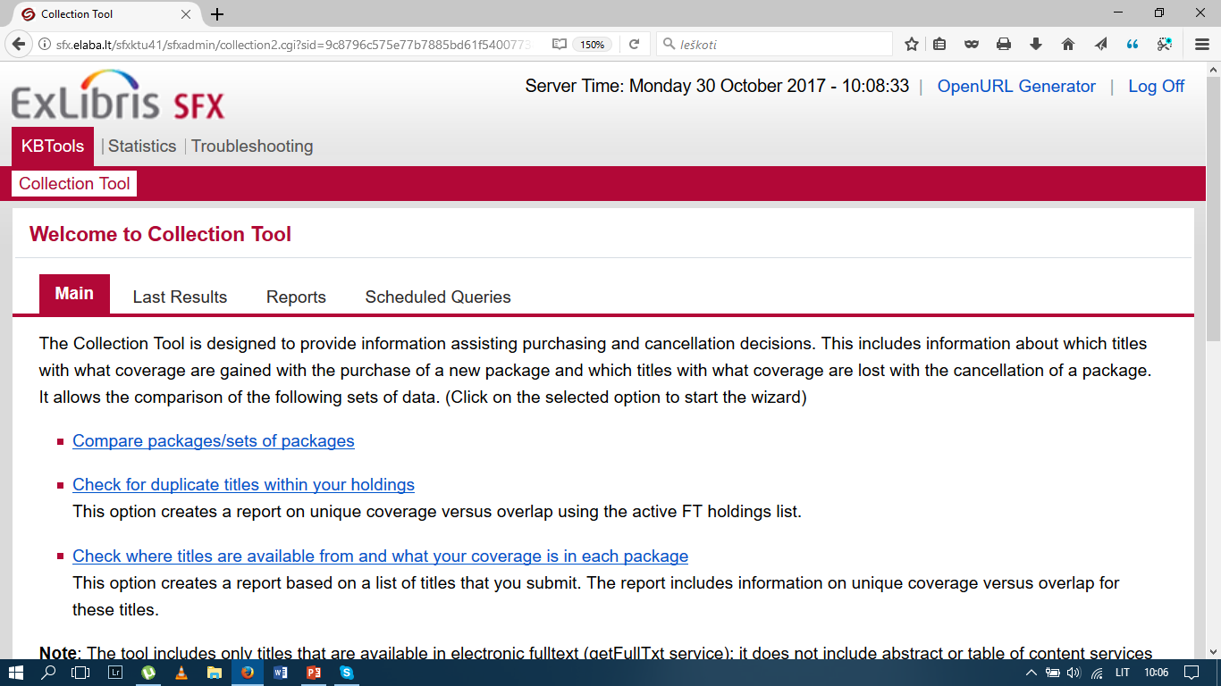
Checking the overlapping
KTU is using SFX (from PRIMO) to check the overlap between new resources and subcribed ones. However, there is a free tool – CUFTS (http://cufts2.lib.sfu.ca/MaintTool/public/compare)

Slide 9
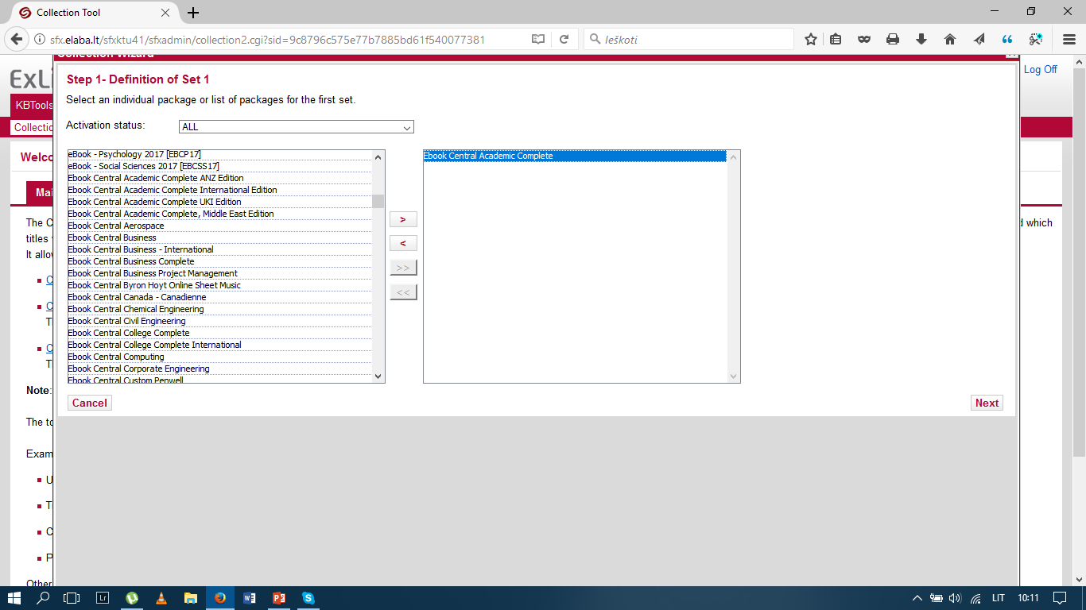
Step 1:

Slide 10
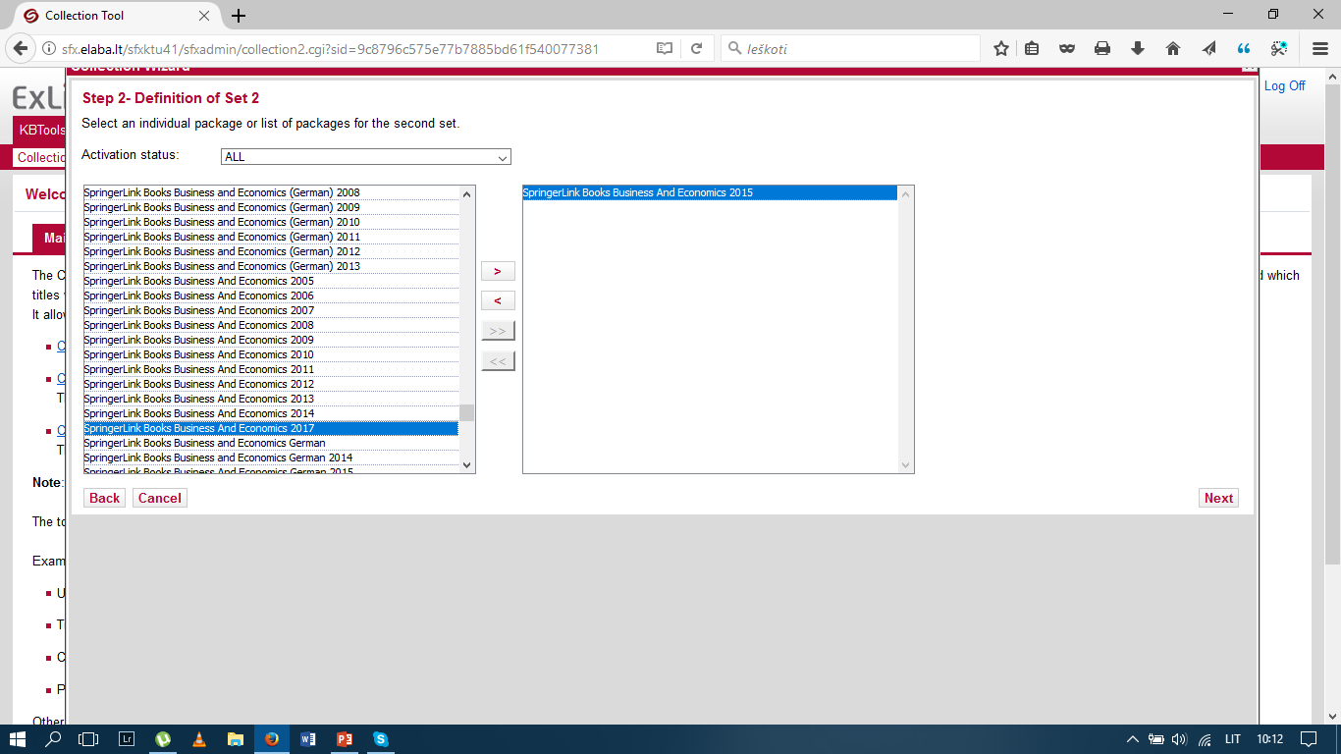
Step 2:

Slide 11
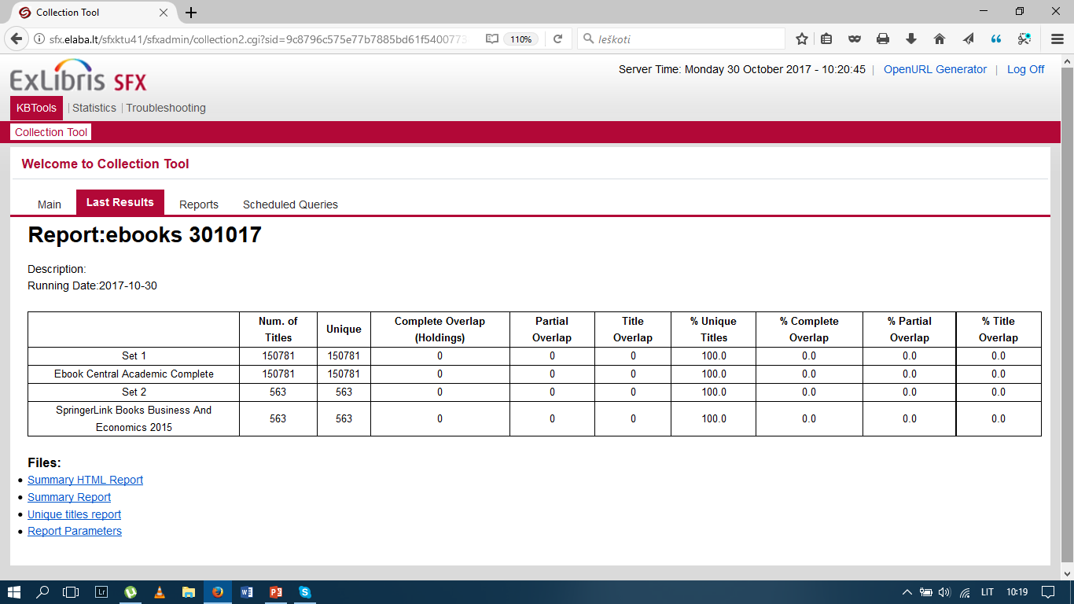
Report:

Slide 12
Tools for assessing informational needs
Survey
Direct contacts
Usage statistics
Subject librarians
Trainings

Slide 13
Training users
Training users
in groups
individual
Additional material
video tutorials
invited publishers
webinars
support guides
subject guides
information on video display units
Go to meet the users rather than wait for them to come

Slide 14
Challenges
Passive teachers / researchers
Changing content (transferred/removed titles)
Funding (content-quality-price)

Slide 15
Consortia role in assessing user needs
Jevgenija Sevcova
Databases Manager
Lithuanian Research Library Conosrtia

Slide 16
Consortium almost never hears the voice of end-user
Actions to do:
  Subjects maps
  Good communication with librarians responsible for the collection development
  Encouraging surveys to identify user needs Usage reports

Slide 17
Subjects maps
Medicine
Chemistry
Physics
Social
science

Slide 18
Good communication - VITAL
E-Librarians are the main persons to contact
Training for newly appointed e-librarians
E-librarians’ responsibilities
Contact before and after trials, get feedback
Contact before a new subscription period, get feedback
Contact if the usage is low, get feedback

Slide 19
Users surveys
Consortium doesn’t run users surveys, but can encourage them
Tools we are using:
Emails
Survey tool integrated into our LMBA web-site intranet
Upcoming: tool integrated into ERMS

Slide 20
Usage reports
Trial usage reports
Most used resources
Less used resources, not used resources
Usage by subjects
Access denied report

Slide 21
Any questions?

